Slide 1
8th – 10th November 2023
Paris, Carrousel du Louvre
Rotational atherectomy for left subclavian artery in-stent occlusions
Arnaud Kerzmann, MD, S. Madani, V. Demesmaker, E. Boesmans, C. Holemans,
D. Szecel, V.A. Alexandrescu, J.O. Defraigne
CHU de Liège, Belgium

Slide 2
Statement of financial interest
I currently have, or have had over the last two years, an affiliation or financial interests or interests of any order with a company or I receive compensation or fees or research grants with a commercial company :
BD (Becton Dickinson)
Boston Scientific
Medicor
iVascular

Slide 3
Introduction
Endovascular treatment with stenting is the preferred therapy for subclavian artery atherosclerotic disease because it is less invasive.^{1,2}
Rotational atherectomy and thrombectomy Rotarex™ device proved its safety and efficacy to treat lower limbs arteries in-stent occlusions. Adjunctive angioplasty is often necessary.^{3,4}
We report 2 cases of symptomatic left subclavian artery (LSA) in-stent occlusion that we treated percutaneously with Rotarex™ device and drug-coated balloon (DCB) angioplasty.
¹ Galyfos GC, Kakisis I, Maltezos C, et al. Open versus endovascular treatment of subclavian artery atherosclerotic disease. J Vasc Surg. 2019;69(1):269-279
² Chatterjee S, Nerella N, Chakravarty S, et al. Angioplasty alone versus angioplasty and stenting for subclavian artery stenosis--a systematic review and meta-analysis. Am J Ther. 2013;20(5):520-3
³ Milnerowicz A, Milnerowicz A, Kuliczkowski W, et al. Rotational Atherectomy Plus Drug-Coated Balloon Angioplasty for the Treatment of Total In-Stent Occlusions in Iliac and Infrainguinal Arteries. J Endovasc Ther. 2019;26(3):316-321
⁴ Loffroy R, Edriss N, Goyault G, et al. Percutaneous mechanical atherothrombectomy using the Rotarex®S device in peripheral artery in-stent restenosis or occlusion: a French retrospective multicenter study on 128 patients.
Quant Imaging Med Surg. 2020;10(1):283-293

Slide 4
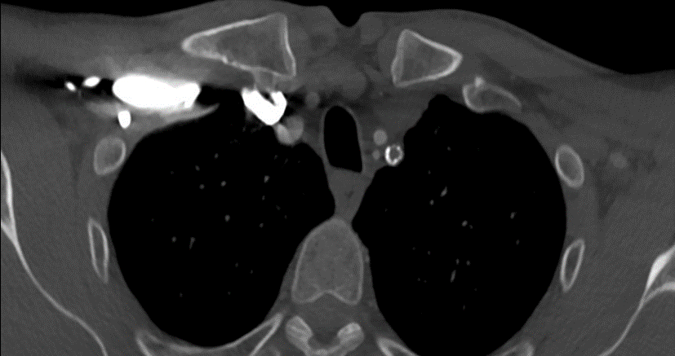
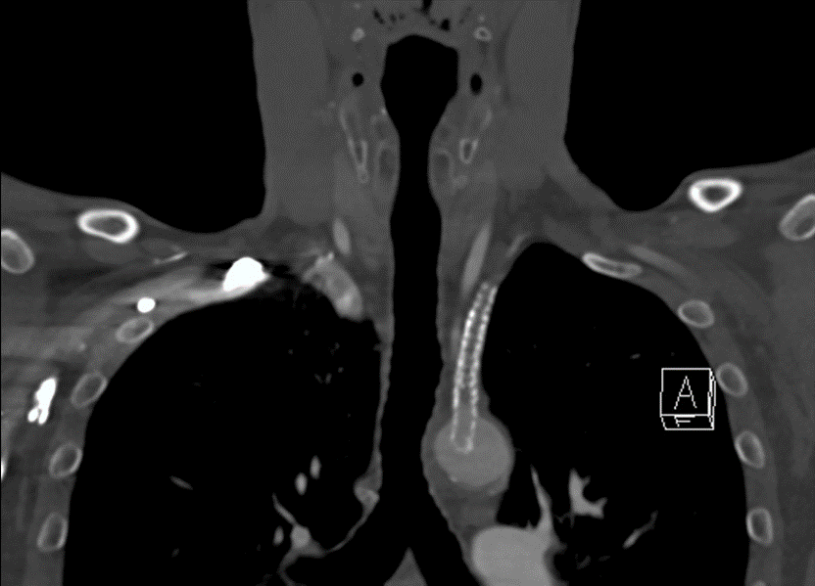
Case report 1
57-year-old man
guitar player, reccurence of left upper limb weakness and pain since 3 months
smoking, dyslipidemia
LSA stenting 31 months earlier and covered stenting for ISR 5 months earlier
CT angiography: proximal LSA 7 mm stent occlusion

Slide 5
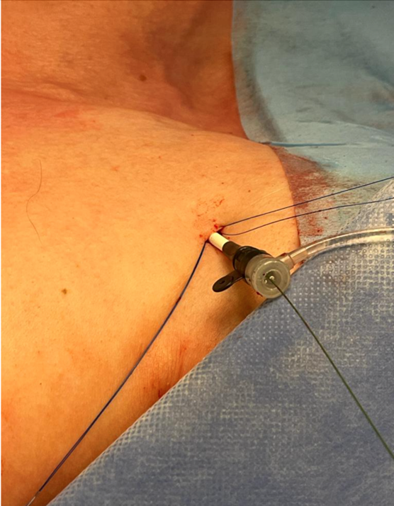
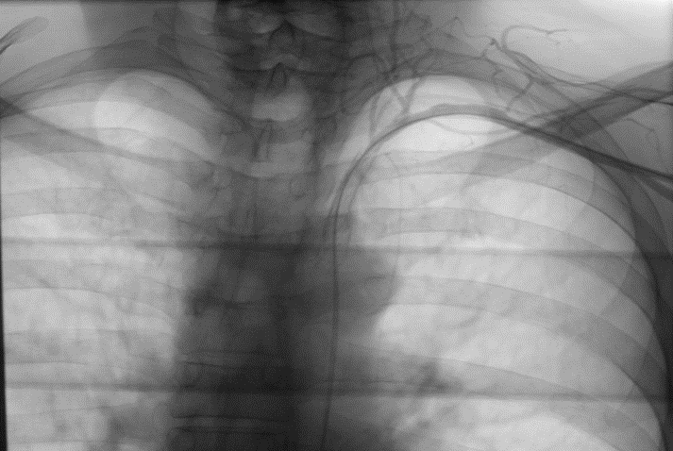
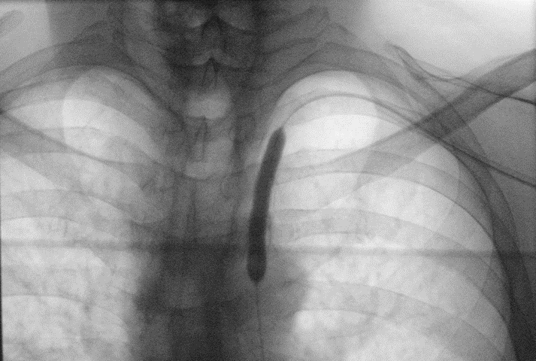
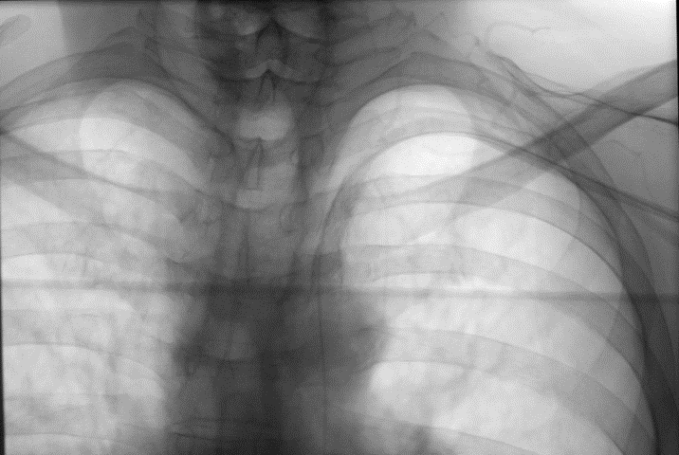
Case report 1
general anesthesia
9F sheath into the left axillary artery
heparin 100 IU/kg
retrograde recanalization
8F Rotarex™ device with sheath‘s perfusion
8 mm DCB angioplasty
closure device
Aspirin + Clopidogrel 3 months
After 9 months follow-up, stent patent at duplex scan

Slide 6
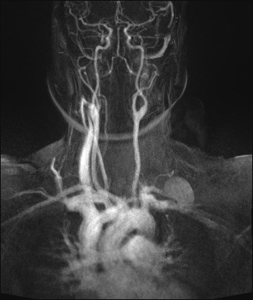
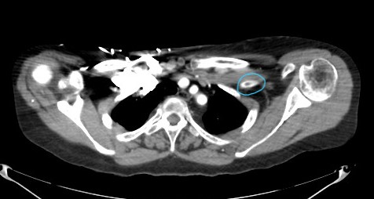
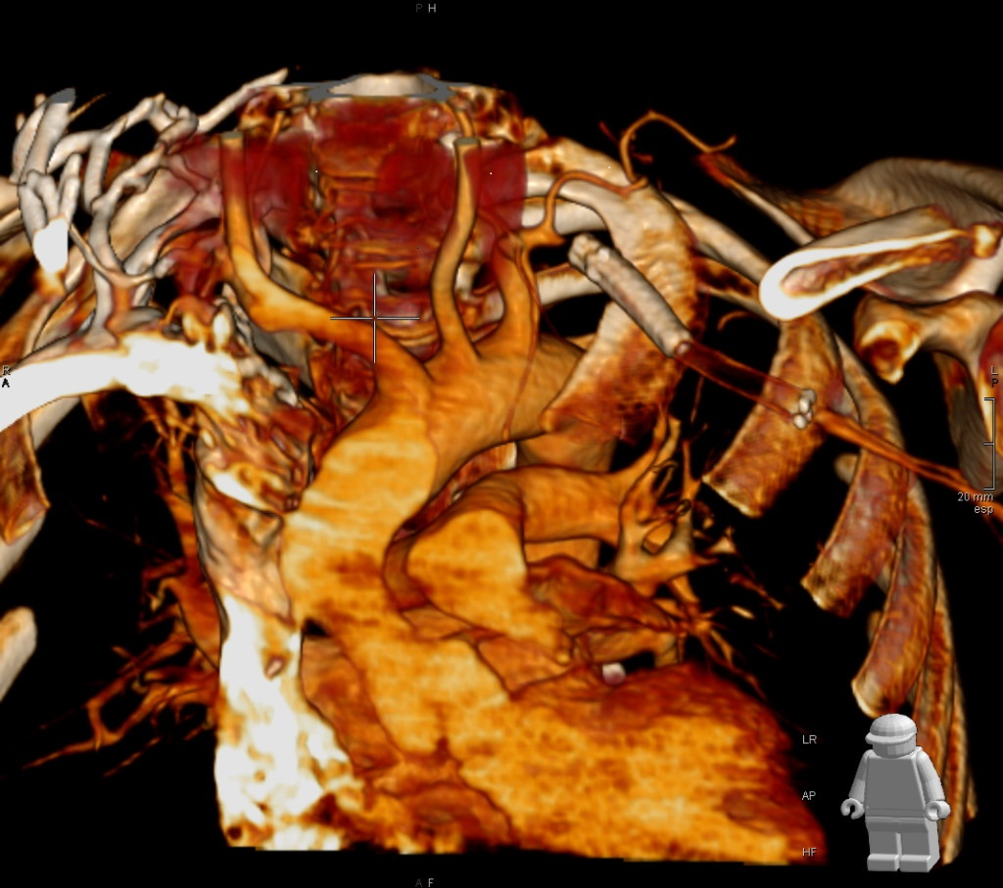
Case report 2
35-year-old African woman
left upper limb pain and weakness
systemic lupus erythematosus, antiphospholipid syndrome, AHT, type 2 diabetes
LSA double covered stenting 5 months earlier for non-infectious saccular aneurysm
CT angiography: post-vertebral 7 and 6 mm stents occlusion

Slide 7
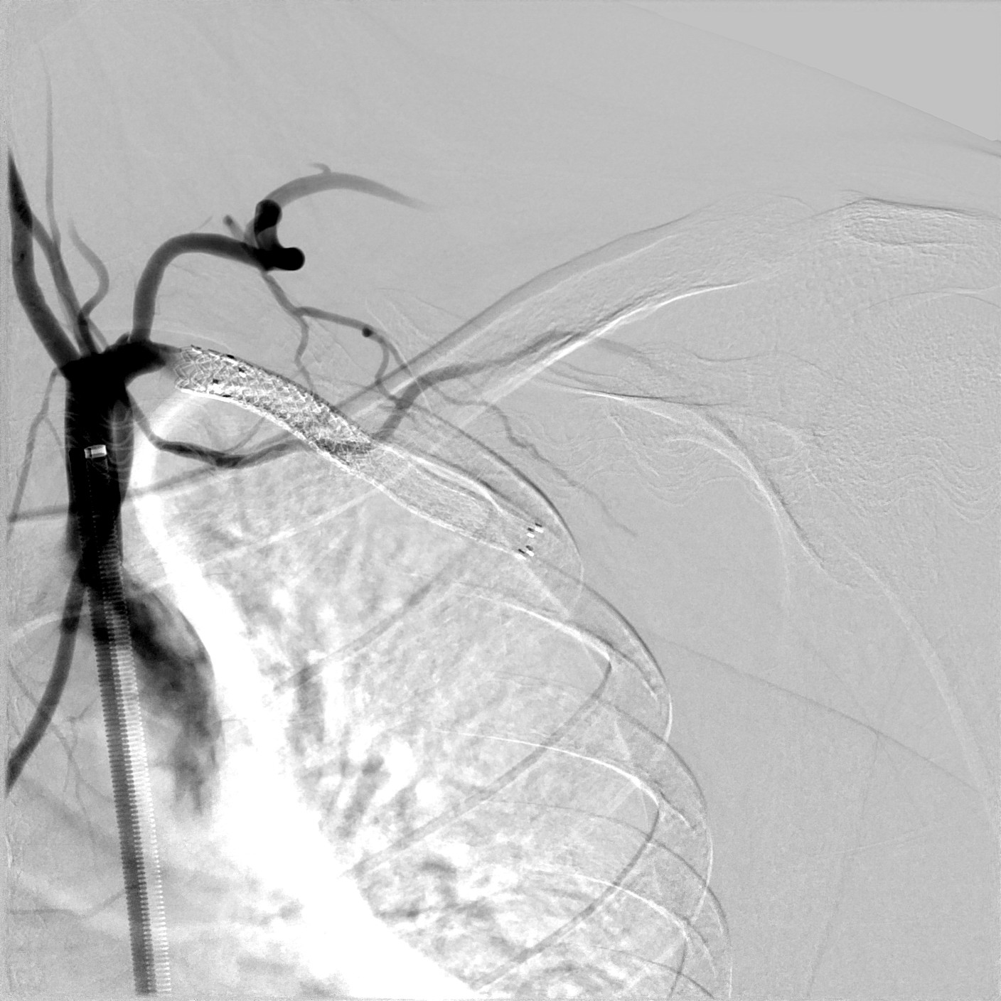
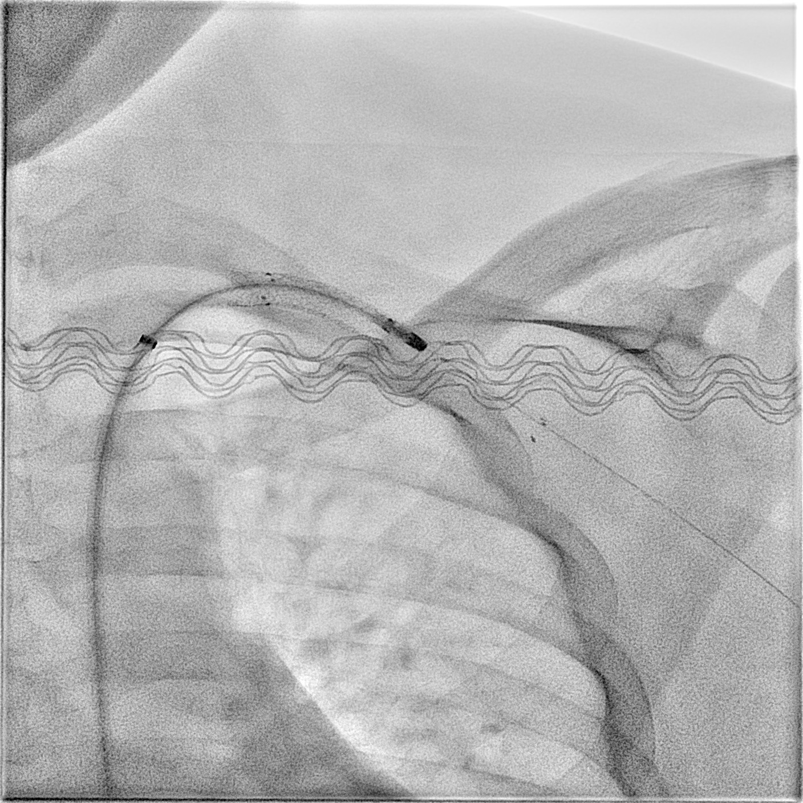
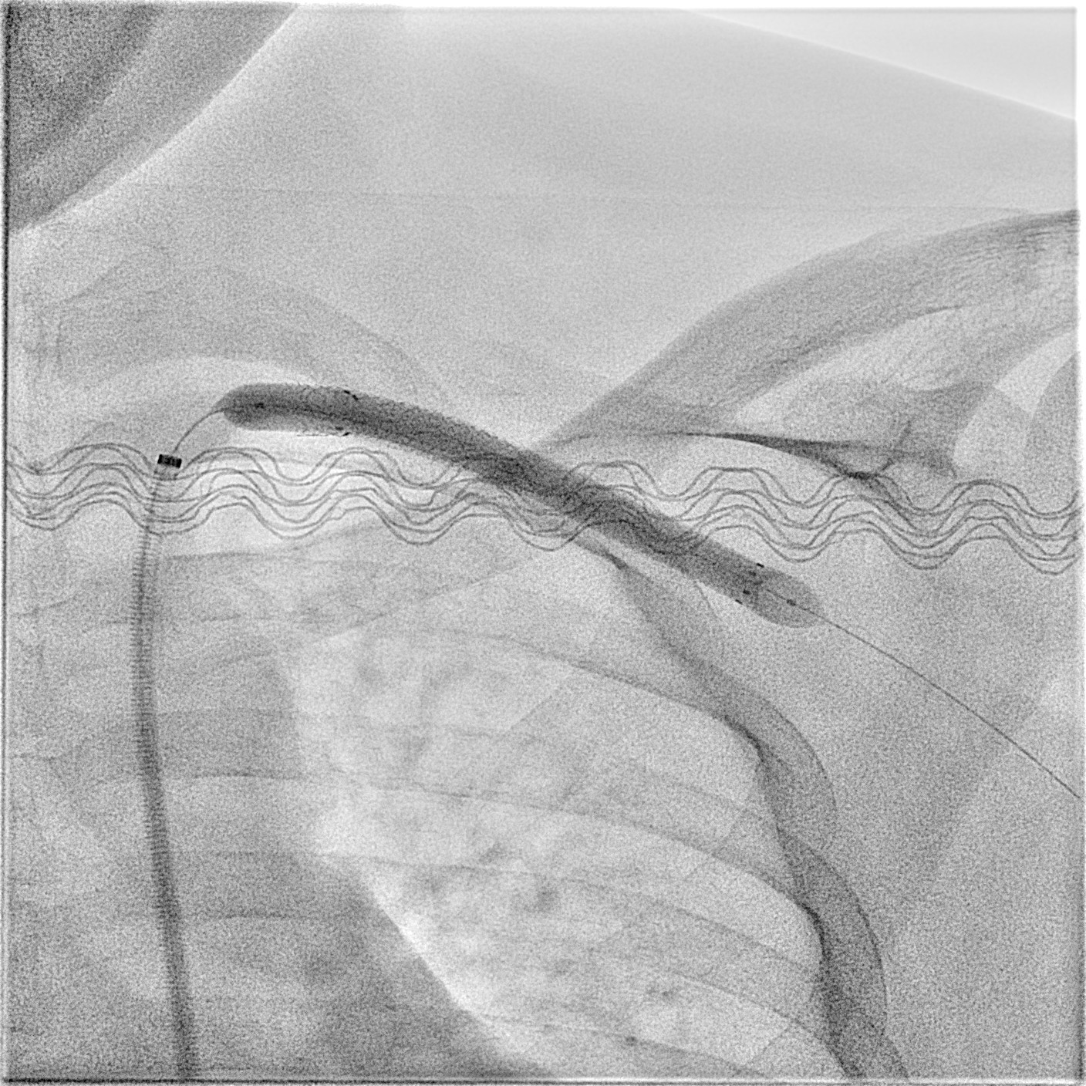
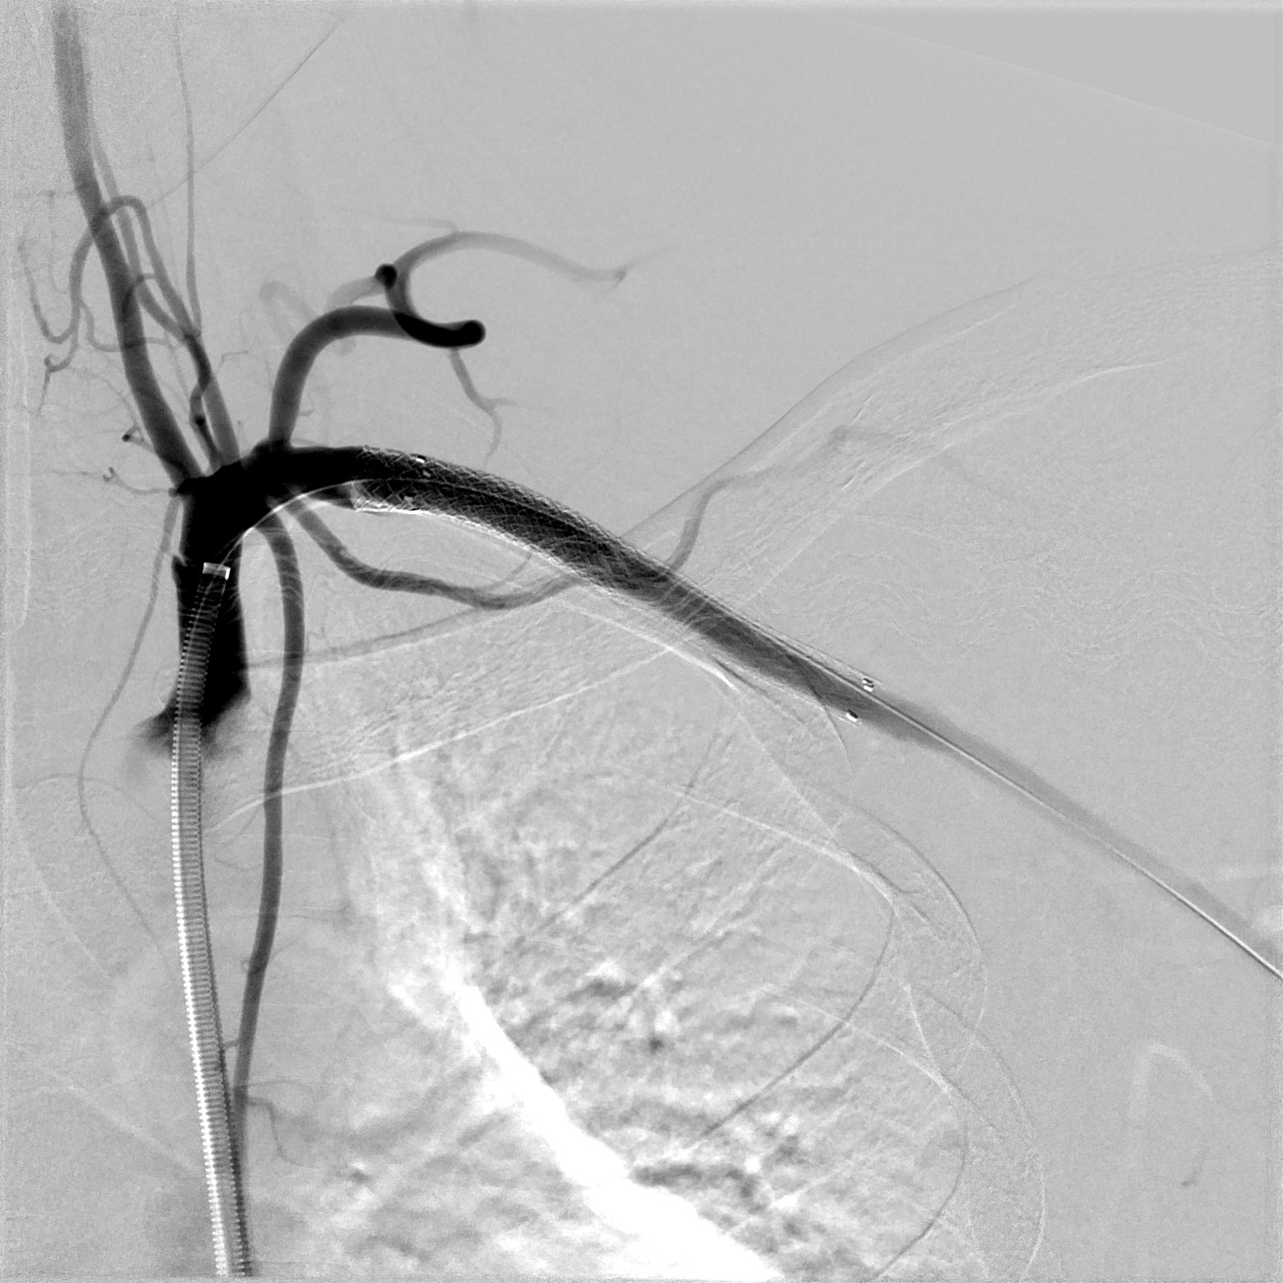
Case report 2
general anesthesia
7F long sheath into the right common femoral artery
heparin 100 IU/kg
anterograde recanalization
predilation with 5 mm balloon
6F Rotarex™ device
7 mm DCB angioplasty
closure device
LMWH 10 days + Aspirin + Clopidogrel 3 months
after 3 months follow-up, stent thrombosis at duplex scan, no treatment

Slide 8
Discussion
One case report already published in 2014.⁵
Rotational atherectomy and thrombectomy Rotarex™ device for LSA in-stent occlusion is feasible and safe.
It can be performed through anterograde or retrograde way.
Adjunctive angioplasty is necessary.
8F Rotarex™ device and oral anticoagulation could have been better options for case report 2.
Limitations: case reports and short follow-up.
⁵ Silingardi R, Lauricella A, Cataldi V, et al. Mechanical thrombectomy in proximal subclavian artery in-stent occlusion. Cardiovasc Interv Ther. 2014;29(2):140-5

