Slide 1

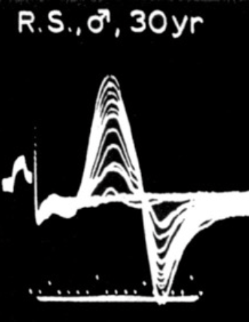
MUNE over the past 30 years : a personal experience
F. Wang
Notes:
Ladies and gentlemen, dear colleagues, dear friends, Firstly, thank you for this invitation. It's a real honor to be here with you, even if my English is terrible, but I'm too old to improve it.

Slide 2



In 1991
Notes:
In 1991, in agreement with Professor Crielaard, I undertook a thesis in electrophysiology and I chose Professor Delwaide as my thesis director. And it was a good choice.

Slide 3
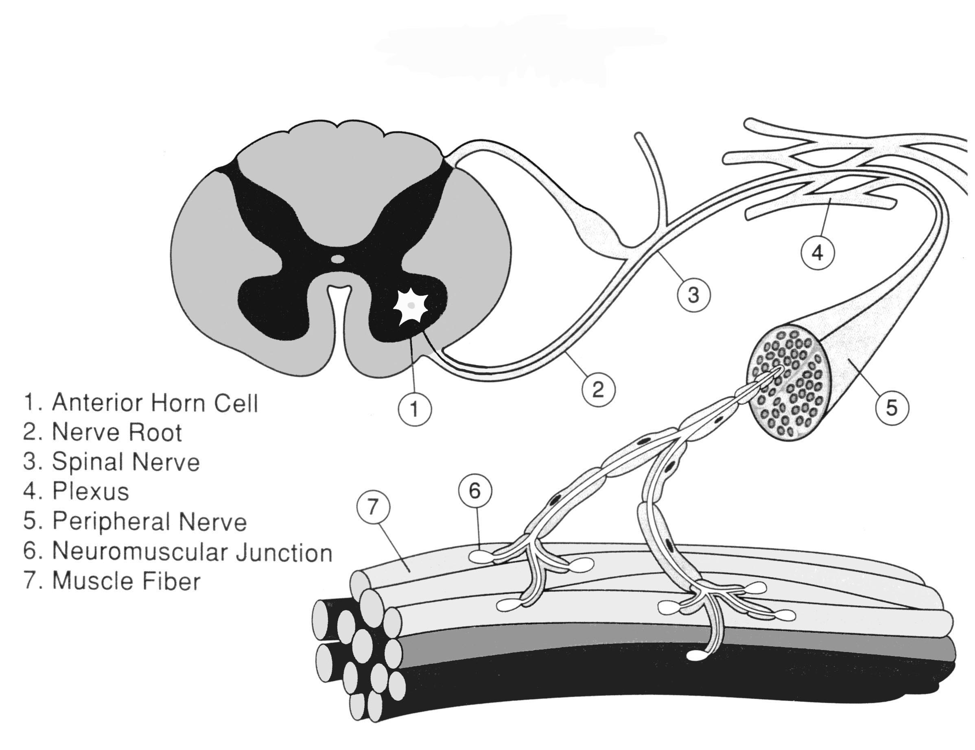
Motor unit
Motor unit potential
Motor Unit Number Estimate
Renewed interest
in the early 1990s
Initial MUNE : McComas et al , 1971
Macro EMG : de Koning et al, 1988
Statistical method : Daube, 1988
Computer MUNE : Galea et al, 1991
MPS : Doherty et al, 1993
STA : Bomberg, 1993
F-response : Stashuk et al, 1994
Notes:
It was decided with Professor Delwaide that I would focus on the motor unit, more precisely on motor unit counting. Indeed, in the early nineties, there was a renewed interest in these counting techniques, with the Macro EMG, the statistical method, the computerized version of the initial method proposed by McComas in 1971, the multiple point stimulation method (MPS), the STA technique, and the F-wave method.

Slide 4
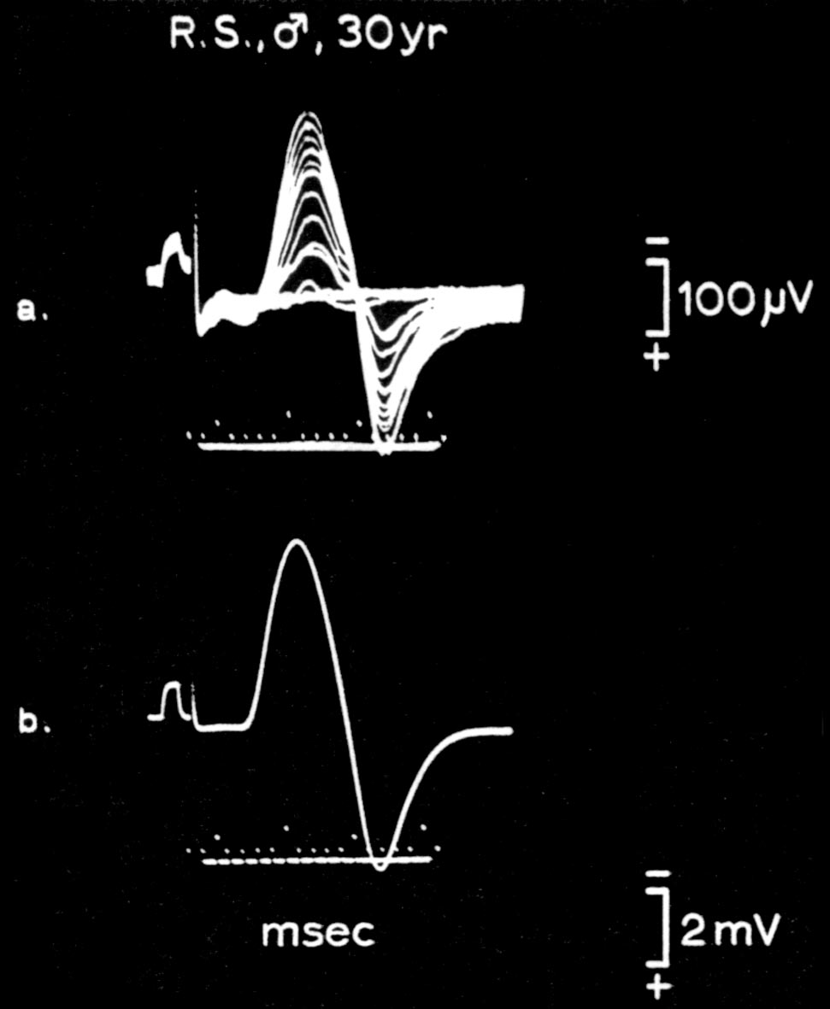
General principle in 2 steps
1. Average MU size estimation
from a 10-20 MU sample
Twitch
MUP
2. Supramaximal Twitch or CMAP size measurement
2
MUNE
=
1
Notes:
The general principle of motor unit counting is quite simple. It involves, first, estimating the average motor unit size from a sample of 10 to 20 motor unit potentials. Then, the maximal CMAP size is divided by this value to obtain a motor unit number estimation or MUNE

Slide 5
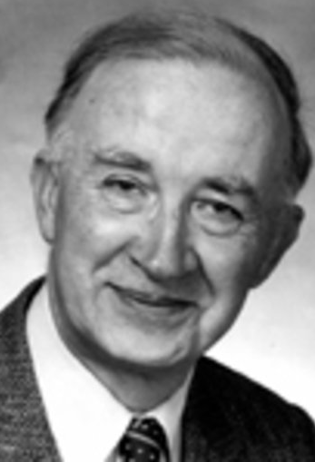
Fundamental principle in 2 steps
Incremental stimulation
- percutaneous nerve stimulation
- short stimulation duration : 0.05 ms
- increased by 0.1 mA increment
=> individual & sequencial motor axon activation
Alan McComas
Initial MUNE technique based on incremental stimulation
- only 1 stimulation site/point
- 10 succesive increments
=> average MUP size
=> supramaximal CMAP size/average MUP size = MUNE
Notes:
So, ultimately, most of the counting techniques distinguish themselves by the method used to estimate the average motor unit size. To achieve this, McComas was the first in 1971 when he proposed a new type of nerve stimulation, named incremental stimulation. This method involves percutaneous nerve stimulation with a very short duration of 50 μs, where the intensity is progressively increased in increments of 0.1 mA. This incremental stimulation allows the individual and sequential activation of motor axons. When incremental stimulation is applied in 0.1 mA increments at one single stimulation point, it becomes possible to obtain 10 successive increments of motor response amplitude, corresponding to the activation of 10 motor units. By dividing this maximal motor response by 10, this makes it possible to estimate the average motor unit size and, subsequently, the MUNE value.

Slide 6



Alan McComas
Niagara falls (Canada)
Motor unit number estimate
Notes:
Professor Delwaide sent me to Canada to meet Alan McComas at McMaster University, near Niagara Falls, to learn about this technique and to start defining the design of my future experimentation.

Slide 7
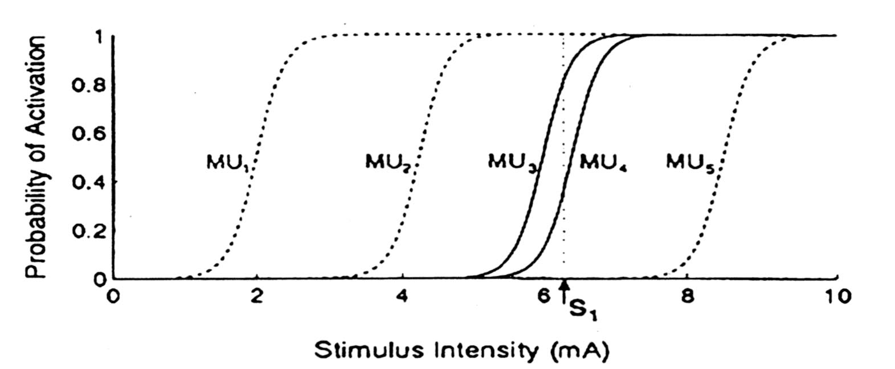
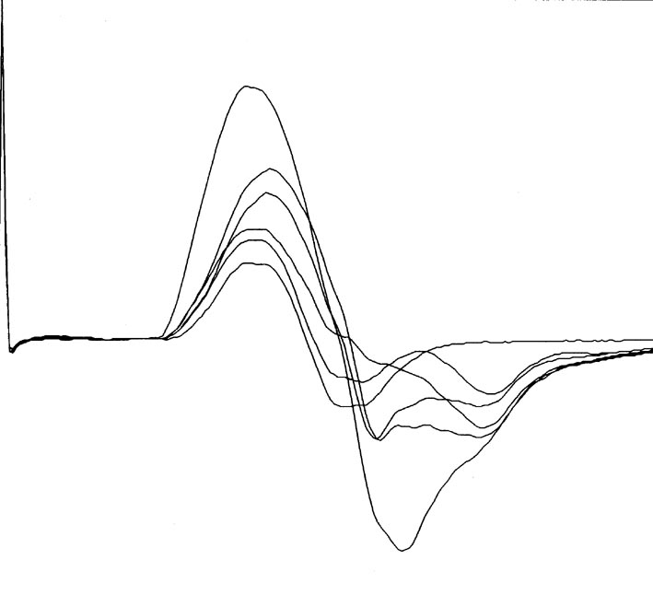
Alternation
Alan McComas
The activation of MU does not occur in an all-or-nothing manner
It occurs with a probability ranging from 0 to 100% based on the intensity of the stimulus
Notes:
Right from the beginning, McComas was aware that his technique was affected by a methodological bias he named himself "alternation." Alternation is related to the fact that the activation of motor units, in response to percutaneous electrical stimulation, does not follow an all-or-nothing law. In fact, the probability of activation fluctuates from 0 to 100% depending on stimulus intensity, following a sigmoid curve.

Slide 8
Alternation
Alan McComas
3 mA
The activation of MU does not occur in an all-or-nothing manner
It occurs with a probability ranging from 0 to 100% based on the intensity of the stimulus
MU1
Notes:
To illustrate the methodological bias associated with the motor unit counting technique related to incremental stimulation, let's imagine that we gradually increase the intensity of nerve stimulation (from the left to the right). At 3 mA, only one motor unit is consistently activated when the stimulation is repeated at this intensity. At 3 mA, we have 100% probability of activation of the MU1.

Slide 9
Alternation
Alan McComas
5 mA
The activation of MU does not occur in an all-or-nothing manner
It occurs with a probability ranging from 0 to 100% based on the intensity of the stimulus
MU1+MU2
Notes:
At 5 mA, motor units 1 and 2 are systematically activated.

Slide 10
Alternation
Alan McComas
6 mA
The activation of MU does not occur in an all-or-nothing manner
It occurs with a probability ranging from 0 to 100% based on the intensity of the stimulus
MU1+MU2+MU3
Notes:
At 6 mA, on the other hand, it's either motor unit 3,

Slide 11
Alternation
Alan McComas
6 mA
The activation of MU does not occur in an all-or-nothing manner
It occurs with a probability ranging from 0 to 100% based on the intensity of the stimulus
MU1+MU2+MU4
Notes:
or motor unit 4,

Slide 12
Alternation
Alan McComas
6 mA
The activation of MU does not occur in an all-or-nothing manner
It occurs with a probability ranging from 0 to 100% based on the intensity of the stimulus
MU1+MU2+MU3+MU4
Notes:
or motor units 3 and 4 that are activated together with MU 1 & 2

Slide 13
Alternation
Alan McComas
5 MU activated
6 distinct motor responses
=> underestimation of average MUP size
=> overestimation of MUNE
The activation of MU does not occur in an all-or-nothing manner
It occurs with a probability ranging from 0 to 100% based on the intensity of the stimulus
9 mA
MU1+MU2+MU3+MU4+MU5
Notes:
Finally, at 9 mA, motor units 1 to 5 are systematically activated. In total, we have 5 motor units activated by incremental stimulation, but 6 distinct motor responses are recorded. This leads to an underestimation of the average motor unit size and an overestimation of the motor unit number.

Slide 14
MPS -> AMPS
Incremental stimulation
- percutaneous nerve stimulation
- short stimulation duration : 0.05 ms
- increased by 0.1 mA increment
Multiple point stimulation method (Brown & Milner-Brown, 1976; Doherty et al, 1993)
- 10 stimulation sites/points along the course of the nerve
- only 1 increment at each site
- Often difficult to evoke 10 distinct motor units at 10 different stimulation sites, particularly when the number of motor units is low =>
Adapted multiple point stimulation method
(Kadrie et al, 1976; validated by Wang & Delwaide, 1995)
- 4-5 stimulation sites/point along the course of the nerve
- 2-3 increments at each site, free of alternation (criteria)
MUP activated in an all-or-nothing manner
Motor axons recruited
- with distinct thresholds,
- in an orderly and reproducible manner
- without any fractionation of the motor
response to successive stimuli.
Notes:
To eliminate the bias associated with alternation, Brown & Milner-Brown, and later Doherty, proposed the multiple-point stimulation method. In this method, the nerve is stimulated at 10 distinct points, and at each stimulation point, only one motor unit is activated. The challenge with this technique is that, it's not easy to locate 10 stimulation points along the nerve course to evoke 10 different motor units, especially in pathology, when the motor unit number is reduced. This led us to develop and validate an intermediate technique between incremental stimulation and the multiple-point stimulation method, which we have called the adapted multiple-point stimulation method (AMPS). With this technique, 4 stimulation sites are typically sufficient, 3 at the distal forearm region, and one at the elbow, with 2 or 3 units recruited at each point by incremental stimulation. To minimize alternation, motor unit potentials must be activated in an all-or-nothing manner and motor axons recruited with distinct thresholds, in an orderly and reproducible manner, without any fractionation of the motor response to successive stimuli.

Slide 15
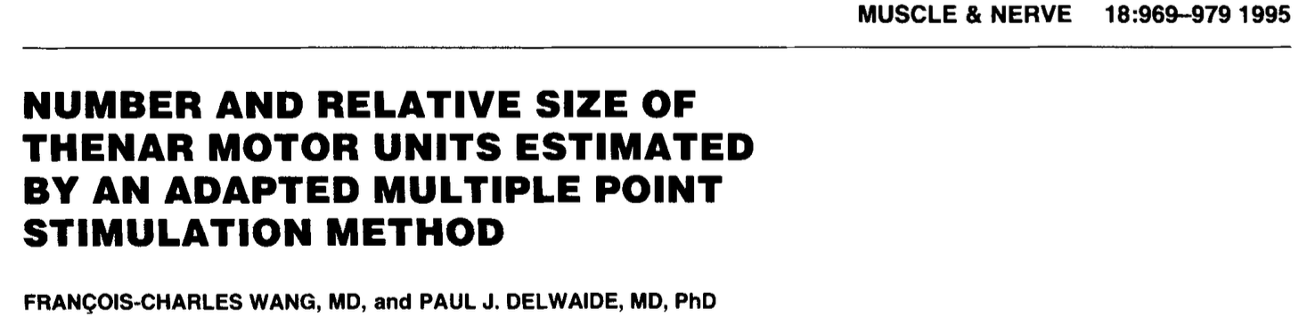
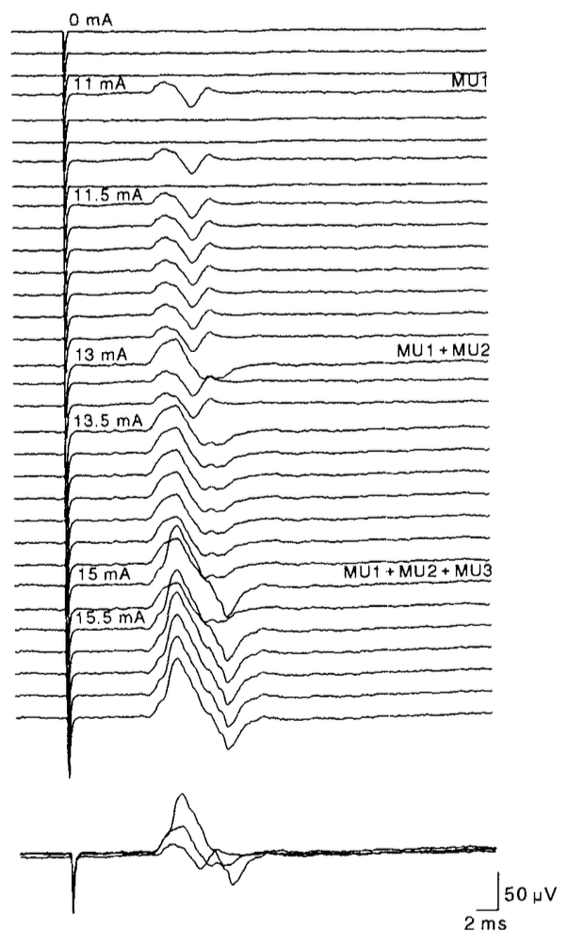
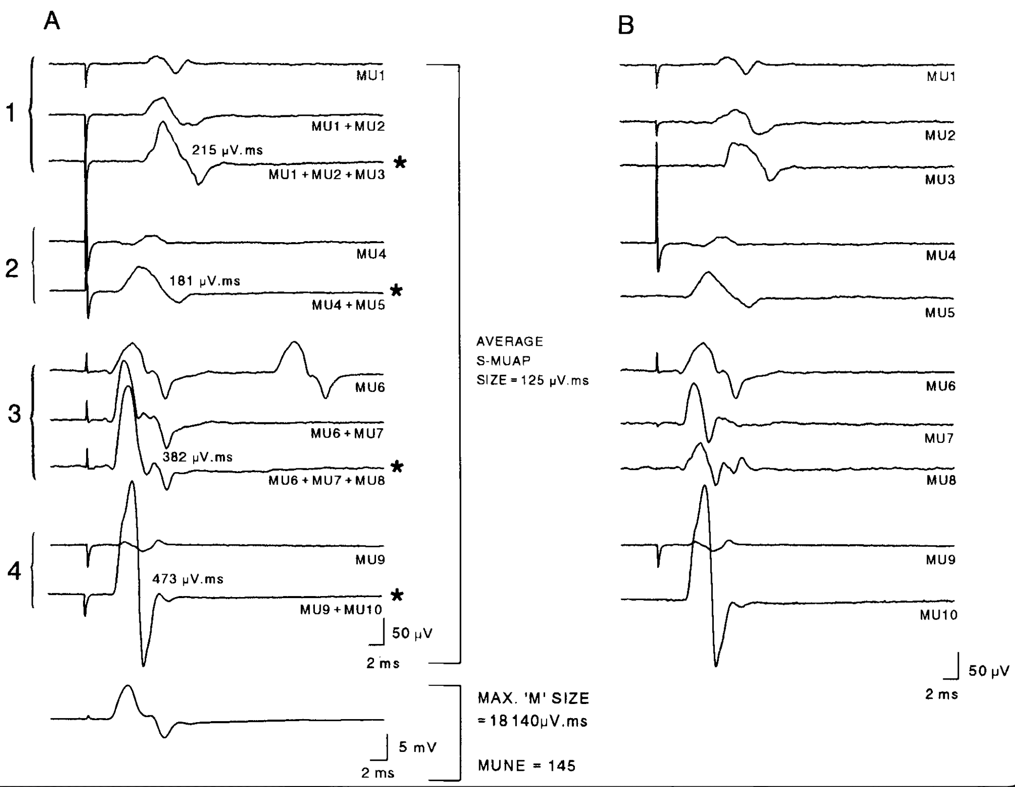
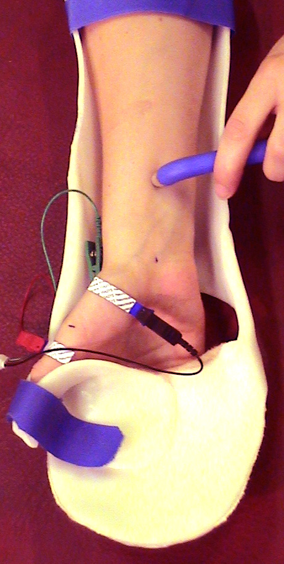
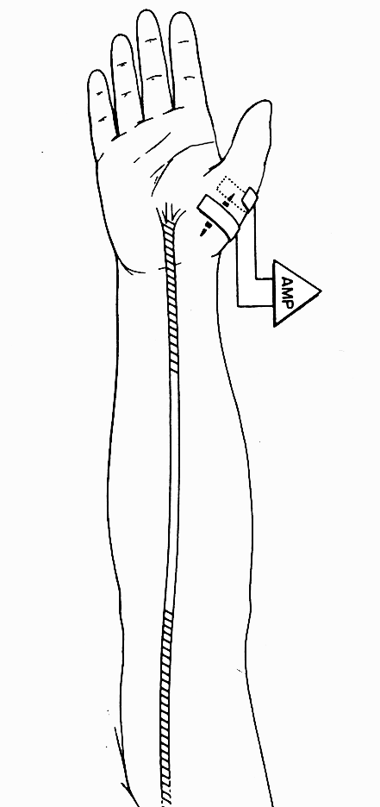
Incremental stimulation
To ensure that the motor units activated at different stimulation points are distinct from each other, the morphology of each motor unit potential is reconstructed using a trace subtraction program
AMPS method
Average
MU size
125 μV.ms
8 cm
1
2
3
4
CMAP size = 18,140 μV.ms
MUNE = 145 MU
Notes:
Here is an example of the recorded responses at a stimulation point using incremental stimulation with 3 motor units successively activated with, as you can see, distinct thresholds and in an all or nothing manner. Here, you have the recorded responses at the 4 stimulation points. To ensure that the motor units activated at different stimulation points are distinct from each other, the morphology of each motor unit potential is reconstructed using a trace subtraction program. By adding the amplitude of the 4 maximal motor responses obtained at the 4 stimulation points and dividing this sum by 10, you obtain the estimate of the average motor unit size. Dividing the maximal CMAP size by this value gives you the Motor Unit Number Estimation (or MUNE).

Slide 16
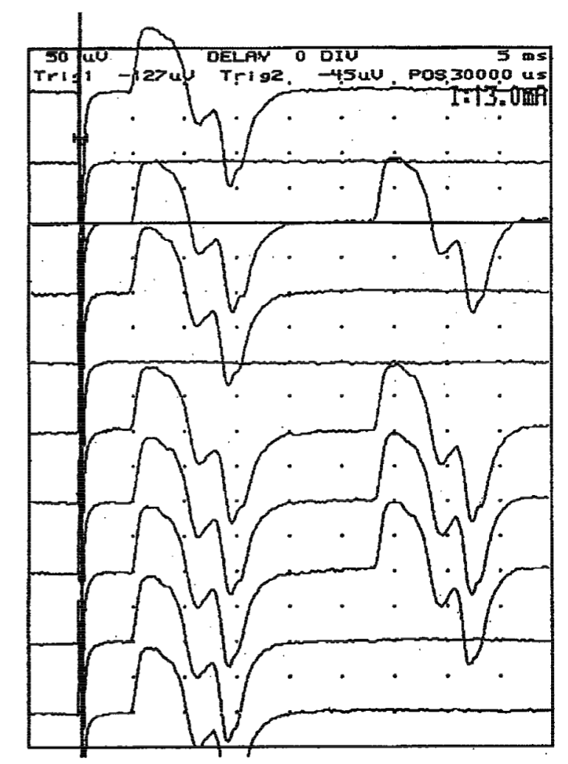
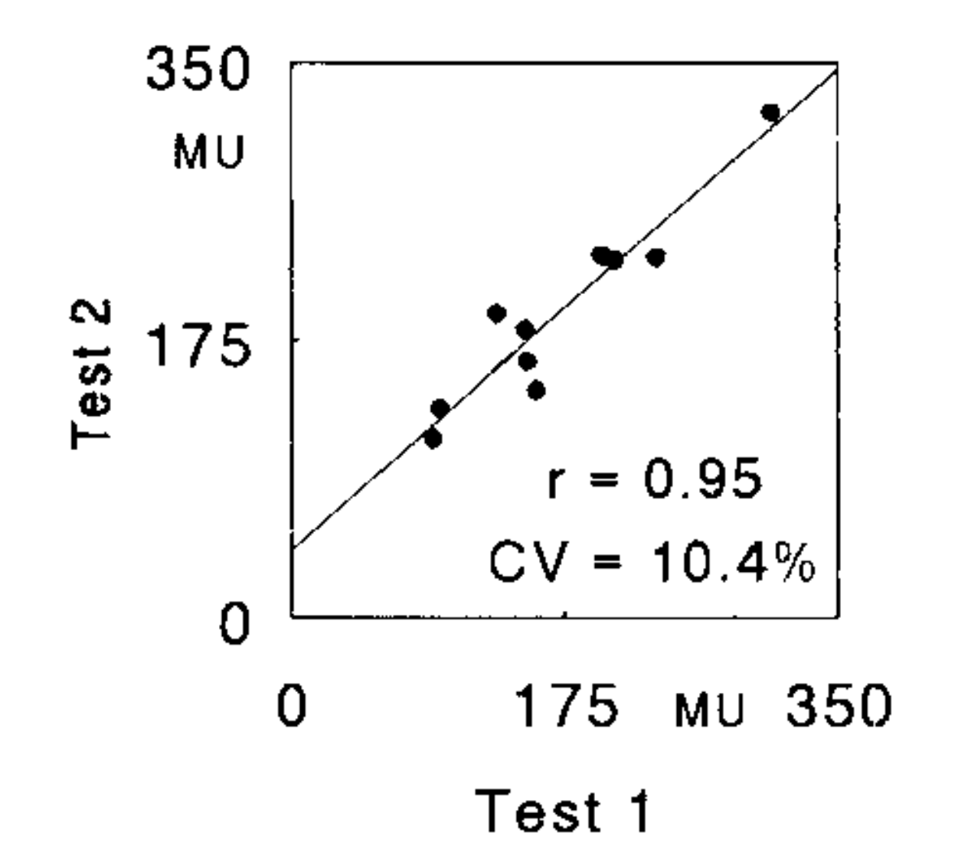
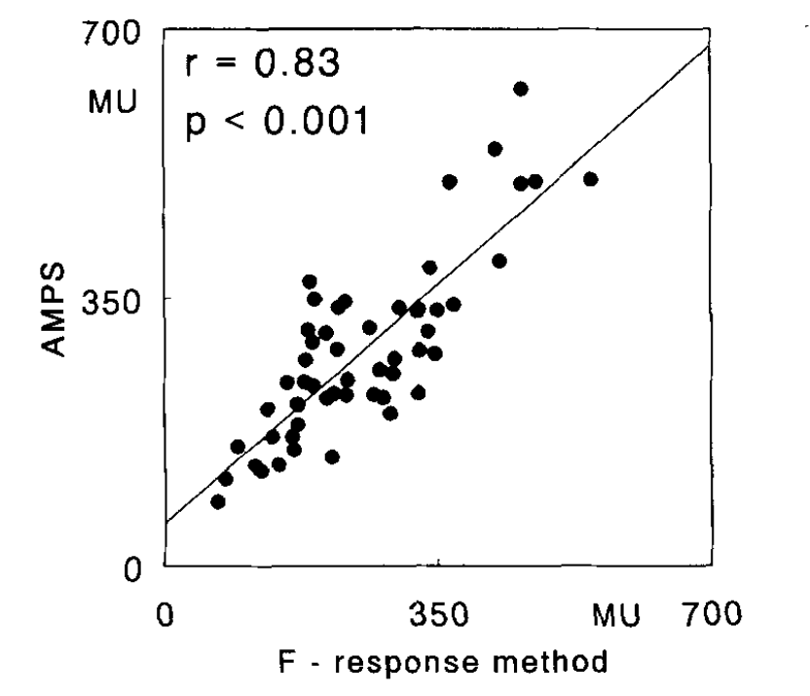
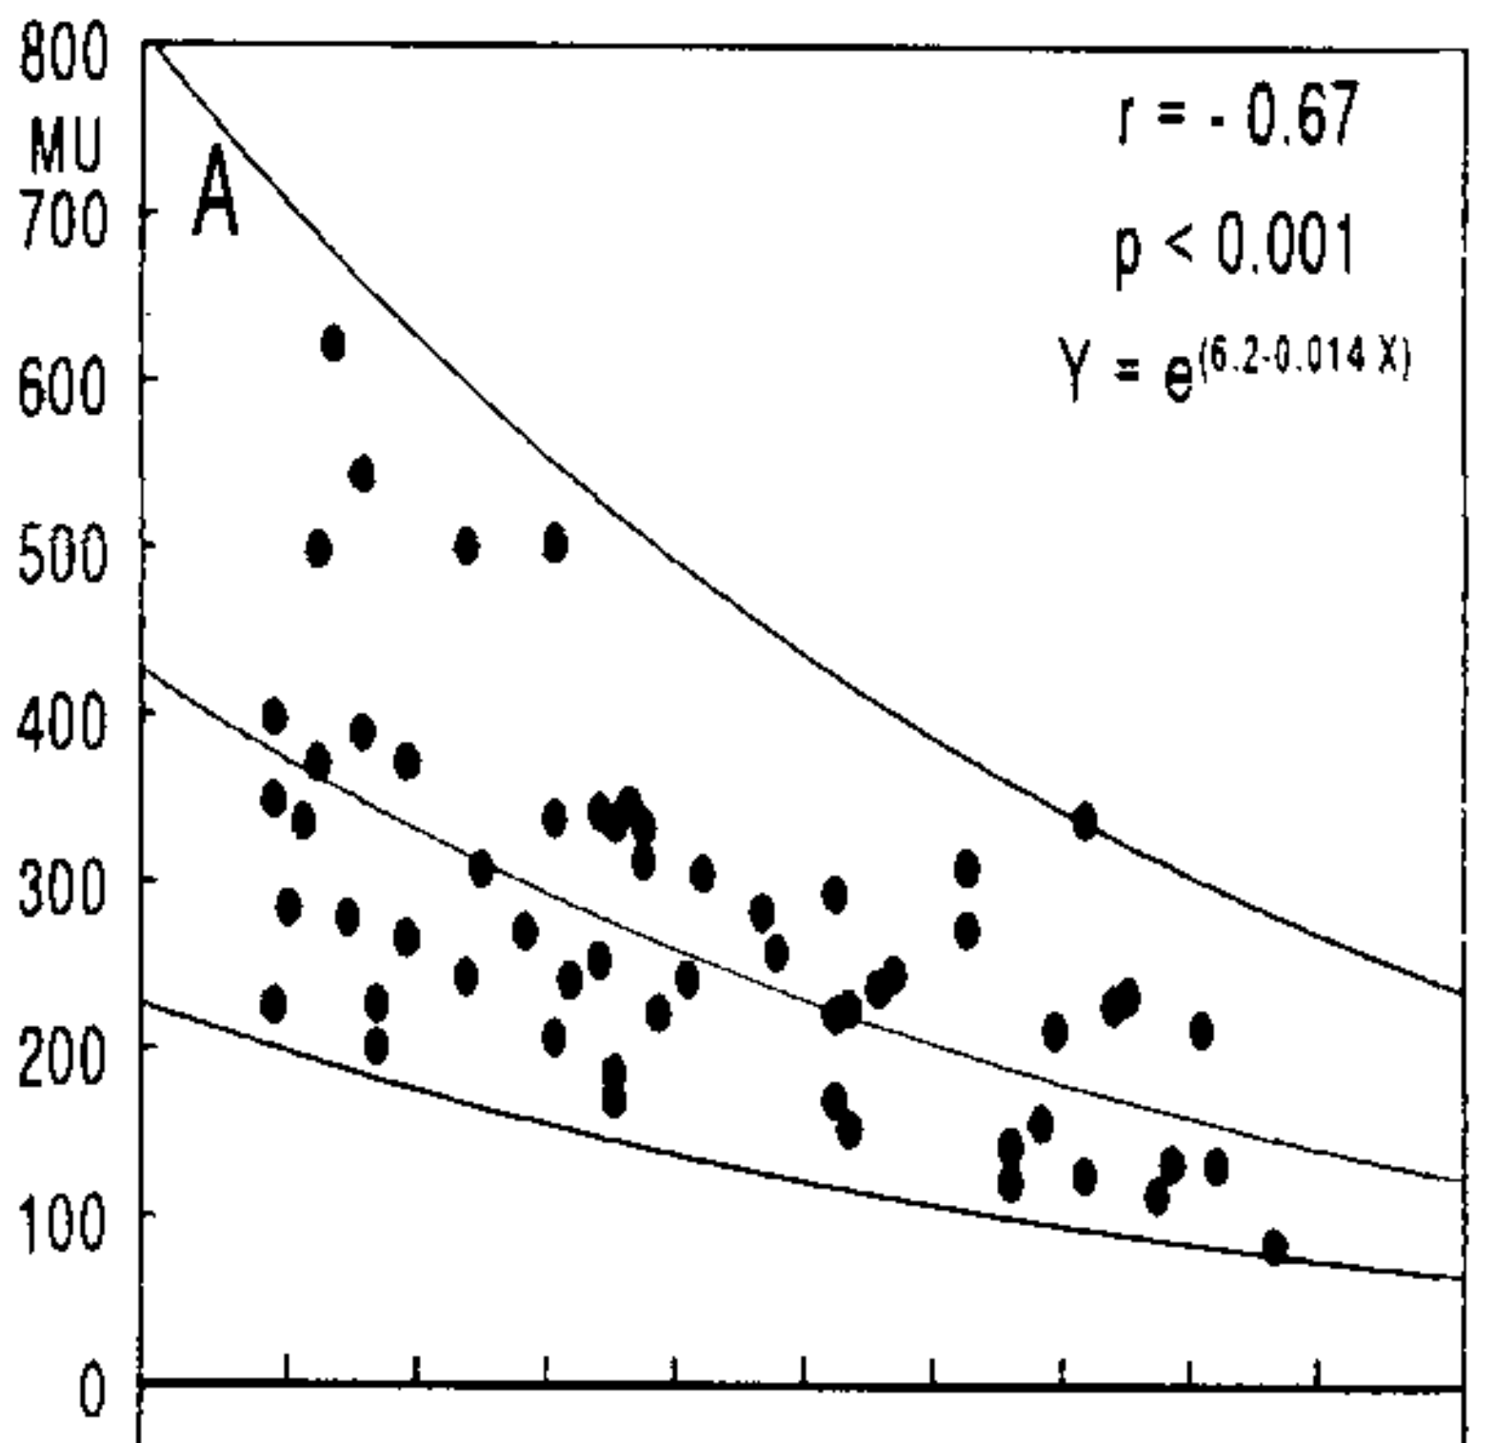
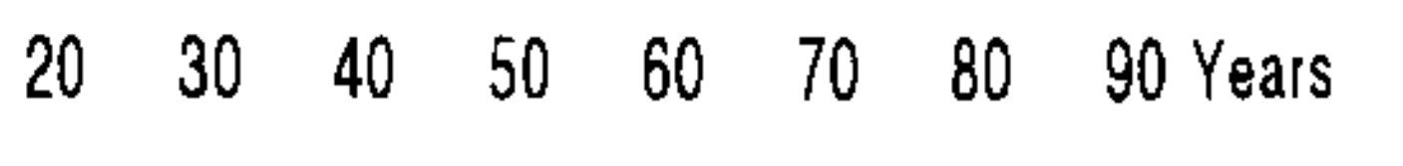
Single MU
F-wave
Convergent validity (n = 54)
Test-retest reliability (n = 10)
MUNE vs Age (n = 59)
-1.4% MU/year
Notes:
To validate AMPS, we compared results obtained using it, with those obtained from an already validated method, the F-response procedure, in 54 control subjects. As you can see, the correlation was very high. Here you can see a single MU F-wave recorded from isolated MU (the morphology of direct response and late response is absolutely identical). The F-response method consisted to record 10 distinct single MU F-Wave to estimate the average MU size and subsequently the MUNE value. We also assessed the test-retest reliability, which proved to be excellent. Following this, we established normative values in a sample of 59 healthy subjects based on age. We calculated a loss of 1.4% of motor units per year.

Slide 17
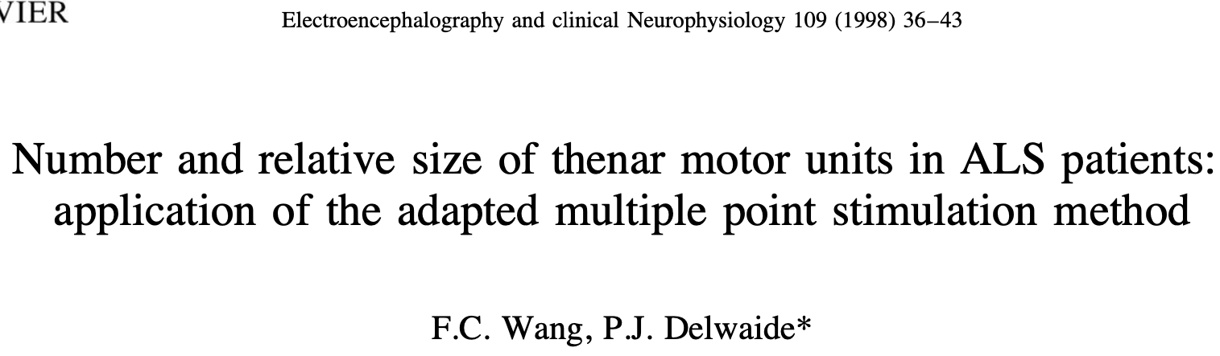
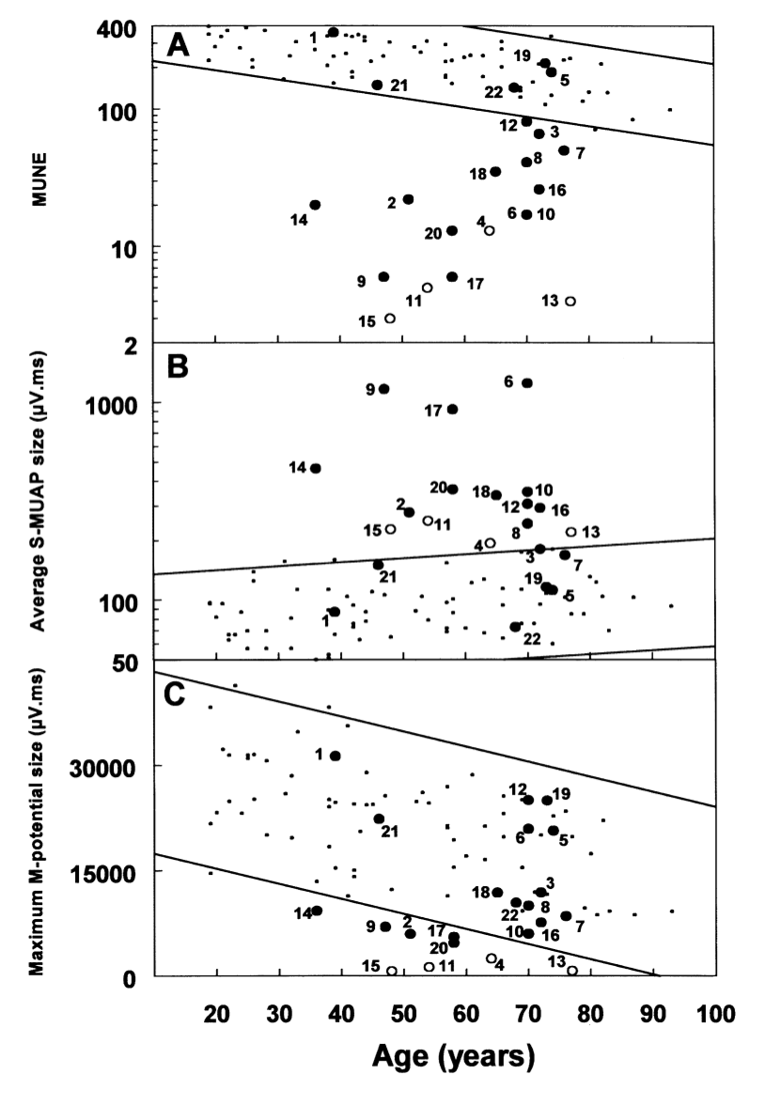
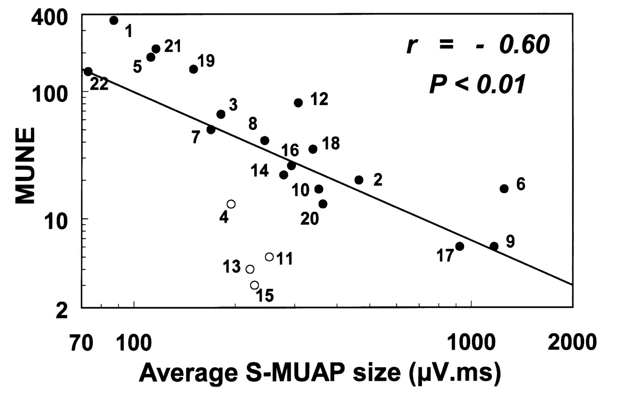
MUNE, MUP & CMAP size in ALS patients (n = 22)
MUNE vs MUP size in ALS patients (n = 22)
Notes:
After that, we applied our technique to patients with amyotrophic lateral sclerosis (ALS). We observed a reduction, often significant, in the motor unit number in most of our patients, and in the same time an increase in the average motor unit size, which we attributed to collateral reinnervation. As a consequence, the reduction in the size of the supramaximal motor response was often less pronounced, and the values frequently remained within the limits of normal. We also showed a negative correlation between the motor unit number and the average motor unit size, once again linked to collateral reinnervation, except in 4 patients whose disease progression was particularly rapid, indicating the failure of collateral reinnervation in these patients.

Slide 18
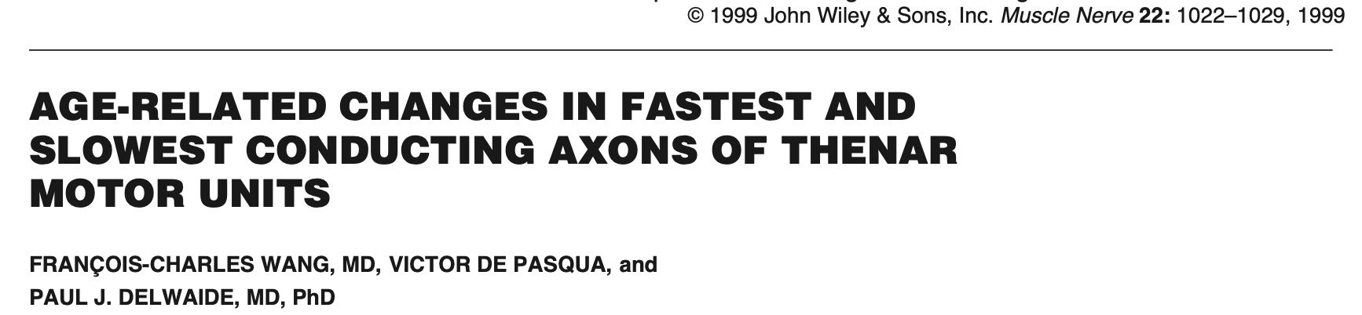
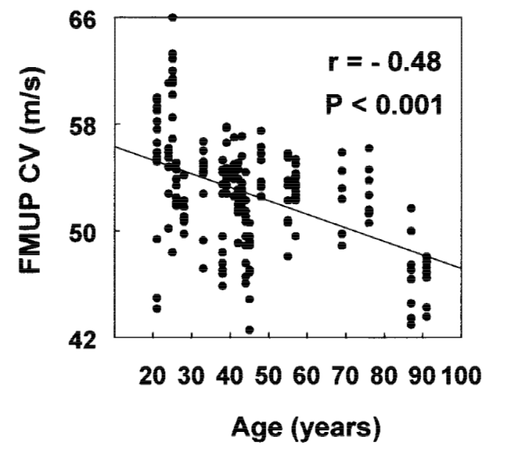
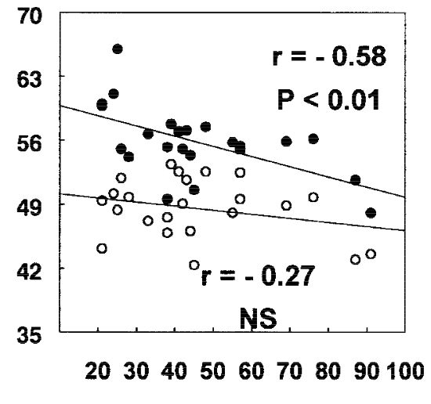

Prominent loss with age
of the largest and fastest conducting MU
Single MU F-wave
Single MU F-wave CV vs Age
The conduction velocity of motor units
decreased significantly with age
Notes:
Since we used the F-response method to validate our counting technique, it was possible to study the conduction velocity of individual motor units. We confirmed that the conduction velocity of motor units decreased with age. We also demonstrated a prominent loss with age of larger, fast-conducting motor units.

Slide 19

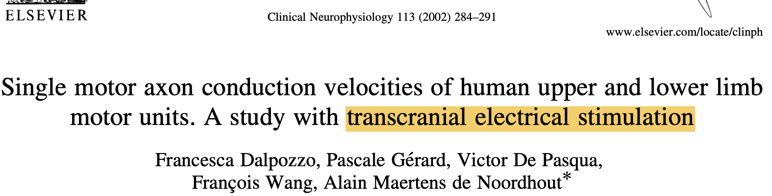
Notes:
This result was confirmed 3 years later by Alain's team, using transcranial electrical stimulation.

Slide 20
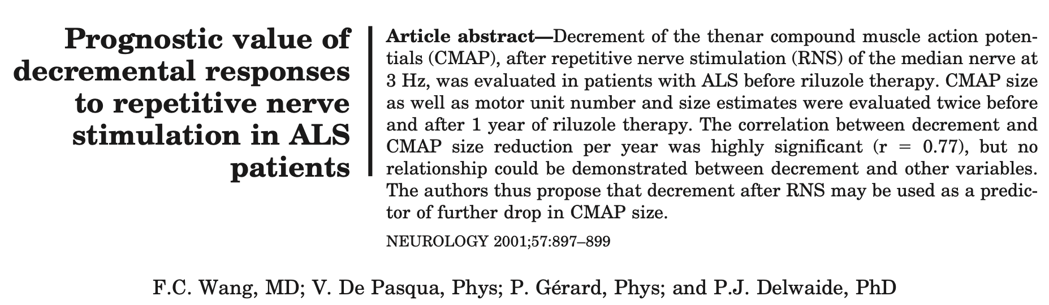
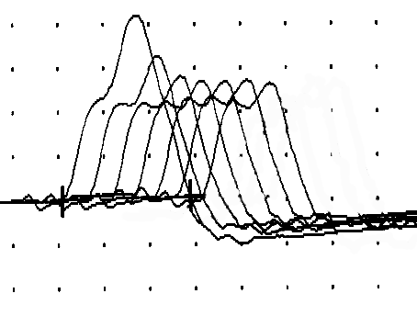
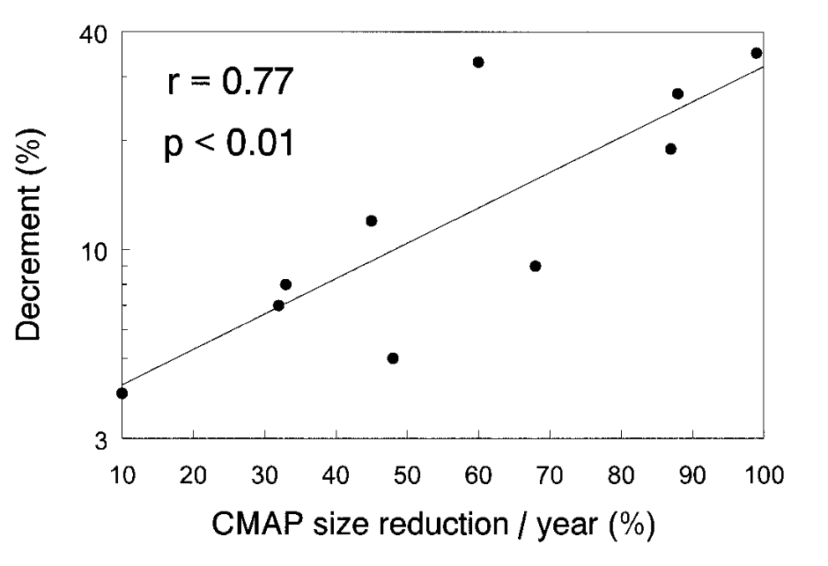
Decrements at the beginning of the study
(median nerve at the wrist)
Decrement may be used as predictor of further drop in CMAP size
25
8 ALS/15 > 10%
Decrement max = 35 %
p < 0.0005
20
15
10
5
5,8
14,9
0
Ctrl (n = 15)
ALS (n = 15)
Notes:
When measuring the motor unit number in patients with amyotrophic lateral sclerosis (ALS), we observed that some changes in the size of motor responses were related to the stimulation frequency. Consequently, we measured decrements during repetitive nerve stimulation at 3 Hz in these patients. Approximately half of the patients exhibited a decrement greater than 10%, with a maximum value of 35%. We also demonstrated that the decrement may be used as predictor of further drop in CMAP size.
We concluded that the decrement was associated with collateral reinnervation immaturity or terminal degeneration of motor units particularly in patients with rapid disease progression.

Slide 21
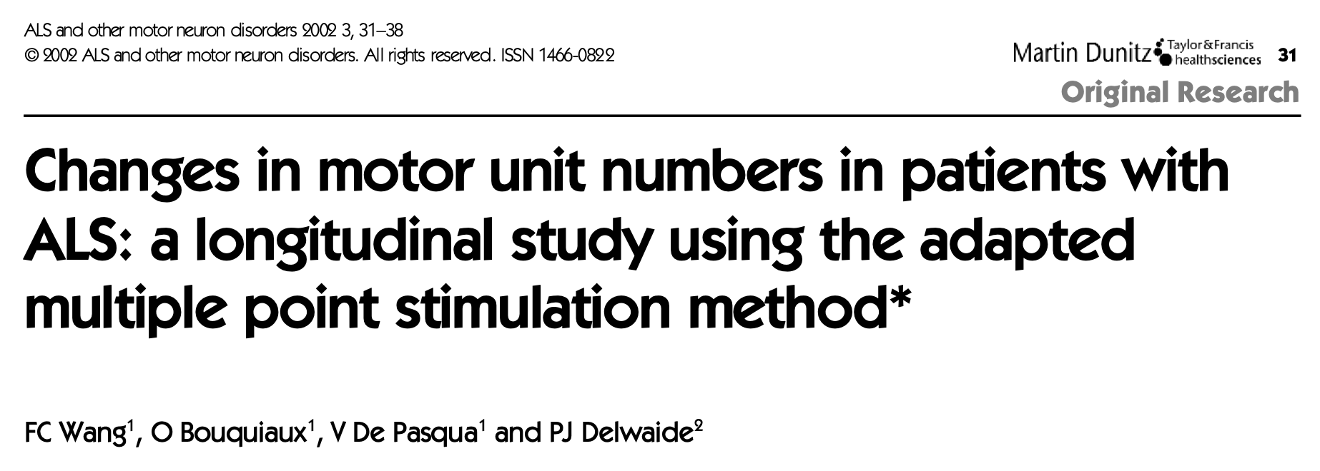
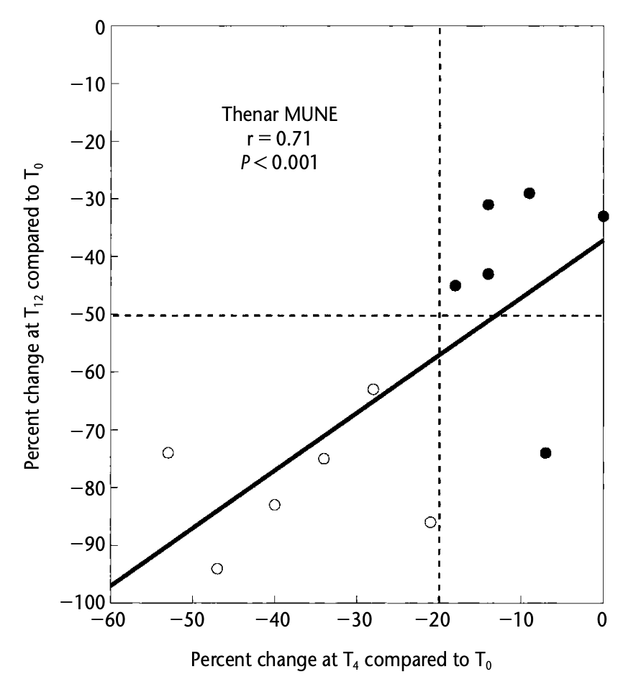
Still among patients with ALS :
Percent change of MUNE at T4, compared to T0
may be used as predictor of percent change of
MUNE at T12, compared to T0
If percent change of MUNE at T4, compared to T0
is > 20%
=> percent change of MUNE at T12, compared to T0
will be > 50%
Ctrl (n = 15)
ALS (n = 15)
Notes:
Later, still among patients with amyotrophic lateral sclerosis (ALS), we demonstrated that
percent change of MUNE at T4, compared to T0 may be used as predictor of percent change of MUNE à T12, compared to T0. Thus, il percent change at T4, compared to T0 is more than 20%, percent change of MUNE at T12, compared to T0 will be more than 50%.
This allowed us to distinguish patients with rapid disease progression from those with slower progression, what could be of interest in the context of the use of the MUNE technique in therapeutic trials.

Slide 22
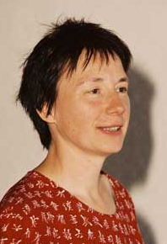
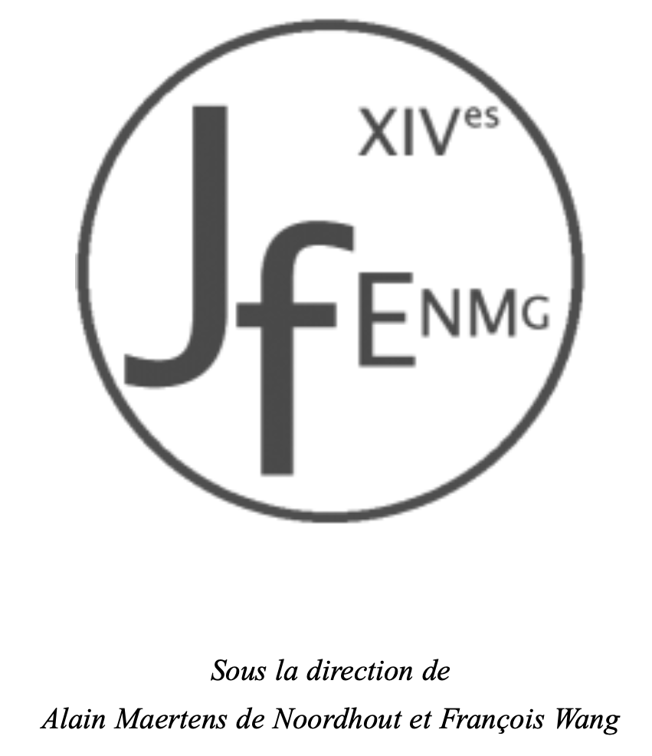
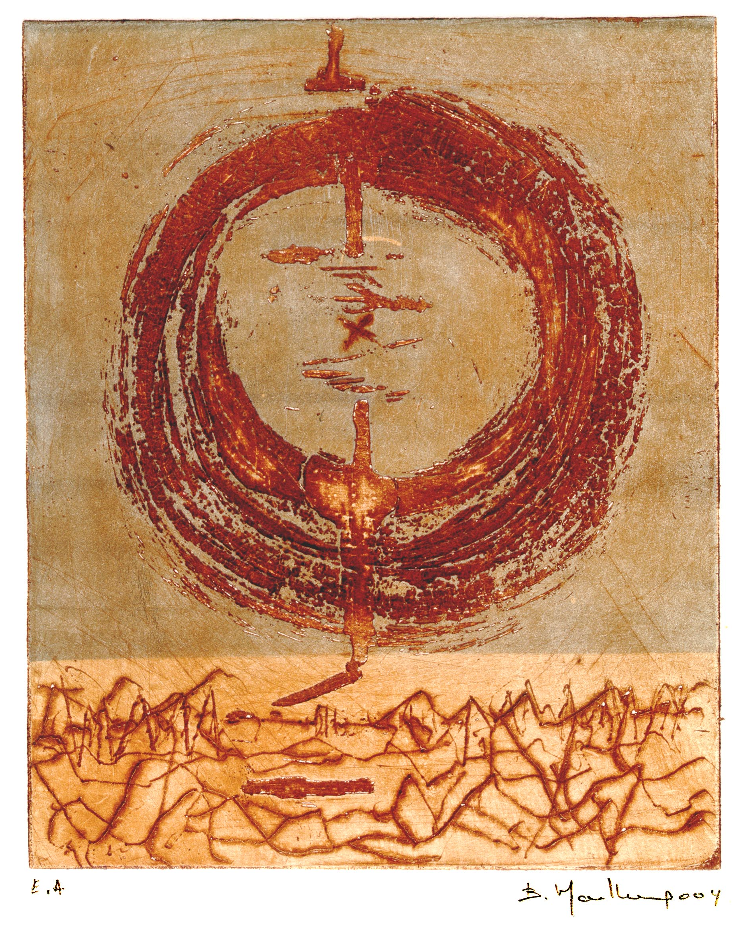
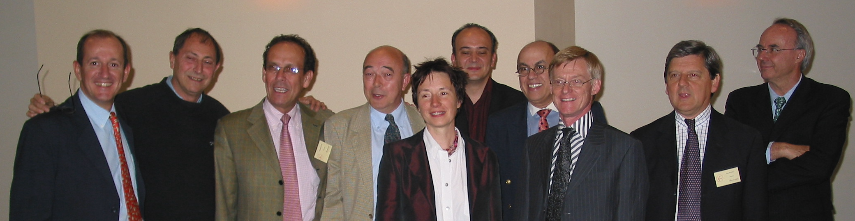
Liège convention center
2004
Ctrl (n = 15)
ALS (n = 15)
Notes:
In 2004, with Alain Mertens de Noordhout, I organized ‘les 14èmes Journées Francophones d’ENMG”, to the Liège convention center. It was a great success.

Slide 23
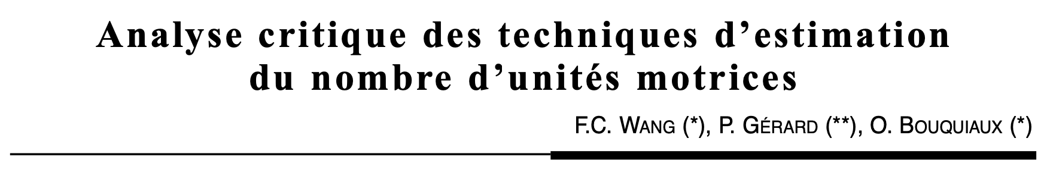
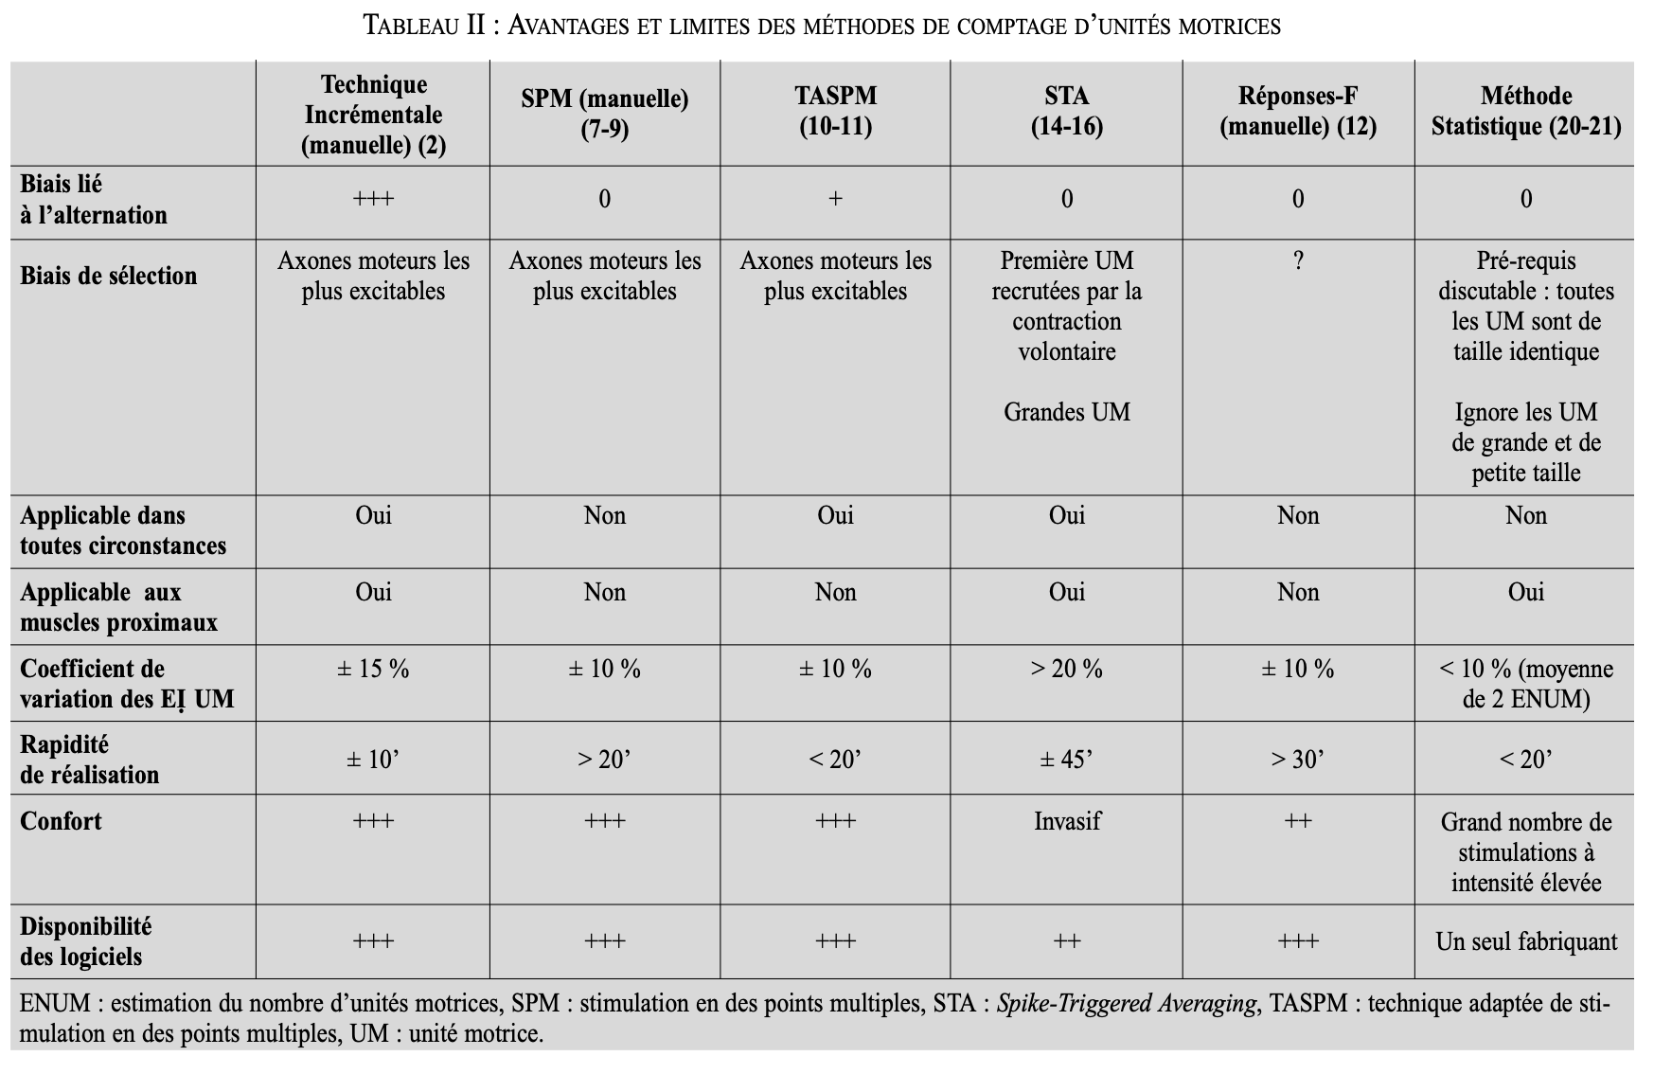
ALS (n = 15)
Critical analysis of various counting methods
Notes:
It was also an opportunity for me to present a critical analysis of various counting methods.

Slide 24

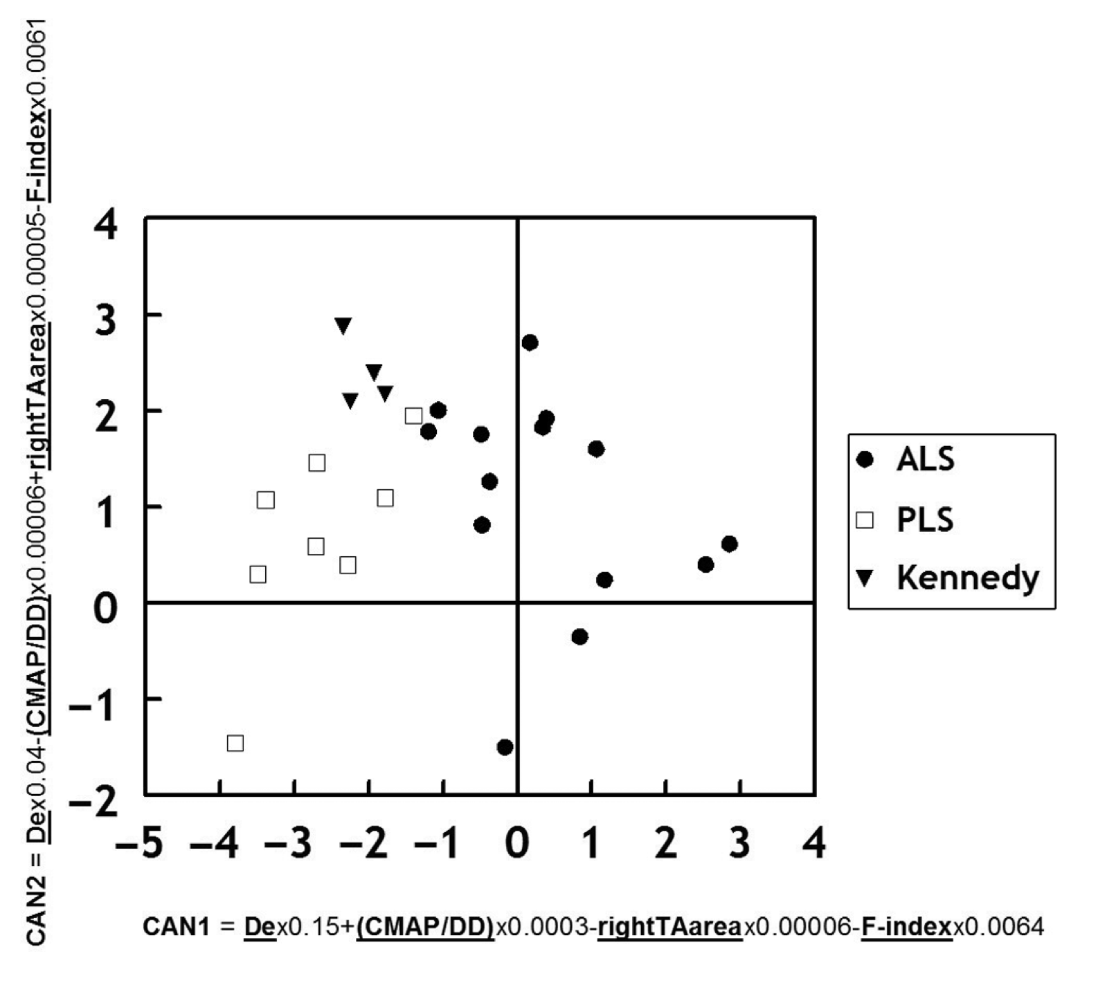
> 3 ans
Survival (n = 22)
< 3 ans
Canonical discriminant analysis
Thenar MUNE
400
r = - 0,42
p < 0,05
100
ALS
PLS
Kennedy
10
r = - 0,69
p < 0,05
F-index =
F-persistance
X F-amplitude
2
0
5
10
15
20
25
30
35
40
45
50
55
60
Ctrl (n = 15)
ALS (n = 15)
Disease duration (months)
Notes:
Later on, Pierre Bouche opened the doors of his department at Pitié-Salpêtrière Hospital, allowing me to expand my patient recruitment among those suffering from motor neuron degeneration. We observed that ALS patients with a survival less than 3 years lost their motor units more rapidly than those with a survival more than 3 years.
This period also provided an opportunity to apply our counting technique to patients with primary lateral sclerosis and patients with Kennedy's disease. A canonical discriminant analysis allowed us to distinguish quite welle the three groups of patients by introducing variables such as the decrement value during 3 Hz stimulation, the maximal thenar CMAP amplitude divided by disease duration, the CMAP area of the tibial anterior muscle, and the product of F-wave persistence and their maximal amplitude, which we named the F-index.

Slide 25
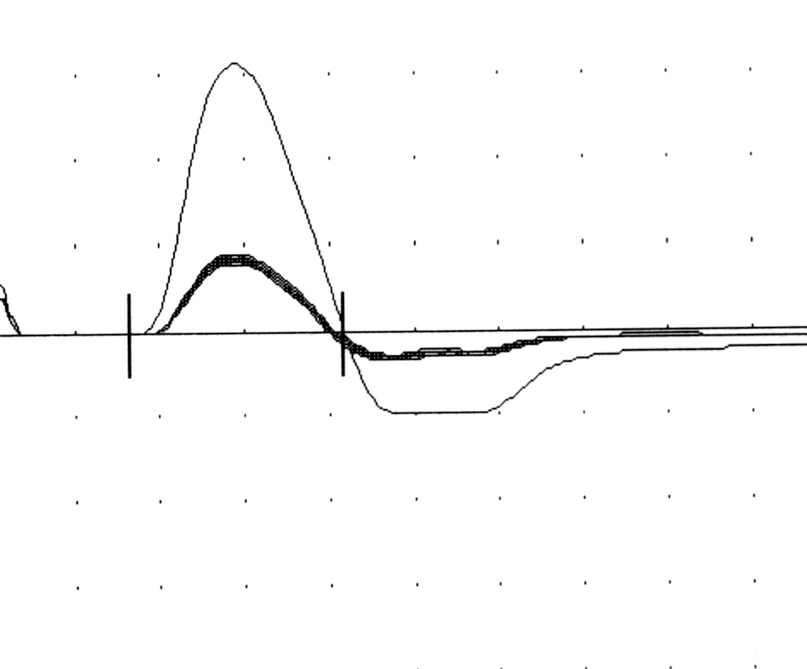
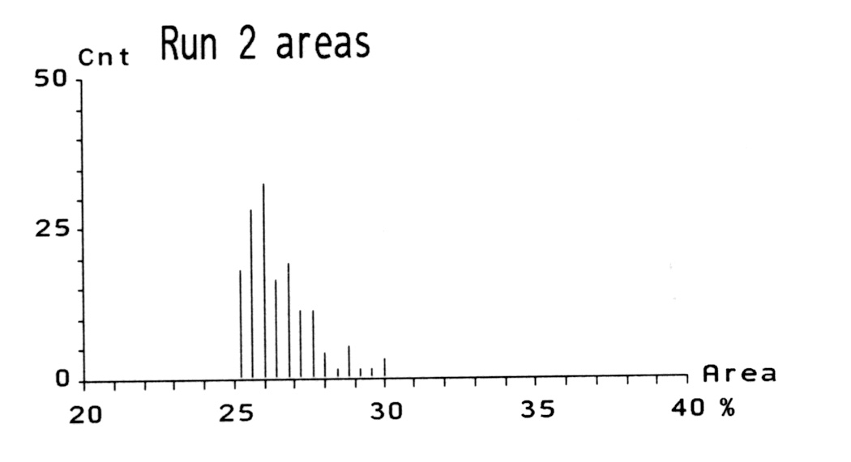
Réponse M max.
Sub-maximal CMAP size
distribution
Réponses M sous-max.
Based on alternation
Poisson distribution
120-300 sub-maximal stimuli
If: - sub-maximal CMAP size distribution is Poisson
- all MUP are identical in size
Variance = Mean
AMPS vs Statistical method (n = 100)
Statistical method
sub-maximal CMAP size variance
PUM size =
mean – minimal (CMAP size)
Dropouts by AMPS: 0%
Dropouts by the statistical method: 15%
AMPS
Notes:
We compared also AMPS results with those obtained using the statistical method, another motor unit counting technique developed by Jasper Daube. The statistical method is not based on incremental stimulation, but on alternation and Poisson distribution of the CMAP sizes elicited by submaximal stimulations. The correlation between the results of the two procedures was particularly high for MUNE values below 100. For values above 100, we observed that the statistical method underestimated the number of motor units, at least in comparison to our counting method.
Additionally, the dropouts with the statistical method reached 15%, either because technical conditions were not met, or because patients were not sufficiently relaxed., while there were no dropouts with the AMPS.

Slide 26
Unpublished data
Patients with a small reduction in MUNE between the 4th or 8th month and the baseline evaluation had significantly longer survival than patients with a MUNE reduction exceeding 30% at the 4th month or exceeding 40% at the 8th month
100
MUNE T0-T4
> 30%
MUNE T0-T4
< 30%
100
MUNE T0-T8
> 40%
MUNE T0-T8
< 40%
Survival (%)
80
Survival (%)
80
60
60
40
40
20
20
0
0
8
16
24
32
40
8
16
24
32
40
Time (months)
Time (months)
The Kaplan-Meier survival analysis
Notes:
The Kaplan-Meier survival analysis confirmed that patients with a small reduction in MUNE between T4 and T0 or between T8 and T0 had significantly longer survival than patients with a MUNE reduction exceeding 30% at T4 or exceeding 40% at T8.

Slide 27
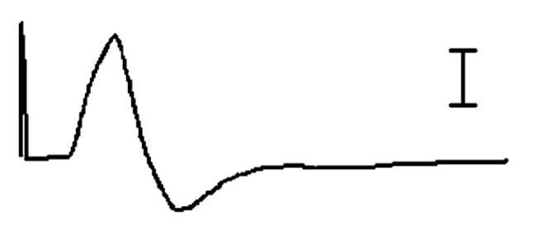
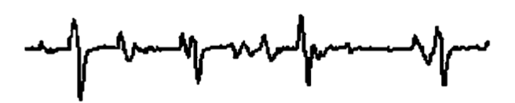
MUNIX
CMAP (percutaneous
nerve stimulation)
Interference pattern by surface EMG (S-SIP)
MUP number: N
MUP amplitude: A-PUM (mV)
MUP area: S-PUM (ms.mV)
MUP power: P-PUM (ms.mV²)
Notes:
And then came the Motor Unit Number Index, MUNIX. In this method, the supramaximal CMAP is compared to the interference pattern detected by surface electrodes in terms of amplitude, area, and power

Slide 28
MUNIX
ICMUC
S-SIP
MUNIX = ICMUC when S-SIP (x) = 20 ms.mV
MUNIX = 290
Notes:
in order to derive an index of the motor unit number.

Slide 29
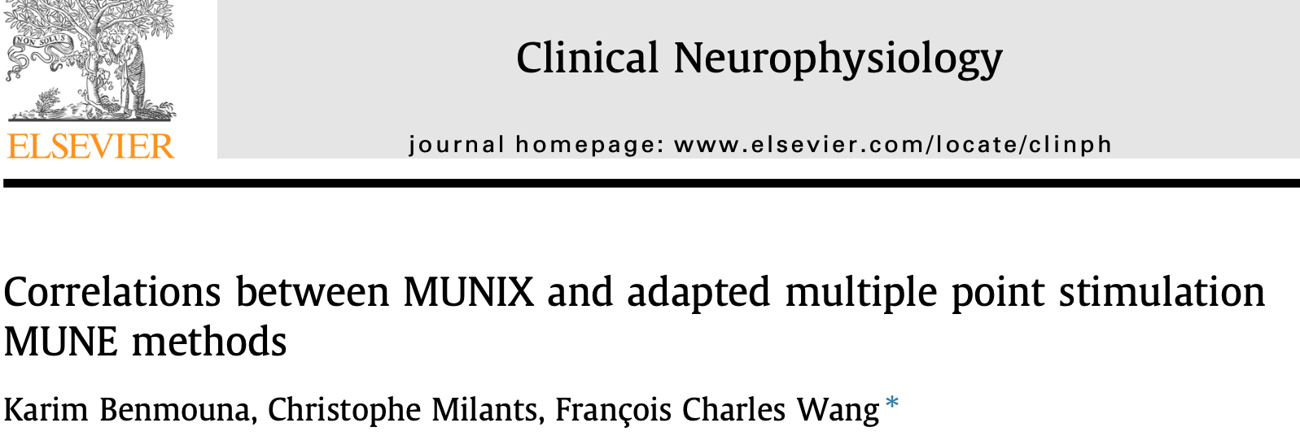
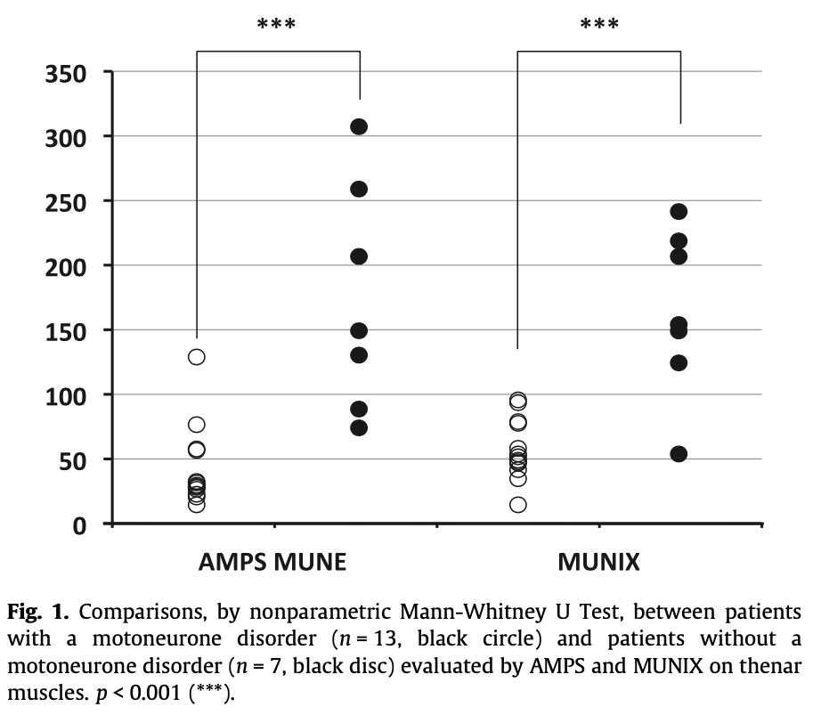
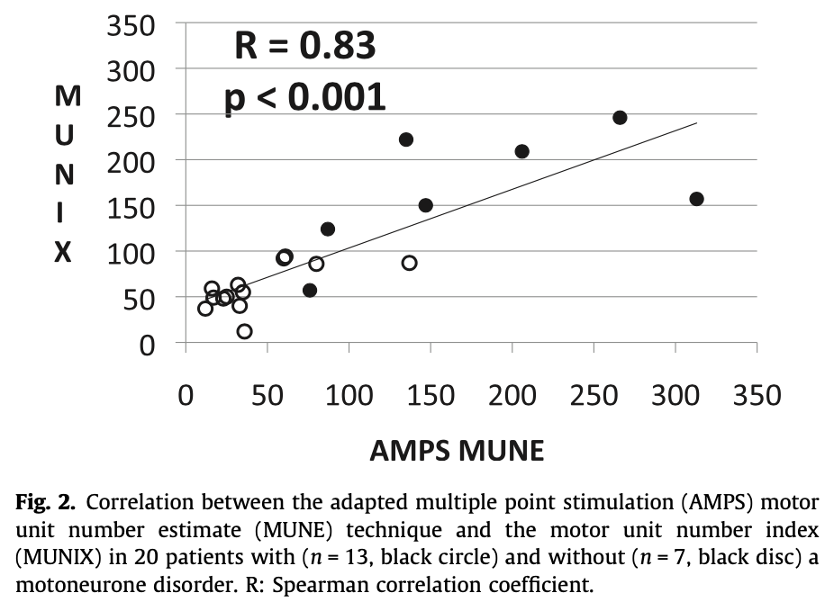
Comparative study between our counting method and the MUNIX procedure, both in healthy subjects and patients with motor neuron degeneration
Comparison
Correlation
Notes:
After publishing a comparative study between our counting method and the MUNIX procedure, both in healthy subjects and patients with motor neuron degeneration,

Slide 30
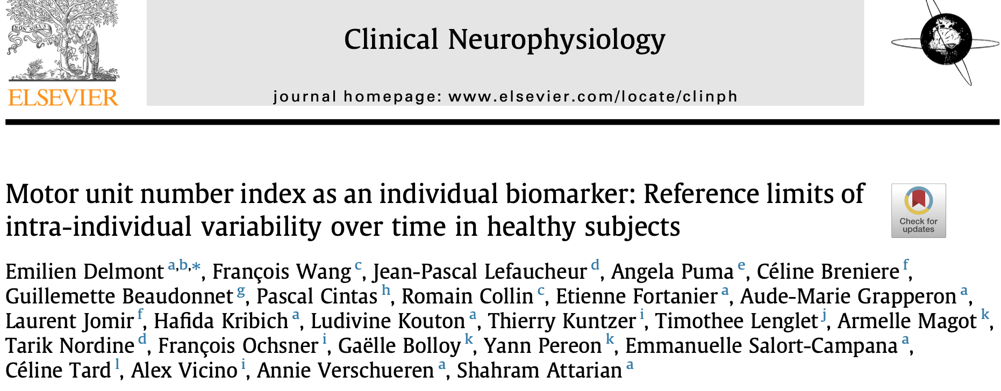


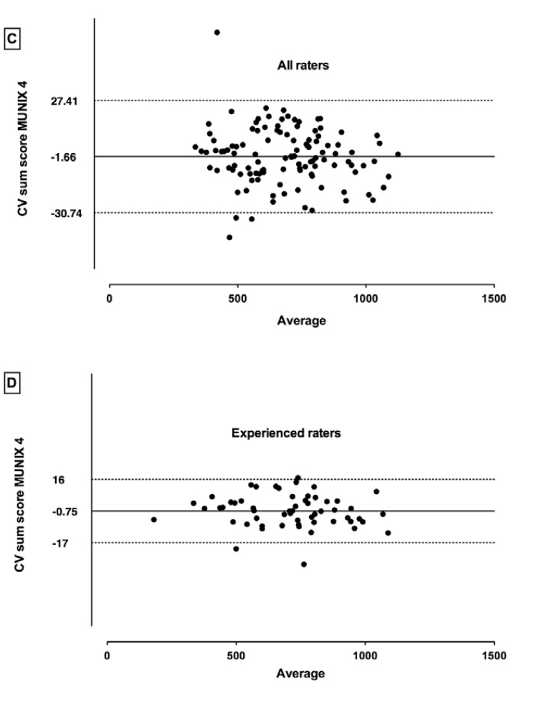
All raters
11 university departments
Five operators were considered experienced because they had been practicing the MUNIX technique several times a month for more than 3 years
Sum score = TA + ADM + APB + deltoïd results
For the purpose of longitudinal patient follow-up
Experienced raters
            A change in the MUNIX sum score more than 20% could be interpreted as a significant change of muscle innervation.
Notes:
I had the pleasure of participating in a large multicenter study initiated by a particularly dynamic team from Marseille. This study demonstrated, among other things, that for the purpose of longitudinal patient follow-up, a change of more than 20% in the MUNIX sum score could be interpreted as a significant change.

Slide 31
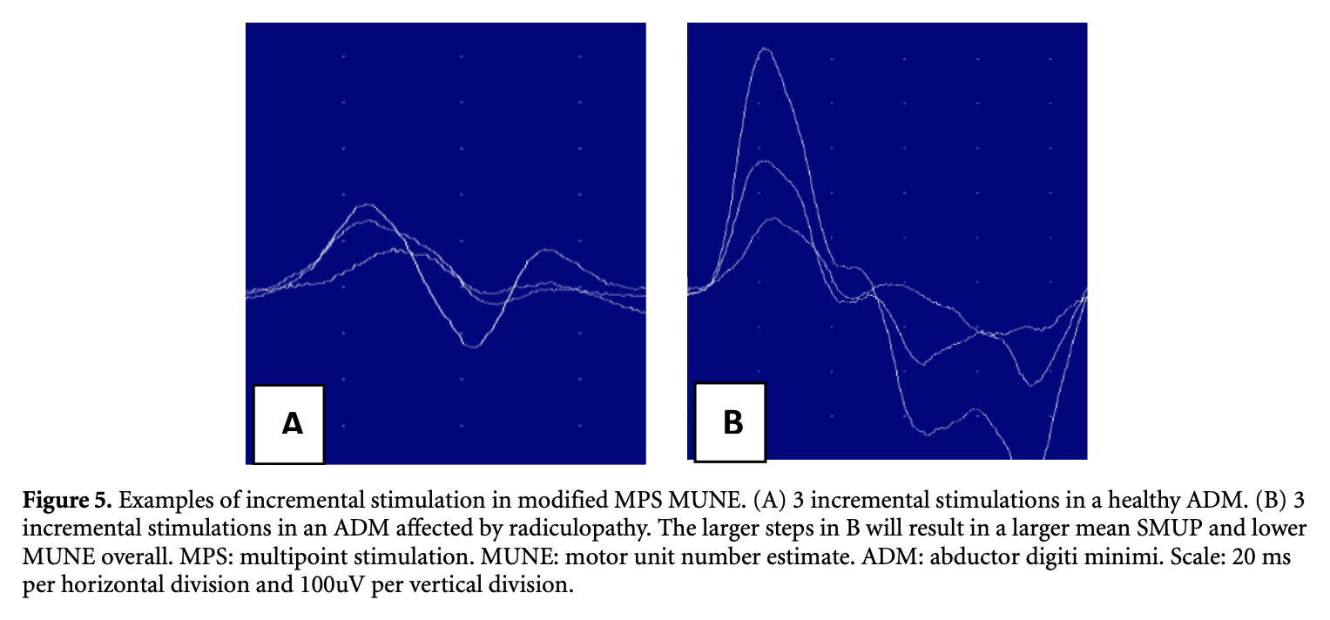
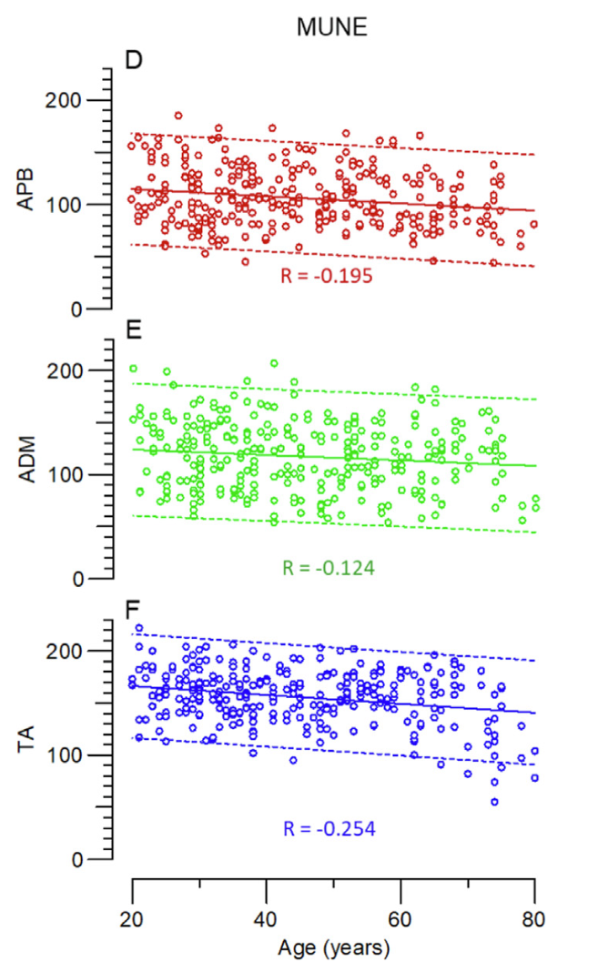
Conclusions
Healthy muscle
Radiculopathy
(Mandeville et al, 2023)
MUNE is always a relevant parameter, for instance for assessing the effectiveness of new treatments in spinal muscular atrophy
AMPS is non-invasive, reliable and fast MUNE technique, applicable to any patient regardless of the reduction in number of motor units
MUNIX : offers many benefits, may best be applied for tracking over time (Mandeville et al, 2023), but perhaps not enough benefits, as its primary developer continues to propose new procedures as STEPIX & AMPIX
(Nandedkar et al, 2022)
High-density S-EMG (van Dijk et al, 2008)
MScanFit MUNE (Bostock, 2016)
(Sørensen et al, 2023)
Notes:
In conclusion, MUNE remains a relevant parameter and a hot topic, as evidenced by the year of these publications, for instance for assessing the effectiveness of new treatments in spinal muscular atrophy.
Our counting technique, AMPS, has numerous advantages: it's non-invasive, reliable, fast, and applicable to any patient regardless of the reduction in number of motor units.
The MUNIX also offers many benefits, but perhaps not enough, as its primary developer Nandedkar continues to propose new procedures, STEPIX & AMPIX.
There are also other techniques I haven't discussed that deserve attention, such as MScanFit MUNE from the Bostock team and the technique using High-Density Surface-EMG from van Dijk.

