Slide 1
PhD Scientific Day ULiège-ULB-UMons
Irrelevant Sentences Detection for Automated Business Process
Modeling
Julie JAMAR, PhD Candidate | November 2023

Slide 2
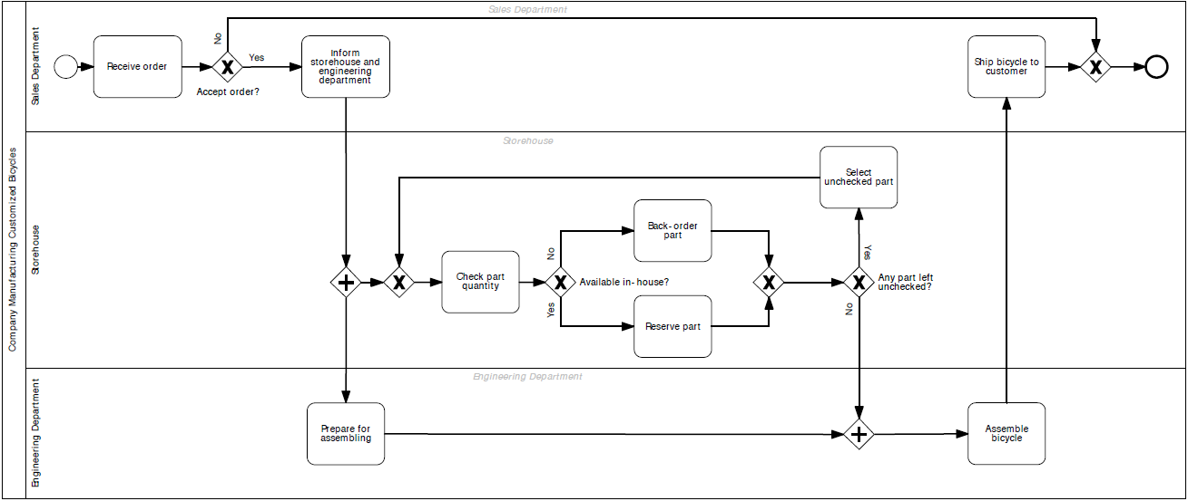
2
page
Irrelevant Sentences Detection for Automated Business Process
Modeling
“Applying NLP Techniques for Automating Business Process Model Generation“
“A small company manufactures customized bicycles. Whenever the sales department receives an order, a new process instance is created. A member of the sales department can then reject or accept the order for a customized bike. In the former case, the process instance is finished. In the latter case, the storehouse and the engineering department are informed. The storehouse immediately processes the part list of the order and checks the required quantity of each part. If the part is available in-house, it is reserved. If it is not available, it is back-ordered. This procedure is repeated for each item on the part list. In the meantime, the engineering department prepares everything for the assembling of the ordered bicycle. If the storehouse has successfully reserved or back-ordered every item of the part list and the preparation activity has finished, the engineering department assembles the bicycle. Afterwards, the sales department ships the bicycle to the customer and finishes the process instance.”
Natural Language Processing
Subfield of Artificial Intelligence
Computers learning human language
Process and analyze large amounts of natural language data

Slide 3
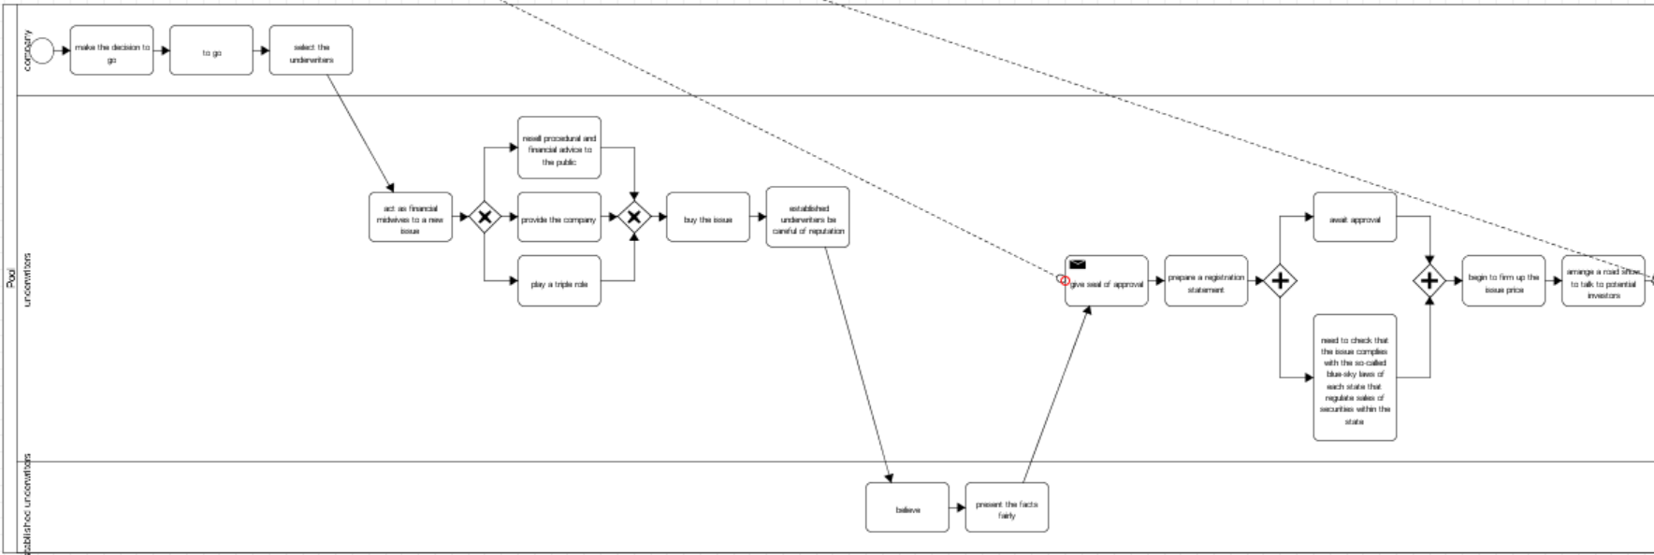
Problem illustration
State of the art algorithm* | results:
Several sentences appear in the model, while they shouldn’t.
*Friedrich, F., Mendling, J., & Puhlmann, F. (2011). Process model generation from natural language text. In Advanced Information Systems Engineering: 23rd International Conference, CAiSE 2011, London, UK, June 20-24, 2011. Proceedings 23 (pp. 482-496). Springer Berlin Heidelberg.

Slide 4
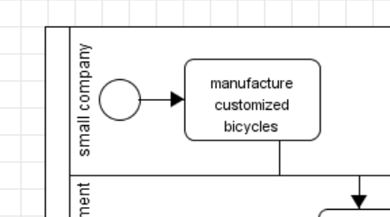
Automatically detect irrelevant sentences, so that the modeling process can ignore them :
“A small company manufactures customized bicycles. Whenever the sales department receives an order, a new process instance is created. A member of the sales department can then […]”
06
page

Slide 5
Different types of irrelevant sentences
5
page
Détails / noise
Introductives Sentence
Sentence used to add precisions, details about machines, materials, components, etc. But shouldn’t be modeled and do not bring any information.
Typically in the beginning of the process, it introduces the latter. But shouldn’t be modeled and do not bring any information.
Irrelevant
Sentence
Example sentence
Sentence used when the author tries to create a more vivid text by using examples to clarify the abstract concepts. However, this information is unwanted within a process model.

Slide 6
Illustration : McDonalds DRIVE-IN process | Description
8
page
The process starts when a customer stops at the McDrive intercom.
McDonalds employees are notified that a customer is waiting.
An employee asks for his order via the intercom.
The customer communicates his order via the intercom.
Then, the customer drives to the payment terminal.
The customer pays cash or pays by card.
Meanwhile, McDonalds employees are preparing his order in the kitchen.
Then the client drives to the pickup window.
A McDonalds employee supplies him with his order.
The customer takes the order and leaves the McDrive, the process is finished.

Slide 7
Illustration: irrelevant sentences
8
McDonalds is a fast food chain, which also offers a "Drive-IN" service.
The process starts when a customer stops at the McDrive intercom.
McDonalds employees are notified that a customer is waiting.
An employee asks for his order via the intercom.
The customer communicates his order via the intercom.
For example, a McMenu with Sprite and McFlurry.
Then, the customer drives to the payment terminal.
The customer pays cash or pays by card.
Meanwhile, McDonalds employees are preparing his order in the kitchen.
McDonald's kitchens contain all the equipment needed to cook burgers.
Then the client drives to the pickup window.
A McDonalds employee supplies him with his order.
The customer takes the order and leaves the McDrive, the process is finished..
Introductives Sentence
page
Typically in the beginning of the process, it introduces the latter..
Example sentence
Sentence used when the author tries to create a more vivid text by using examples to clarify the abstract concepts.
Détails / noise
Sentence used to add precisions, details about machines, materials, components, etc.

Slide 8
DATA
3
AI is a very promising technology, but most techniques need a lot of data to train the algorithms.
page
Business Processes descriptions contain very confidential information, that most company don’t want to share publicly
We had to create Business Process descriptions by ourselves, collect some process from companies or internet.

Slide 9
Data Base
Source
# Process
# Sentences
Machine Learning
Generate irrelevant phrases based on existing data: replace terms in a phrase with semantically related words to create new phrases.
750
/
Academic
BONUS / non-mandatory assignment for MASTER and BAC3 students, consisting of transcribing one or two process descriptions.
1078
15794
Internet
Several sites offer process descriptions. Some had to be adapted.
377
12855
Existing literature
Process descriptions obtained from active researchers in the field, used in their research.
56
572

Slide 10
Initial methodology
Random Forest classifier
Parallel learning on numerous randomly constructed decision trees trained on different subsets of data,
Reduces the variance of predictions from a single decision tree,
In this case, the aim is to classify the sentences in the process descriptions as 'relevant' or 'irrelevant'. The main steps are described below:
Manual annotation of data ('relevante' or 'irrelevante' sentences) to form a gold standard.
Data pre-processing (removal of special characters, single characters, multiple spaces, etc.)
Conversion of data into TF-iDF matrix with TfidfVectorizer
Parameters used: max_features=2000, min_df=7, max_df=0.8
Feature extraction
Separation of matrices into 'train' and 'test' subsets
Classification of sentences using the 'Random forest tree classifier'.
Parameters: n_estimators=200, random_state=0
Algorithm

Slide 11
Comparison with other methods
Support Vector Machine (SVM):
Brings back a space classification problem in which the data are separated into several classes whose boundary is as far away as possible from the data points.
BERT (Bidirectional Encoder Representations from Transformers)
Google's machine learning model.
- BERT_{base} : 12 layers, 12 attention heads, and 110 million parameters.
- BERT_{large} : 24 layers, 16 attention heads and, 340 million parameters.

Slide 12
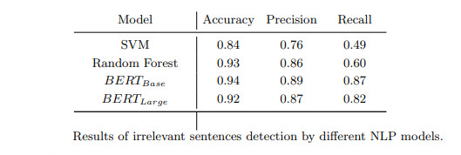
Results / Conclusion
We could improve those results by adding more and more data to the data set (planed)
This method could be adapted to other languages
We could consider partially-irrelevant sentences

Slide 13
THANK YOU

