Slide 1
Advanced platforms for
Electricity retailers
Antonio SUTERA & Damien Ernst

Slide 2
RETAILERS FOR ELECTRICITY - reminder
Retailers are the bridge between the electricity markets and the final consumers.
The role of the retailer is to buy electricity from producers to sell it to consumers.
Two main types of retail electricity contracts:
Fixed-price contracts:
Price = A [€/kWh] * X [kWh] + B [€]
Constant during the entire contract duration
Less risk averse
Variable-price contracts:
Price = (A [€/kWh] + C [1] * Index [€/kWh]) + B [€]
Index and thus the price varies during the entire contract duration
More risk averse
Very few retail contracts charge for the electricity by multiplying the quantities consumed per market period with the spot prices per market period. This retail electricity contract has a dynamic price tariff.
Source:
- Lecture 3 “From monopolies to market”
- Damien Ernst, G2PF for Retailers: https://hdl.handle.net/2268/307257

Slide 3
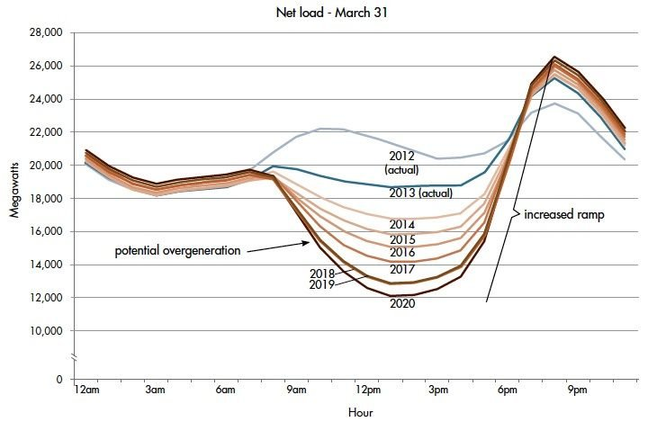
Change of context
Source: https://www.energy.gov/eere/articles/confronting-duck-curve-how-address-over-generation-solar-energy

Slide 4
Evolution of customers
Demand
Differenciation based on price only
Stable & long-term electricity products
No concern about energy transition
No concern over the origin of energy & label “guarantee of origin”
Challenges
Lack of differentiation
Need for stable, long-term renewable electricity products
Customer cost control issues in parallel with energy transition issues
Questioning of existing labels “guarantee of origin”
New products, services and configurable platforms
PPA, assets, clicks, creation of (virtual) energy communities with energy sharing
Decision support tools for customers - consumers and prosumers - to reduce their bills and facilitate their active participation in the transition
Traceability through contracts and transparency through the customer interface
New demand

Slide 5
A new type of customer: EV users
Let us focus on the problem with existing contracts for EV users.
Most of the existing contracts do not offer incentives for charging the EVs when energy is cheap on the spot market.
People who own an electric vehicle generally also care about energy transition. They may have on-site PV production and/or a home battery.
However, they are currently tied in to classical electricity contracts.
Issues:
- How do they better participate in the energy transition?
- The differentiation is only on prices.

Slide 6
How to address new customers and their wishes?
Retailers can offer different and novel retail electricity contracts!
What are the desired features for these new retail electricity contracts?
They should…
Address the new wishes in terms of transparency, traceability of energy sources, …
Allow consumers to hedge against increases in energy prices
Allow consumers to participate more actively in the energy transition
Help consumers to take the right decisions when it comes to purchasing and selling electricity
Help consumers to exploit the flexibility of their dynamic load management
Help consumers to invest in renewable energy production and/or storage, and how.

Slide 7
What are the key constitutive elements ?
What are the elements required for a new retail electricity contract?
Electricity supply products
Marketplace
Decision support tools
(User interface)
➔ Designing a new retail electricity contract consists in defining which elements you want to integrate in your offer and how you combine them.

Slide 8
1. Electricity supply products
Three main types of products:
Products not related to the consumption of electricity
Products related to the consumption of electricity
Residual products

Slide 9
1.A Products not related to the consumption
A product not related to the consumption of electricity is a product whose purchased volumes for each market period are independent of the customers’ consumption.
Examples:
“Click” products: this is a product that involves purchasing the same quantity (in MW) of electricity for a given time period. The time periods are often standardised (calendar (one year), quarterly, monthly and weekly). A “click” product is defined by its price and time window.
Power Purchase Agreement (PPA) products: a PPA is an electricity supply product in which a percentage of the output of one or more power stations is purchased for a given period at a defined price expressed in €/MWh (or through more complex tariff forms).
An “asset” product: instead of buying the output of power stations at a set price, you buy parts of one or more power stations and benefit from their output. Note that in this context, the operating costs (OPEX) are also paid by the consumer.
A day-ahead market product: every day, the consumer buys volumes of electricity on the day-ahead market. Purchasing can also be delegated to the supplier.

Slide 10
1.B Products related to the consumption of electricity
A product related to the consumption of electricity is a product that covers a certain percentage of a customer's consumption volume.
With this type of contract, a customer could cover a given share of its volume of electricity required for each market period at a set price, using a well-defined pricing formula.
Example:
A classic electricity retail contract: a classic fixed-price or variable-price contract is a product linked to consumption that covers 100% of the volume.

Slide 11
1.C Residual products
The products related and not related to the consumption of electricity do not guarantee that the customer will be able to obtain the exact volume they need to cover their consumption for each market period.
A residual product is a product that define the pricing rules that apply to the consumer for volumes of electricity not covered by other contracts. Note that these volumes can also be negative.
Examples:
Imbalance exposition: exposing consumers to imbalance prices on the wholesale markets
Spot exposition: exposing them - for these residual volumes - to the price on the day-ahead markets to which a margin would be added that would allow the supplier to cover the risks it takes on by buying the residual volumes on the day-ahead markets.

Slide 12
PPAs
What is the related market?
There is no organised market for the PPAs. A PPA is between two parties who decides to buy/sell the production of an asset.
What is a PPA?
A PPA refers to “Power Purchase Agreement”, and as its name implies, means that a consumer buys from the producer a given amount of power capacity of an asset, and in fact the consumer buys the future energy that will be produced by this asset power capacity.
Typically, we refer to C-PPA for corporate PPAs to means that they are between two corporations/companies.
Example: Consumer A and producer B agree on a PPA of 1MW of energy from a nuclear plant. For this example, let us consider a nuclear plant instead of a renewable energy sourced asset to have a deterministic production. It means that if the asset produces at full capacity, it will produce 1MWh every hour and thus consumer A will have 1MWh per hour during the PPA contract period.
In practice, PPA are for assets using renewable energy such as solar or wind. It means that you do not know in advance how much the asset will produce and it is the main reason why you buy a power capacity instead of the amount of produced energy.

Slide 13
PPAs
What are the C-PPA “modes”?
In addition, since you do not know when and how much energy the asset will produce, you have different types that differ based on “who” is taking the risk:
Pay-as-produced: The consumer receives ALL produced energy (everything that is produced) and therefore pays “produced energy x price”. The consumer takes the risk, if too much is produced or too little, then the consumer may have too much / little supplied energy.
Pay-as-consumed: The consumer receives sufficient energy ONLY to cover the need, and therefore pays “received energy at x price”. The producer takes the risk, if too much energy is produced, then the producer will not be paid for that energy and should find another way to valorised it.
Pay-as-nominated/pay-as-forecasted: The consumer receives energy based exactly on what is planned ahead. The producer should always be able to provide what was planned and therefore takes the risk.
Baseload: The consumer will receive a fixed volume per hour. Again, the producer should always be able to provide what was planned and therefore takes the risk.

Slide 14
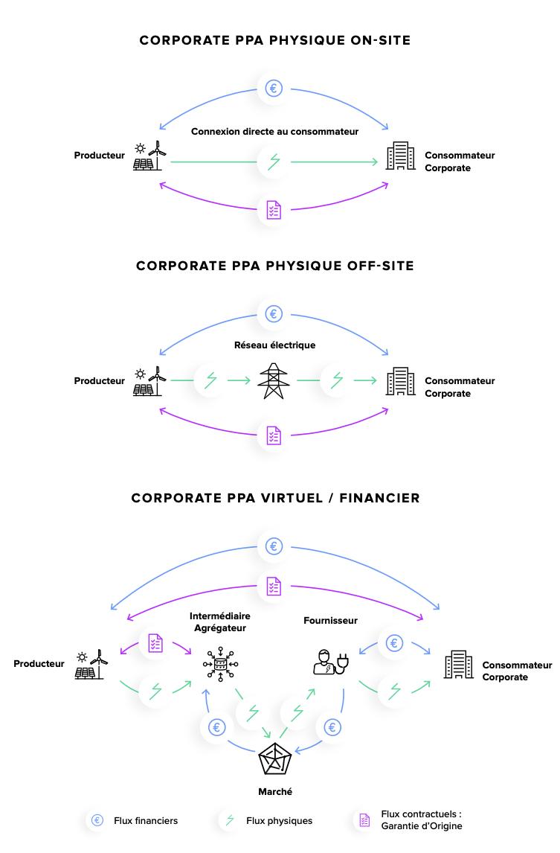
PPAS
What are the C-PPA types?
Physical
Off-site: Energy exchange through the grid.
On-site: The producing asset is already on-site and so the energy exchange does not need the grid to go from the consumer to the producer.
Virtual: this is a financial product using an existing market as a proxy. Actually there is no exchange of energy but rather just financial flows. The producer injects the production in the grid and receives payment for it and the consumer offtakes it from the grid and pays some money for it. To comply with the PPA agreement, the consumer OR the producer will pay back the other party depending on the market price (= the reference market).
Source: https://www.alterna-energie.fr/livre-blanc-ppa

Slide 15
PPAS Pricing: Contracts for difference applied on PPAs
Contracts for differences for PPAs work in the following manner:
The two parties agree on a PPA price and the purchased power.
The contract is settled in a way that the difference between the PPA price and the reference market (typically, the spot market), at that time period, times the produced amount of energy is paid by one party to the other based on the sign of the value of the difference between the PPA price and the reference market price.
Source: Lecture 3 “From monopolies to market”

Slide 16
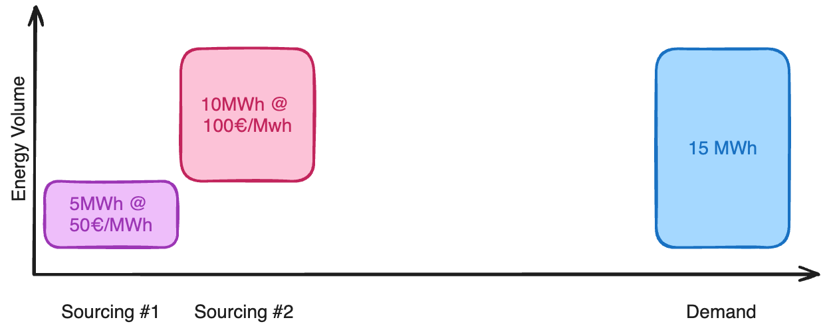
Swapping mechanism

Slide 17
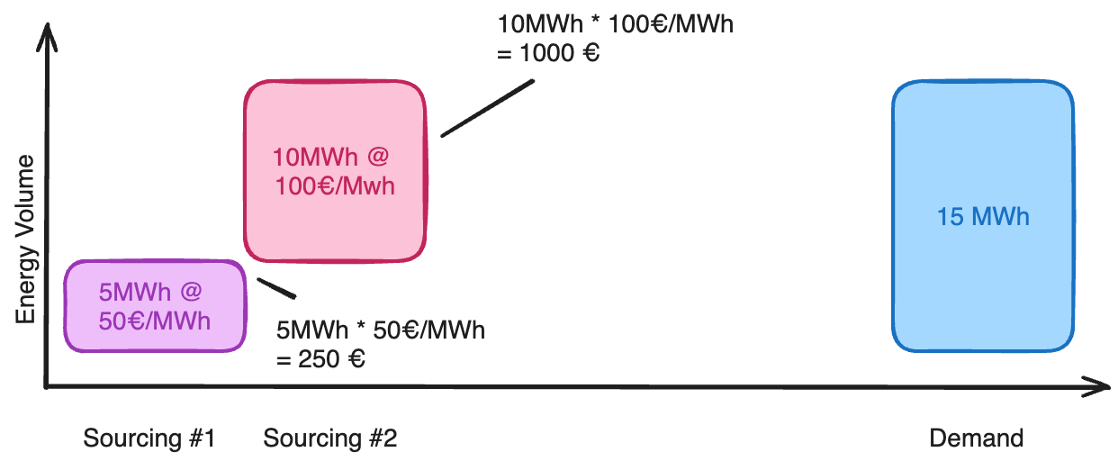
Swapping mechanism

Slide 18
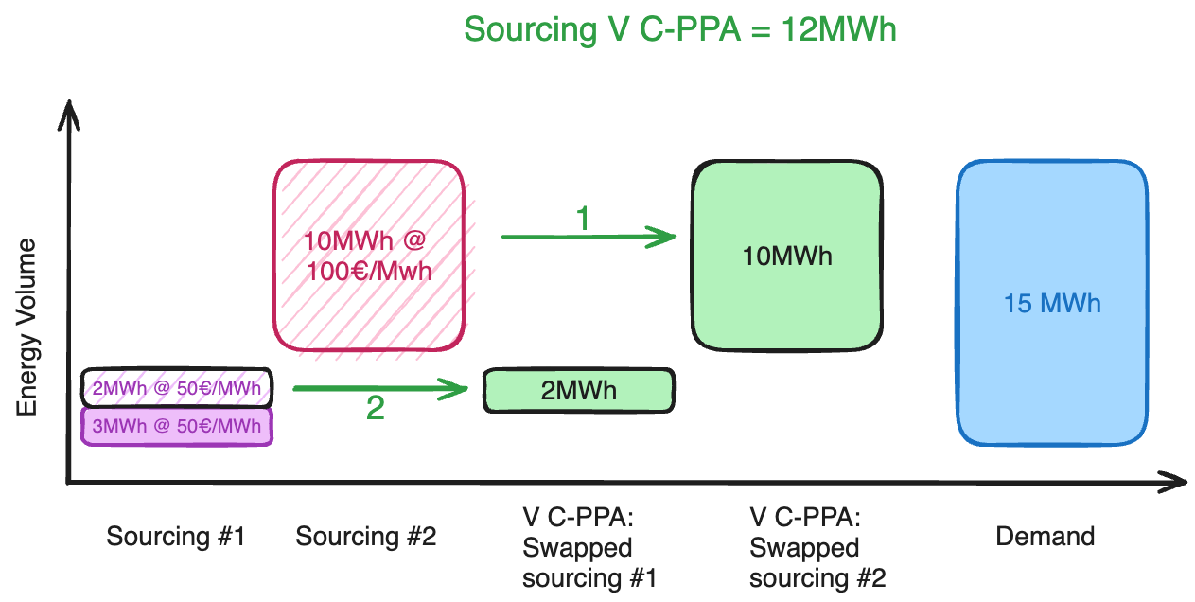
Swapping mechanism

Slide 19
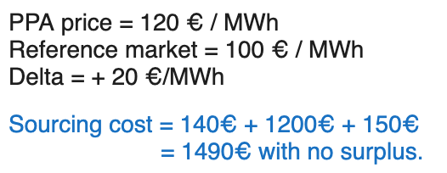
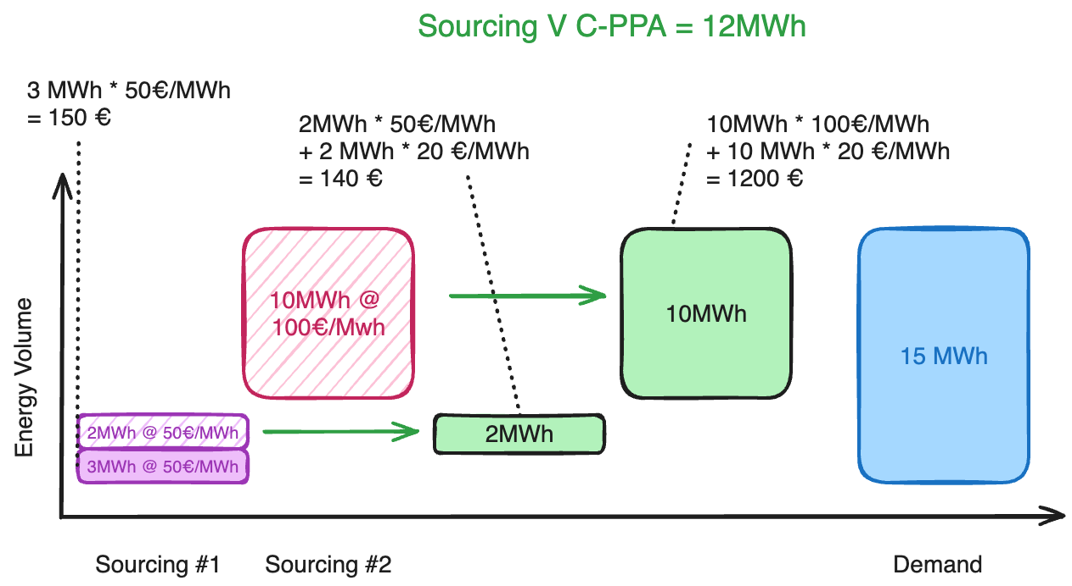
Swapping mechanism

Slide 20
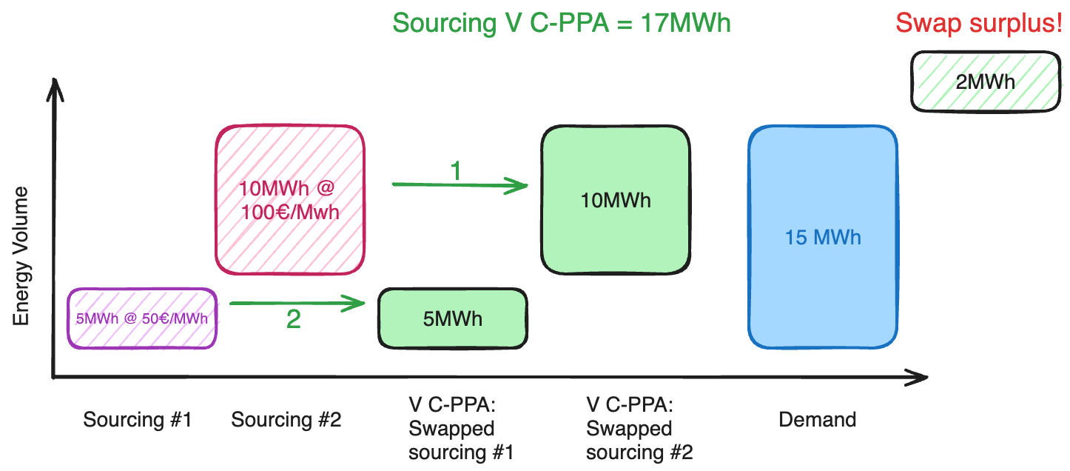
Swapping mechanism

Slide 21
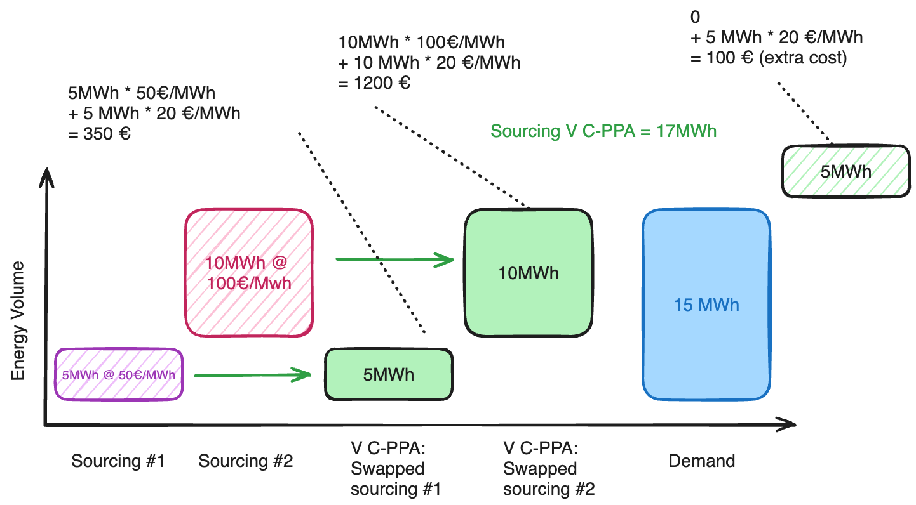
Swapping mechanism

Slide 22
2. Marketplace
Customers need be able to select what they purchase/sell in their electricity retail contracts.
A marketplace is defined as the place where the customer can purchase a specific supply product.
Example: A retailer can provide a way to click a forward product on its customer app and then actually buy the supply product on the forward market once purchased by the customer.

Slide 23
3. Decision support tools
There are three types of decision support tools:
Tools to help with the purchase of market products
Tools for dynamic load management
Support tools for off-platform investments (e.g., a tool that gives recommendations about the optimal size of the PV installation and battery in which to invest to minimize the energy bill).

Slide 24
3.A Tools to help with the purchase market products
These tools enable customers to choose which products to buy or to place bids on the various markets to which they have access.
Example:
A customer can have access to two types of supply product:
A product not related to consumption (say, PPAs) and
A product based on the day-ahead markets to cover residual consumption.
The natural question is "Which PPAs should I buy to meet some of my specific objectives?”
One of this customer's objectives could be to ensure that the PPAs he buys correspond to an annual volume of electricity equal to his annual consumption, while maximising the energy from these PPAs that he can consume over an annual period. The tool will then recommend which PPAs to purchase.

Slide 25
3.B Tools for dynamic load management
The demand of a customer may have flexibility potential.
Example:
The customer has an electric vehicle or a home with a high thermal inertia heated by a heat pump.
Customers may also have contracted supply products that expose them to variable prices for part of their consumption. In such cases, they may be interested in exploiting their flexibility to minimise their electricity bill, for example. The aim of dynamic load management tools is to help consumers manage this flexibility in order to meet their objectives.

Slide 26
3.C Tools for dynamic load management
Customers may also want to know what investments they should make in PV or batteries to minimise their electricity supply costs.
Off-platform investment support tools are typically designed to answer such questions.
Based on an analysis of the customer's consumption history, this same type of tool could also indicate which household appliances consume too much electricity and might be worth changing. Or where it would be wise to invest in maintenance services.

Slide 27
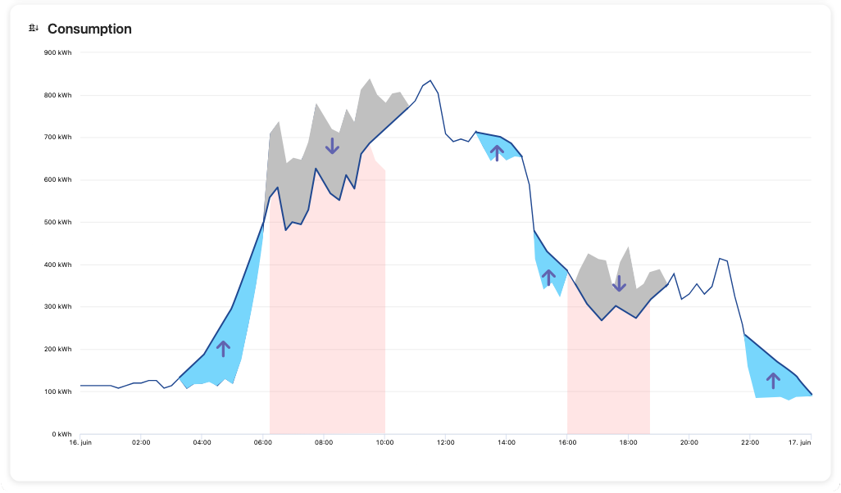
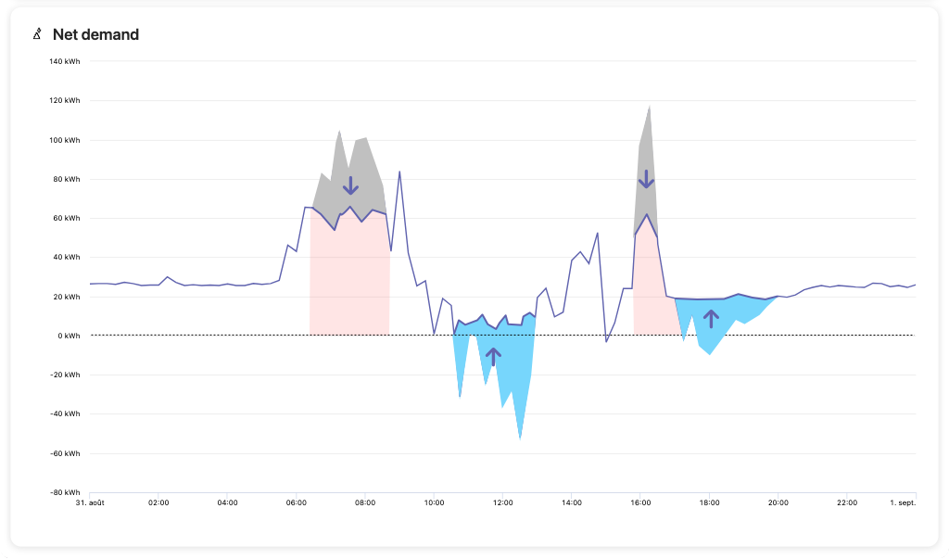
Direct AND indirect load management
Spot-like hourly tariff
Demand shifting
Demand shifting consists of shifting a part of its demand towards another time of the day.
Demand reduction/increase are also included in load management.
What is the difference between direct & indirect load management?
Time-of-use tariff
Local self-consumption

Slide 28
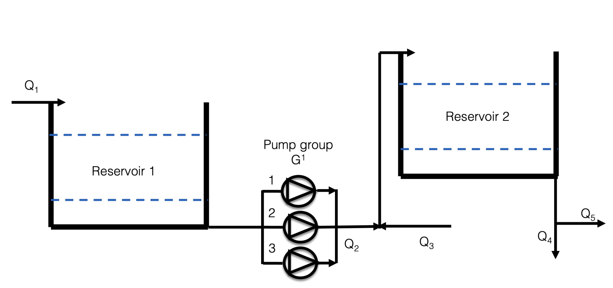
Specific use case:
Two water reservoirs are connected by a set of high-pressure pumps that consume most of the energy of the site.
One can decide when to activate the pumps as long as the technical constraints of the reservoir are met at any time.
This is a source of flexibility potential that can be exploited.
Practical use case
Source: https://hdl.handle.net/2268/302546

Slide 29
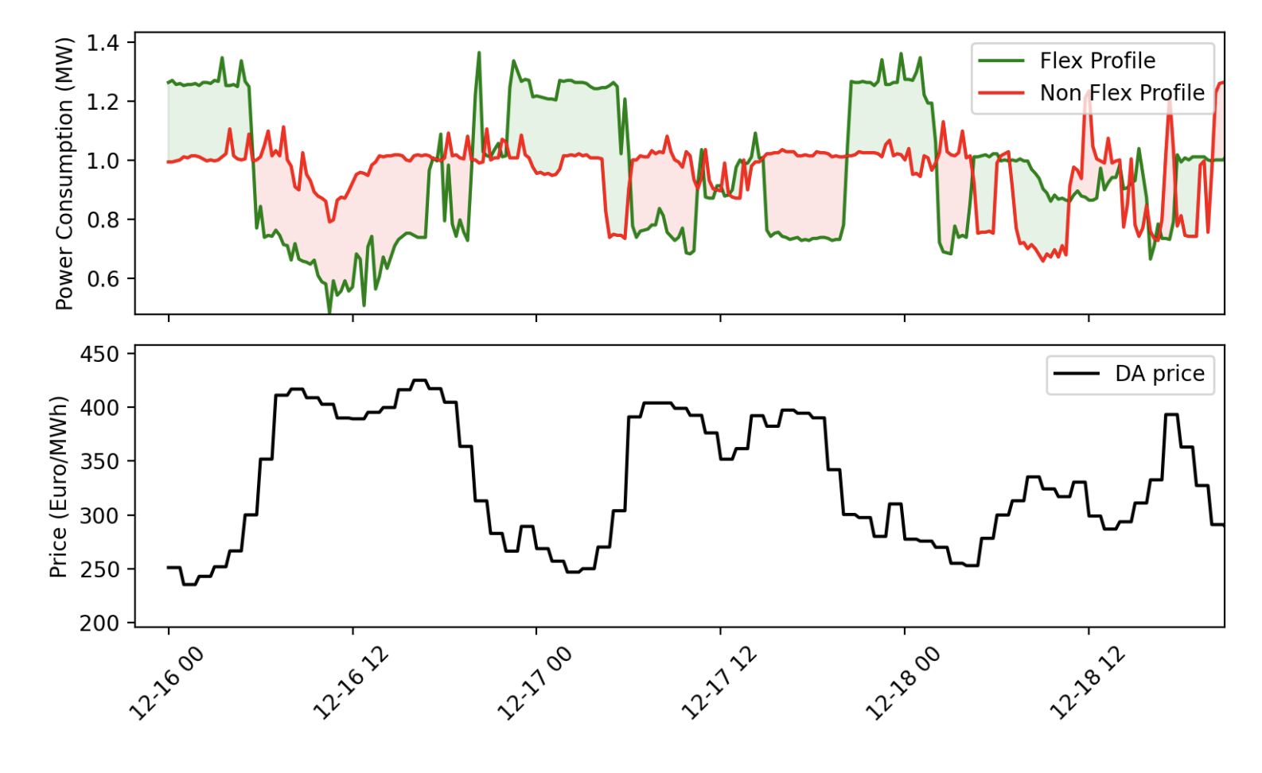
Practical use case
What is the necessary condition(s) for this to be profitable?
Source: https://hdl.handle.net/2268/302546

Slide 30
Practical use case
Source: https://hdl.handle.net/2268/302546

Slide 31
Haulogy is a software company that has advanced platforms for electricity retailers.
It can accommodate a large class of electricity supply products, marketplaces and decision support tools that define retail electricity contracts.
With this platform, retailers can now easily design new electricity contracts to meet the different needs of their customers and improve their brand image.

