Slide 1
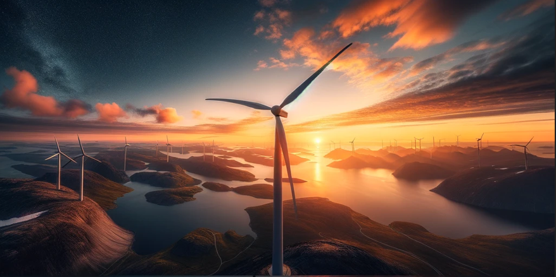

  Harvesting wind energy in Greenland and exporting it as electricity or energy-rich molecules
Prof. Damien ERNST

Slide 2
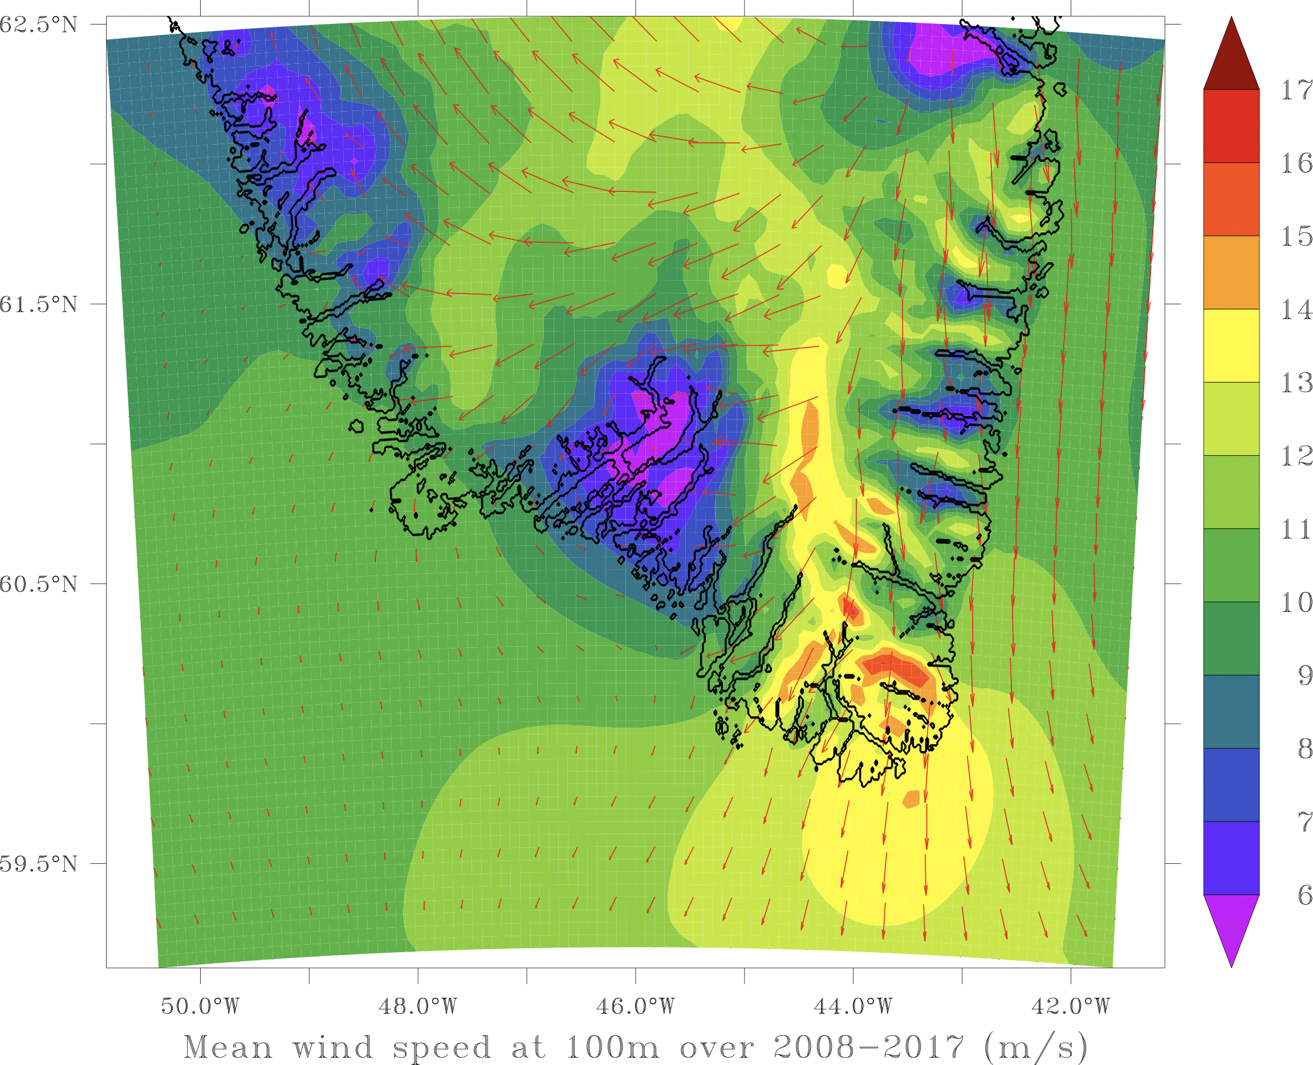
  Why harvesting wind energy in the southeast Greenland is a good option?
1. Consistently strong winds.
2. Decorrelation with European wind patterns.
3. Huge areas. No NIMBY issues.
4. Ideally located half way between Europe and the US.
5. Optimum flagship project for accelerating the building of the global grid.

Slide 3
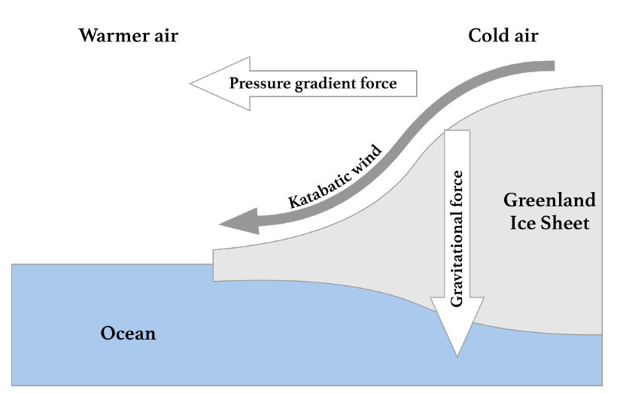
  Winds in southeast Greenland
In the southeastern part of Greenland, general circulation winds (driven by the Sun’s energy) create katabatic winds.
Katabatic winds are the result of heat transfer processes
between the cold ice cap and the warmer air mass above it.
When the air mass temperature is higher than that of the ice sheet, the former is cooled down by radiation, thus the air density increases forcing it down the sloping terrain.
The flow of katabatic winds is driven by gravity, temperature gradient and inclination of the slope of the ice sheet.

Slide 4
  Data acquisition for our analysis
We have relied on data reanalysis to reconstruct wind signals from the past in situ and satellite observations.
The regional MAR (Modèle Atmosphérique Regional) model was used for data reanalysis over Greenland. This model can accurately represent physical processes in Greenlandic regions, including katabatic winds. Boundary conditions are determined by the ERA5 reanalysis model.
Hourly values of wind speed at 100 meters above ground level are generated using reanalysis models for the period 2008-2017.

Slide 5
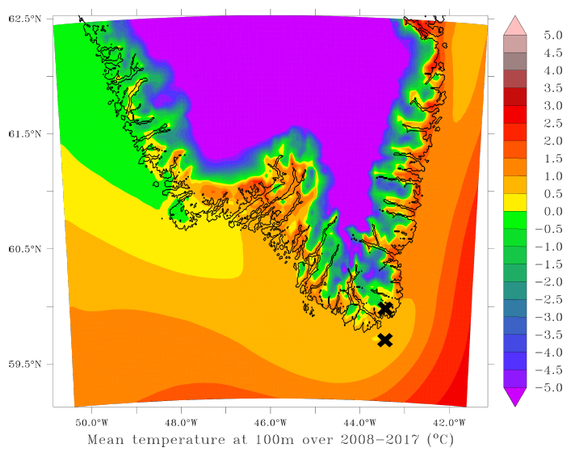
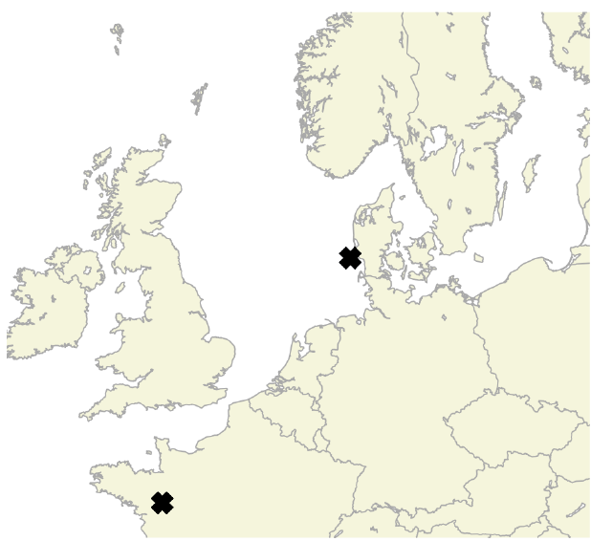
Regions selection for our analysis
Two areas in Greenland: one offshore (GR_{OFF}) and one onshore (GR_{ON}).
Temperatures too high for the sea to freeze or for there to be permanent ice onshore.
Two areas in Europe: one offshore wind farm in Denmark (DK) and one on-shore wind farm in France (FR).

Slide 6
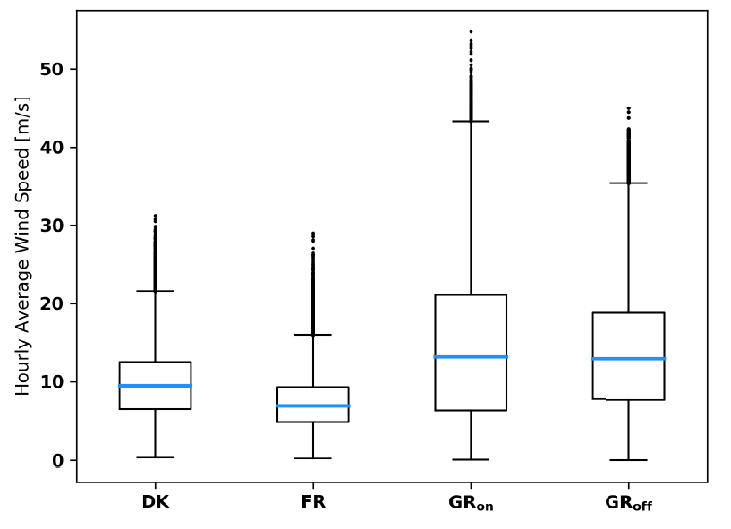
  Wind ressource assessment
There are higher mean wind speeds in Greenland than in the two European locations.
Distribution of wind speeds are more assymetric for GR_{off} and GR_{on} than for DK and FR.
The high standard deviations of the wind speeds in Greenland do not correspond to a high turbulence intensity, but to the strong influence of seasonality of the local natural resource.

Slide 7
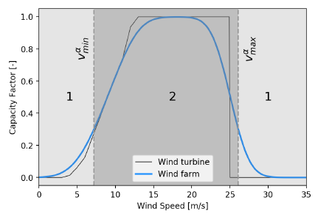
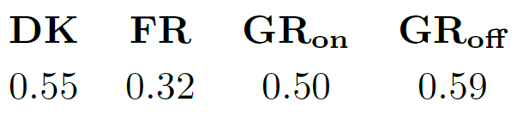
  Load factors of the wind farms
Single turbine and wind farm transfer functions. Example of a wind farm power curve aggregation based on multiple aerodyn SCD 8.0/168 units.
Capacity factors for the different locations.

Slide 8
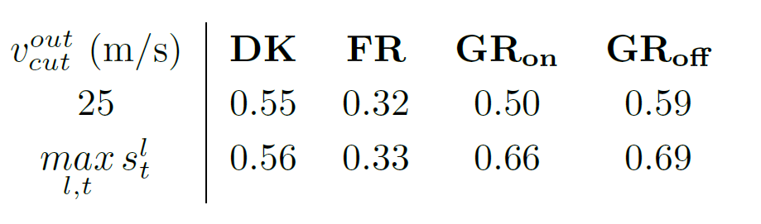
Capacity factors versus
cut-out wind speed for the wind turbines.
Highest wind speed observed
Important remarks for manufacturers of wind turbines willing to tap into the Greenland wind energy market:
Wind turbines capable of operating with higher cut-out speed lead to significantly higher load factors in Greenland.
It may also be interesting to design wind turbines with greater capabilities in terms of power output for higher wind speeds (i.e., turbines having a higher rated output speed).

Slide 9
  Critical time windows for studying the complementarity of wind production
In a power system, a window of duration ẟ is said to be critical for a set of locations if the average power generated in those locations over the time window is below a fraction α of the installed capacity.
Conjecture: The export of wind energy from Greenland to Europe would reduce to zero the number of these long, critical periods of time during which Europe would be unable to rely on wind energy to cover a significant amount of its energy needs (or more generally renewable energy - a phenomenon known as Dunkelflaute in German).

Slide 10
Occurrence of critical time windows
« Probability » of occurrence of critical time windows when using as set of locations: the two European locations (black); the Greenland sites (green) and all four locations (blue).
Results show that the number of critical windows drops when connecting an electricity supply to mainland Europe from Greenland.

Slide 11
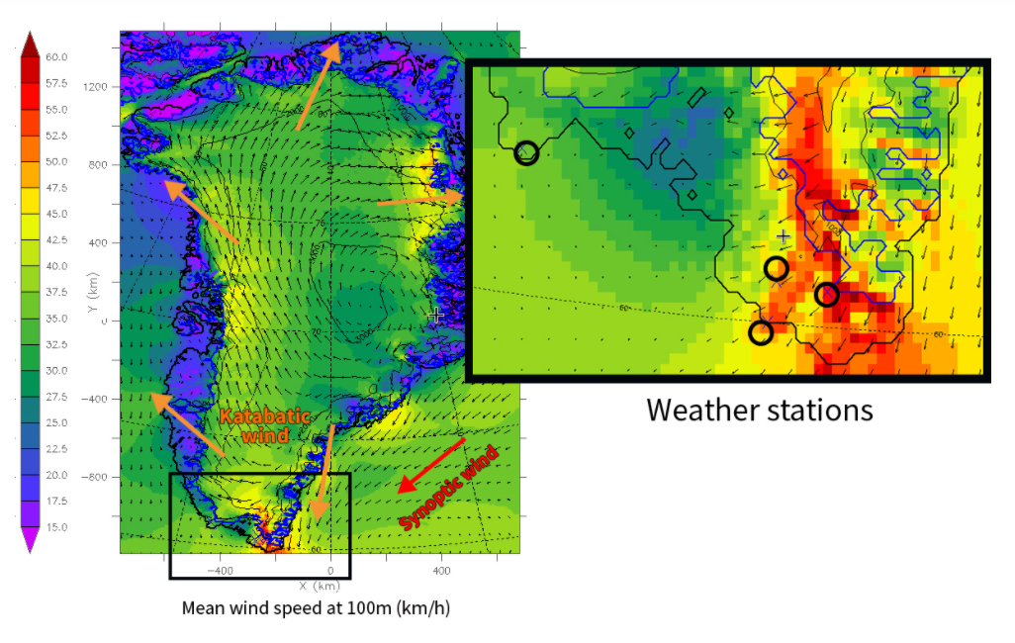
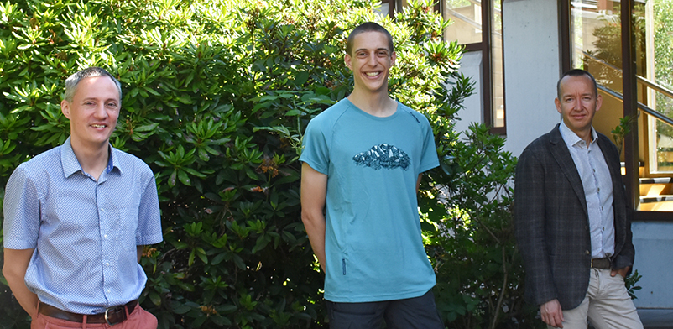
Katabata project
Goal of the project: installing three weather stations in the south-east of Greenland. The wind in this area has never been properly measured before!
The numerical model (MAR) needed to be validated in this area with measured wheather data.
The team: Prof. Xavier Fettweis, Dr. Michaël Fonder and Prof. Damien Ernst
More on the Katabata project:
https://www.katabata-project.uliege.be/cms/c_5654602/en/katabata-project

Slide 12
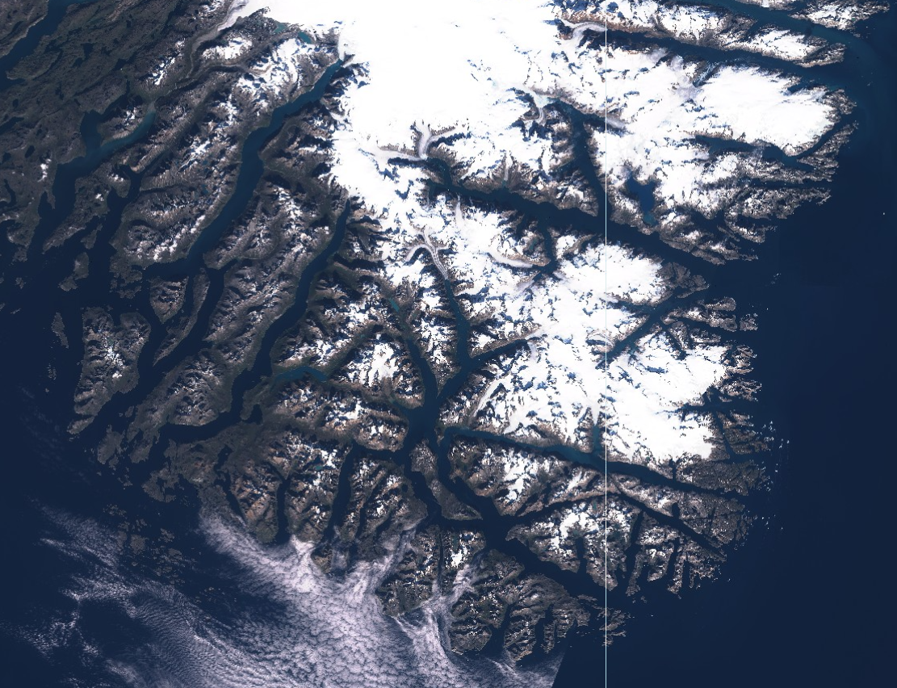
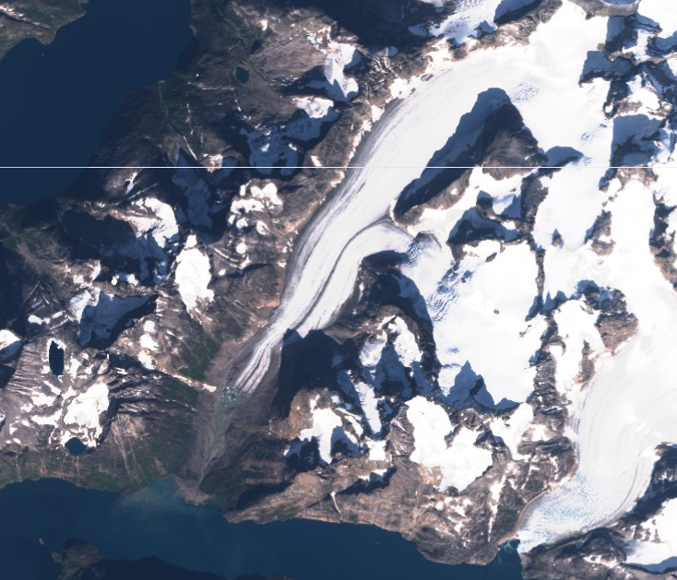
Location of the weather stations
AWS2 (both winds)
+ venturi effect
AWS3 (local katabatic winds)
AWS1 (synoptic wind + see breezes)
Zoom on AWS3

Slide 13
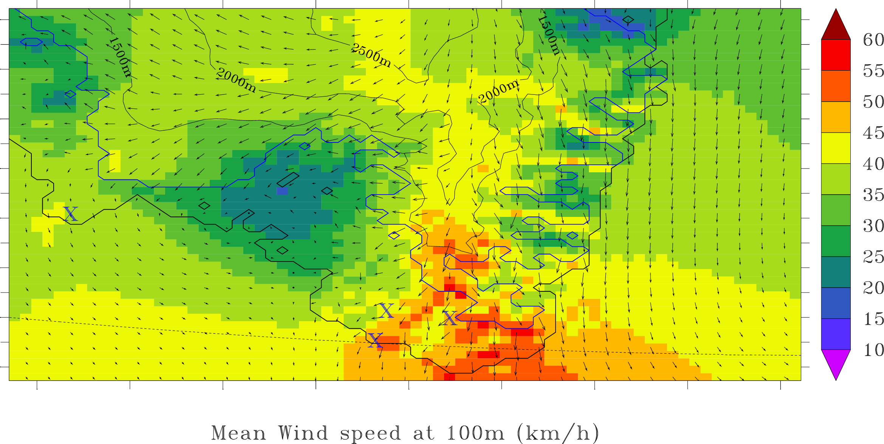
Winds at those locations
Mean Wind Speed at 100m (km/h). Location of the weather stations indicated by the symbol X

Slide 14
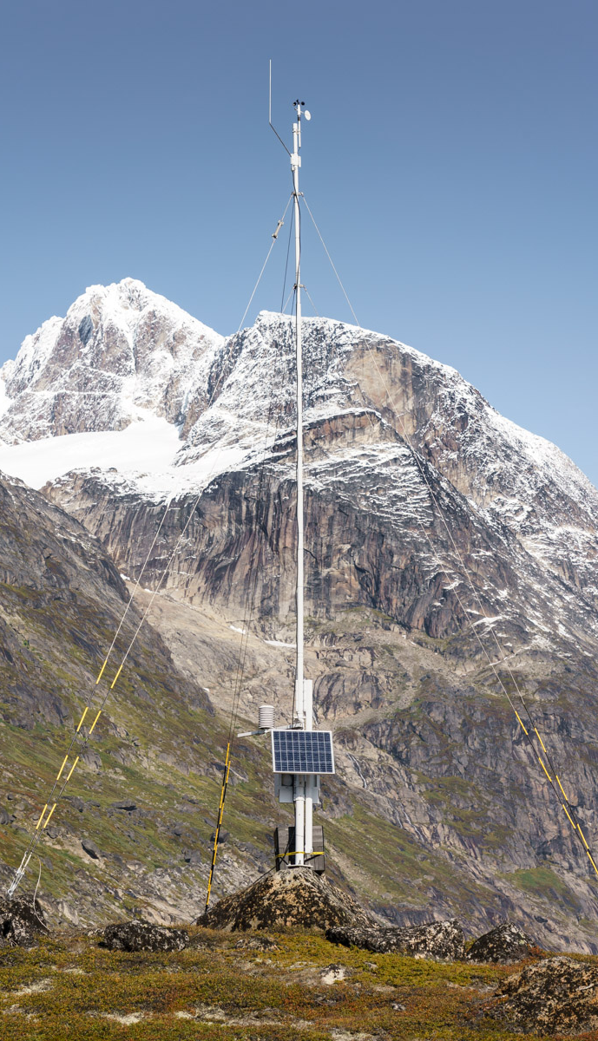
Vaisala’s AWS310 stations
Description of AWS310 stations:
4 sensors:
  Anemometer for wind speed
  Weathervane for wind direction
  Thermometer
  Humidity sensor
Satellite antenna for data transfer
10m mast with three guy wires
Battery with photovoltaic panel for lengthy operations in complete autonomy
Our AWS310s are also synonyms for an epic delivery:
Packages weighing more than 350kg for a total volume of 2m³ divided into seven boxes for each station
A total delivery delay of three months

Slide 15
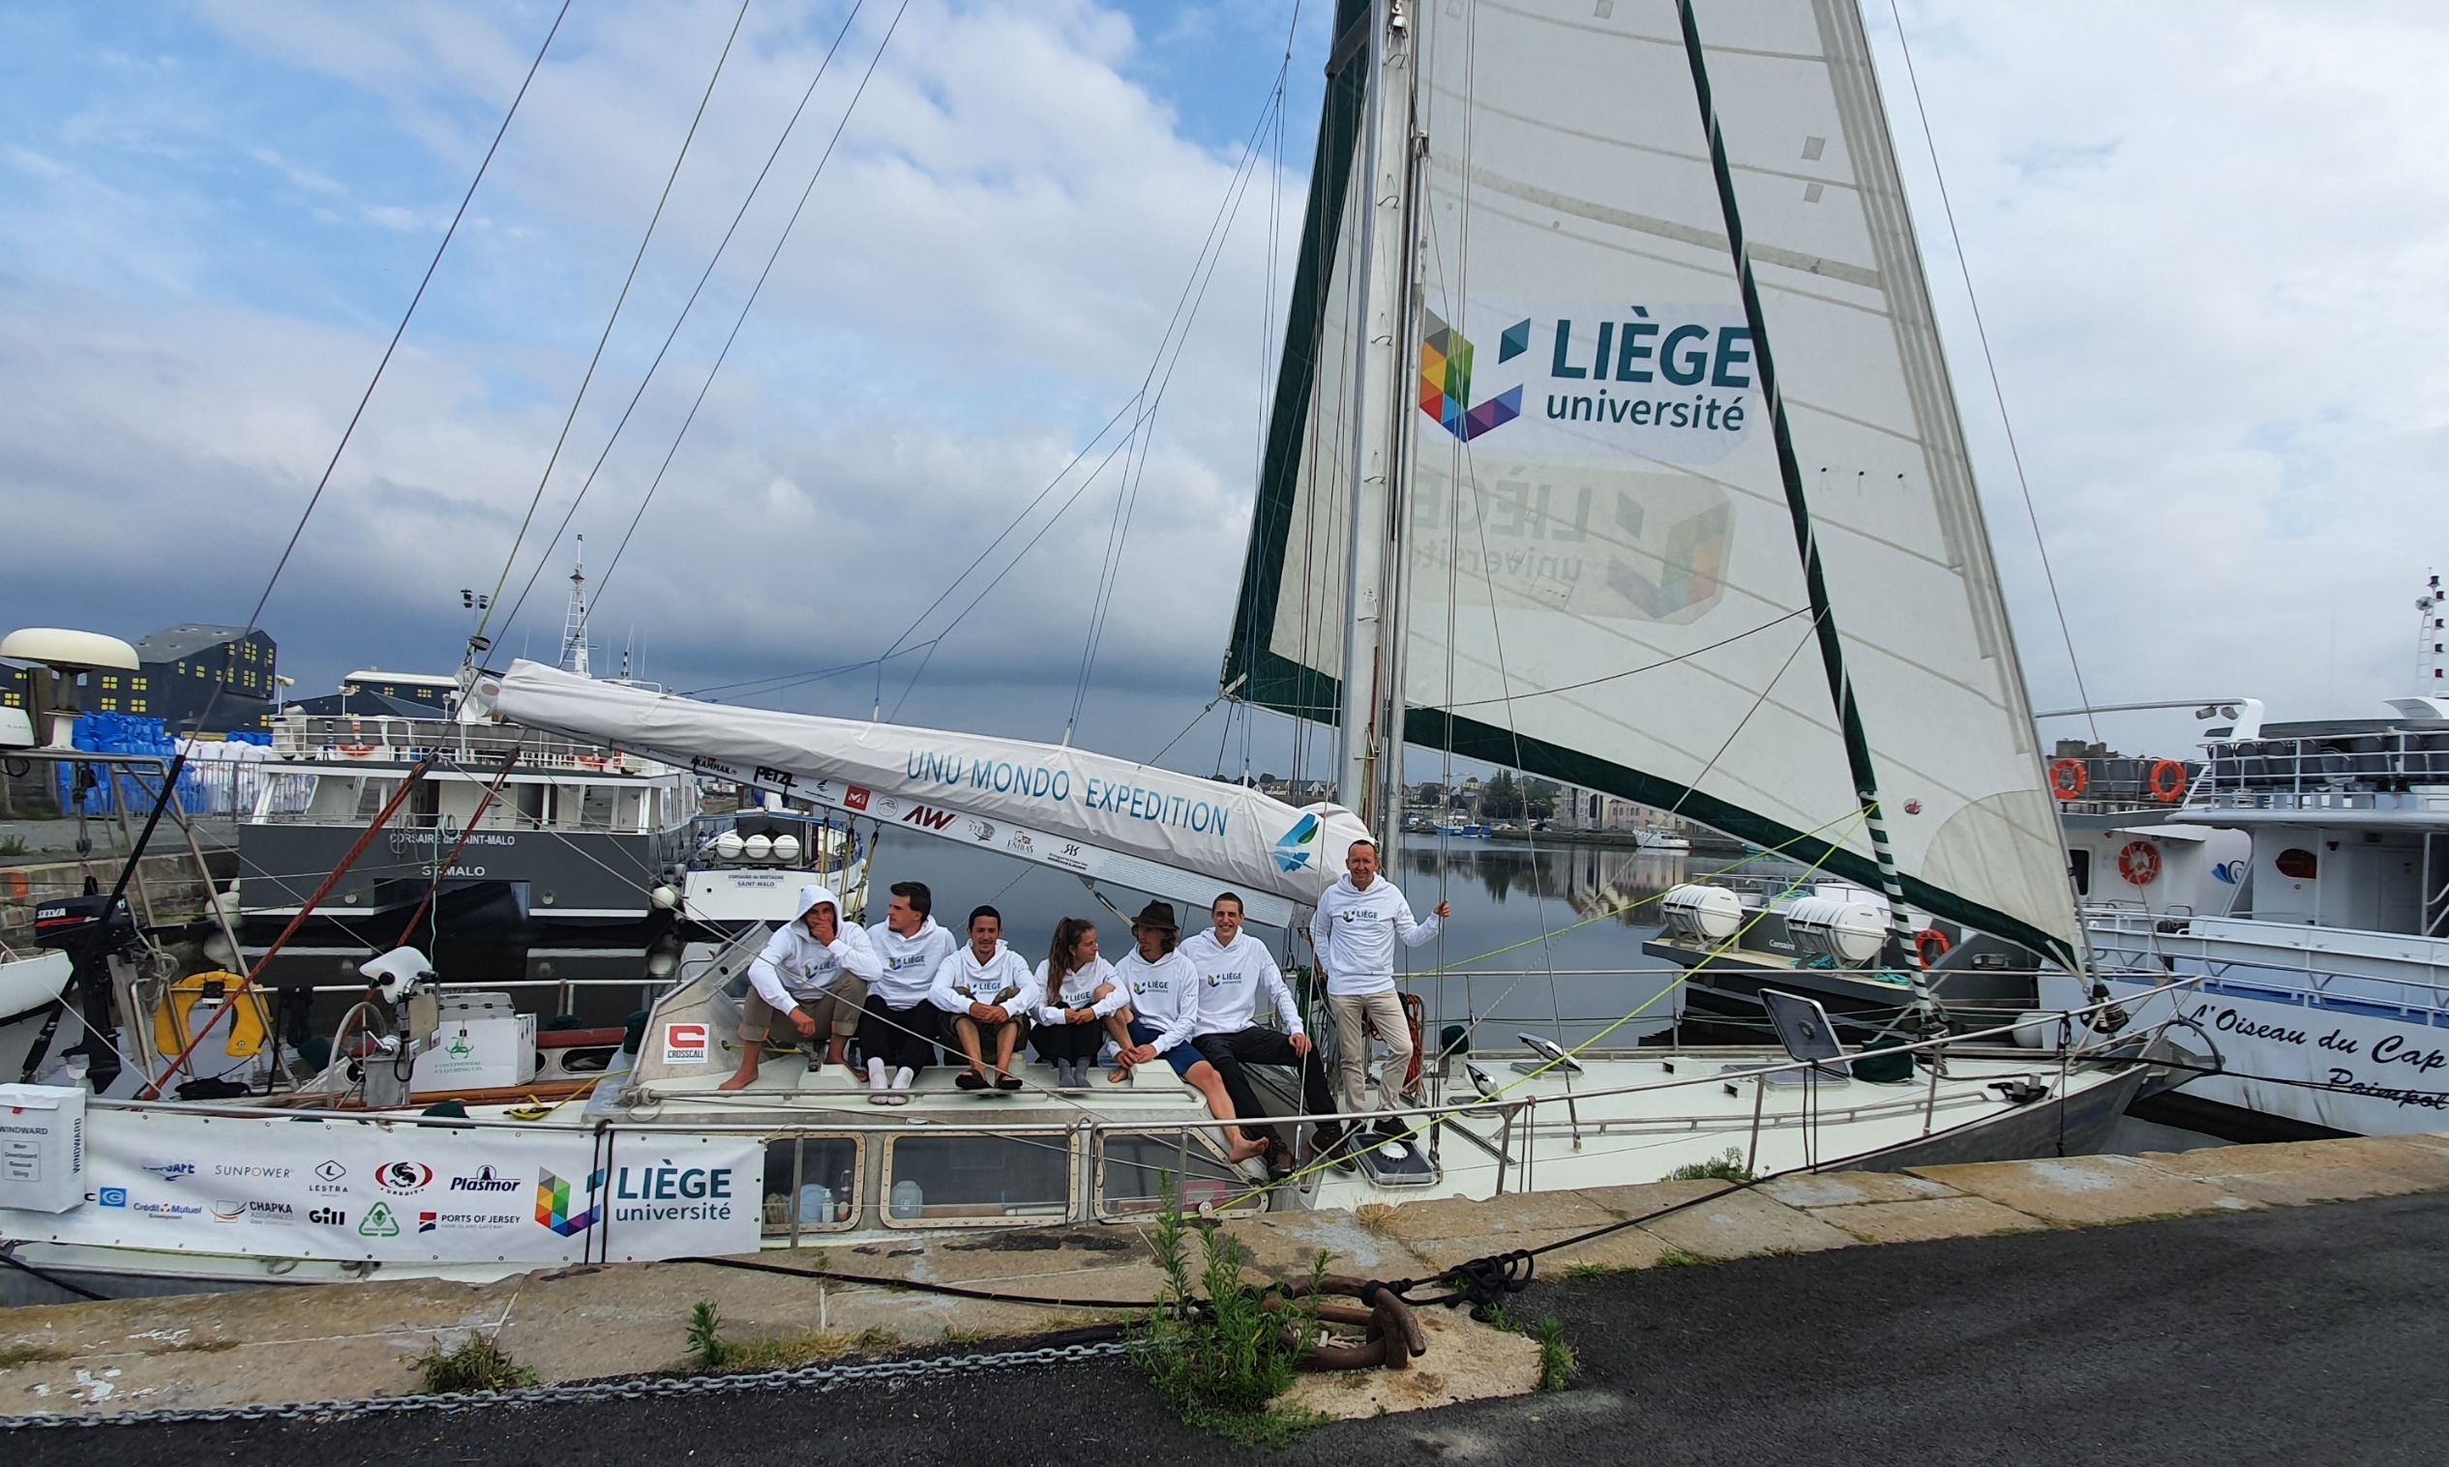
Departure from Saint-Malo

Slide 16
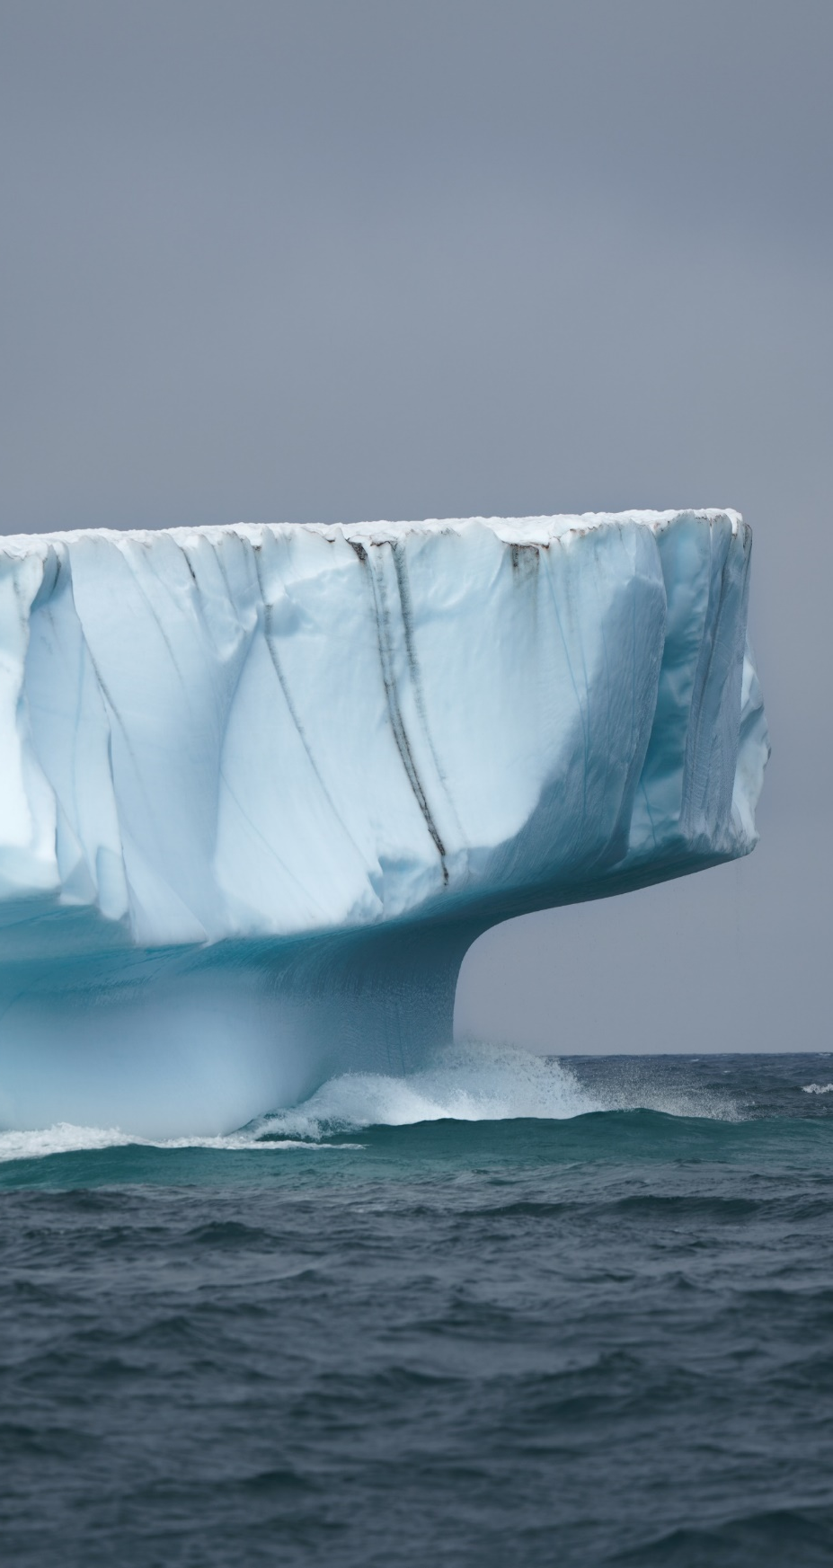
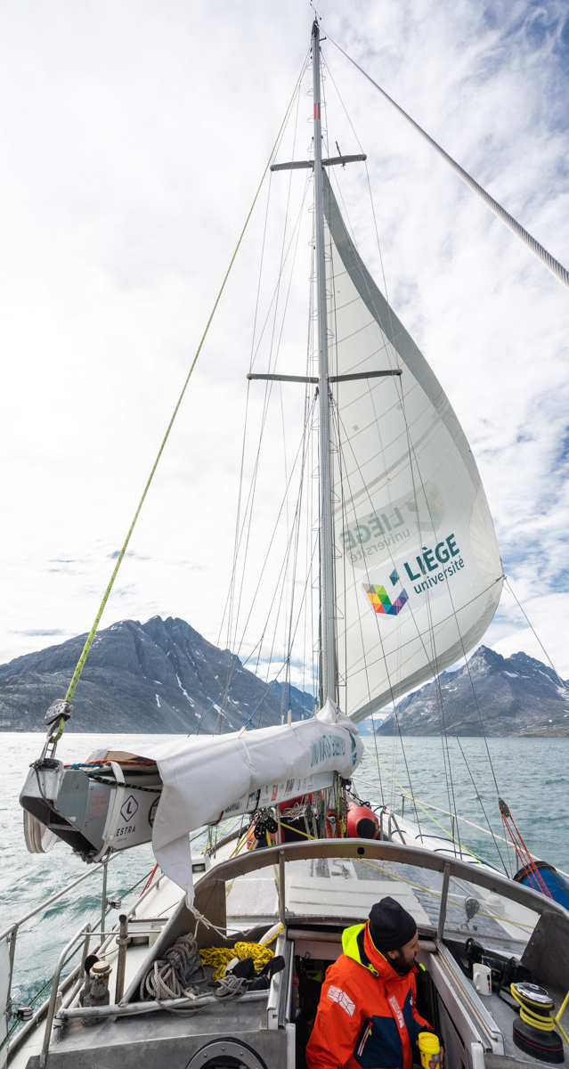
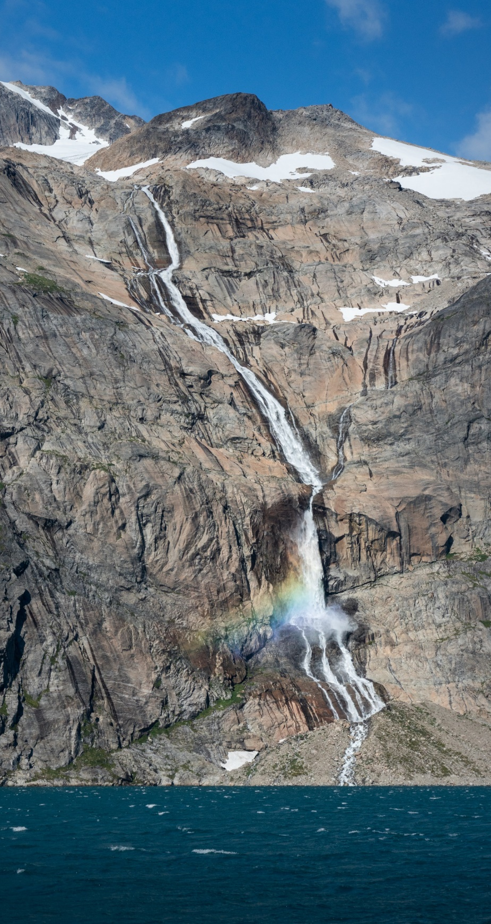
Arrival in Greenland

Slide 17
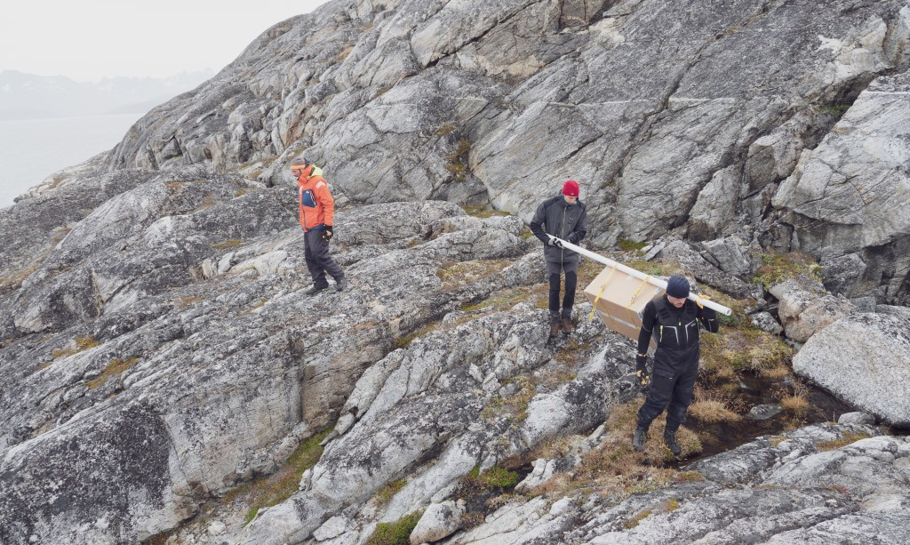
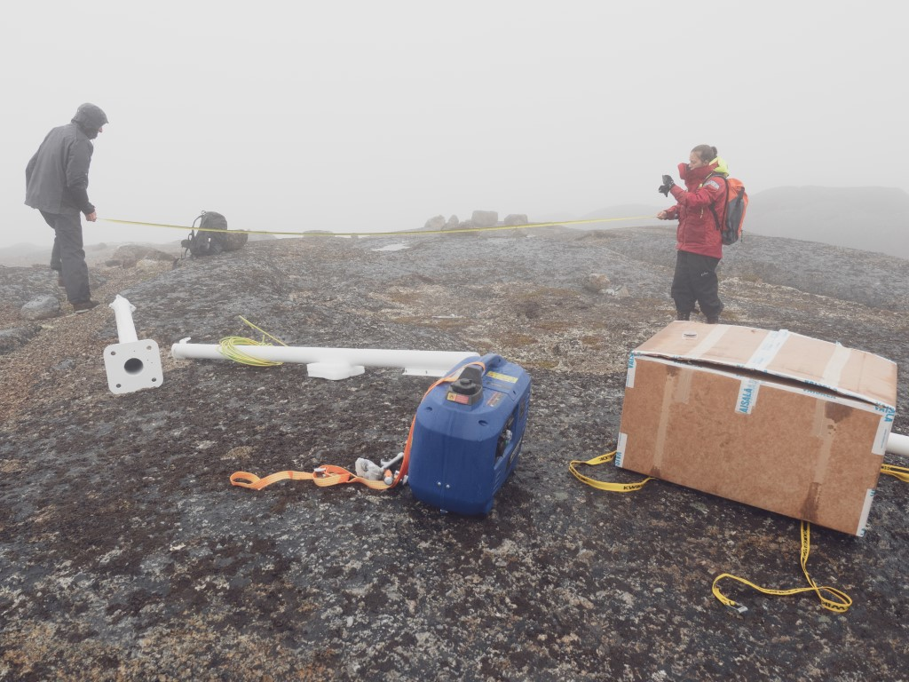
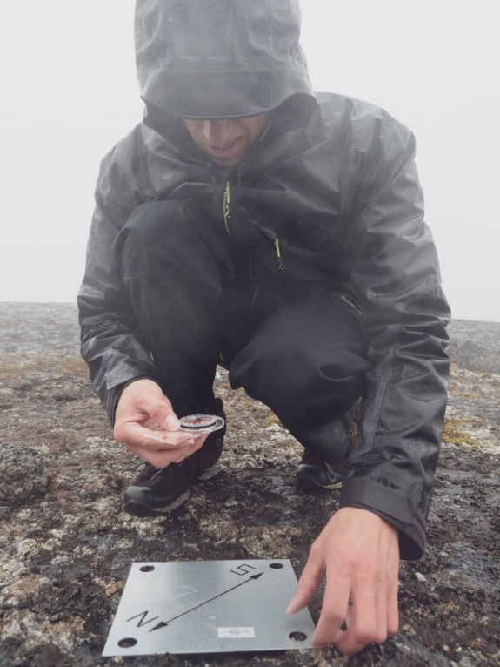
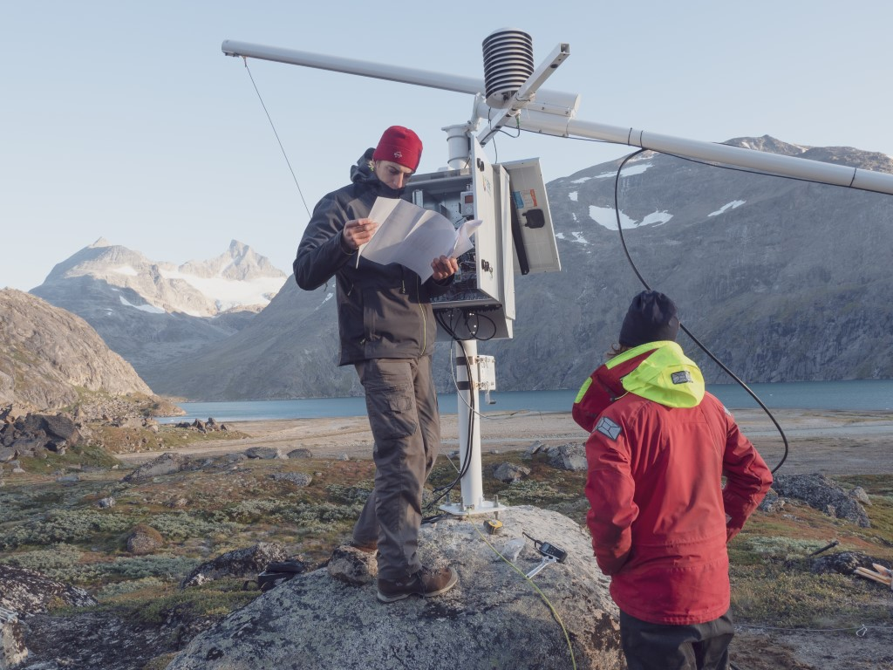
Installing a station is easier said than done!
Installing a station is a challenging task:
Planning all details on the boat
Transferring everything ashore
Finding the right spot for the station
Getting everything on site
Starting the installation, hoping for the best
Dealing with unpredictable weather
Photos © Julien Fumard

Slide 18
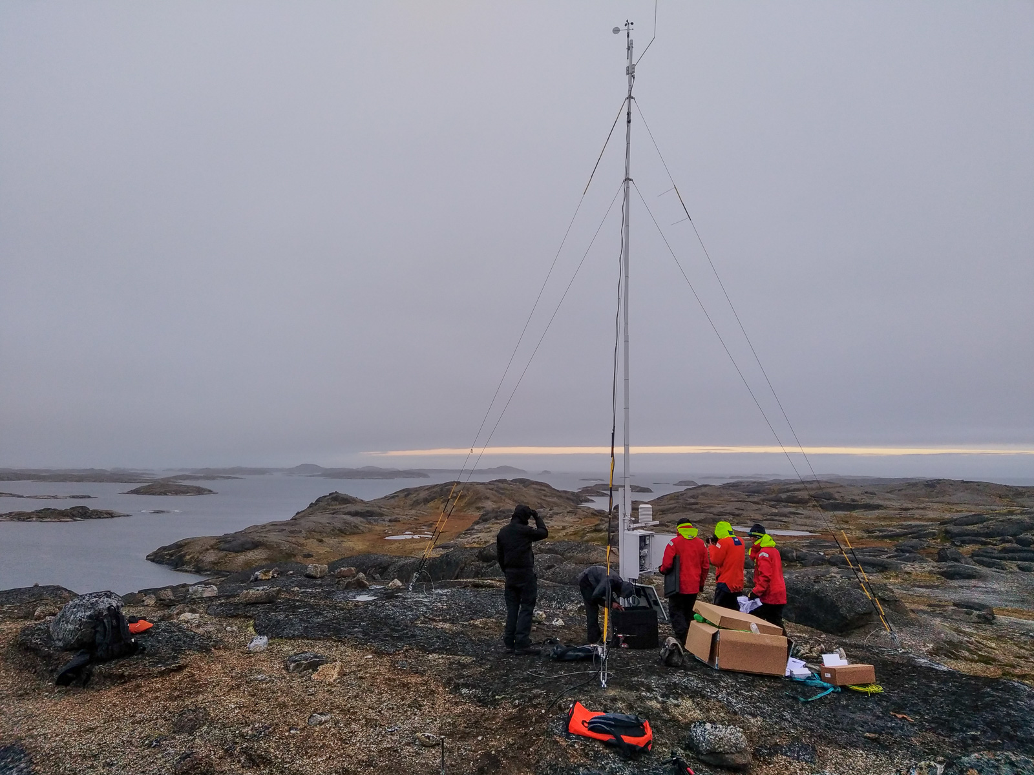
Finalising the installation of Station 1

Slide 19
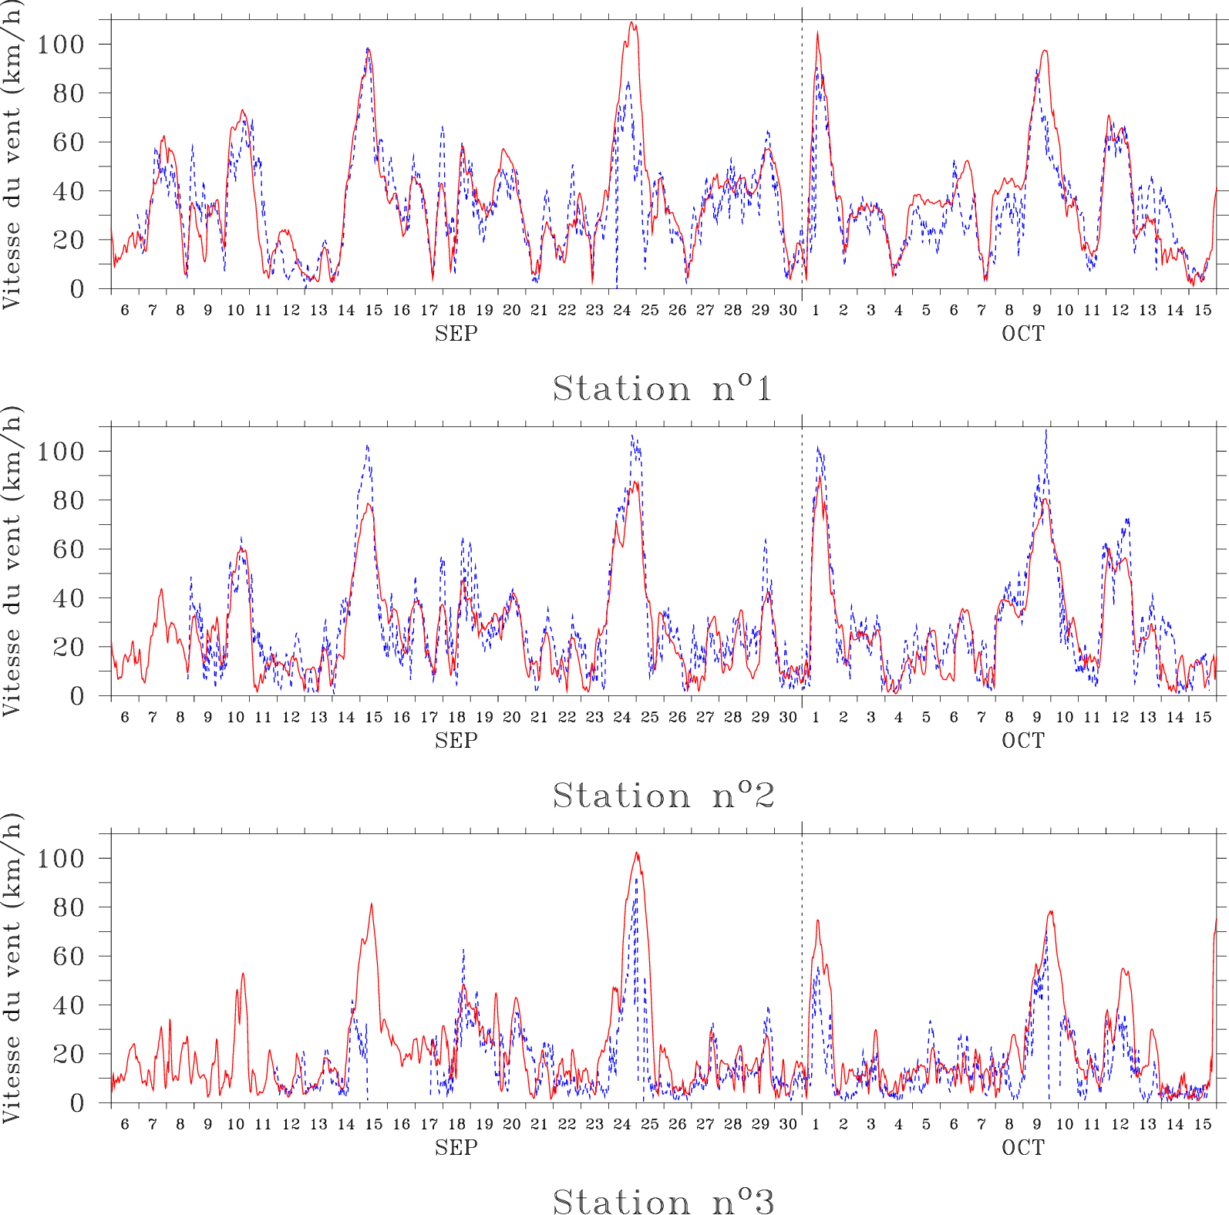
First comparison: MAR vs observations
AWS1
Correlation: 0.87
Bias=+2.4km/h
RMSE=11km/h
Mean: 34±20km/h
1 observation every 20m from 6 SEP 2020 to 15 OCT 2020.
Wind measured at 10m
AWS2
Correlation: 0.9
bias=-2km/h
RMSE=10km/h
Mean: 29±23km/h
Problem with the censor when high wind speeds
AWS3
Correlation: 0.86
bias=+4km/h
RMSE=11km/h
Mean: 17±17km/h
MAR is able to simulate spatial and temporal variability at the three stations.

Slide 20
Remote renewable energy hub for carbon-neutral fuel production

Slide 21
Remote renewable energy hub in Greenland: cost breakdown
Methane comes at a price 76.4 €/MWh in Zeebrugge (WACC 0%).

Slide 22
Pros and cons of carbon-neutral energy-rich molecules to export this energy
Pros
Molecules can be used to power loads that are difficult to electrify (airplanes, etc.).
They can exploit existing downstream infrastructure (gas networks, heating systems, etc.).
Hubs are easier to develop than large-scale intercontinental electrical connections.
The byproducts of hubs, such as heat and pure water, can be exploited locally.
Cons
Exporting this energy in the form of energy-rich molecules generally results in greater losses than when it is repatriated in the form of electricity.
You still depend on imports for your energy supply.

Slide 23
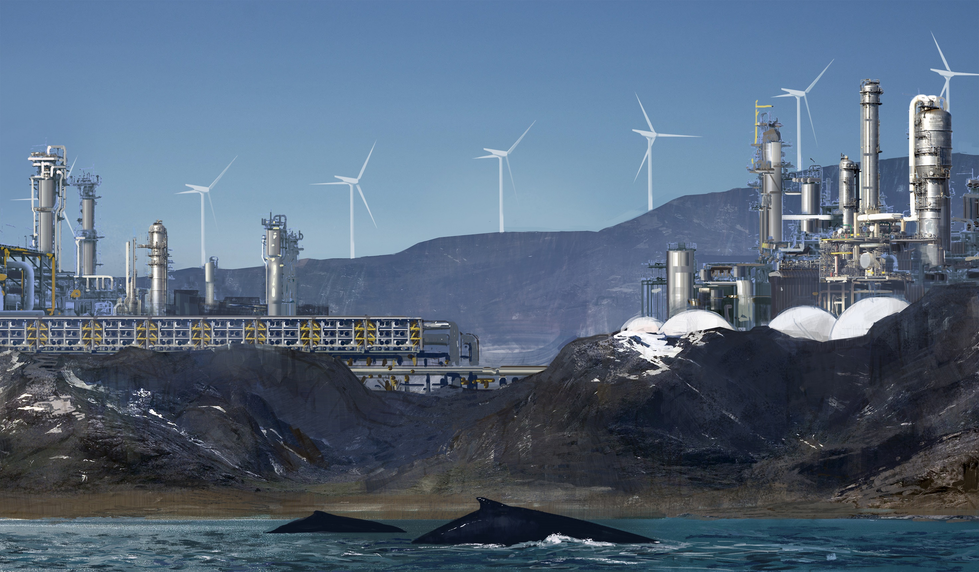
Artist representation of a remote energy hub located in Greenland.

Slide 24
  References
Chatzivasileiadis, S., Ernst, D., & Andersson, G. (2013). The global grid. Renewable Energy, 57, 372-383. doi:10.1016/j.renene.2013.01.032
Radu, D.-C., Berger, M., Fonteneau, R., Hardy, S., Fettweis, X., Le Du, M., Panciatici, P., Balea, L., & Ernst, D. (2019). Complementarity Assessment of South Greenland Katabatic Flows and West Europe Wind Regimes. Energy, 175, 393-401. doi:10.1016/j.energy.2019.03.048
Berger, M., Radu, D.-C., Fonteneau, R., Henry, R., Glavic, M., Fettweis, X., Le Du, M., Panciatici, P., Balea, L., & Ernst, D. (2020). Critical Time Windows for Renewable Resource Complementarity Assessment. Energy, 198. doi:10.1016/j.energy.2020.117308
Berger, M., Radu, D.-C., Fonteneau, R., Henry, R., Glavic, M., Fettweis, X., Le Du, M., Panciatici, P., Balea, L., & Ernst, D. (2020). Critical Time Windows for Renewable Resource Complementarity Assessment. Energy, 198. doi:10.1016/j.energy.2020.117308
Berger, M., Radu, D.-C., Detienne, G., Deschuyteneer, T., Richel, A., & Ernst, D. (2021). Remote Renewable Hubs for Carbon-Neutral Synthetic Fuel Production. Frontiers in Energy Research. doi:10.3389/fenrg.2021.671279
Lambin, C., Fettweis, X., Kittel, C., Fonder, M., & Ernst, D. (2022). Assessment of future wind speed and wind power changes over South Greenland using the MAR regional climate model. International Journal of Climatology. doi:10.1002/joc.7795
Dachet, V., Benzerga, A., Fonteneau, R., & Ernst, D. (2023). Towards CO2 valorization in a multi remote renewable energy hub framework. Proceedings of ECOS 2023 - The 36th International Conference on Efficiency, Cost, Optimization, Simulation and Environmental Impact of Energy Systems, Las Palmas, Spain.

