Slide 1
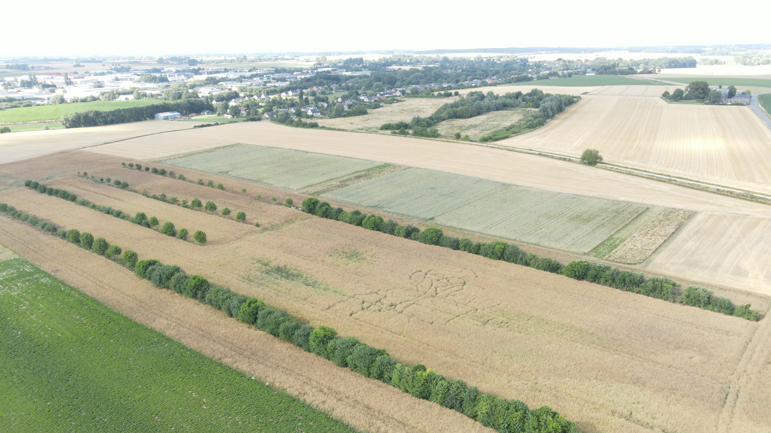
EFFECT OF CROP ROTATION ON WEED COMMUNITY: THE CASE OF AN INNOVATIVE LONG-TERM CROPPING SYSTEM IN BELGIUM
Christophe Lacroix
Christophe Lacroix (speaker) ¹
Martin Van Den Abeele ¹
Arnaud Monty ²
Caroline De Clerck ¹
Benjamin Dumont ¹
¹Plant Sciences-Terra Research Centre, Gembloux Agro-Bio Tech, University of Liège ² Biodiversity and Landscape-Terra Research,Gembloux Agro-Bio Tech, University of Liège

Slide 2
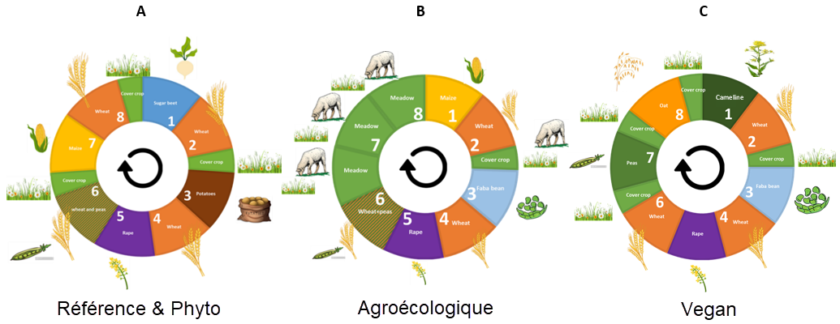
The EcoFoodSystem trial of Uliege-GxABT
Innovative long-term crop rotations based on Eat-lancet diet (vegan or omnivorous)
Launched in 2020
No pesticides (except BAU manage with and without herbicide)
Business As Usual (BAU)
Integreated livestock system (ICLS)
Vegan
(VEGAN)
Business As Usual herbicide free (BAU_HF)

Slide 3
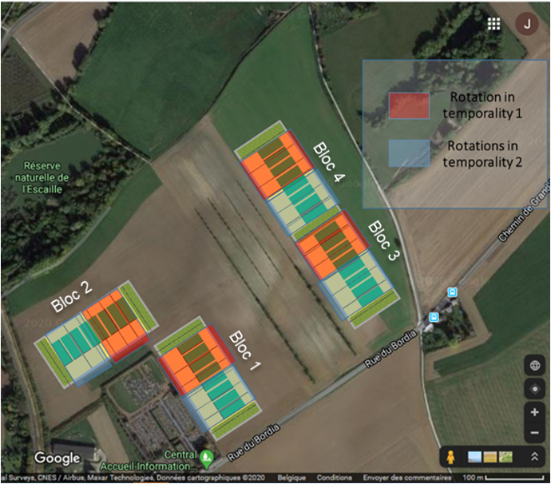
Trial implementation
4 blocks
8 plots per blocks
2 temporalities per block
Plot size : 18m x 80m

Slide 4
Trial implementation
Crops assessed in 2022
Business As Usual (BAU)
Integreated livestock system
(ICLS)
Vegan
(VEGAN)
Business As Usual without herbicide (BAU_HF)

Slide 5
Research questions
Rape seed
Wheat
Potatoes
spelt
Malting barley
Maize
Faba bean
≠
≠
?
Rape seed association
Wheat-pea
Malting barley
Lens-camelina
Spelt
Maïze
Wheat-Faba bean

Slide 6
Research questions
Rape seed
Wheat
Potatoes
spelt
Malting barley
Maize
Faba bean
≠
≠
?
Rape seed association
Wheat-pea
Malting barley
Lens-camelina
Spelt
Maïze
Wheat-Faba bean

Slide 7
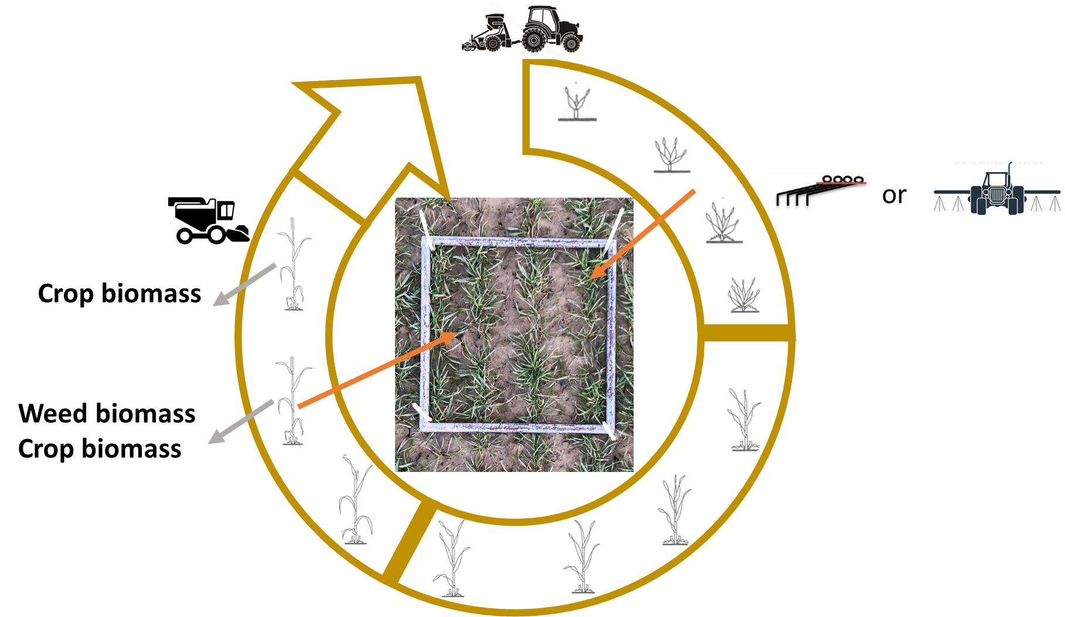
Experimental design - Measurements
Weeds on the field
Quadrat: 0.5x0.5m
5 quadrat/field
Counting

Slide 8
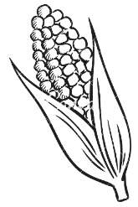
Results and discussion
End of winter :
Weed density higher under Vegan rotation
Preceding crop

Slide 9
Results and discussion
End of winter :
Weed density higher under Vegan rotation
Wheat Flowering :
Weed density and biomass are the lowest in BAU (with herbicide)
Vegan rotation shows a weed density 7 times higher than BAU rotation
Preceding crop

Slide 10
Results and discussion
End of winter :
No difference for biodiversity indices between rotations

Slide 11
Results and discussion
End of winter :
No difference for biodiversity indices between rotations
Wheat Flowering :
Biodiversity indices are always lower for BAU rotation.
Vegan rotation has the higher number of species (~5)

Slide 12
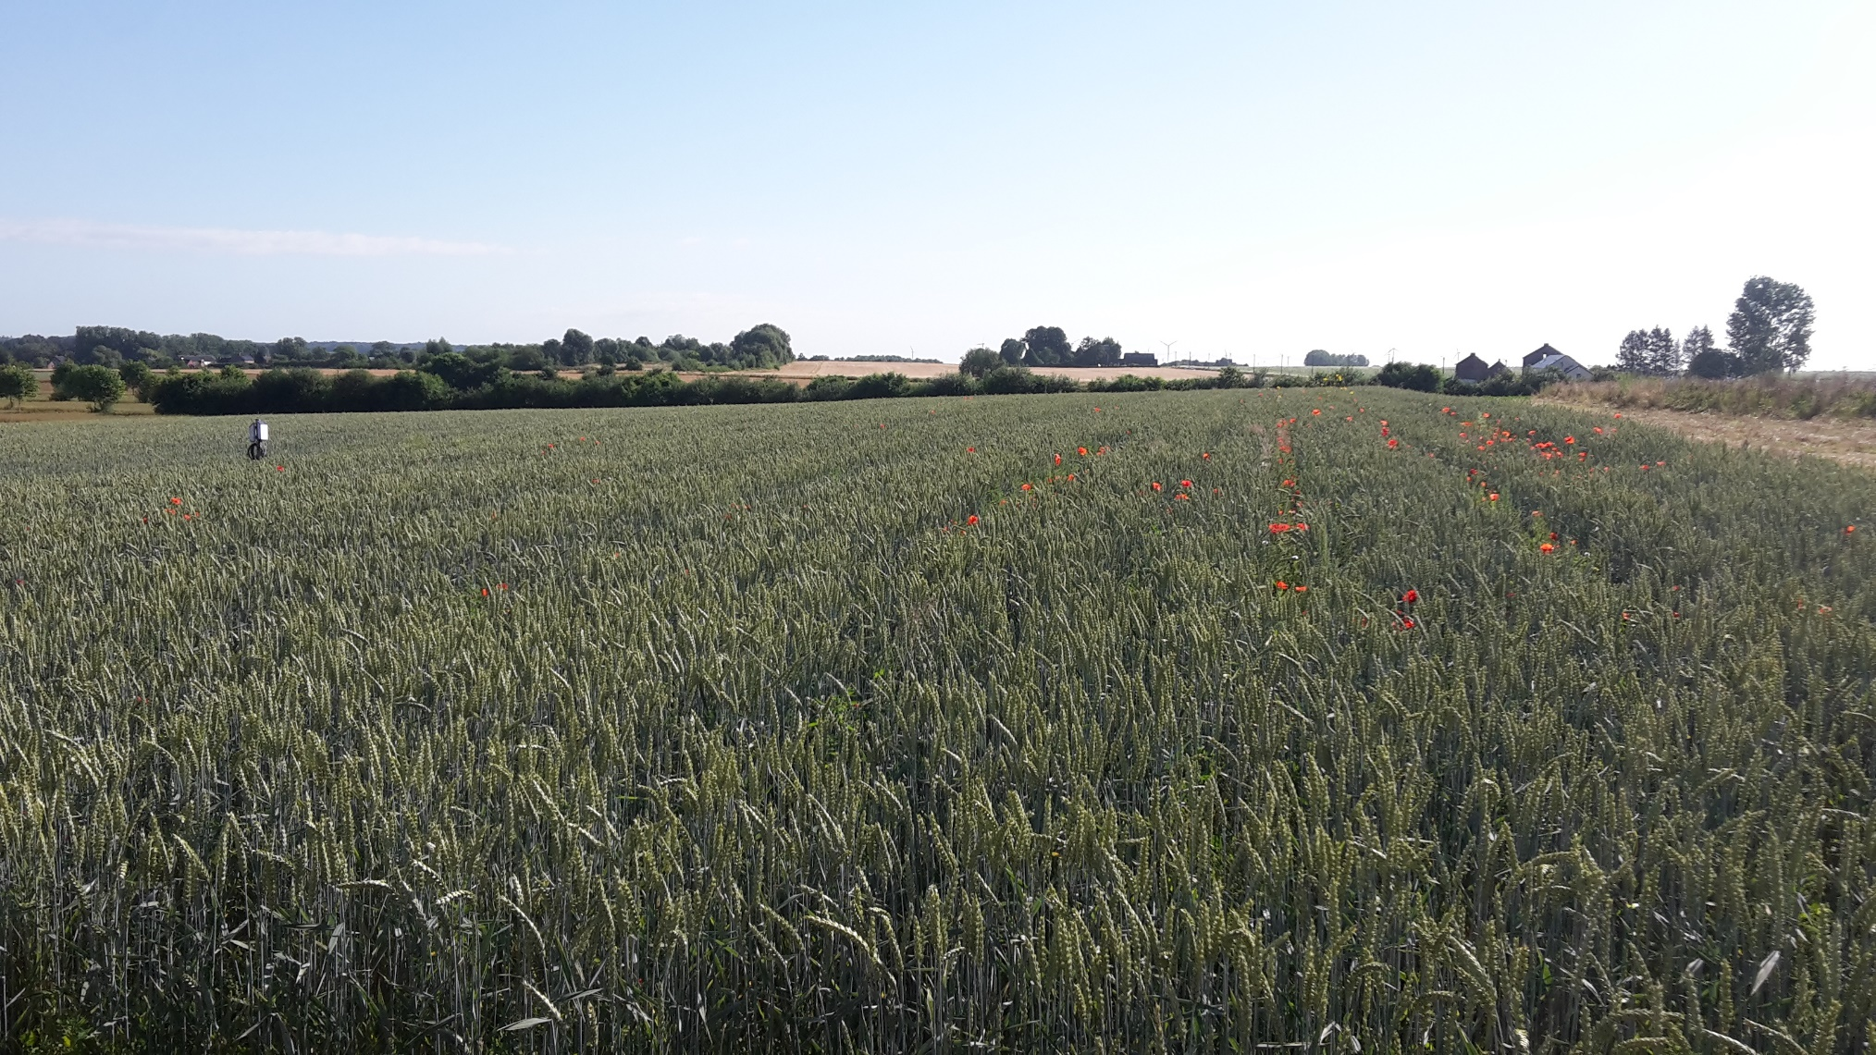
Results and discussion

Slide 13
Results and discussion

Slide 14
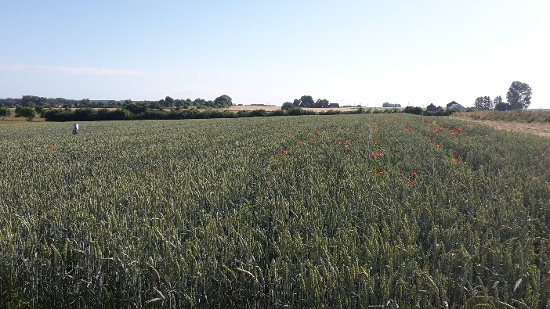
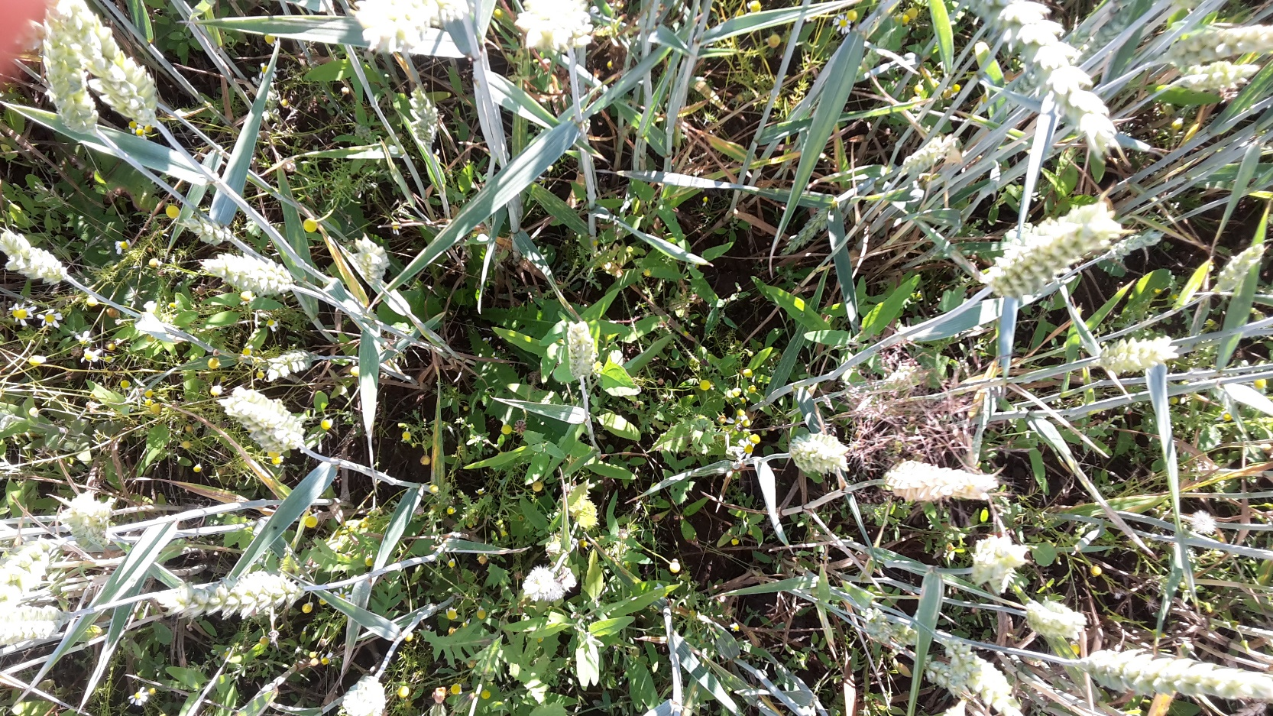
Results and discussion
Weeds are mainly present below canopy

Slide 15
Results and discussion
No relation between weed biomass and wheat biomass at flowering !

Slide 16
Results and discussion
No relation between weed biomass and wheat biomass at flowering !
No relation between weed biomass and wheat yield

Slide 17
Results and discussion
No relation between weed biomass and wheat biomass at flowering !
No relation between weed biomass and wheat yield
➔ The lack of correlation could be explained by the high aggressiveness and maybe a low selectivity of harrow during weeding

Slide 18
Results and discussion
ICLS with maize as previous crop has the lower yield
Highest yield observed under VEGAN rotation (previous crop : Camelina) Statisticaly equivalent to BAU_HF (previous crop : sugar beets).

Slide 19
Conclusions
Rape seed
Wheat
Potatoes
spelt
Malting barley
Maize
Faba bean
≠
≠
Species Richness
Shannon diversity index Eveness
Rape seed association
Wheat-pea
Malting barley
Lens-camelina
Spelt
Maïze
Wheat-Faba bean

Slide 20
Conclusions
Rape seed
Wheat
Potatoes
spelt
Malting barley
Maize
Faba bean
≠
≠
Species Richness
Shannon diversity index Eveness
?
BAU_HF
BAU
ICLS
VEGAN
Rape seed association
Wheat-pea
Malting barley
Lens-camelina
Spelt
Maïze
Wheat-Faba bean
Yield differences mostly explained by previous crop
No relationship between weeds and wheat biomass or yield (agressiveness of harrow ? )

Slide 21
Perspectives
Study the impact on initial weeds population (through weed seedbank)

Slide 22
EFFECT OF CROP ROTATION ON WEED COMMUNITY: THE CASE OF AN INNOVATIVE LONG-TERM CROPPING SYSTEM IN BELGIUM
Christophe Lacroix
Christophe Lacroix (speaker) ¹
Martin Van Den Abeele ¹
Arnaud Monty ²
Caroline De Clerck ¹
Benjamin Dumont ¹
¹Plant Sciences-Terra Research Centre, Gembloux Agro-Bio Tech, University of Liège ² Biodiversity and Landscape-Terra Research,Gembloux Agro-Bio Tech, University of Liège

