Slide 1
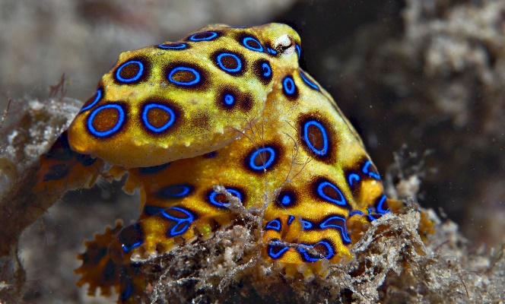
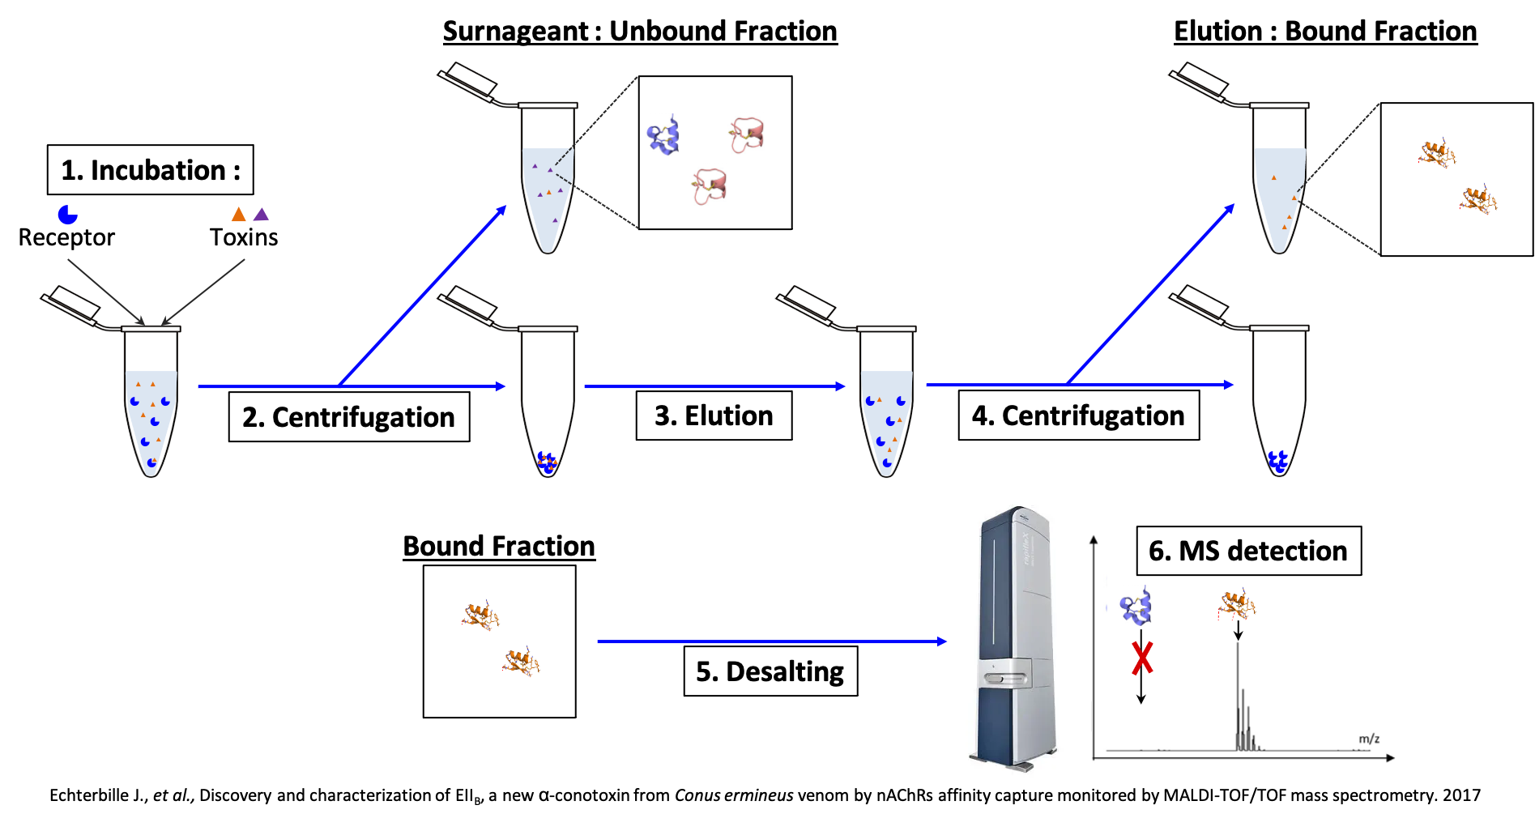
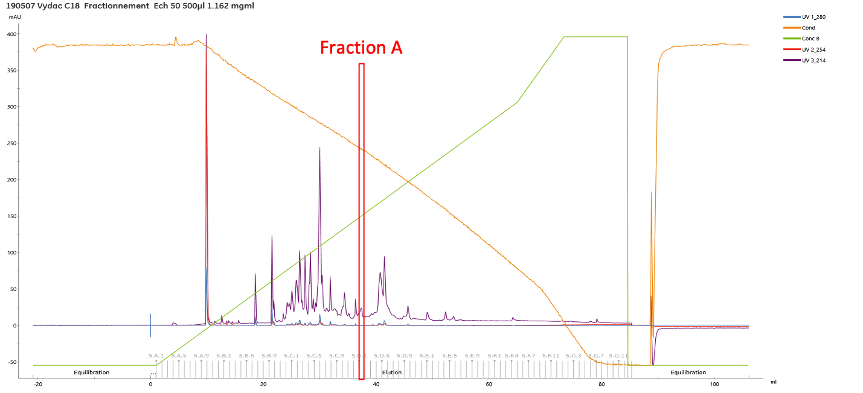
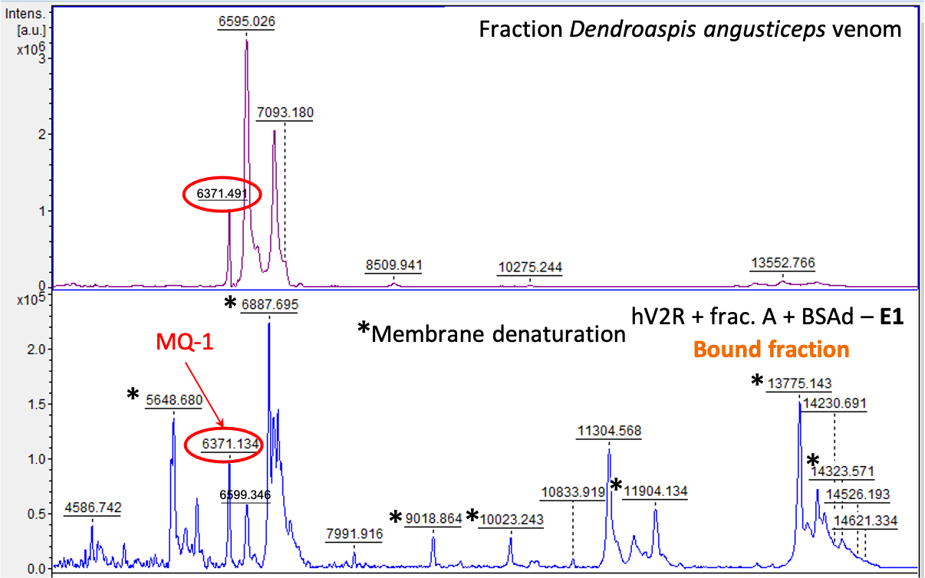
Towards a high-throughput mass spectrometry methodology to fish peptide toxins from crude venoms by affinity capture on cell membrane receptors
Lou Freuville¹, Fernanda Gobbi Amorim¹, Romain Vitello², Rudy Fourmy³, Aude Violette³, Jean-François Liégeois² ,Alain Brans⁴, Loïc Quinton¹.
¹Mass Spectrometry Laboratory, MolSys Research Unit, Department of Chemistry, University of Liège, 4000 Liège, Belgium; ²Laboratory of Medicinal Chemistry and C.I.R.M, University of Liège, 4000 Liège, Belgium; ³Alphabiotoxine Laboratory sprl, Montroeul-au-bois 7911, Belgium; ⁴Centre for Protein Engineering, University of Liège, 4000 Liège, Belgium.
lfreuville@uliege.be
Introduction
Animal venoms are complex chemical cocktails containing a wide range of biologically active peptides named toxins.
Toxins act against membrane receptors, such as ion channels and GPCRs, of which they modulate the functions.
This property may help clarify critical physiological processes and lead to novel therapeutic molecule development.
Sequencing the venom peptides is now routinely done, but determining the biological activity of their toxins is still tedious.
The ideal methodology for doing so must allow:
- direct observation of ligand-receptor interactions without the need to have access to a ligand that has to be known and labeled beforehand, opening the way to receptor deorphanization and reducing the experimental constraints.
- simultaneously fishing multiple toxin ligands from a complex mixture
- high-throughput automation, to meet the constraints imposed by the millions of toxins to screen.
Mass spectrometry appears as the solution, not only in terms of sensitivity and versatility but also thanks to its identification power by MS and MS/MS
© divescotty.com
© H. Krisp
Methodology
© R. Bartz
Selected model: the vasopressin receptors (hV2R). hV2R is a GPCR. This receptor has a selective ligand, the mambaquaretin-1 (Ciolek J., et al. 2017). The hV2R was purchased from Perkin-Elmer, and displays an expression level of Bmax = 11.5 pmol/mg of membrane proteins – K_{D} = 0.18 nM
Development
As the work is carried out with V2Rs, the method was first developed using a toxin known to have an affinity for this receptor: vasopressin. Peptides coming from digested BSA were added to mimic a complex mixture.
Here are presented the MALDI-TOF spectra showing the first results :
Reference spectrum: containing the AVP and BSA digested peptides.
Crude venom
Unbound fraction: should contain the peptides that did not bind to the membranes. As expected, BSA peptides and an excess of vasopressin (m/z 1084.5) are detected.
Crude venom tests: Mambaquaretin-1 (MQ-1) is a known V2R peptide ligand, found in the venom of Dendroaspis angusticeps. Once validated by capturing pure MQ-1, the method has been evaluated to capture the toxin from a fractionated crude venom.
Bound fraction: should containing the potential ligands, captured by affinity from the mixture. The only intense peak observed in the elution is the vasopressin. The other detected peaks are compounds coming from membrane denaturation.
Mambaquaretin-1 6367 Da
3 SS
Conclusion
Bibliography
Fishing ligands for membrane receptors, from complex mixtures, have been demonstrated efficient.
The method still needs to be adapted to a high-throughput system in order to study a large number of potential peptides present in venoms as well as a large number of different receptors.
Echterbille J, Gilles N, Araóz R, et al. Discovery and characterization of EII_{B,} a new α-conotoxin from Conus ermineus venom by nAChRs affinity capture monitored by MALDI-TOF/TOF mass spectrometry. Toxicon. 2017;130:1-10.
Ciolek J, Reinfrank H, Quinton L, et al. Green mamba peptide targets type-2 vasopressin receptor against polycystic kidney disease. Proc Natl Acad Sci U S A. 2017;114(27):7154-7159. doi:10.1073/pnas.1620454114
The authors want to thank the Belgian F.R.S-FNRS for the funding of the PDR “Venom4Liege” in the frame in which this work has been performed.

