Slide 1
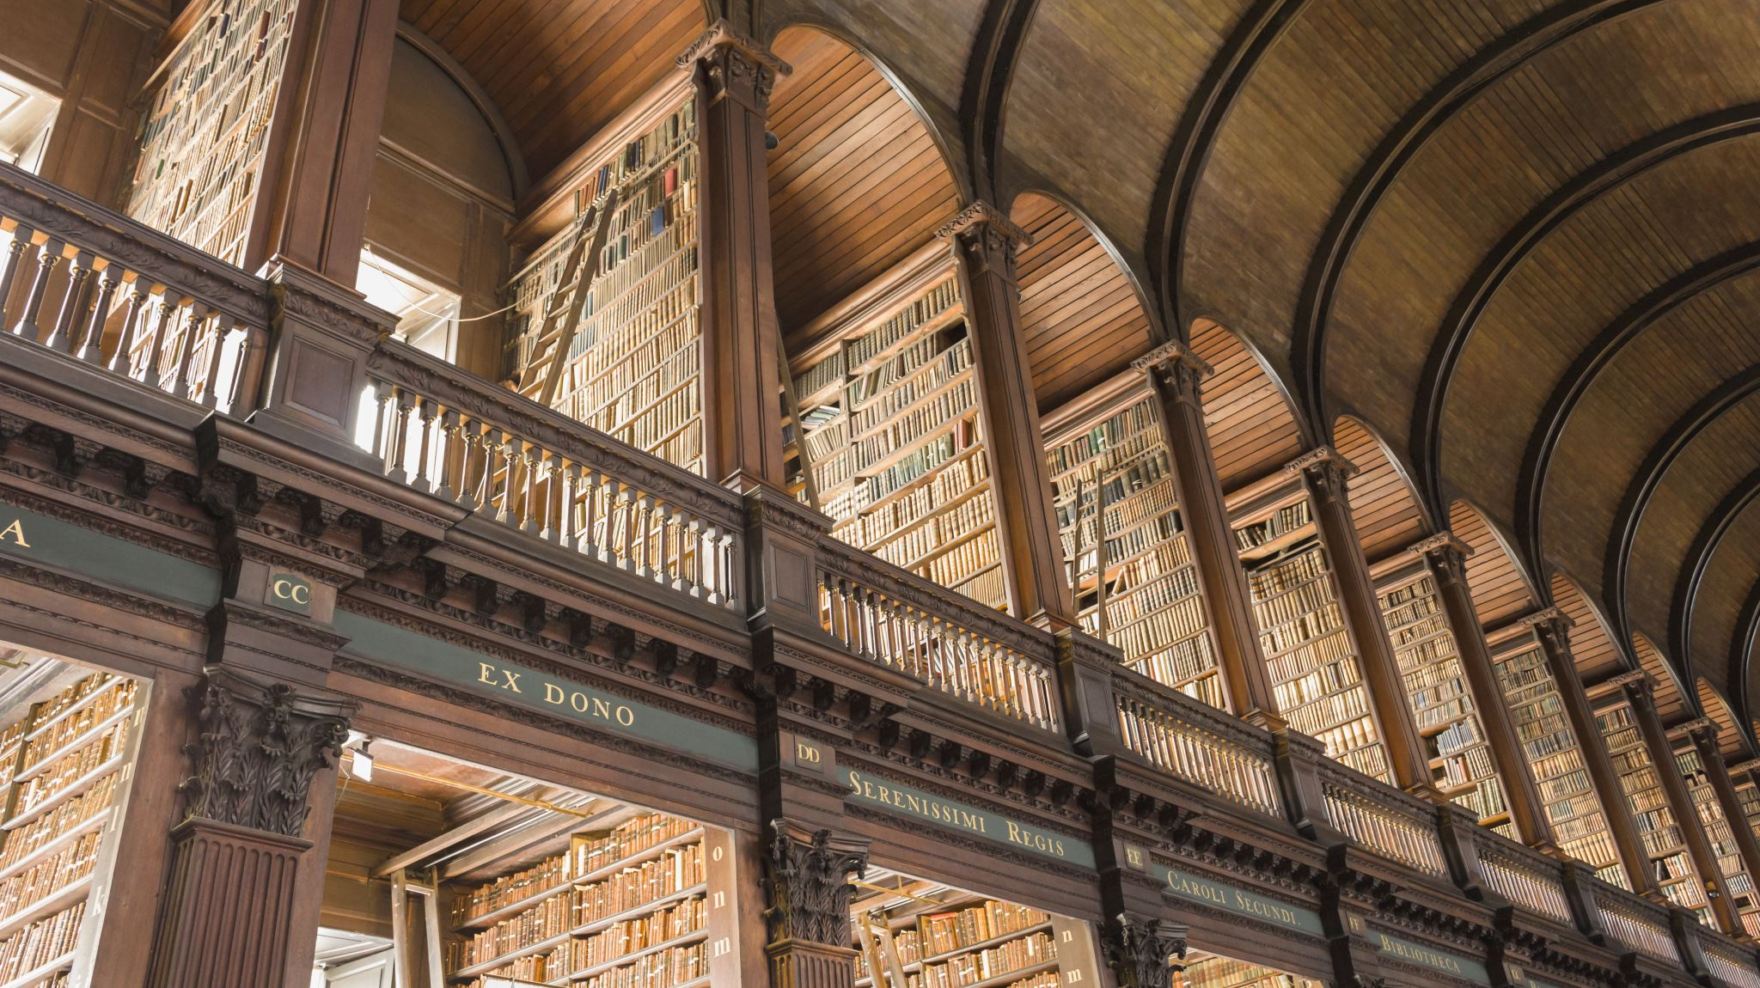
Provenance marks and Sammelbände as tools for library history
The case of the Jesuit college library in Liège
Sammelband 15-16: Lyon Winter Workshop 2022
Emile Thonar – ULiège
Notes:
Hello everyone
First and foremost I would like to thank M. Malcolm Walsby and the Sammelband 15-16 group for giving me the opportunity to speak in front of you today. I am sincerely grateful since this is my first ever workshop as a speaker. I am a young historian, I’ve only finished University a few months ago, so I will be open to any comment and advice coming from the experts you are.
The elements i’m about to present here are drawn from my master thesis on the Library of the Jesuit college of Liège.

Slide 2
Outline
How can provenance marks help us reveal donation networks ?
How can sammelbände help us understand library practices ?
Compiling books and their marks
Identifying donors
Making sense of the gifts
Resorting to other sources
A few examples
Why bind titles together ?
Role of the librarian
Dating the binding
Generalization to whole SJ
Notes:
I Initially wanted to talk only about Provenance marks as tools for reconstructing networks. But once I dived back into my works, I realized I could also talk quite a bit about the Sammelbände of this library.
However this is not at all something I was familiar with during my master thesis.
Quite the contrary, I have only been familiar with Sammelbände for a few weeks now, so feel free to correct me on technical topics. For this reason I decided to talk about what these sources can bring to the historian, specifically to library history.
This presentation will follow two major themes : the first part will focus on provenance marks, their strengths and limits. I will explain how they can or cannot be used to reconstruct donation networks around the library. This can then be used to assess how successfully the jesuits settled in Liege.
In the second part I will explain how Sammelbände can teach us about library practices in a specific jesuit college. We will see how different volumes can be attributed to different librarians, and what it tells about their idea of the library. We will then compare it to the normative framework of the Society of Jesus.
I will start by very briefly giving some contextual information to set the stage, and then develop the two main points of my argument.

Slide 3
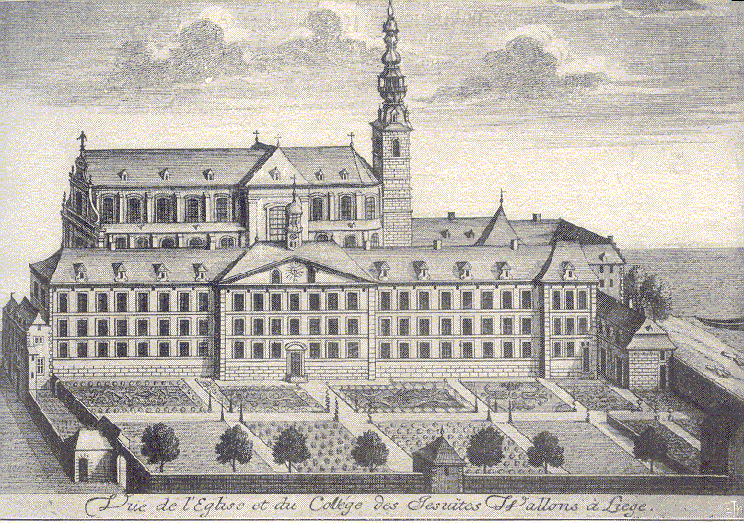
The jesuits in Liège
1567 – Beginning of the mission
1581 – Opening of the college
Library grows thanks to donations
Actively took part in the urban life of Liège
1678 – First known catalogues (3)
1773 – Suppression of the Society of Jesus
Notes:
The jesuit college of Liege was founded in 1581 and sits in a very dense jesuit province, in the Principality of Liege.
For about 200 years they actively took part in the day-to-day life of the city, until the Society was suppressed in 1773.
Of course like any religious order, they gave a lot of importance to books. It is then no surprise that one of their very first concern was obtaining some. As soon as they moved into a proper building, they set up their own library, which started growing quite fast thanks to donations by local figures. We have evidence of their ownership of books before 1581, but not of an organized library.

Slide 4
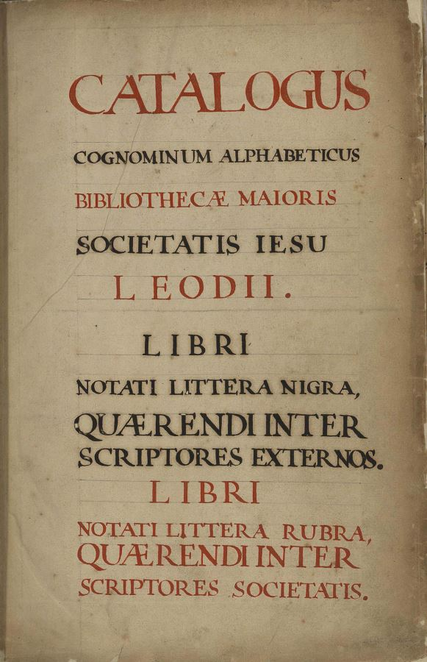
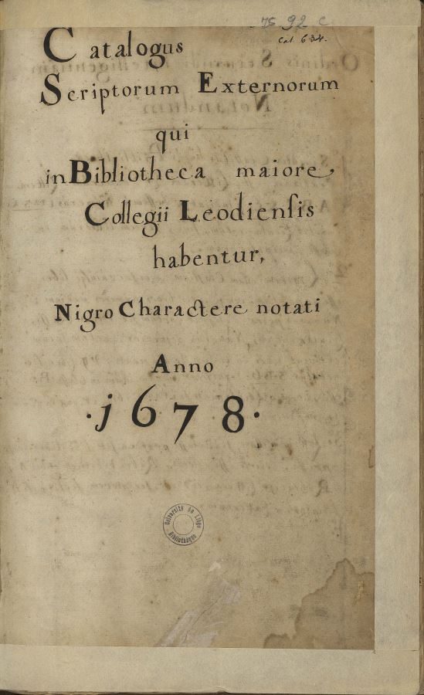
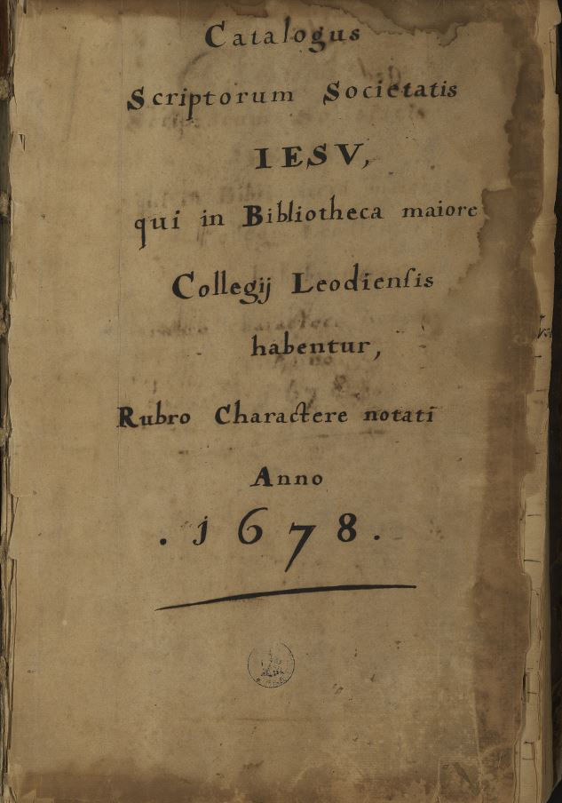
Alphabetical catalogue – All authors
ULiège, ms. 90C.
Topographical catalogue – Non-jesuit authors
ULiège, ms. 92C.
Topographical catalogue – Jesuit authors
ULiège, ms. 1421C.
Notes:
The usual suspects when it comes to library history are of course, library catalogues.
For this library we are lucky to still preserve 3 of them, which is quite a remarkable survival rate. They were all written in 1678. The first one is alphabetical. The other two are topographical. What is interesting is that you can try to match the titles between the catalogues, but I will get back to them later. All in all this makes for a rich system of instruments that offers several different perspectives on a single book collection.
However I was more interested by how the books were acquired by the jesuits. If they were bought, gifted, exchanged.
I could not find this in library catalogues and I strongly believed that physical bibliography had something to bring on the table, so I chose to look primarily at the ancient books of this library.

Slide 5
Physical bibliography
Went through every book
Compiled every note, mark, or clue
Used those clues as indicators of library practices
Compared practices to the normative framework of the Society
Library | Consulted books
ULiège | 656
Liège Episcopal Seminary | 244
Royal Library of Belgium | 24
UGhent | 42
B. Mazarine | 13
BNF | 1
Total | 980
Notes:
I collected all the books of I could identify and went through every one of them.
In total, I went to many different collections, and I had to identify the books with the property mark of the college. On top of that, I looked for any kind of clue, note or mark that could me with understand library practices. In total I found 980 ancient books that once belonged to the jesuits.

Slide 6
Provenance marks
Type of provenance | n. of books (out of 980)
Ex-dono | 399
Ex-libris | 52
Ex-dono + Ex-libris | 6
Went through every book
Compiled every note, mark, or clue
457 relevant books/980
Identify the 106 different donors
Prosopography -> Stand-out groups
Notes:
About half of those displayed a relevant provenance mark : 399 ex-donos, 52 ex-libris, and 6 had both, accounting for 106 donors. With this data, I chose to higlight a few stand-out groups, such as canons, women, or local burghers, rather than resorting to an exhaustive prosopography. I am only going to talk about the canons, as they are the biggest group.
The goal of this approach was to investigate how integrated the jesuit were in the religious landscape of the city. I could then understand the relations between all clergymen in the city and reconstruct networks thanks to book donations.

Slide 7
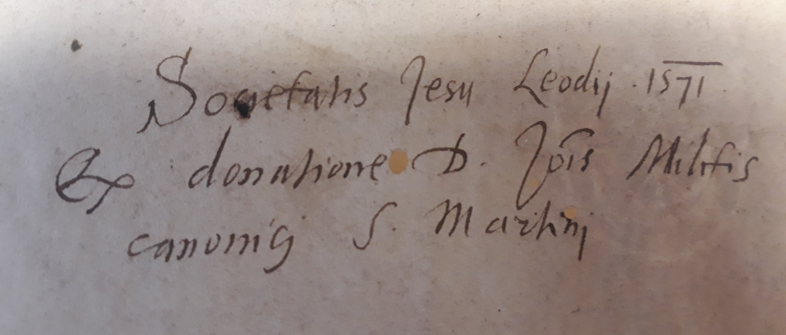
Book donations by canons
Societatis Jesu Leodii 1571 ex donatione D. Jo[ann]is Militis canonici S. Martini
Dono R. admodum D. Francisci d’Anthine Officialis et Canonici S. Lamberti
Collegii Societatis Jesu Leodii Dono D. a Curia Canonici S^{ti} Joannis
Notes:
Here are a few examples of what I found on the books : these are obviously ex-donos by canons from the different collegiate churches of the city.

Slide 8
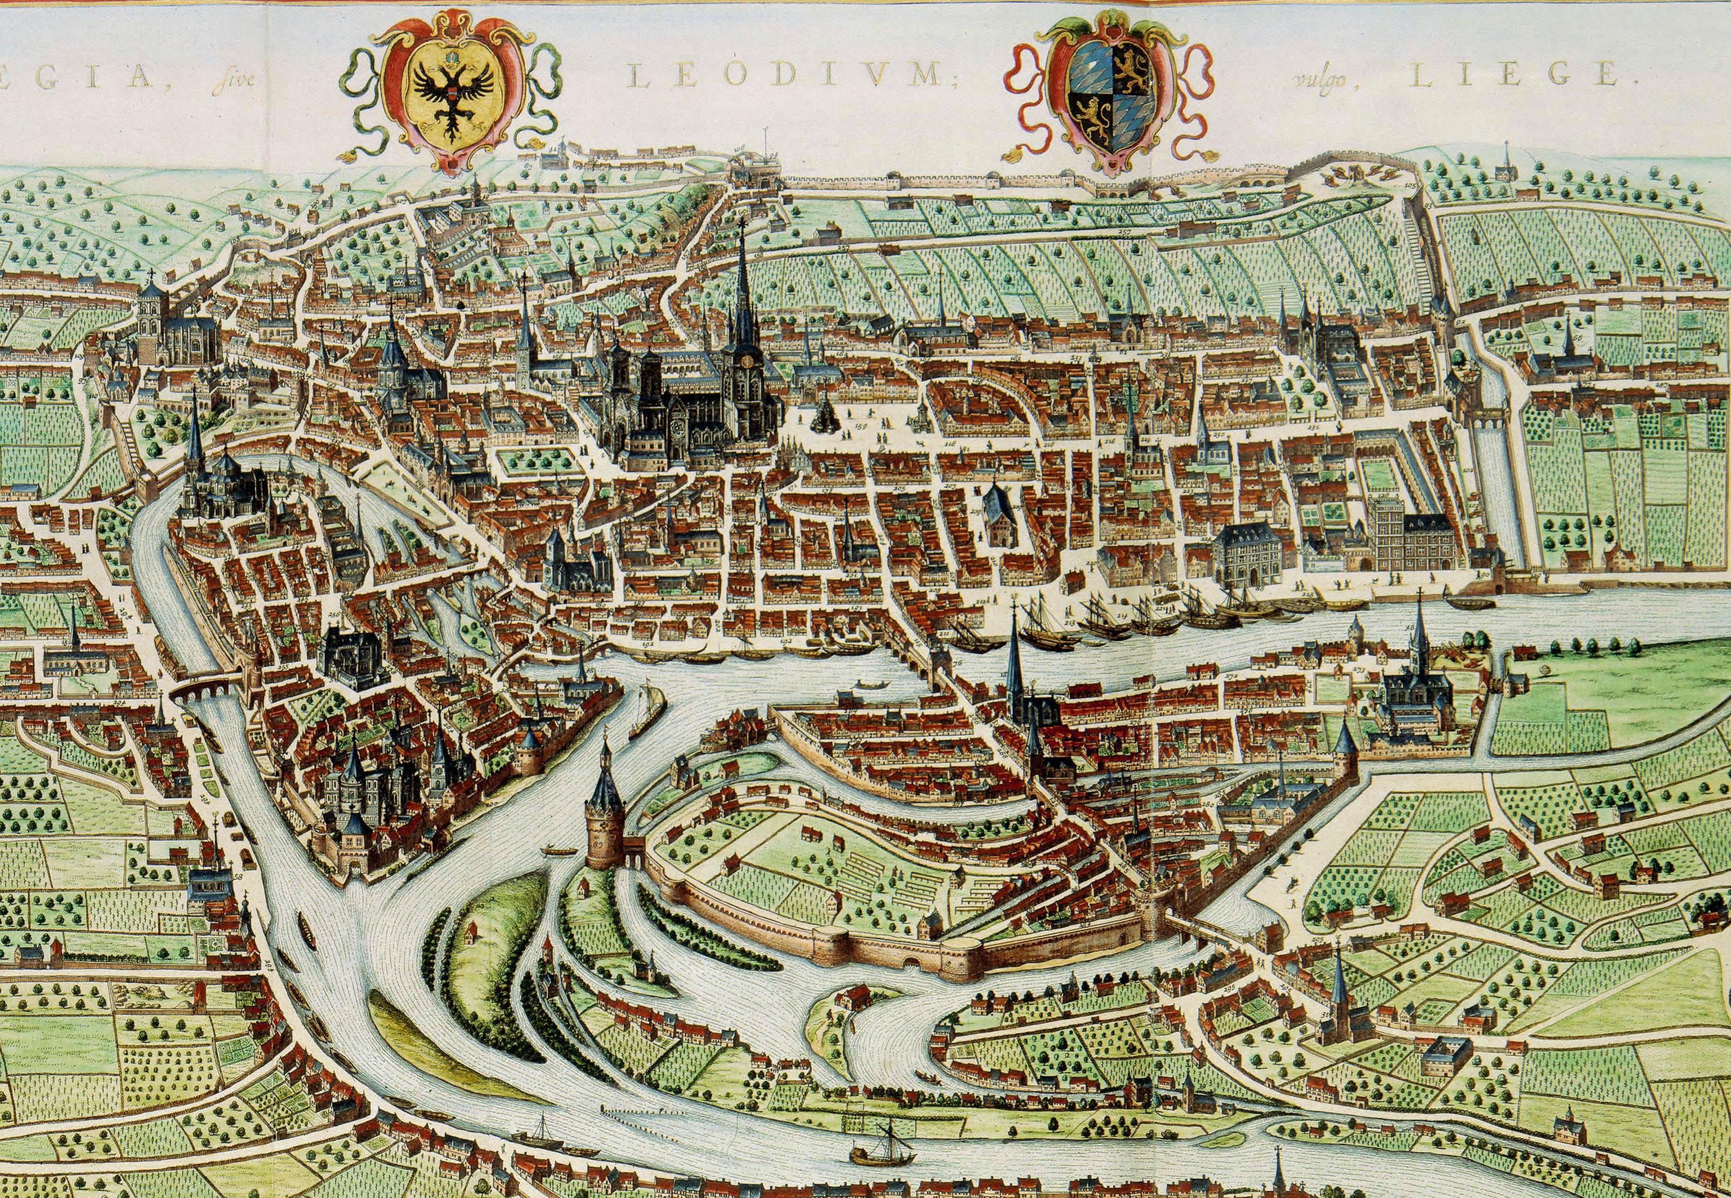
St. Martin - 7
St. Pierre - 2
St. Barthélemy - 2
St. Croix - 4
St. Lambert - 17
St. Jean le Baptiste - 1
St. Jean l’Évangéliste - 5
St. Denis - 3
St. Paul - 4
Jesuit college
Unidentified canons - 3
Novum ac magnum theatrum urbium Belgicæ Regiæ, ad præsentis temporis faciem expressum, Amsterdam, Johannes Blaeu, 1649.
Notes:
In total, I found 48 canons who gifted books to the library.
I put them all on a map so that I could visualize where the donors come from.
All these canons who donated books almost all lived at the same period, in the beginning of the seventeenth century, often deemed the golden age of the Society of jesus in the Low Countries.
However, this is where provenance marks hit their limit. They cannot really tell more than that.

Slide 9
Provenance marks as tools for reconstructing networks
Benefits
Limits
Identifying groups
Linking up donors and the books they gifted
Rewriting narratives through use of new sources
Acting as sole measure of social link and neglecting others means
Hard to understand the reasons and motivations behind the gifts
Notes:
They only give account of one book donation at a given moment. They can’t characterize themselves. They don’t mention any personal reason or motives behind the gift. In short, they are just good at what they do, and not much more.
Therefore, can we really admit that they demonstrate an effective local integration of the jesuits ? That might be a stretch. I needed a tool to really give depth and meaning to these gifts.
And this is where I turned to comprehensive sociology. Or trying to make sense of a book donation by understanding the donor’s point of view.
I needed sources that could answer this question : What sense did the canons make of their own donations ?
For this presentation I will limit myself to a single example.

Slide 10
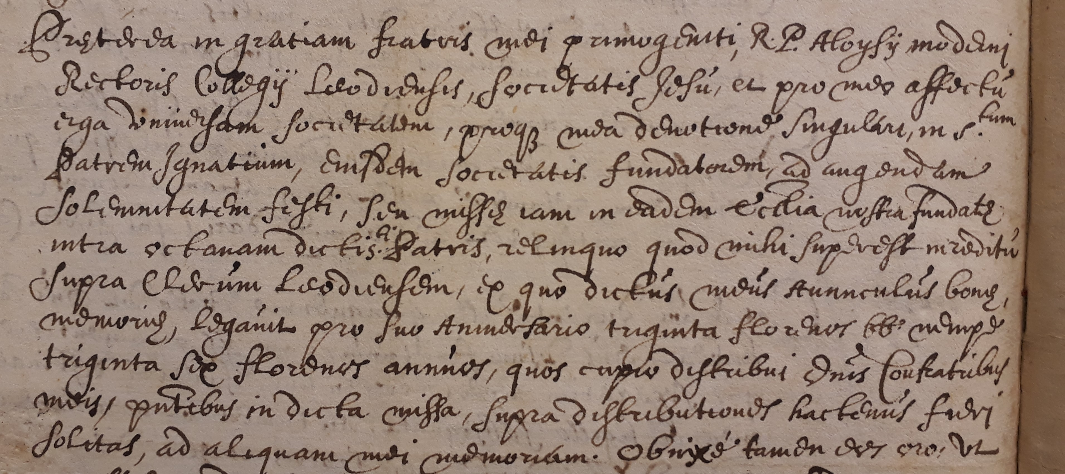
Comprehensive sociology of the gift
François d’Anthisnes, canon of Saint-Lambert
Archival sources : testaments and last wills
Taking into account the motives the historical agents gave to their own actions
Personal reasons for appreciating the jesuits
Personal devotion towards St. Ignatius
Funding a mass for St. Ignatius
Praeterea in gratiam fratris mei primogeniti R.P. Aloysii moderni Rectoris Collegii Leodiensis, Societatis Jesu, et pro meo affectu erga universam Societatem, proque mea devotione singulari in S^{tum} patrem Ignatium, eiusdem Societatis fundatorem, ad augendam Solennitatem festi, seu missae iam in eadem ecclesia nostra fundatae intra octavam dictis S^{ti} Patris, relinquo quod mihi superset in reditu supra Clerum Leodiensem, ex quo dictus meus avunculus bonae memoriae, legavit pro suo anniversario triginta florenos bb. nempe triginta sex florenos annuos, quo cupio distribui omnibus confratribus meis, parentibus in dicta missa […]
Liège, Archives de l’état à Liège, Cathédrale Saint-Lambert, Secrétariat, nº 276, Testaments (1633-1654), f. 83vº-84rº, Testament de François d’Anthisnes.
Notes:
Specifically I chose to use last wills or testaments and looked at how the canons phrased their gift and what motivated them.
I found the testament of a canon of Saint Lambert I showed earlier, François d’Anthisnes, which hopefully gives more details about his special relation with the jesuit college.
What I found is that he asked to leave a part of his income to finance a mass for St. Ignatius of Loyola, the founder of the Society of Jesus. He wanted his name to be associated with this mass, as he said he had a special devotion towards Ignatius. This is a first indication of his sincere attachment to the Jesuits.

Slide 11
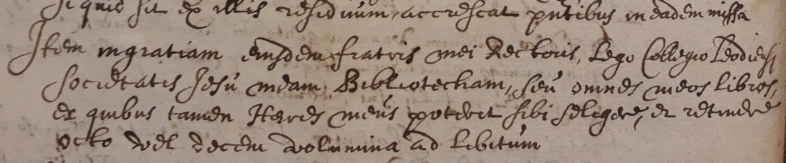
Comprehensive sociology of the gift
François d’Anthisnes, canon of Saint-Lambert
Archival sources : testaments and last wills
Taking into account the motives the historical agents gave to their own actions
Reasons behind the book donation
Brother is the rector of the college
Item in gratiam eiusdem fratris mei Rectoris lego Collegio Leodiensi Societatis Jesu meam Bibliothecam, seu omnes meos libros, ex quibus tamen Haeres meus poterit sibi selegere et retinere octo vel decem volumina ad libitum.
Liège, AÉL, CSL, S, nº 276, Testaments (1633-1654), f. 83vº-84rº, Testament de François d’Anthisnes.
Notes:
Further, François d’Anthisnes gives the reason for the donation of his personal library : he is actually the brother of the rector of the jesuit college.
We finally found an element that gives the exact motive behind a gift, according to the donor himself. However, in this exact case, it seems that this gift was motivated by personal of familial reasons, not by genuine affection towards the college.
And to my surprise, this was it. No other testaments talked about book donations to the college. When clergymen died, they often gave their personal library to their nephew, which is quite usual in the church, since the nephew is meant to pursue an ecclesiastical career.
One the one hand, this makes the gift of d’Anthisnes quite exceptional, since he breaks with this church tradition to favour the college. On the other hand, we saw that this donation may have been motivated by his brother, the rector of the college rather than personal affectinon.

Slide 12
Provenance marks as tools for reconstructing networks
Provenance marks
Not self-sufficient
Do not explain nor give background to the gifts
Coupled with other sources
Sometimes give unexpected outcomes
Heuristic perspectives
Physical bibliography still has a lot more to bring
Turning to sammelbände
Notes:
Wrapping up this first section, I’ll start by saying that provenance marks can’t be our only tool when it comes to measure local urban integration. Even if we think book donations are good indicators of social networks, gift marks cannot explain them, they merely account for them. Which is already good, but forces us to turn to other sources. In my case, it was archives that allowed to put book donations into perspective, realizing they are actually quite rare. They also showed that a book gift does not equal affection for the college, and could just be due to familial affairs.
In conclusion, provenance marks can be quite tricky for understanding library practices on their own.

Slide 13
Sammelbände as tools for library history
General outline of the sammelbände of the library
Volumes bound by the jesuits
On their demand
By themselves ?
Material clues on sammelbände
Dating the binding
Linking them to librarians
Deducing library practices
« Bookseller » sammelbände
Deducing library practices
Notes:
Fortunately, physical bibliography is not reduced to those. In this second part, we will look at a few Sammelbände, and demonstrate how rich they can be for the library historian.
First, I will quantify the sammelbände I found and show their general outline.
After that i’ll show examples of Sammelbände that were made by the jesuits, or on their demand.
With these, some handwritten or paratextual clues will give us more information about their binding, and the period they were bound. This will also allow us to link them to the different librarians of the college.
I will briefly talk about the content of some Sammelbände and how they can be linked to library practices.
Finally I’ll show a different kind of books that I called « Bookseller Sammelbände ». They also have something to teach us.

Slide 14
Sammelbände of the library
22 Sammelbände (2% of total)
Majority made up of 2 titles
3 incunables (2x2 titles and 1x4 titles)
Earliest edition : ca. 1475
Latest edition : 1757
n. of titles | n. of sammelbände
2 | 10
4 | 3
5 | 4
7 | 1
11 | 1
14 | 1
16 | 1
24 | 1
Notes:
Of the 980 volumes I found, 22 were Sammelbände. It is more than what I initially remembered, but it is still quite low when compared to the total.
There are all quite different, as I show on this table, 10 sammelbände are made up of only 2 titles, while some can include up to 24 titles, but really short ones in this case.

Slide 15
Sammelbände of the library
22 Sammelbände (2% of total)
Majority made up of 2 titles
3 incunables (2x2 titles and 1x4 titles)
Earliest edition : ca. 1475
Latest edition : 1757
Date of titles in the sammelband | n. of sammelbände
15th c. | 3
15th-16th c. | 1
16th c. | 6
16th-17th c. | 0
17th c. | 5
17th-18th c. | 4
18th c. | 2
16th-17th-18th c. | 1
Notes:
Moreover, a lot of them contain titles from the seventeenth or eighteenth century, so a bit beyond the scope of this workshop, but they still prove to be useful for understanding library practices.
I’m not going to go through each and everyone of them, I just selected some I thought to be the more interesting ones for arguing my point.
Let’s start with Sammelbände that were bound by the jesuits or at least upon their request.

Slide 16
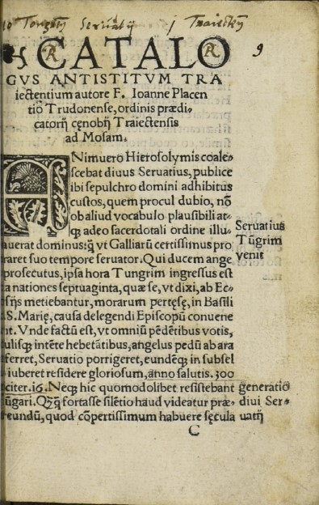
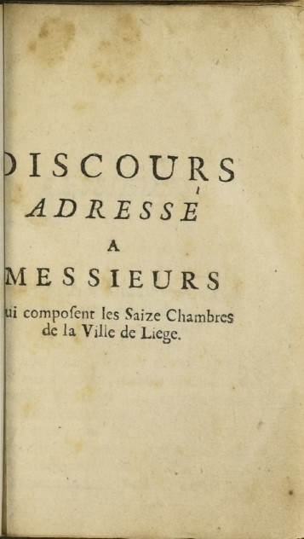
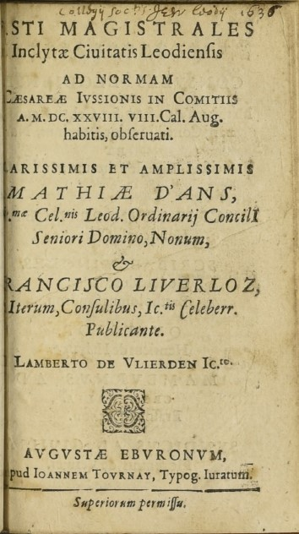
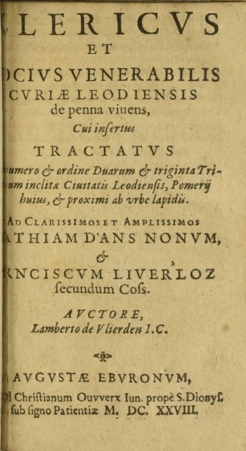
Finding the books in the catalogues
(Uliège R746A)
Placentius J. L., Catalogus omnium antistitum Tungrorum, Trajectensium ac Leodiensium, Antwerp, Willem Vorsterman, [1529].
Discours adressé a messieurs qui composent les Saize Chambres de la Ville de Liege, [Frankfurt], s.n., [1757].
De Vlierden L., Fasti Magistrales Inclytae Civitatis Leodiensis, Liège, Joannes Tournay, [1628].
De Vlierden L., Clericus et Socius venerabilis Curiae Leodiensis de penna vivens, Liège, Christianus Ouwerx, 1628.
Notes:
One way to make sure that the jesuits actually bound some volumes themselves is to go back to the library catalogues I showed earlier
We can cross those with the preserved books.
The exercice is very simple : you find the book you have in your hand in the catalogues, and see what matches and what doesn’t.
For example, this Sammelband contains 4 different titles and I tried to look for all four of them in the catalogues.

Slide 17
Finding the books in the catalogues
(Uliège R746A)
Placentius J. L., Catalogus omnium antistitum Tungrorum, Trajectensium ac Leodiensium, Antwerp, Willem Vorsterman, [1529].
Placentii Joannis Catalogus omnium Antistitum Tungrensium, Traiectensium, Leodiensium, Antuerpiae 12º perg. 9R15
Discours adressé a messieurs qui composent les Saize Chambres de la Ville de Liege, [Frankfurt], s.n., [1757].
De Vlierden L., Fasti Magistrales Inclytae Civitatis Leodiensis, Liège, Joannes Tournay, [1628].
De Vlierden L., Clericus et Socius venerabilis Curiae Leodiensis de penna vivens, Liège, Christianus Ouwerx, 1628.
Lamberti de Vlierden Fasti Magistrales Civitatis Leodiensis Item Clericus et Socius de penna vivens item francisiae 32^{um} tribuum, et proximi ab urbe lapidis, 8º parvo perg. Leodii, 1628 8T7
Notes:
And we can see that, at the moment the catalogue was written, in 1678, they are still separated books, not yet bound together. You see that the first title, as well as the third and fourth one are classified at different places. The second title can’t be found because it was not yet published in 1678. Since it was published in 1757, we can then be sure that these four itls were bound together after this date, which will help us later.

Slide 18
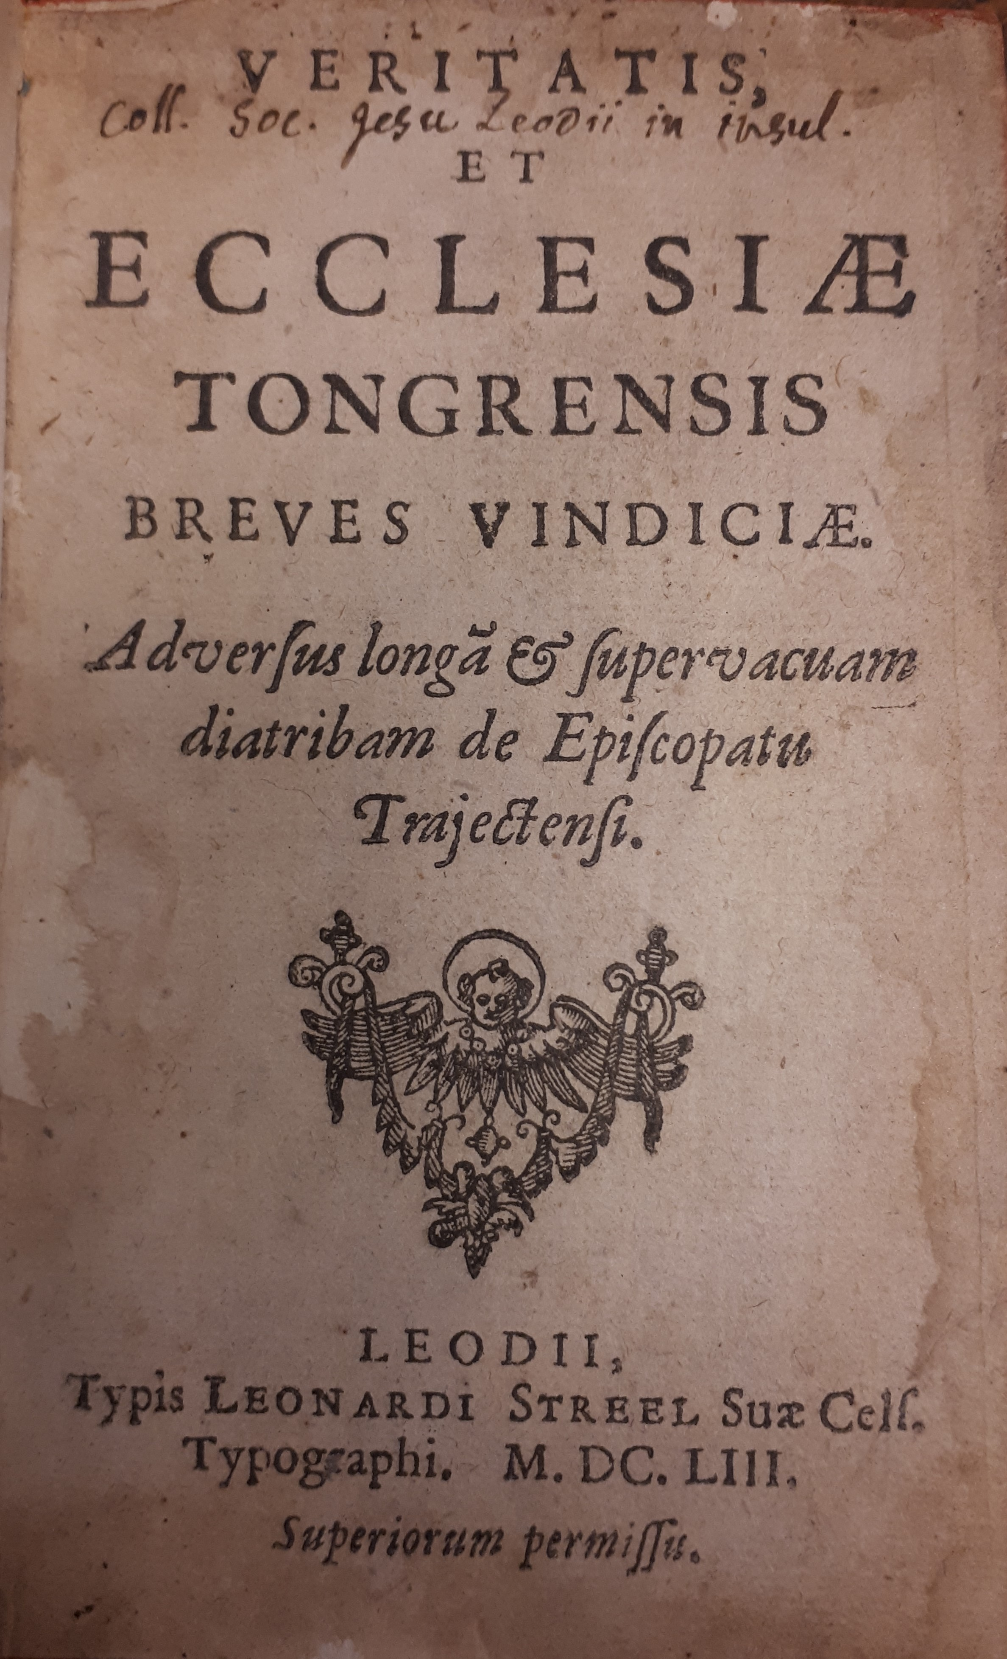
Two marks in a single volume (Seminary 14B18)
[Fullonius J.-E.], Veritatis et Ecclesiae Tongrensis breves Vindiciae. Adversus longam et supervacuam diatribam de Episcopatu Trajectensi, Liège, Leonardus Streel, 1653.
(...)
[Sluse R.-F.], De S. Servatio episcopo Tungrensi, ejus nominis unico : adversus nuperum de Sancto Arvatio, vel duobus Servatiis Commentum, Dissertatio Historica, Liège, Guilielmus Henricus Streel, 1684.
(...)
Property marks on several titles in a single volume
Notes:
Finally, one last clue that indicates that the jesuits bound their books themselves is to look at their property mark.
It is quite easy to understand the logic : sometimes, several titles inside a book are bearing the mark of the college. which means they were first acquired individually and then bound together as a whole unit that makes sense to the jesuits.
My best example of that is this compilation of works regarding the local history of the Liege Diocese. We see in this Sammelbänd that the very first title bears the mark of the college

Slide 19
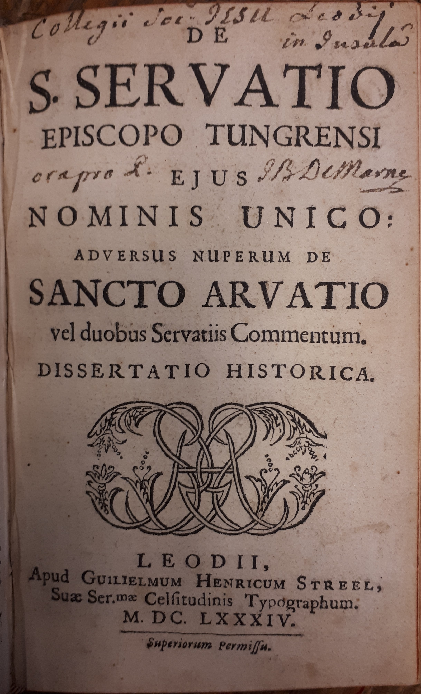
Two marks in a single volume (Seminary 14B18)
[Fullonius J.-E.], Veritatis et Ecclesiae Tongrensis breves Vindiciae. Adversus longam et supervacuam diatribam de Episcopatu Trajectensi, Liège, Leonardus Streel, 1653.
(...)
[Sluse R.-F.], De S. Servatio episcopo Tungrensi, ejus nominis unico : adversus nuperum de Sancto Arvatio, vel duobus Servatiis Commentum, Dissertatio Historica, Liège, Guilielmus Henricus Streel, 1684.
(...)
Property marks on several titles in a single volume
Notes:
as well as the sixth one in the volume.

Slide 20
Binding a controversy (Seminary 14B18)
Varia Historiae Leodiensis
[Fullonius J.-E.], Veritatis et Ecclesiae Tongrensis breves Vindiciae. Adversus longam et supervacuam diatribam de Episcopatu Trajectensi, Liège, Leonardus Streel, 1653.
De Crassier G., Brevis Elucidatio Quaestionis Jesuiticae de Praetenso Episcopatu Trajectensi ad Mosam, Liège, Everardus Kints, 1738.
De Crassier G., Additamentum ad brevem Elucidationem Quaestionis Jesuiticae de Praetenso Episcopatu Trajectensi ad Mosam, Liège, Everardus Kints, 1742.
Dolmans P. Observationes Apologeticae pro Episcopatu Trajectensi ad Mosam, Antwerp, Alexander Everaerts, [1740].
Dolmans P. Alterae observationes Apologeticae pro Episcopatu Trajectensi ad Mosam, Leuven, Joannes Jacobs, [1742].
[Sluse R.-F.], De S. Servatio episcopo Tungrensi, ejus nominis unico : adversus nuperum de Sancto Arvatio, vel duobus Servatiis Commentum, Dissertatio Historica, Liège, Guilielmus Henricus Streel, 1684.
[Sluse R.-F.], De Tempore et Causa Martyrii B. Lamberti Tungrensis Episcopi Diatriba chronologica et Historica, Liège, Guilielmus Henricus Streel, 1679.
Notes:
Together with the other editions in the book, they form a controversy about the origins of the diocese of Liège.
In short, Pierre Dolmans, a jesuit, argued that the bishopric of Liege was first established in Tongeren, then Maastricht, and then Liège, three cities of the Prince-Bishopric.
While his opponent Crassier argued that it was never established in Maastricht.
It seems to me that the jesuits attempted to give credit to their colleague Dolmans by binding the controversy with older titles that supported his claim, directing the opinion of the reader and undermining Crassier’s argument.
At the same time, it makes for a very practical handbook tailored for one specific subject : local religious history. This is a very classical use of Sammelband as a thematic compilation, but also as a way of guiding minds with regard to a specific topic. The book was even tagged as « Varia Historiae Leodiensis », but I believe this binding is rather from the nineteenth century.

Slide 21
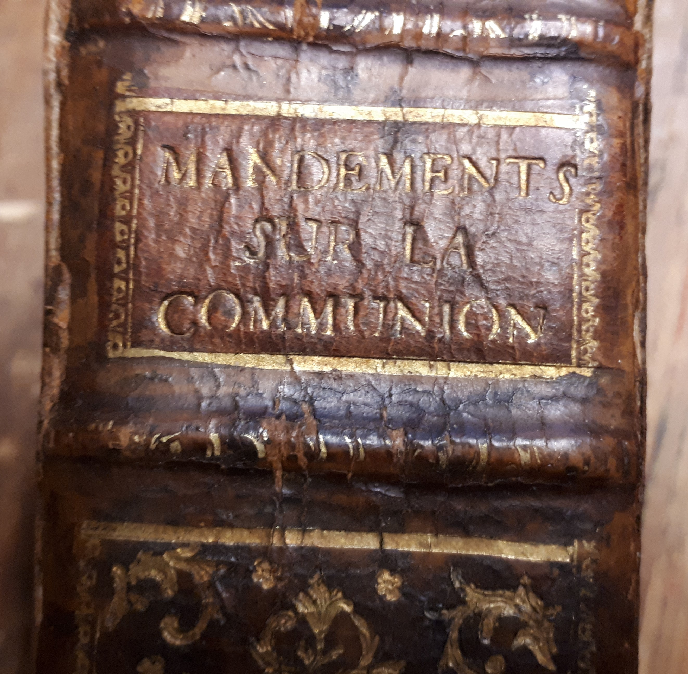
Tagging the spine (Seminary 25h1)
Mandements sur la communion
Huge controversy about Jean Pichon, Jesuit arguing in favor of Frequent Communion
Replies by several French bishops
Latest edition in the volume : 1748
Notes:
However, I am sure about this one. It’s again a compilation of controversies regarding Frequent communion in the 18th century, here they tagged the book as « Mandements sur la communion ».
As I mentioned earlier, these Sammelbände can only be bound as late as the latest edition featuring in them. The last two examples seem to have been compiled towards the middle of the eighteenth century : at least 1742 for the first, 1748 for the second one.

Slide 22
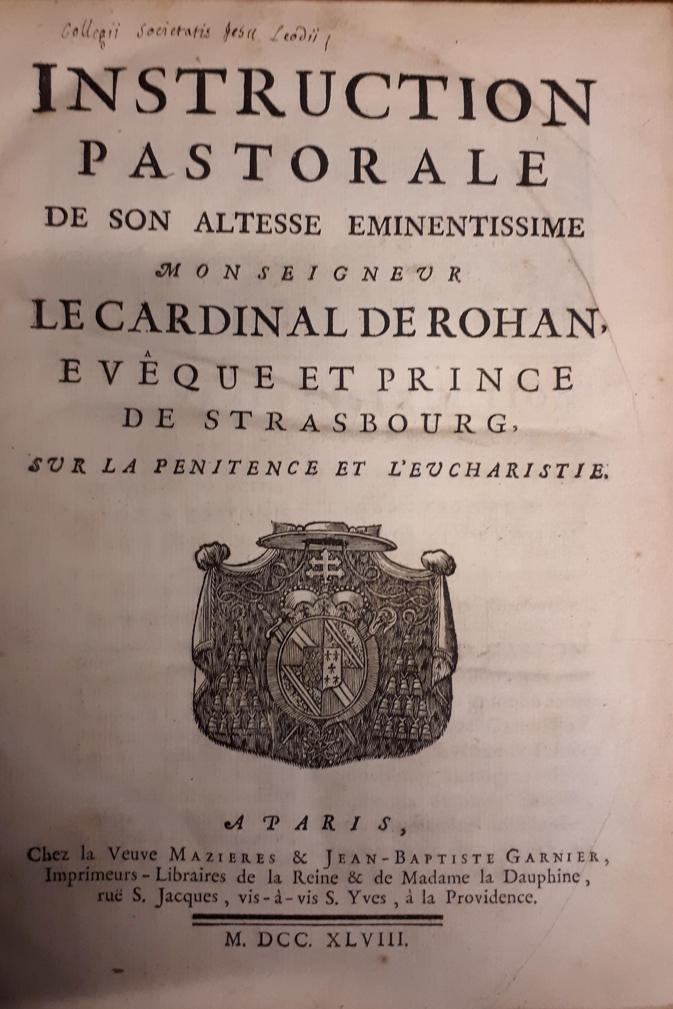
Dating the binding (Seminary 25h1)
Dating from the latest edition featuring in the volume (1729 ; 1742 ; 1748 ; 1757)
Role of handwritten notes on the sammelbände
Numbering the different titles in a volume
Identifying a handwriting and dating it
Instruction pastorale de son altesse eminentissime Monseigneur le Cardinal de Rohan, Evêque et Prince de Strasbourg sur la penitence et l’eucharistie, Paris, Widow Mazières & Jean-Baptiste Garnier, 1748 (Liège Seminary – 25H1).
Notes:
We can also remember a previous example I gave, suggesting the year 1757 as the earliest possible time it was bound. Meaning that most of them seem to point towards the same period.
This is where physical bibliography allows us to be even more precise.
One very interesting thing I found on these volumes is that someone marked the order of titles in it by numbering them. As you can see it goes from 1 to 24.

Slide 23
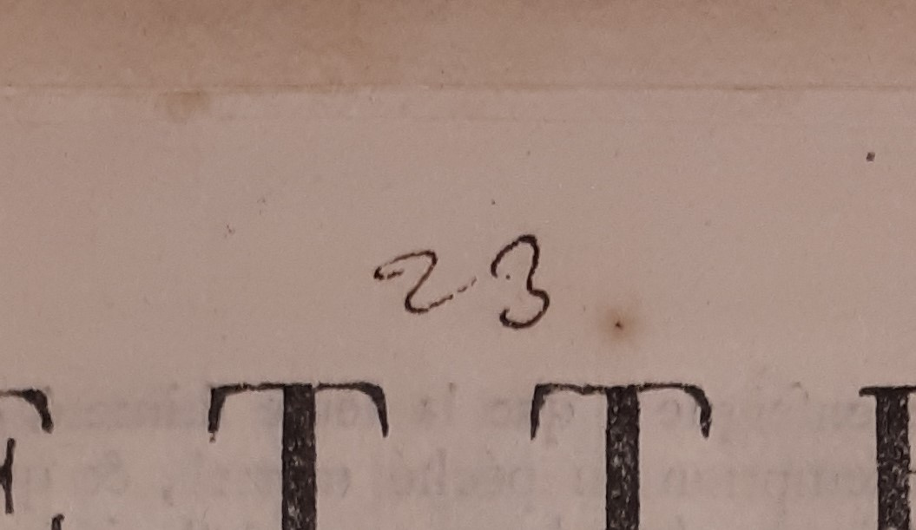
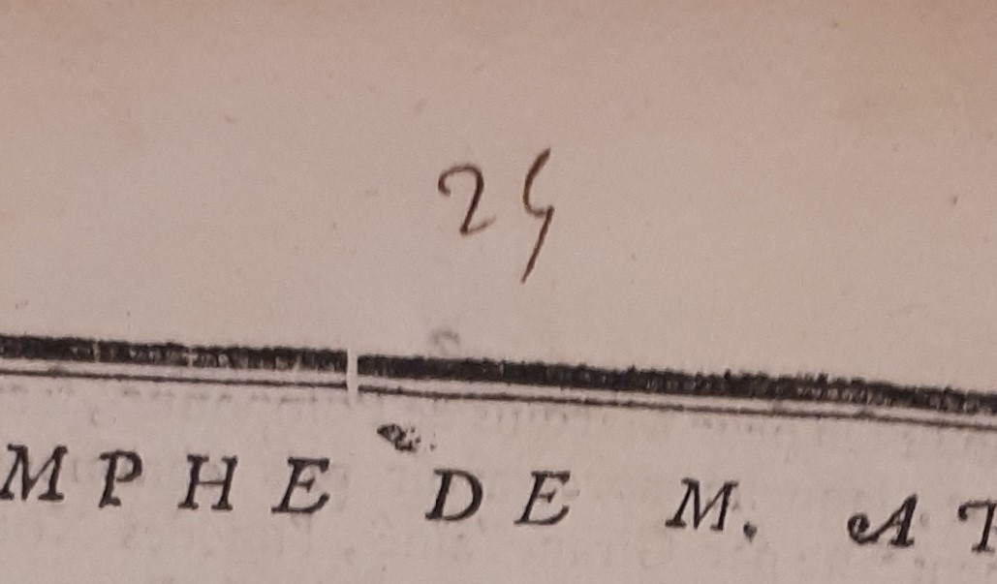
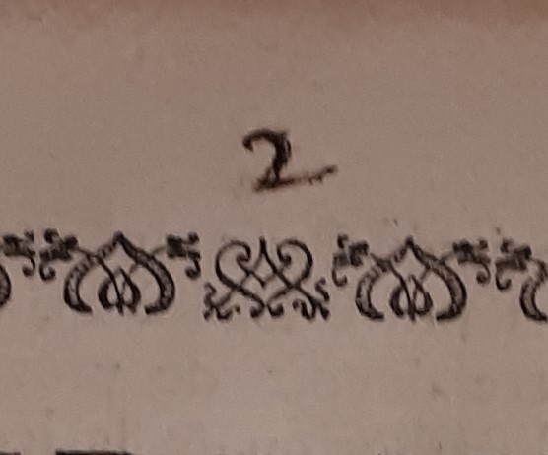
Dating the binding (Seminary 25h1)
Dating from the latest edition featuring in the volume (1729 ; 1742 ; 1748 ; 1757)
Role of handwritten notes on the sammelbände
Numbering the different titles in a volume
Identifying a handwriting and dating it
3. De Souillac J.-G., Ordonnance et instruction pastorale de Monseigneur l’Evêque de de Lodève, portant condamnation d’un Livre Intitulé : l’Esprit de Jesus-Christ & de l’Eglise sur la fréquente Communion ; Par le Pere Pichon, Jesuite, Montpellier, Jean Martel, 1748 (Liège Seminary – 25H1).
23. Berger de Charancy G.-L., Lettre de Monseigneur de Charanci eveque de Montpellier a Monseigneur l’Archeveque de Sens du 4. Décembre 1747, s.l., s.n., [1748] (Liège Seminary – 25H1).
1. Instruction pastorale de son altesse eminentissime Monseigneur le Cardinal de Rohan, Evêque et Prince de Strasbourg sur la penitence et l’eucharistie, Paris, Widow Mazières & Jean-Baptiste Garnier, 1748 (Liège Seminary – 25H1).
2. De Sault-Tavannes N., Mandement de Monseigneur l’Archevêque de Rouen, primat de Normandie, portant condamnation d’un Livre Intitulé l’Esprit de Jesus-Christ & de l’Eglise sur la fréquente Communion, [Rouen], [Jacques-Joseph le Boullenger], [1748] (Liège Seminary – 25H1).
24. Arnauld de Pomponne H.-C., Le triomphe de M. Arnaud, copie de l’acte de Dépôt fait par Monsieur l’Abbé de Pomponne, le 2 May 1748, s.l., s.n., [1748] (Liège Seminary – 25H1).
Notes:
One very interesting thing I found on these volume is that someone marked the order of titles in it by numbering them. As you can see it goes from 1 to 24.

Slide 24
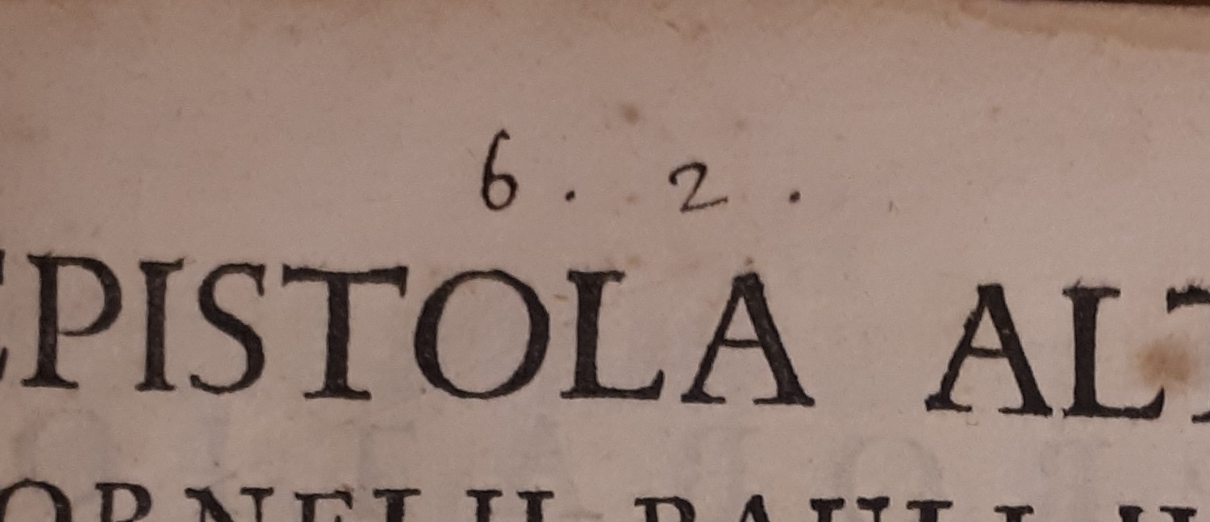
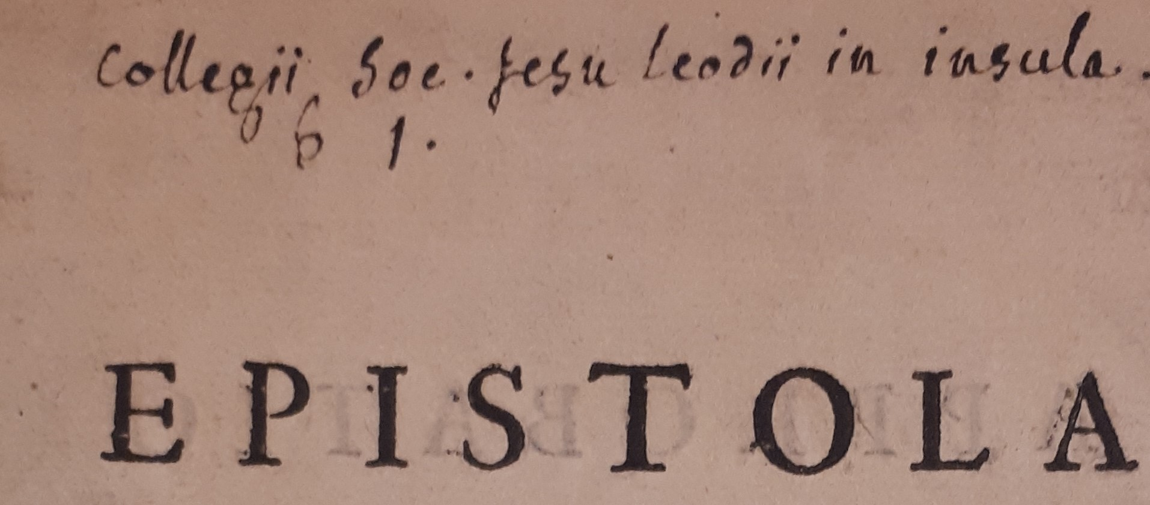
Dating the binding (Seminary 27h28)
Dating from the latest edition featuring in the volume (1729 ; 1742 ; 1748 ; 1757)
Role of handwritten notes on the sammelbände
Numbering the different titles in a volume
Identifying a handwriting and dating it
Hoynck van Papendrecht C. P., Epistola ad Joannem Christianum Erckelium, J.U.L. ..., [Mechelen], [Laurentius Vander Elst], [1728] (Seminary 27H28)
6.1 Hoynck van Papendrecht C. P., Epistola ad Joannem Christianum Erckelium, J.U.L. Presbyterum Ultrajectinum, occasione Sententiae per Magnificum Rectorem Universatis Loveniensis contra Zegerum Bernardum van Espen, J.U.D. & SS. Canonum Professorem, [Mechelen], [Laurentius Vander Elst], [1728] (Seminary 27H28).
6.2 Hoynck van Papendrecht C. P., Epistola altera ad Joannem Christianum Erckelium, J.U.L. Presbyterum Ultrajectinum, occasione Declarationum Clar. DD. Laurentii Hacquii et Joannis Antonii Brenart in Alma Universitate Lovaniensi J.U. Doctorum & Antecessorum, Mechelen, Laurentius Vander Elst, 1728. (Seminary 27H28).
6.14 De Sainte-Marie H., Observations sur l’histoire ecclesiastique de Monsieur l’Abbé Fleury &c. adressées a nostre S.P. le Pape Benoist XIII et a nos seigneurs les evesques, [Mechelen], [Laurentius Vander Elst], 1729 (Seminary 27H28).
Notes:
Another example is this volume, bound after 1729, it bears the same numbering. This one concerns a controversy aswell. It is a compilation of letters regarding jansenism in the church of Utrecht.
The numbering here goes from 6.1 to 6.14. Three books in total display this particularity, and it is quite obvious that all these marks come from the same hand. By identifying this handwriting, we can link these Sammelbände to a specific librarian of the college.

Slide 25
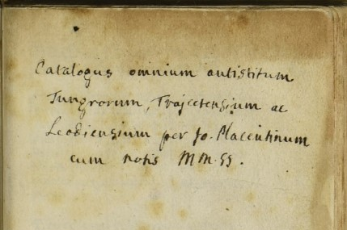
Dating the binding by Identifying a handwriting (Seminary 27h28)
Charles Wastelain
Librarian of the college (1765-1773)
Liège, Archives de l’État à Liège, Couvent jésuite, nº 12, Registre aux charges.
Hoynck van Papendrecht C. P., Epistola ad Joannem Christianum Erckelium, J.U.L. ..., [Mechelen], [Laurentius Vander Elst], [1728] (Seminary 27H28)
Placentius J. L., Catalogus omnium antistitum Tungrorum, Trajectensium ac Leodiensium, Antwerp, Willem Vorsterman, [1529] (ULiège R746A).
Roggeveen J., Histoire de l'expedition de trois vaisseaux ..., Den Haag, VOC, 1739 (ULiège XXIII.209.4).
Notes:
And it is quite easy to identify, once you cross the handwriting with other instances of it in archive pieces, and in other books. Here are some examples. The name given by the top right picture, as well as the date featuring on the bottom right leave us no doubt : these notes are the work of a certain Charles Wastelain. He was the last librarian of the college before the Suppression of the order.
Basically, crossing notes on different sammelbände allowed us to connect them to a single individual. Wastelain seems to have contributed in a lot of different ways to the book collection and to the book themselves.
And in my opinion the numbering of the titles in some volumes heavily suggests that the binding of the Sammelbände was his request aswell. The most likely explanation behind this numbering is that he gave orders to a bookbinder. He numbered the titles so that the bookbinder could know in what order to bind them.

Slide 26
Wastelain’s doing
Helping the reader by tagging spines
Dolmans & Crassier controversy
Binding titles in a thematically coherent volume (4)
Numbering the titles in sammelbände
Notes to inform the reader
Notes:
In many different ways, it seems that Wastelain’s goal was to help the reader.
He decided to bind some titles together in a way that’s comfortable and practical for the reader. Four sammelbände out of 22 can be attributed to him.
He also tagged these Sammelbände with a made up title, once again easing the consultation of books. Maybe the numbering can also be seen as a way of guiding the reader.
Finally, in the same vein, I did not talk about this, but he sometimes added a few notes to the books, to give precisions about it.

Slide 27
Wastelain’s policies
Four sammelbände bound in the XVIIIth century
Work of Charles Wastelain, last librarian of the college (1765-1773)
Notes aimed at an audience larger than just the library personnel
« Rationalization » of the library
Rebinding volumes thematically coherent
Numbering the titles
Notes and titles on the spine
Help the reader in the library
Notes:
The whole policy of Charles Wastelain was then to make life easier for the reader, by tagging spines or binding subjects together.
This is, of course, not intended for the librarian, but for external readers, such as other jesuits.
These policies are aimed towards an audience unfamiliar with the collection, not towards someone who knows it like the back of his hand.
In other words, these are hints that the library was open to more people than just the librarian. But there’s a problem with this policy.

Slide 28
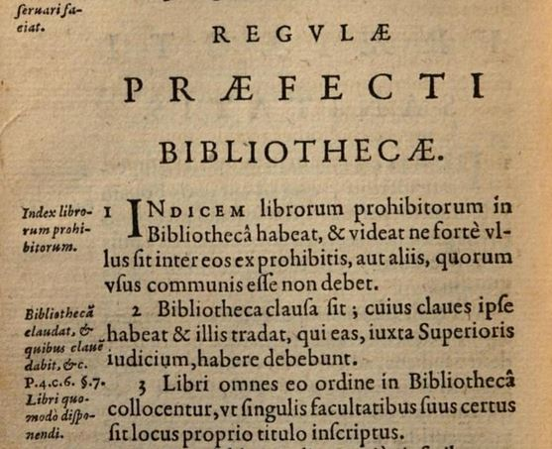
The librarian, the rules and the « jesuit way of proceeding »
Wastelain’s policies >< Rules of the order
Easing the access to books and rationalizing their reading serves the purpose of the jesuit mission
Librarian is free to interpret/bypass the rules if he thinks it fulfils his task better
2. Let the library be locked, let him [the librarian] have the keys, and let him pass them on to those who may have them, at the discretion of the superior.
Regulae Societatis Iesu, Auctoritate Septimae Congregationis Generalis auctae, Rome, Collegio Romano, 1616, f. Q1rº-Q2vº.
Notes:
The problem strikes when you look at the Rules of the Society of Jesus, specifically the rules for the librarian. Technically, we see that the access to the library is forbidden. It has to be locked. Moreover, the librarian should be the sole intermediate between the books and the readers. This is not unexpected at all : reading controversy or forbidden books was, of course, considered dangerous. Sometimes, other jesuits may have the keys but those are exceptions.
Wastelain’s policies actually seem to clash with the rules. Does that mean that the jesuits were outlaws ? No, of course.
This falls within a way of looking at rules and regulations that is specific to the jesuits. It was deemed by historians « The jesuit way of proceeding ». Basically, their understanding of their own mission and goals makes them modify some rigid rules for the greater good. This means that the jesuits were not afraid of bending rules when they thought it was necessary for their apostolic mission.
More freedom in roaming the library and in reading dangerous books maybe meant better teaching, better preaching, and better fighting against the religious enemy. This is what it’s all about.

Slide 29
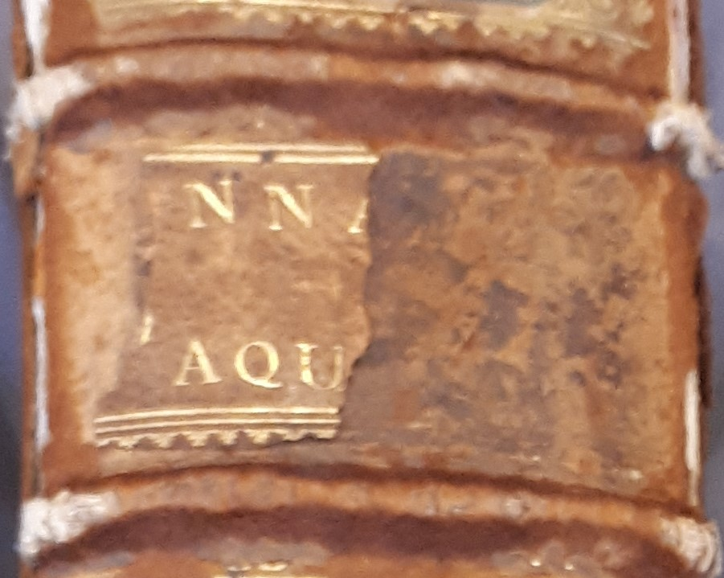
Cases of “Bookseller Sammelbände” (Uliège XXII.157.1)
Annales d’Aquitaine
Bouchet J., Les Annales d’Aquitaine. Faicts et gestes en sommaire des Roys de France et d’Angleterre, Pays de Naples & de Milan, augmentees de plusieurs pieces rares et Historiques extraictes des Bibliothecques, & recueillies par A. Mounin. (USTC 6806419)
De La Haye J., Les memoires et recherche de France, et de la Gaule Aquitanique. (USTC 6806409)
De l’Université de la ville de Poictiers, du temps de son erection, du recteur, et officiers et privileges de ladite Université, extraict d’un ancien manuscrit latin. (USTC 6806406)
De l’Université de la ville de Poictiers, du temps de son erection, du recteur, et officiers et privileges de ladite Université, extraict du livre du scribe de l’Université, et d’un ancien manuscript latin. (USTC 6810172)
Filleau J., La preuve historique des litanies de la grande Reyne de France Saincte Radegonde. (USTC 6806407)
All : Poitiers, Abraham Mounin, 1643-1644.
Notes:
We’ve seen several examples of Sammelbände that were bound on the jesuits demand or maybe by the librarian himself. There’s a second category of books that I called « Bookseller Sammelbände », in the sense that they are not unique assemblies. Sometimes, a bookseller or the printer wanted to sell different titles only as packages, making it almost inevitable that some editions always end up together. This is, I believe, the case with 5 volumes out of the 22 I found.
This volume is an example. It contains 5 titles, all referring to the history of Poitiers.
The first work in here, Les Annales d’Aquitaine is a reprint of an older title, published in the sixteenth century. Everything becomes quite obvious when you read the complete title of this reprint, which means « Augmented with several rare and historical pieces collected by Abraham Mounin » Abraham Mounin being the printer and bookseller. The « said historical pieces » are the four other titles, and we can then be sure that this entire volume is the work of this printer and bookseller.

Slide 30
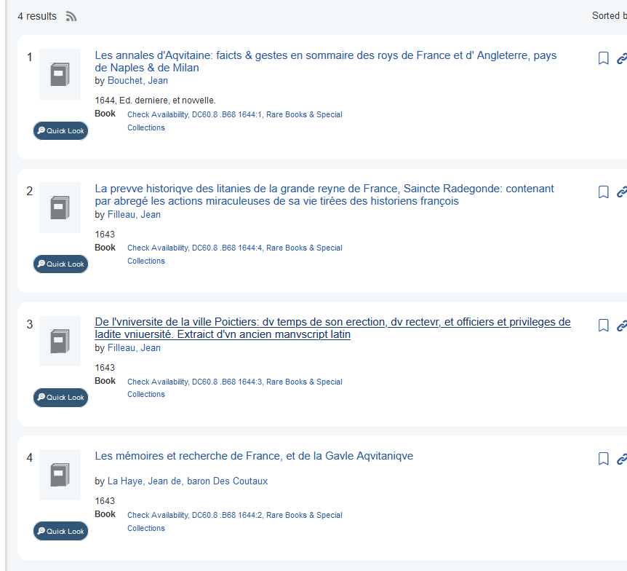
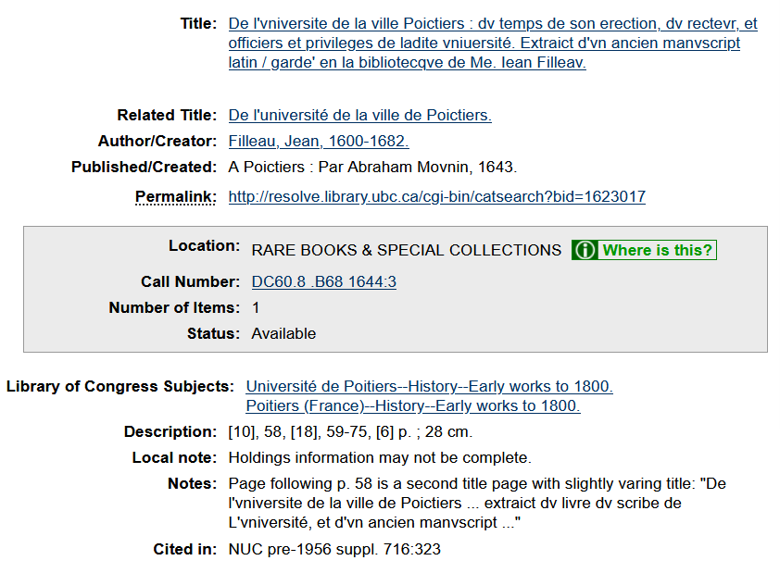
Vancouver
Notes:
And as I sad, you can find this volume in exactly the same shape in Vancouver. It only shows four title, because the fifth one hasn’t been catalogued the same way, but it’s here.

Slide 31
Kiel
Notes:
And you also find the exact same Sammelband in Kiel, Germany. It’s a bit weird since the first title out of the five was catalogued as a whole book, and the four next were classified as chapters in it. This shows how difficult it is for modern librarians to make sense of these volumes. This also demonstrates how valuable it is to look at the actual physical volume and how different it can be from an online catalogue.

Slide 32
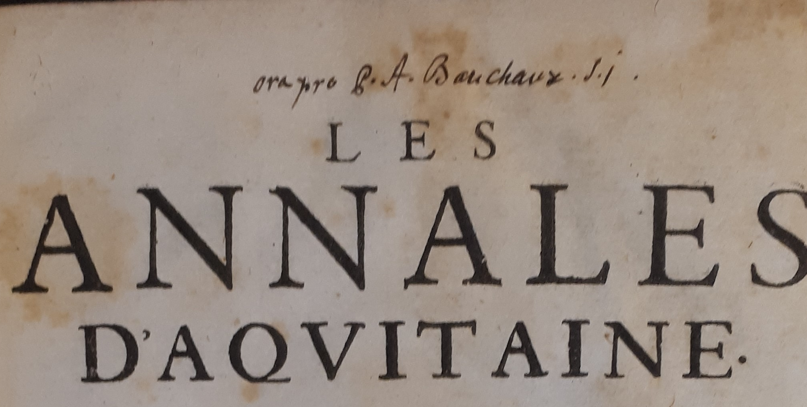
“Bookseller Sammelbände”
“Bookseller Sammelbände”
Have to be bought as units
Not perfect reflections of what Jesuits wanted
Ora pro P.A. Bauchaux S.I.
Pray for Father André Bauchaux, Societatis Iesu
André Bauchaux, librarian of the college (1746-1765)
Dramatically increased the collection
Notes:
The point I want to make with these « bookseller Sammelbände » is that when you look at their provenance marks– we’ve gone full circle – you see that these were both acquired the same way.
« Ora pro P.A. Bauchaux SJ» means « pray for André Bauchaux », and this indicates that those books were both bought by André Bauchaux, who was the librarian of the college just before Charles Wastelain.
These two « bookseller sammelbände » were then bought by the same librarian and more than a hundred years after their publication.

Slide 33
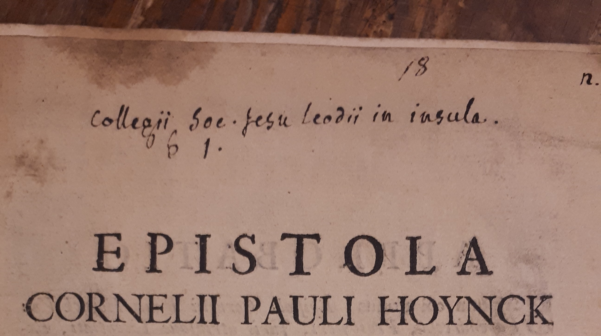
The librarian, the rules and the « jesuit way of proceeding »
Librarian is free to interpret the rules and his own role according to his mission
Wastelain : creating his own sammelbände
Bauchaux : buying « Bookseller Sammelbände »
Notes:
Knowing this, we can then fall back on what we learned with Wastelain and compare it with Bauchaux.
Wastelain chose to bind his own sammelbände in a thematically coherent way, in order to make sensible volumes and help the reader, he also had a more open conception of the library, as we saw.
On the contrary, André Bauchaux prefered to buy premade sammelbände, volumes that were already compiled by the booksellers, maybe because he had no choice when buying them.
This allows us to wrap up this part by insisting on the jesuit way of proceeding : each librarian had his own idea of his role and was free to interpret the rules as he wished. The rules of the Society of Jesus were more seen as broad guidelines indicating the general spirit of the order, rather than as strict regulation.

Slide 34
Conclusion
Sammelbände
Provenance marks
A few handwritten notes on selected examples
Understanding library practices through librarians' roles
Examples of the “Jesuit way of proceeding”
Not enough to be used as standalone sources
Great for laying down baseline information
Need to be coupled with other sources
Notes:
In the end, we did not really stick strictly to the theme of provenance marks, and Sammelbände, we even ventured into the late eighteenth century, but this demonstrates the wide range of possibilities that physical bibliography has to offer. On the one hand, we observed that provenance marks are not self-sufficient for reconstructing donations networks, and need to be backed with other tools. Nevertheless, they are still quite practical for establishing a strong basis from which the historian can start. On the other hand; Sammelbände, almost alone, along with small handwritten notes put together, proved to be useful tools for revealing library practices in a single college, allowing us to shed light on the entire jesuit way of proceeding. All in all, I think I made the case for both of these as fruitful historical sources and how they can combine.

Slide 35
The donation register
D. Joannes Militis [dedit] Bassolis in 4^{um} Sent.
Illustris ac R^{dus} Dominus Franciscus d’Anthisnes Officialis ac Canonicus S. Lamberti ...
D. Adrianus a Curia Canonicus S^{ti} Joannis ...
Notes:
However this does not draw the whole picture, because on top of the ancient books, we actually still preserve the donation register of the library. In it you fall upon these same people, Militis, d’Anthisnes, Curia as I show here

Slide 36
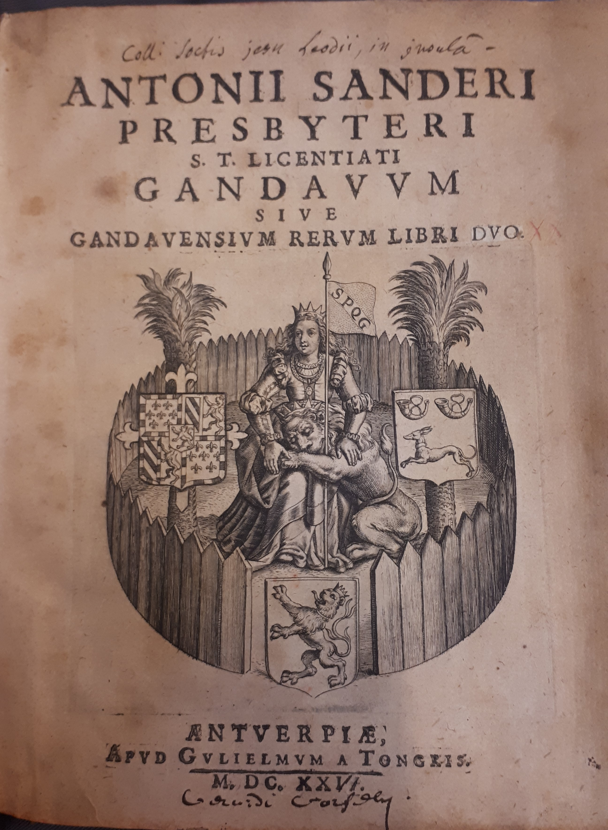
Cases of “Bookseller Sammelbände” (Uliège XXIII.29.17)
Sanderus A., Gandavum, sive Gandavensium rerum libri duo. (USTC 1003786)
Sanderus A., Hagiologium Flandriae, sive De Sanctis eius Provinciae, liber unus. (USTC 1003775)
Sanderus A., De scriptoribus Flandriae Libri Tres, ad Illustres eiusdem Provinciae Ordines. (USTC 1003793)
Sanderus A., De Gandavensibus eruditionis fama claris Libri Tres. (USTC 1003787)
Sanderus A., De Brugensibus eruditionis fama claris Libri Duo. (USTC 1003231)
All : Antwerp, Willem van Tongeren, 1624-1625.
Notes:
We’ve seen several examples of Sammelbände that were bound on the jesuits demand or maybe by the librarian himself. There’s a second category of books that I called « Bookseller Sammelbände », in the sense that they are not unique assemblies. Sometimes, a bookseller or the printer wanted to sell different titles only as packages, making it almost inevitable that some editions always end up together. This is, I believe, the case with 5 volumes out of the 22 I found.
One example of this is this compilation of works by Antoon Sanders, in which these titles are almost always bound together.
Sanders’s writings have quite a complex bibliographic history. In short, these last four titles were reprinted in 2 volumes in 1641 in Cologne. But this is not what we’re encountering here. They were all printed in 1624 by Willem van Tongeren in Antwerp, and another edition was added to these four.
I could suggest that the last four titles were bought as a single volume by the jesuits, and then they would have added the first one.
However, their property mark only appears once, on this first title. I thus think that they bought it as a premade sammelband.

Slide 37
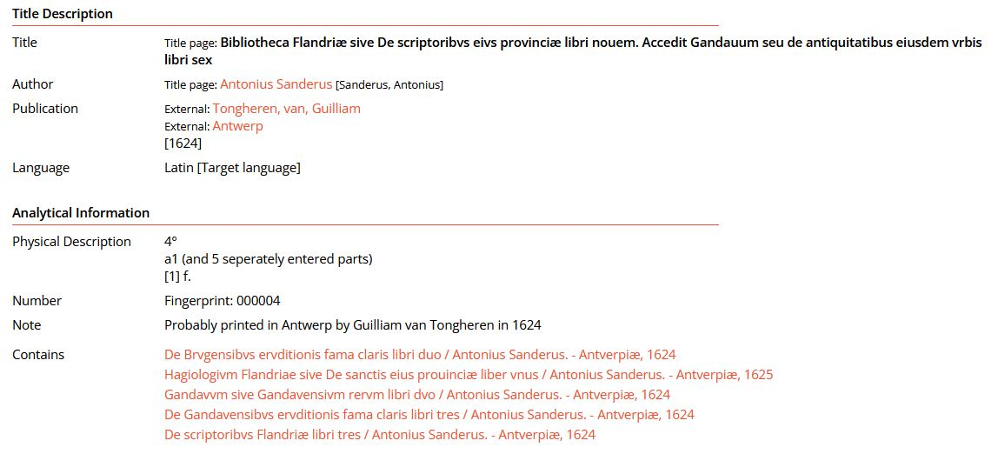
Short title catalogue vlaanderen
Notes:
We can see here that a perfectly identical Sammelband exists in Gent. Hence I think it was sold as a five-title sammelband from the beginning. Here on the Short title catalogue vlaanderen, a title is given to the whole volume. This is not the case with the one I found in Liege, so it’s still a bit confusing.
Feel free to correct me if you feel like I’m missing something.
The thing with this kind of Sammelbände is that all the titles in the volume are printed by the same printer, around the same years. When you check the activities of these printers, sure enough you find that they were also booksellers and binders.

Slide 38
The donation register
D. Lambertus Gaen Canonicus S. Dio[n]ysii [dedit] Nizolium
R.D. Joannes Hodaige Canonicus S^{ti} Pauli dedit Jani Misii Erythrai Pinacothecam virorum illustrium
Notes:
but also other individuals who gifted books that we do not have anymore, such as these canons : Lambert Gaen of Saint Denis, or Joannes Hodaige of Saint Paul. Combining provenance marks with this register gave us

Slide 39
Alphabetical catalogue
Suarez Franciscus
Disputationes in i^{am} partem D. Thomae
De deo eiusque attributis &c. 3C4
De angelis 3C6
ULiège, ms. 90C.

Slide 40
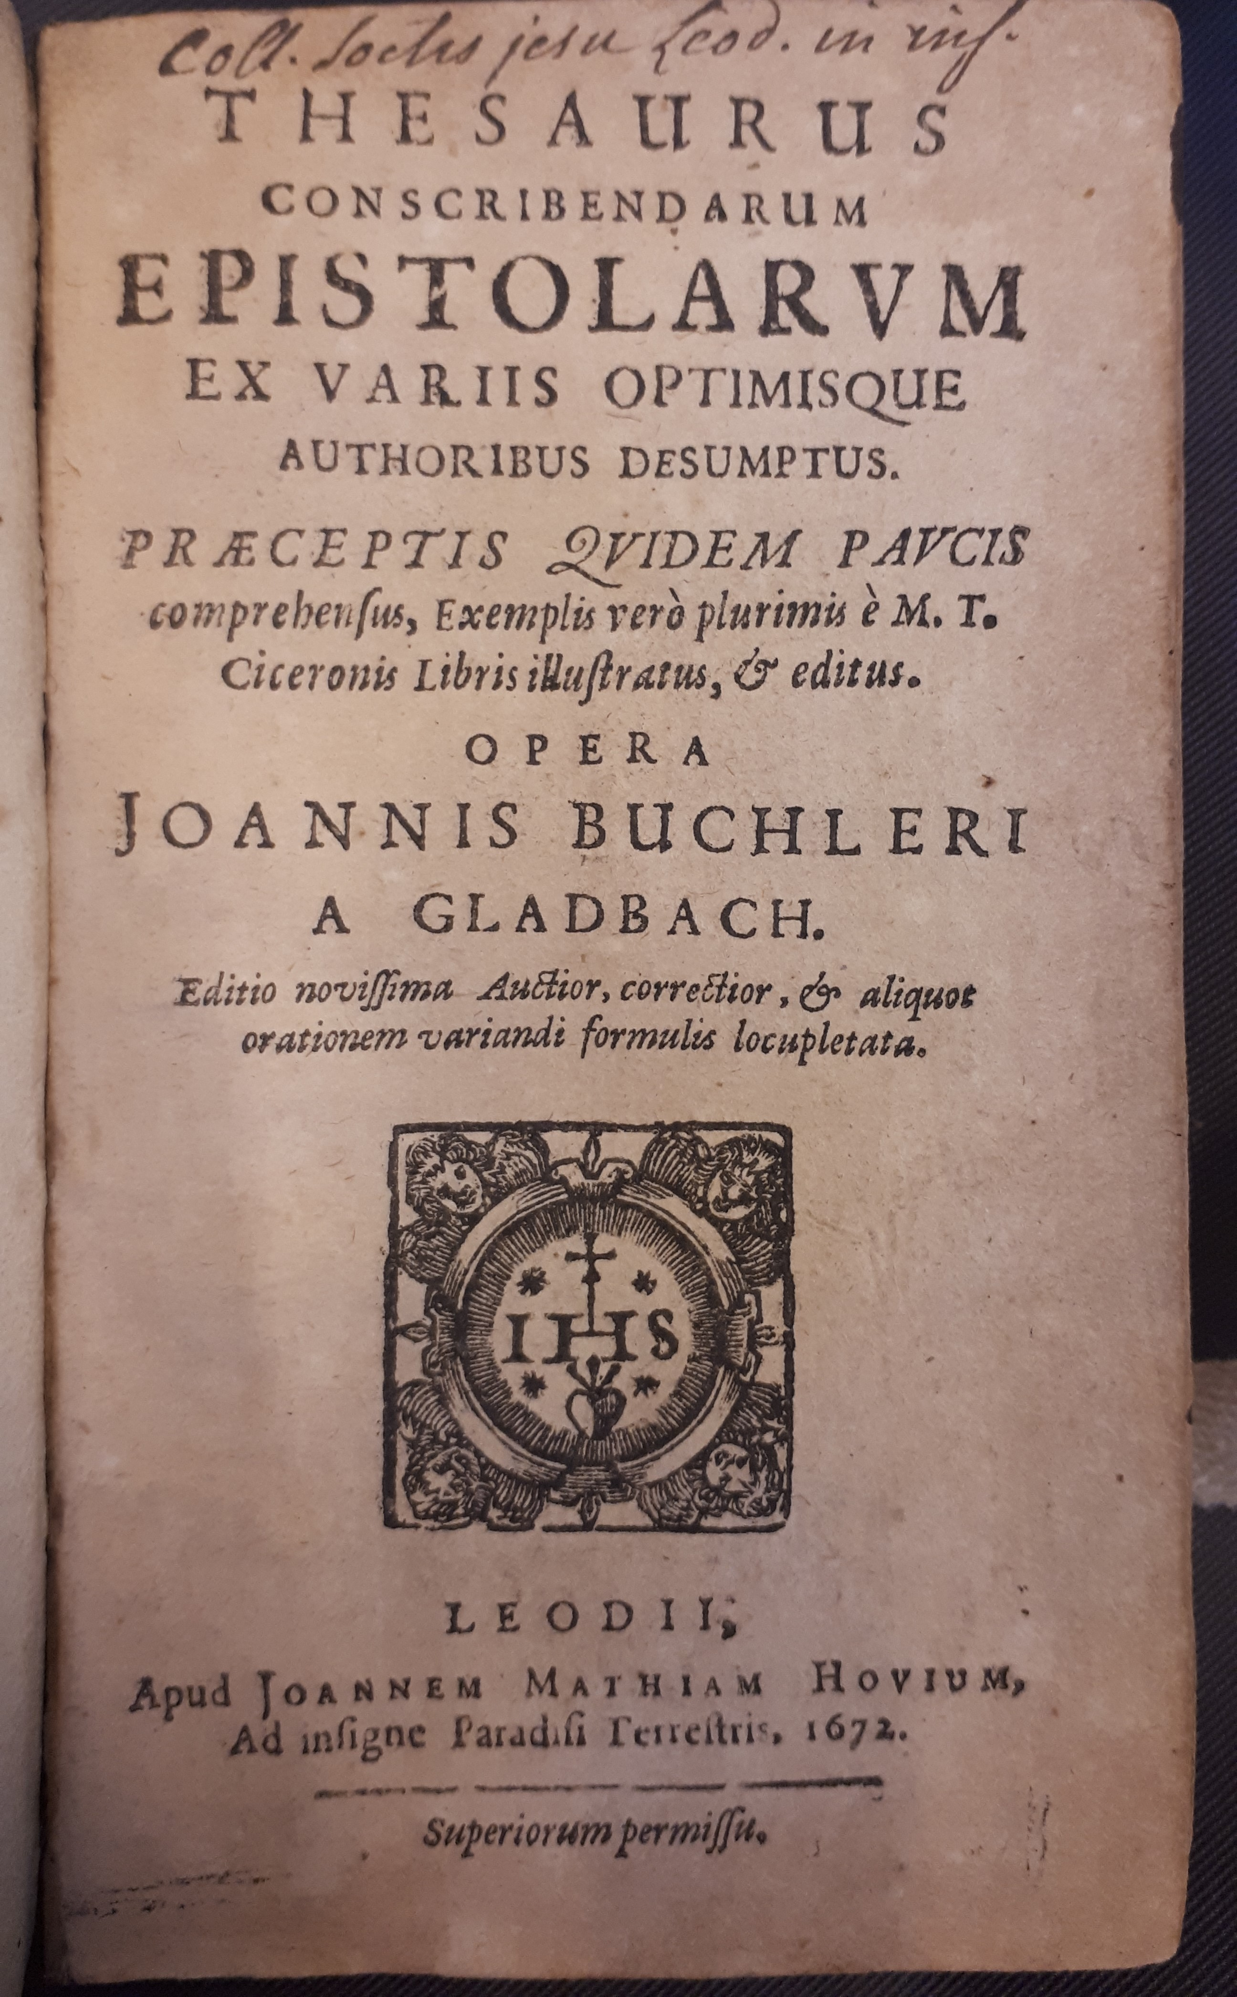
A Binding for the jesuits (Uliège XVI.141.2)
Two-title sammelband
Both reprints of earlier works
Hovius often collaborated with the college
Cicero is taught in the jesuit curriculum
Probably bound on the jesuits’ demand
Buchler J., Thesaurus conscribendarum epistolarum ex variis optimisque authoribus desumptus, Liège, Jean Mathias Hovius, 1672.
Buchler J., Elegantiarum centum et undesexaginta regulae, Liège, Jean Mathias Hovius, 1676.
Notes:
For this first example we have to use contextual clues to make sense of this volume.
First, both of the titles in this book are reprints made by the same printer. This printer, Joannes Mathias Hovius, is very close to the jesuit college, as you can see on his printer mark.
The two editions featuring in this volume are editions of Cicero’s works, and are then ideal for teaching and learning latin in the college, which is what the jesuits do.
We can then conclude that they were probably printed for the college, and bound a little later, maybe by the printer.

Slide 41
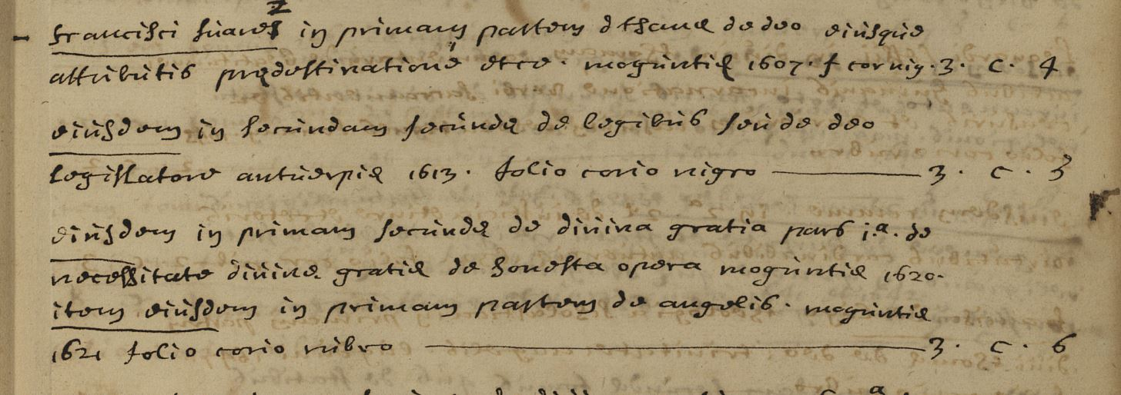
Topographical catalogues
Two catalogues
One for Jesuit authors only
One for external authors
One can find matches between the alphabetical and the other two
Francisci Suarez in primam partem d. Thomae de deo eiusque attributis praedestinatione etc. Moguntiae 1607 f. cor. nig. 3C4
(...) 3C5
Eiusdem in primam secundae de divina gratia pars iª de necessitate divinae gratiae de honesta opera Moguntiae 1620
Item eiusdem in primam partem de angelis Moguntiae 1621 folio corio rubro 3C6

Slide 42
The librarian, the rules and the « jesuit way of proceeding »
Wastelain’s policies >< Rules of the order
Easing the access to books and rationalizing their reading serves the purpose of the jesuit mission
Librarian is free to interpret/bypass the rules if he thinks it fulfils his task better
Bauchaux : buying « Bookseller Sammelbände »
Wastelain : creating his own sammelbände
2. Let the library be locked, let him have the keys, and let him pass them on to those who may have them, at the discretion of the superior.
Regulae Societatis Iesu, Auctoritate Septimae Congregationis Generalis auctae, Rome, Collegio Romano, 1616, f. Q1rº-Q2vº.
Notes:
Access to books was usually heavily controled, since being able to freely read controversy or prohibited books was considered dangerous, and forbidden. If you go back to the normative framework of the Society of Jesus, you find that the Prefect of the library is the only one who may access it, and that he has to keep it locked at all times. Other jesuits can sometimes own the keys but they are exceptions.
The practices we observed clash with the rules of the Order. The policies that Wastelain set up are meant to facilitate the life of a reader who is roaming alone in the library. Does that mean the jesuits were outlaws ? No. Their understanding of their own mission makes them bypass some rigid rules for the greater good. This falls within what has been called « the jesuit way of proceeding ». Adapting and inflecting the rules in order to play one’s role in the society better.

Slide 43
Comprehensive sociology of the gift
François d’Anthisnes, canon of Saint-Lambert
A way of making sense of the donations
Taking into account the motives the historical agents gave to their own actions
Reasons given by the Jesuits are generic and unsatisfactory
Need to resort to other types of sources
François d’Anthisnes :
pro suo affecto in Soc^{tem} n[ost]ram affectu singulari
« on behalf of his exceptional affection towards our Society »
Notes:
Fortunately, we happen to preserve a donation register of the library.
I will not go into details right now but it’s basically made to honor the individuals who contributed the most to the library.
Sure enough we can find the kind of information I’m looking for regarding a canon I mentioned earlier : François d’Anthisnes, canon of the Saint-Lambert’s Cathedral. It is said that he gifted his personal library « on behalf of his exceptional affection towards the Society of Jesus ». It is quite unclear what is meant by that. Unfortunately this statement, written by the jesuits is simply a generic phrase, and do not really help understand the gifts.

Slide 44
Dating the binding (Seminary 27h28)
Charles Wastelain
Librarian of the college (1765-1773)
Dating from the latest edition featuring in the volume (1729 ; 1742 ; 1748 ; 1757)
Role of handwritten notes on the sammelbände
Numbering the different titles in a volume
Identifying a handwriting and dating it
Writing notes in the beginning of a volume
Catalogus omnium antistitum Tungrorum, Trajectensium ac Leodiensium, per Jo. Placentium cum notis MM.SS.
Uliège R746A
Notes:
Many clues lead me to believe that this numbering is the work of Charles Wastelain, the last Jesuit librarian before the Suppression of the order. Why ?

Slide 45
The librarian, the rules and the « jesuit way of proceeding »
Wastelain’s policies >< Rules of the order
Easing the access to books and rationalizing their reading serves the purpose of the jesuit mission
Librarian is free to interpret/bypass the rules if he thinks it fulfils his task better
Bauchaux : buying « Bookseller Sammelbände »
Wastelain : creating his own sammelbände
Notes:
Wastelain had his own idea of the library that deviated a bit from the traditional rules of the Society, because he thought it served the purpose of the Order. More freedom in roaming the library and in reading dangerous books maybe meant better teaching, better preaching, and better fighting against the religious enemy.
Regarding his own role, Wastelain prefered to see himself as a guide, a help rather than as the only intermediate between the books and the jesuit fathers. If we go back to the very first examples I gave, we remember that the books I called « Bookseller sammelbände » were both bought by the same librarian, André Bauchaux, who directly predates Wastelain as the prefect of the library. This indicates that these two successive librarians had different opinions on the library and on Sammelbände, the first prefered to buy them directly, the second had apparently decided to create his own compilations. Once again showing that the jesuits had their own conception of their individual role, and that it could in many ways be interpreted and vary from person to person.

Slide 46
Roggeveen J., Histoire de l'expedition de trois vaisseaux, envoyés par la Compagnie des Indes Occidentales des Provinces-Unies, aux Terres Australes, Den Haag, VOC, 1739 (ULiège XXIII.209.4).

Slide 47
Physical bibliography
 | Consulted books
ULiège | 656
Liège Seminary | 244
KBR | 24
UGhent | 42
B. Mazarine | 13
BNF | 1
Total | 980
Went through every book
Compiled every note, mark, or clue
Used those clues as indicators of library practices
Compared practices to the normative framework of the Society

Slide 48
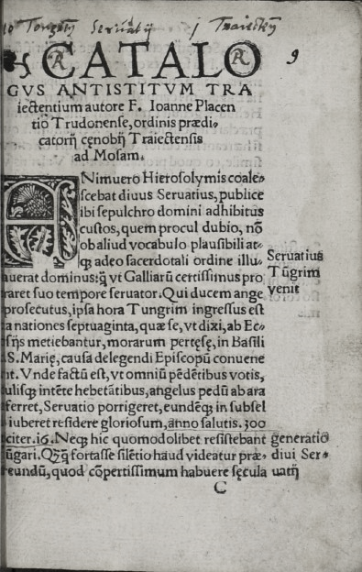
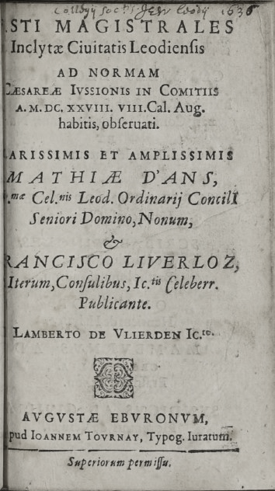
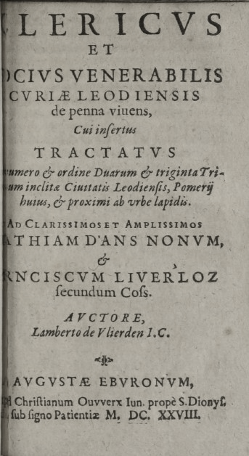
Latest edition : 1757
(Uliège R746A)
Placentius J. L., Catalogus omnium antistitum Tungrorum, Trajectensium ac Leodiensium, Antwerp, Willem Vorsterman, [1529].
Discours adressé a messieurs qui composent les Saize Chambres de la Ville de Liege, [Frankfurt], s.n., [1757].
De Vlierden L., Fasti Magistrales Inclytae Civitatis Leodiensis, Liège, Joannes Tournay, [1628].
De Vlierden L., Clericus et Socius venerabilis Curiae Leodiensis de penna vivens, cui insertus Tractatus numero & ordine Duarum & triginta Tribuum inclitae Civitatis Leodiensis, Liège, Christianus Ouwerx, 1628.

Slide 49
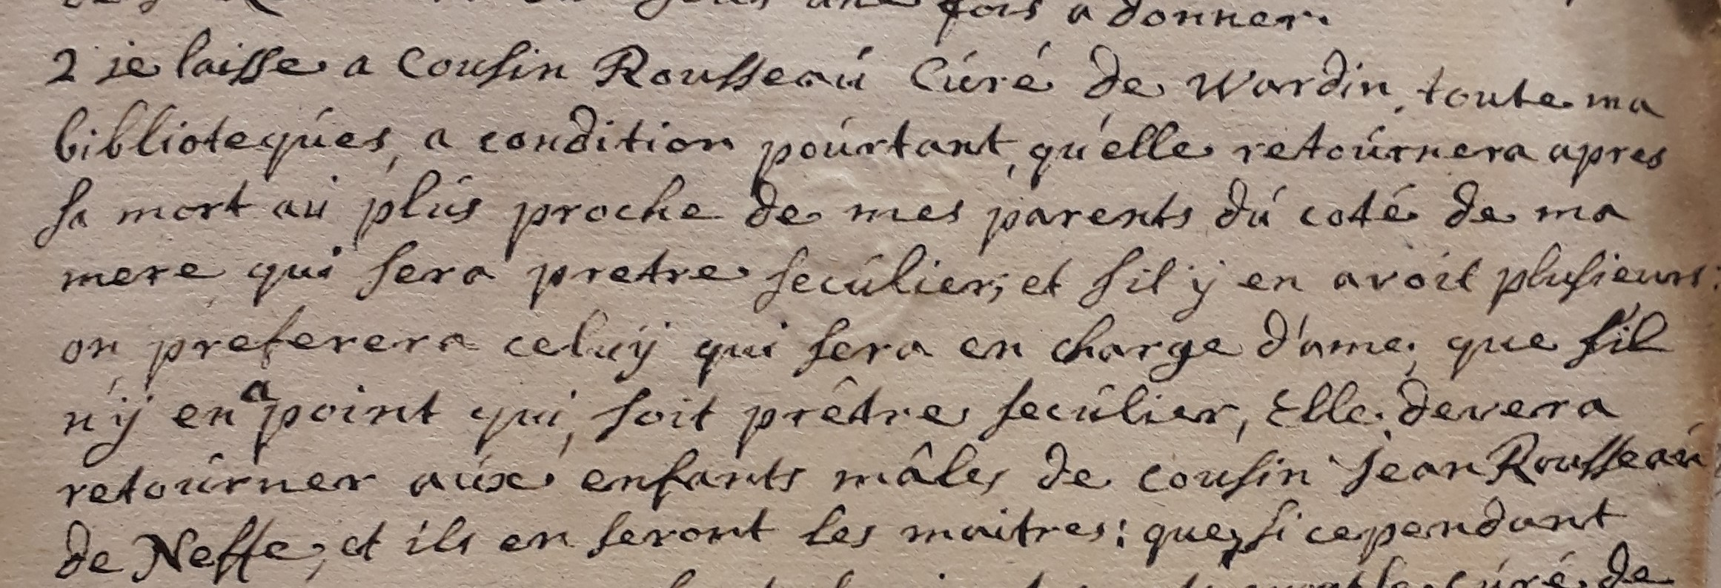
Book donations in the church
Archival sources : testaments and last wills
Gifting his library to a college
Breaking with a church tradition
Favoring the Jesuits over family
No other account of book gifting in testaments
Gifts were made during the life of the donors
Renouncing the use of the book
2. Je laisse a cousin Rousseau curé de Wardin toute ma biblioteque a condition pourtant qu’elle retournera apres sa mort au plus proche de mes parents du coté de ma mere qui sera pretre seculier; et sil y en avoit plusieurs on preferera celuy qui sera en charge d’ame. Que sil n’y en a point qui soit prêtre seculier, elle deverra retourner aux enfants males de cousin Jean Rousseau de Neffe, et ils en seront les maitres.
Liège, AÉL, CSL, S, nº 280, Testaments (1720-1736), f. 148rº, Testament de Nicolas Gerardi.
Notes:
And to my surprise, no other testaments talked about book donations. When religious figures died, they gave their personal library to their nephew, which is quite usual in the church, since the nephew is meant to pursue an ecclesiastical career.
I drew two conclusions from this : first, this makes the gifts of Visbroeck and d’Anthisnes that we saw earlier somewhat exceptional : they break with the tradition of gifting to their nephew, maybe because they don’t have any, but they still favour the jesuits over their relatives.
The second conclusion is that most of the book gifts must have taken place during the life of the canons, not when they died, or else we should find them in the testaments. Which means they actually gave up their use of the given book for the rest of their lives. This tells another story than if the books were ceded at the moment of their death.

Slide 50
Physical bibliography
Went through every book
Compiled every note, mark, or clue
Used those clues as indicators of library practices
Compared practices to the normative framework of the Society
 | Consulted books
ULiège | 656
Liège Episcopal Seminary | 244
Royal Library of Belgium | 24
UGhent | 42
B. Mazarine | 13
BNF | 1
Total | 980
Notes:
Provenance marks have proven to be quite tricky for understanding library practices on their own.
Fortunately, physical bibliography is not reduced to those. In this second part, we will look at a few Sammelbände, and demonstrate how rich they can be for the library historian.
First, I will show examples of Sammelbände that were made by the jesuits, or on their demand.
Some handwritten or paratextual clues will give us more information about their binding, and the period they were bound. This will also allow us to link them to the different librarians of the college.
I will briefly talk about the content of some Sammelbände and how they can be linked to library practices.
Finally I’ll show a different kind of books that I called « Bookseller Sammelbände ». They also have something to teach us.

Slide 51
A Binding for the jesuits
(Uliège XVI.141.2)
Buchler J., Thesaurus conscribendarum epistolarum ex variis optimisque authoribus desumptus, Liège, Jean Mathias Hovius, 1672.
Buchler J., Elegantiarum centum et undesexaginta regulae, Liège, Jean Mathias Hovius, 1676.
Two-title sammelband
Both reprints of earlier works
Hovius often collaborated with the college
Cicero is taught in the jesuit curriculum
Probably bound on the jesuits’ demand
Notes:
Let’s start with Sammelbände that were actually bound by the jesuits or at least upon their request. Here we have to use contextual clues to make sense of this volume.
First, both of the titles are reprints made by the same printer. This printer, Joannes Mathias Hovius, is very close to the jesuit college, as you can see on his printer mark.
The two editions featuring in this volume are editions of Cicero’s works, and are ideal for teaching and learning latin in the college.
We can then conclude that they were probably printed for the college, and bound a little later.

Slide 52
Money gifts to the college
Archival sources : testaments and last wills
Money gifts : more numerous than book donations
Expecting prayers in return
Jesuits are put on the same level as other religious orders
Pro quibus missae sacrificiis celebrandi dabunt dicti mei Testamenti huius executors centum florenos Capucinis, Centum Recollectis, Centum Augustinianis ac Centum Jesuitis; dabunt etiam Pauperibus Clarissis ducentos semel florenos ut pro animae mea refrigero preces fundant Apud Altissimum […]
Liège, AÉL, CSL, S, nº 277, Testaments (1654-1679), f. 243rº, Testament de Henri de Gruysen.
Notes:
One last thing that I did not expect to find in the archives was money gifts to the college. Compared to books gifts, money donations in testaments are plenty. However, the jesuits are by no mean special in this case. In most cases, canons leaving money upon their death give it to all the different religious institutions and convents in the city, usually expecting masses and prayers in return as a counter-gift. Here we have an example a Saint Lambert Canon, who give guilders to the Capuchins, the Augustines, the jesuits, the recollects and the Clares.

