Slide 2
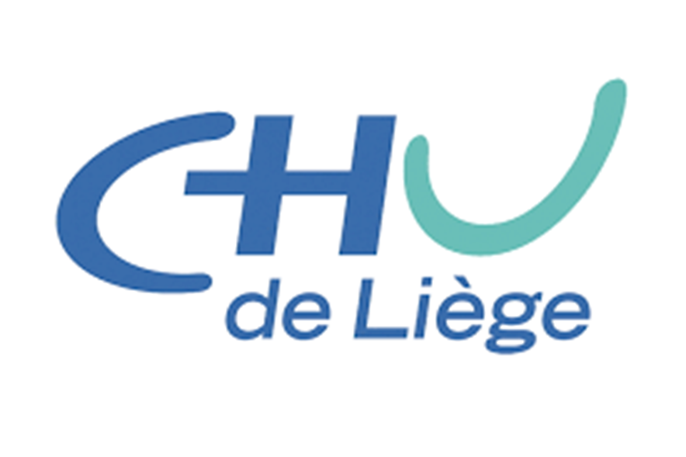
Round table AngiojetTM
Brussels, September 28th, 2023
Arnaud Kerzmann, MD

Slide 3
Introduction to the technology
AngiojetTM is a percutaneous thrombectomy device
Based on a rheolytic mechanism :
high speed saline solution infusion (800 km/h)
↓ ↓
Bernoulli principle = thrombus
speed acceleration results fragmentation
in pressure decrease
↓
negative pressure creates aspiration

Slide 4
Introduction to the technology
Pharmacological neoadjuvant therapy with urokinase
Actosolv®
perfusion under pressure
20 to 30 minutes reaction time
Power pulse mode
AngiojetTM allows quick thrombus removal (critical ischemia, cost benefit)

Slide 5
Introduction to the technology
Indications
acute thrombosis, less than 15 days (artery, vein, access)
embolism (arterial or PE)
Contra-indications
active bleeding
recent open surgery
Adverse events
hemolysis with hemoglobinuria and AKI
embolism
puncture site

Slide 6
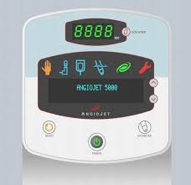
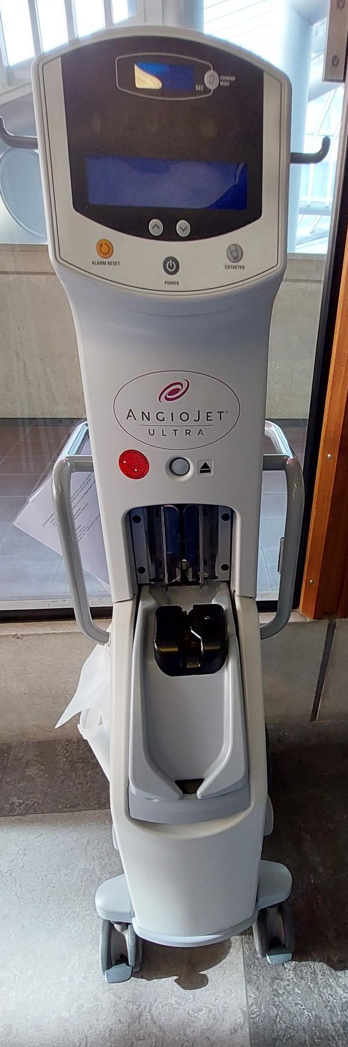
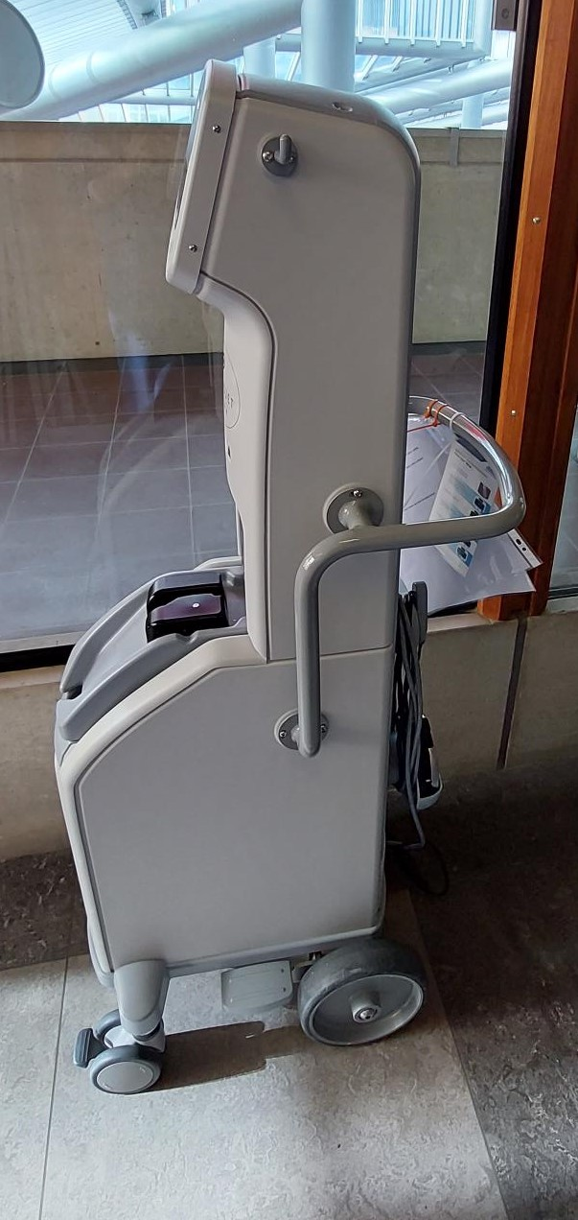
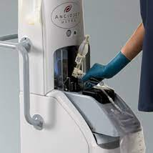
Presentation of Angiojet device
first part : console
compact
mobile
intuitive
step-by-step procedure

Slide 7
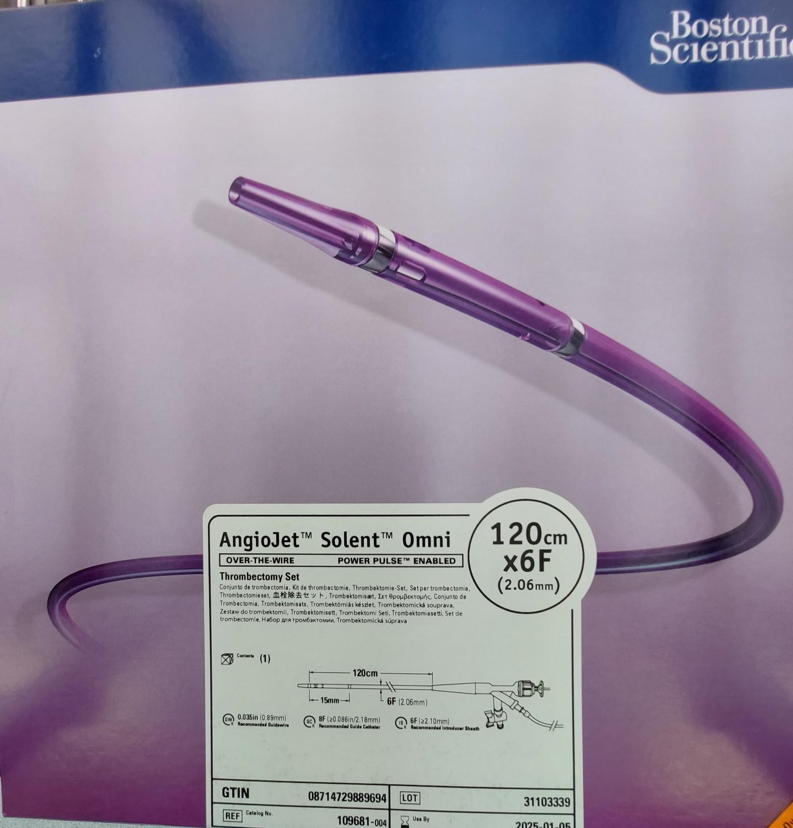
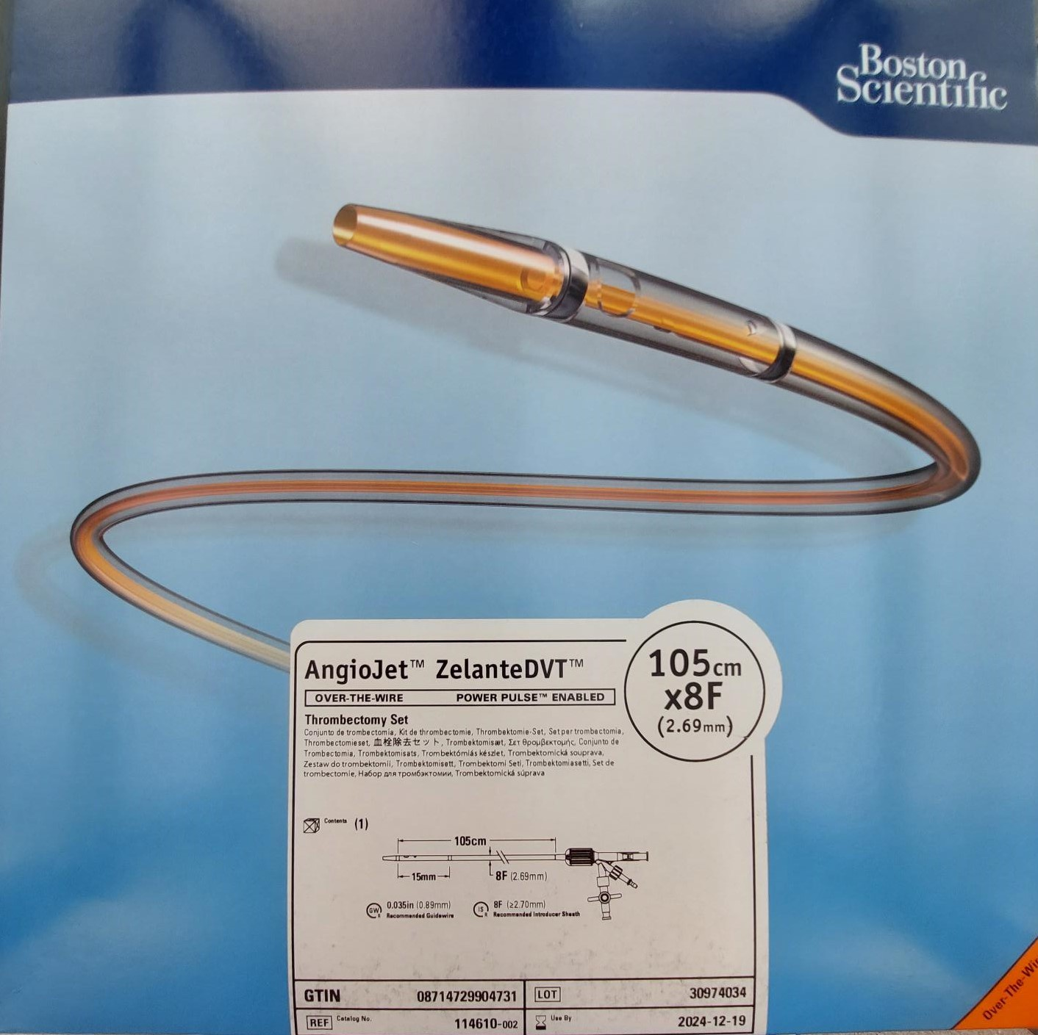
Presentation of Angiojet device
second part :
catheter
sterile
over the wire
2 lumen
different specifications for different indications

Slide 8
Presentation of Angiojet device
second part : catheter

Slide 9
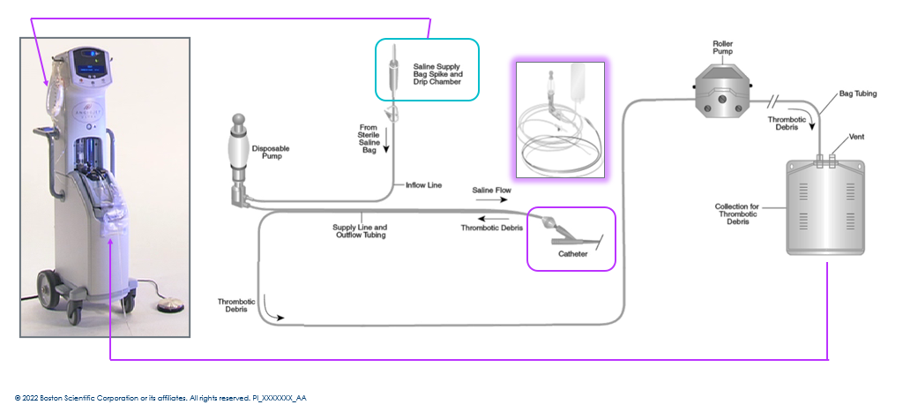
Presentation of Angiojet device

Slide 10
Literature review

Slide 11
Literature review

Slide 12
Literature review
AngiojetTM = catheter-directed
thrombolysis (CDT)
Procedure success rate
Complications rate
AngiojetTM > CDT
Less incidence of post-thrombotic syndrome
Less severe post-thrombotic syndrome
Better quality of life
Duration of treatment
Drug dose

Slide 13
Literature review

Slide 14
Literature review
PEARL = PEripheral use of Angiojet Rheolytic thrombectomy with a variety of catheter Lenghts
Prospective multicenter observational study (34 centers in the US and Europe)
238 patients enrolled between 2007 and 2013
2 groups : AngiojetTM alone (52%) versus AngiojetTM with catheter-directed thrombolysis (48%)

Slide 15
Literature review

Slide 16
Literature review
PEARL Registry : results
AngiojetTM alone better for
→ procedure success rate (88% vs 74%)
→ 12-month amputation-free survival (87% vs 72%)
→ 12-month freedom from amputation (96% vs 81%)
results are worse when there is infrapopliteal involvement

Slide 17
Literature review

Slide 18
Literature review

Slide 19
Literature review
J Vasc Surg 2021;73:950-9.

Slide 20
Literature review
Fast-track thrombolysis protocol for arteries in one US center
Retrospective study
42 patients enrolled between 2014 and 2019
Oral anticoagulant therapy for all
Procedure success rate 81% and additional stenting 81% (34/42 each)

Slide 21
Literature review
After 5 years follow up, no
significant hemorrhage
limb loss
mortality
It is safe, efficacious and
cost-effective

Slide 22
Literature review
J Vasc Surg 2012;56:1308-16.

Slide 23
Literature review
Retrospective study in one european center
Between 2000 and 2011, 3147 procedures, 18 embolisms (0,5%), 14 treated with AngiojetTM
Technical and clinical success rate 93% (13/14)
With filter wire
Adjunctive local thrombolysis or clot trapping with stent in 64%

Slide 24
Literature review

Slide 25
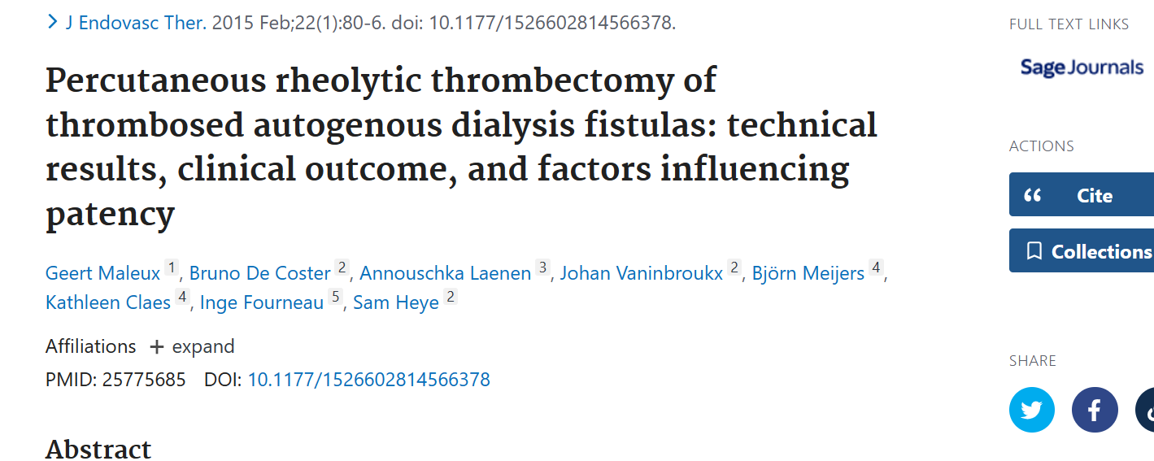
Literature review

