Slide 1


Proceedings of the 18th Conference on Computational Intelligence Methods for Bioinformatics & Biostatistics (CIBB 2023)
September 6th, 2023
Towards Interpretable Multitask Learning for Splice Site and Translation Initiation Site Prediction
Espoir Kabanga, Arnout Van Messem, Wesley De Neve

Slide 2
Contents
Introduction
Proposed Approach
Experimental Setup and Results
Conclusions and Future Research
2
2

Slide 3
Contents
Introduction
Proposed Approach
Experimental Setup and Results
Conclusions and Future Research
3
3

Slide 4
1. Introduction
Traditional deep learning models were designed for a single task.
→ The model network expects one input set
→ The training of the model is done for this one task
→ An output is generated and then interpreted
Task 1
Dataset 1
Model 1
Predictions 1
Task 2
Dataset 2
Model 2
Predictions 2
…
…
…
Task n
Dataset n
Model n
Predictions n
4
4

Slide 5
1. Introduction
Predicting multiple tasks simultaneously from a single model.
→ The model network expects more than one input set
→ parameters shared between different tasks during the training
→ Correctly interpret output generated by the multitask model
Joint model
Task 1
Dataset 1
Predictions 1
Task 2
Dataset 2
Predictions 2
…
…
Task n
Dataset n
Predictions n
5
5

Slide 6


1. Introduction
Predicting multiple tasks simultaneously from a single model.
→ The model network expects more than one input set
→ parameters shared between different tasks during the training
→ Correctly interpret output generated by the multitask model
Joint model
[dog, human]
[boy, girl]
6
6

Slide 7
1. Introduction
A model that tries to learn from multiple tasks simultaneously and improves learning for one task by using information contained in the training signals of other related tasks (Caruana, 1997)
Technical advantages
Parameter sharing (Caruana, 1998)
Faster generalization for different tasks (Baxter, 2000)
Positive transfers (Weiss, 2016)
Attention focus (Ruder, 2017)
Model performance improvement (Huang, 2018)
Feature augmentation (Zhang, 2021)
Managerial advantages
Lower computational costs
Simplified deployment
Easier maintenance workflows
7
7

Slide 8
Contents
Introduction
Proposed Approach
Experimental Setup and Results
Conclusions and Future Research
8
8

Slide 9
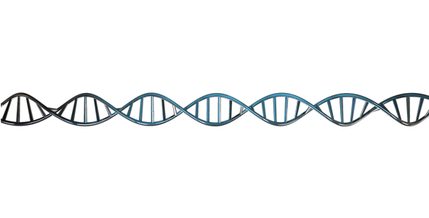
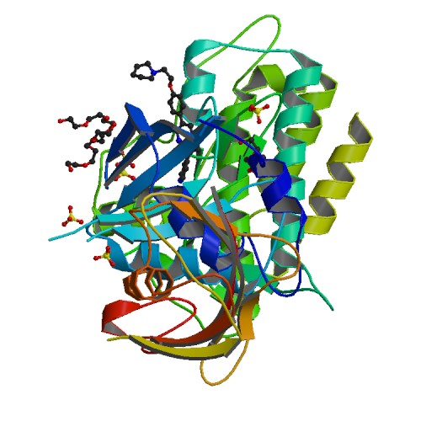
2. Proposed Approach
Donor splice site
Acceptor splice site
3 different prediction tasks:
→ Donor splice site prediction
→ Acceptor splice site prediction
→ Translation initiation site prediction
UTR
EXON
INTRON
EXON
INTRON
EXON
INTRON
EXON
UTR
Transcription
(DNA -> mRNA)
GT
AG
GT
AG
GT
AG
Translation initiation
Translation initiation site
Stop codon
…
3’ end
5’ end
A
T
G
T
G
A
Notes:
In this work, we propose to combine three different tasks:
Donor splice sites prediction
Acceptor splice sites prediction
Translation initiation sites prediction
After transcription (copying of DNA to messenger RNA), each gene can be split up in a couple of parts
- A leading and a trailing untranslated region (UTR)
- Exons (coding regions), that make for the coding of proteins
- Introns (non-coding regions), that regulate the selection of exons
Very simplified version: between transcription and translation, all exons get combined together, and the final protein is formed based on that sequence.
In practice: not all exons get combined together, as there is something as Alternative Splicing. Different exons (and sometimes even introns) can get combined, which makes that one gene can code for a lot of different proteins. The introns have a regulatory function in choosing which exons get combined. The latter can also be influenced by other factors, such as the tissue where the cell is located.

Slide 10
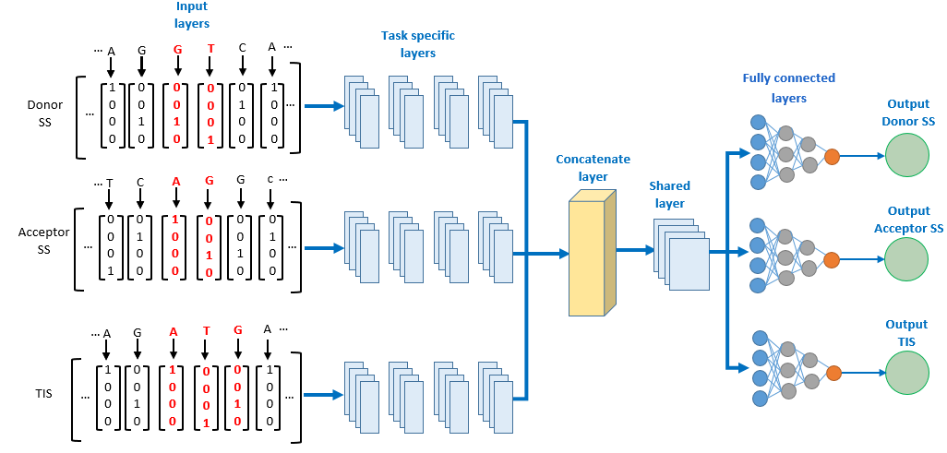
2. Proposed Approach
Model Architecture
SpliceRover
Layer | Details
conv | 70 filters of size (9,4)
dropout | p = 0.2
conv | 100 filters of size (7,1)
dropout | p = 0.2
conv | 100 filters of size (7,1)
maxpool | pool size (3, 1)
dropout | p = 0.2
conv | 200 filters of size (7,1)
maxpool | pool size (4, 1)
dropout | p = 0.2
conv | 250 filters of size (7,1)
maxpool | pool size (4, 1)
dropout | p = 0.2
dense | 512 neurons
dropout | p = 0.2
sofmax | 2 outputs
__________________________________________________________________________________________________________________________________
Zuallaert, J. et al., SpliceRover: interpretable convolutional neural networks for improved splice site prediction, Bioinformatics, 2018
10
10
Notes:
In constructing our MTL model, we drew inspiration from the SpliceRover model. To maintain consistency, we retained various parameters such as the number of convolutional layers, filters, sizes, and neurons in the fully-connected layer. The primary adjustment was transitioning from stochastic gradient descent to the adaptive learning rate benefits of the Adam optimizer.

Slide 11
Contents
Introduction
Proposed Approach
Experimental Setup and Results
Conclusions and Future Research
11
11

Slide 12
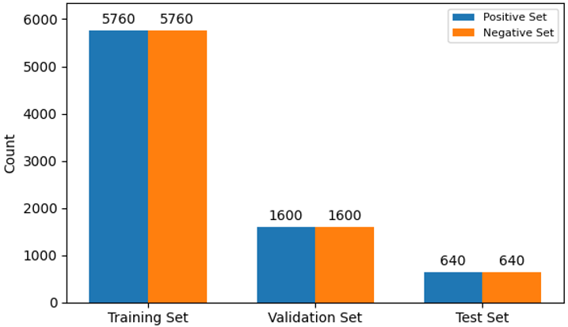
3. Experimental Setup and Results
● Dataset contains DNA sequences from Arabidopsis Thaliana species
● The size of the dataset is the same for all 3 tasks
12
12

Slide 13
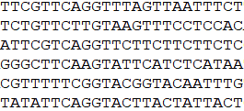
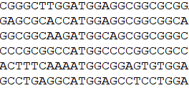
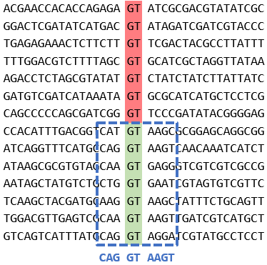
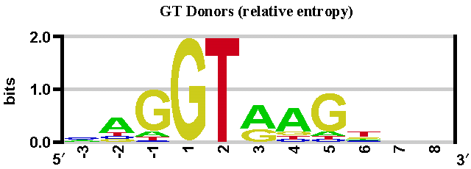
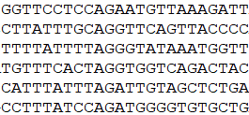
3. Experimental Setup and Results
● Sequences are of fixed length
Donor splice site
● For each task, candidate sites are located at fixed position
…
…
● Positive sequences have higher frequencies for certain nucleotides around the position of the candidate site.
Translation initiation site
Example for donor splice site:
…
…
Acceptor splice site
…
…
● Each sequence is converted into one-hot encoding
…
A
T
C
G
T
C
A
…
1
0
0
0
0
0
0
1
0
1
0
0
0
0
1
0
0
0
0
1
0
1
0
0
1
0
0
0
13
…
…
13

Slide 14
3. Experimental Setup and Results
Model Architecture
14
14
Notes:
Our MTL model was designed to simultaneously address three tasks, adopting a soft parameter learning approach.
It consists of a total of three input layers, one for each task. A task-specific layer dedicated to feature learning is incorporated for each task, comprising four convolutional layers. These layers are thoughtfully followed by dropout layers and max pooling layers to prevent overfitting and enhance feature extraction. Following the task-specific layers, a concatenate layer merges the distinct task-learned features, expanding the feature space and facilitating inter-task feature interaction. Shared convolutional layers follow, and then max pooling and dropout layers, promoting robustness against overfitting and enabling the discovery of comprehensive task representations. The MTL model has three output layers, each consisting of two neurons. These neurons generate predictions for both positive and negative sites in each task, enabling a comprehensive assessment of task performance.

Slide 15
3. Experimental Setup and Results
Quantitative Results
 |  | Specificity | Sensitivity | F1-score | MCC
Donor splice site | Single-task | 0.9367 ± 0.0121 | 0.9434 ± 0.0073 | 0.9403 ± 0.0028 | 0.8803 ± 0.0064
 | Multitask | 0.9326 ± 0.0064 | 0.9315 ± 0.0047 | 0.9320 ± 0.0030 | 0.8642 ± 0.0062
Acceptor splice site | Single-task | 0.9265 ± 0.0043 | 0.9361 ± 0.0049 | 0.9316 ± 0.0049 | 0.8627 ± 0.0096
 | Multitask | 0.9184 ± 0.0150 | 0.9269 ± 0.0167 | 0.9229 ± 0.0029 | 0.8456 ± 0.0045
Translation initiation site | Single-task | 0.9199 ± 0.0189 | 0.9211 ± 0.0136 | 0.9206 ± 0.0033 | 0.8413 ± 0.0076
 | Multitask | 0.9103 ± 0.0117 | 0.9044 ± 0.0162 | 0.9070 ± 0.0038 | 0.8149 ± 0.0052
15
15

Slide 16
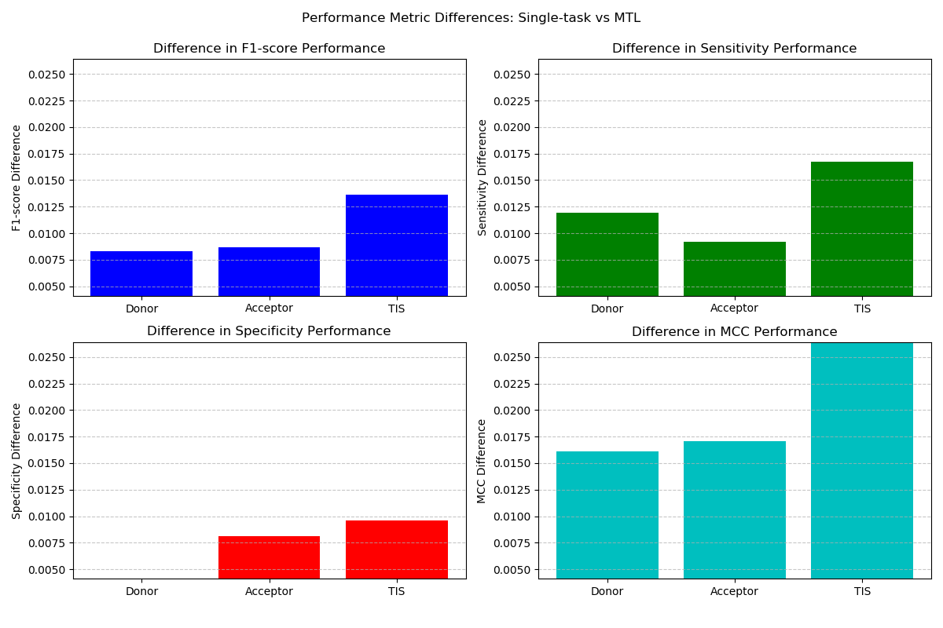
3. Experimental Setup and Results
16
16
Notes:
The plotted differences in F1-score, Sensitivity, Specificity, and MCC between single-task and MTL models suggest that the MTL models generally perform on par with their single-task counterparts across all tasks. While minor differences exist, these discrepancies are not substantial enough to establish a clear advantage for either approach. The comparable performance indicates that the MTL approach successfully leverages shared information while maintaining task-specific capabilities.

Slide 17
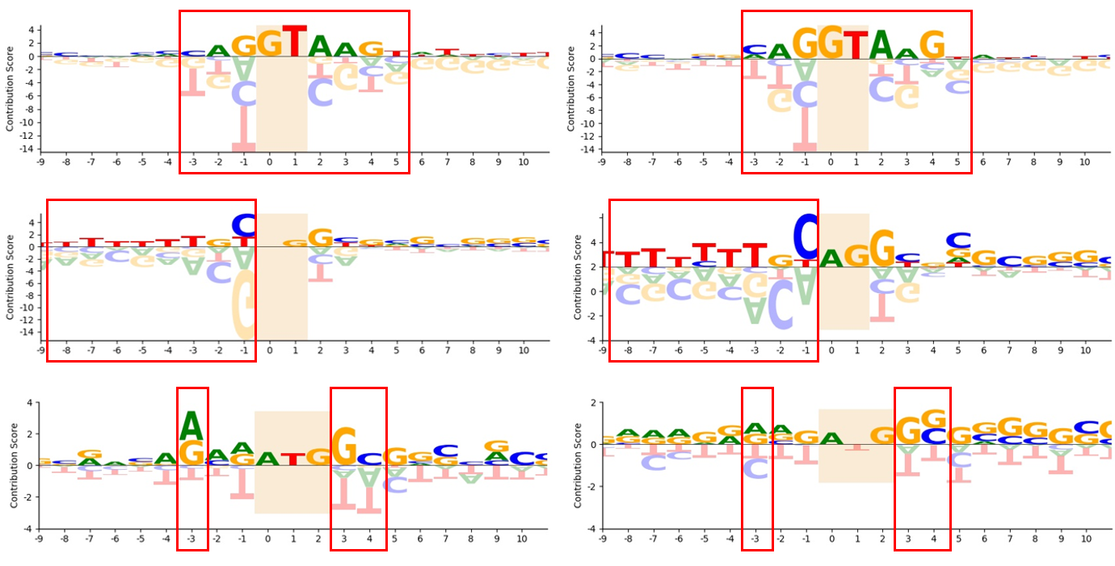
3. Experimental Setup and Results
Qualitative Results
Donor splice site
Acceptor splice site
Translation initiation site
17
Single-task model
MTL
Notes:
Higher interest lies in understanding MTL model's ability to learn task-specific features.
Leveraged the saliency maps approach for feature interpretation.
Generated contribution scores for nucleotides in DNA sequences.
Computed gradients of model output with respect to input to obtain saliency values.
Saliency values linked to nucleotides, forming saliency maps.
Enhanced comparability by dividing each saliency value by average of absolute values.
Further normalization: Scaled average saliency down by a factor of 100.
These steps ensure consistent values across diverse sequences.
The comparison between single-task and MTL models across all tasks demonstrated consistent patterns in terms of feature recognition. While there were slight variations in the contribution score magnitudes between the two approaches, the differences were generally insignificant. This suggests that both single-task and MTL models were capable of capturing important features for the respective tasks without a substantial divergence in their predictive abilities.

Slide 18
Contents
Introduction
Proposed Approach
Experimental Setup and Results
Conclusions and Future Research
18
18

Slide 19
4. Conclusions and Future Research
Conclusions
Performance Parity: The comparative analysis between single-task and multitask learning (MTL) models across various tasks (donor splice sites, acceptor splice sites, and translation initiation sites (TIS)) reveals closely matched performance.
Metric Differences: Minor differences in Specificity, Sensitivity, F1-score and MCC were observed between the two approaches. However, these differences remain statistically insignificant.
Shared Insights: MTL models demonstrate the ability to leverage shared information while preserving task-specific performance, rendering them comparable to single-task models.
19
19

Slide 20
4. Conclusions and Future Research
Future Research
Fine-tuning Strategies: Investigate fine-tuning techniques to enhance MTL model performance in specific categories or metrics, ensuring consistent benefits across different tasks.
Task Dependencies: Examine the impact of task dependencies on MTL model performance. Explore methods to incorporate domain knowledge and determine optimal task combinations.
Feature Engineering: Explore feature engineering strategies that could enhance model performance by leveraging shared features across tasks and exploiting their interdependencies.
Interpretable Models: Investigate techniques to improve interpretability of MTL models, enabling better insights into their decision-making process and enhancing model trustworthiness.
20
20

Slide 21
Thank you
Q&A

Slide 22



Espoir Kabanga Teaching and Research Assistant, Center for Biosystems and Biotech Data science Ghent University Global Campus Ph.D. Student, Faculty of Engineering and Architecture Department of Electronics and Information Systems Ghent University E espoir.kabanga@ghent.ac.kr T +82 32 626 43 06 www.ghent.ac.kr www.ugent.be
Universiteit Gent / Ghent University Global Campus @ugent / @ugentkorea
@ugent / @ghentuniv.kor.official Ghent University

