Slide 1
In Silico Experiments for CRISPR-based Antimicrobials
2022 MSK: S16 Lessons from Phage-Bacteria Interactions
Hyunjin (Jin) Shim

Slide 2
Content
Introduction to Antimicrobial resistance (3 mins)
Project 1: CRISPR-Cas13 antimicrobials (6 mins)
Project 2: Anti-CRISPR proteins (6 mins)
Conclusion and Q&A (5 mins)

Slide 3
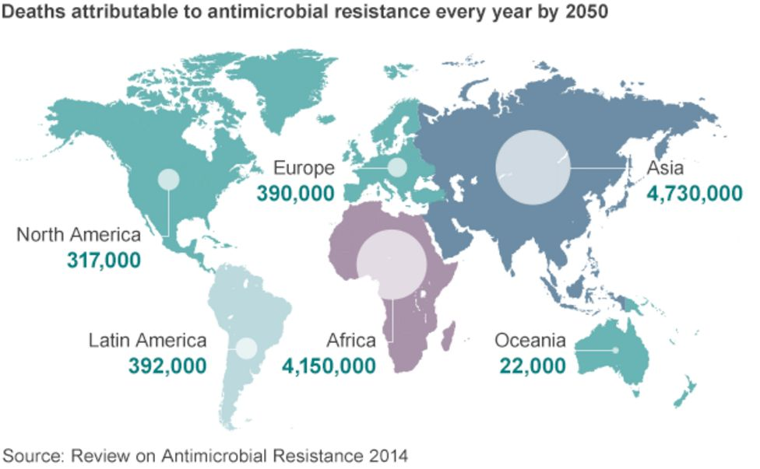
Antimicrobial resistance (AMR) is a silent pandemic
Superbugs cause 1.3 million deaths each year worldwide.
The numbers will increase to 10 million deaths a year worldwide by 2050.
Antimicrobial resistance undermines the progress of modern medicine.
The antibiotic market is broken, as new antibiotics can only be used sparingly.

Slide 4
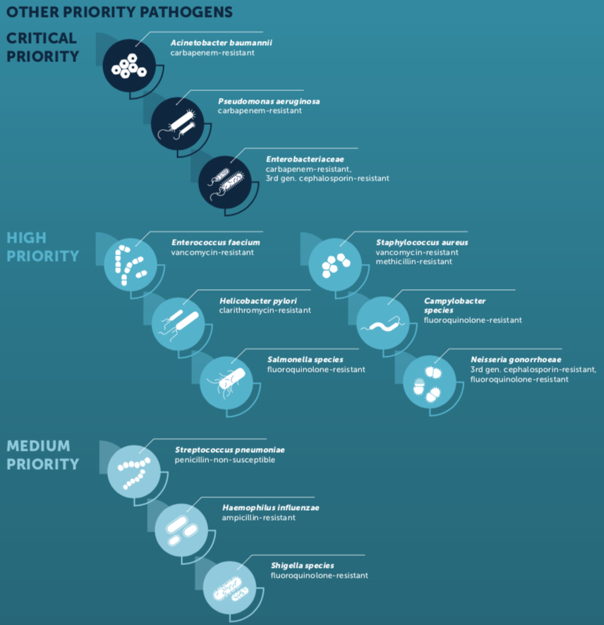
World Health Organisation: priority pathogen list
WHO pathogen list of 12 superbugs.
Traditional antibiotics are small molecules.
Bacteria quickly develop resistance against them.
Non-traditional antibiotics in clinical development:
phage therapy
antibodies
How can a computational biologist contribute?
CRISPR-Cas-based antimicrobial

Slide 5
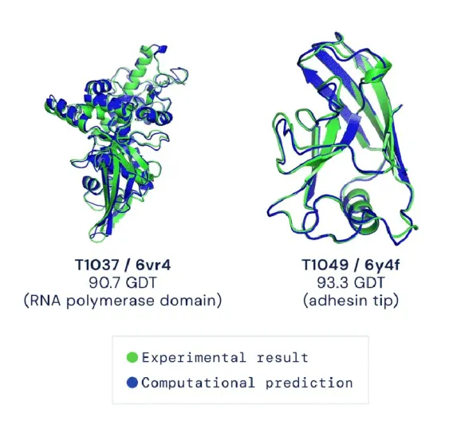
Meaningful in silico experiments are our dream!
In silico experiments that predict in vivo outcomes accurately
Model-based: human expertise
Data-based: data + computational power
AlphaFold (2020): deep learning-based program to predict protein structure
Accuracy: a median global distance score of 92.4%
In vitro protein crystal diffraction:
$5,000 and one year
AlphaFold-predicted protein structure:
Free and one hour
Source: AlphaFold

Slide 6
Project 1:
In silico experiments of CRISPR-Cas13
Park H-M*, Park Y*, Berani U, Bang E, Vankerschaver J, Van Messem A, De Neve W, Shim H.
In silico optimization of RNA–protein interactions for CRISPR‑Cas13‑based antimicrobials. Biology Direct 17 (1), 1-16 (2022).

Slide 7
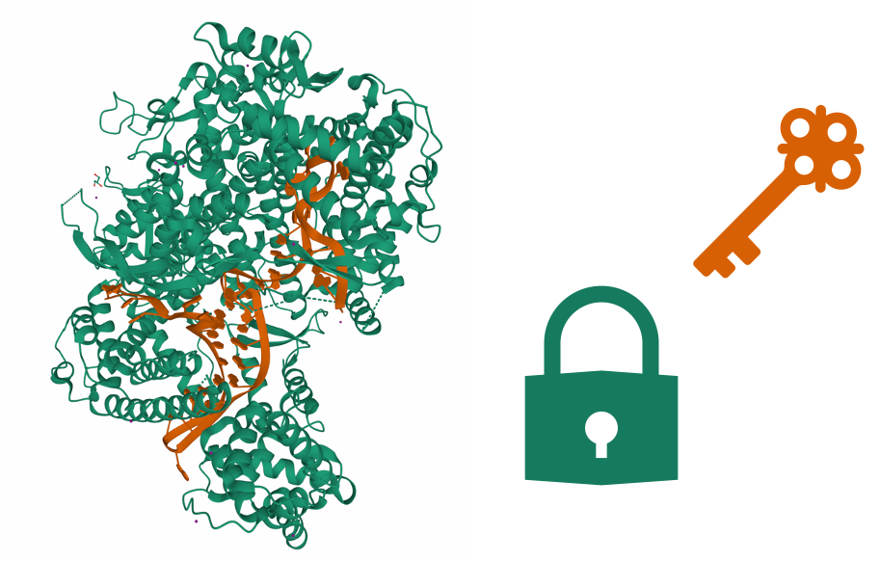
CRISPR-based antimicrobials target AMR genes
CRISPR-Cas systems are specific and programmable against invading foreign DNA/RNA.
CRISPR RNA can be reprogrammed to target AMR-related genes in bacteria.
However, bacteria have own CRISPR-Cas systems which may cause off-target effects.
For a stable tool, optimal binding between CRISPR RNAs and Cas proteins is essential.

Slide 8
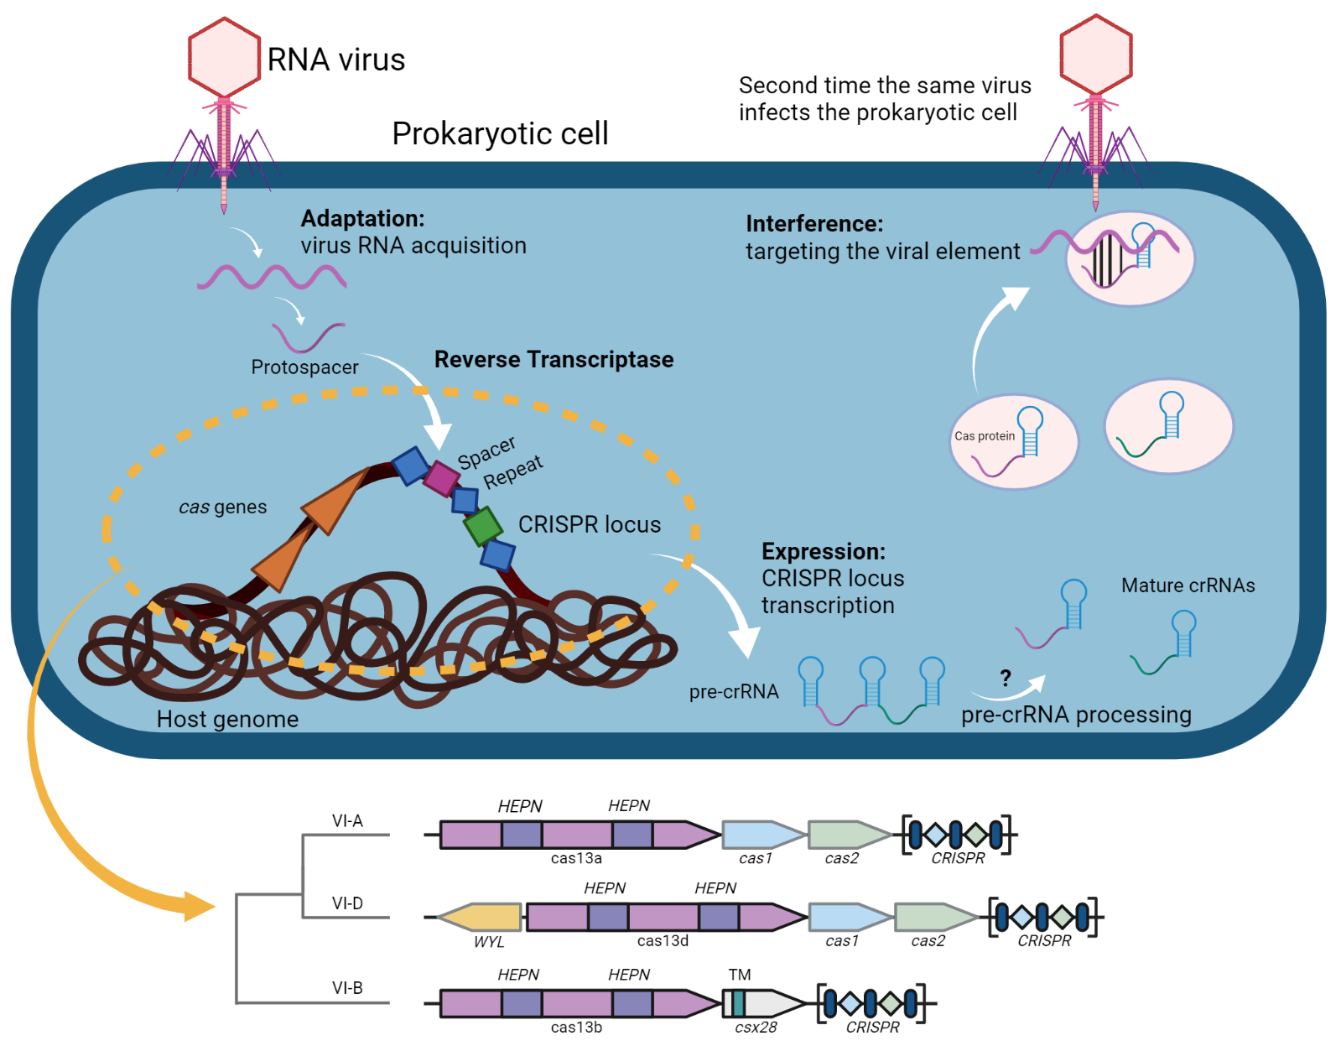
CRISPR-Cas13 antimicrobials target RNA
CRISPR-Cas13 systems
Class 2 Type VI
degrade specific foreign single-stranded RNAs
activate non-specific RNase activities
cause cell cycle arrest
cannot be repaired with bacterial repair systems
often have no CRISPR arrays in vicinity
How to find optimal CRISPR and Cas13 pairs in silico?

Slide 9
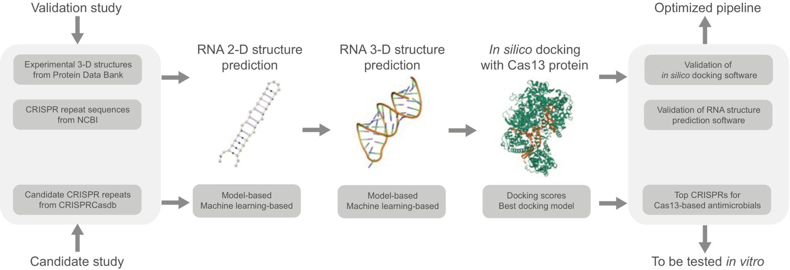
Begin in silico experiments by program validation
Validation studies use experimental data to validate and optimize programs.
Our validation study selects for the best programs to predict 2D RNA structure, 3D RNA structure, and in silico docking.

Slide 10
Let’s find CRISPRs that bind optimally with Cas13
We used in silico docking experiments to find the best CRISPRs for each Cas13 protein in terms of binding affinities.

Slide 11
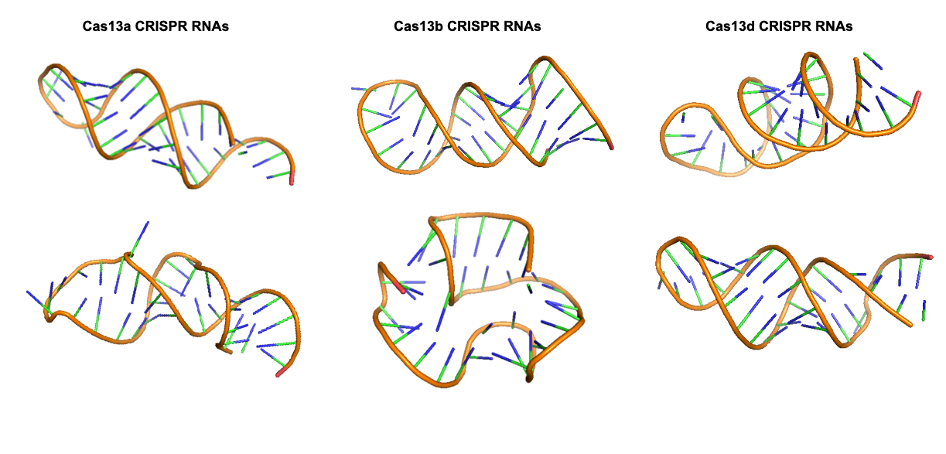
Dataset of candidate CRISPRs was built
We built a candidate CRISPR list by finding all CRISPR arrays within ± 10,000 base pairs of Cas13 proteins from prokaryotic genomes.
3D RNA structures of these CRISPRs were predicted.
CRISPR RNAs had diverse structures, including hairpin (some examples below).

Slide 12
CRISPR was docked on Cas in silico successfully
CRISPR RNA was docked onto Cas protein in silico.
According to the validation set (which had experimental RNA-protein complexes), in silico docking of CRISPRs on Cas proteins reached an acceptable accuracy.
Purple: experimental structure
Blue: computer selected best docking model
Green: human selected best docking model
12

Slide 13
Top CRISPR candidates were selected
In silico docking was performed with ~100 candidate CRISPR RNAs for each Cas13 protein.
CRISPR RNAs (red dots as the center of mass) which docked closest to the actual binding site (black dot) were selected.
Their genetic sequences differed according to MSA.
Some CRISPR RNAs were predicted to have better binding affinities to Cas proteins than the experimental structure.

Slide 14
For every Cas13 protein…
In silico docking using candidate CRISPRs was performed for every Cas protein currently available.
Cas13a: 10
Cas13b: 2
Cas13d: 4
For each Cas protein, we released a list of CRISPR RNAs that have better binding affinities than their experimental structures (some results shown).
CRISPR-Cas13-based antimicrobials should use the optimal pair!

Slide 15
Project 2:
Anti-CRISPRs on AlphaFold
Park H-M, Park Y, Vankerschaver J, Van Messem A, De Neve W, Shim H. Rethinking protein drug design with highly accurate structure prediction of anti-CRISPR proteins. Pharmaceuticals. 15:310 (2022).

Slide 16
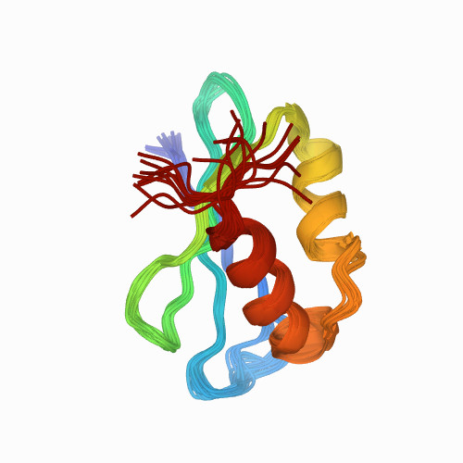
Anti-CRISPRs are genetically and structurally diverse
AcrIF1 from Pseudomonas phage
Experimental structure
Anti-CRISPRs are small proteins that inhibit CRISPR-Cas systems.
Anti-CRISPRs have several inhibition mechanisms.
16

Slide 17
AlphaFold predicts anti-CRISPR structures well
The first step is to validate AlphaFold using 100 anti-CRISPRs with experimental structures.
Our validation study shows AlphaFold is good at predicting 3D structures of anti-CRISPR proteins (median accuracy score: ~90%)
17

Slide 18
Can we learn more from anti-CRISPR structures?
Additional 100 anti-CRISPRs without experimental structures.
Build structure-based evolutionary trees to show diversity and functional relationships of all anti-CRISPRs
Find structural homologues from Protein Data Bank (PDB) to infer inhibitory mechanisms of some anti-CRISPRs
18

Slide 19
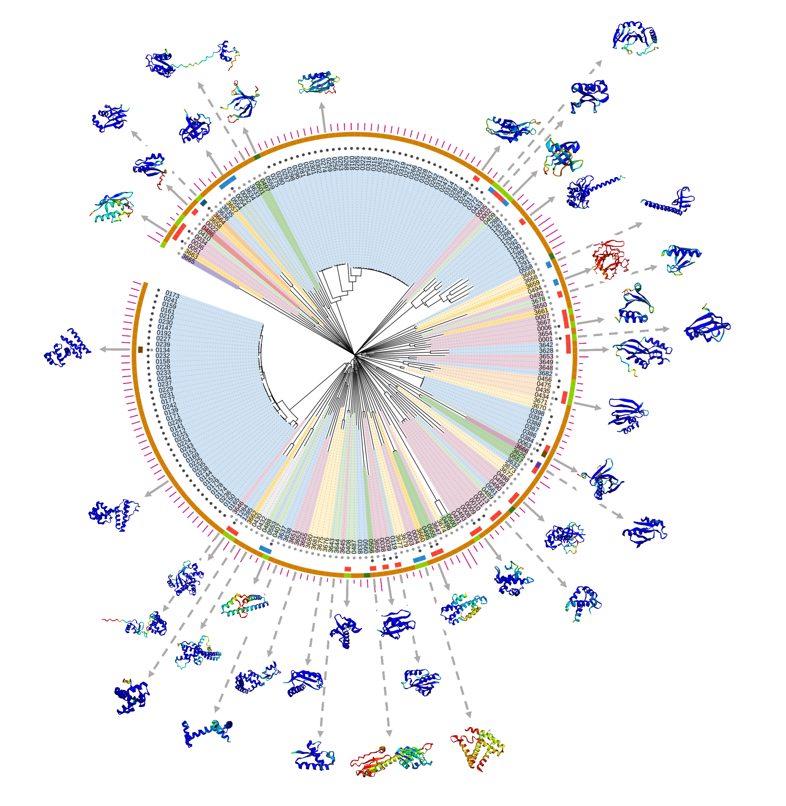
Evolutionary tree of anti-CRISPRs based on structure
Structure-based evolutionary tree built from 207 anti-CRISPR proteins.
Some of them have known inhibitory mechanisms but most do not.
Evolutionary tree shows the diversity of anti-CRISPR protein structures.
If on the same branch, proteins are related by structure.
If rooted in the center, these protein structures are unique.
19

Slide 20
Structure can infer inhibitory function
A clade with homologues related to acetyltransferase (purple arrow).
Acetylation of Cas proteins disables their function.
Anti-CRISPRs (labelled “3625”) are known to disable TypeVA (Class 2) CRISPR-Cas systems enzymatically.
Anti-CRISPRs of unknown function (labelled “3666”) are in the same clade and belong to the family of anti-CRISPRs disabling TypeIB (Class 1) CRISPR-Cas systems!
20

Slide 21
New family of Anti-CRISPR has enzymatic inhibition?
Closest structural homologues to these anti-CRISPRs were all acetyltransferases (4U9W: Homo sapiens, 1Y9W: Bacillus cereus, 7AK8: Salmonella enterica) .
AcrIB protein has a higher similarity score to its acetyltransferase homologue.
21
Homologue from Dong et al. 2019

Slide 22
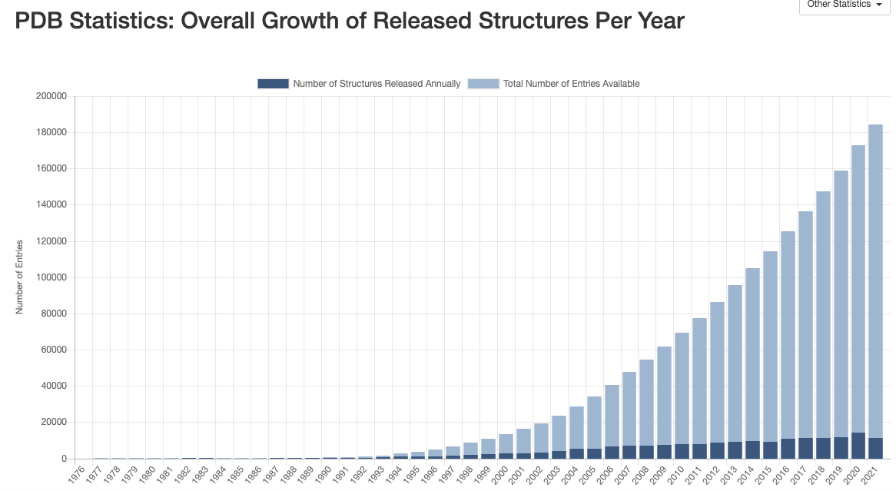
Some have no homologue in the Protein Data Bank
22
Source: PDB 2021

Slide 23
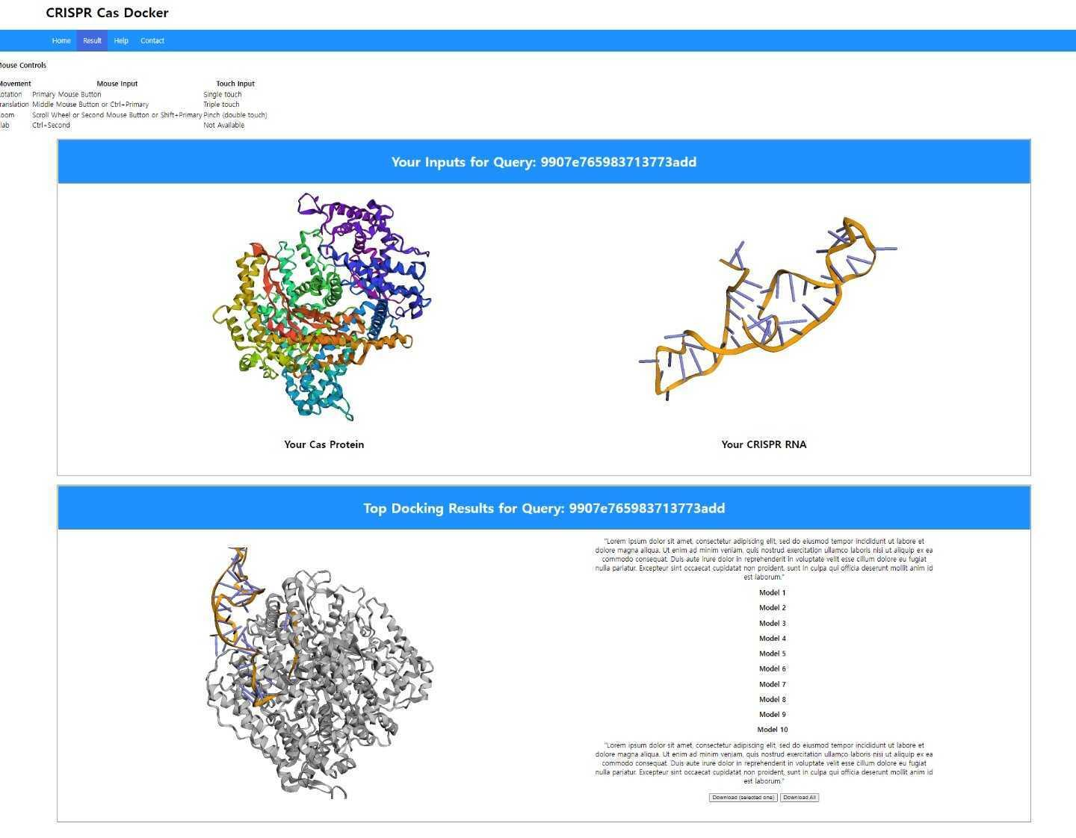
Future directions
CRISPR-Cas-Docker: open-source program that can dock CRISPR with Cas protein
2 options for users to dock:
Experimental or AlphaFold-predicted Cas protein
with
Experimental or 3D-predicted CRISPR RNA

Slide 24
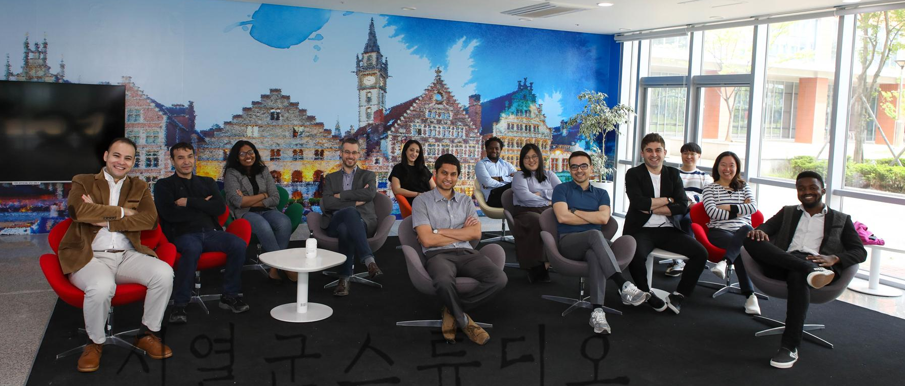
Acknowledgements
Ghent University Global Campus Center for Biosystems and Biotech Data Science
Wesley De Neve
Joris Vankerschaver
Homin Park
Eunkyu Bang
Jongbum Won
University of Liège
Arnout Van Messem
Ghent University
Yunseol Park
Urta Berani

Slide 25
Key takeaway messages
Thank you! Any questions?
In silico experiments are useful as preliminary studies.
In silico prediction narrows down candidates, but still have to be verified experimentally.
In silico docking of CRISPR-Cas13 gave a list of candidate CRISPRs binding optimally with each Cas13 protein.
AlphaFold predicted a new family of anti-CRISPR that may have enzymatic inhibition.

Slide 26
Hyunjin Shim Research professor Department of Molecular Biotechnology, Environmental Technology, and Food Technology E hyunjin.shim@ghent.ac.kr T +32 626 41 21 M +32 400 00 00 00 www.ugent.be
Www. ghent.ac.kr
Universiteit Gent @ugent
@ugent Ghent University

