Slide 1
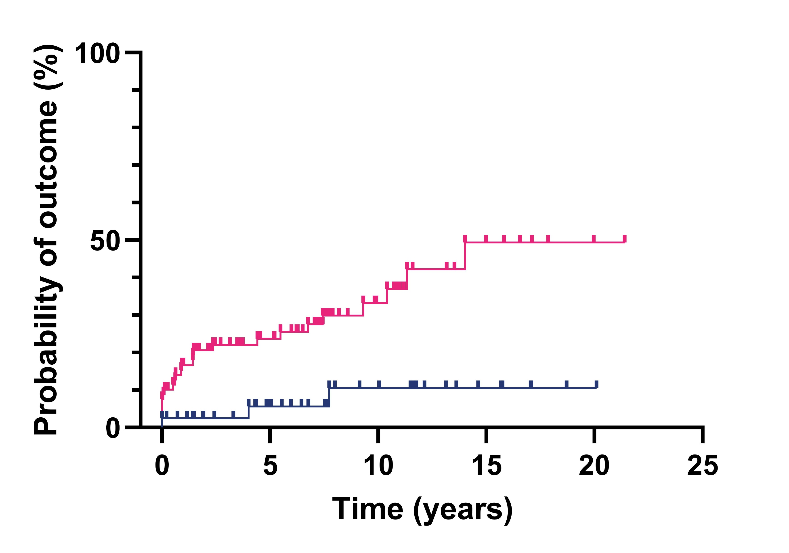
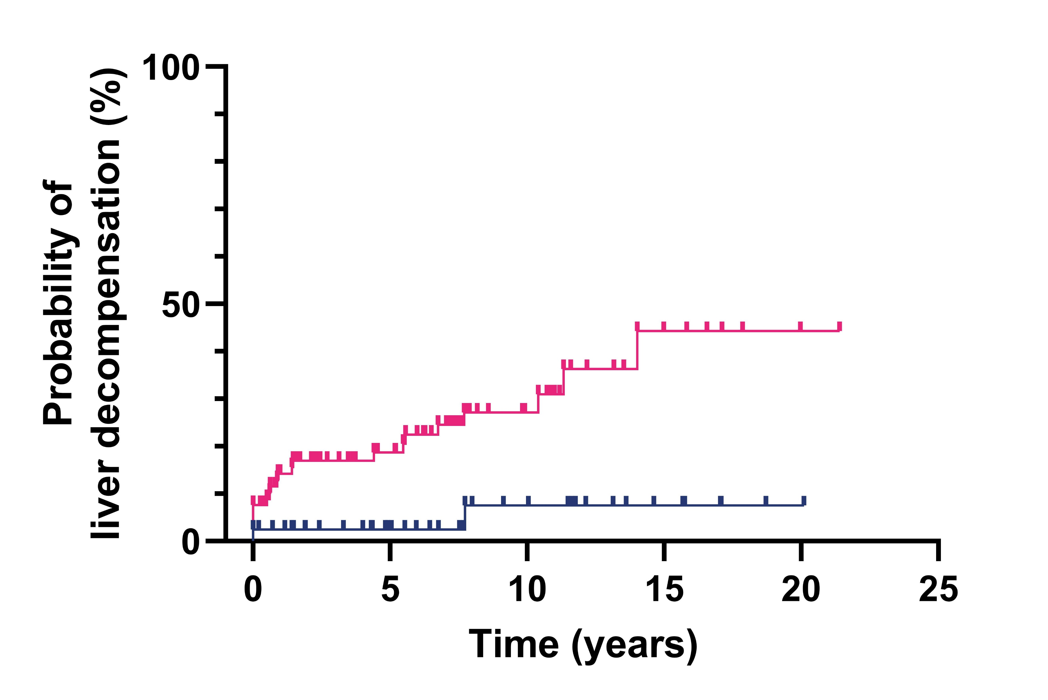
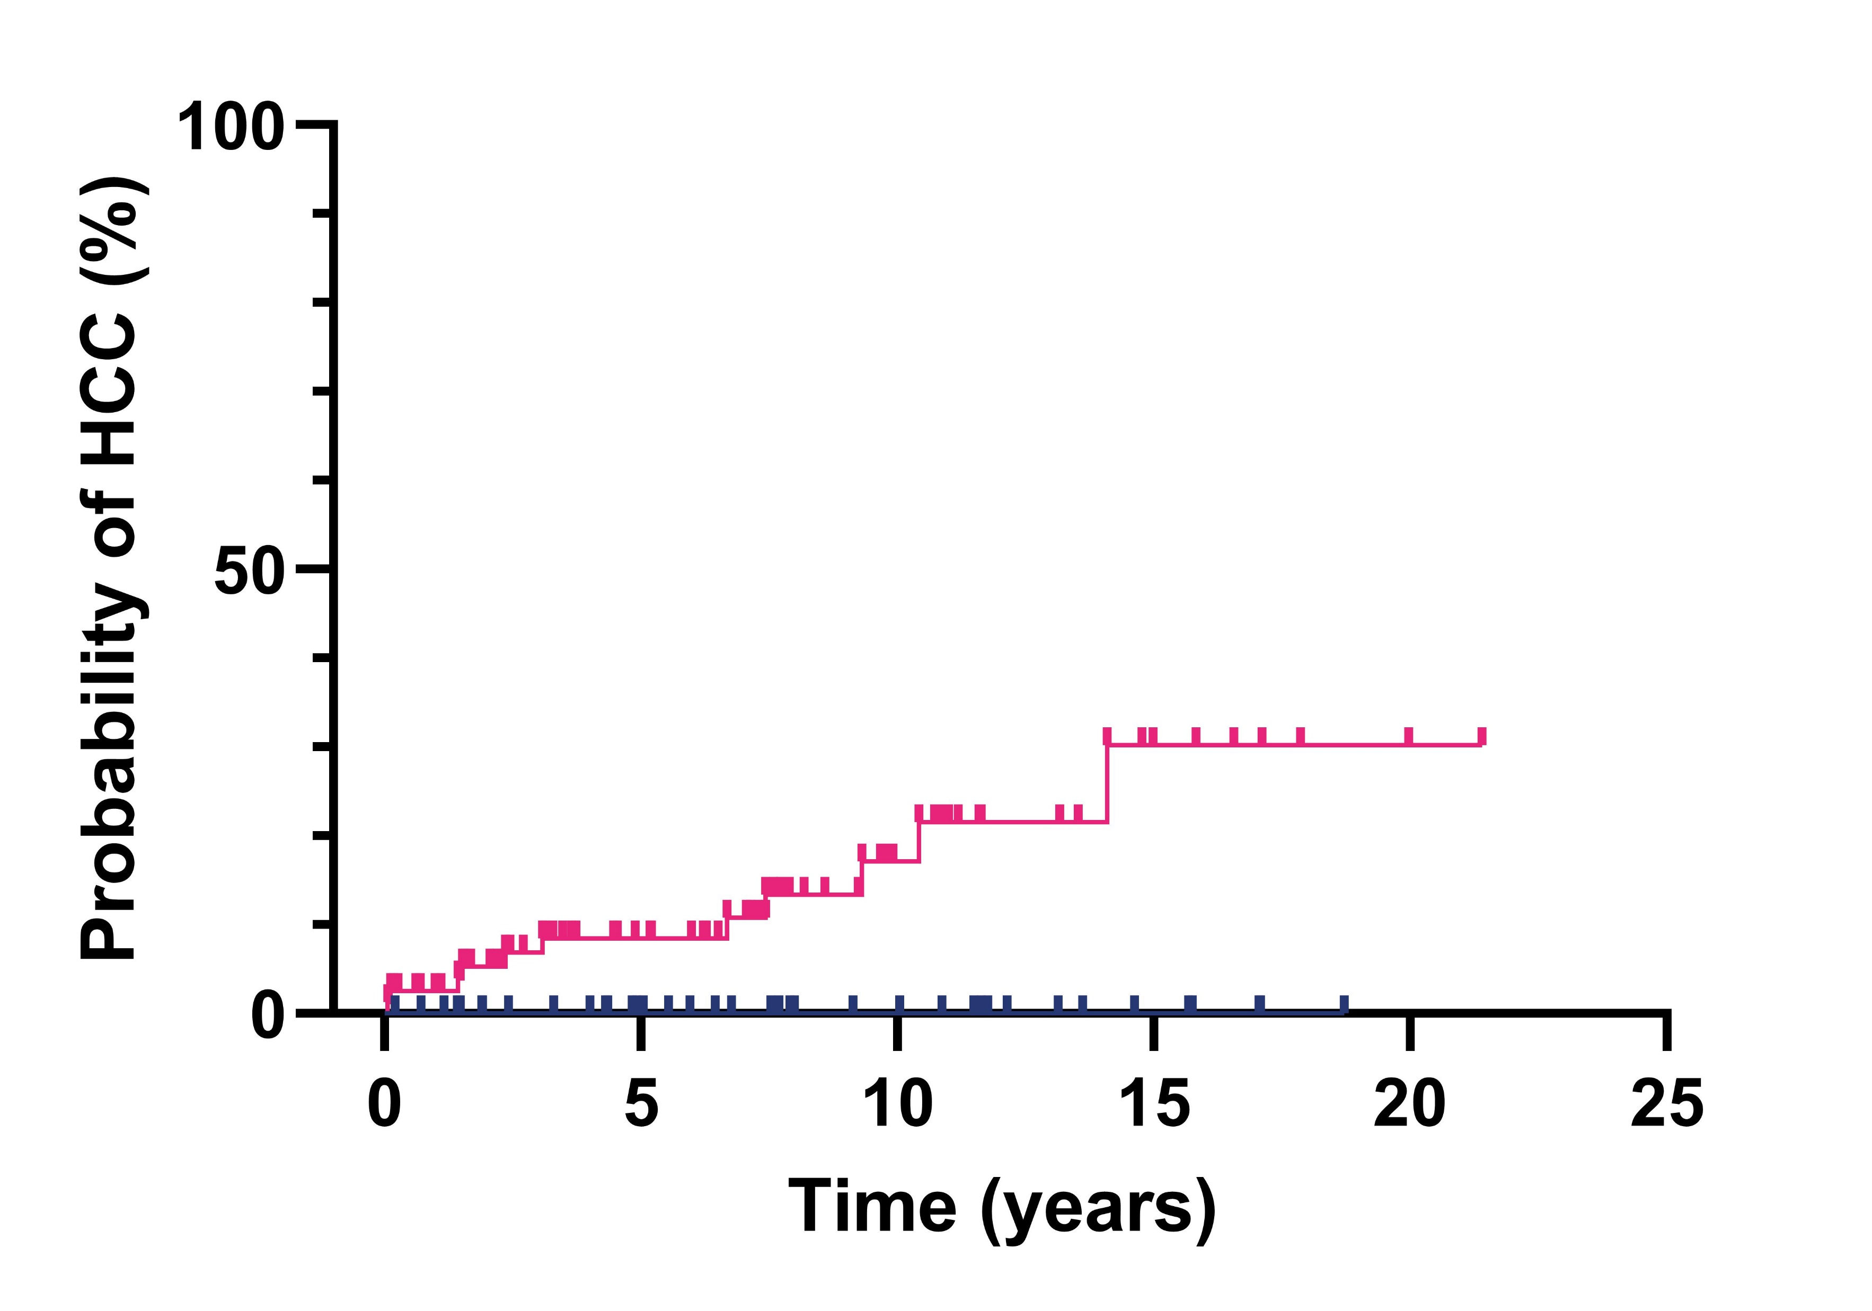
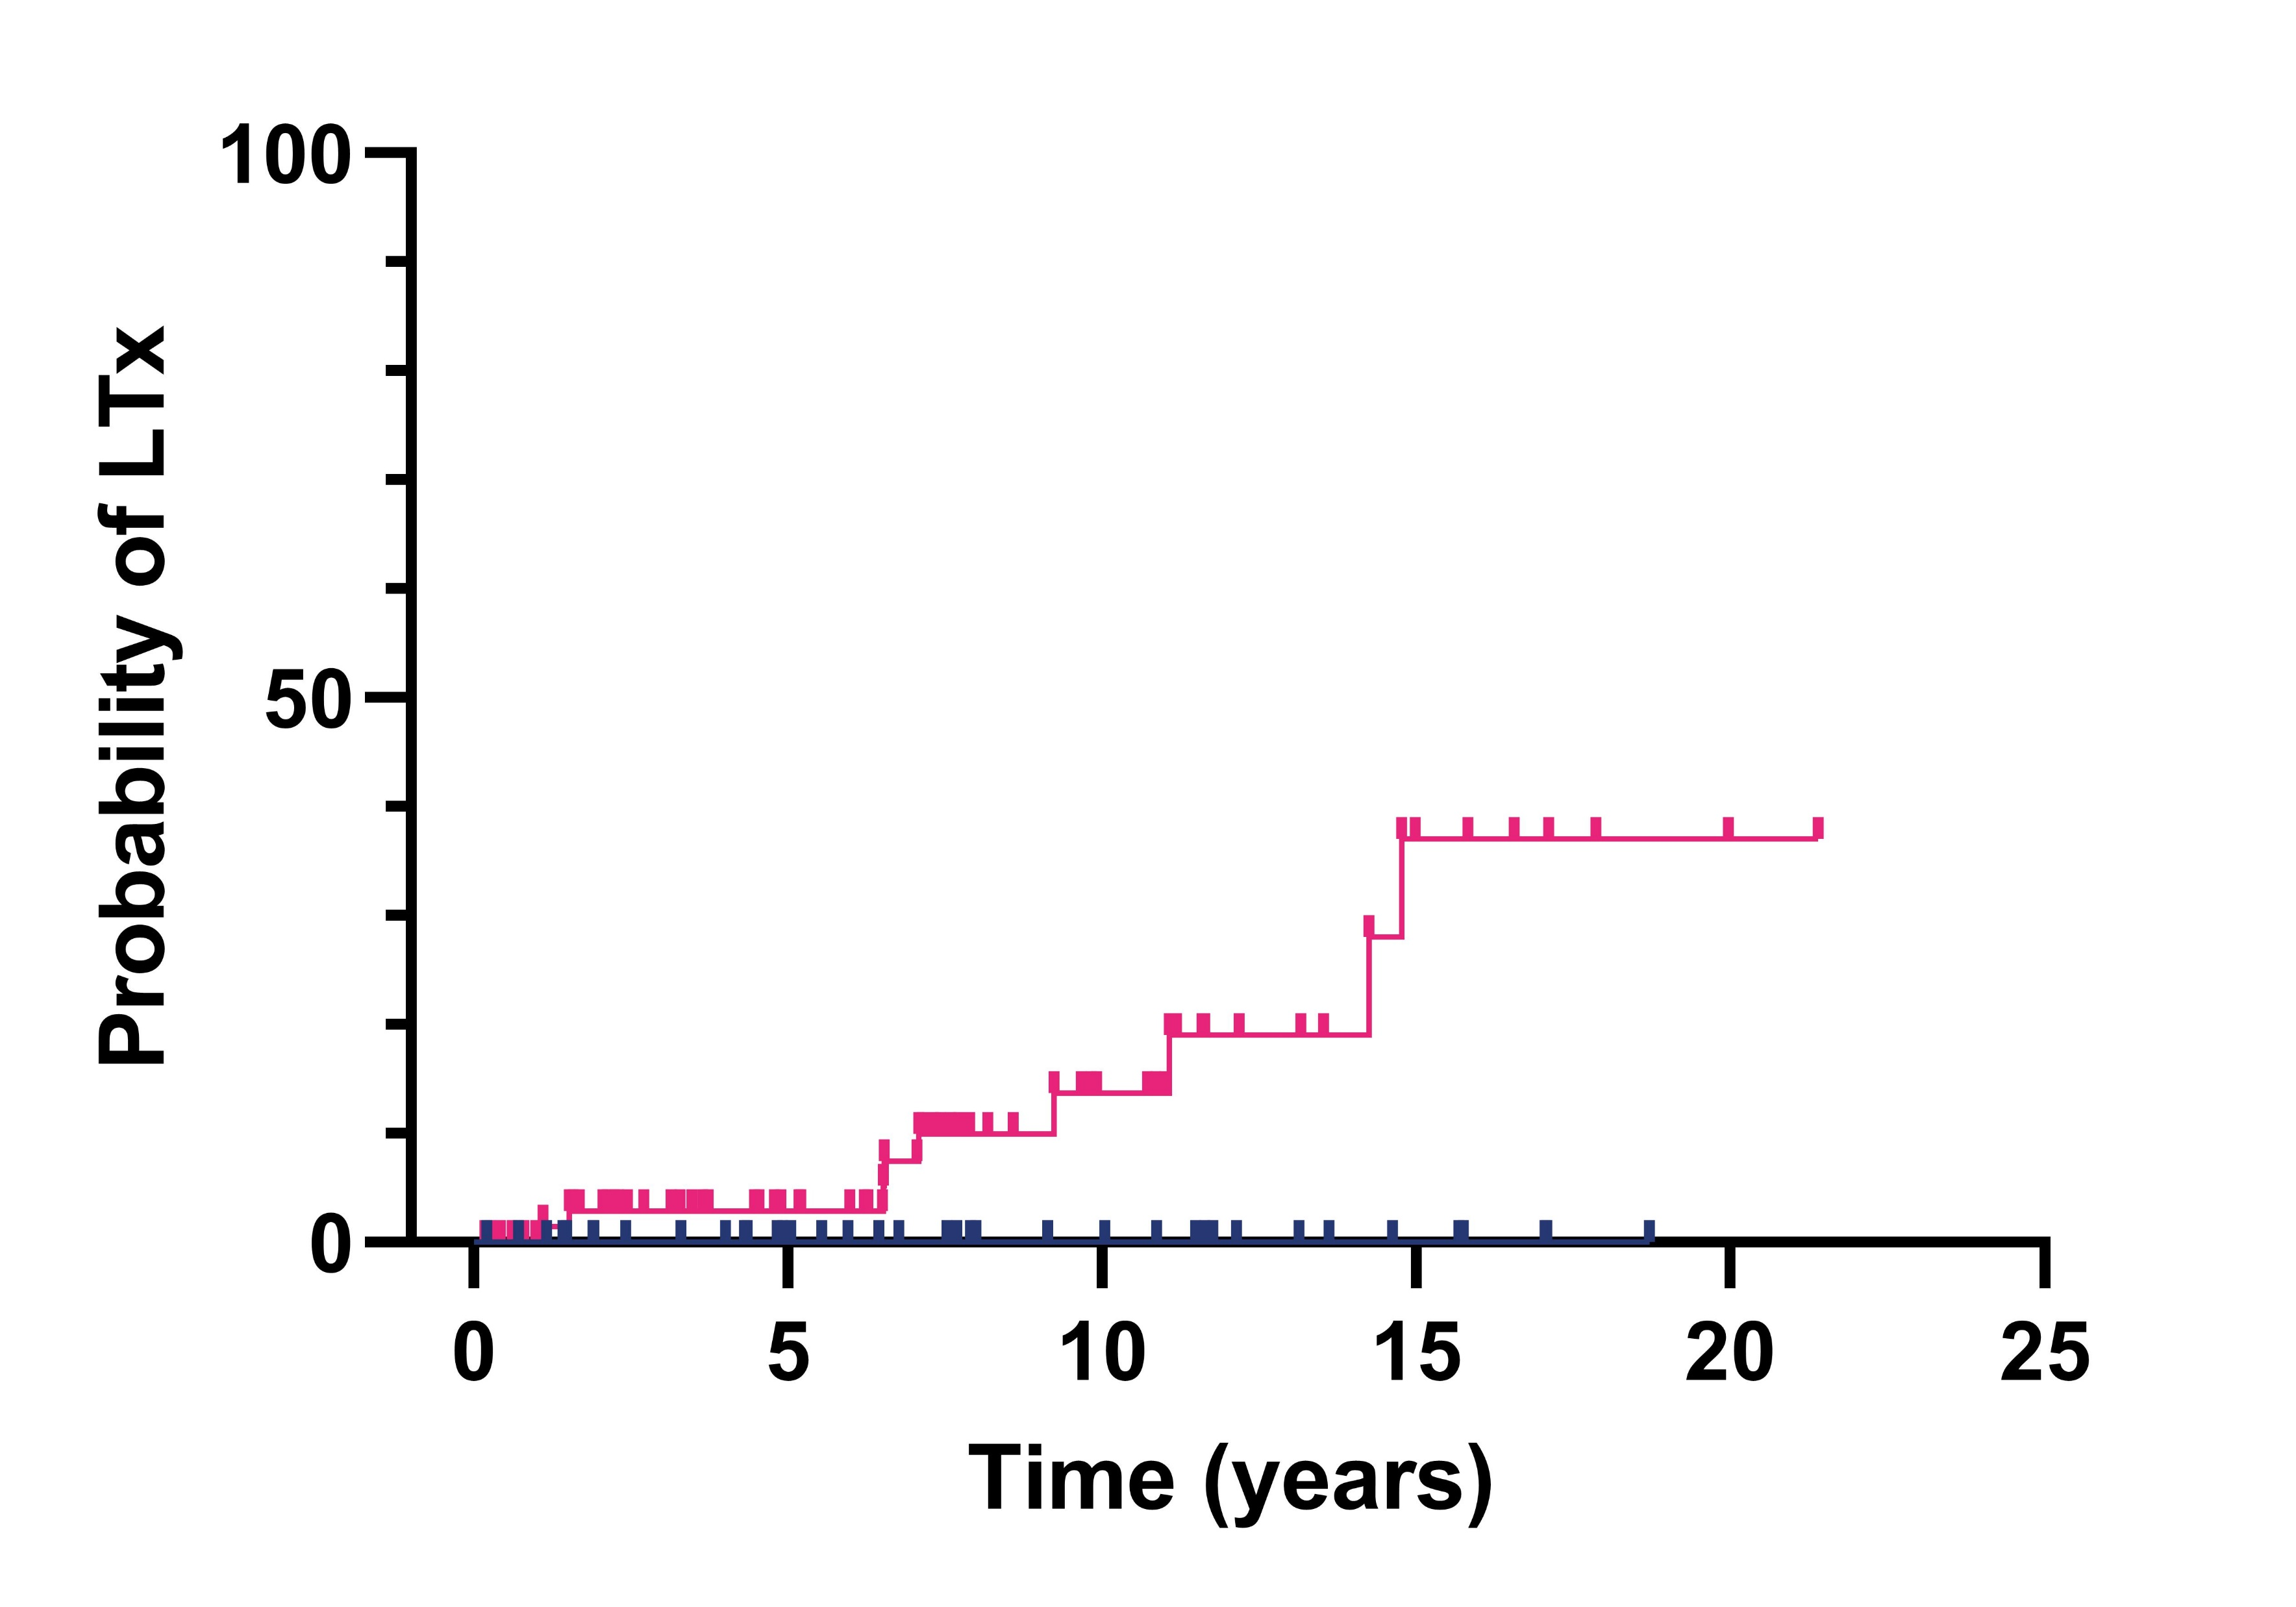
PROGNOSIS OF HDV INFECTIONS IN BELGIUM
FURQUIM D’ALMEIDA^{1, 2}, E. HO², L. GOVAERTS², P. MICHIELSEN², T. SERSTE³, J. DELWAIDE⁴, S. BOURGEOIS⁵, C. MORENO^{6,} H. VAN VLIERBERGHE⁷, C. DE GALOCSY⁸, H. ORLENT⁹, M. PEETERS¹⁰, E. PADALKO¹¹, S. VAN GUCHT¹⁰, T. VANWOLLEGHEM^{1, 2}
1. University of Antwerp, Viral Hepatitis Research Group, Laboratory of Experimental Medicine and Pediatrics, Belgium. 2. Antwerp University Hospital, Department of Gastroenterology and Hepatology, Belgium. 3. CHU Saint-Pierre, Department of Hepato-Gastroenterology, Belgium. 4. CHU de Liège, Department of Hepato-Gastroenterology, Belgium. 5. ZNA Antwerp, Department of Gastroenterology, Belgium. 6. CUB Hôpital Erasme, Department of Gastroenterology, Hepatopancreatology and Digestive Oncology, Belgium. 7. Ghent University Hospital, Department of Gastroenterology, Belgium. 8. Hôpitaux Iris Sud Bracops, Department of Gastroenterology and Hepatology, Belgium. 9. AZ Sint-Jan, Department of Gastroenterology and Hepatology, Belgium. 10. Sciensano, Infectious Diseases in Humans, Viral Diseases, National Reference Centre for Hepatitis Viruses, Belgium. 11. Ghent University Hospital, Laboratory of Medical Microbiology, Belgium.
Background
Results
HBV/HDV coinfection is considered to be the most severe form of chronic viral hepatitis
Anti-HDV seroprevalence is 4.5% among HBsAg positive patients^{a,b}
National long-term studies are scarce
Belgian data is lacking
 | TOTAL | HDV RNA | HDV RNA |  | NO OUTCOME | OUTCOME | UNIVARIATE ANALYSIS |  | MULTIVARIATE ANALYSIS
 | N = 137 | NEGATIVE N = 41 | POSITIVE N = 79 | P VALUE | N = 101 | N = 36 | HR (95% CI) | P VALUE | HR (95% CI) | P VALUE
Age (years) | 36.4 (6.7 – 61.7) | 34.9 (17.0 – 61.7) | 36.4 (6.7 – 31.0) | 0.62 | 32.7 (6.7 – 61.7) | 46.3 (21.4 – 61.0) | 1.11 (1.07 – 1.15) | <0.001 | 1.09 (1.04 – 1.14) | <0.001
Male – n (%) | 88 (64.2) | 29 (70.7) | 46 (58.2) | 0.18 | 66 (65.3) | 22 (61.1) | 0.75 (0.38 – 1.48) | 0.41
Ethnicity – n (%) African Asian Caucasian Middle-Eastern | 53 (38.7) 10 (7.3) 57 (45.3) 12 (8.8) | 24 (58.5) 5 (12.2) 5 (12.2) 7 (17.1) | 25 (31.6) 5 (6.3) 46 (58.2) 3 (3.8) | <0.001 | 42 (41.6) 8 (7.9) 42 (41.6) 9 (8.9) | 11 (30.6) 2 (5.6) 20 (55.6) 3 (8.3) | 1.17 (0.87 – 1.59) | 0.30
Follow-up (years) | 6.8 (0.2 – 21.4) | 7.7 (0.2 – 20.1) | 7.1 (0.2 – 21.4) | 0.23 | 7.5 (0.2 – 21.4) | 4.5 (0.2 – 14.8)
Laboratory AST (U/L) ALT (U/L) Tot. Bilirubin (mg/dL) INR | 54 (9 – 1735) 61 (13 – 5463) 0.6 (0.2 – 15.0) 1.1 (0.9 – 6.0) | 35 (9 – 140) 41 (13 – 205) 0.6 (0.2 – 9.7) 1.1 (1.0 – 1.7) | 63 (27 – 957) 72 (16 – 2211) 0.6 (0.2 – 9.7) 1.1 (1.0 – 1.7) | <0.001 <0.001 0.35 0.02 | 43 (9 – 957) 58 (13 – 2211) 0.5 (0.2 – 9.7) 1.1 (0.9 – 1.5) | 77 (33 – 1735) 67 (27 – 5463) 1.0 (0.5 – 15.0) 1.2 (1.0 – 6.0) | 1.00 (1.00 – 1.00) 1.00 (1.00 – 1.00) 1.19 (1.09 – 1.31) 1.67 (1.26 – 2.22) | 0.02 0.19 <0.001 <0.001 | 1.00 (1.00 – 1.00) 0.91 (0.54 – 1.54) 29.75 (1.29 – 686.7) | 0.35 0.74 0.03
Cirrhosis – n (%) | 54 (42.2) | 10 (26.3) | 37 (49.3) | 0.02 | 26 (27.1) | 28 (87.5) | 11.40 (4.00 – 32.55) | <0.001 |  | 0.06
HDV RNA positive – n (%) | 79 (65.8) |  |  |  | 54 (58.7) | 25 (89.3) | 5.18 (1.56 – 17.21) | 0.007 | 7.37 (1.54 – 35.29) | 0.01
Methods
N = 189
NATIONAL REFERENCE CENTER
N = 160
PARTICIPATING SITES
N = 137
INCLUDED PATIENTS
Site selection
Excluded: 23
HBV negative: 2
HDV negative: 8
HDV missing: 4
Only 1 visit: 3
Missing baseline data: 3
Doubles: 2
Table 1: Baseline characteristics. All values are expressed as median (range), unless otherwise specified. For some variables, data were not complete but were at least available for >77% of cases.
Characteristics were compared between groups using Mann Whitney or independent samples t-test for continuous variables and Chi square or Fisher’s exact test for qualitative variables. Cox proportional hazard regression method was used for the univariate and multivariate analysis.All analyses were performed using SPSS V28.0.
Real-world retrospective medical chart review
Clinical, demographic, laboratory and radiology data were collected from July 2001 to January 2023
Inclusion criteria:
HBsAg or HBV DNA positive
Anti-HDV or HDV RNA positive
At least 1 follow-up visit
Definition outcome: liver decompensation, HCC, LTx or death
P = 0.003
P = 0.004
P = 0.009
P = 0.016
At risk
HDV RNA negative |  | 41 | 26 | 16 | 6 | 1 |  | 41 | 26 | 16 | 6 | 1 |  | 41 | 27 | 17 | 6 | 1 |  | 41 | 27 | 17 | 6 | 1
HDV RNA positive |  | 79 | 44 | 18 | 6 | 1 |  | 79 | 45 | 19 | 6 | 1 |  | 79 | 48 | 19 | 6 | 1 |  | 79 | 49 | 20 | 6 | 1
References
Conclusions
Stockdale, A. J., et al. (2020). "The global prevalence of hepatitis D virus infection: Systematic review and meta-analysis." Journal of Hepatology 73(3): 523-532.
Ho, E., et al. (2013). "Coinfection of hepatitis B and hepatitis delta virus in Belgium: a multicenter BASL study. Prospective epidemiology and comparison with HBV mono-infection." J Med Virol 85(9): 1513-1517.
38% of patients with HDV in Belgium develop a severe liver-related outcome within 10 years
Age, INR and a detectable HDV RNA are independent risk factors for a liver-related outcome
arno.furquimdalmeida@uantwerpen.be

