Slide 1
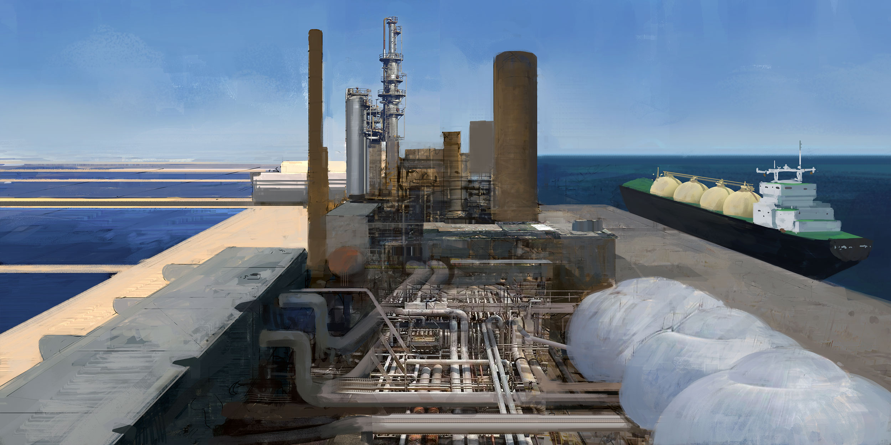


Hydrogen as the basis of Remote Renewable Energy Hubs
Authors: Victor DACHET, Bardhyl MIFTARI, Guillaume DERVAL
and Damien ERNST

Slide 2
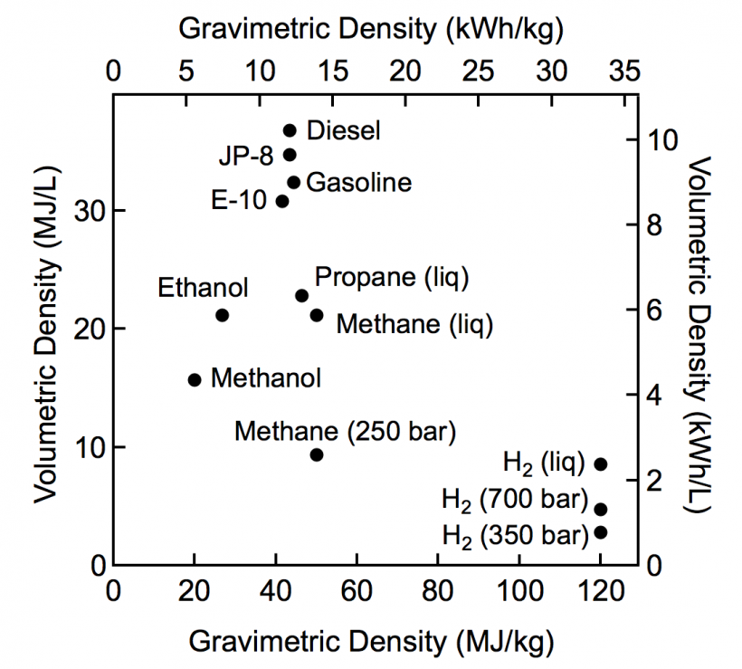
H2 is hard to store (high pressure/low temperature)
Low volumetric density
Losses in storage/transport
Hydrogen will probably not reach the last steps of the energy usage (mobility, home heating, electricity generation, …).
What are the other usages?
Source: US energy dept.

Slide 3
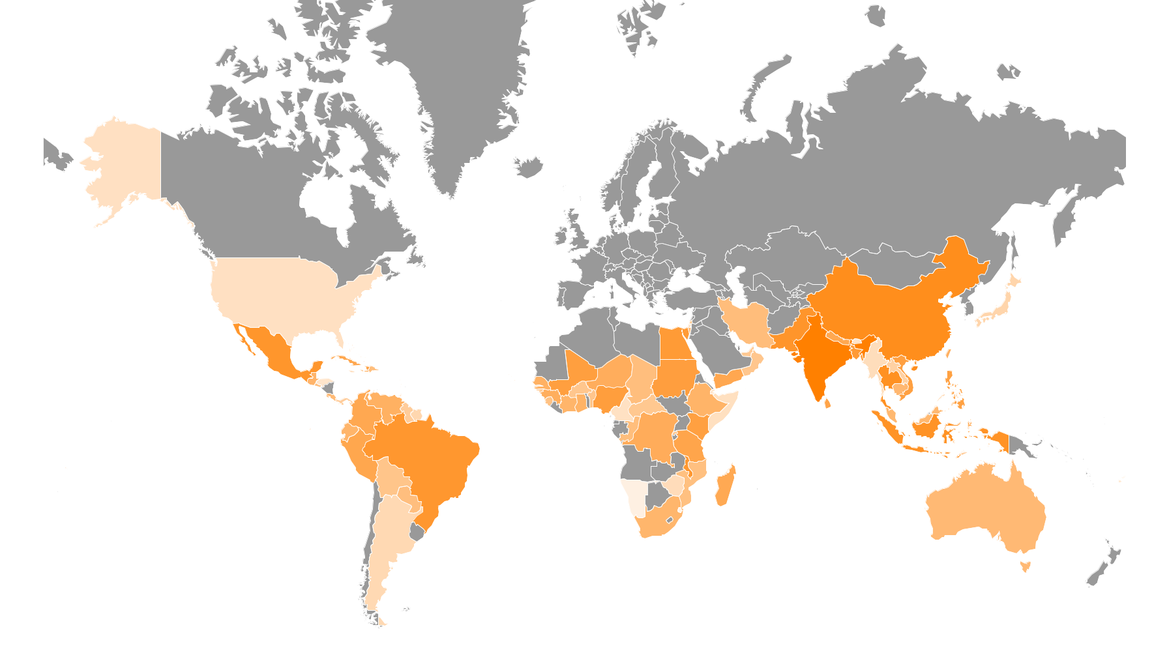

Slide 4
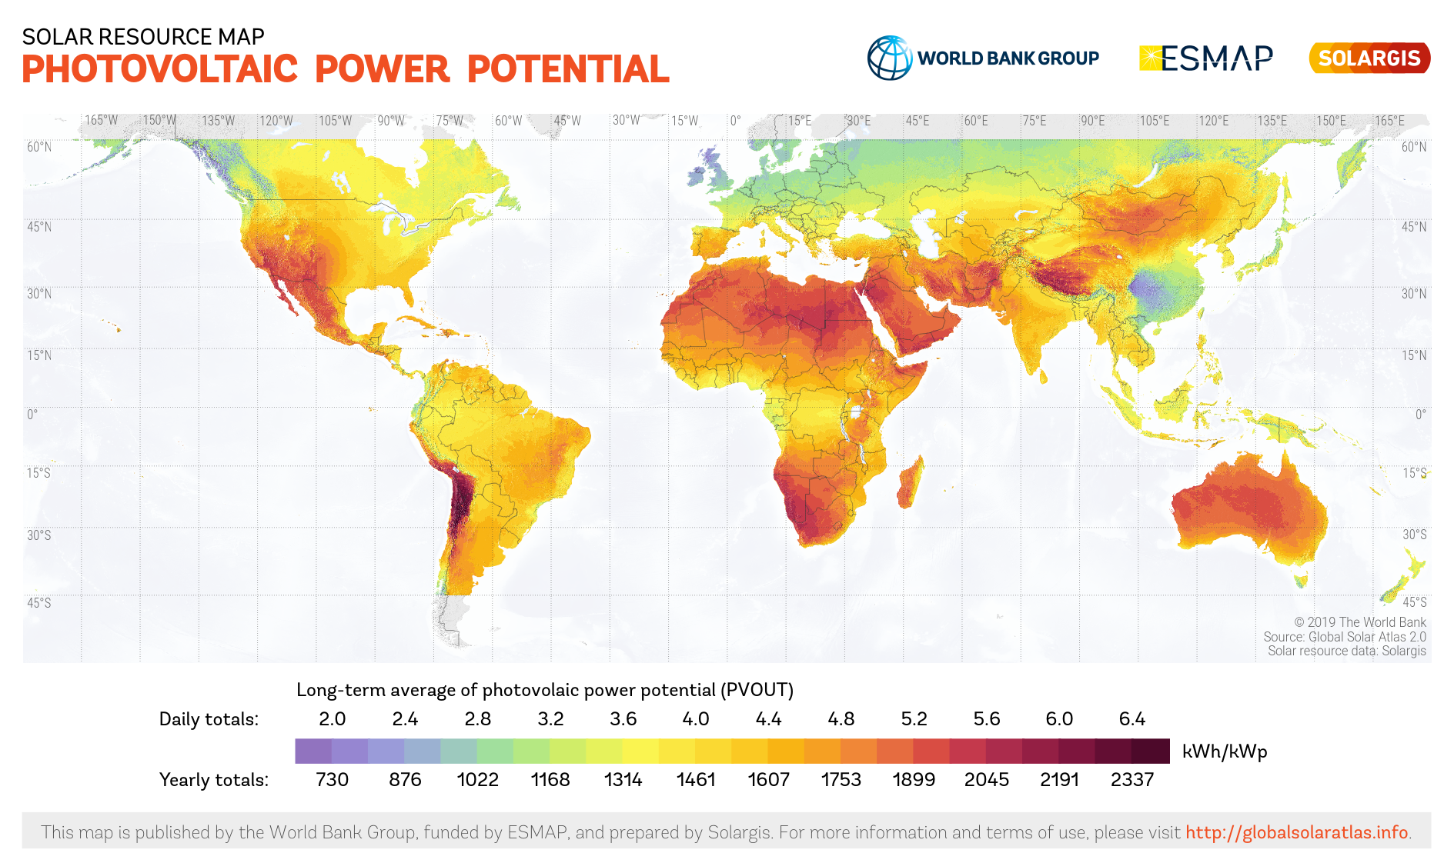

Slide 6
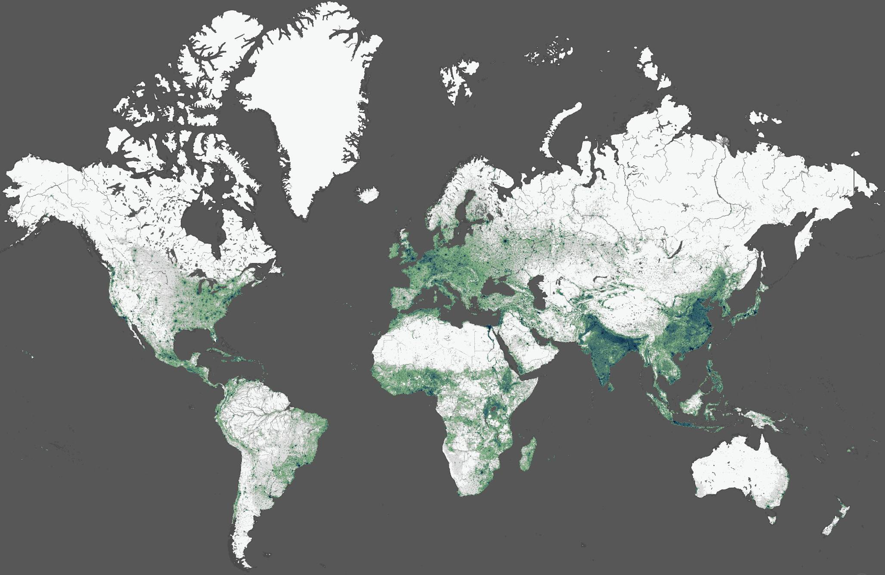
World population density

Slide 7

Mismatch
High population density
High photovoltaic power
potential
High wind power density
potential

Slide 8
Remote Renewable Energy Hubs

Slide 9
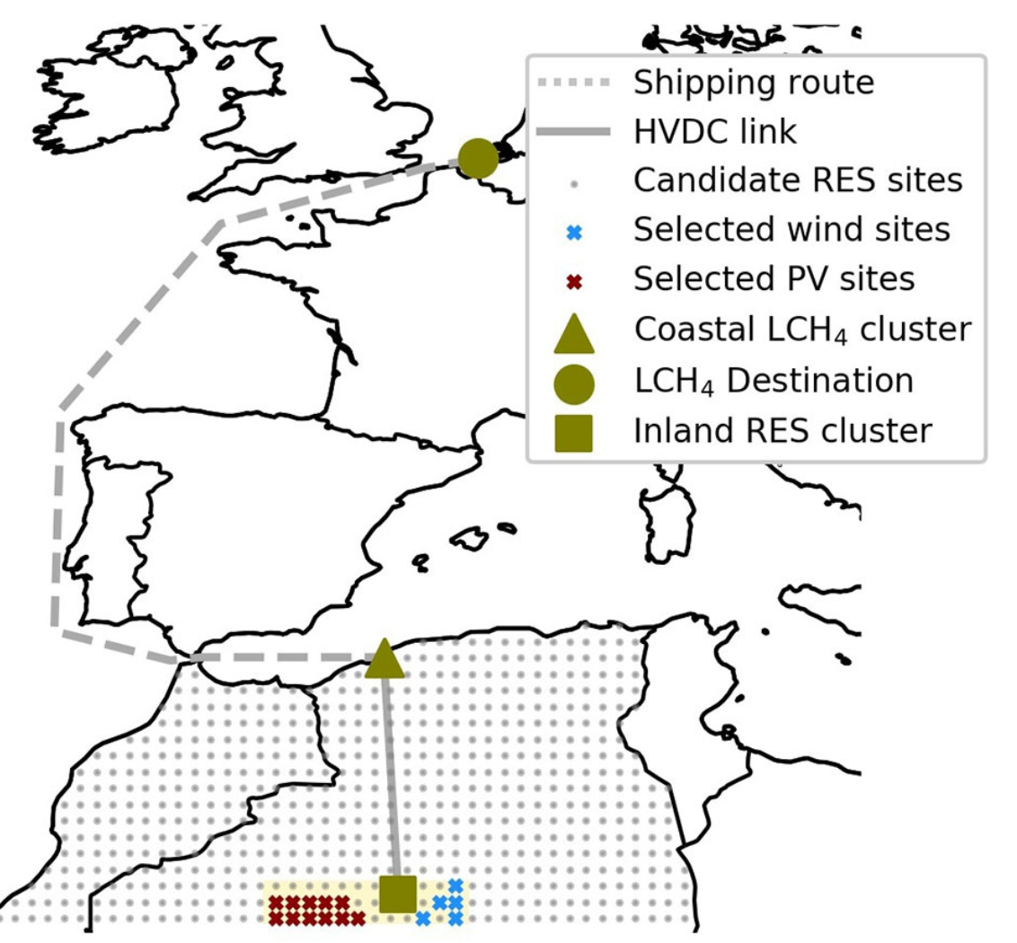
Remote Renewable Energy Hub: definition
A Remote Renewable Energy Hub (RREH) is an energy hub located far away from large load centres where abundant, high-quality renewable energy is harvested.

Slide 10
Why RREH?
Energy in load centers is scarce/low quality
RREHs harvest abundant energy outside load centers
Production of decarbonized fuel (and export)
Can be build in parallel
Benefit to local communities

Slide 11
Schematic view of an RREH
Technologies
Links
Imports
By-products
Local opportunities

Slide 12
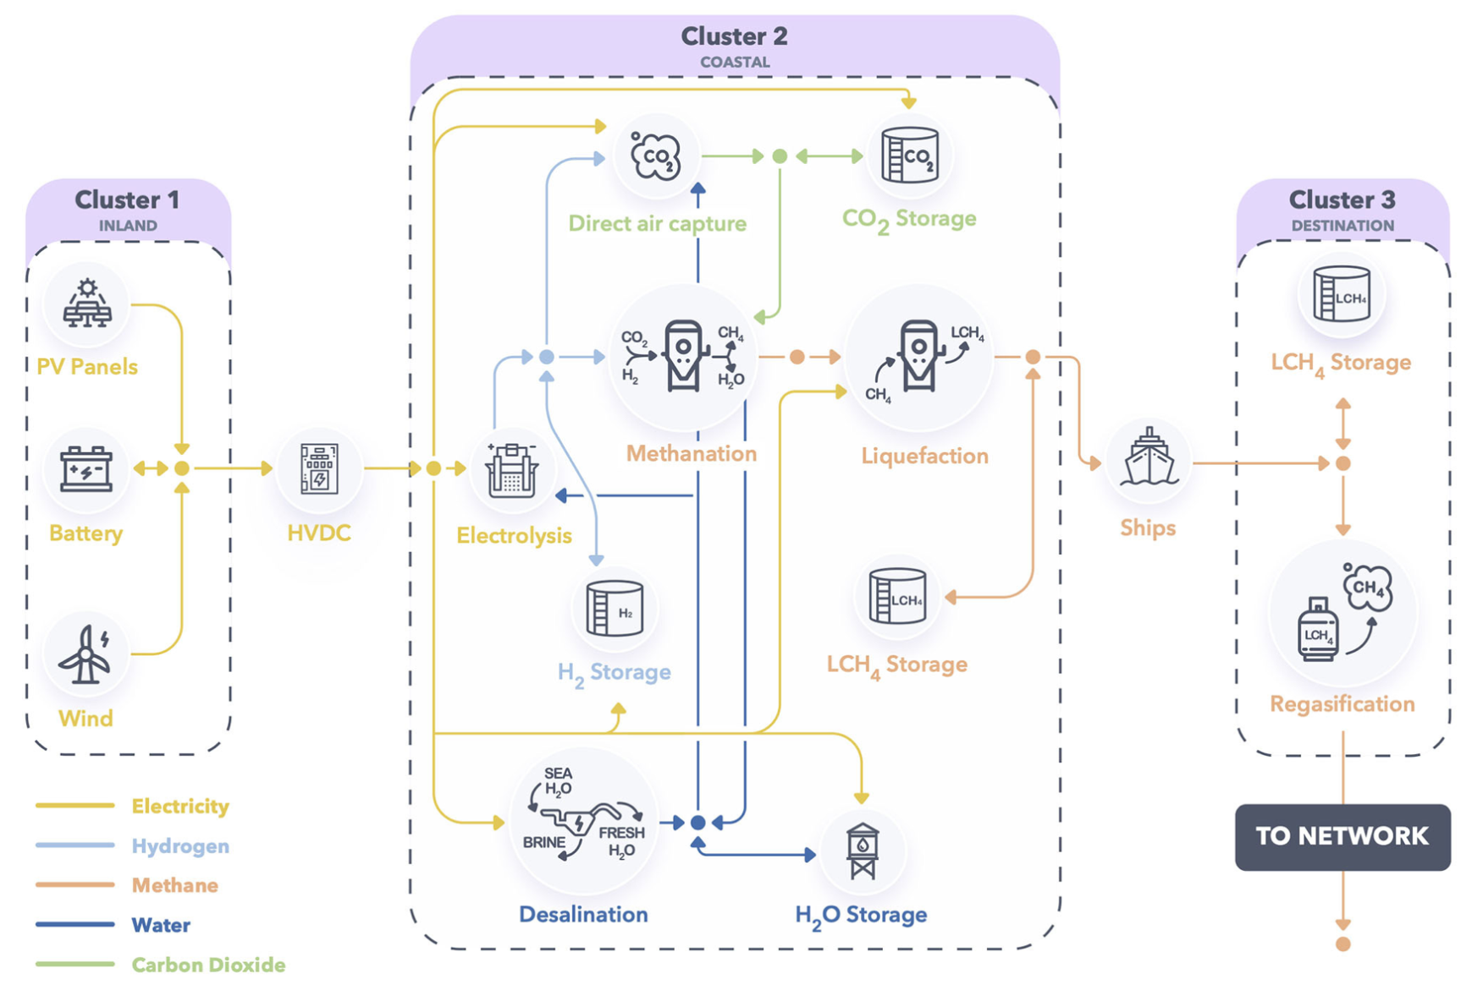
Example: A hub in the desert for carbon-neutral fuel
CH4 from the Algerian desert

Slide 13
But also ammonia…

Slide 14
Or methanol…

Slide 15
Or hydrogen directly!

Slide 16
Hydrogen always at the center of the process!

Slide 17

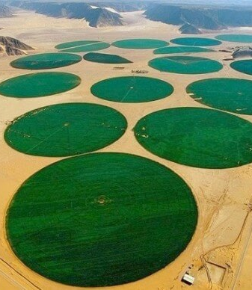
Artistic representation of a ‘Dubai of Greenland’ which would emerge thanks to the significant wind resources of the country, see e.g. Radu et al. (2019).
Irrigation carousel in the Wadi Rum desert in Jordan.

Slide 18
Optimization of the Hubs

Slide 19
Two existing challenges for optimizing a hub
Uncertainty: how to take into account uncertainty related, for example, to the cost of commodities, the renewable energy profiles, the cost of technologies.
Optimizing the technology: how can we determine what improvements should be made to the technology to optimize the economy of hubs? For example, designing windmills with higher cut-out speed and rated output speed may significantly improve the economics of an RREH located in windy Greenland; see Radu et al. (2019).*
* We are currently using Reinforcement Learning (RL) techniques as a way to solve these challenges, see e.g. Boland et al. (2022).

Slide 20
Conclusion
RREHs offer magnificent opportunities for rapidly transitioning to low-carbon economies.
Possibility to take advantage of local opportunities for farming and water.
Identifying the optimal hubs is a complex optimization task, especially if multi-energy vector hubs are considered.

