Slide 1
Devices for measuring interplay between photoprotection and phototaxis in Euglena gracilis
Alain GERVASI
Promotor : Pierre Cardol
Co-promotor : Prof. Patrick E. Meyer
BotaBotLab

Slide 2
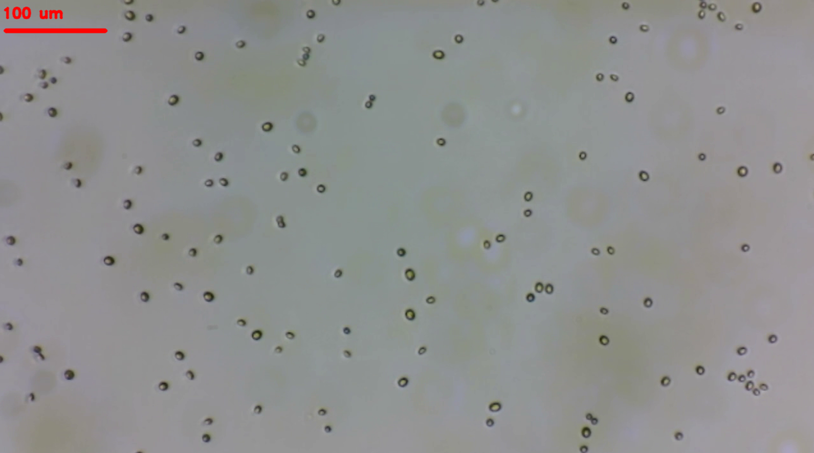
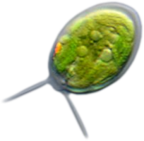
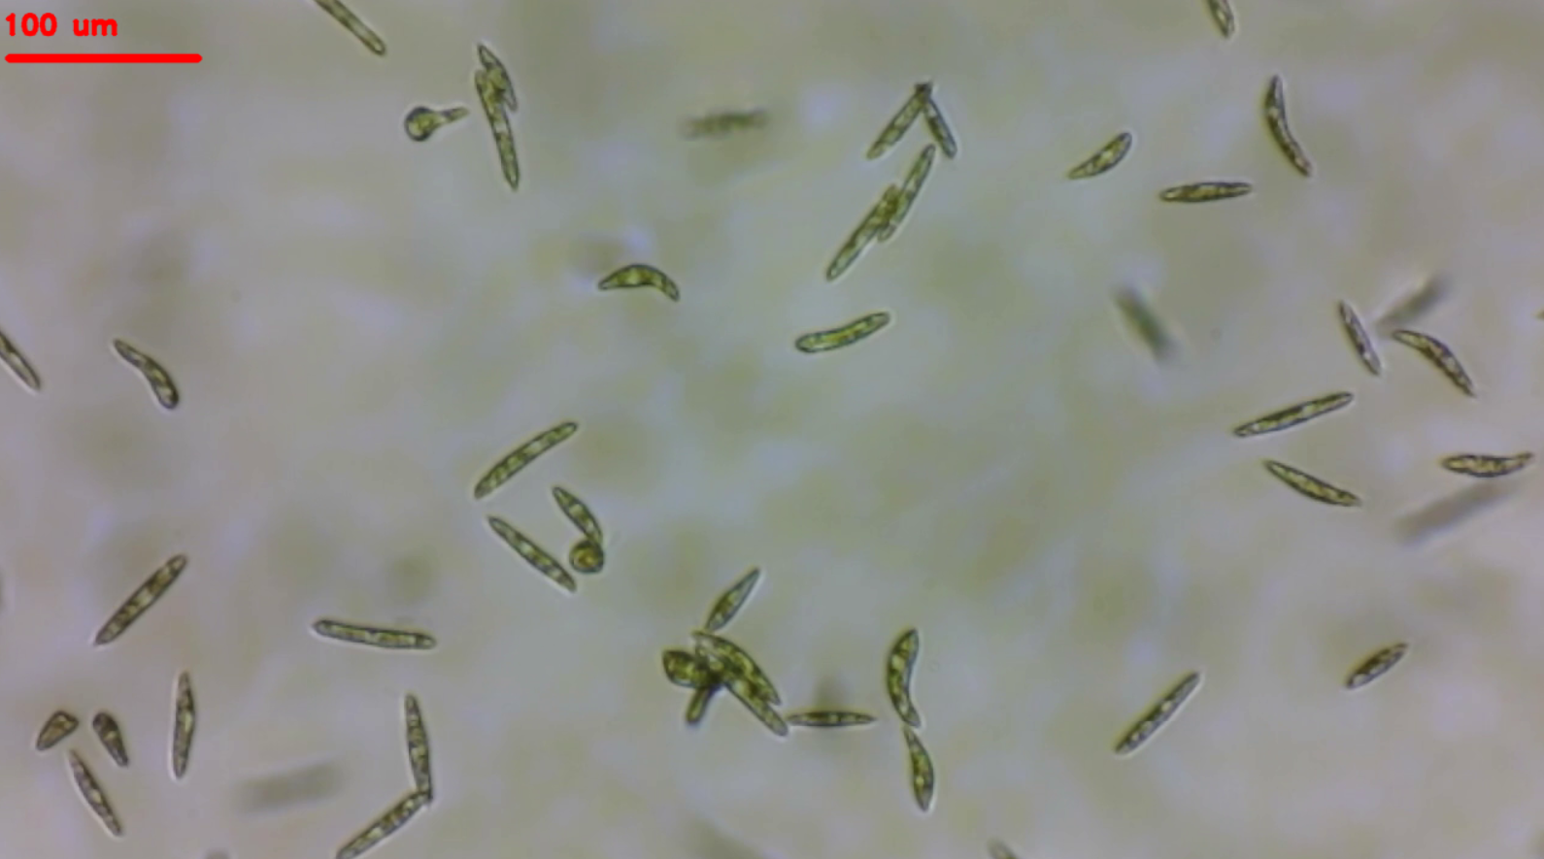
Context
Chlamydomonas reinhardtii
Algae
Unicellular
Fresh water
Photosynthetic
Motile
Euglena gracilis

Slide 3
Photoprotection in general ?
Motility
?
Timing
?
?
Light
detection
Joint
measurement
Efficiency
Interactions
?
Environmental factors
Energy dissipation
Medium composition
Light
Temp.
CO₂

Slide 4
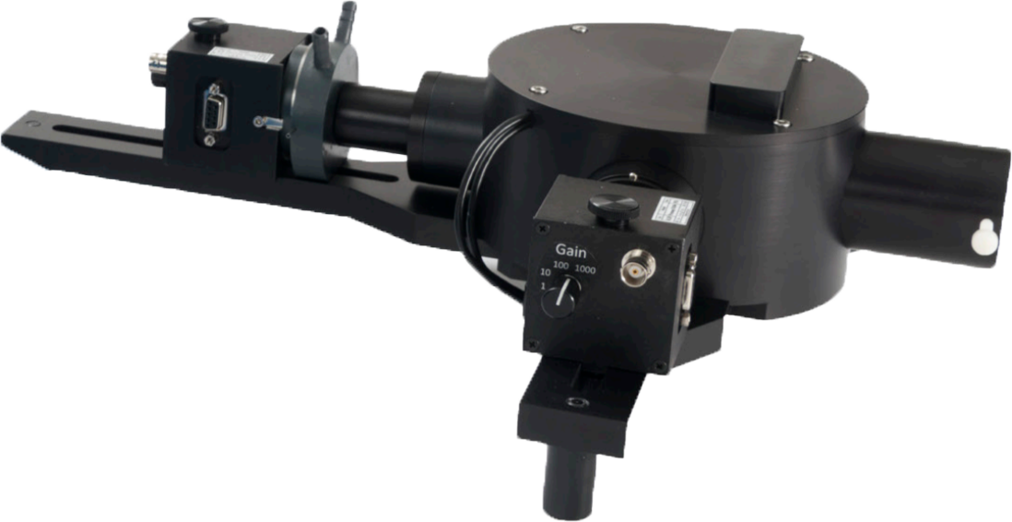
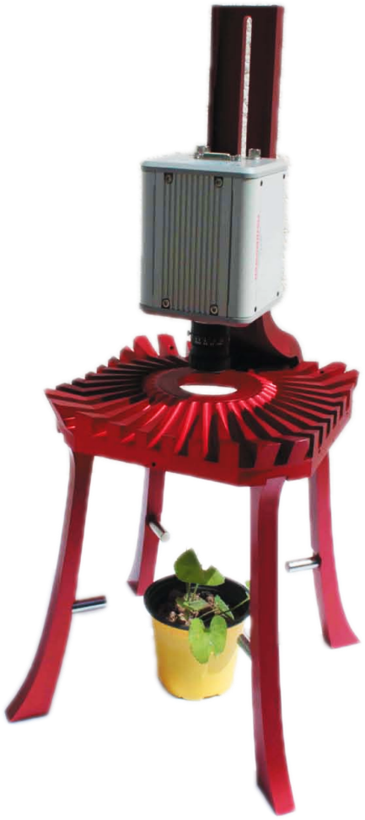
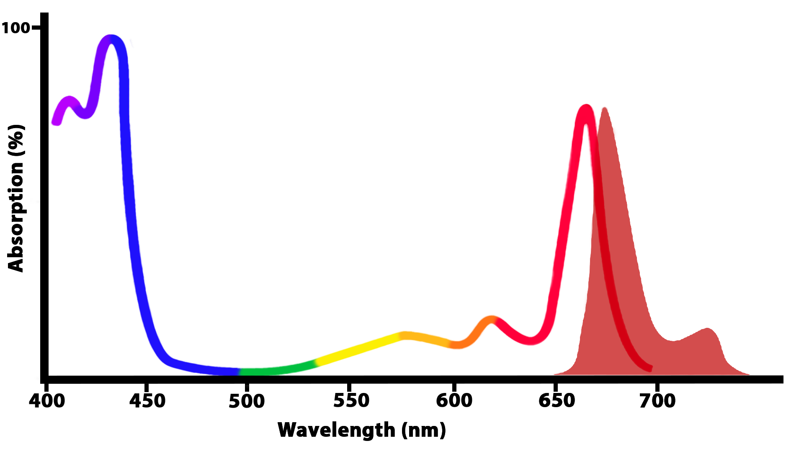
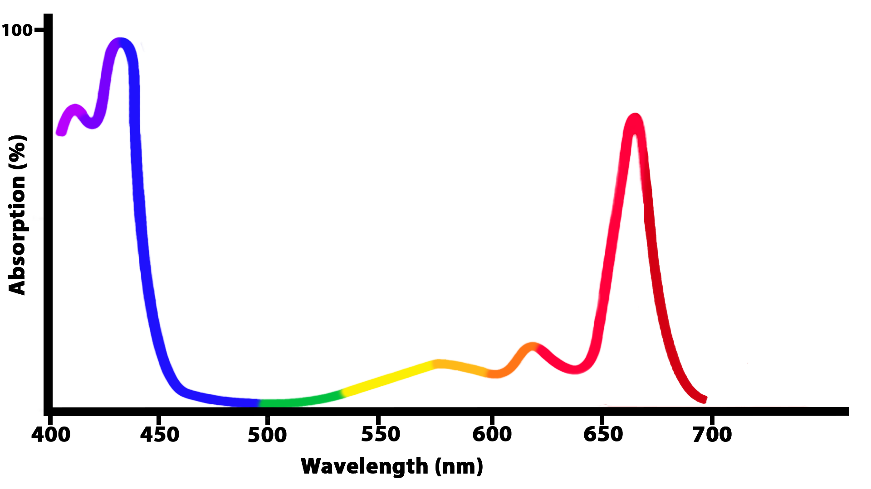
PSII fluorescence
¹Chl*
Fluorescence
Photochemistry
Heat (NPQ)
Chl

Slide 5
Fluorescence measurement
Fluo
F_{m}
qI
qT
F_{v}/F_{m} = (F_{m} – F₀) / F_{m}
NPQ
Φ_{PSII} = (F_{m}’ – F_{s}) / F_{m}’
qE
qP _{PSII} = (F_{m}’ – F_{s}) / (F_{m} – F₀)
F_{m}’
NPQ = (F_{m} - F_{m}’) / F_{m}’
qP
F_{s}
F₀
Time
Actinic light
Measurement light pulse

Slide 6
NPQ measurement

Slide 7
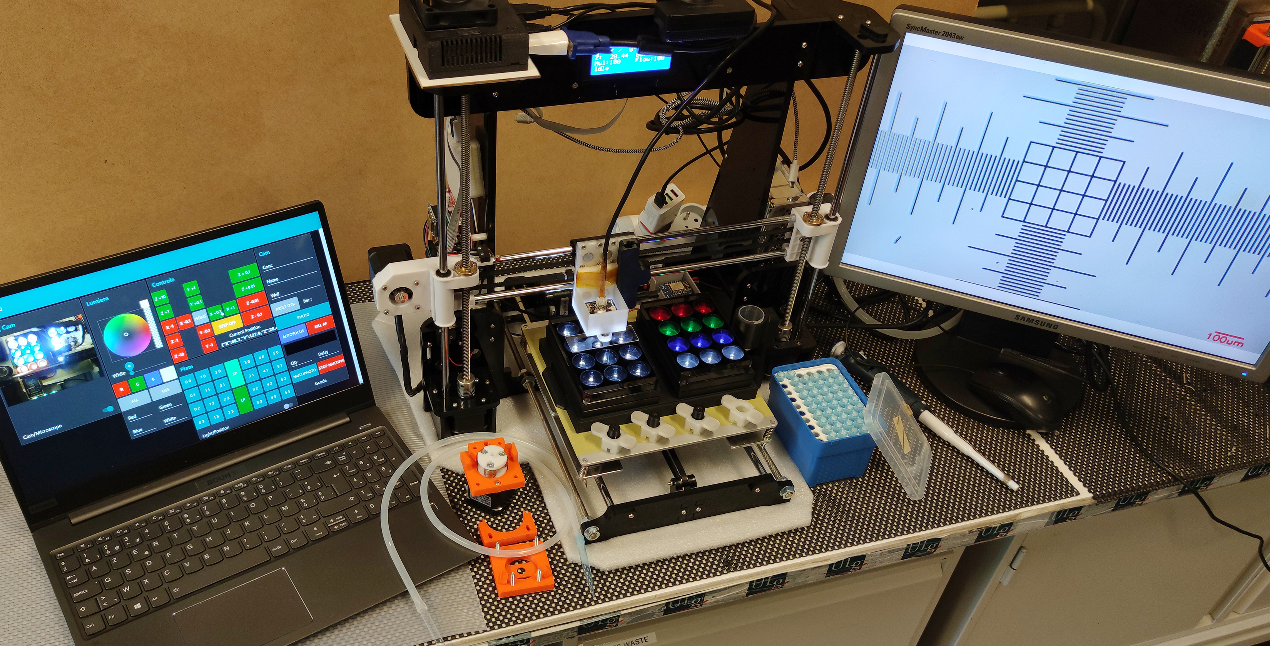
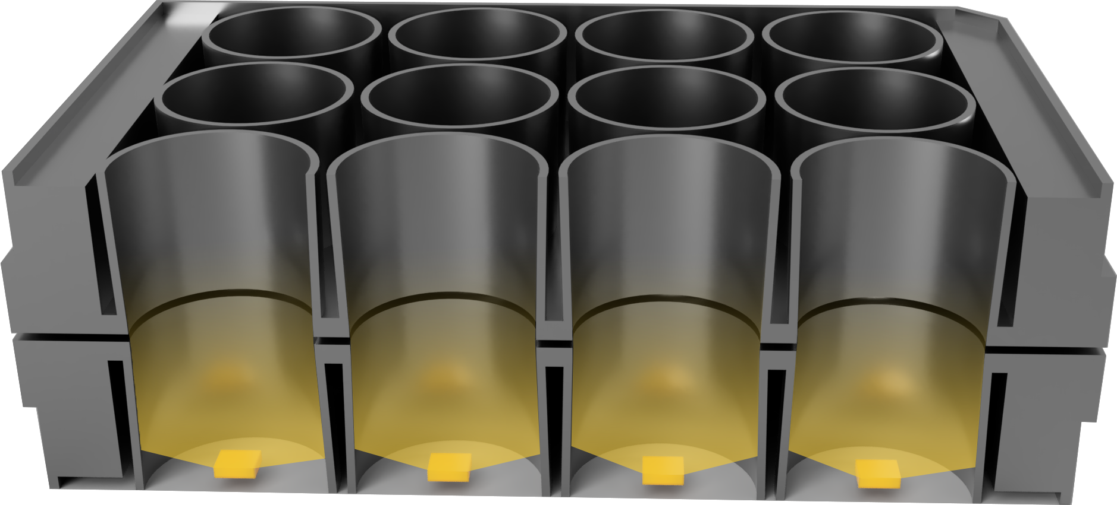
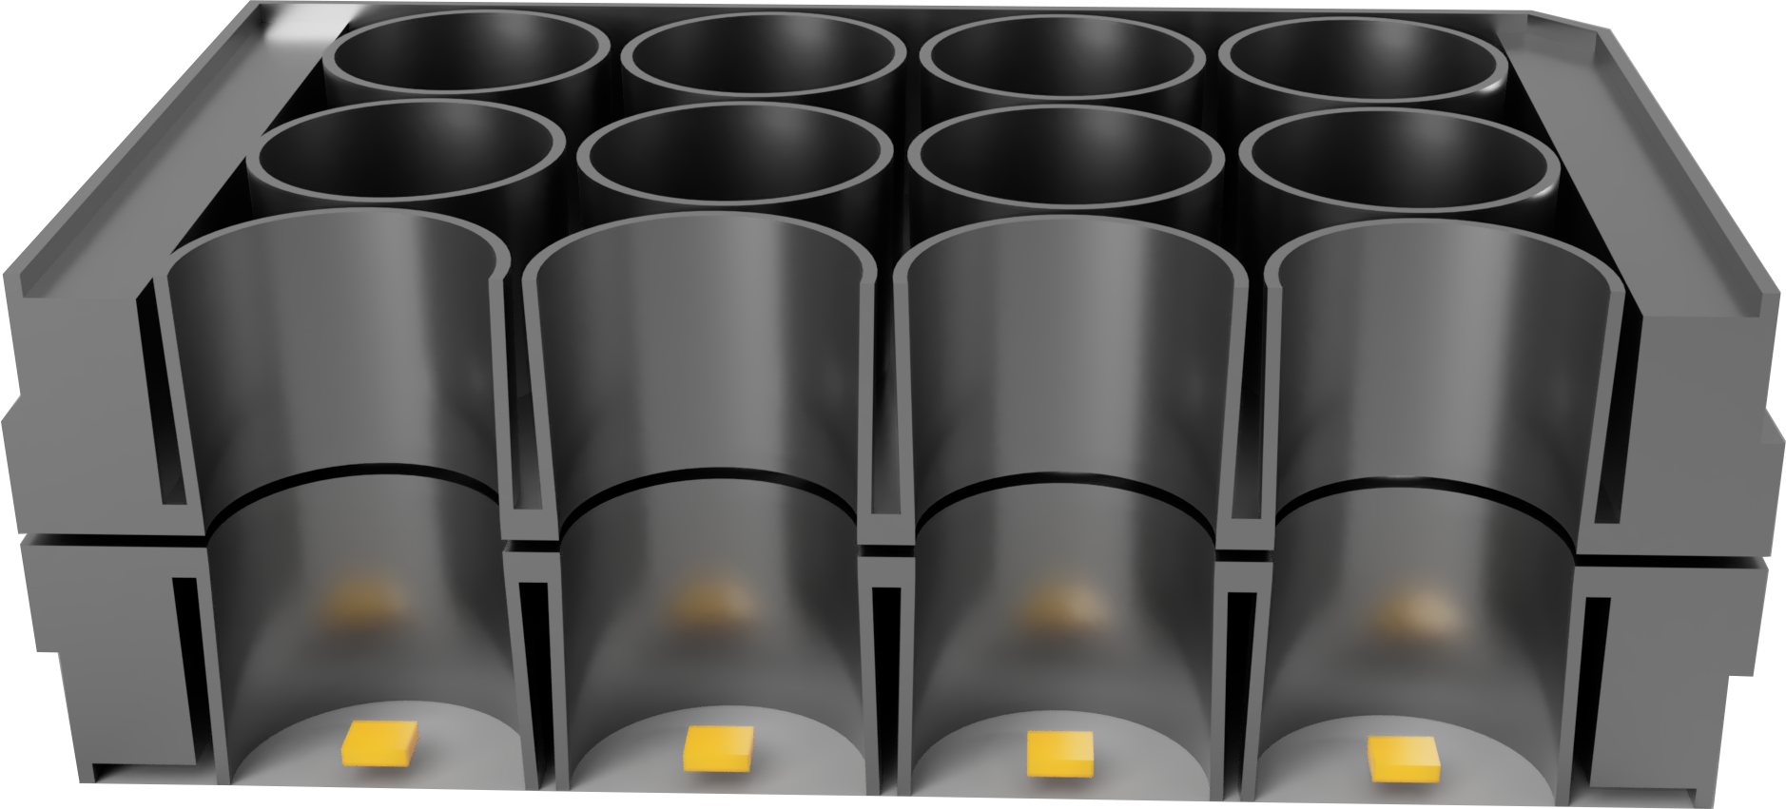
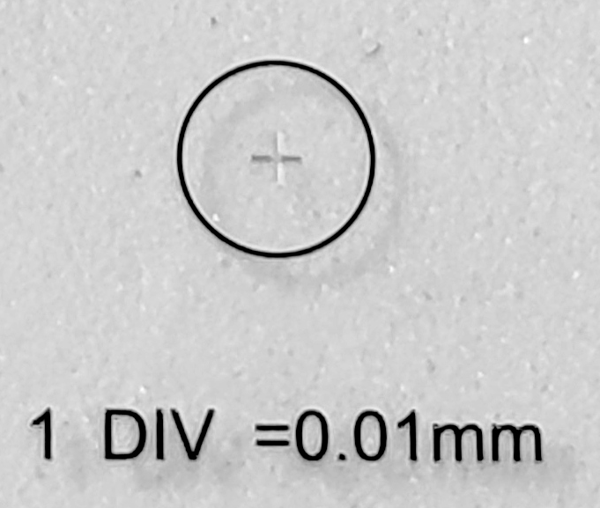
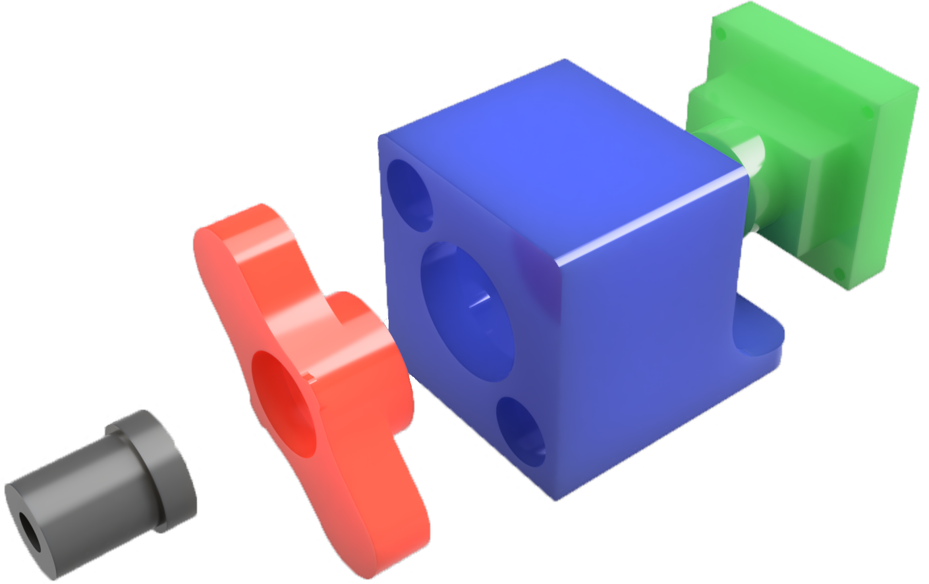
Automated microscope
Gervasi et al. (2022) https://doi.org/10.3390/mi13060833

Slide 8
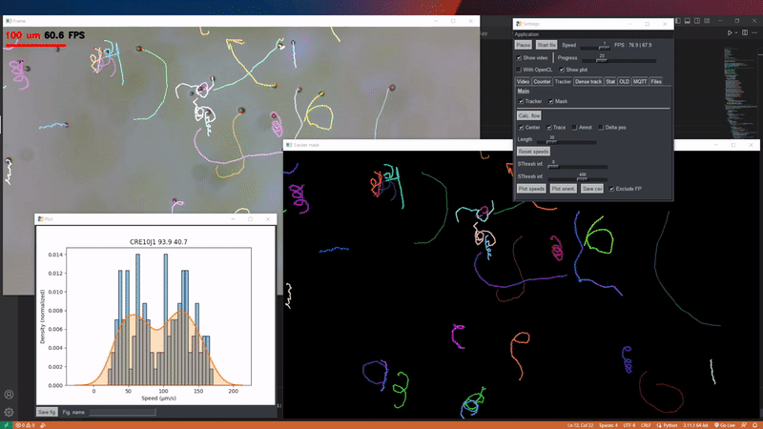
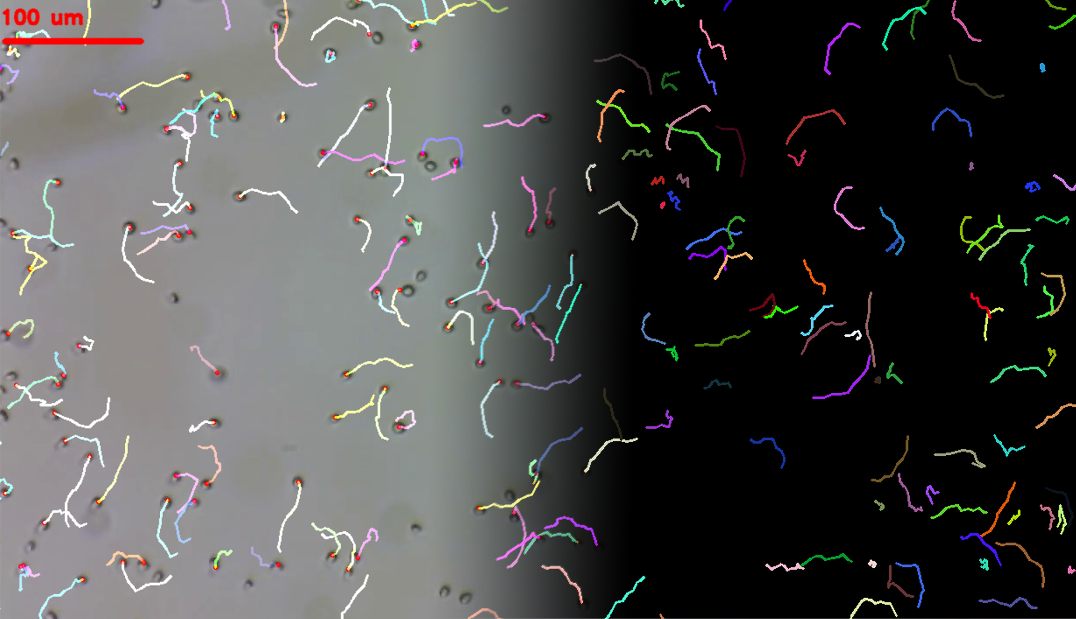
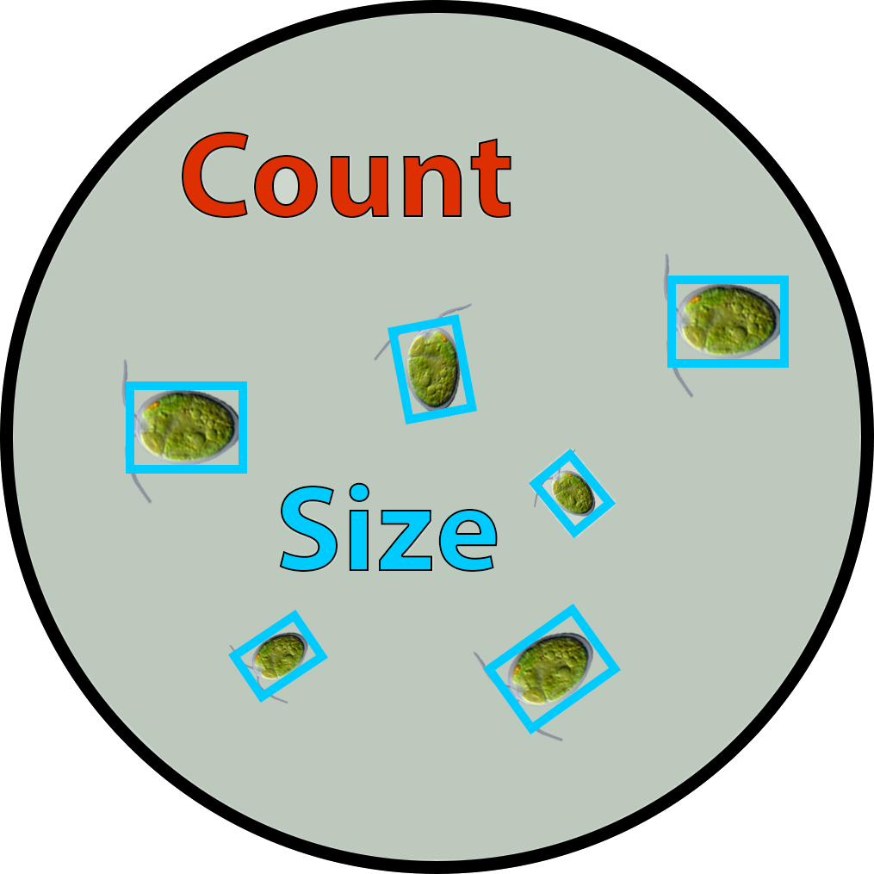
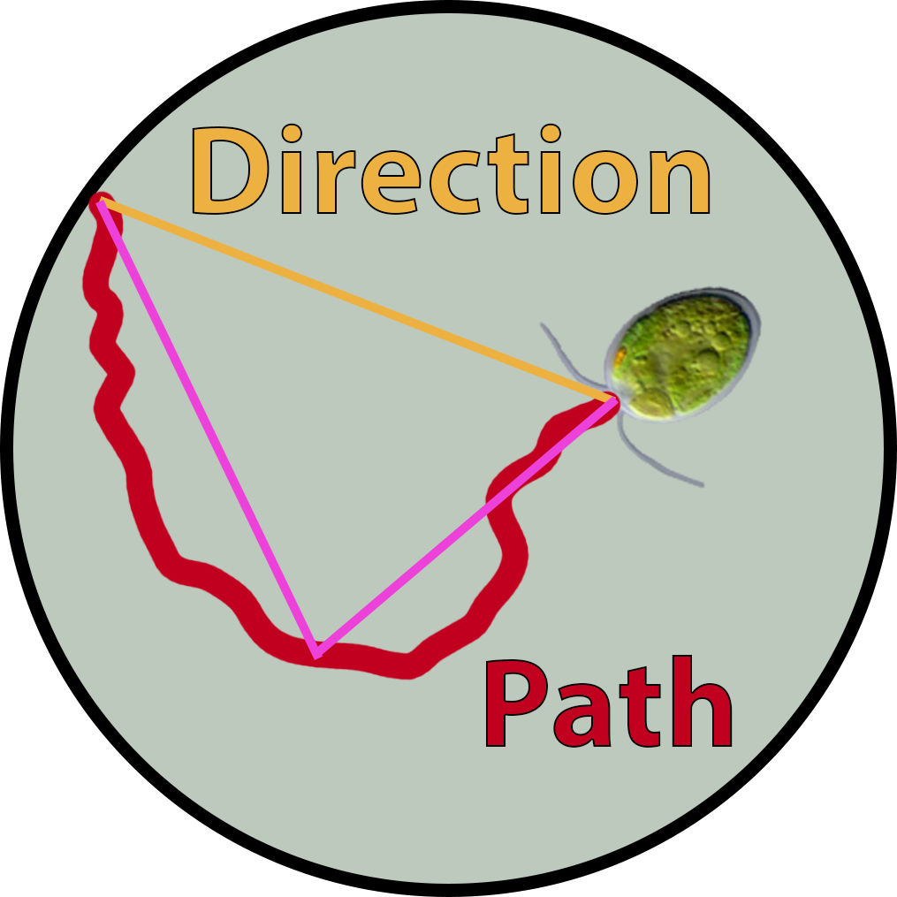
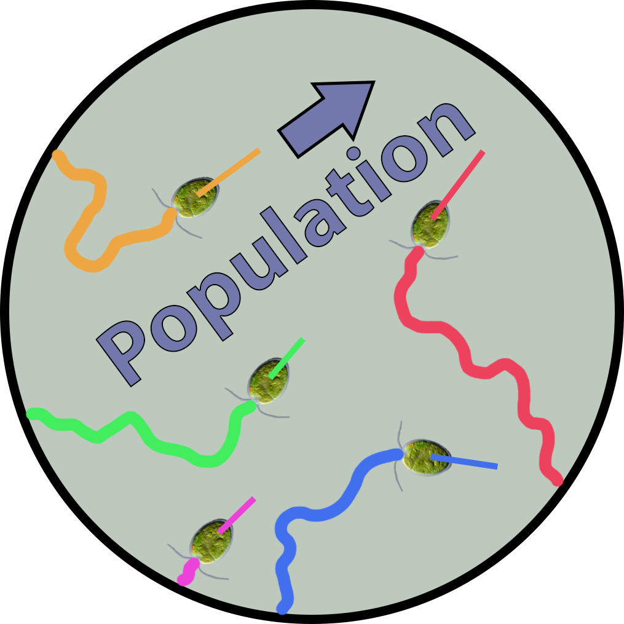
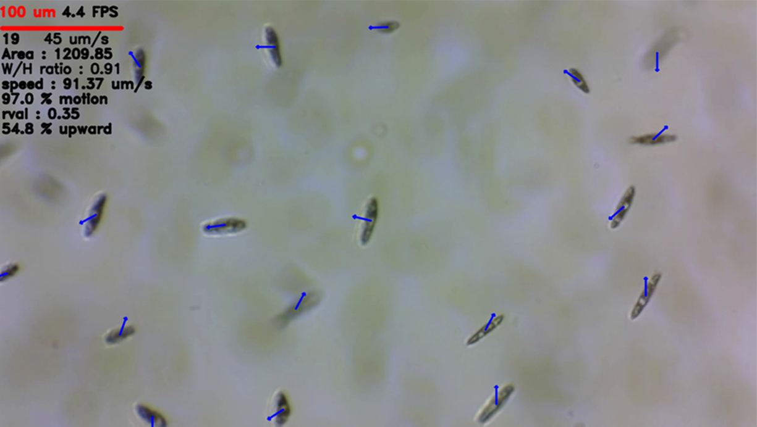
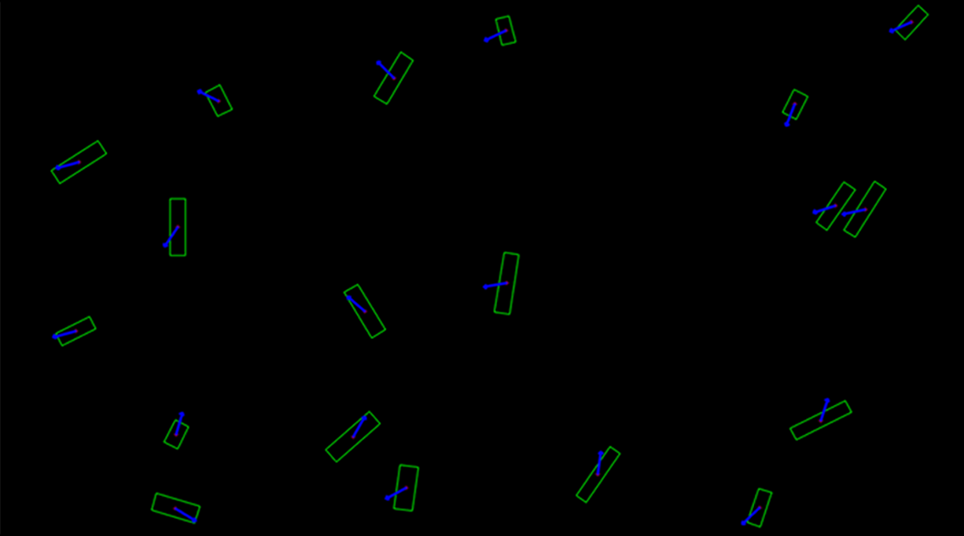
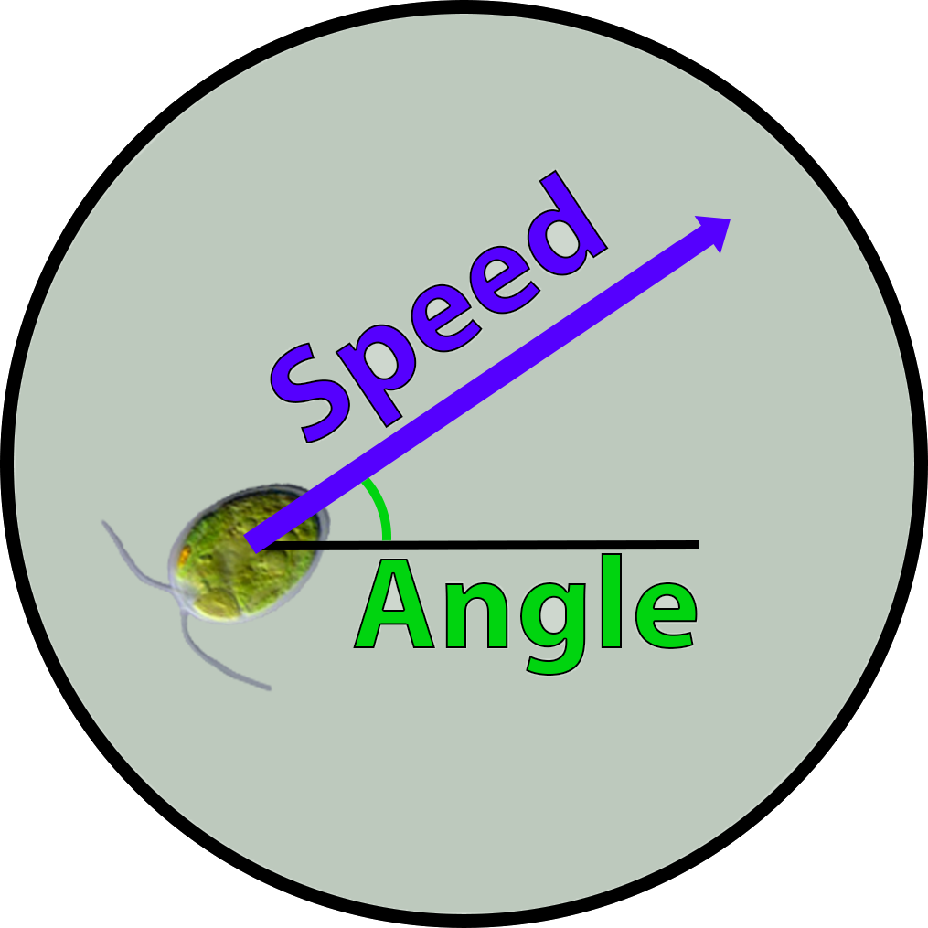
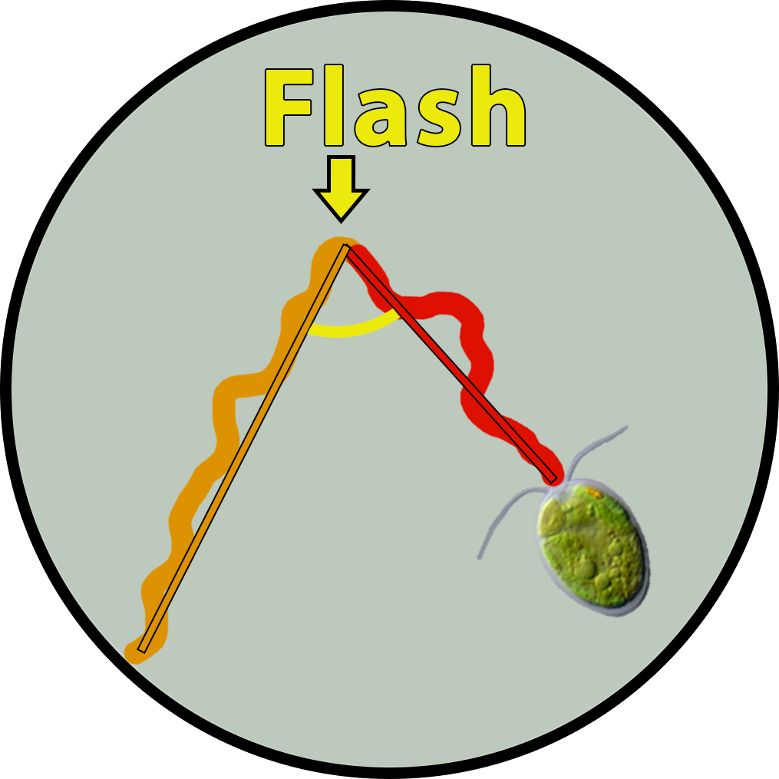
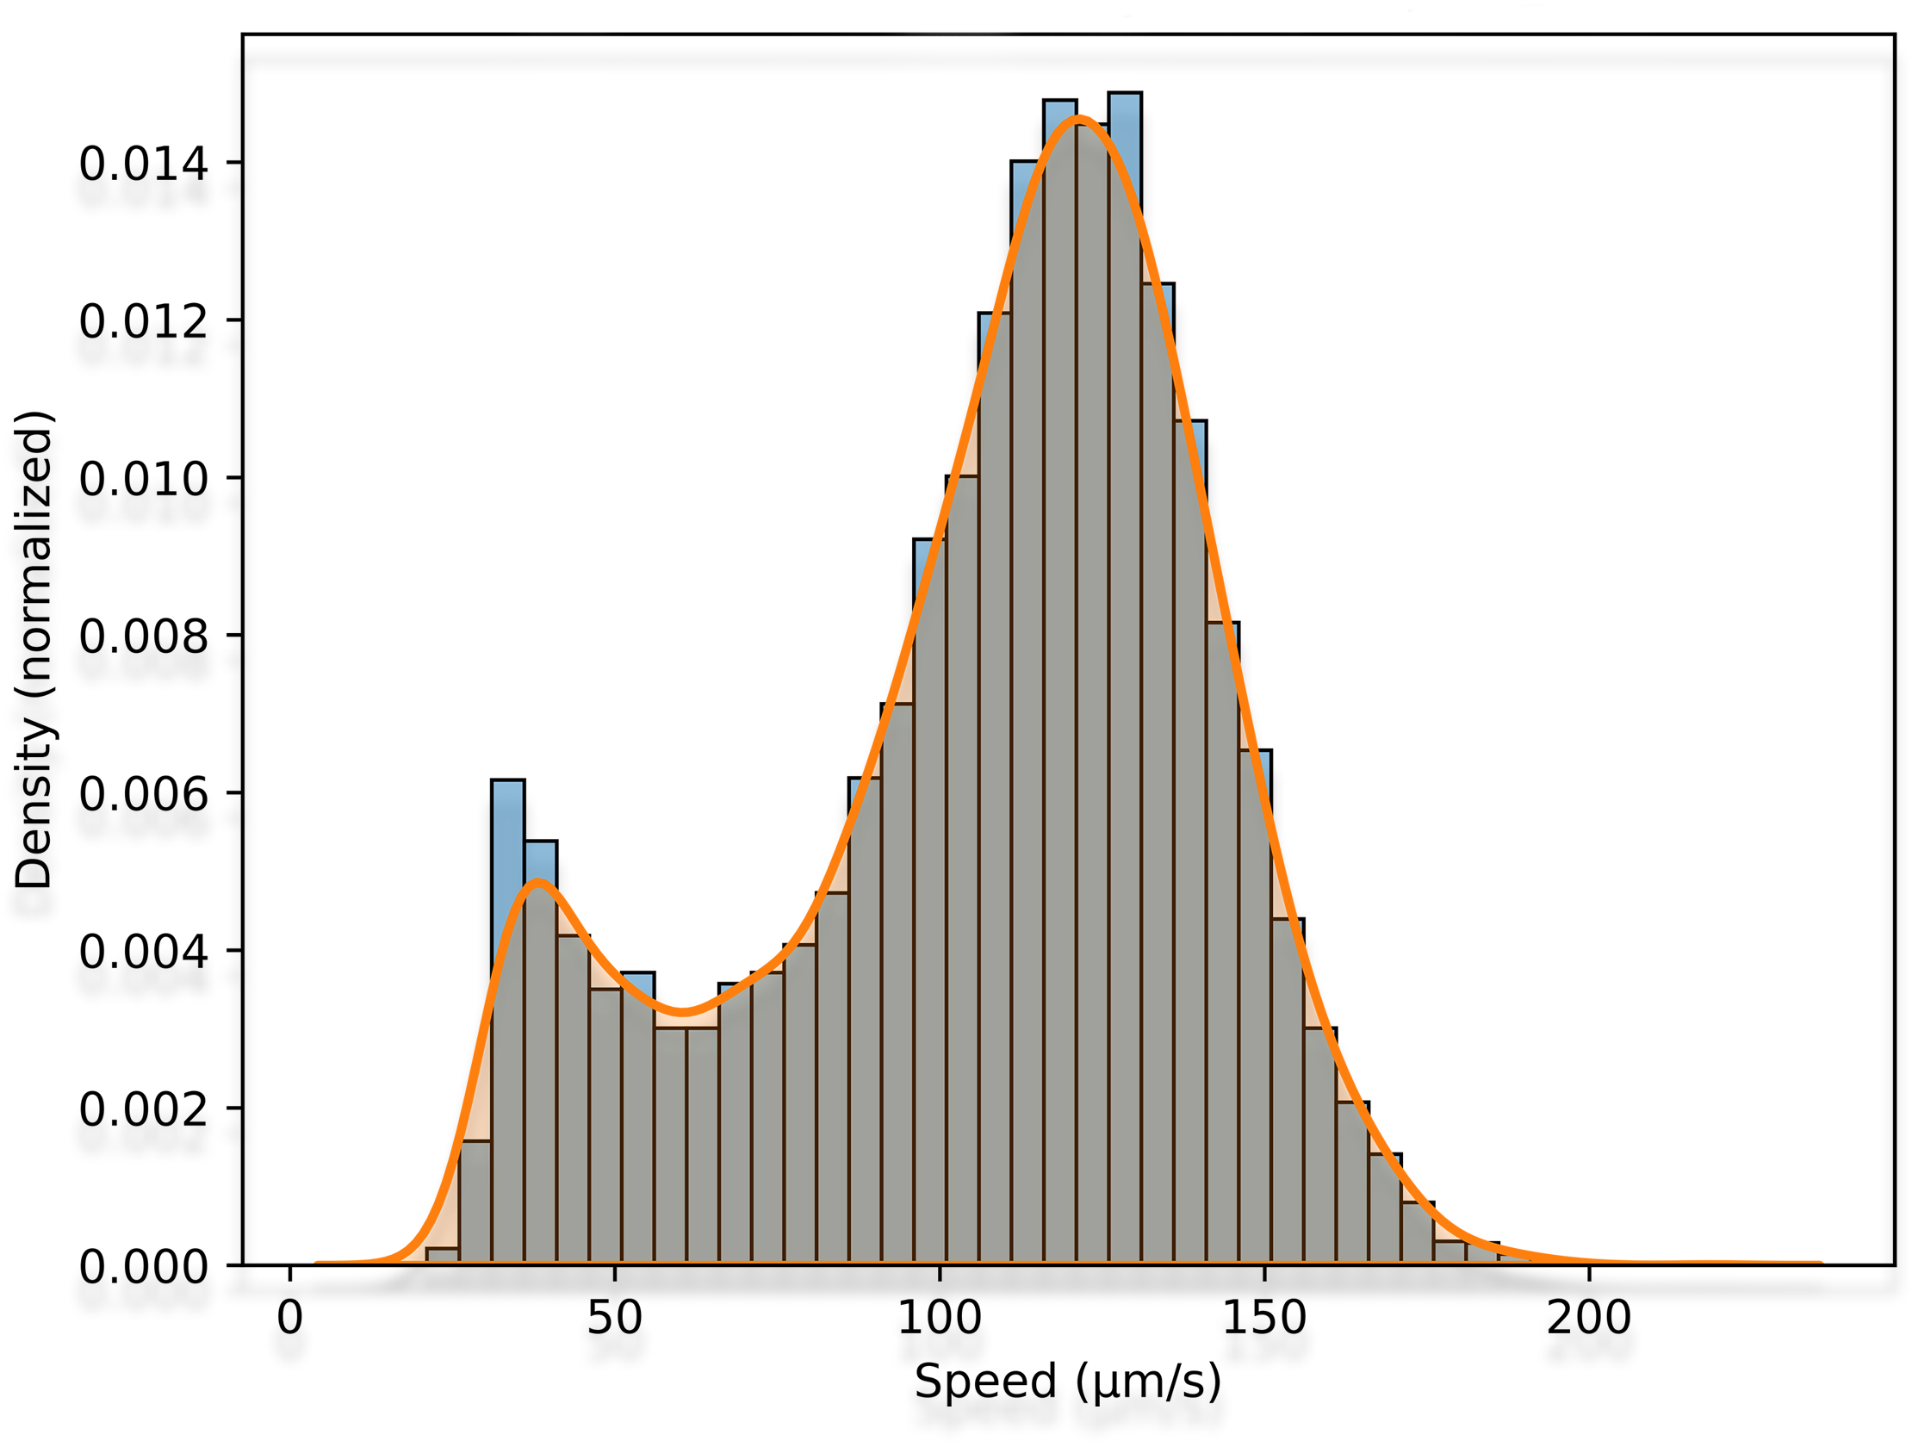
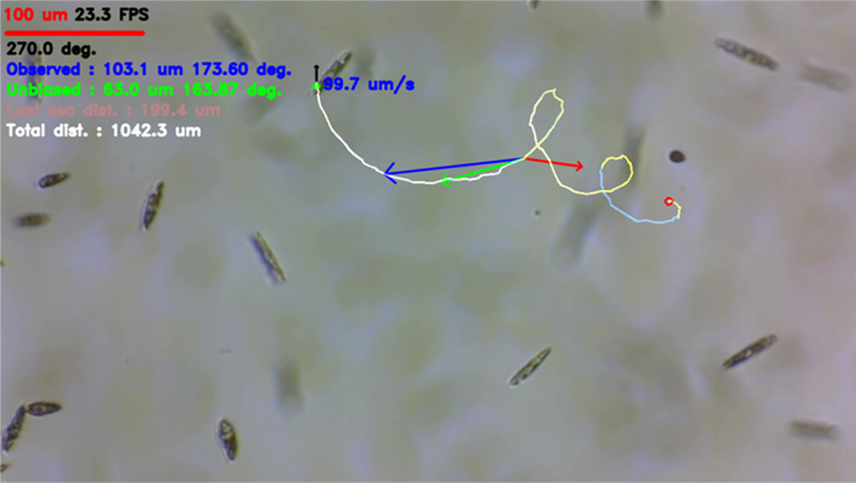
Motility quantification
Image analysis
Acquisition/calibration
Preprocessing => Binarisation
Cell detection => Edge detection
Selection correction => Watershed
Tracking => Optical flow
Movement correction => Vector addition
Trajectory analysis
Data export
Gervasi et al. (2022) https://doi.org/10.3390/mi13060833

Slide 9
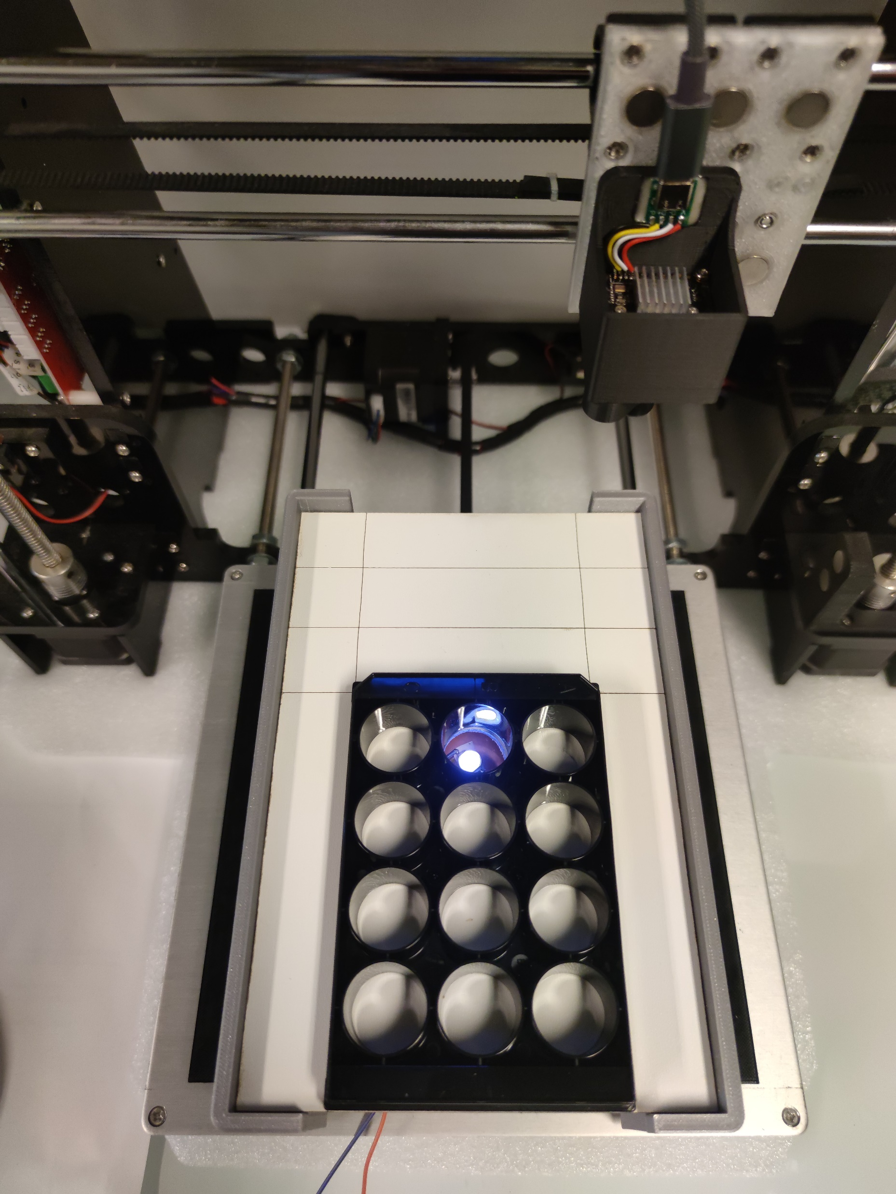
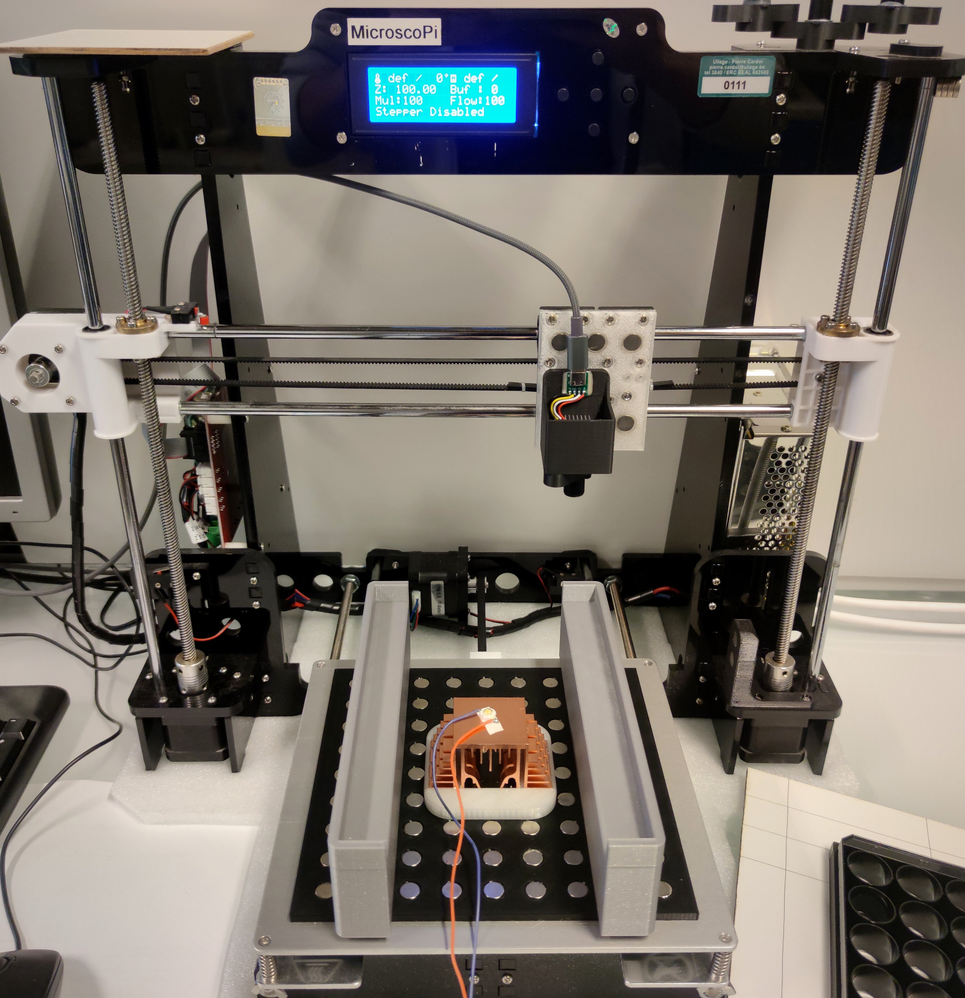
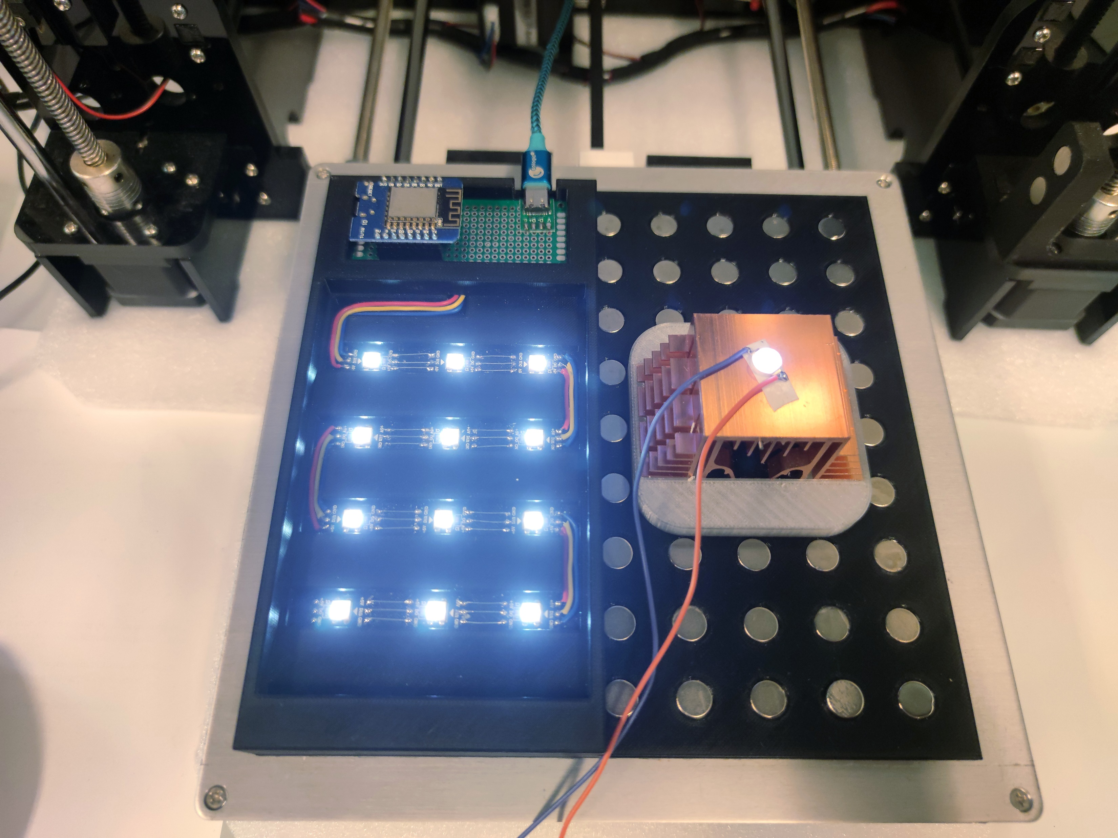
Limitations of the microscope

Slide 10
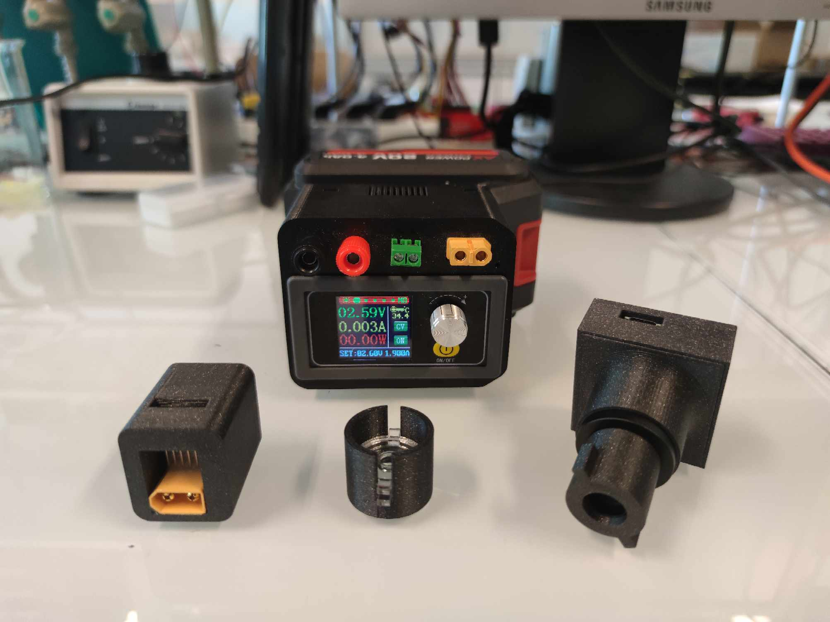
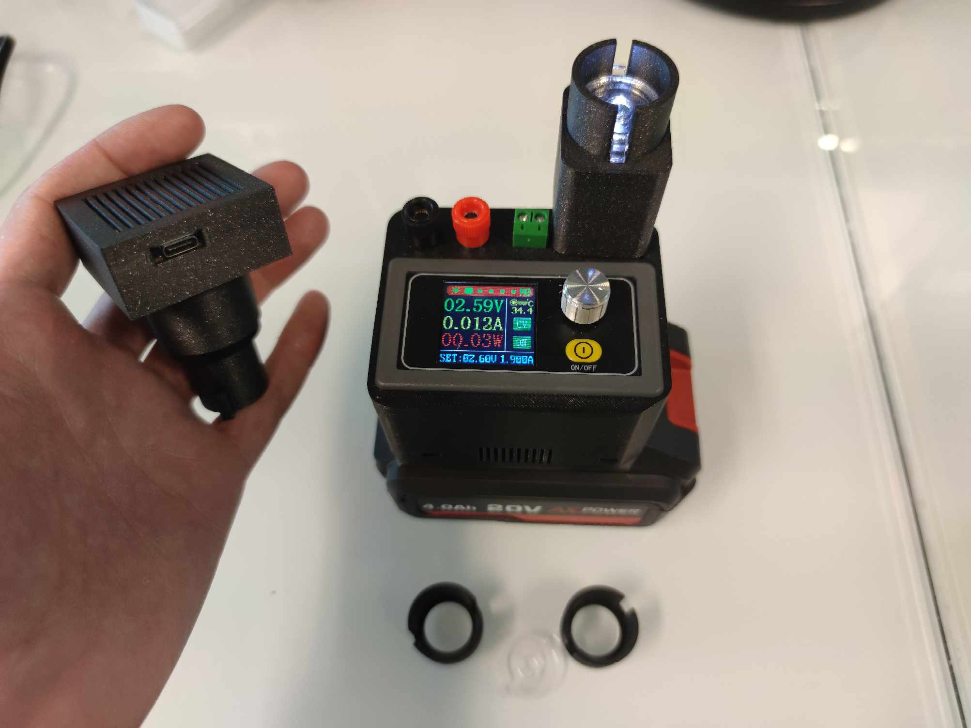
New microscope module

Slide 11
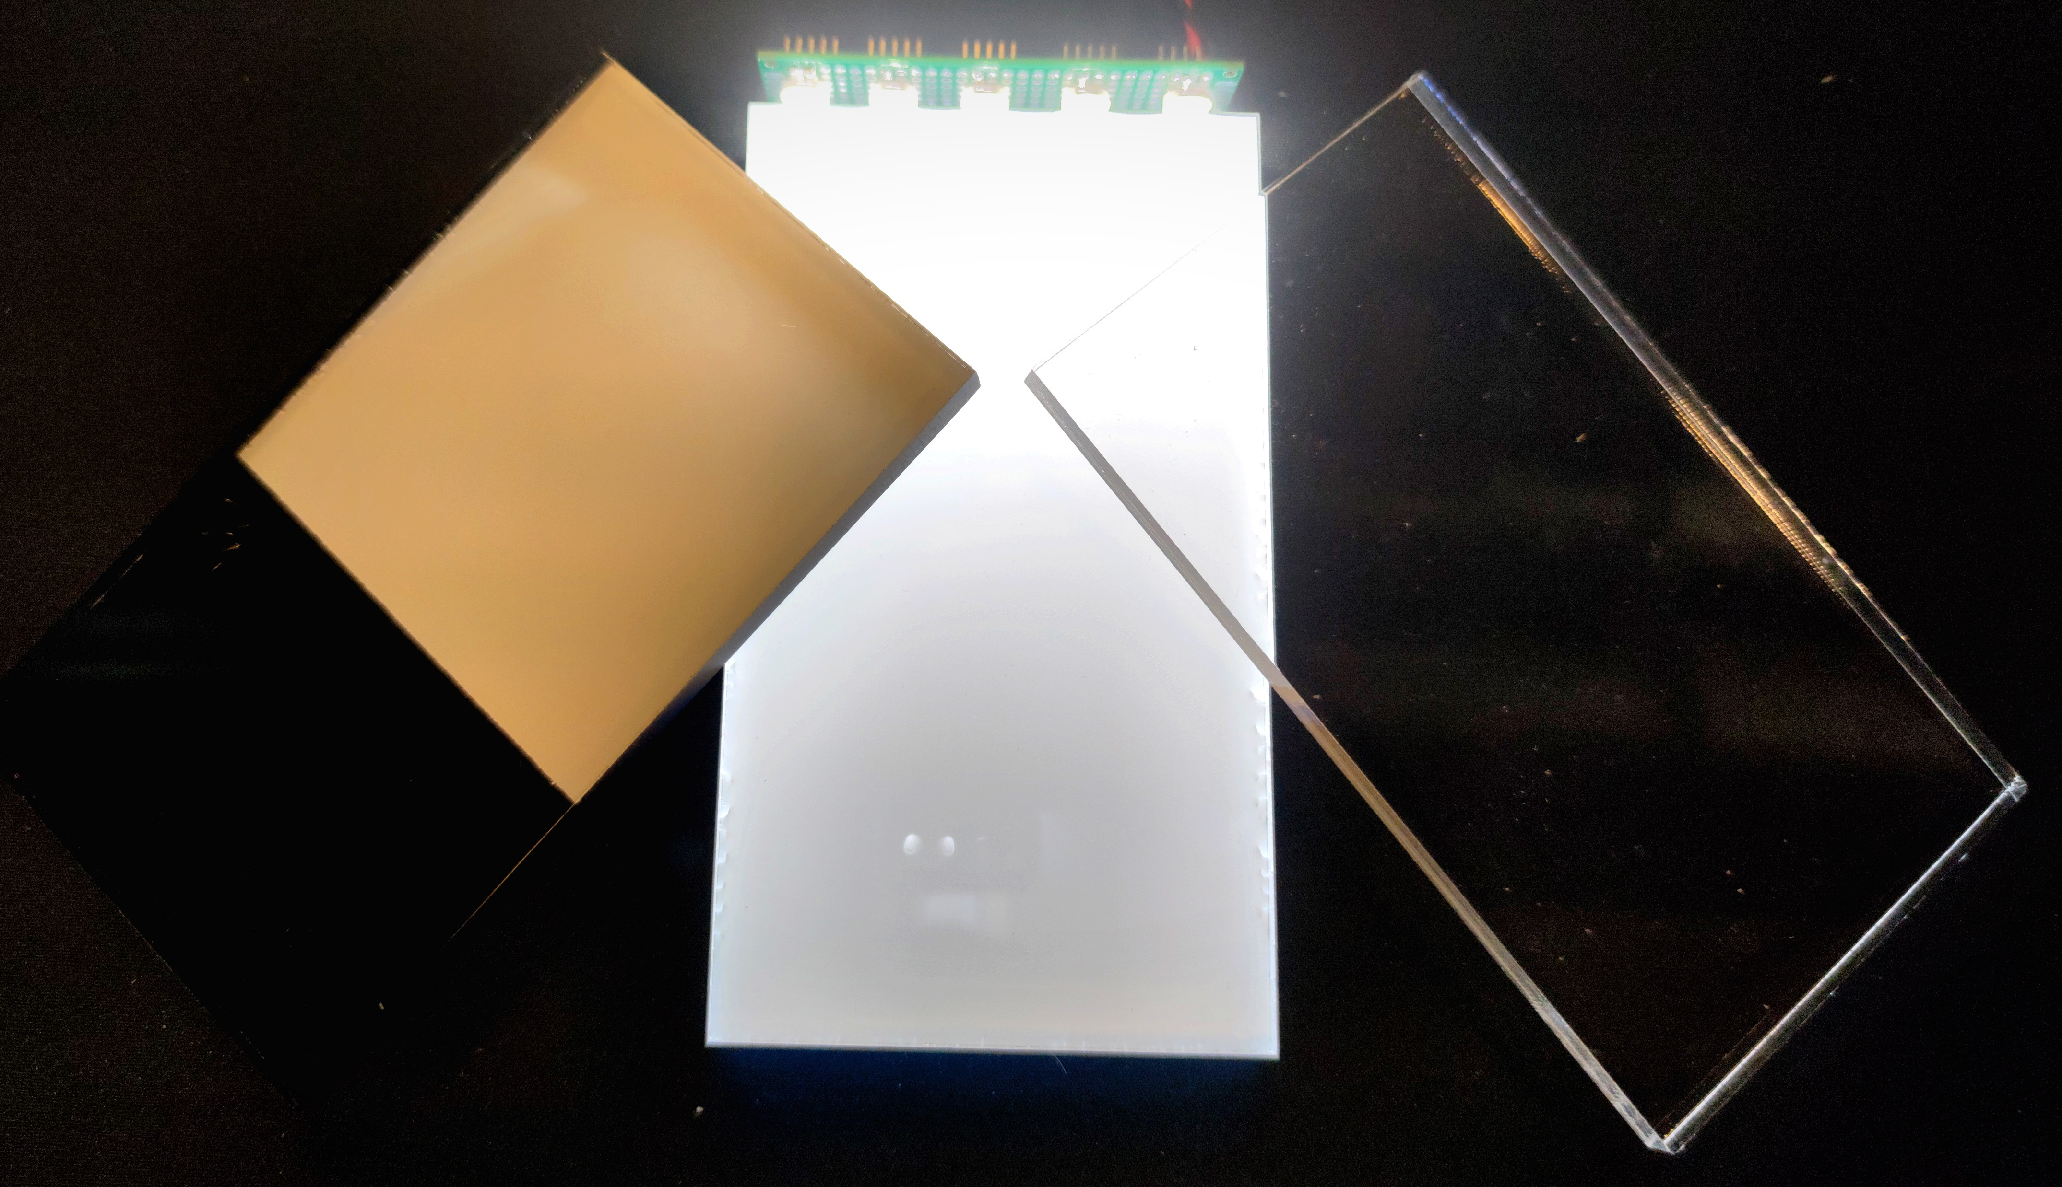
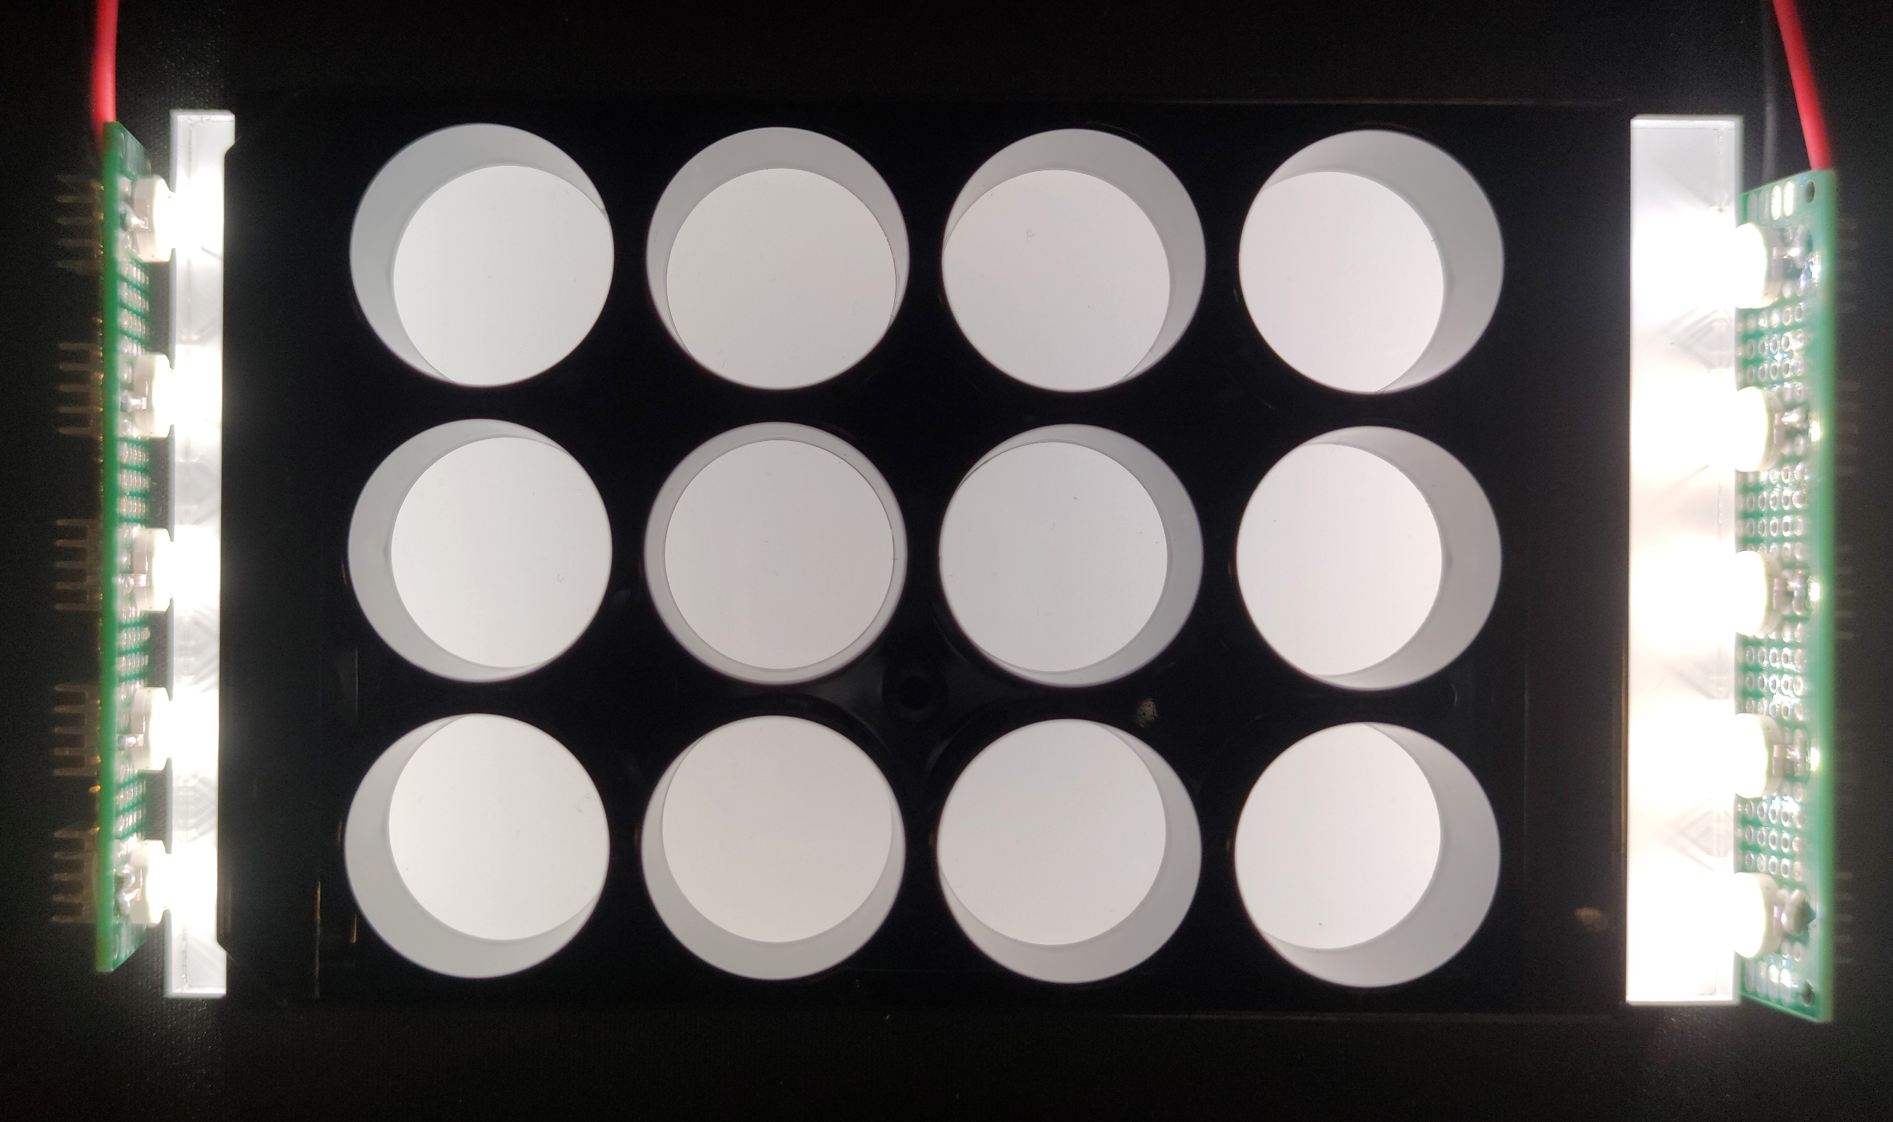
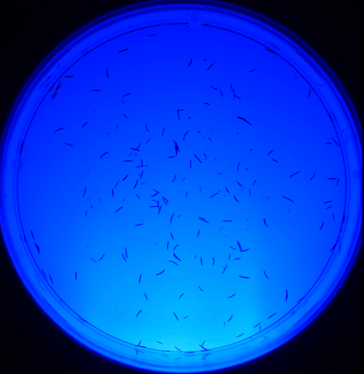
Lighting system

Slide 12
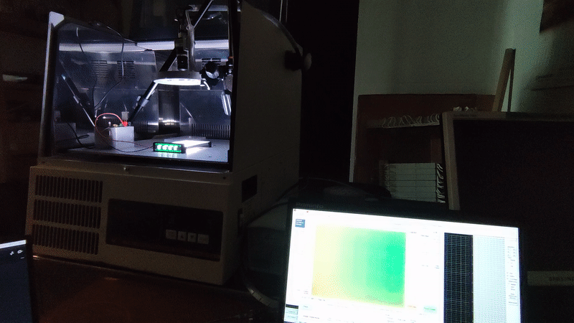
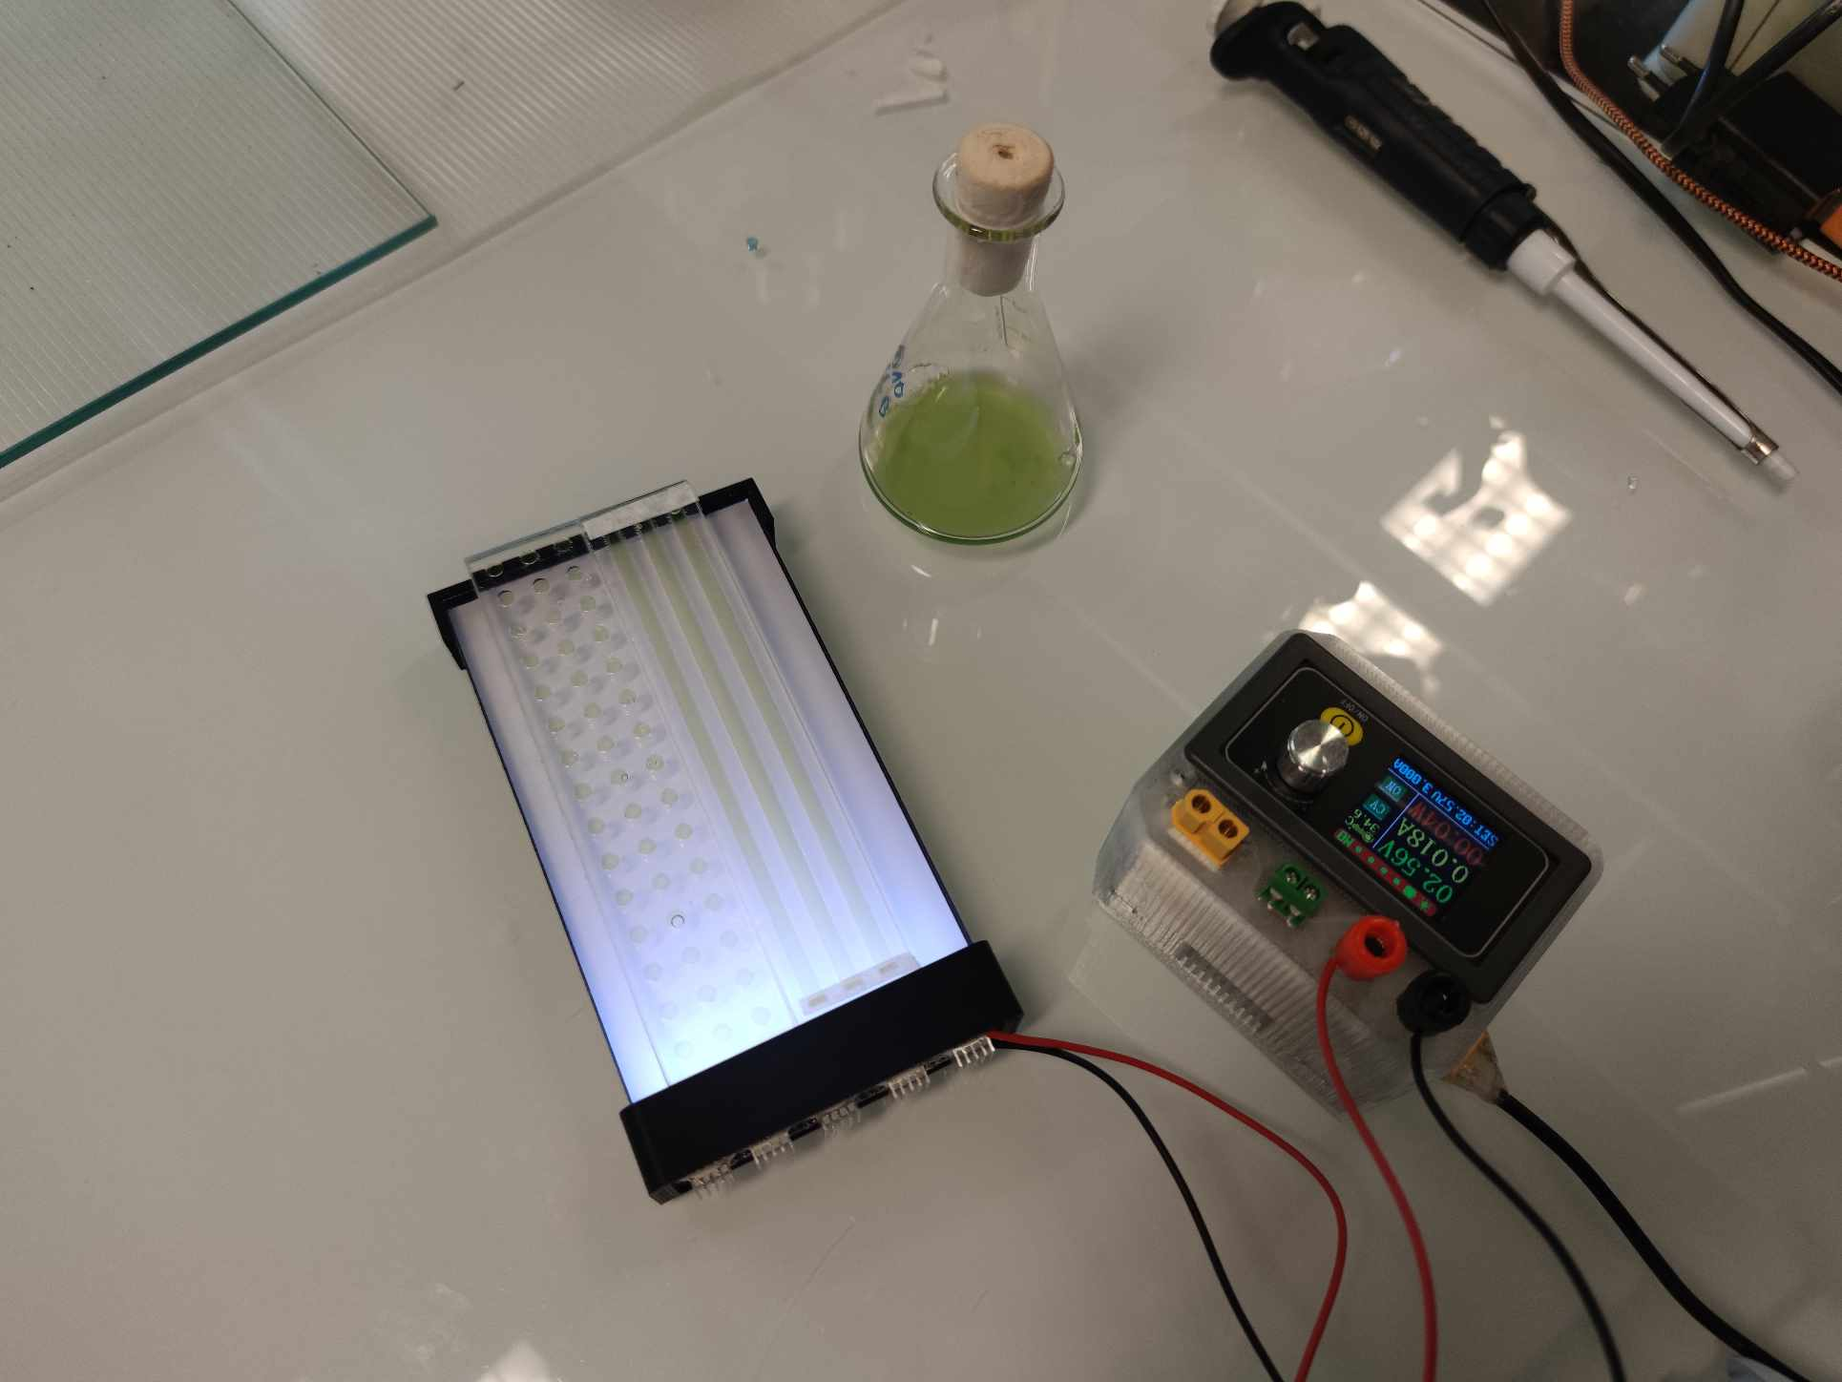
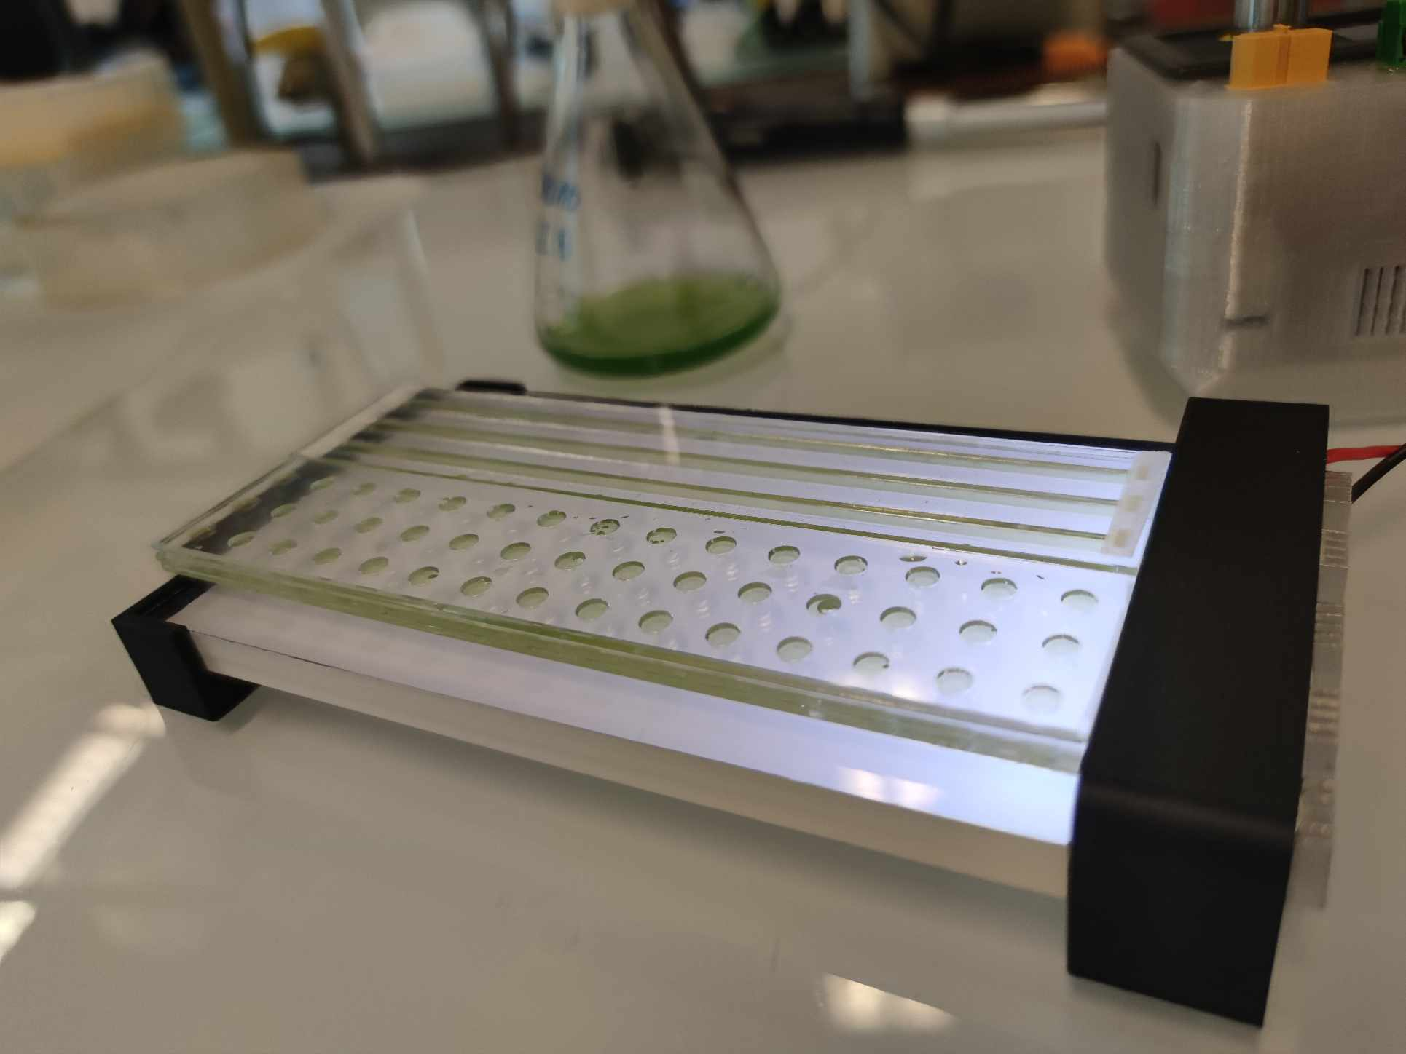
Joint measurements

Slide 13
Thank you for your attention

