Slide 1

NATURAL FIRE TESTS ON GLT COLUMNS INCLUDING THE COOLING DOWN PHASE
Fabienne Robert, Silvio Renard, Fire Testing Centre, CERIB, France
Jean-Marc Franssen, Univ. of Liege, Belgium
Jochen Zehfuß, Sven Brunkhorst, Techn. Univ. Braunschweig, Germany
Patrick Bamonte, Politecnico di Milano, Italy
Robert McNamee, RISE Res. Inst. of Sweden and Lund Univ., Sweden
Thomas Gernay, Johns Hopkins University, USA

Slide 2
1. The context
1. The context
Tfire
1.1 Timber columns in non-standard fires
Fire Resistance Rating
Time
Fires that last longer than the Fire Resistance Rating?
No.
Fires that are shorter than the Fire Resistance Rating?
Yes (majority of the fires)

Slide 3
1. The context
1.1 Timber columns in non-standard fires
1.2 General concern
The heat wave continues propagating in the section after the peak of the fire.
Note: The same happens in other materials.
Problem for timber is that:
temperatures in the centre of the section as low as 200°C or 100°C
lead to a significant reduction of compressive strength.
f_{c}(100°C) = 1/4 f_{c}(20°C) according to Eurocode 5.

Slide 4
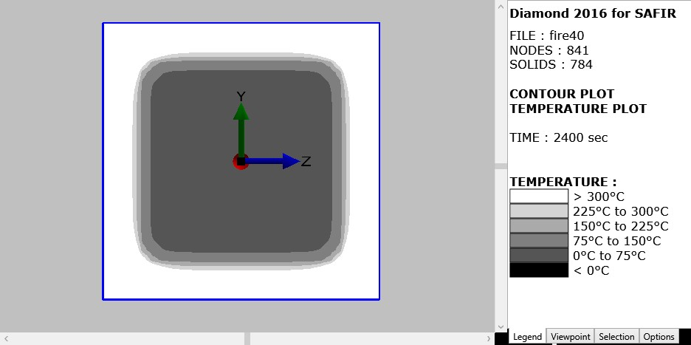
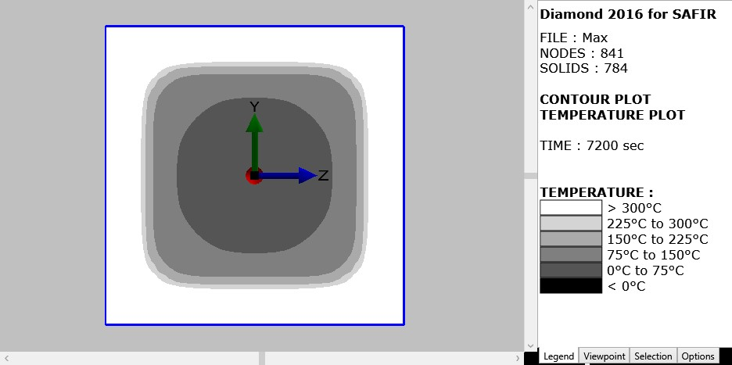
Illustration: GLT section 280 mm x 280 mm
Designed to have FRR = 60 minutes
T at 40 minutes
T_{max} after 120 minutes
-43°C/min.
MAXIMUM

Slide 5
1. The context
1.1 Timber columns in non-standard fires
1.2 General concern
1.3 Numerical analyses with SAFIR®
Gernay, Fire resistance and burnout resistance of timber columns, Fire Safety Journal, 122, 103350, 2021
A timber column that has a certain Fire Resistance Rating “FRR”
cannot survive a complete fire
if the heating phase of the fire does not stop
before a duration of 20% to 50% of this FRR.
Example:
A timber column has a FRR of 60 minutes.
If the heating phase lasts for more than 30 minutes,
the column will collapse at a later stage.

Slide 6
1. The context
1.1 Timber columns in non-standard fires
1.2 General concern
1.3 Numerical analyseswith SAFIR®
1.4 Furnace tests
OK, but these simulations are based on several hypotheses,
especially when timber is cooling from a certain temperature T_{max}.
Hyp.: all properties have been assumed as irreversible during cooling.
Property at T = Property at T_{max}
=> Let us go to the furnace (iBMB, Braunschweig) .

Slide 7
Gernay et al., Experimental investigation of structural failure during the cooling phase of a fire: Timber columns, Fire and Materials, 1-16, 2022
Loaded GLT Column, 280 mm x 280 mm, designed to have a FRR of 60 minutes.
R = 55 and 58 min (2 specimens)

Slide 8
Same columns, heating for 10 minutes => cooling at -10°C/min
No collapse (2 specimens)
-10°C/min

Slide 9
Same columns, heating for 15 minutes => cooling at -10°C/min
Collapse after 98 and 153 minutes (2 specimens)
-10°C/min

Slide 10
Gernay et al., Experimental investigation of structural failure during the cooling phase of a fire: Timber columns, Fire and Materials, 1-16, 2022
OK, but these were tests in a furnace, powered by oil burners.
=> Let us go to compartment fires (Fire Testing Centre, CERIB, France).

Slide 11
The context
The recent compartment fires
2.1 Description

Slide 12
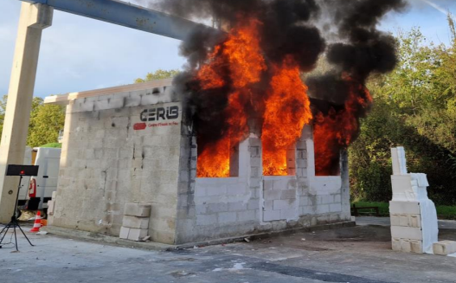
The compartment
Length: 6 meters
Width: 4 meters
Height: 3,10 meters
Floor: concrete + 20 mm of plaster board.
Walls and ceiling: aerated concrete (ceiling protected by mineral wool for tests 11 to 15)

Slide 13
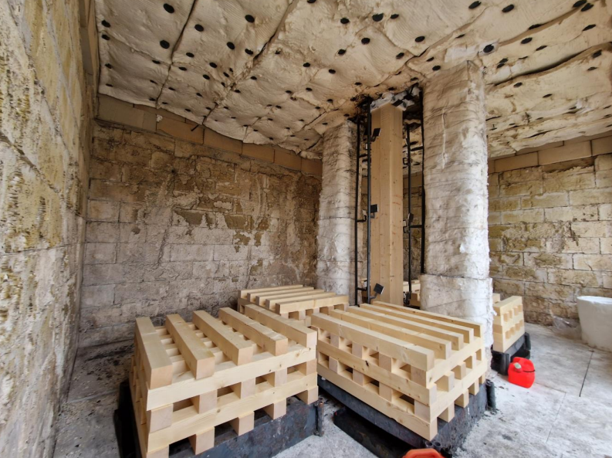
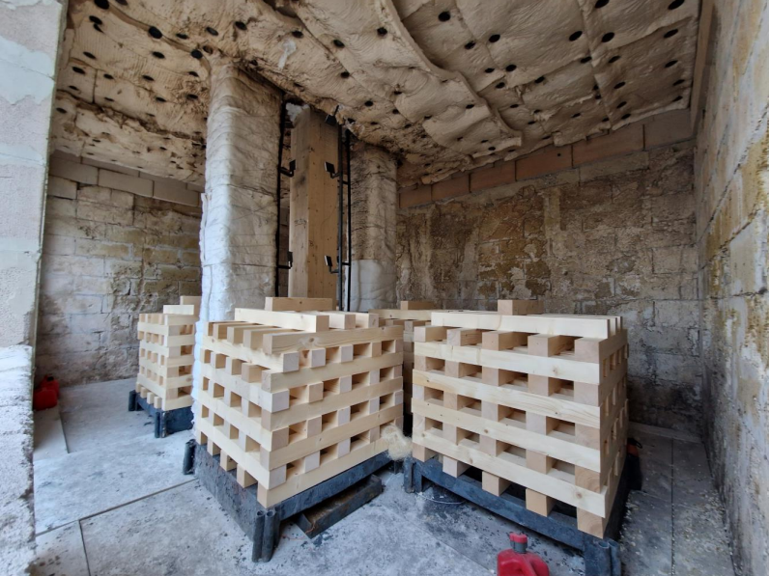
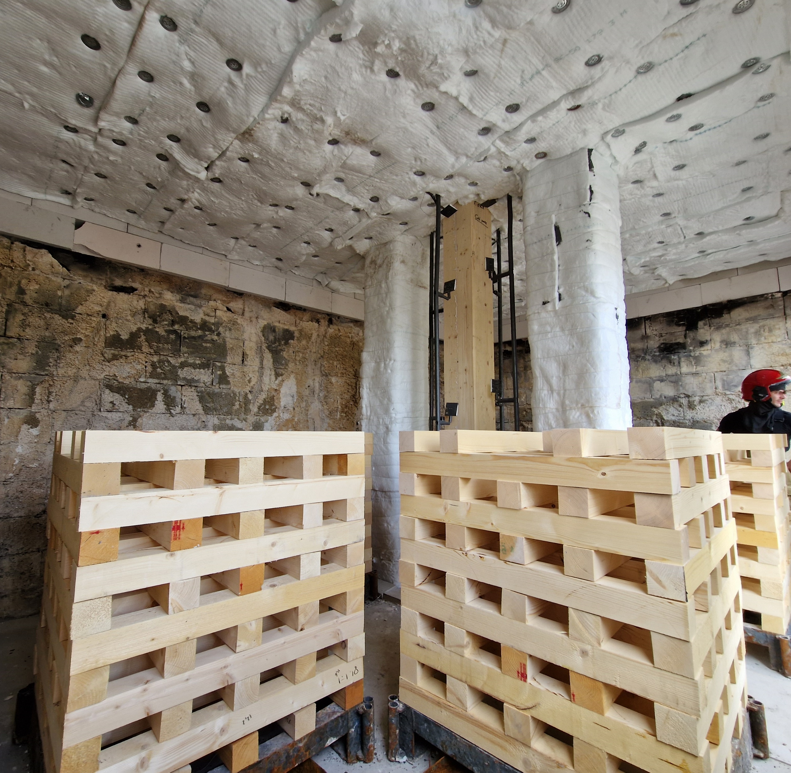
The fire loads
420 MJ/m²
Average value for offices in EC1
1 test
780 MJ/m²
≈ average value for dwellings in EC1
5 tests
950 MJ/m²
≈ 80% fractile for dwellings in EC1
1 test
Note: Values of the fire loads including heptane (22,75 MJ.m²).

Slide 14
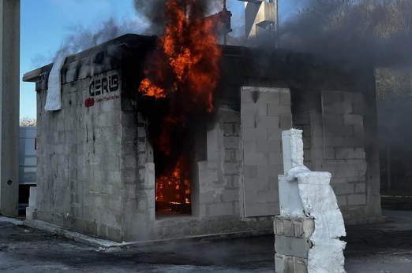
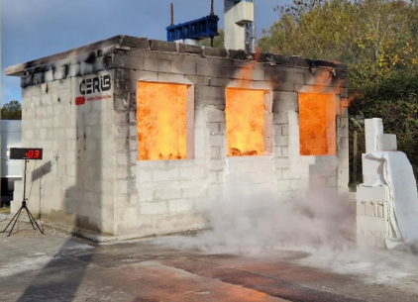
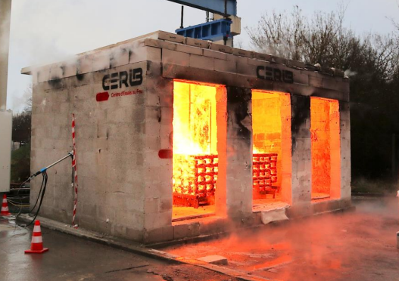
Openings
O = 0.032 m^0.5: 1 test
O = 0,065 m^0.5: 5 tests
O = 0.144 m^0.5: 1 test

Slide 15
The column
L = 3,72 meters - Pinned-pinned;
N = 322 kN - e = 20 mm / 20 mm
Section;
280 x 280 mm² (section: 1,00 A) : 5 tests
340 x 340 mm² (section: 1,47 A) : 1 test
360 x 360 mm² (section: 1,65 A) : 1 test

Slide 16
The context
The recent compartment fires
2.1 Description
2.2 Results

Slide 17
Test | 0 [m^0,5] | q [MJ/m²] | A [mm²] | T_{max} [°C] | End of heating phase [min.] | Failure [min]
10 | 0,065 | 780 | 280 x 280 | 1 150 | 30 | 47
-10°C/min

Slide 18
Test | 0 [m^0,5] | q [MJ/m²] | A [mm²] | T_{max} [°C] | End of heating phase [min.] | Failure [min]
10 | 0,065 | 780 | 280 x 280 | 1 150 | 30 | 47
9 | 0,144 | 780 | 280 x 280 | 1 000 | 30 | 71
-10°C/min

Slide 19
Test | 0 [m^0,5] | q [MJ/m²] | A [mm²] | T_{max} [°C] | End of heating phase [min.] | Failure [min]
10 | 0,065 | 780 | 280 x 280 | 1 150 | 30 | 47
9 | 0,144 | 780 | 280 x 280 | 1 000 | 30 | 71
11 | 0,065 | 950 | 280 x 280 | 1 200 | 29 | 35
-10°C/min

Slide 20
Test | 0 [m^0,5] | q [MJ/m²] | A [mm²] | T_{max} [°C] | End of heating phase [min.] | Failure [min]
10 | 0,065 | 780 | 280 x 280 | 1 150 | 30 | 47
9 | 0,144 | 780 | 280 x 280 | 1 000 | 30 | 71
11 | 0,065 | 950 | 280 x 280 | 1 200 | 29 | 35
12 | 0,065 | 780 | 340 x 340 | 1 150 | 28 | 90
-10°C/min

Slide 21
Test | 0 [m^0,5] | q [MJ/m²] | A [mm²] | T_{max} [°C] | End of heating phase [min.] | Failure [min]
10 | 0,065 | 780 | 280 x 280 | 1 150 | 30 | 47
9 | 0,144 | 780 | 280 x 280 | 1 000 | 30 | 71
11 | 0,065 | 950 | 280 x 280 | 1 200 | 29 | 35
12 | 0,065 | 780 | 340 x 340 | 1 150 | 28 | 90
13 | 0,065 | 780 | 360 x 360 | 1 180 | 30 | Test stopped at 98’
-10°C/min

Slide 22
Test | 0 [m^0,5] | q [MJ/m²] | A [mm²] | T_{max} [°C] | End of heating phase [min.] | Failure [min]
10 | 0,065 | 780 | 280 x 280 | 1 150 | 30 | 47
9 | 0,144 | 780 | 280 x 280 | 1 000 | 30 | 71
11 | 0,065 | 950 | 280 x 280 | 1 200 | 29 | 35
12 | 0,065 | 780 | 340 x 340 | 1 150 | 28 | 90
13 | 0,065 | 780 | 360 x 360 | 1 180 | 30 | Test stopped at 98’
14 | 0,065 | 420 | 280 x 280 | 600(*) | 36 | 66
(*) ≈ 1 000°C during 7 minutes
Heptane
-10°C/min

Slide 23
Test | 0 [m^0,5] | q [MJ/m²] | A [mm²] | T_{max} [°C] | End of heating phase [min.] | Failure [min]
10 | 0,065 | 780 | 280 x 280 | 1 150 | 30 | 47
9 | 0,144 | 780 | 280 x 280 | 1 000 | 30 | 71
11 | 0,065 | 950 | 280 x 280 | 1 200 | 29 | 35
12 | 0,065 | 780 | 340 x 340 | 1 150 | 28 | 90
13 | 0,065 | 780 | 360 x 360 | 1 180 | 30 | > 98
14 | 0,065 | 420 | 280 x 280 | 600(*) | 36 | 66
15 | 0.032 | 780 | 280 x 280 | 1 250 | 40 | 37
(*) ≈ 1 000°C during 7 minutes
-10°C/min

Slide 24
The context
The recent compartment fires
Conclusions
Timber columns can collapse in the decay phase of a fire.
Self extinction of the column does not solve the problem.
We are still looking for a solution to design timber columns for survival to non-standard fires.

Slide 25
The context
The recent compartment fires
Conclusions
Next tests
One test with lower compartment temperatures, section 280x280 mm².
One test where the fire will be supressed after a certain time to simulate fire fighter intervention, section 280x280 mm².
One test with a higher section 400x400 mm².

Slide 26
Thank you

