Slide 1
Cross provincial comparison of drivers impacting urban densification: A case study of Brussels capital region, Flemish and Walloon Brabant
Doctoral student - Anasua Chakraborty
A.chakraborty@uliege.be
Associated authors:
Dr. Jacques Teller, Urban and Environmental Engineering, University of Liege (Ulg)
Dr. Hichem Omrani, Luxemburg Institute of Socio-Economic Research (LISER)

Slide 2
Table of contents.
Aim of the work
01.
03.
Materials and Methods
Results and Conclusion
05.
Study
Area
Driving
Factors
Future
Work
02.
04.
06.

Slide 3

What is Urban Densification?
As per urban design or planning, Densification is a complex process defining new urban development in an already built-up area due to functional or structural requirement.
Notes:
Since the state reform of 1993, Belgium has undergone a significant political transformation with a decentralization of land-planning policies from the state level to regional authoritiesFor Flanders and the Brussels Capital Region, slope and distance to roadways are the most significant drivers explaining densification, whereas densification in Wallonia is predominantly influenced by land-use policies, especially the zoning regime. These results highlight the impact of considering cross-regional divergences in the implementation of planning policies at the metropolitan level, especially in those metropolitan areas that are expanding into different regions with divergent planning policies.

Slide 4

Aim of the work
To analyse a multi-level built up densities ranging from low to high built-up density
To Understand the interplay between socio-economic, political, geographic and accessibility factors(independent variable) and multi-density built-up i.e.(dependent variable) using multinomial logistic regression model
To understand cross-regional divergences in planning policies between Brussels Capital Region, Flemish Brabant and Walloon Brabant
Notes:
The focus of the present paper is to provide a framework to analyze the process of urban densification in the Brussels metropolitan area (BMA). As the BMA is expanding over three different regions, i.e., the Brussels Capital Region, Wallonia, and Flanders, our study compares the impact of drivers on densification in these three regions so as to highlight the potential effects of different policies on land-use processes. We also examined the relationship between several built-up densities and other variables in order to identify the drivers of densification. We support our claims by using multinomial logistic regression (MLR) through the period of 2000–2020. The distribution of the studied variables was analyzed at a statistical level for socioeconomic, regional, and spatial planning characteristics.

Slide 5
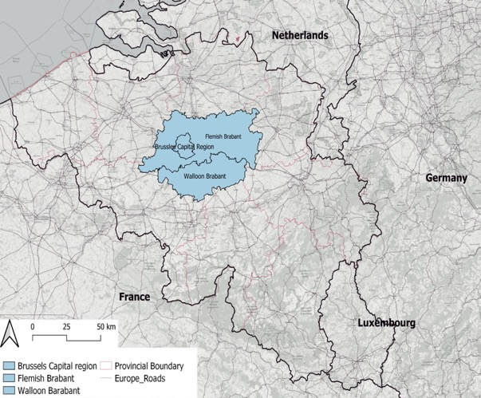
Study Area
98.12% of total population of Belgium stays in or near urban cores
As per latest census of Belgium, the three main province of Flanders, Brussels capital region and Wallonia accounts to total population of over 11.5 million
It experienced a mixed landscape of dense urban cores like Brussels capital region and cities like Antwerp, Ghent and, while Wallonia and north of Flanders experience strong rural landscape structure with fragmented urban growth
Notes:
Belgium is Europe’s one of the most urbanized nations
Where, Brussels capital region and cities like Antwerp (508,000 inhabitants), Ghent (249,000 inhabitants), Charleroi(204,000 inhabitants) and Liège (196,000 inhabitants) creates the, while Wallonia and north of Flanders experience strong rural landscape structure with fragmented urban growth

Slide 6
Materials and Methods
Notes:
The Belgian cadastral data is vector-based data provided by the land registry consisting of building footprint information at a two-dimensional level. This data were used to create built-up density maps for the years 2000, 2010 and 2020 . These cadastral maps were rasterized at a very fine resolution of 2 ∗ 2 m cells in order to avoid any but due to prolonged computation time, as a result of which, the 2 ∗ 2 m images were aggregated to a 100 ∗ 100 m resolution. Most data were available in statistical and municipality level. Thereby these data were standardized and classified in different density classes – Low , Medium and High using a geometric classification techniques. Once done, we perform MLR test followed by validation using receiver operating characteristics(ROC) curve.

Slide 7
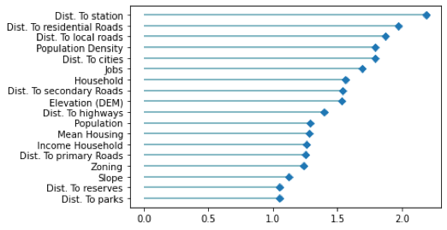
Driving Factors controlling urban densification
It is important to select the accurate driver for an efficient modelling.
Though it is evident that the response(s) and predictor(s) of a model can be highly correlated to each other, but the problem arises if predictors are highly correlated.
VIF value of less than 4 is taken into consideration for modelling. Many authors considered 10 as a severe limit for correlation while few other takes 4 as their threshold value . So, the variable considered in our study satisfy under both criteria.
Notes:
It is important to select accurate drivers for efficient modelling. It is often possible to have two drivers with different information that are highly correlated to each other.
In our study, variation inflation factor (VIF) was conducted to test multicollinearity. The test exhibits a value for each driver considered and ideally a variable with a VIF value of less than 4 is taken into consideration for modelling. Many authors considered 10 as a severe limit for correlation while others use 4 as their threshold value [88]. So, the variables considered in our study satisfy both criteria. A value exceeding 4 or 10 depicts that there is high correlation between the drivers. Our test was conducted for two consecutive runs. During first test run there was a high correlation between housing and household with values of 63.24 and 66.25, respectively. This is due to the fact that earlier household and housing data were treated the same, and their X matrix holds a linear constraint. Because our work involves urban densification, the number of households was chosen as it has a significance in terms of floor area ratio and infill development

Slide 8

Results
The urban core and metropolitan city centers of Brussels and Leuven in Flanders experience a high-density built-up concentration.
Though comparatively less but cities like Waterloo and Tienen also shows a progress shift towards infill development.
Zoning impacts the scenario of densification in peri-urban region of Walloon Brabant because of the relative availability of land allowed by spatial planning regulations in this part of the region and the reluctance against densification observed in low-density areas
Where (-) represents negative impact
Where (+) represents negative impact
Where (?) represents negative impact
Notes:
Flanders’ spatial plan places special emphasis on sustainable development, particularly in the urban areas, whereas Brussels follows a two-tier system with the key priority of striking a balance between the socioeconomic, demographic and accessibility aspects of the region
Recent densification nearby railway hubs is much more important in Flanders than in RBC, which may be since the vicinity of railway stations is already very dense in RBC, which was not the case in Flanders in the early 2000s. By contrast, one does not observe densification around railway hubs in Walloon Brabant. The implementation of transit-oriented development policies appears to be far more advanced in Flanders and RBC than in Walloon Brabant. The population of the three regions is unequally distributed with 1.14 million in Flanders in the north, 0.45 million in Walloon Brabant in the south and 1.22 million in Brussels. It is crucial to emphasize that the Flemish Region completely envelops and connects Brussels, making it more than just a crossroads of Europe. As a result, the demand for new infrastructure and housing units has increased, adding to the difficulty of demographic growth.
The year 2019 saw an approximately 10-point regional variation in unemployment rates in Belgium, with the Flemish region’s rate falling to 3.3% and the Brussels Capital Region’s rate rising to 12.8% [98]. A key feature of infill development is not only that it is happening faster than before, but that it is also happening in medium-density areas where job opportunities are relatively low. Accessibility to cities and road networks have increased job search efficiency and intensity in Flanders and Brussels. The ease of access to the labour market is a small but significant controlling factor in the Flemish province: new built-up land is primarily developing in the areas with a higher employment potential in the vicinity of the city of Leuven and in the west of the study area close to the employment centres in the Brussels area. Jobs in Wallonia have a big attraction effect on the high-density area. As expected, it is generally rising from medium- to high-density areas due to an influx of opportunity, particularly in city centres such as Tienen, Liege etc.

Slide 9

Conclusion
Densification methods are crucial in preventing future land consumption and organizing already-existing peri-urban regions according to their unique characteristics
The factors driving urban densification vary across regions, and understanding these factors is crucial in developing effective regulations for spatial planning of areas for future development
Factors such as distance to highways and rail stations, income of households, and proximity to green spaces have different impacts on urban densification across different regions in Belgium

Slide 10
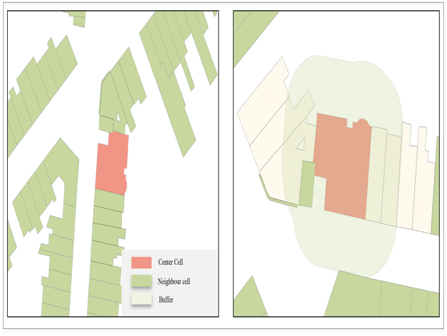
Future Works
Ingesting the three-dimensional(3D) aspects for more realistic study
Creating “Nature” based classification to understand interaction between different building categories and their uses
15 minutes city can be conceptualized in aiding to limit the land take adversities by addressing demands at the national level.

Slide 11
Thanks for your kind attention.
Do you have any questions?
A.Chakraborty@uliege.be
University of Liege
Link to the publication: https://www.mdpi.com/2005608

