Slide 1
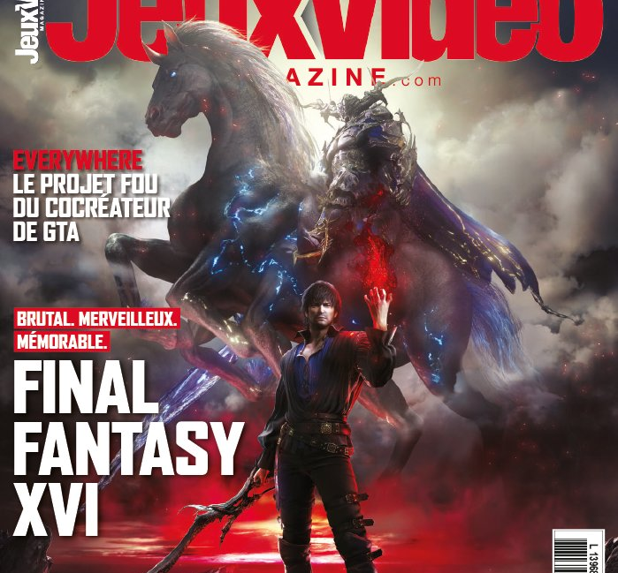
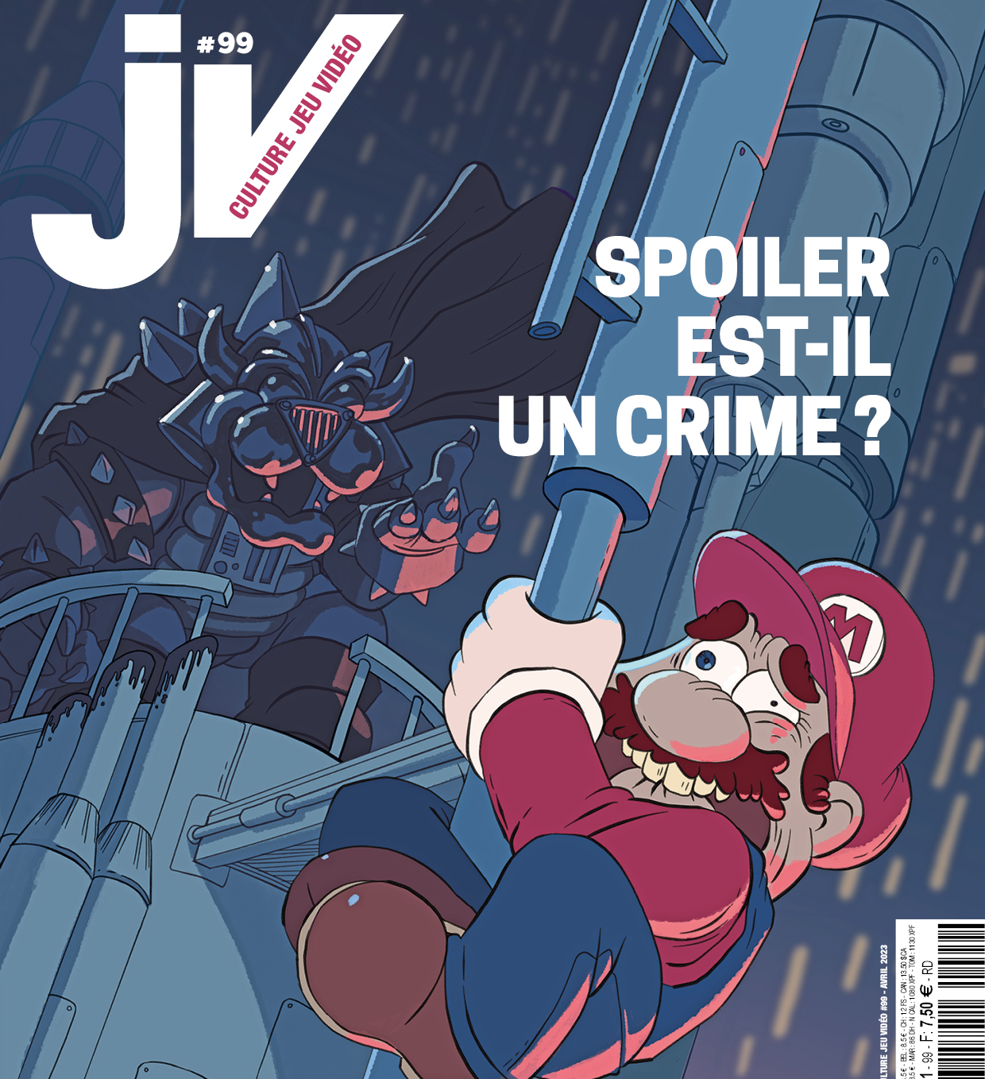
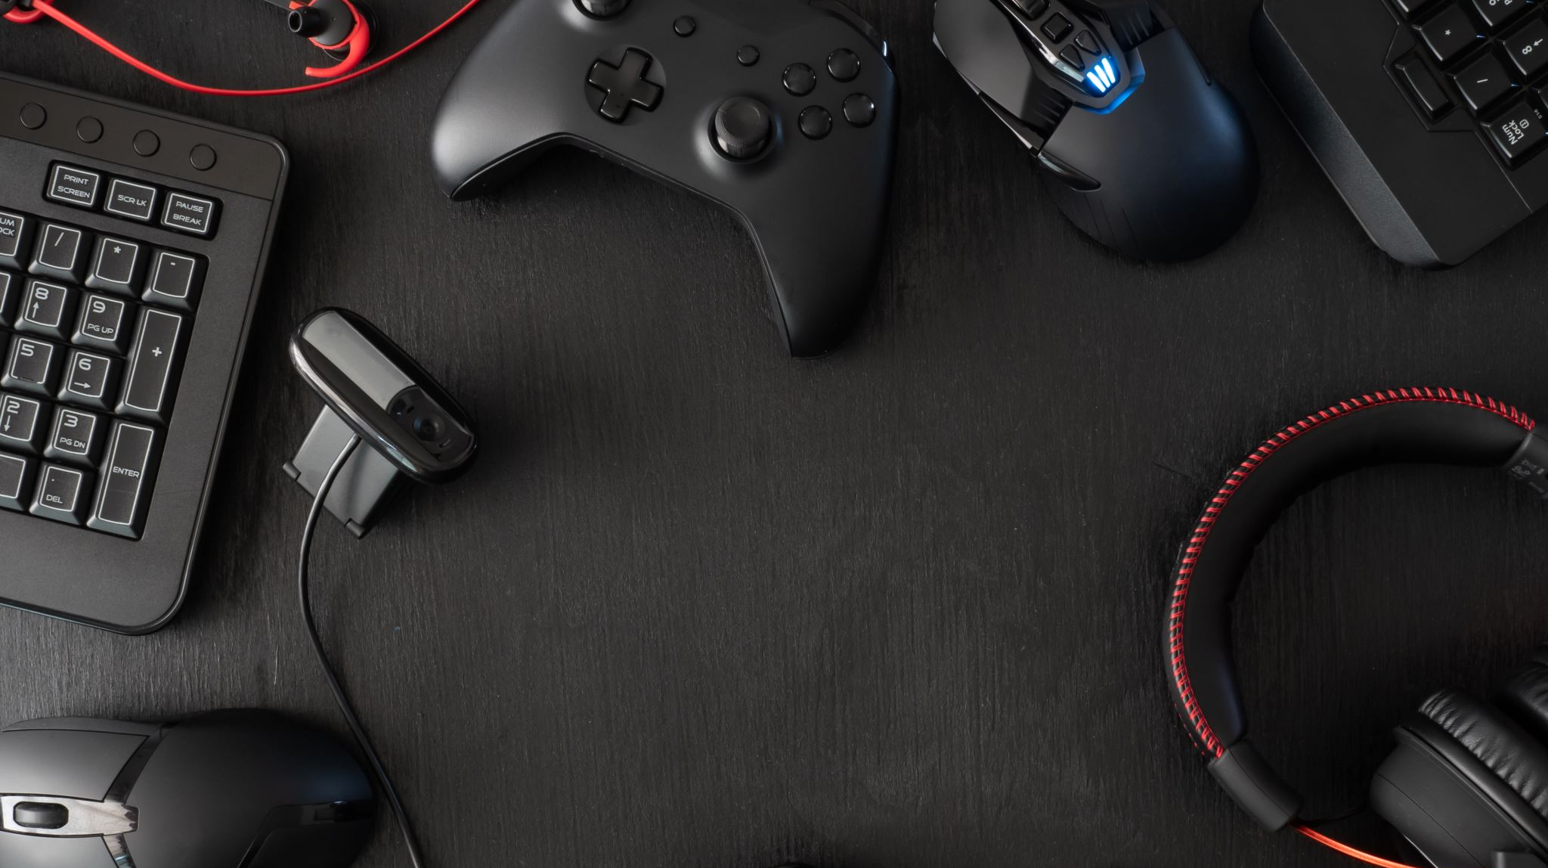
Video Game magazines’ streaming practices
From information to entertainment ?
Boris KRYWICKI - Université de Liège, Liège Game Lab

Slide 2
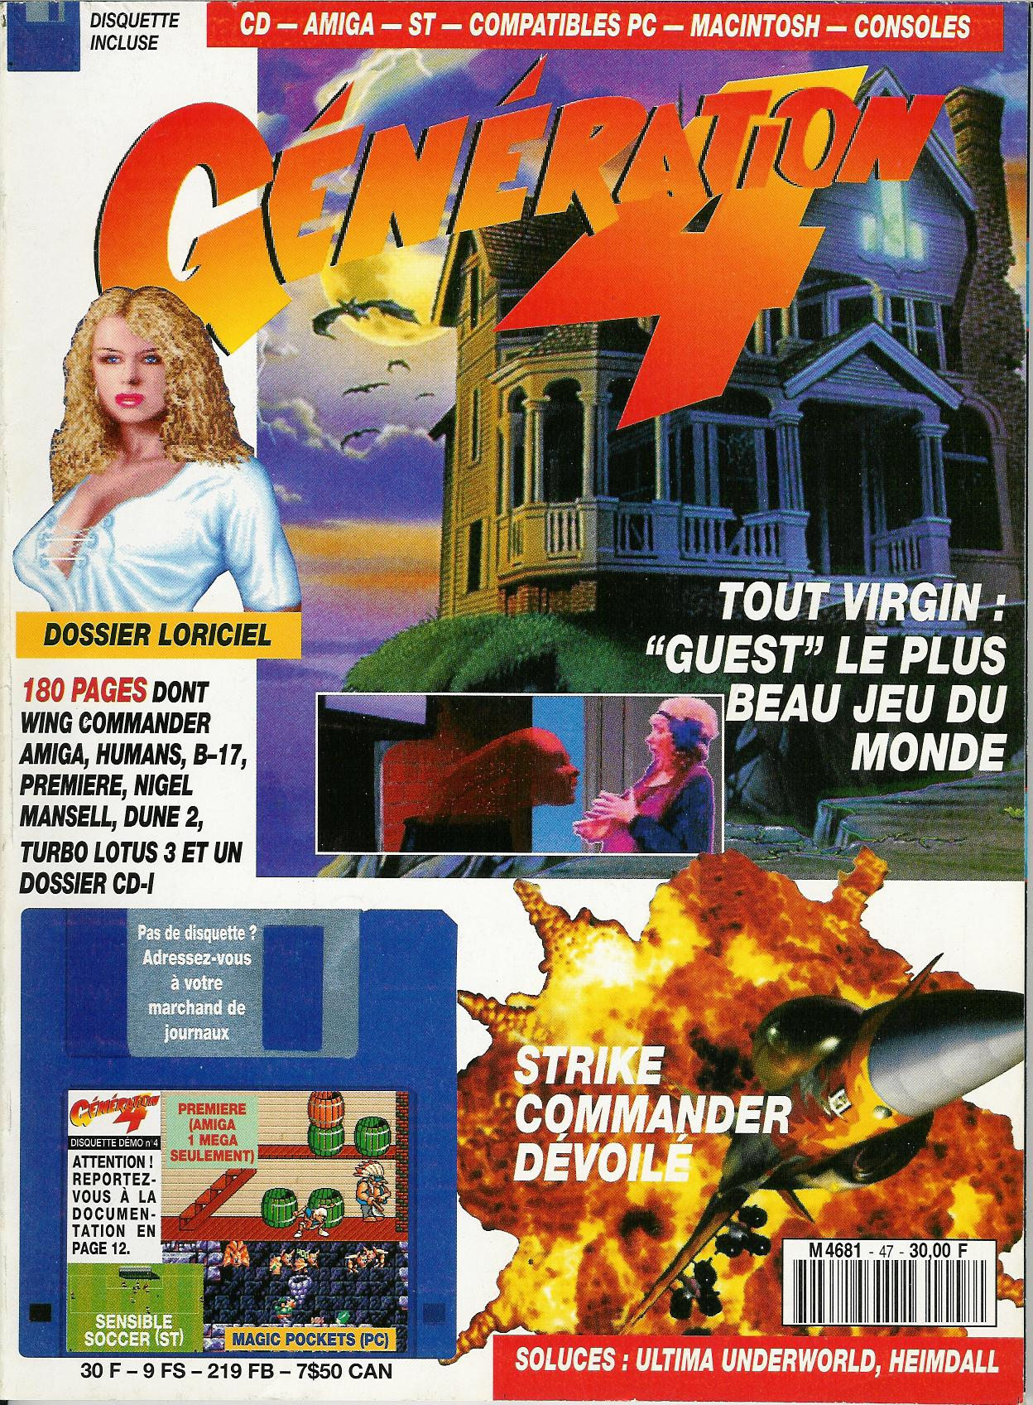
VIDEO GAME MAGAZINES’ ICONOPHILIE
« The most beautiful video game in the world »
Génération 4, #47, sept. 92
The visual aspect and iconophilie, preponderant in most magazine titles in general (Dakhlia, 2018: 50), are particularly emphasized in the layout and cover choices of specialized video game magazines (Mansuy, 2019).

Slide 3
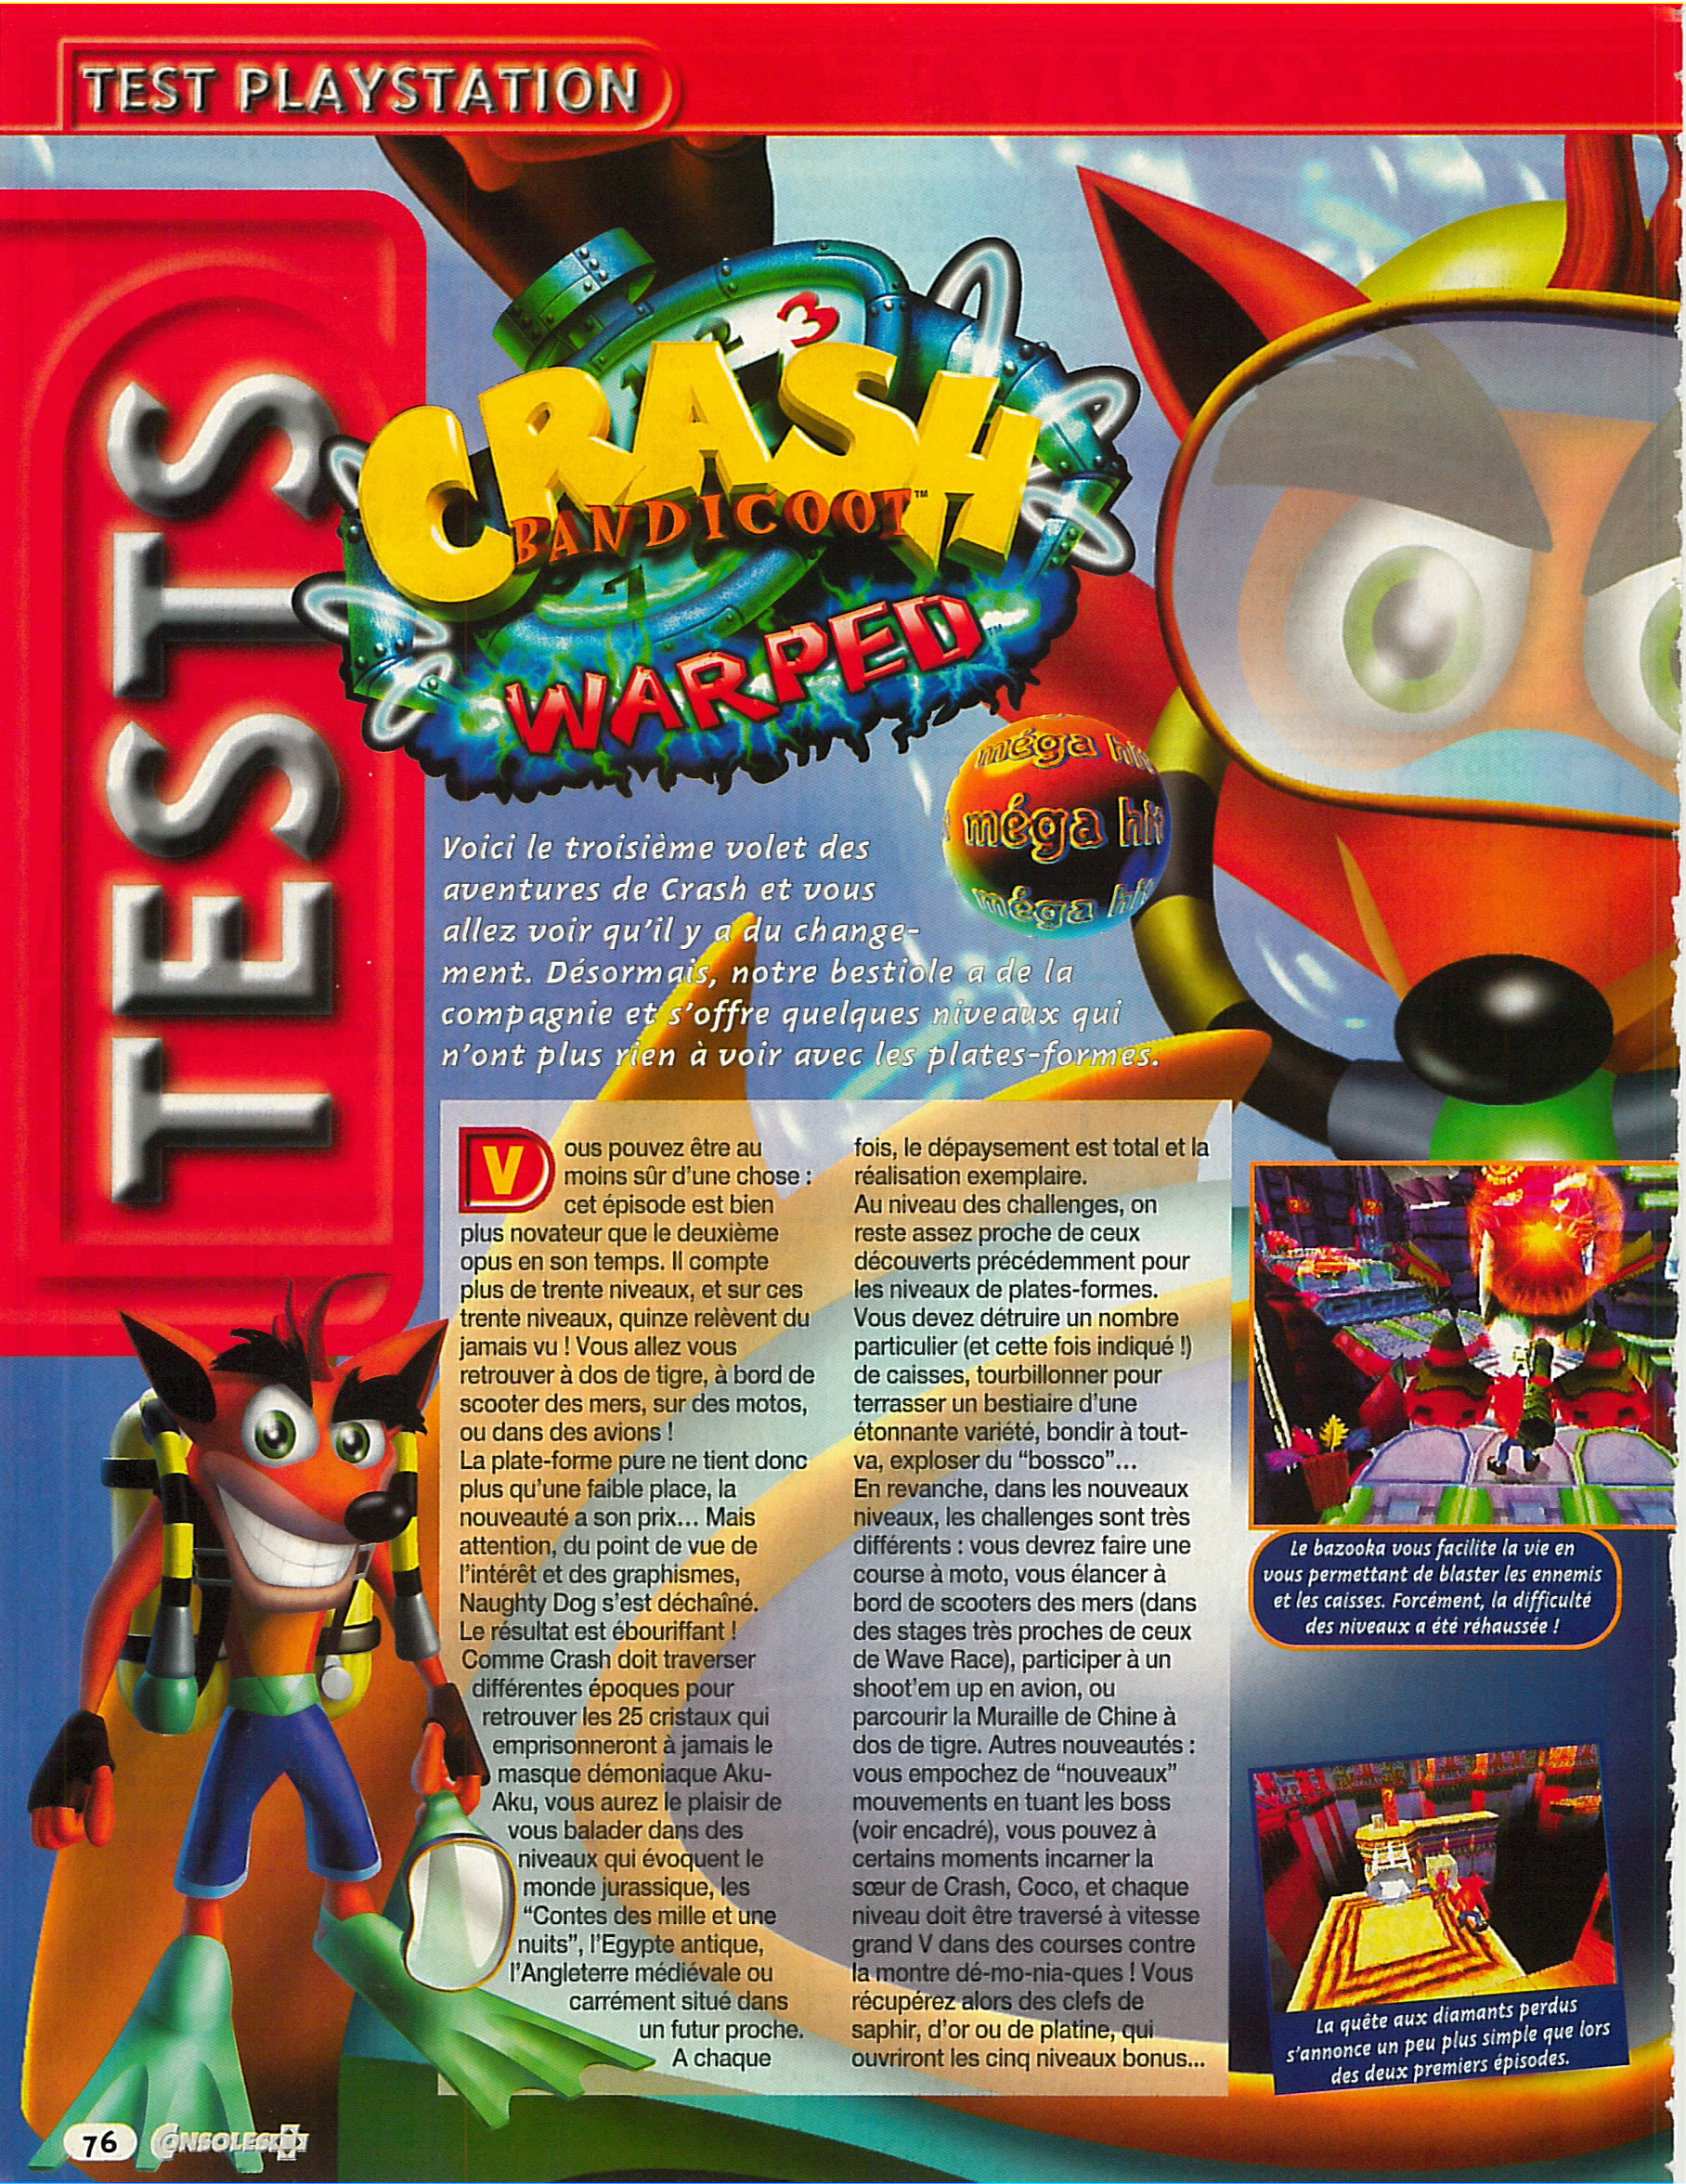
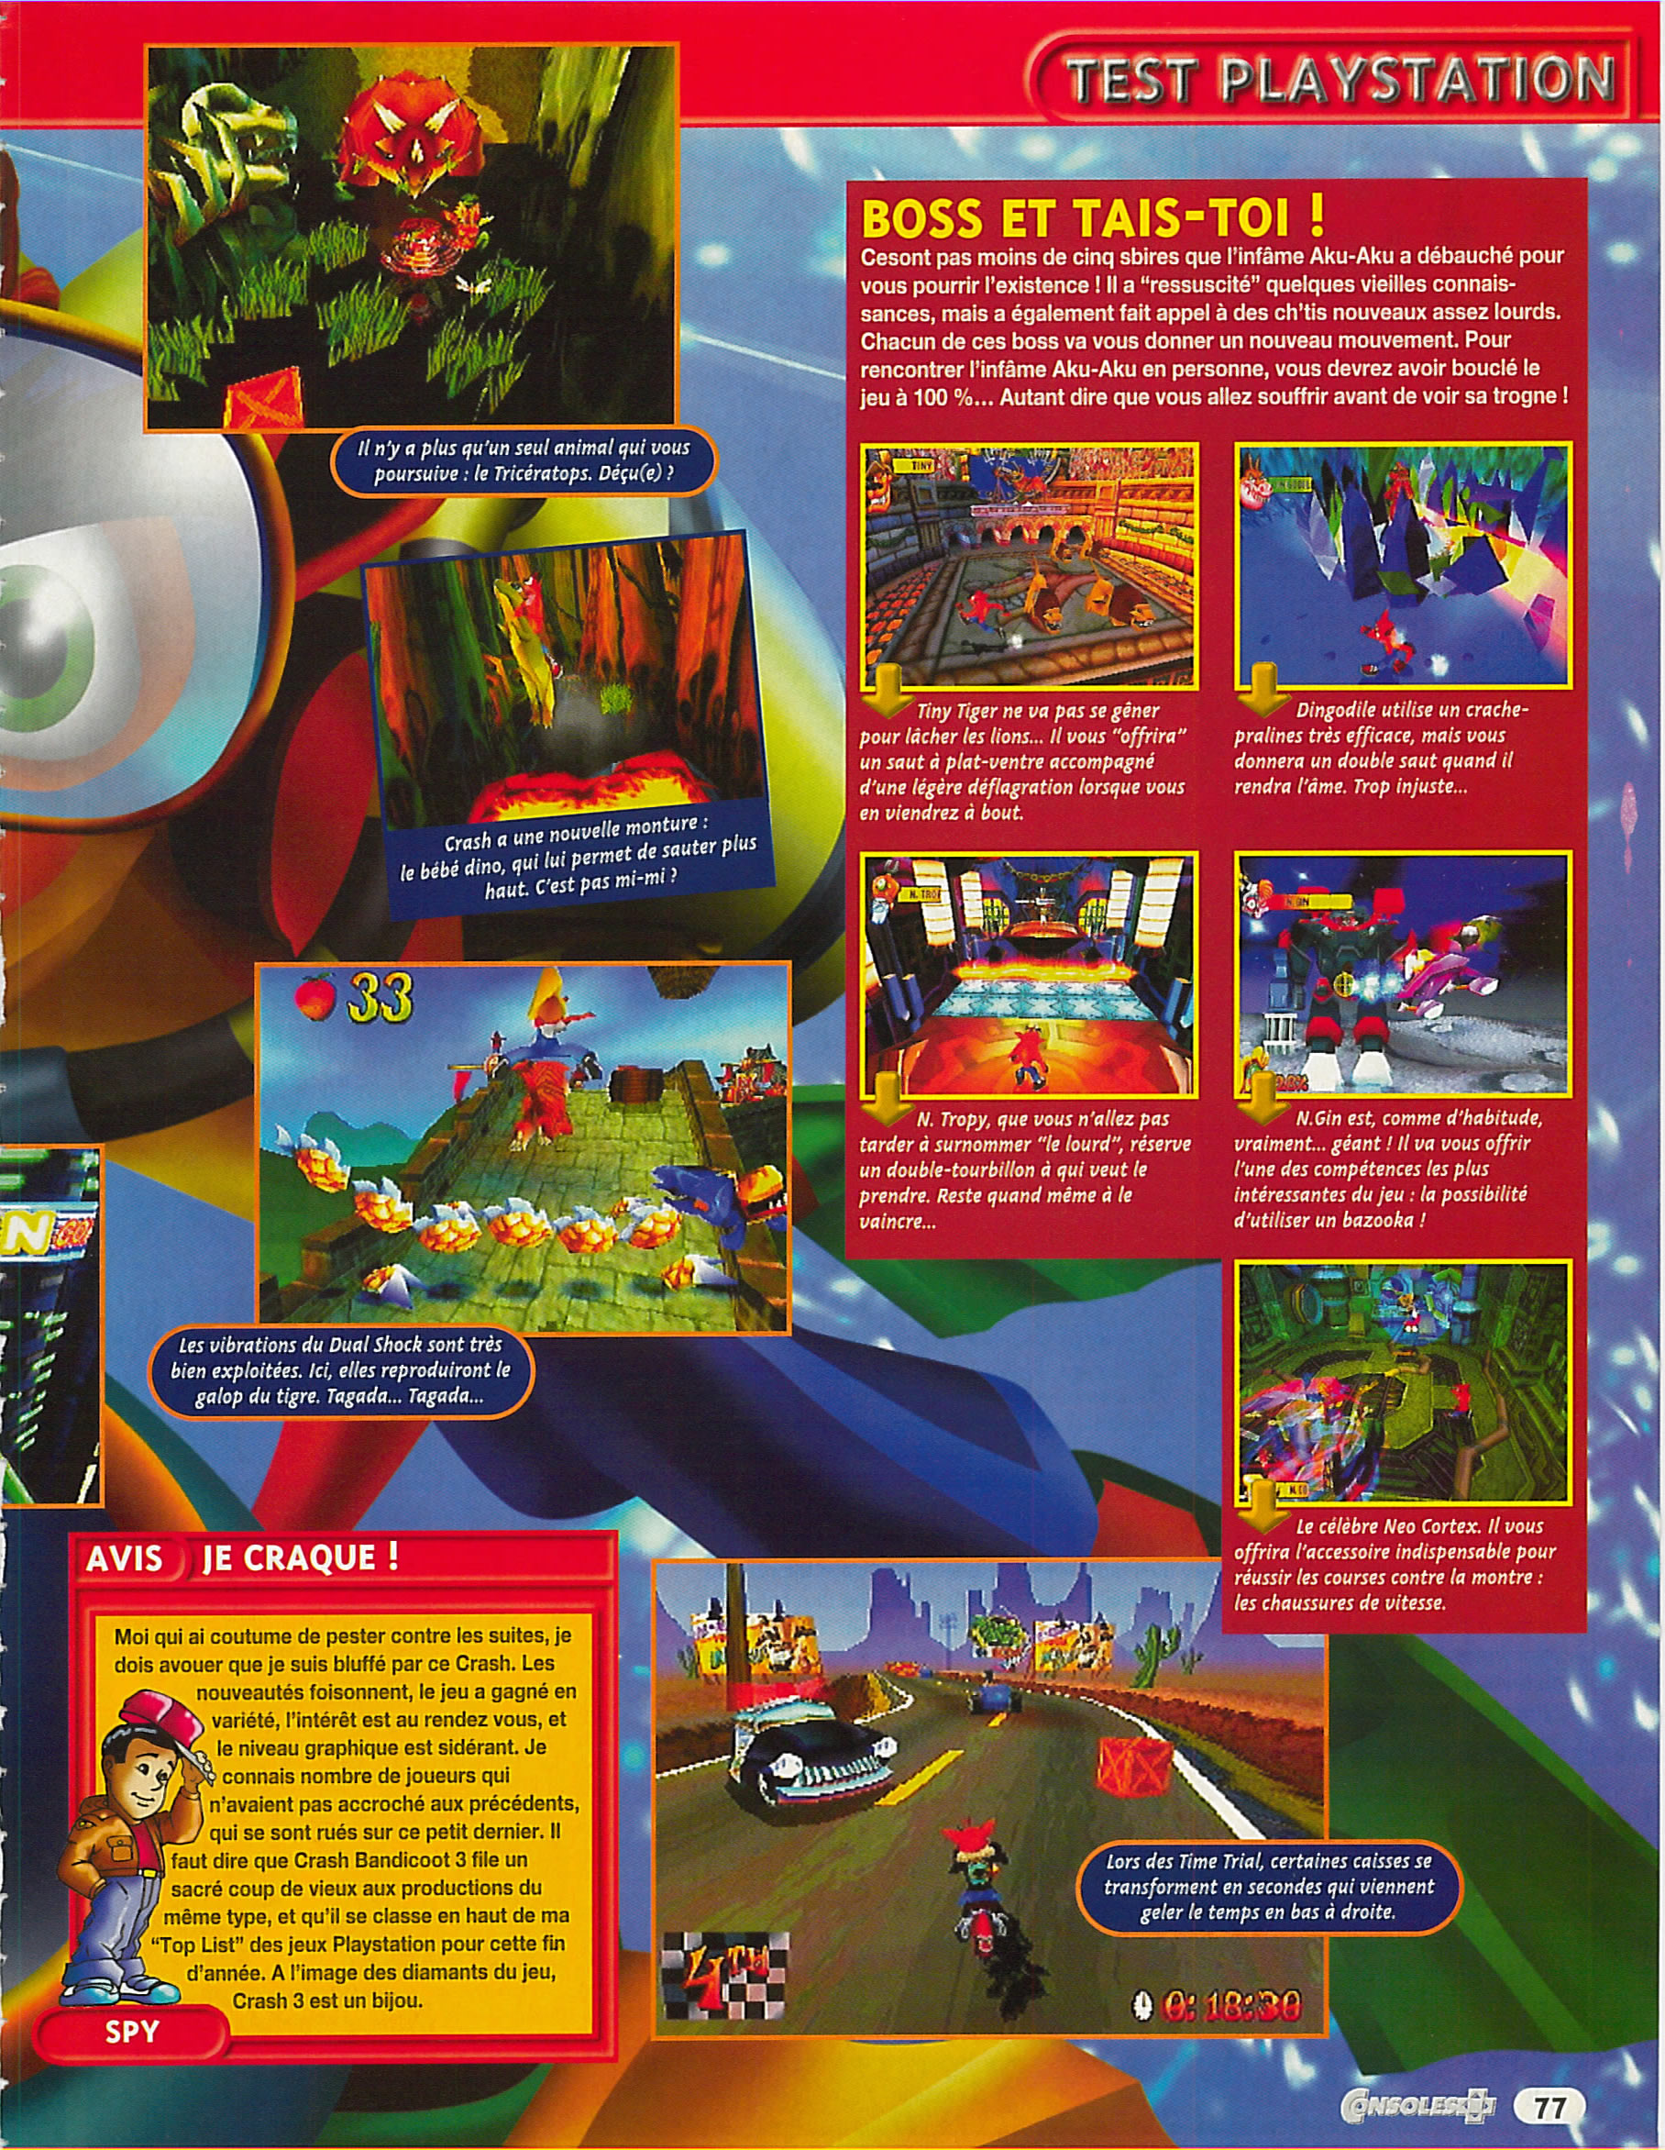
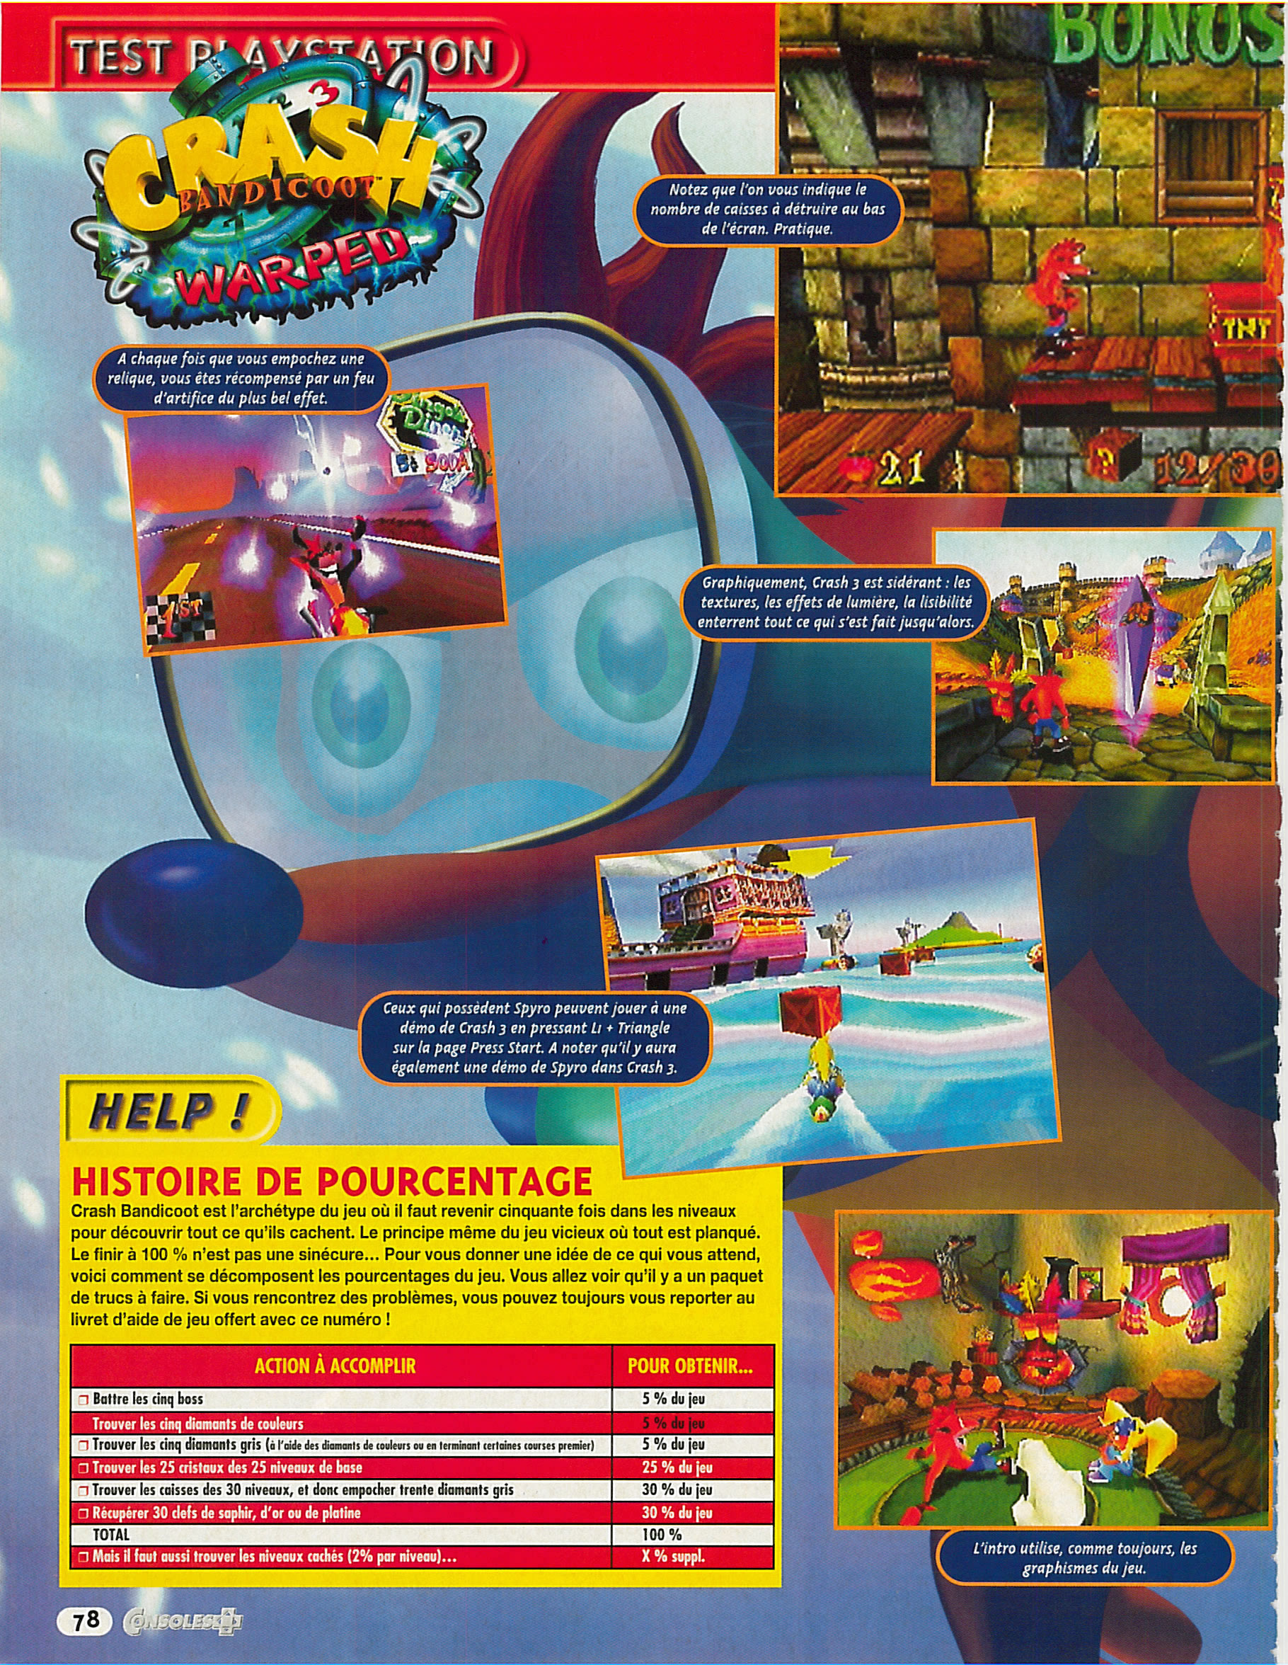
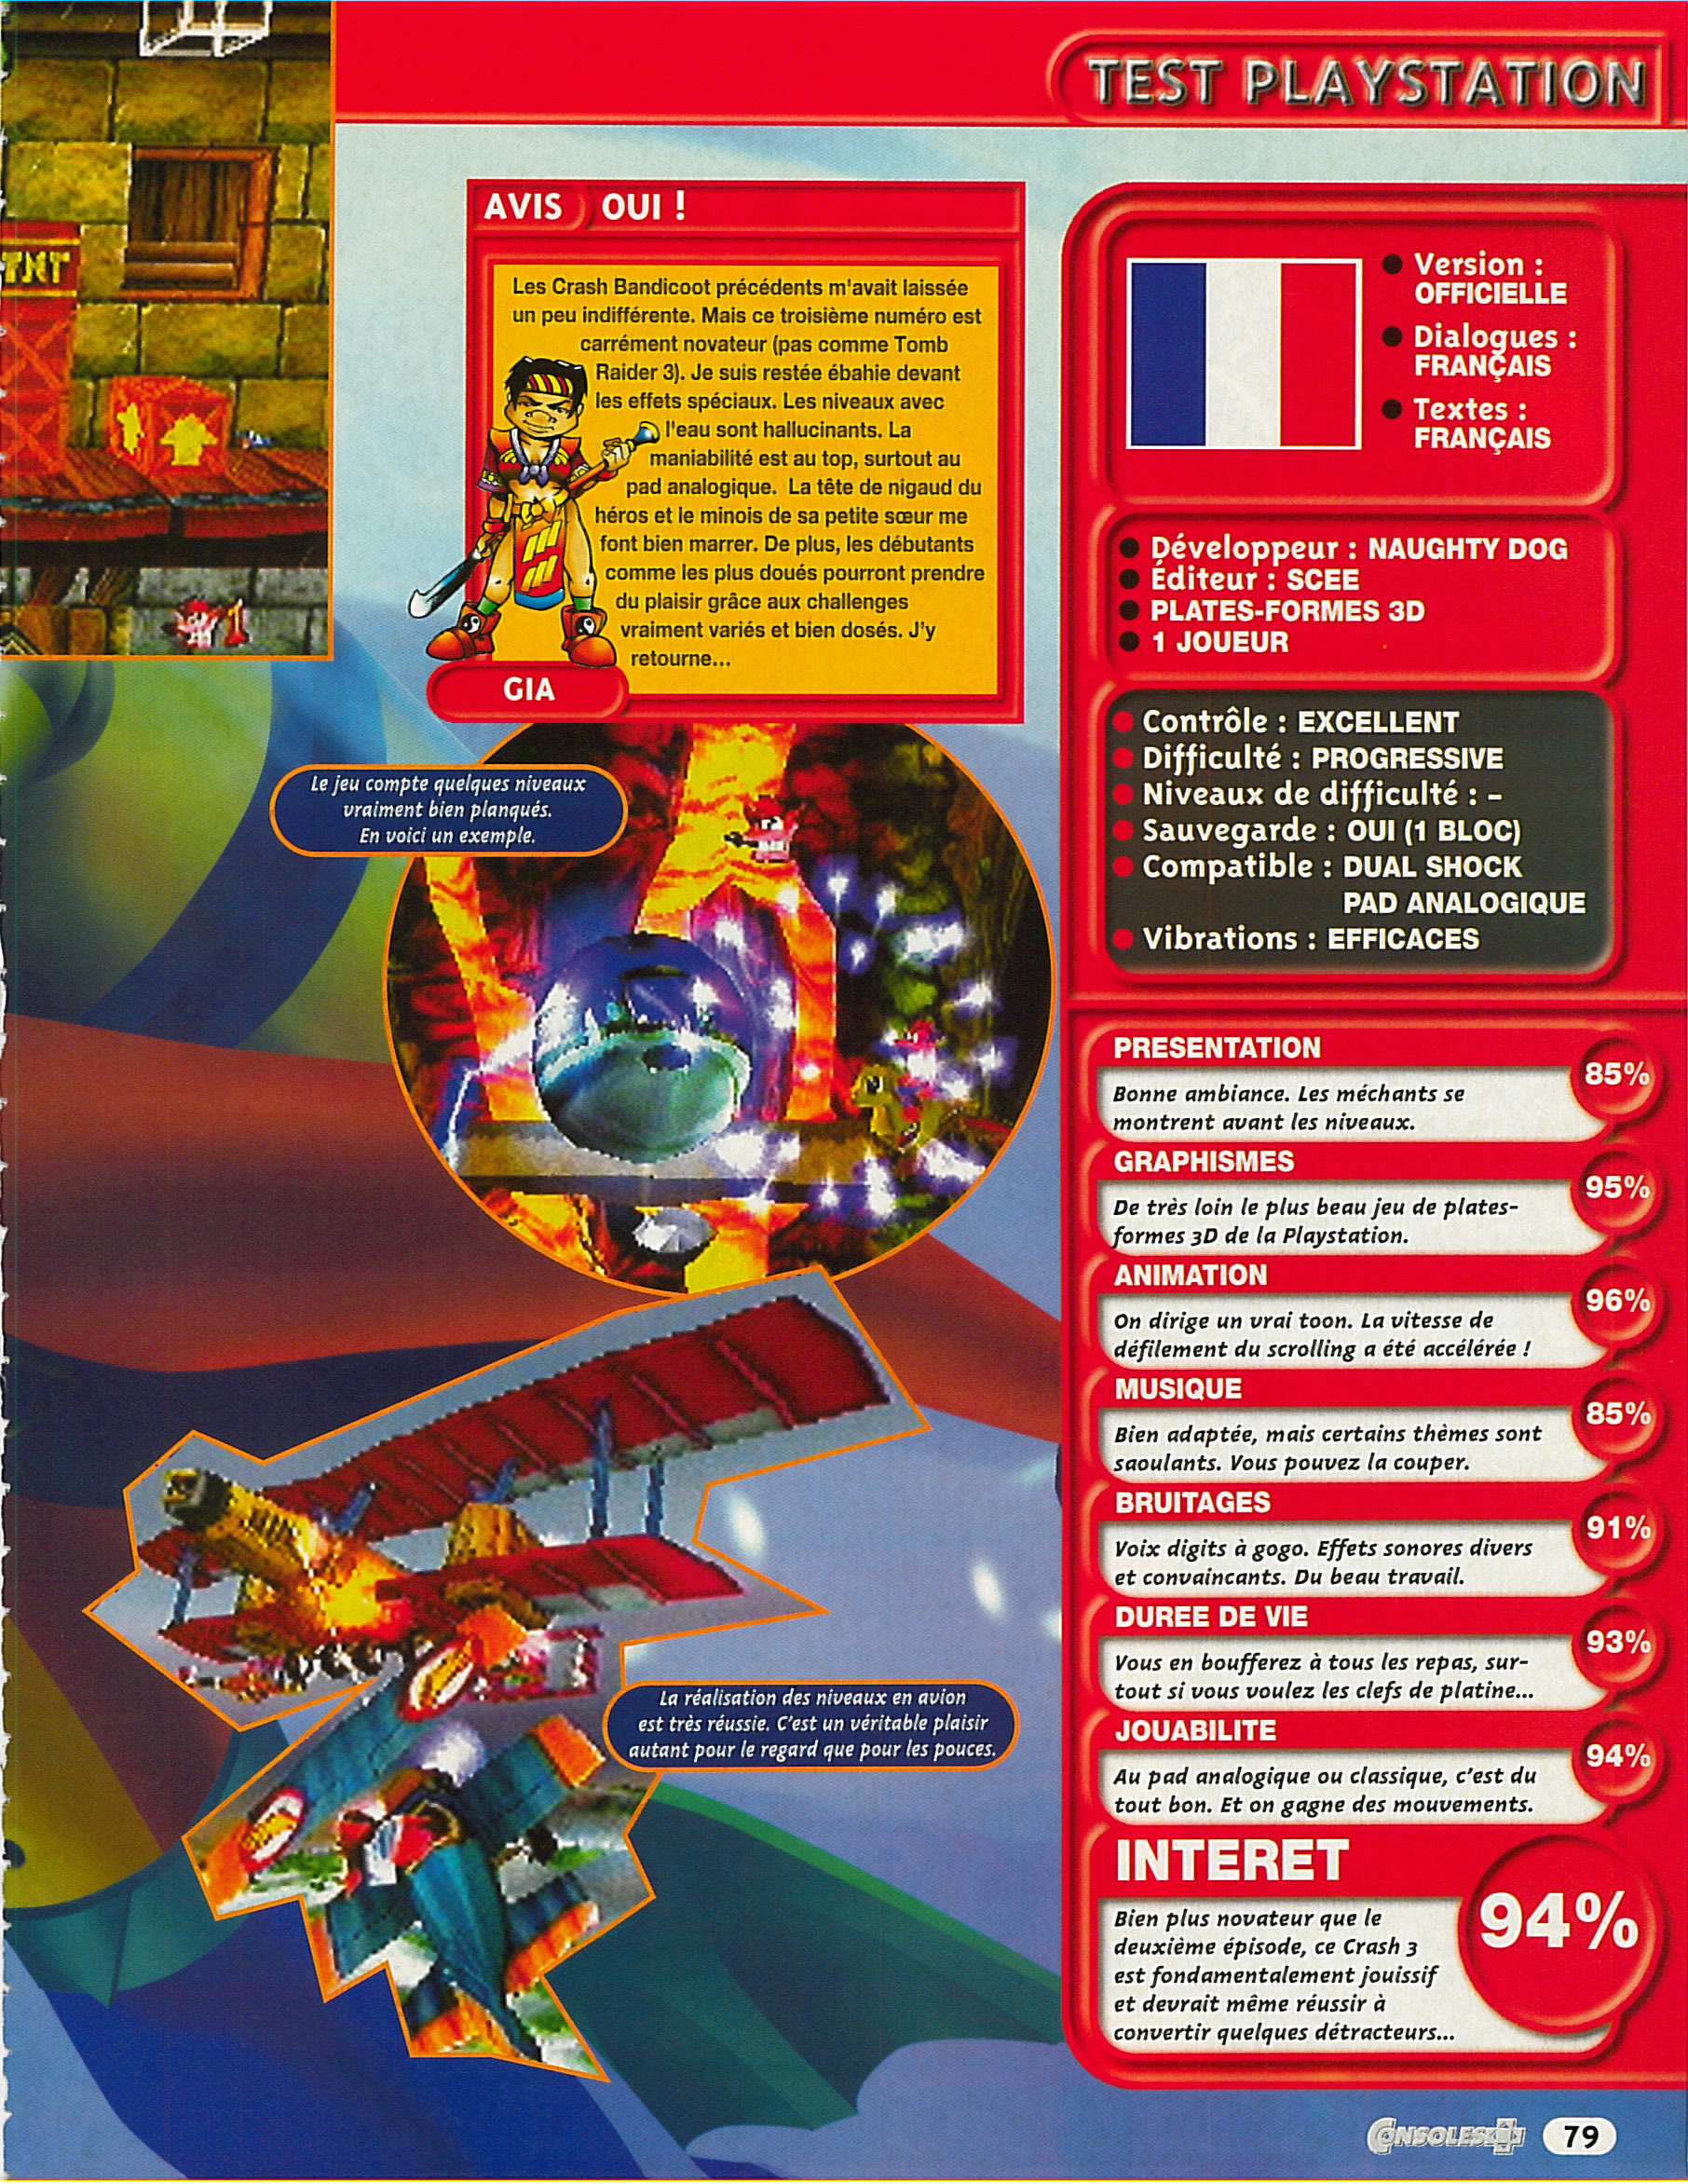
half a page of text for 3 or 4 pages of images
In the 1990’s, an enthusiastic “a-critical discourse” regularly unfolds, a “fascination with a powerfully desirable future” (Triclot, 2022: 49).
« Test : Crash Bandicoot 3 », Consoles +, #83, pp.76-79, December 1998
All these video game magazines are free and accessible on http://abandonware-magazines.org

Slide 4
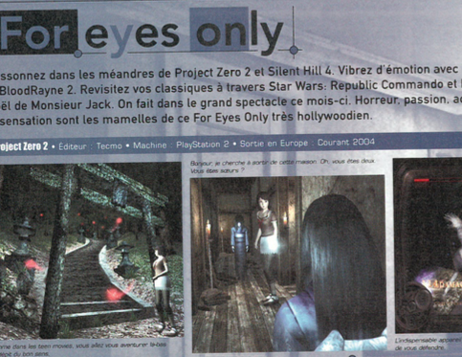
Only SCREENSHOTS, NO « ADDED Value »
By piling up images, specialized magazines offer a form of "vicarious play" (Barnabé, 2017) and transmit first-hand "gaming capital" (Consalvo, 2007), of which they are the main mediators.
« FOR EYES ONLY », JOYPAD, #139, p.40, MARCH 2004

Slide 5
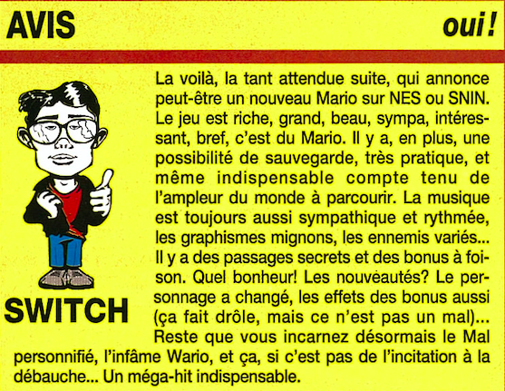
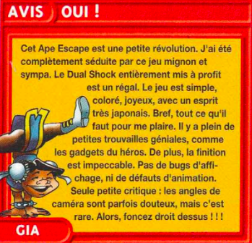
IllustratING THEIR gamer-tester persona
SWITCH, « Wario Land », Consoles +, n°31, p.86, avril 1994
GIA, « Ape Escape », Consoles +, n°90, pp.134-135, juillet-août 1999

Slide 6
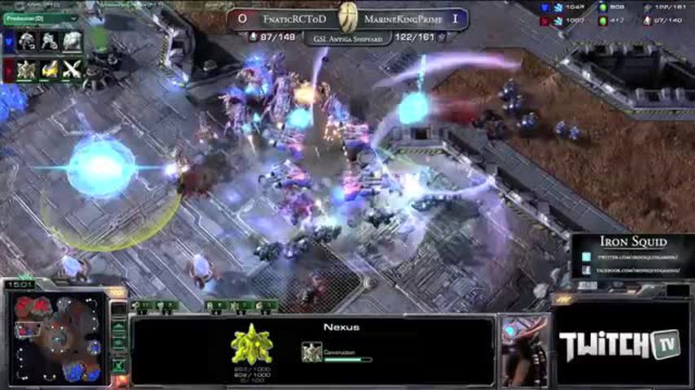
adventurous pure players, reluctant print media
Pure Players
Printed Magazines
2023 : no website, just an online shop
(Jeux Vidéo Magazine)
2012 : Commenting video games
2007 : « Broadcast regime » (Dagiral and Parasie, 2010 : 112)
2016 : first website, created through crowdfunding (Canard PC)

Slide 7
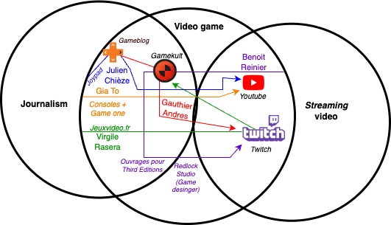
from online media move to video platforms

Slide 8
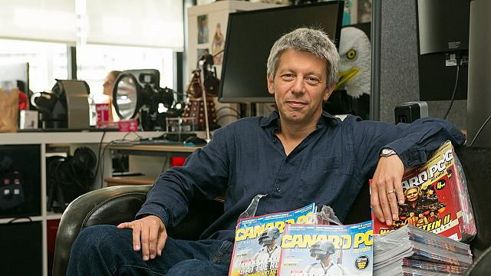
Being different from influencers
« We were dismayed to see hours and hours of distressing Let's Plays hosted by casters whose level of vocabulary, inversely proportional to their forced enthusiasm, would make a men's deodorant advert look like a reception speech at the Académie française. It didn't help that YouTube and Twitch were, in the final analysis, nothing more than 21st-century blogs, aimed at an audience of young teenagers that had never been Canard PC's audience. Nor did the emergence, as youtubers became more and more professional, of shows that copied only the worst of television (their puppet-like smiles in prime-time game-show settings). There was no way we were going to jump into the swamp just to be like everyone else ».
GAUDÉ Ivan, « “Et si on faisait une émission ?” », Canardpc.com, [online] april 2019.

Slide 9
Research question
Does the investment in this new space imply a shift in ethos, from that of journalist (information) to that of host (entertainment)?
What place is left within video streams for the materiality of print magazines and their long-term investigations?

Slide 10
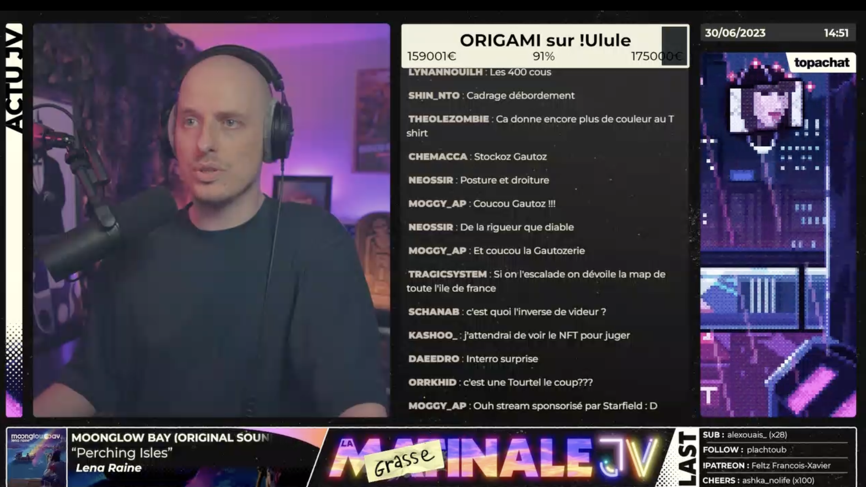
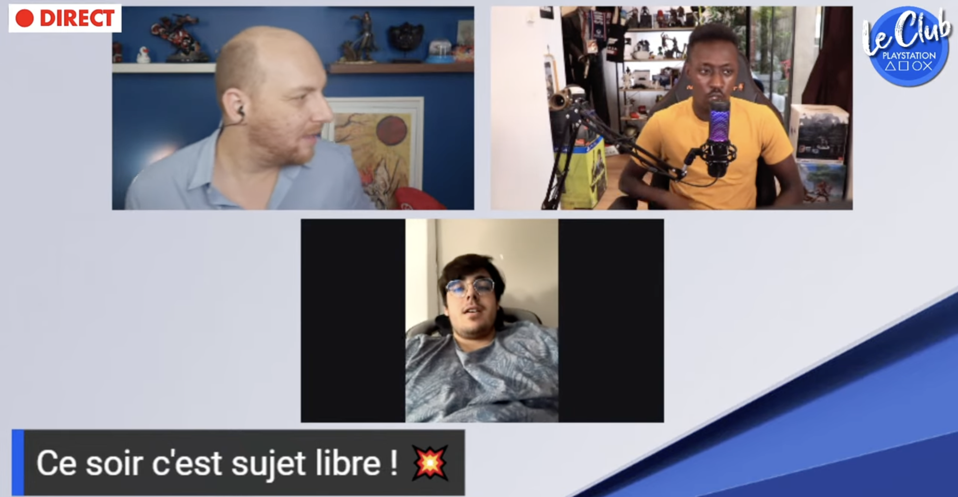
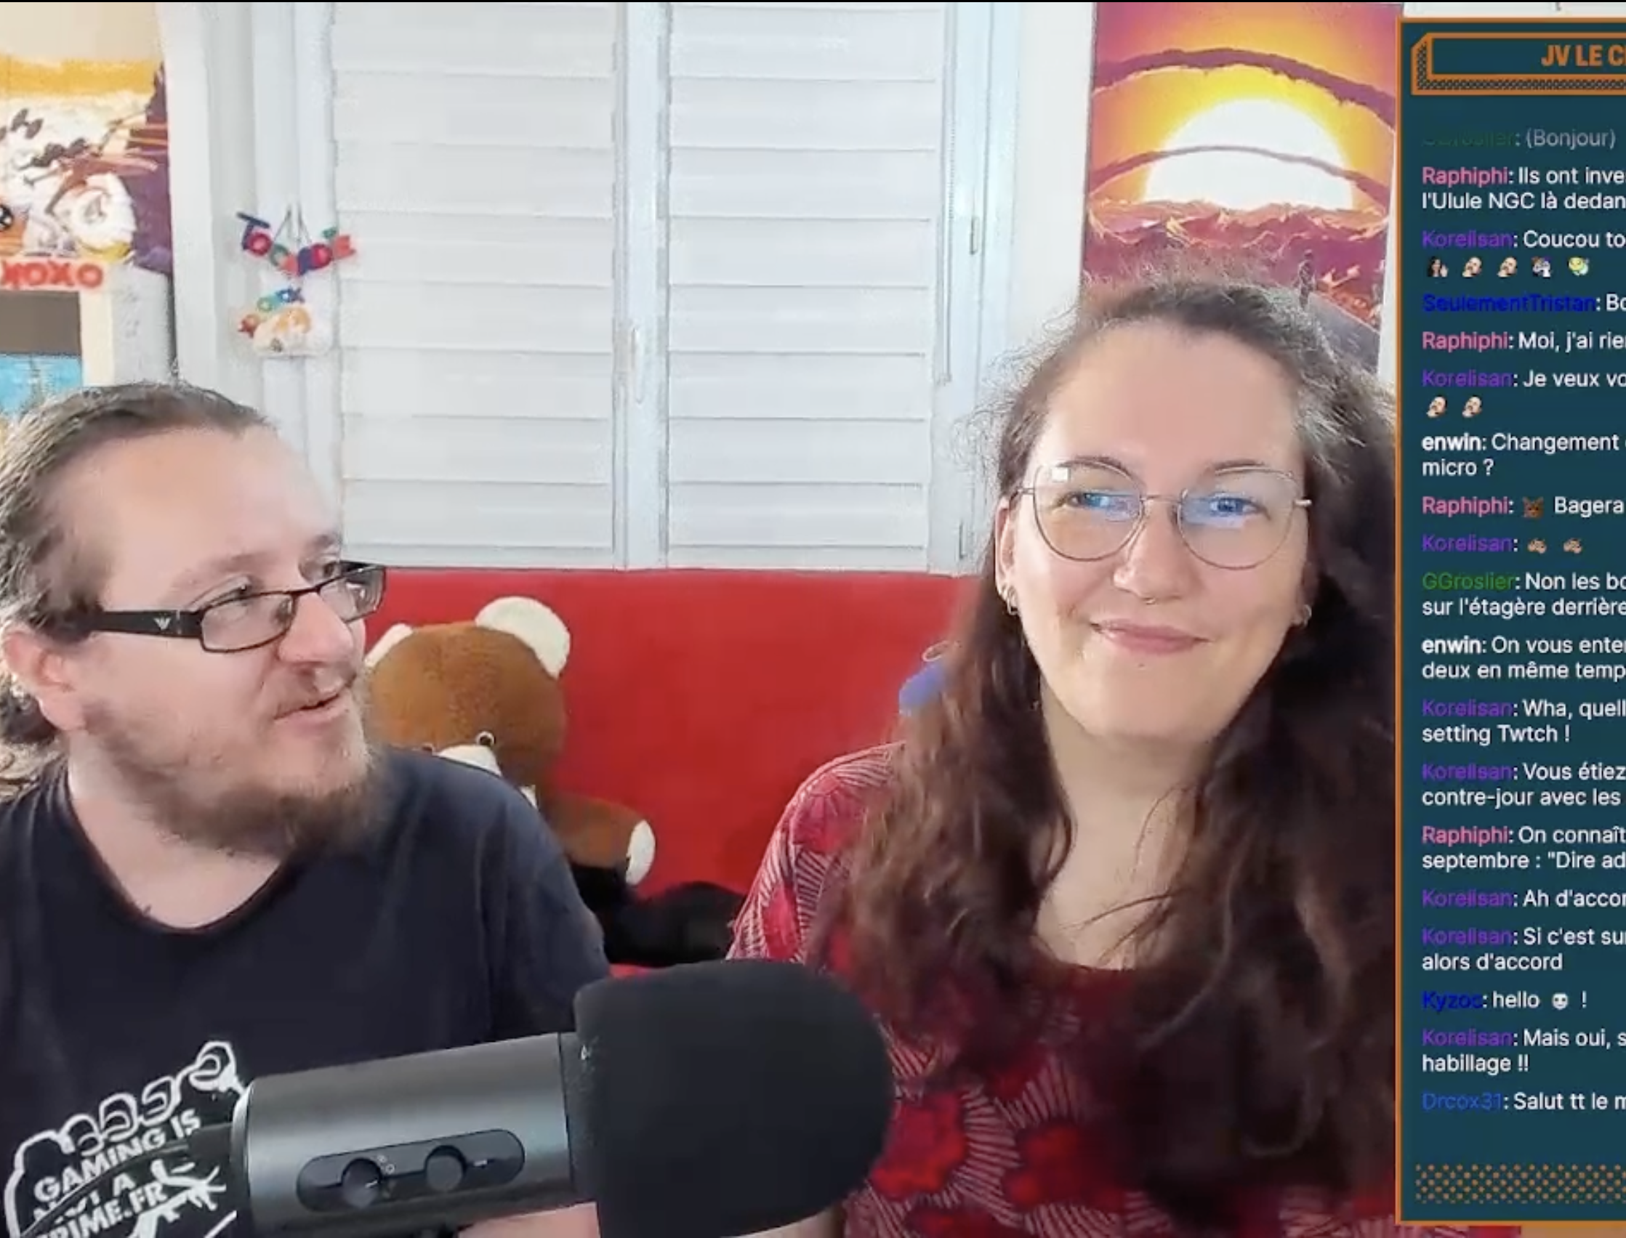
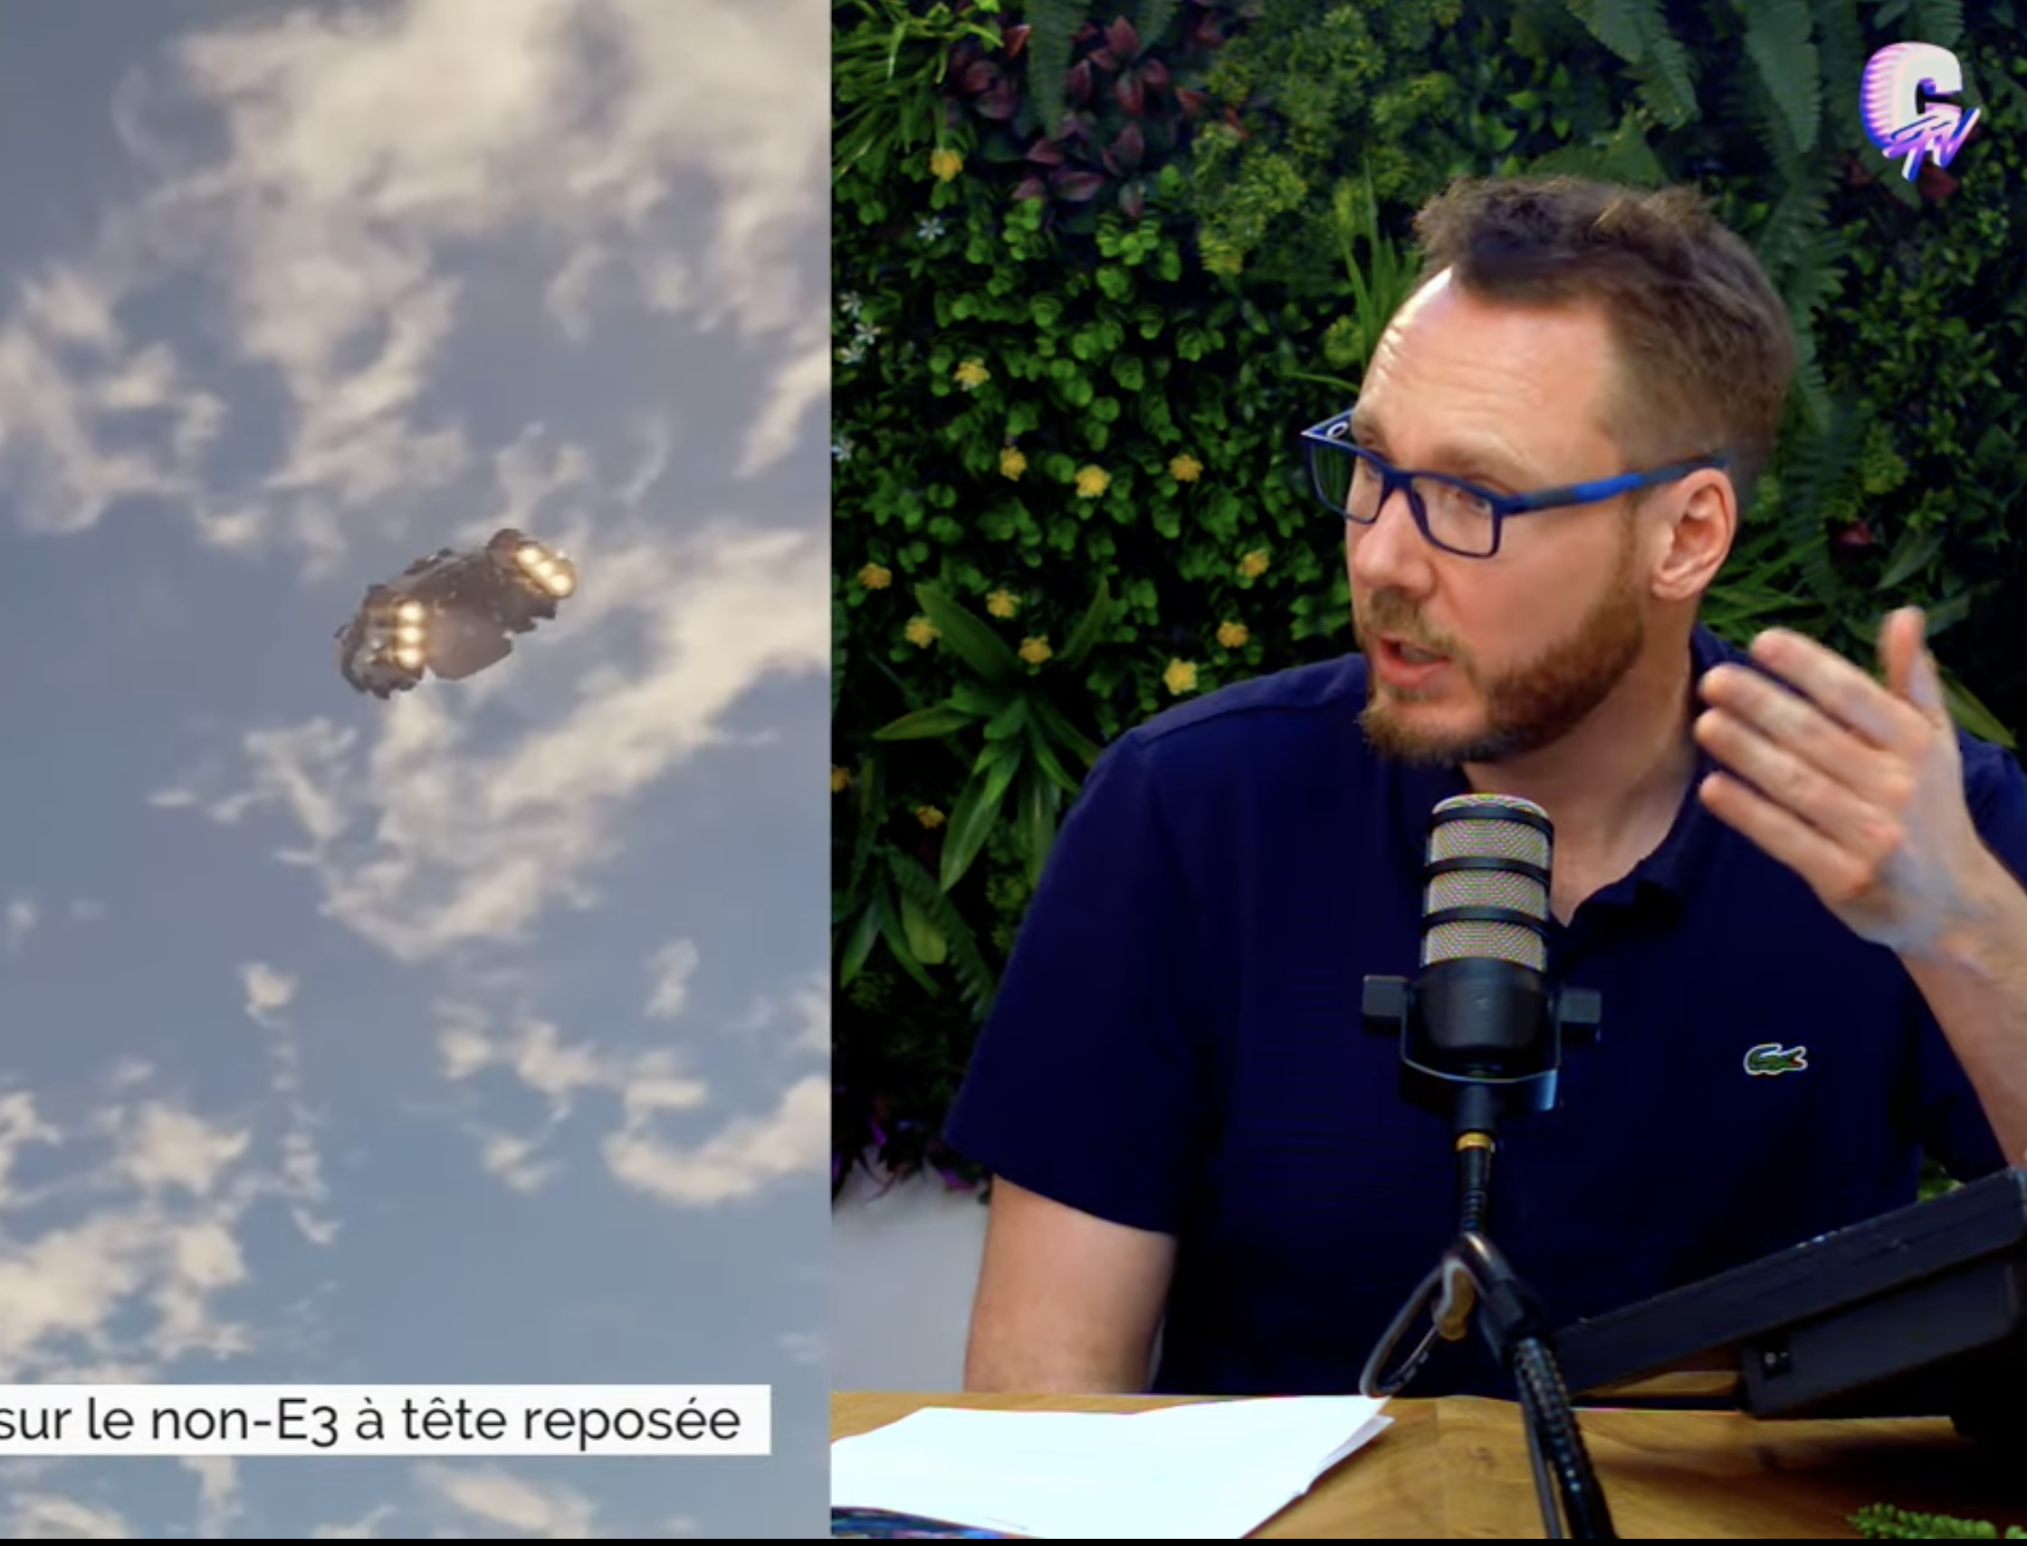
Corpus
Daily watch of Gautoz, Jeux Vidéo Magazine, Gâchette Gauche (Libération), JV Le Mag, Canard PC

Slide 11
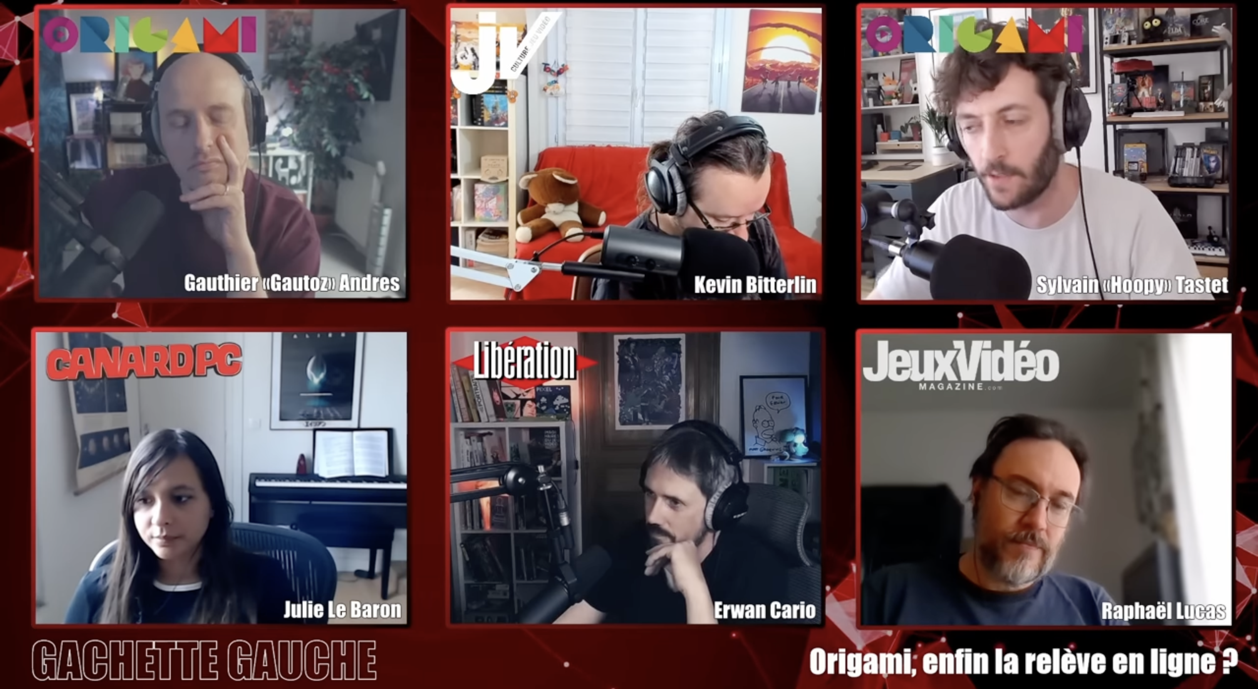
Interactivity and horizontality
Paying attention to messages sent by viewers in chat
Viewers as central (“Le Club” by Jeux Vidéo Magazine) or peripherical (Gâchette gauche)

Slide 12
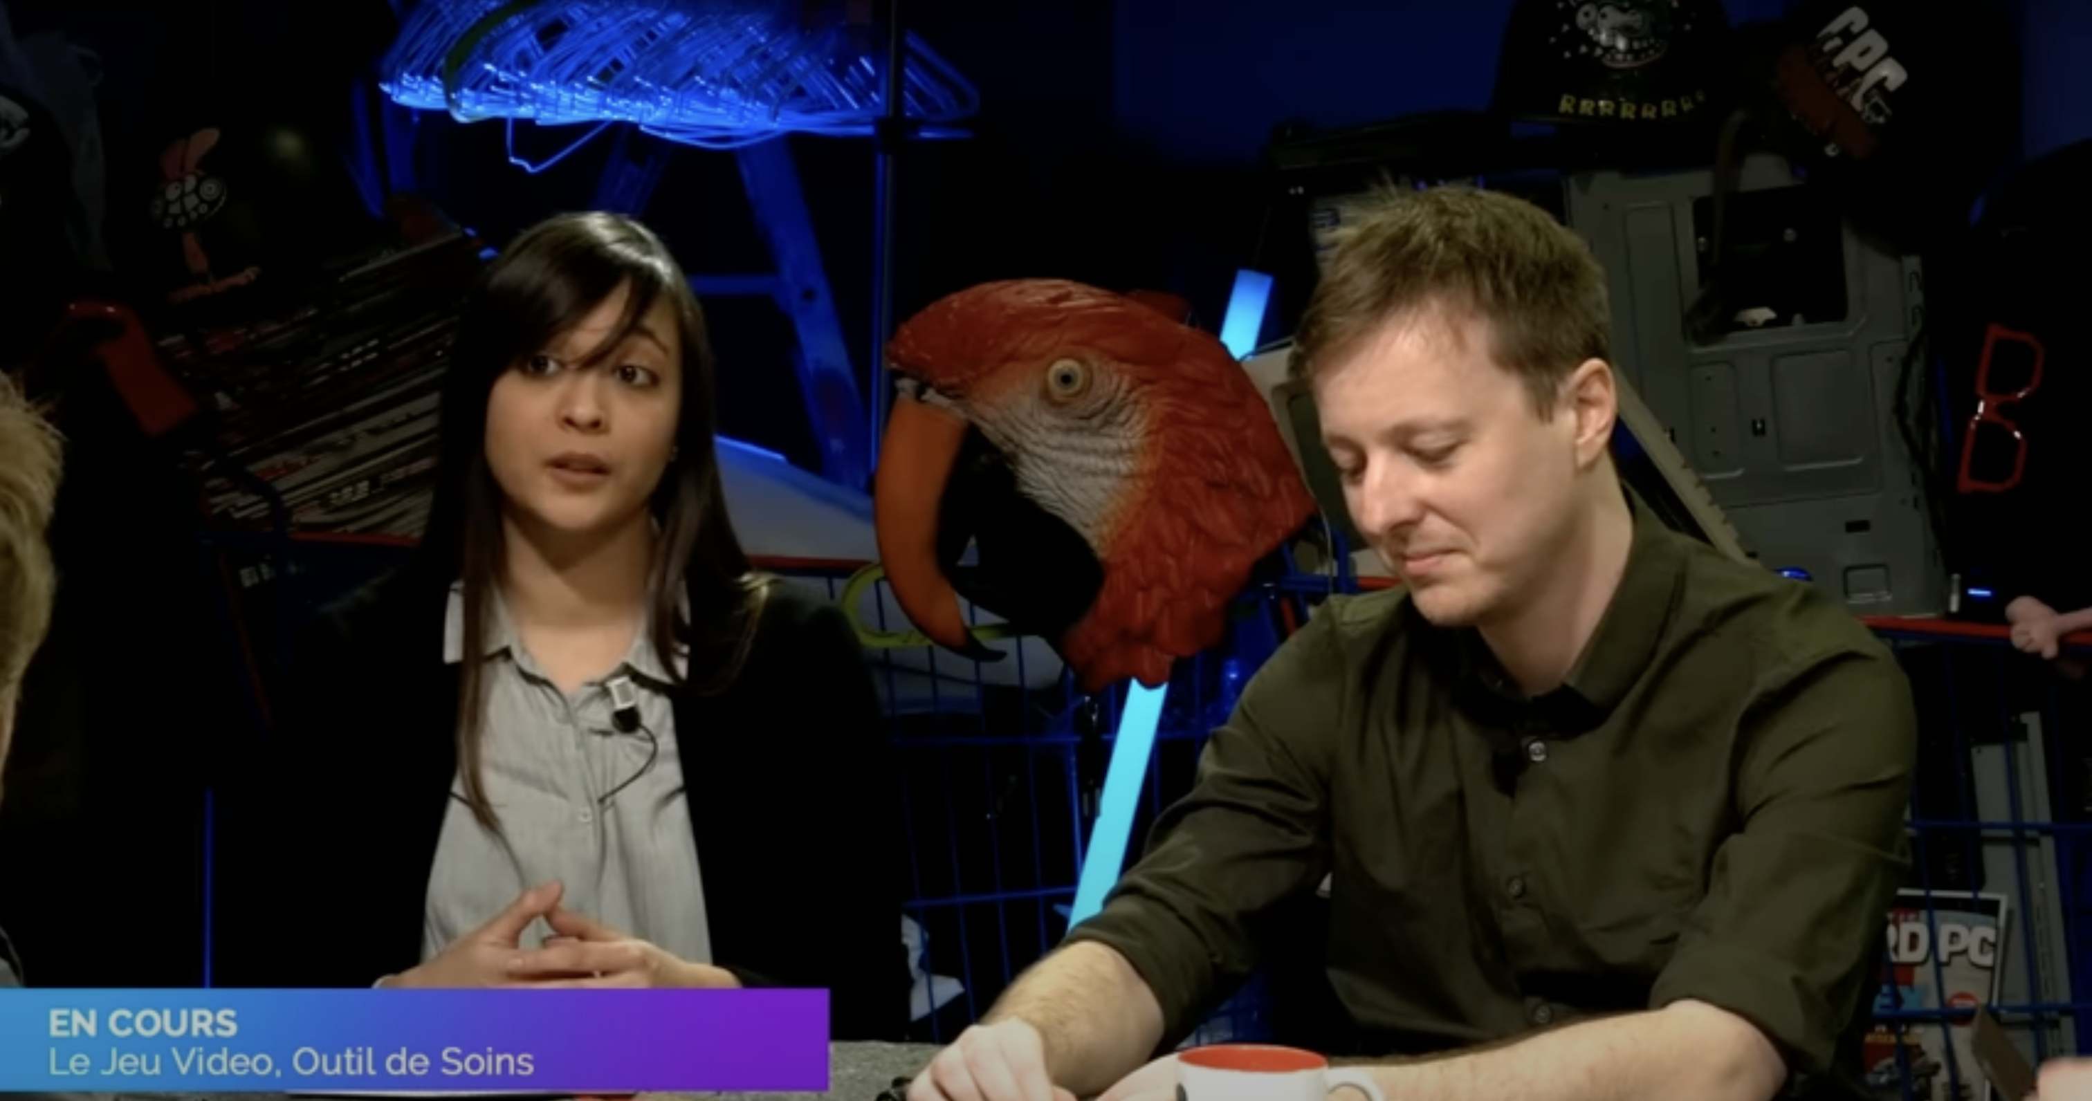
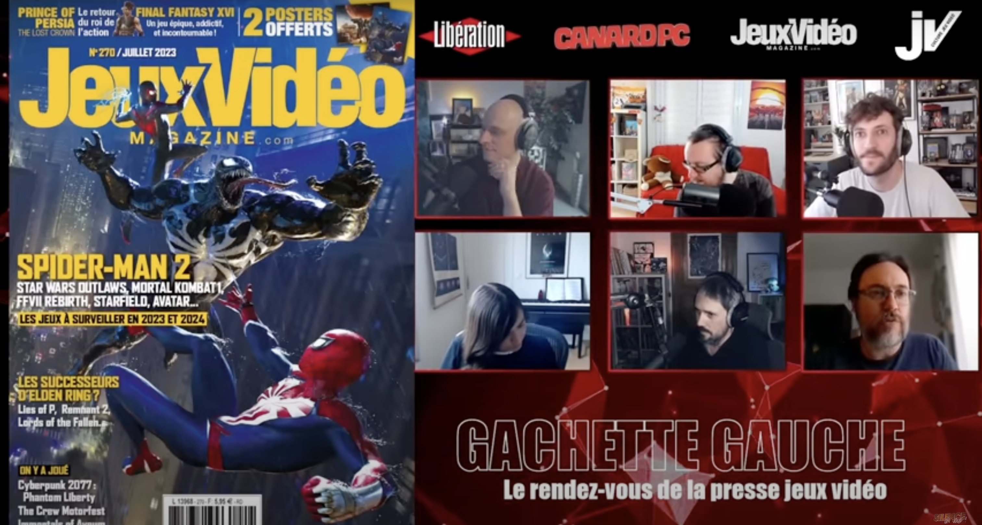
Entertainment and Support
Twitch broadcasts as complements to printed magazines, after publication
Product of appeal : Canard PC’s show relies on investigations published in the magazine to launch live debates between its journalists
Showcase : each guest editor invited in “Gâchette Gauche” is given a sequence to highlight the contents of their monthly issue

Slide 13
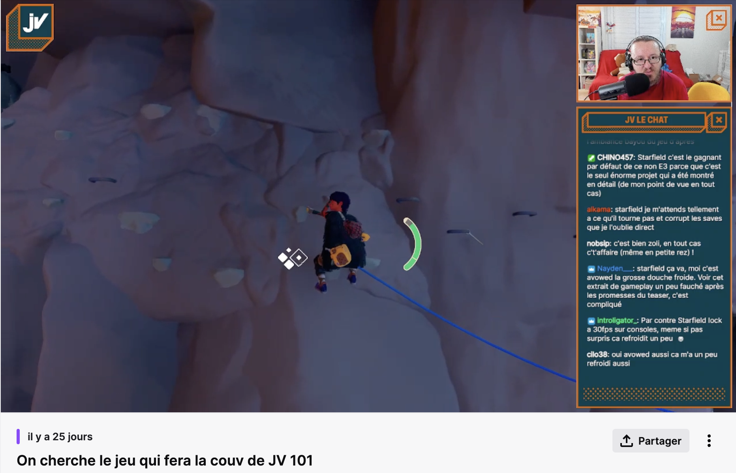
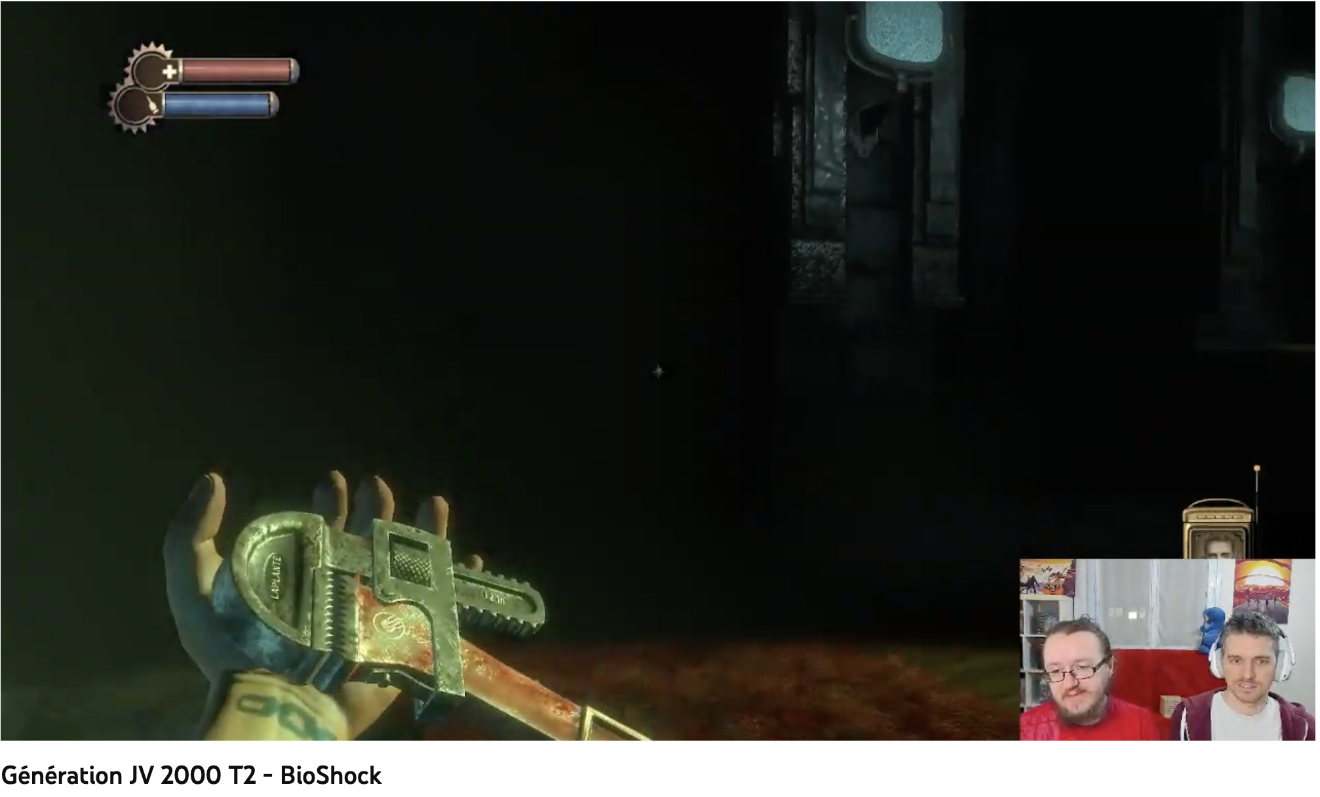
Entertainment and Support
We're looking for the game that will be on the cover of issue 101
Editorial production is shown before publication
Choosing the video game for the magazine cover during a live broadcast
Rediscovering the games analyzed in the forthcoming book
Desacralizing everyday professional life and integrating readers into the editorial process
JV Le Mag as a counter-example

Slide 14
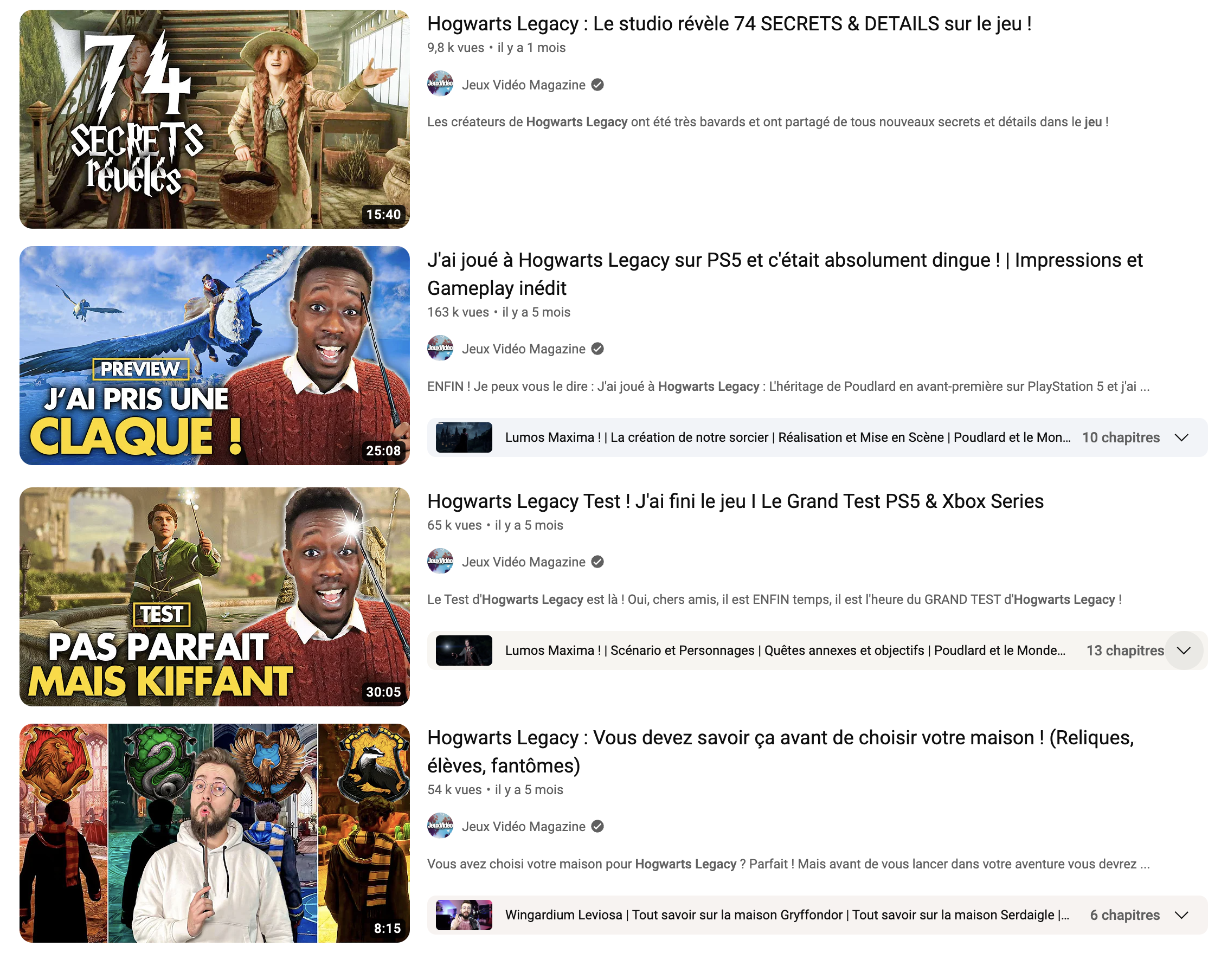
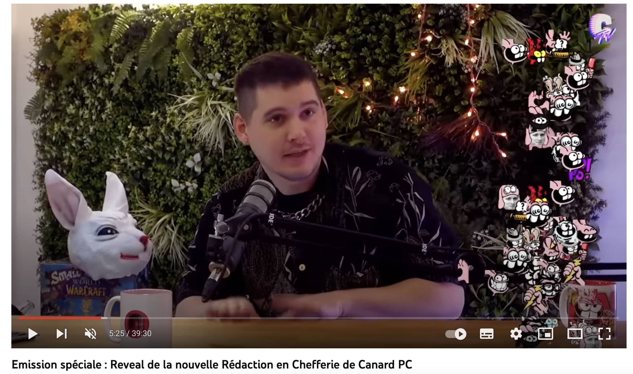
Building the spectacular and staging
Special broadcast: Reveal of the new Canard PC Editor-in-Chief
Jeux Vidéo Magazine ; creating "original" content about the work it's focusing on, seeking, of course, to benefit in turn from the "mediatic capital" (Marchietti, 1997: 26) of an highlighted game.
Canard PC : creating its own events relating to the internal life of the publication .
JV Le Mag : giving a participatory funding campaign a final boost

Slide 15
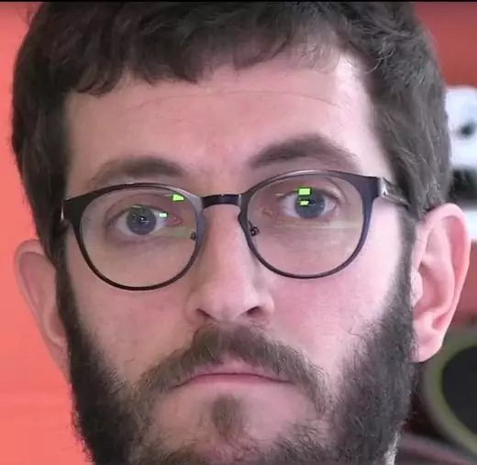
Building the spectacular and staging
« We come from a paper press where we were just signatures at the bottom of articles, and nowadays we carry projects in terms of image. There's a shift happening here. In the magazines of the 1990s, there were already trombinoscopes, the equivalent of Youtube before Youtube. That's what you're going to build a community around. There's a very cold side to magazine writing, and video can make you more human ». Sylvain Tastet, video game journalist
« Streaming was a natural extension of the comic strip boxes in [the video game magazine] Joystick that personified you. A story told between the pages ». Gauthier Andres, video game journalist
Sylvain Tastet
Gauthier Andres

Slide 16
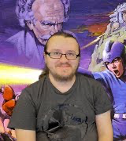
Building the spectacular and staging
A MATTER OF SURVIVAL
« Without [our Twitch show] "Le 13/14", [our paper magazine] JV wouldn't be here today. Because, thanks to streaming, we've managed to create this closeness with people. For a long time, paying for video game news seemed unnatural. For people to get over that moral hurdle, they have to feel involved, and not just give money for information or a magazine, but also because you embrace the philosophy conveyed by the medium you're supporting ». Kevin Bitterlin, JV Le Mag’s chief editor

Slide 17
Conclusions
Print media’s video channels are hybrid spaces staging a journalistic practice, but with a relaxed tone and setting.
An extension of the magazine’s editorial line, but in a space conceived more as a place for discussion than as a vector for information.
Live broadcasting implies a form of nonchalance, but it also showcases the expertise of journalists, who illustrate the breadth of their specialized knowledge in a performative way.
Journalists don't swap their professional hats for those of influencers when they invest in Twitch.
« We don't intend to become the entertainers or presenters who, in this business, often don't dare to have strong opinions on camera about an industry that feeds them and is trigger-happy. We're no longer [in this balance of power]: we're going to buy the games on our own and do without the industry, end of story ». Gauthier Andres, video game journalist

Slide 18
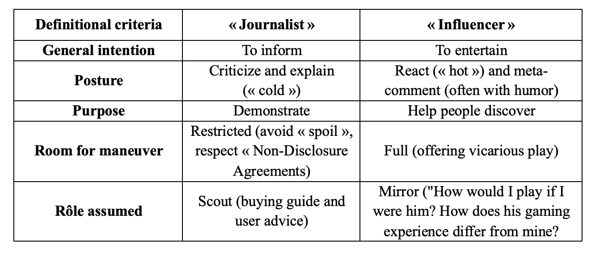
Conclusions
The role of influencer complements the role of journalist, and vice versa (see above)
Video channels are seen as a product of appeal leading viewers to the core business, the production that demands the most time and effort: the print magazine itself.

Slide 19
Conclusions
As a sign of the crisis in the paper industry and of professional reinvention, video platforms have recently become the place for a decentralized, nuclearized form of investigative journalism, disconnected from traditional media companies.
Gauthier Andres : began by press reviewing the work of colleagues, and then progressively carrying out his own investigations, broadcasted on Twitch, when other media left grey areas that he decided to fill.
« We're going to talk about [the video game in development] Beyond Good and Evil 2, which was the subject of a little investigative article by Kotaku, which motivated me, for my part, to dig into the subject too. »
ANDRES Gauthier, « What’s the human cost for Beyond Good and Evil 2 ? », Youtube, 1st march 2023

Slide 20
Conclusions
Origami : a new perspective for investigative journalisme on Twitch, supported by crowdfunding.
By asserting the presence of investigative journalism in a space traditionally affiliated with entertainment, these journalists are defending a transversal professional journalistic ideology (Deuze, 2004), which can be exercised everywhere with the same deontology and rigor, whatever the medium.
By freeing themselves from a lot of constraints (negotiation with publishers, printing delay, page layout issues…), journalists intend to revive a form of responsiveness and authenticity : Twitch as a space of freedom.

Slide 21
Having contributed to the demise of the video-game press with the advent of the Internet, the web now offers, through the streaming gateway, a way for video-game magazines to reinvent themself, to finance journalism differently and to personify the efforts required to transmit quality information.

Slide 22
Bibliography
BARNABÉ Fanny, « Réthorique du détournement vidéoludique. Le cas de Pokémon », Thèse de doctorat, Université de Liège, 2017.
BREEM Yves, KRYWICKI Boris, Presse Start ! 40 ans de magazines de jeux vidéo, Omake Books, 2020.
CONSALVO Mia, Cheating : Gaining Advantage in Videogames, Cambridge MIT Press, 2007.
DAGIRAL Eric, PARASIE Sylvain, « Vidéo à la une ! L’innovation dans les formats de la presse en ligne », in Réseaux, vol. 160-161, pp. 101-132, 2010.
DAKHLIA Jamil, « Propriétés et fonctions de la presse magazine », in BLANDIN Claire (dir.), Manuel d’Analyse de la Presse Magazine, Armand Colin, pp. 49-62, 2018.
DOZO Björn-Olav, KRYWICKI Boris, « La presse vidéoludique », in BLANDIN Claire (dir.) Manuel d’analyse de la presse magazine, Armand Colin, pp. 213-227, 2018.
DOZO Björn-Olav, KRYWICKI Boris, « Les livres de journalistes francophones spécialisés en jeu vidéo : du capital ludique au capital journalistique », in GAMELAB UNIL-EPFL (dir.), Penser (avec) la culture vidéoludique, Presses Universitaires de Liège, 2022.
MANSUY Julien, « Usage de l’image(s) par la presse vidéoludique des années 1990 », Mémoire de Master, Université de Lille, 2019.
MARCHIETTI Dominique, « Contribution à une sociologie des transformations du champ journalistique dans les années 80 et 90. À propos d’“événement sida” et du “scandale du sang contaminé” », Thèse de doctorat, École des Hautes Études en Sciences Sociales, 1997.
TRICLOT Mathieu, « Désirs et techniques : les figures de “l’avenir des jeux vidéo” dans la presse spécialisée francophone au tournant des années 1980 et 1990 », in Lire les magazines de jeux vidéo, Presses Universitaires de Liège, 2022.

