Slide 1
Institutionalization and subjective wellbeing in Europe:
An attempt to compare private homes and nursing homes
Anne Laferrère (Université Paris-Dauphine) and Jérôme Schoenmaeckers (HEC-Liège)
LAGV, 28-30 June 2023

Slide 2
Introduction (1)
Statement:
  Desire to age « in place » avoiding nursing home (NH)
  Recent COVID-19 pandemic increased this willingness (Achou et al., 2022)
  Even before the pandemic, excess mortality observed in NH in some European countries (Flawinne et al., 2023)… but before the end of life, link between housing choices and wellbeing is also important and less explored
  → Are older Europeans really better off at home than in care institutions?
Notes:
Strict lockdown measures led to solitary deaths
Question for good practices in NH management and organisation

Slide 3
Introduction (2)
Extension of Böckerman et al. (2012) research in Finland on differences in quality of life of people institutionalised
  Higher levels of subjective wellbeing for Finns in old-age homes
  Some people living at home are frail and should really be living in old-age institution (subsidized) but because of the queues for that particular mode of living, they are living at home with a decreased quality of life
Using 5 pre-COVID SHARE waves, we extend in three ways:
  15 countries
  Selection of an a priori comparable sample of people with already at least one limitation in the activities of daily living
  Addition of propensity score matching methods to OLS and ordered probit models
Notes:
Ageing and Society but without tackling the issue of endogeneity
By holding health, functional status and income level constant

Slide 4
Data (1)
Data from SHARE survey
  Waves 4 to 8 (pre-COVID), from 2010 to 2020
  65+
  ADL >= 1 (bathing, eating, …)
We keep a maximum of countries → to point to good practices
We leave aside countries such as Greece where NH are very few
Leaving aside observations with missing values
→ 20,088 observations (5.4% in NH)
Notes:
Restriction on the sample in order to have people in the database who have some difficulties → in order to avoid or at least reduce selection bias in the baseline sample.

Slide 5
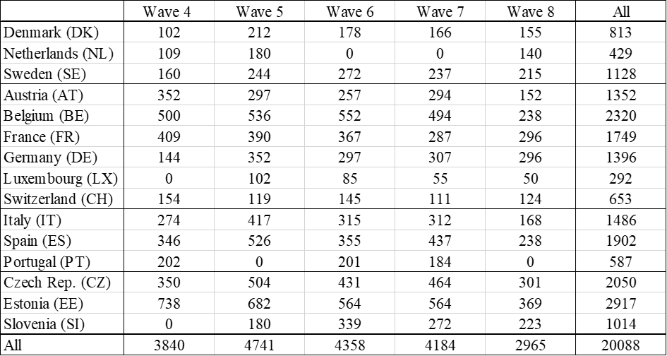
Data (2): sample
Notes:
Wave 8 stopped in February 2020 because of the COVID-19 epidemic, hence the smaller sample size.

Slide 6
Data (3)
The two main variables in SHARE
  1) measuring well-being: “We are also interested in how people think about their lives in general. On a scale from 0 to 10 where 0 means completely dissatisfied and 10 means completely satisfied, how satisfied are you with your life?”.
  2) NH defined as : “A nursing home provides all of the following services for its residents: dispensing of medication, available 24-hour personal assistance and supervision (not necessarily a nurse), and room & meals”. + “A housing complex with services for older people (residential home or sheltered housing)”
Notes:
1) The question is asked to all respondents, including those living in NH. Note that it is naturally a non-proxy question, i.e. it is not asked if the respondent cannot answer by herself. The answer will be missing for those with more cognition problems, who are thus left out. Indeed the rating of life satisfaction was missing for 33% of those living in NH, versus 5% for those living in the community.

Slide 7
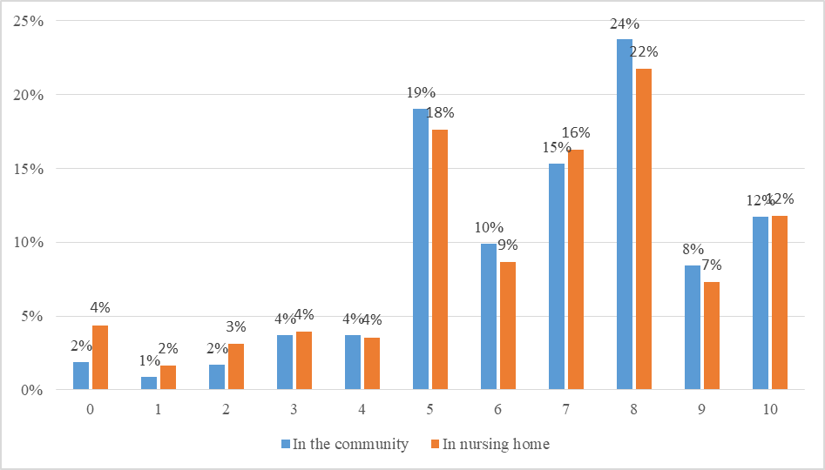
Data (4) : Life satisfaction of the 65+ (scale from 0 to 10) in fifteen European countries
 | Mean | Std. Err.
Private home | 6.75 | 0.02
Nursing home | 6.45 | 0.08
All | 6.73 | 0.02
Notes:
The average rating of quality of life seems quite high: 6.75/10. It is slightly lower in nursing homes: 6.45.
The distribution of rating is ordinal but not a continuous variable (Figure 1). So besides running OLS regressions we also run ordered probits as robustness checks. OLS coefficients are easier to interpret, even is one should beware that the measure of differences is full of pitfalls. It would meaningless to state “You are twice more happy, or 10% happier than I am”.

Slide 8
Data (5): Difference in satisfaction by countries
Large differences of satisfaction between countries
Higher share of people aged 65+ with a limitation in ADLs living in NHs in the Northern countries
Larger difference in LS between NH and private home in Italy and Portugal
→ More robust analysis needed to conclude to NH leads to under-satisfaction
Notes:
Than southern and Eastern countries

Slide 9
Data (6): Difference in satisfaction by covariates
SSE variables (+ income, wealth)
Health variables (+ IADLs, SPH, mobility issues, health conditions issues)
Family variables
→ More robust analysis needed to conclude to NH leads to under-satisfaction
Notes:
Higher satisfaction for men but they less satisfied than women when they are in NH
The more ADLs, the less happy but no difference in terms of satisfaction according to the dwelling
The more children, the more they are satisfied but if they still have children, they are less satisfied if they are in NH.

Slide 10
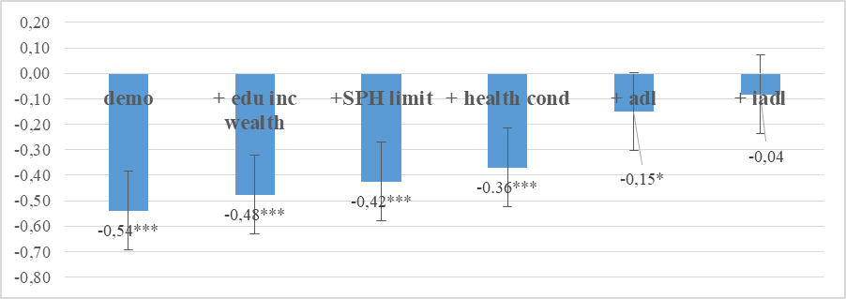
Results (1): OLS
OLS models of the life satisfaction rates (effect of being in NH)
All models control for demographics (age, sex, number of children, and the presence of a spouse or partner, country and wave fixed effects)
Notes:
We gradually add control for various aspects of health: self-perceived health, mobility limitations, four health conditions (dementia, Parkinson, pulmonary, cardiovascular disease), then the limitations in activities of daily living (ADL) and instrumental limitations (IADL) in such activities. → effect of being in NH tends to disappear…
Results go in the same direction for ordered probits.
When we do an analysis by country, the significant and negative effect disappears for all except Italy.

Slide 11
Results (2): Matching methods
Above a certain level of disability it is difficult to stay at home, and the selection into nursing home may be linked to unobservables → it is not because I live in a NH that I feel worse, but because of my unobserved level of disability
To get closer to a causal effect of nursing homes on satisfaction, it is important to control for the possible simultaneous determination of health and housing arrangement
→ we use a propensity score matching method. That is, every individual in a nursing home is matched to a set of individuals living at home with similar observable characteristics. It allows to condition on sufficient observable information to obtain a counterfactual against which to measure the effect of being in a nursing home.
Notes:
Difficulties of comparing people in nursing homes and private homes from linear or even multinomial probit models
This is why we selected a sample of individuals aged 65+ who had at least one ADL limitation but the characteristics of people in nursing homes can still differ significantly from those living “at home”.

Slide 12
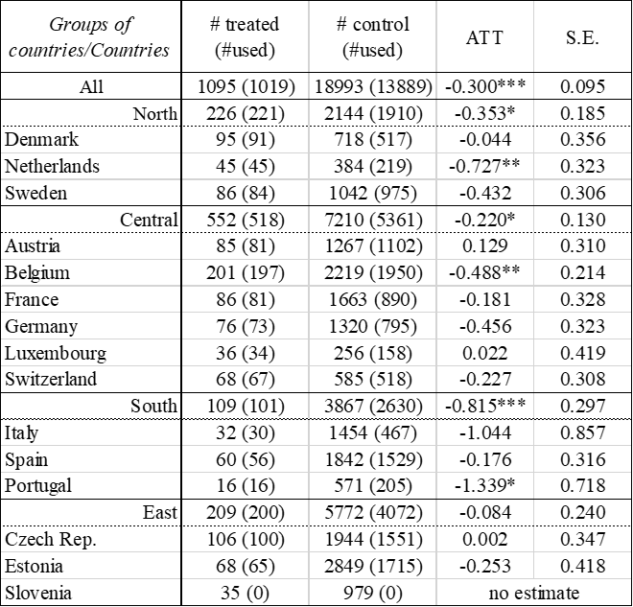
Results (3): ATT by regions and countries
To match similar individuals from the two groups so that the differences in outcomes (here self-reported life satisfaction) of these matched pairs can then be attributed to the treatment, i.e. being in a nursing home.
No functional form of outcome equation + CIA assumption
Kernell algorithm + exact matching
Cet.par people feel worse in NH than in private homes
Notes:
The main advantage of the method is that it does not require specifying a functional form of the outcome equation and is therefore not susceptible to misspecification bias along that dimension.
Our analysis relies on the conditional independence assumption (CIA) that the life satisfaction of the individuals in the control group and in the treated group are independent of the residence status once we control for a set of observable characteristics → you could tell me that there could be a missing variable which is really important and that we forget.
To avoid matches that could bias our analysis, we request that the pairs are perfectly matched according to country, gender, marital status and wave.
With the same dataset, the matching method leads to conclude that cet.par. people feel worse in NH than in private homes. This in all groups of countries, except in our three Eastern countries. At the country level the association is negative in the Netherlands, Belgium and Portugal. Hence the matching method gives a slightly different result from simple OLS.
Results are robust (other algorithms, etc.)

Slide 13
Results (4): Heterogeneity of ATTs
Strongest impact on men and youngest residents (but driven by South)
No effect from number of ADLs
→ a contrario useful role of NH in cases of heavy dependence
More difficult if still partner or children
Notes:
The strong impact of living in a NH on the satisfaction of men is clearly observed, whatever the region except the East. In the South, being in NH is particularly harmful for the youngest residents while it is for the oldest residents in Central Europe. The number of ADLs appears to have no effect. This could demonstrate a contrario the useful role of nursing homes in cases of heavy dependence. Finally, we see that it is even more difficult to be in a nursing home if one still has a partner or if one has many children, certainly considering that one would prefer to be taken care of by one's partner or by one's children.

Slide 14
Conclusion
This paper looked at whether people rate their quality of life lower living in a nursing home than in a private home
Using simple OLS, people do not seem to be less happy in nursing homes (except for Italy)
→Using matching methods, more definite negative effect of the life in NH
  Margin for improvement of the care delivered in NH
Differential negative effect is worse for men, for younger people, for those with more children or with a spouse
  important psychological effects beyond various local care practices
  improvement in NH management could be to make NH more open to non-professional carers such as family members
Possible extension of this work would include data on out-of-pocket care and accommodation expenses in NH and in private homes
Notes:
. A margin for improvement in NH management could be to make NH more open to non-professional carers such as family members.

