Slide 1
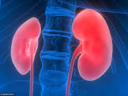
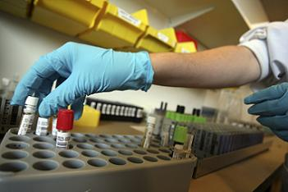
CHU Liege: Impacting CKD patients by leveraging a Clinical Decision Support system
Notes:
The University Hospital of LIEGE is constituted by 2 main sites, each sites has its laboratory. Both of them uses the same lab diagnostic plateforms. We provide diagnostic services for a large population of in-out-patients. Our laboratory performs an estimated 25,000 tests a month, covering the full spectrum of laboratory medicine.

Slide 2
Agenda
CHU Liège objectives
Abbott AlinIQ CDS Phase 1 project
CHU Liège Retrospective analysis findings
Validation
Clinical recommendations
Test ordering behavior
Impact on validation and optimal follow up of CKD patients
Potentiel impact on cost of clinical biology prescription
Tracability and transparency of CDS AlinIQ system
Phase 2 projet implementation
CDS benefits in CHU Liège
Notes:
On peut faire court pour dire tout cela :
We have a 15 189 accreditation for XXX analysis for many years. The CHU labs count approximately 400 medical technicians and xxx Clinical Biologists.
In our large laboratory that use "high-throughput" equipment, we use for more than 15 years, VALAB, an expert system that permits real-time validation of data. This tool is designed to be equivalent to validation by the Clinical Chemist.
it is now possible to use artificial intelligence techniques to aid decision making and validation of data
Auto-validation rate is 95%, percentage automatically approved by VALAB
The CHU of LIEGE, in partnership with Abbott, completed a pilot project to establish how the use of Abbott’s AlinIQ CDS solution could standardize the medical validation of clinical chemistry analysis thanks to the application of clinical guidelines. We also wanted to evaluate if it could help some bad clinician test-ordering practices and save laboratory time and resources.

Slide 3
CHU LIEGE Objectives
Strategic:
Maintain state-of-the-art and excellence in Medical Care
Reinforce the advices service offered to doctors and patients​
​Continue to pave the way to informatic innovation in Assistants Education
Quality:
Optimize biological validation methods and auto-validation.​
Improve communication workflow between stakeholders involved in patients diagnose​
Optimize the identification of critical and chronic patients, impacting patient management and outcomes.
Financial:
Optimize the current workload required for validation
Optimize test ordering according to available Clinical Guidelines

Slide 4
AlinIQ CDS - Phase 1 Project
Kickoff meeting / objectives definition
10th of November 2020
CHU LIEGE TEAM
Management Prof. Etienne Cavalier
Medical Team Françoise Luyckx Romy Gadisseur
Information Technology Jessica Jacques Marie-Pierre Cunin
ABBOTT TEAM
Informatics Specialist Andres Garcia
Application Specialist Sally Hazer
Professional Services Executive Julien Wallemacq
Integration Specialist Jesus Alvarez
Ambassador Myriam Othmane
Project Management Dina Hamouda
Installation / data analysis
Use cases definition
Rules building
Interim results analysis
Review data requirements
Refine knowledge base
Final phase 1 report and next steps
25th of March 2021
Notes:
The CHU of LIEGE, in partnership with Abbott, completed a pilot project to establish how the use of Abbott’s AlinIQ CDS solution could standardize the medical validation of clinical chemistry analyze.
Therefore, we defined our internal human resource at CHU of Liège. In all, we were two clinical chemists, our Lab manager (Professeur Cavalier) and 2 colleagues from the IT team.
During xxx weeks, we let ourselves be guided by our partner and we spent time in developing the tool. We also had regular virtual meetings to work together and improve the tool.
The IT team spent time to integrate the application into our IT system so that it could be possible for CDS to use our historical “raw” datas. This was done in accordance with the hospital's confidentiality charter.
The CHU implementation team defined an initial set of XXX rules for several diseases (CKD, Phosphocalcic metabolism, diabetes) and defined our “use cases”. During that first phase, the CHU of Liège team could evaluate the ease of creating rules and the potential comments, reflex tests..…

Slide 5
Lab Validation Recommendations (Valab)
518 aut
ORDER
Actions
959 patients, 21 rules
518 auto-validations
42 %
Recommendation for “automatic validation” | Findings
25VTD range 5 - 100 | 207
Albumin and Proteins total = Normal Range | 189
PTH is normal and 25-OH Vitamin D is normal | 34
Calcium is low and Albumin is low | 27
Albumin and Proteins totals < Normal Range | 21
Physician Emergency is true and 0 < Troponin < 200 | 14
PTH is normal and 25-OH Vitamin D is normal and Creatinin is normal and Calcium is normal | 9
Physician Cardiology is true and Troponin is normal | 8
25VTD <10 ng/mL => validate PTH range 10-40 | 2
PTH is normal and 25-OH Vitamin D is normal and Creatinin is normal | 2
Albumin and Proteins totals > Normal Range | 2
Physician Nephrology or Dialysis and MDFG/FDFG < 40 | 1
Calcium Ionized is low and Albumin is low | 1
Physician Nephrology or Dialysis AND PTH range 30-100, OR Creatinine range 2-8, OR Potassium range 3-6mmol/L, Phosphates range 1,5-2,5 mmol/L | 1
Blocked for human Validation
Recommendation | Findings
Age > 65 y and 25VTD >50 | 3
3 cases blocked for validation
Add Comment :
“Vitamin D supplementation”
Recommendation | Findings
Physician Pediatry and 25VTD < 2 | 1
Female and Ca Ionized <1,15 OR > 1,30 | 1
2 cases auto-validated with a comment
Notes:
The first aim of the Phase1 was to evaluate how Auto-validation could be possible with CDS.
We decided to challenge CDS with 21 rules that we used to analyze historical data of a “one-day” routine. Datas came from a one-day extraction form our LIS. In all, we included 959 lab orders from our in-out-patients.
518 lab orders were fully auto-validated. CDS decided to block auto-validation of 42% lab order
CDS was able to find 3 lab orders corresponding to one rule “do not validate the vitamin D result upper than 50 if patient is aged upper 65yo”
CDS was able to find 3 lab orders corresponding to one rule “do not validate the vitamin D result upper than 50 if patient is aged upper 65yo” as it is not frequent
and on retroactively provide treatment and testing guidance.
It analyzed xxx cases from XXX to XXX extracted from our medical record (Omnipro) from CHU of Liege and provided a validation study our rules as well as interpretation, testing…
Automatic comments integration

Slide 6
CDS “comments” on OMNIPRO data
323.327
lab orders
135.730 comments reported
CLINICIAN
86.530 patients
1 year Data extract
from OmniPro
~ 2 comments per patient
94
recommendations
72.352 individual patient reports generated
~ 1 report per patient
~84% of the overall patients received interpreted reports
1/3 of the overall patients received CKD related Comments
PATIENT

Slide 7
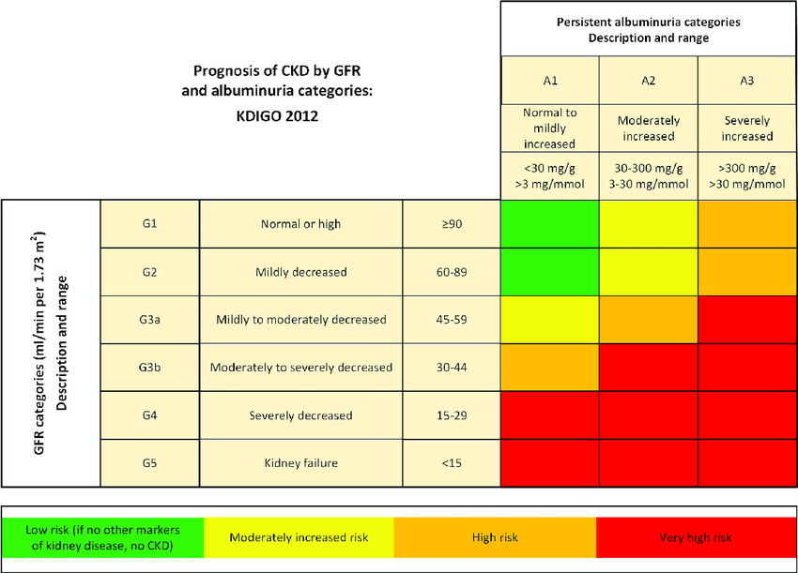
Stages of CKD: Clinical guidelines KDIGO
Chronic Kidney Disease
KDIGO 2012 Clinical Practice Guidelines for the Evaluation and Management of Chronic Kidney Disease
GFR : Glomerular filtration rate
KDIGO : Kidney Disease Improving Global Outcomes

Slide 8
Patients distribution according to GFR and CDS “Comments”
G1
G2
G3a
G3b
G4
G5
Total
Patients
26 315
30 909
6 213
2 601
1 048
442
67 528
Multiplying Factor
× 3.53
× 3.23
× 5.34
× 8.01
× 11.67
× 18.12
× 3.96
Comments
92 863
99 948
33 213
20 828
12 244
8 025
267 121
Rapid Progression
(All Stages)
CKD Stages
G3a – G5
Once per year : PTH, Ca, and PAL, Phosphate (G3a-G5)
Patients
19.378 (28.7%)
10.304 (15.2%)
4091 (6%)
Lab Orders
74.310
Relevance
Automatic identification of critical patients
Automatic staging of patients <60 GFR
Automatic identification of gaps in follow up

Slide 9
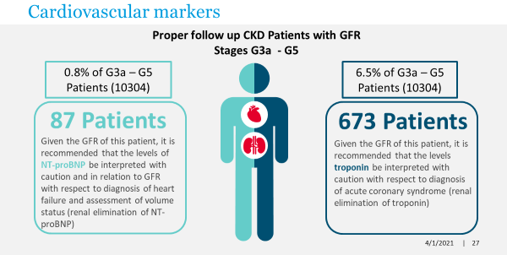
Optimal follow up of CKD G3a-G5 patients
Patients in GFR categories G3b-G5 it is recommended to measure at least once as a baseline PTH, Phosphate, calcium, and bone alkaline phosphatase. Additionally, it is suggested to keep phosphate concentrations in the normal range
GFR G3b-G5
AlinIQ CDS Findings: 4091
PTH
GFR G3b-G5
GFR G3a-G3b
Patients with GFR stages G3a-G3b should receive a HGB test once per year
In people with CKD and with PTH above normal limit, it is important to evaluate for hyperphosphatemia, hypocalcemia and Vitamin D deficiency
AlinIQ CDS Findings: 8216
AlinIQ CDS Findings: 75
GFR G4-G5
Patients with GFR stages G4-G5 should receive a HGB at least test twice per year
AlinIQ CDS Findings: 1490
| 9

Slide 10
Cost of actual situation of ordering behavior of creatinin
At least 2 Creatinin
Time Intervals | All Patients |  | Internal Medicine Patients
 | No. of Patients | % | No. of Patients | %
< 24 Hours | 15347 | 18% | 4058 | 12%
< 8 Hours | 12286 | 14% | 2645 | 8%
< 1 Hour | 4386 | 5% | 718 | 2%
>24 hours | 54511 | 63% | 27637 | 79%
Total | 86530 | 100% | 35058 | 100%

Slide 11
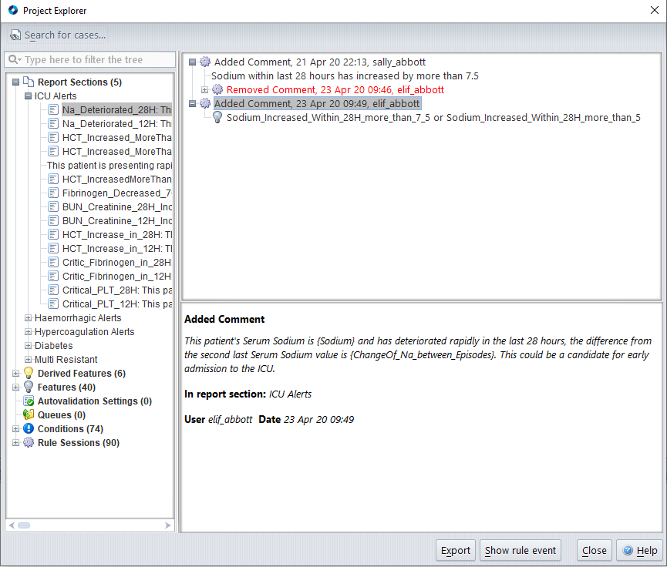
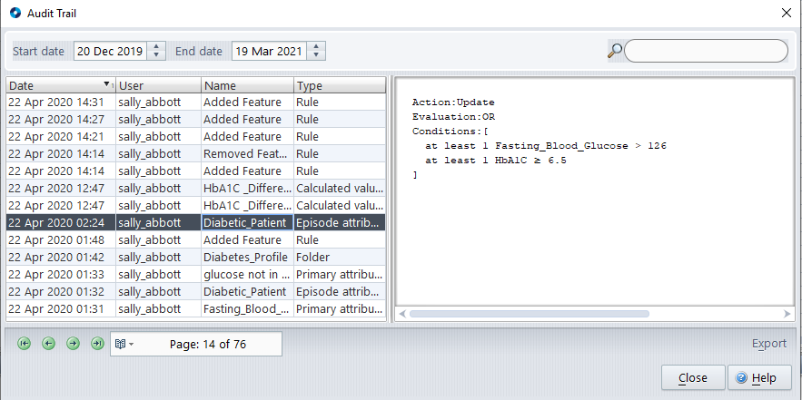
Traceability and transparency on rules
Project Explorer
Audit Trail

Slide 12
ALinIQ CDS BENEFITS IN CHU LIEGE
Quality
Harmonize biological validation methods and auto-validation.​
​Improve communication workflow between stakeholders involved in patients diagnose.​
Optimize identification of critical and chronic patients, impacting patient management and outcomes.​
Strategic
​Reinforce the service offered to doctors and patients
Fully integrated with all Institutional Information Systems
Increase traceability and transparency on rules and interpretive comments ​
Financial
Optimize the current workload required for validation
Identify improper ordering behavior or over utilization
Reduce costs of laboratory prescription according to available medical guidelines

Slide 13
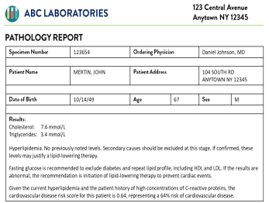
Phase II AlinIQ CDS: Live implementation and real-time actions
Once live, the CDS rules engine acts on new cases and applies rules to generate patient-specific reports and alerts.
Integration of CDS and validation to the LIS/middleware and other data sources
ALINIQ CDS
OmniPro
ALINIQ CDS
INTEGRATION ENGINE
Reports and alerts are sent to clinicians via existing workflows (e.g. LIS/Omnipro, email, or SMS)
GLIMS
Expansion to additional data sources
(radiology)
On-premise installation

