Slide 1
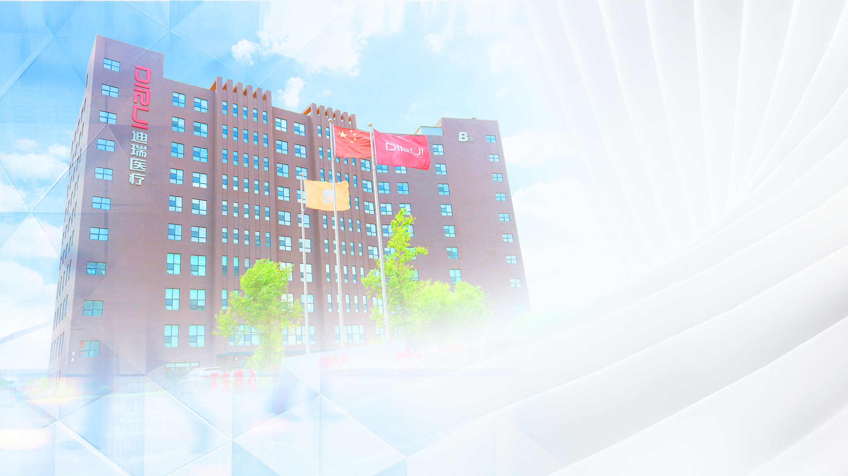


The interest in urine crystals recognition from a clinical point of view.
Romy Gadisseur
Department of Clinical Chemistry
CHU of Liège, Belgium
romy.gadisseur@chuliege.be

Slide 2

For this presentation & in this field,
I have no financial disclosure to declare

Slide 3
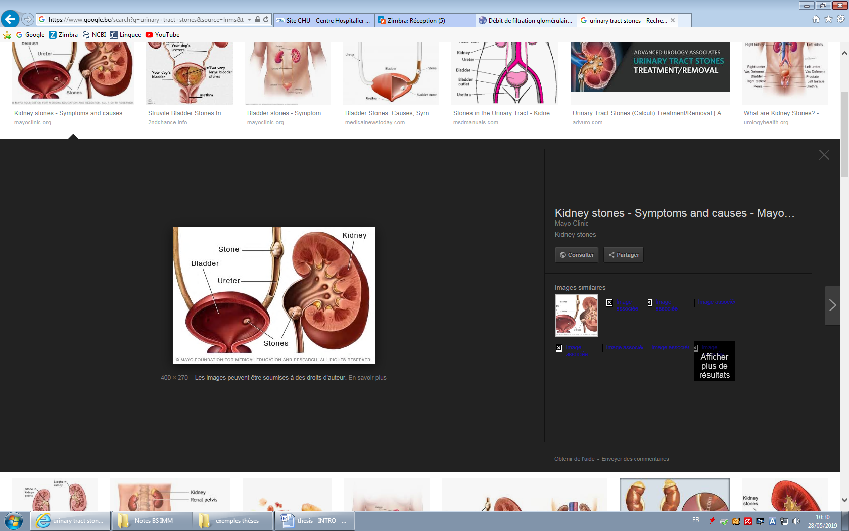
Renal stone disease
Nephrolithiasis/urolithiasis → kidney / urinary stone
Prevalence: 8-15%
  Gender ratio: M/F : 2/1
Renal colic
Complications:
  Genetical disease
  Infection
  Renal disease: 2-3 % of SF (3% of dialysis)
Recurrence: >30% within 10 years
>60% in some subgroups

Slide 4
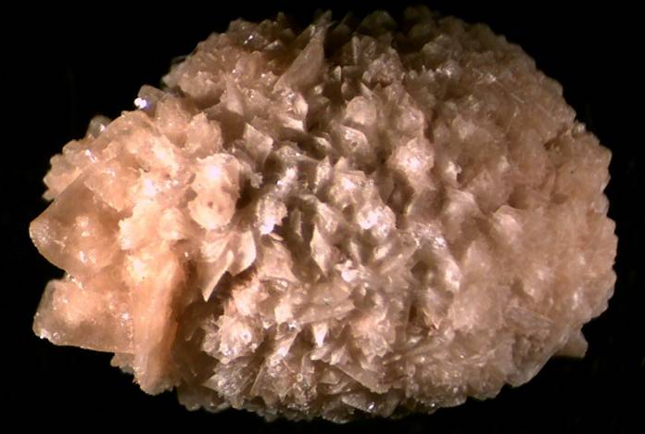
Stone formation
Risk factors
Urine biochemistry
Calcium
Inherited conditions,
Urological malformation
Oxalate
Phosphate
Uric acid
Urine crystals
Stone
Acquired conditions,
Diet
Many others constituents
Analyses

Slide 5
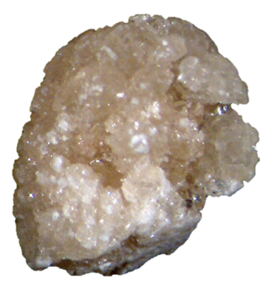
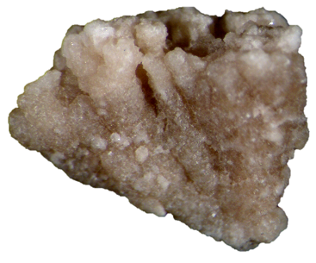
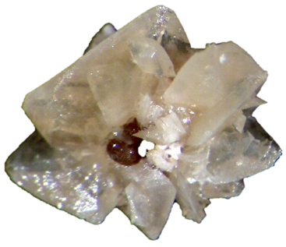
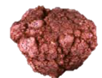
Laboratory Medicine Specialties
Whewellite
Primary Hyperoxaluria
Weddellite
Hypercalciuria
Cystine
Congenital cystinuria
2,8-DHA
APRT deficiency
Daudon Michel

Slide 6
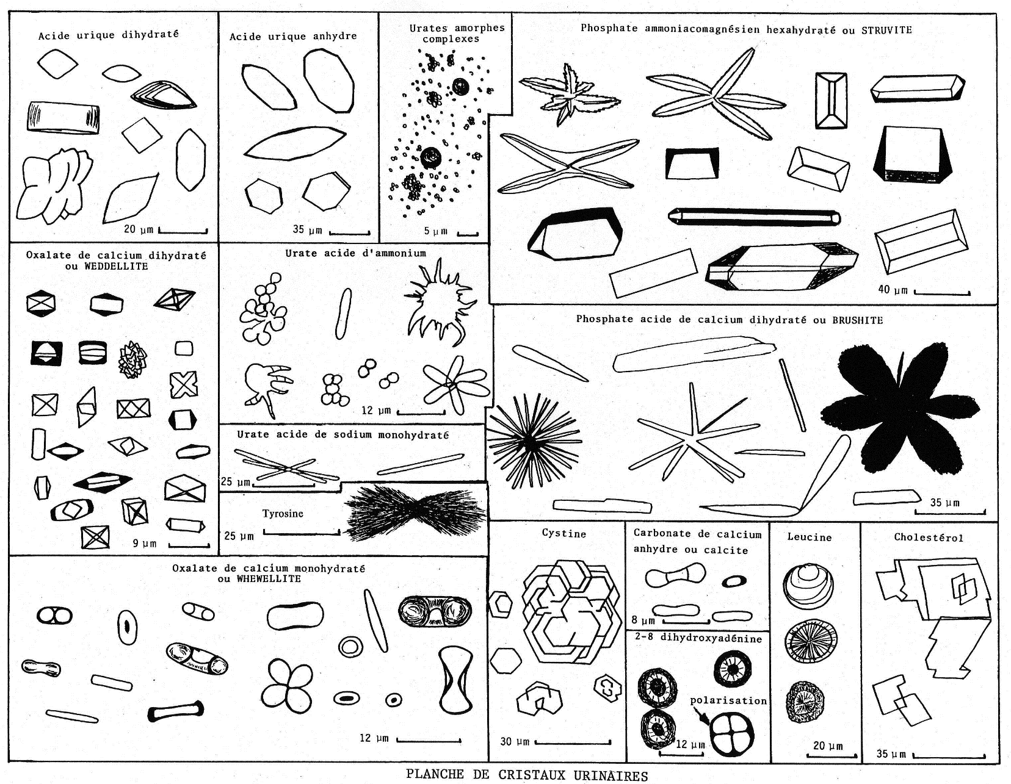
Ideal sample for crystalluria
Choice of sampling :
    Fasting urine is ideal : morning first or second urine
      High sursaturation
    Ideally urinated in the laboratory.
Standard Protocol :
    Urine stored at 37°C
      Sample processed upon receipt
        or within 3 hours at 37°C.
        or within 2 hours at 20°C.
      NEVER store at 4 degrees !

Slide 7
FUS-3000 plus
AI - Artificial intelligence in the aim to better the automatic recognition of crystals

Slide 8
Crystal and pH relation
Ammonium Urate
Struvite (MAPH)
Amorphe Phosphate
Brushite
CaOx.H₂0
CaOx.2H₂0
Amorphe Urate
Uric acid
5,55
5,90
6,35
6,65
7,45
7,95
5,0
6,0
7,0
8,0
5,20

Slide 9
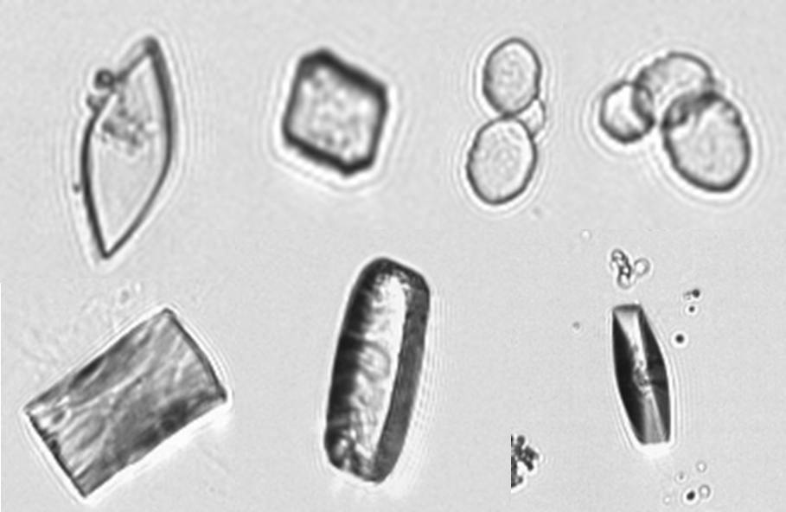
Uric acid crystalluria
Presence ≥ 0,1 crystal /mm³
  If urine pH < 5,3 = urine acidity
  If urine pH ≥ 5,3 = Hyperuricuria
Aggregates ≥ 100µm
  imbalance between inhibitors and promoters of crystallization
  GAG deficiency
  major risk of recurrence
pH dependent (< 6)

Slide 10
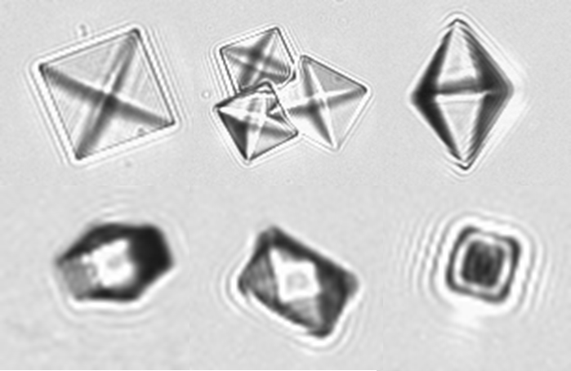
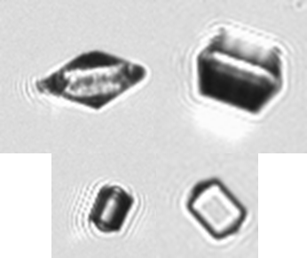
OxCa dihydrate (Weddellite) crystalluria
If octahedron
  Supersaturation CaOx without clinical significance
If hexagonal - dodecahedron
  Major Hypercalciuria (6mmol/L)
Volume ≥ 500 µm3 /mm³
  If Primary Hyperoxaluria + renal transplant
    Risk of transplant rejection
If crystal > 35 µm
  Hypocitraturia + Hyperoxaluria
  Major risk of kidney stone
pH independent
Hypercalciuria

Slide 11
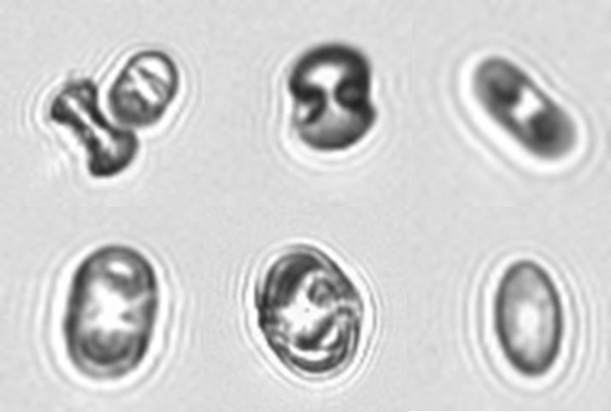
OxCa monohydrate (Whewellite) crystalluria
Presence ≥ 0,1 crystal /mm³
    Hyperoxaluria
If hexagonal – stretched shuttle
  Ethylene-glycol intoxication
Presence > 200/mm³
  Major Hyperoxaluria : explore Primary Hyperoxaluria or enteric hyperoxaluria
pH independent
Hyperoxaluria

Slide 12
Calcium Phosphate crystalluria
Presence ≥ 0,1 crystal /mm³
    No clinical significance
Granular casts ≥ 0,1 /mm3 or > 10 / mm³
    Explore tubular acidosis
    Alkalizing treatment
pH ≧ 6,6

Slide 13
Struvite (Magnesium Ammonium PHosphate)
crystalluria
Presence ≥ 0,1 crystal /mm³
    Urinary tract infection due to urease bacteria
If other non-ureasic bacteria found
  Search for a second !
pH dependant (> 7)
Quite often with Ammonium urates
Uréolysis

Slide 14
Brushite crystalluria
Presence ≥ 0,1 crystal /mm³
  hypercalciuria + hyperphosphaturia +/- hypocitraturia
Agregates ≥ 500µm³
  Explore Hyperparathyroidism
Heterogenous agregates « Brushite +CaOx.2H₂O (weddellite) »
  major risk of recurrence of kidney stones
pH-dependant
Hypercalciuria

Slide 15
Ammonium urate crystalluria
Presence ≥ 0,1 crystal /mm³
    Hyperuricuria + Hyperammoniogenesis
If urine pH < 7,0
  Renal Hyperammoniogenesis – diarrhea, Phosphate deficiency
If urine pH >7,3
  Urinary hyperammonigenesis dur tu urinary tract infection and ureasic bacteria.
pH dependant (> 7)
Hyperuricuria
Quite often + Struvite

Slide 16
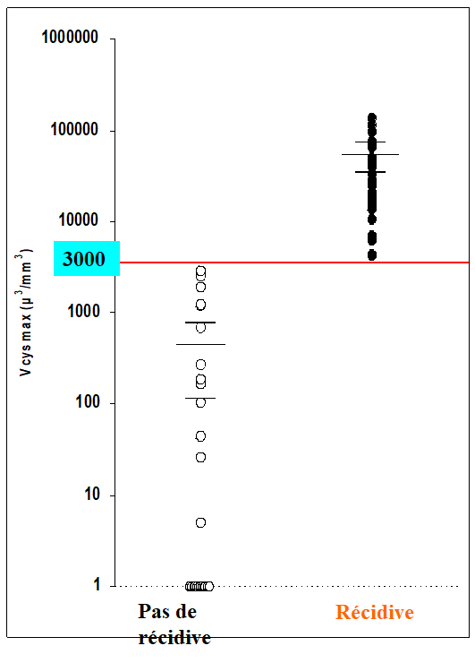
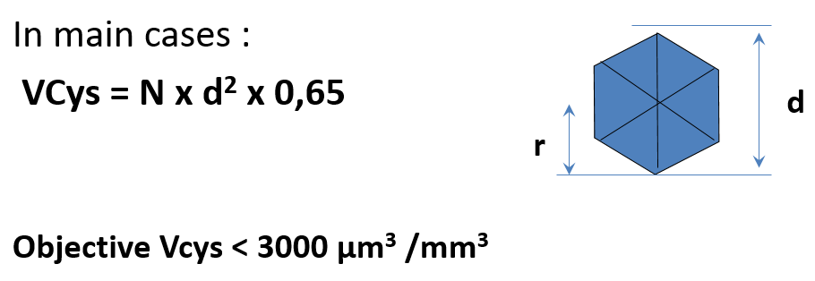
Cystine crystalluria
Presence ≥ 0,1 crystal /mm³
    Congenital Cystinuria – Congenital Cystinuria-Lysinuria
  6-8% kidney stone in children
No recurence
Recurence

Slide 17

Criteria for interpreting crystalluria
Chemical component
Cystine, Struvite, Ammonium urate, 2,8-DHAd, Xanthine
Crystalline nature
CaOx mono = hyperoxaluria
Brushite = Hypocitraturia without hyperoxaluria
Crystalline facies
Hexagonal CaOx di = major HCI
CaOx mono shuttles = Ethyleneglycol intox
Quantity
Brushite : Primary Hyperparathyroidism – CaOx mono = Primary Hyperoxaluria Cystine volume = recurrent
Crystal size
CaOx di = Hyperoxaluria + HCI
Agregates
Citrate deficiency

