Slide 1
T 2.3 THM modelling… [ULiege]
Work done until now:
2.3.1 2D Generic Models
2.3.1.1 Near field / short term:
a) Isotropic/anisotropic elasticity and isotropic plasticity for Boom clay and COx.
b) Anisotropic plasticity with 2nd gradient model for COx.
2.3.1.2 Far field / long term:
2D plane strain (half-width) model (width = 25m; height = 1000m)
Outcome: Evolution of PWP, Temperature, and Stresses at the prescribed locations, along with the isochrones along the depth
Work plan for next 12 months:
2.3.2 Implement the thermal-mechanical law to model the tensile response from heating.
2.3.3 Model the in-situ heater test: PRACLAY and ALC1605.
Collaborations with other WP : EURAD-Gas
Publications:

Slide 2
T 2.3 THM modelling… [ULiege]
Work done until now:
2.3.1 2D Generic Models
2.3.1.1 Near field / short term:
a) Isotropic/anisotropic elasticity and isotropic plasticity for Boom clay and COx.
b) Anisotropic plasticity with 2nd gradient model for COx.
2.3.1.2 Far field / long term:
a) Evolution of PWP, Temperature, and Stresses at the prescribed locations
Work plan for next 12 months:
2.3.2 Implement the thermal-mechanical law to model the tensile response from heating.
2.3.3 Model the in-situ heater test: PRACLAY and ALC1605.
Collaborations with other WP : EURAD-Gas
Publications:

Slide 3
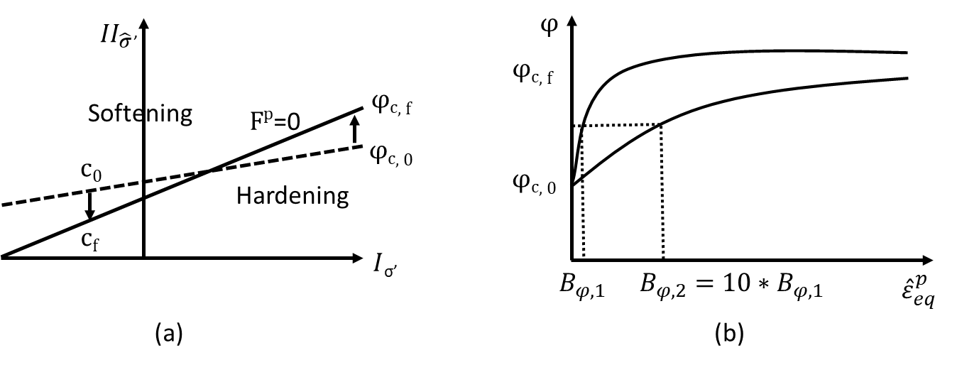

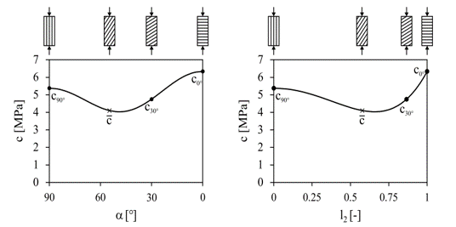
T2.3 Modelling-Benchmark - [ULiege]
COx Claystone – Strain localisation (THM)
First gradient law: Van Eekelen criterion
Plasticity
Deviatoric strain increment
Total deviatoric strain
Excavation
T0+24 h
1e-3
1e-5
1e-5
3m×3m
Van Eekelen yield surface with hardening/softening
hyperbolic relation for two values of coefficient Bϕ
Waiting
T0+180 days
1e-3
1e-5
1e-5
Second gradient law:
Mindlin, 1965
Internal length scale: control of bands’ width
Variation of cohesion for cross-anisotropic rock (fabric tensor):
Niandou et al., (1997); Valès et al., (2004)
Heating
T0+198 days
1e-3
1e-4
1e-5
Heating
T0+10 years
1e-3
1e-5
1e-5

Slide 4
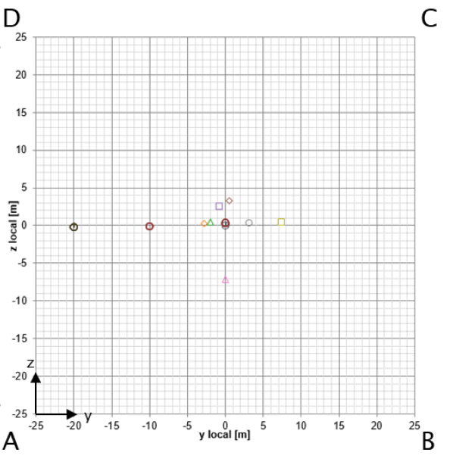
T2.3 Modelling-Benchmark - [ULiege]
12.1MPa
ALC1605 heater test
2D generic model
4.7MPa, 21℃
Objective:
Reproduce the thermal effects on the liner and THM behavior of COx
Attention:
Excavation effect from GAN drift and two neighboring cells
AHA1605
12.4MPa
HAE1602
ALC1605
4.7MPa, 23℃
Modelling of casing structure
Required output nodes
Step1: Initiate Pw
Step2: Excavation
Pw: 4.7 to 4.3 MPa
Steel and soft material:
Fix Pw (0.1MPa)
Field:
Pw decreases linearly
to 4.3 MPa at Y axis
from the start of GAN
Pw: 4.3 to 0.1 MPa
Steel and soft material:
Pw=0.1MPa
Stress release at tunnel wall to 0
Pw decreases to 0.1MPa at tunnel wall
COx
COx
ALC1605
Casing
ALC1605
Casing
Steel
Steel
Step3: Injection
Step4: Heating
Pw: 0.1 MPa
COx
Steel and MREA:
Replace soft material with MREA
Release the Pw of MREA and steel
Thermal flux
COx
Field:
Release the T of the field
ALC1605
Casing
Injection (MREA)
ALC1605
Casing
Injection (MREA)
Steel
Steel
Pore pressure evolution

Slide 5
T 2.3 THM modelling… [ULiege]
Work done until now:
2.3.1 2D Generic Models
2.3.1.1 Near field / short term:
a) Isotropic/anisotropic elasticity and isotropic plasticity for Boom clay and COx.
b) Anisotropic plasticity with 2nd gradient model for COx.
2.3.1.2 Far field / long term:
2D plane strain (half-width) model (width = 25m; height = 1000m)
Outcome: Evolution of PWP, Temperature, and Stresses at the prescribed locations, along with the isochrones along the depth
Work plan for next 12 months:
2.3.2 Implement the thermal-mechanical law to model the tensile response from heating.
2.3.3 Model the in-situ heater test: PRACLAY and ALC1605.
Collaborations with other WP : EURAD-Gas
Publications:
Notes:
In far-field modeling we considered a 2D plane strain half width model with anisotropic elasticity and isotropic plasticity for the host rock.
The results were obtained in terms of pore water pressure, temperature and stress evolution. Also we plotted the isochornes along the depth.

Slide 6
Introduction: 2D generic model (Initial state)
Schematic representation of model geometry used for the modelling with in-situ stress state
Notes:
In the exercise, the cross-sectional profile of 1000m was given to us with the material properties.
The initial values were given to us in terms of temperature, pore water pressure and stresses.

Slide 7
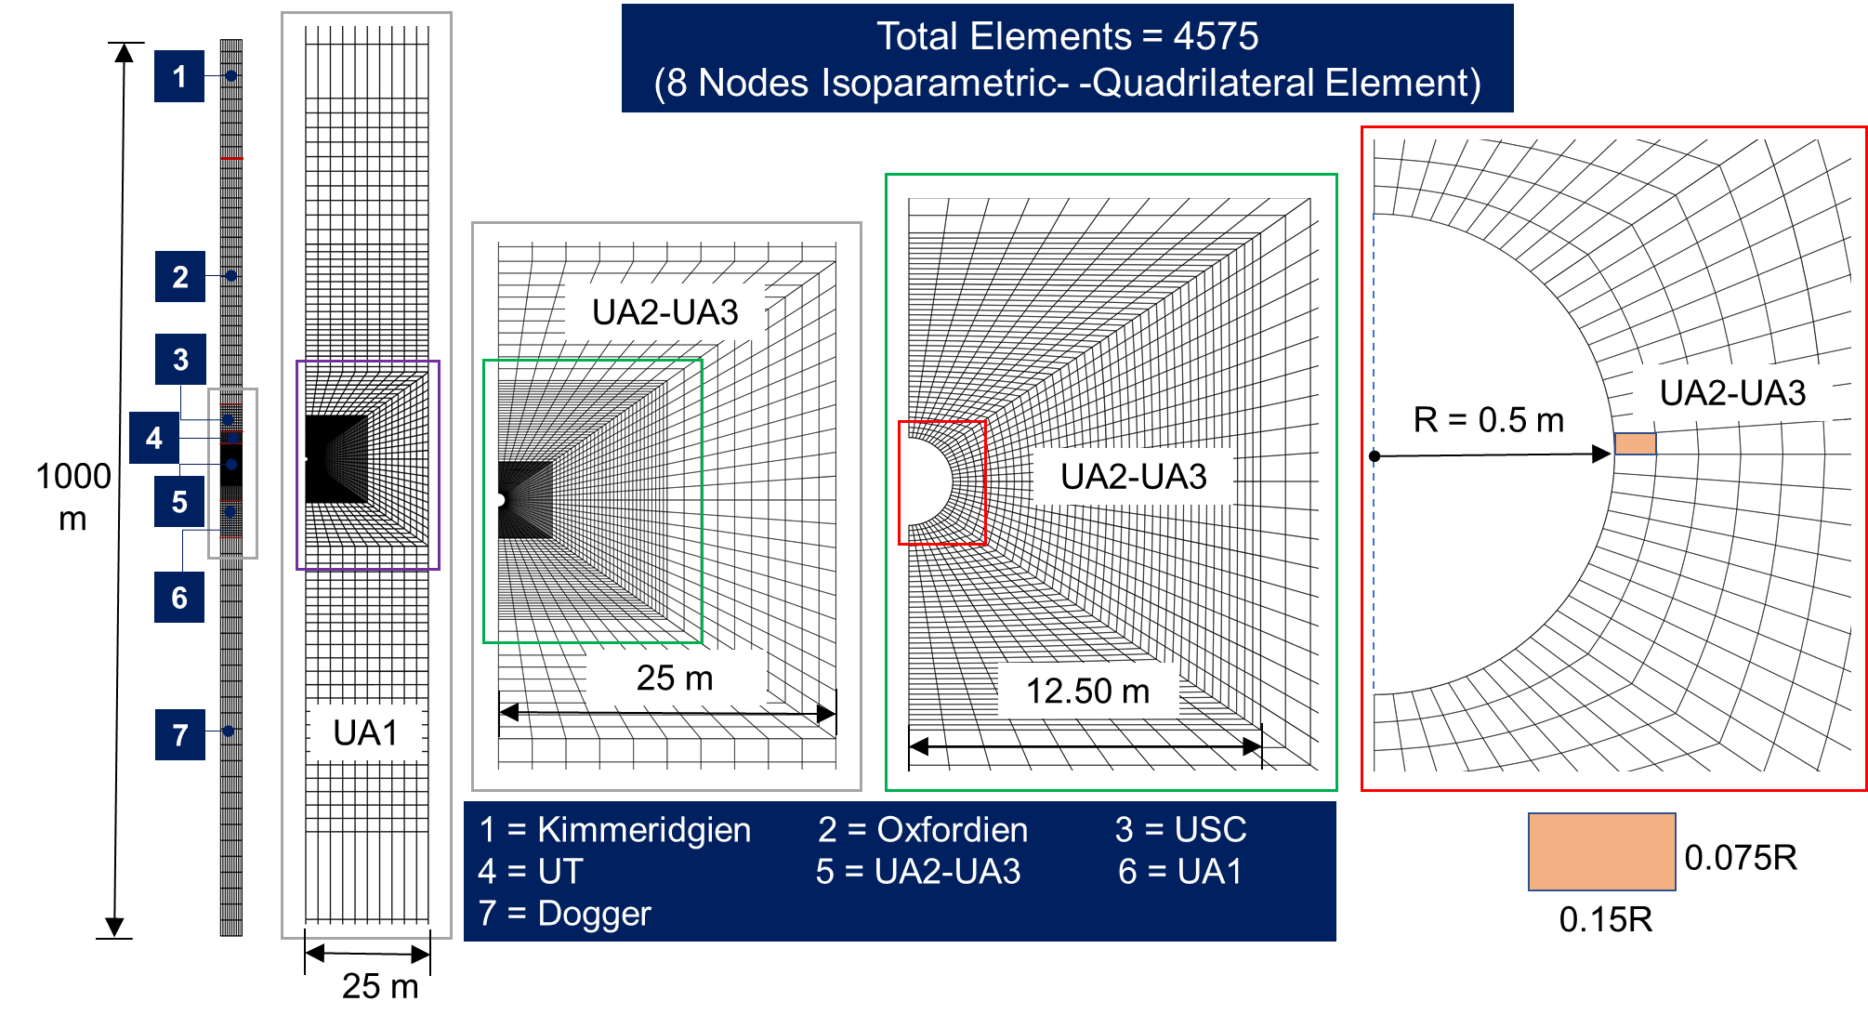
Features of FEM Simulation: FE Mesh
0.075R
0.15R
Fig. 2: Features of FE-mesh used for simulation
7
Notes:
Based upon the geometrical features, we created the finite element mesh as shown in this slide with a total of four thousand five hundred seventy-five elements.

Slide 8
Features of FEM Simulation: Time-varying BCs
Stage | Time | Mechanical BCs | Hydraulic BCs | Thermal BCs
1. Excavation | 0 - 24 Hours | Initial in-situ stress reaches to 0 | PWP reduces linearly to 0.1 MPa | No flow (natural geothermal field)
2. Waiting | 24 Hours – 2 Years | Linear stress increase from 0 to 3 MPa over 2 years of waiting stage | No-flow (Undrained condition) | No flow (natural geothermal field)
3. Heating | 2 – 1000 Years | 3 MPa constant pressure | No-flow (Undrained condition) | Case I: 85 years of cooling Case 2: 55 years of cooling
Table: Time-varying BCs at the disposal borehole wall
(c)
(a)
(b)
Setting-up of time-varying BCs, (a) mechanical BCs, (b) Thermal flow data, and (c) thermal flow in simulation
8
Notes:
The simulation was run for 1000 years with three different stages.
In excavation stage we reduce the total stress to zero at the face of wall.
In waiting phase, the stress value was increased linear to 3MPa in two years.
In the heating phase we imposed the heat flow as per the prescribed two different cases as shown in Fig. b and c.

Slide 9
Features of FEM Simulation: Material properties
Material | E | Poission Ratio | G | Biot's coefficient | Permeability | Thermal conductivity
Kimmeridgian | Isotropic | Isotropic | Isotropic | Isotropic | Isotropic | Anisotropic
Oxfordian | Isotropic | Isotropic | Isotropic | Isotropic | Isotropic | Isotropic
USC | Isotropic | Isotropic | Isotropic | Isotropic | Anisotropic | Isotropic
UT | Anisotropic | Anisotropic | Anisotropic | Anisotropic | Anisotropic | Anisotropic
UA2-UA3 | Anisotropic | Anisotropic | Anisotropic | Anisotropic | Anisotropic | Anisotropic
UA1 | Anisotropic | Anisotropic | Anisotropic | Anisotropic | Anisotropic | Anisotropic
Dogger | Isotropic | Isotropic | Isotropic | Isotropic | Isotropic | Isotropic
Table: THM parameters for the host rocks
Fig.: Temperature dependency of (a) water viscosity, and (b) vol. thermal expansion coefficient of water
9
Notes:
Here, I want to mention the material properties particularly for host rock with anisotropic values.
Also, the temperature dependency of water viscosity and thermal expansion coefficient was considered in the simulation.

Slide 10
Results: Task 2.3 (Far-field modelling)
Expected output: Stress, strain, temperature, and PWP evolution at the following points
At the borehole wall (0.5D)
At 1D (1m from the face)
At 2D (2m from the face)
At 5D (5m from the face)
At 10D (10 m from the face)
At 25D (25 m, Far-boundary)
X
X
X
X
1
6
Additionally, we have plotted the temperature, PWP and stress isochrones along the depth.
0.075R
0.15R
Notes:
In the exercise the results were expected at 6 different locations as shown in this slide.
Point 1 was located at the face of wall while the point 6 is located at the 25 time diameter .
Additionally we plotted the temperature porewater pressure and stress isochrones along the depth.

Slide 11
Results: Task 2.3 (Far-field modelling)
(a)
(b)
Evolution of Biot’s effective stress (SigmaYY’) at 25D, (a) for Case 1, and (b) Case 2
Notes:
So, we compared the evolution of Biots effective stress in Y direction with the other teams which agrees well.
The stress in case 2 reaches almost to zero during the heating phase.

Slide 12
Results: Task 2.3 (Far-field modelling)
(a)
(b)
Temperature isochrones at 25D along the depth (a) for Case 1, and (b) Case 2
Notes:
With a good agreement with the other teams, we also plotted the temperature isochrones along the depth at 25D location. So here is the initial distribution.

Slide 13
Results: Task 2.3 (Far-field modelling)
(a)
(b)
Temperature isochrones at 25D along the depth (a) for Case 1, and (b) Case 2
Notes:
It is at 2 years and 12 years.

Slide 14
Results: Task 2.3 (Far-field modelling)
(a)
(b)
Temperature isochrones at 25D along the depth (a) for Case 1, and (b) Case 2
Notes:
So it is at 50 years, so we can observe the heat dissipation in both X and Y direction.

Slide 15
Results: Task 2.3 (Far-field modelling)
(a)
(b)
Temperature isochrones at 25D along the depth (a) for Case 1, and (b) Case 2
Notes:
It is for T = 100 years

Slide 16
Results: Task 2.3 (Far-field modelling)
(a)
(b)
Temperature isochrones at 25D along the depth (a) for Case 1, and (b) Case 2
Notes:
So, with the elapsed time temperature increases both in the host rock and other geological mediums.
In case 1, the maximum temperature at 25D was observed close to 500 years.
While in case 2, the maximum temperature was observed close to 100 years.

Slide 17
Results: Task 2.3 (Far-field modelling)
(a)
(b)
Temperature isochrones at 25D along the depth (a) for Case 1, and (b) Case 2
Notes:
Later the heat dissipated into the far-field as a result the temperature decreases slightly in the host rock under the imposed boundary conditions.

Slide 18
Results: Task 2.3 (Far-field modelling)
(a)
(b)
Pore water pressure isochrones at 25D along the depth (a) for Case 1, and (b) Case 2
Notes:
Like the temperature, we also plotted the pore water pressure isochrones. So here is the initial values.

Slide 19
Results: Task 2.3 (Far-field modelling)
(a)
(b)
Pore water pressure isochrones at 25D along the depth (a) for Case 1, and (b) Case 2
Notes:
This is for time 2 and 12 years.

Slide 20
Results: Task 2.3 (Far-field modelling)
(a)
(b)
Pore water pressure isochrones at 25D along the depth (a) for Case 1, and (b) Case 2
Notes:
This is for 50 years, and

Slide 21
Results: Task 2.3 (Far-field modelling)
(a)
(b)
Pore water pressure isochrones at 25D along the depth (a) for Case 1, and (b) Case 2
Notes:
This is for 100 years, So here we can see that the pore water pressure rises in the host rock mainly due to temperature.

Slide 22
Results: Task 2.3 (Far-field modelling)
K = 10⁻¹⁹ m²
(a)
K = 10⁻¹⁶ m²
K = 10⁻²⁰ m²
K = 10⁻¹⁸ m²
(b)
Pore water pressure isochrones at 25D along the depth (a) for Case 1, and (b) Case 2
Notes:
This is for 500 years,
during the period between 100-to-500 years, the pore water pressure dissipated towards the top and bottom of the host rock.
In figure a and b we can observe the effect of intrinsic permeability in the Oxfordian and Dogger.
Due to the difference in the permeabilities the dissipation of pore water pressure in more towards the Oxfordian clay as compared to the Dogger.

Slide 23
Results: Task 2.3 (Far-field modelling)
K = 10⁻¹⁹ m²
(a)
K = 10⁻¹⁶ m²
K = 10⁻²⁰ m²
K = 10⁻¹⁸ m²
(b)
(b)
Pore water pressure isochrones at 25D along the depth (a) for Case 1, and (b) Case 2
Notes:
This is for 1000 years.
The pore water pressure decreases in the host rock due to the dissipation towards the Oxfordian clay.

Slide 24
Results: Task 2.3 (Far-field modelling)
(a)
(b)
Biot’s effective stress (SigmaYY’) isochrones at 25D along the depth (a) for Case 1, and (b) Case 2
Notes:
In the further analysis of simulation results, the Biots effective stress isochrones were plotted.
So it is the initial stress distribution along the depth.

Slide 25
Results: Task 2.3 (Far-field modelling)
(a)
(b)
Biot’s effective stress (SigmaYY’) isochrones at 25D along the depth (a) for Case 1, and (b) Case 2
Notes:
It is for time 2 and 12 years.

Slide 26
Results: Task 2.3 (Far-field modelling)
(a)
(b)
Biot’s effective stress (SigmaYY’) isochrones at 25D along the depth (a) for Case 1, and (b) Case 2
Notes:
It is for 50 years. So, we can see that in case 2, the vertical effective stresses decreases to zero, which is mainly due to the temperature-induced pwp.

Slide 27
Results: Task 2.3 (Far-field modelling)
(a)
(b)
Biot’s effective stress (SigmaYY’) isochrones at 25D along the depth (a) for Case 1, and (b) Case 2
Notes:
It is for t = 100years

Slide 28
Results: Task 2.3 (Far-field modelling)
(a)
(b)
Biot’s effective stress (SigmaYY’) isochrones at 25D along the depth (a) for Case 1, and (b) Case 2
Notes:
It is for 500 years

Slide 29
Results: Task 2.3 (Far-field modelling)
(a)
(b)
Biot’s effective stress (SigmaYY’) isochrones at 25D along the depth (a) for Case 1, and (b) Case 2
Notes:
It is for 1000 years.
In both the cases we can see that the temperature-induced pore water pressure govern the stress distribution in the host rock particularly in the initial phase of heating.
Later the pore water pressure dissipates mainly in the Oxfordian zone as a result we can observe more reduction in the stresses in Oxfordian as compared to the Dogger.

Slide 30
Remarks and future work…
The expected outputs (i.e., stresses, PWP, and temperature evolution) agree well with the other teams at the prescribed locations.
In our simulation exercise we found that the time-steps affects the temperature evolution and considering the isotropic v/s anisotropic Biot’s coefficient values for the host rock components (i.e., USC, UT, UA2-UA3, and UT) affects the stress evolution and the values of initial stresses.
In the coming 12 months we will focus on
Implement the thermal-mechanical law to model the tensile response due to heating.
Model the in-situ heater test: PRACLAY and ALC1605.

Slide 31
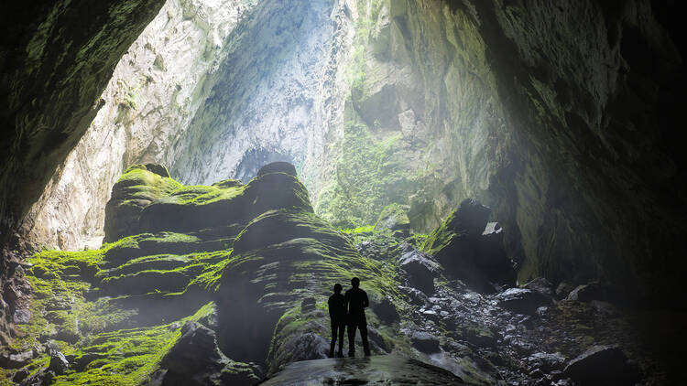
Thank you for your kind attention…

