Slide 1
Pleasure and displeasure factors for physical activity in young inactive adolescents
A. Besseling , A. Mouton, M. Evrard, A. Sikivie
Department of Sport & Rehabilitation Sciences
University of Liège
Belgium

Slide 2
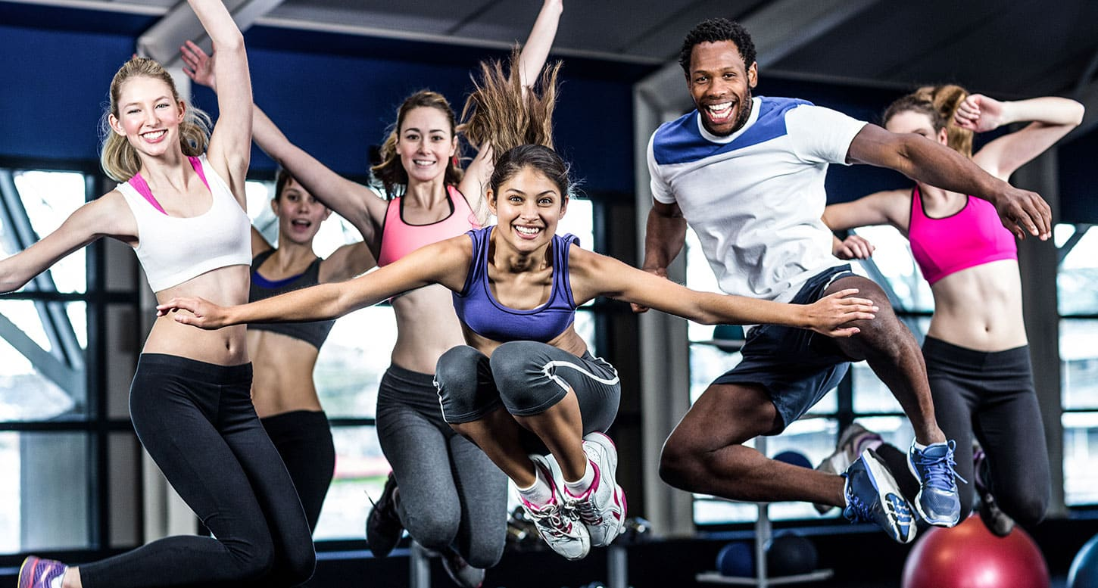
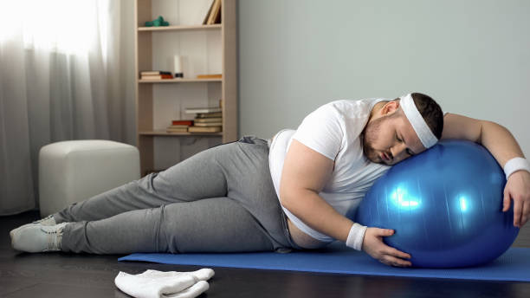
Is physical activity pleasant for everyone?
Dream
VS
Reality

Slide 3
Introduction
What factors influence young inactive teenagers’ pleasure and displeasure of physical activity?

Slide 4
Physical activity during adolescence, a societal challenge?
Adolescence is a time of change (Discour, 2011)
Transition from childhood to adolescence is crucial (Kemp, Cliff, Chong & Parrish, 2018)
During adolescence, the mean percentage PA decline per year is -7% (Dumith, Gigante, Domingues & Harold, 2010)
PA during adolescence as a predictor of adult PA practice (Thompson, Humbert & Mirwald, 2003)
Focusing on young inactive teens is effective for promoting PA (Bajamal, Hashish & Robbins, 2020)

Slide 5
Why target the notion of pleasure ?
Experiences of pleasure and displeasure are linked to the practice of physical activity (Williams & Evans, 2014)
Linking pleasure or displeasure affects with physical activity in our memory is a predictor of exercise behavior (Ekkekakis & Dafermos, 2012)
The use of strategies designed to promote enjoyment of physical activity is effective (Bajamal, Hashish & Robbins, 2020)

Slide 6
Introduction
Objectives & Methods
What factors influence young inactive teenagers’ pleasure and displeasure of physical activity?

Slide 7
Objectives
Primary objective
Identify pleasure and displeasure factors in young inactive adolescents
Secondary objectives
Identify the optimal intensity of effort for pleasure
Identify the most important factors for girls and boys

Slide 8
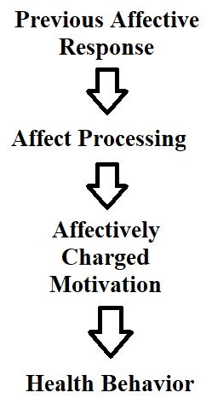
Method
52 inactive students
Semi-structured interviews
Affect and health behavior framework (Williams & Evans, 2014)
First step on the continuum : Previous affective response
Feeling scale (Hardy & Rejeski, 1989)
Critical incident technique (Flanagan, 1954)

Slide 9
Analysis
Pleasure and intensity of effort - Quantitative analysis
Friedman test
Wilcoxon signed-rank test - Holm’s method (P)
Effect size (r)
Pleasure and displeasure factors for PA - Qualitative analysis
Meaning units
Pleasure & displeasure for PA (inactive students, inactive boys, inactive girls)

Slide 10
Introduction
Objectives & Methods
What factors influence young inactive teenagers’ pleasure and displeasure of physical activity?
Results

Slide 11
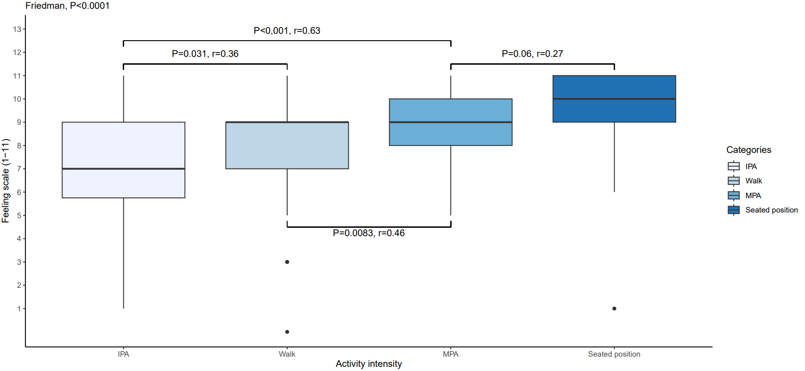
Level of pleasure as a function of activity intensity
P<0,001
r : 0,63
Pleasure of MPA significantly higher than pleasure of IPA (P<0,001)
Important effect size
(r : 0,63)
Pleasure is reduced at the onset of lactate accumulation in the blood (Ekkekakis, Parfitt & Petruzzello, 2011)
IPA
MPA

Slide 12
Classification of sources of pleasure for physical activity (based on causal attribution theory)
Internal source : Feelings can influence their pleasure
External source : Pleasure is controlled by environmental factors (Fullin & Mills, 1995)
 | Inactive students' sources of pleasure for PA
Internal source | Sense of autonomy Sense of competence and self-accomplishment Sense of proving your competence Sense of pride Emotional state
External source | Positive reinforcement Activity type People present at the activity Reinforcement through play Environment Challenges Learning / discovery Breaking the routine Routine Ambience Weather

Slide 13
Classification of sources of displeasure for physical activity (based on causal attribution theory)
Internal source : Feelings can influence their pleasure
External source : Pleasure is controlled by environmental factors (Fullin & Mills, 1995)
 | Inactive students' sources of displeasure for PA
Internal source | Pain and the physical repercussions of physical activity Emotional state Sense of competence and self-confidence False beliefs Previous personal experience Health Body appearance and physical capacity
External source | Activity type The gaze of others Weather Negative results of an activity Ambience Constraint People present at the activity and their behavior Monotony / boredom Pressure

Slide 14
Factors contributing to pleasure of physical activity cited at least 10 times by inactive students
Social support is an important factor associated with physical activity level in adolescents (Mendonça, Cheng, Mélo & Cazuza de Farias, 2014)

Slide 15
Factors contributing to displeasure of physical activity cited at least 10 times by inactive students
Negative affective associations with responses to exercise, such as pain and discomfort during vigorous exercise (Williams & Evans, 2014)

Slide 16
Factors contributing to pleasure of physical activity cited at least 4 times by inactive boys
Boys have higher self-esteem than girls (Fourchard & Courtinat-Camps, 2013)
Boys participation in PA could improve their self-esteem (Daniels & Leaper, 2006)

Slide 17
Factors contributing to pleasure of physical activity cited at least 4 times by inactive girls
Encouragement is an important factor in increasing PA levels among girls (Vander Ploeg, Kuhle, Maximova, McGavock, Wu & Veugelers, 2013)

Slide 18
Factors contributing to displeasure of physical activity cited at least 5 times by inactive boys

Slide 19
Factors contributing to displeasure of physical activity cited at least 5 times by inactive girls
Girls attach importance to their appearance, but are relatively dissatisfied with it, which affects their self-esteem (Fourchard & Courtinat-Camps, 2013)
The gaze of others can influence self-worth (Rochat, 2013)

Slide 20
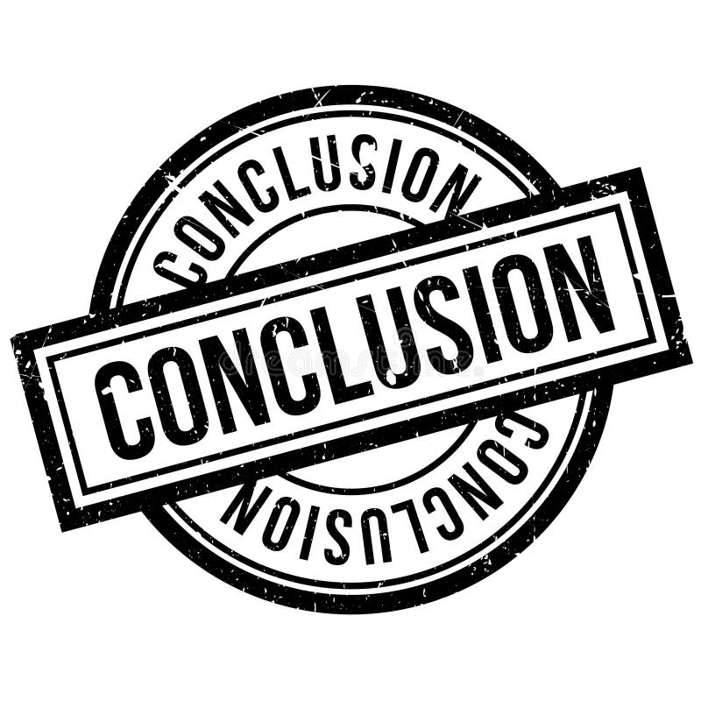
Introduction
Objectives & Methods
What factors influence young inactive teenagers’ pleasure and displeasure of physical activity?
Conclusion & perspectives
Results

Slide 21
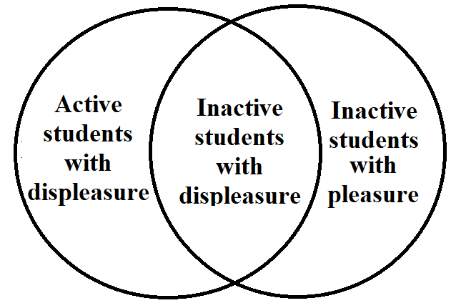
Conclusion & perspectives
Conclusion :
Multiple factors influencing the pleasure and displeasure of physical activity
Moderate physical activity (> avoid pain)
Importance of the social aspect and sense of competence
Perspectives :
Future studies should not restrict the exploration of pleasure to inactive students
Guide PE teachers to :
Detect students who practice PA with displeasure
Set up interventions to elicit pleasure for these students

Slide 22
Thank you for your attention

Slide 23
References
Bajamal, E., Abou Hashish, E. A., & Robbins, L. B. (2022). Enjoyment of Physical Activity among Children and Adolescents: A Concept Analysis. Journal of School Nursing. https://doi.org/10.1177/10598405221137718
Bok, D., Rakovac, M., & Foster, C. (2022). An Examination and Critique of Subjective Methods to Determine Exercise Intensity: The Talk Test, Feeling Scale, and Rating of Perceived Exertion. In Sports Medicine (Vol. 52, Issue 9, pp. 2085–2109). Springer Science and Business Media Deutschland GmbH. https://doi.org/10.1007/s40279-022-01690-3
Daniels, E., & Leaper, C. (2006). A longitudinal investigation of sport participation, peer acceptance, and self-esteem among adolescent girls and boys. Sex Roles, 55(11–12), 875–880. https://doi.org/10.1007/s11199-006-9138-4
Discour, V. (2011). Changements du corps et remaniement psychique à l’adolescence. Les Cahiers Dynamiques, 50(1), 40. https://doi.org/10.3917/lcd.050.0040
Dumith, S. C., Gigante, D. P., Domingues, M. R., & Kohl, H. W. (2011). Physical activity change during adolescence: A systematic review and a pooled analysis. International Journal of Epidemiology, 40(3), 685–698. https://doi.org/10.1093/ije/dyq272
Ekkekakis, P. & Dafermos, M. (2012). Exercise Is a Many-Splendored Thing, but for Some It Does Not Feel So Splendid: Staging a Resurgence of Hedonistic Ideas in the Quest to Understand Exercise Behavior. Oxford University Press) Inc.
Ekkekakis, P., Parfitt, G., & Petruzzello, S. J. (n.d.). The Pleasure and Displeasure People Feel When they Exercise at Different Intensities Decennial Update and Progress towards a Tripartite Rationale for Exercise Intensity Prescription.
Flanagan, J. C. (1954). The critical incident technique. Psychological Bulletin, 51(4), 327–358. https://doi.org/10.1037/h0061470
Fourchard, F., & Courtinat-Camps, A. (2013). L’estime de soi globale et physique à l’adolescence. Neuropsychiatrie de l’Enfance et de l’Adolescence, 61(6), 333–339. https://doi.org/10.1016/j.neurenf.2013.04.005
Fullin, C., & Mills, B. D. (n.d.). Attribution Theory in Sport: Problems and Solutions.
Kemp, B. J., Cliff, D. P., Chong, K. H., & Parrish, A. M. (2019). Longitudinal changes in domains of physical activity during childhood and adolescence: A systematic review. In Journal of Science and Medicine in Sport (Vol. 22, Issue 6, pp. 695–701). Elsevier Ltd. https://doi.org/10.1016/j.jsams.2018.12.012
Mendonça, G., Cheng, L. A., Mélo, E. N., & de Farias Júnior, J. C. (2014). Physical activity and social support in adolescents: A systematic review. In Health Education Research (Vol. 29, Issue 5, pp. 822–839). Oxford University Press. https://doi.org/10.1093/her/cyu017
Ploeg, K. A. vander, Kuhle, S., Maximova, K., Mcgavock, J., Wu, B., & Veugelers, P. J. (2013). The importance of parental beliefs and support for pedometer-measured physical activity on school days and weekend days among Canadian children. http://www.biomedcentral.com/1471-2458/13/1132
Rochat, P. (2013). The gaze of others. In M. R. Banaji & S. A. Gelman (Eds.), Navigating the social world: What infants, children, and other species can teach us (pp. 205–211). Oxford University Press. https://doi.org/10.1093/acprof:oso/9780199890712.003.0037
Thompson, A. M., Humbert, M. L., & Mirwald, R. L. (2003). A longitudinal study of the impact of childhood and adolescent physical activity experiences on adult physical activity perceptions and behaviors. Qualitative Health Research, 13(3), 358–377. https://doi.org/10.1177/1049732302250332
Williams, D. M., & Evans, D. R. (2014). Current emotion research in health behavior science. In Emotion Review (Vol. 6, Issue 3, pp. 277–287). SAGE Publications Ltd. https://doi.org/10.1177/1754073914523052

