Slide 1



Exploring interactions, immersion, and presence in a Virtual Reality experience for mooting
8th International XR-Metaverse Conference
XR meets the Metaverse
28-30 June 2023
Las Vegas
ETIENNE Elodie ª
CHO Justin ^{b}
JUNG Timothy ^{b}
SCHYNS Michaël ª
ª QuantOM , HEC Liège, University of Liège
^{b} Faculty of Business and Law, Manchester Metropolitan University

Slide 2
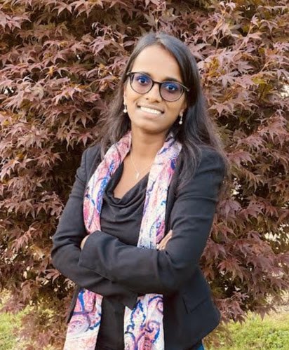


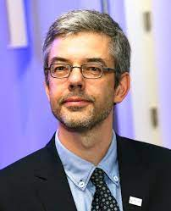
Collaboration between HEC Liège & MMU
ETIENNE Elodie
HEC Liège
University of Liège
Ph.D. Candidate
CHO Justin
Faculty of Business & Law
MMU
Ph.D. Candidate
JUNG Timothy
Faculty of Business & Law
MMU
SCHYNS Michaël
HEC Liège
University of Liège

Slide 3
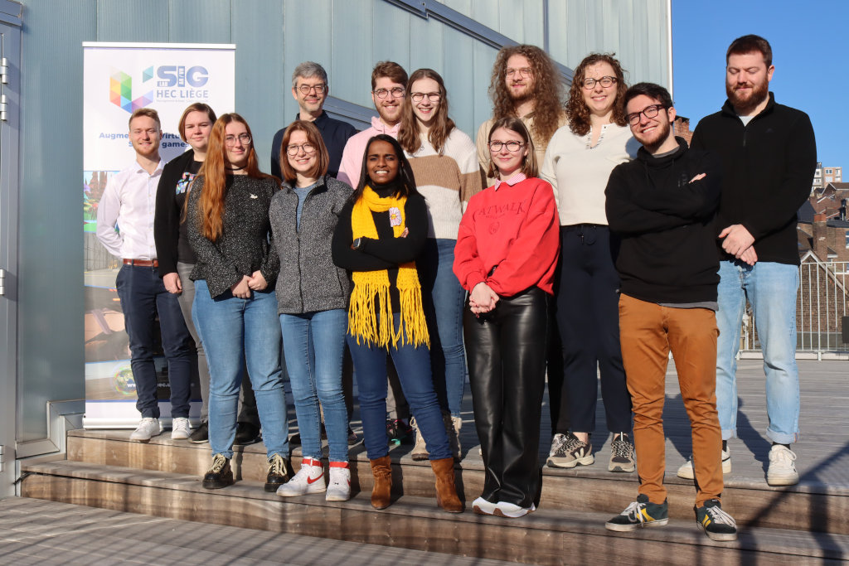
HEC SIG AR/VR Lab (Digital Business)
Researchers
  Immersive technologies (AR/VR)
  Artificial Intelligence (optimization)
  New technologies
  (Digital Twins, IoT)
3D Artists
Tech Art
Animators
Notes:
Team of researchers working on AR, VR and XR in general.
We wanted tailored virtual environments, so we decided to hire developers specialized in the creation of XR environments. So we are developping ourselves the virtual environmnts to correspond to our needs for research and education.

Slide 4
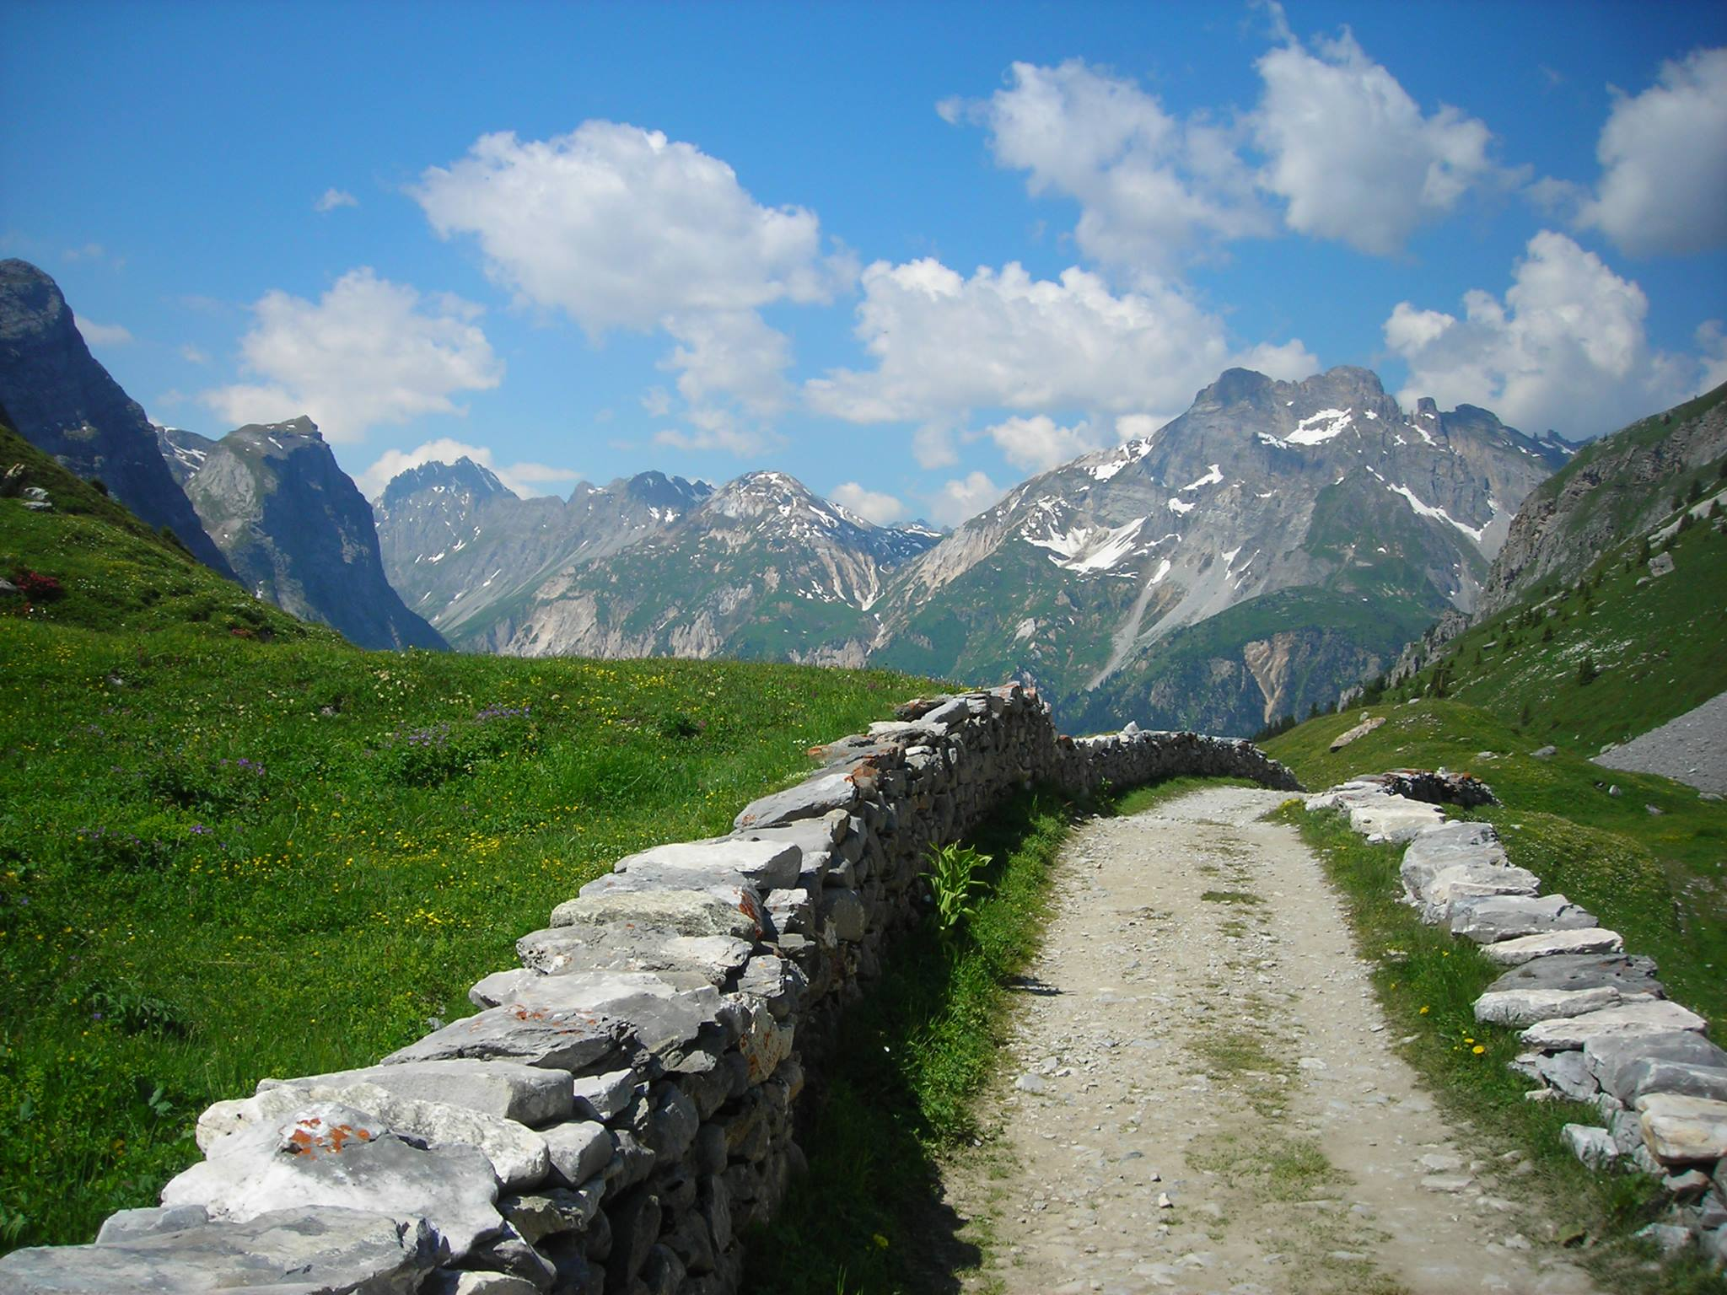
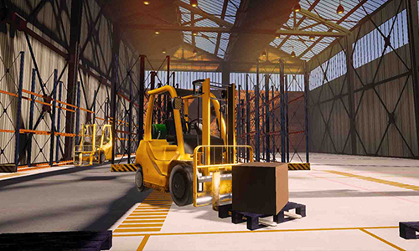
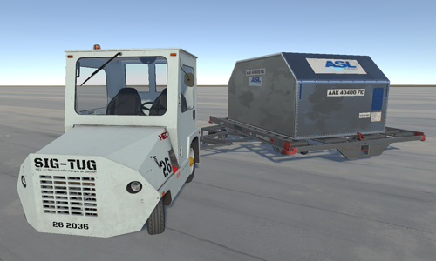
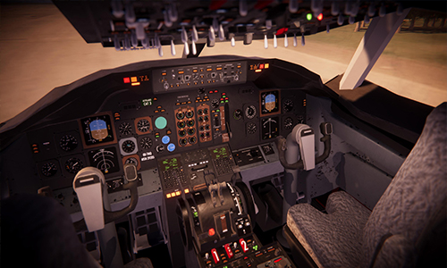
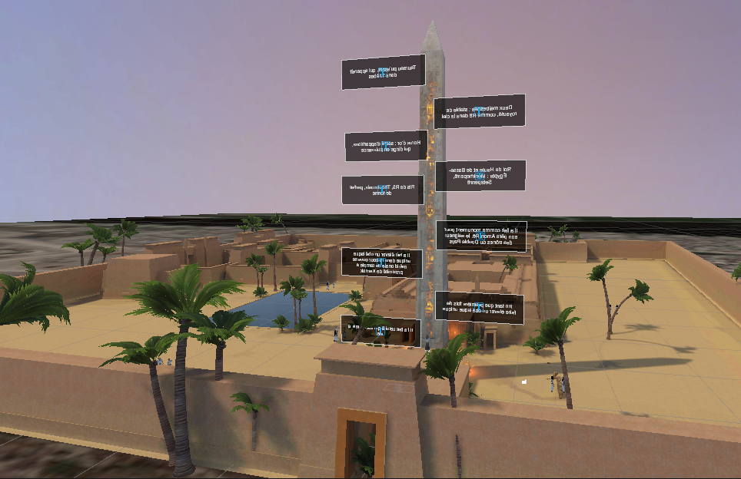
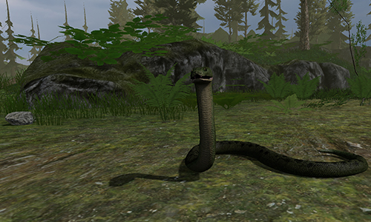
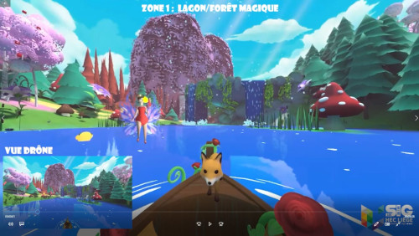
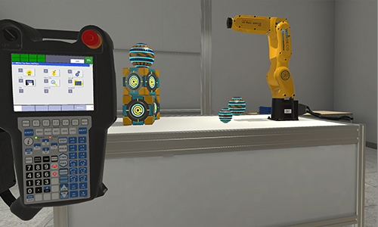
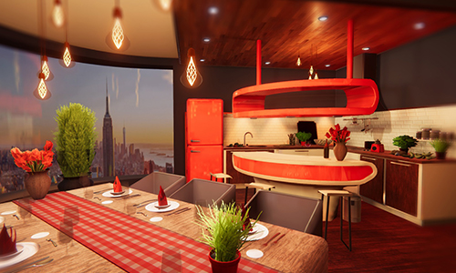
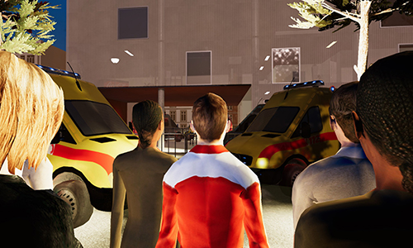

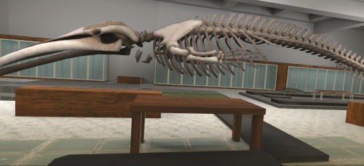
Serious games : training, research, society services
Formation pilote

Slide 5
Introduction

Slide 6
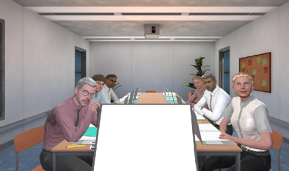
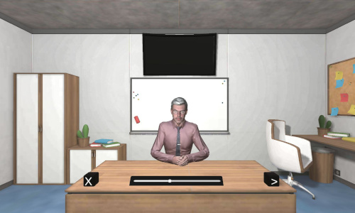
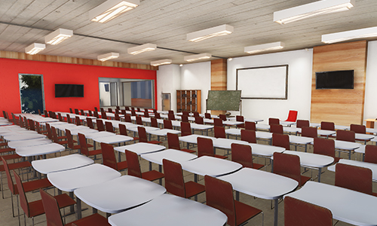
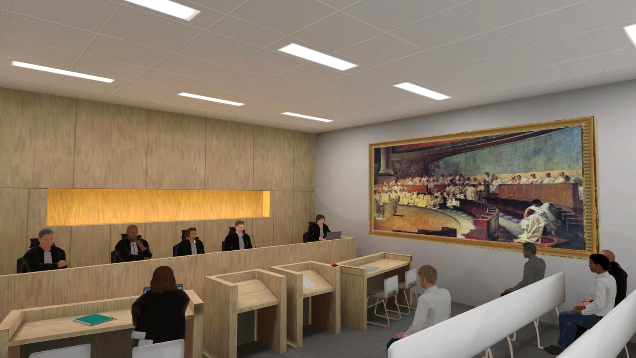
Projects
Public speaking
Notes:
Differents projects about acquiring soft skills (especially communication):
Mooting : You may have epistemological concerns about considering mooting as a form of public speaking (without taking into account the purpose and semantic value)

Slide 7

Why mooting in VR?
Public speaking in VR
Life-like environment and replicate situations (Remacle et al. 2021)
Interactive audience or avatars giving feedback (Chollet et al, 2021)
Progressive and controllable (Eckeert and Mower, 2020)
Legal training issues
Unprepared graduated law students to meet the demands of practice (Levine, 2016)
Go beyond simple legal analysis and integrate all three dimensions for a lawyer (legal doctrine, practical skills, and ethical values) (Alleva, 2019)
How to enhance the experience in a virtual environment for mooting in terms of the quality of immersion, the feeling of presence, and the efficiency of the training?
Notes:
and thusMore efficient learning processes and faster progression

Slide 8
The environment

Slide 9
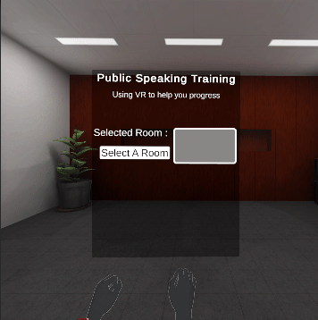
Public speaking training and the mooting environment

Slide 10
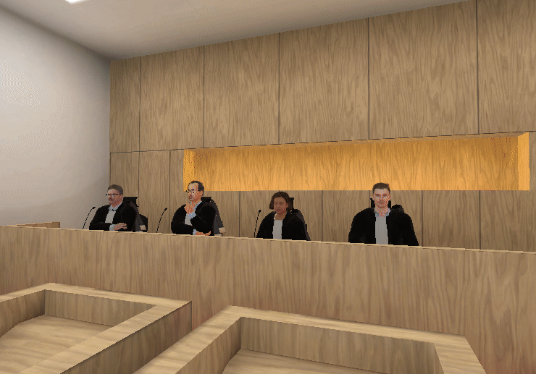
The mooting environment
Notes:
- the judge is taking notes while listening
- the juries are listening with a positive or negative valence, and a high or low level of arousal.
- the parties are listening and taking notes when the opponent is speaking.
- the audience is listening with a positive or negative valence and a high or low level of arousal.
- the clerk is taking notes on his computer while listening.

Slide 11
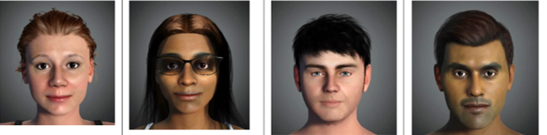
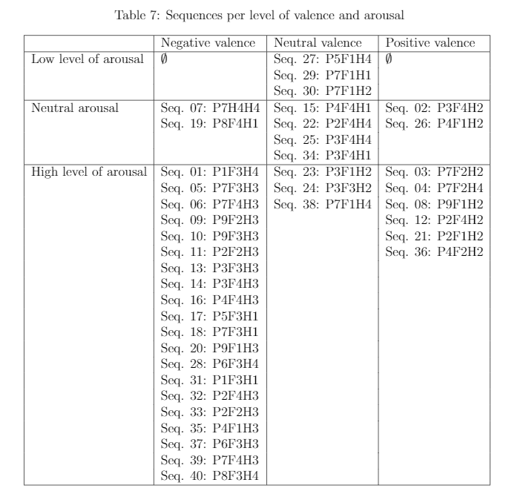
Creation of the environment
(Etienne et al., 2023)
Photorealistic avatars
Attitudes
Postures and hands:
P1: Backward posture – Arms crossed
P2: Backward posture –Arms stand (elbows on the table with hands crossed)
P3: Backward posture – Arms behind the head
P4: Upright posture – Hand on hand (hands on the table, one on top of the other)
P5: Upright posture – Hands together (hands crossed on the table)
P6: Upright posture – Hands separated in front
P7: Forward posture – Hands together
P8: Forward posture – Arms stand (elbows on the table with hands crossed)
P9: Froward posture – Arms crossed
Facial expressions:
F1: None
F2: Smiling
F3: Frowning
F4: Eyebrows raised
Head movements:
H1: None
H2: Nod
H3: Shake
H4: Questioning (head tilted at 45 degrees)
Notes:
Based on previous work

Slide 12
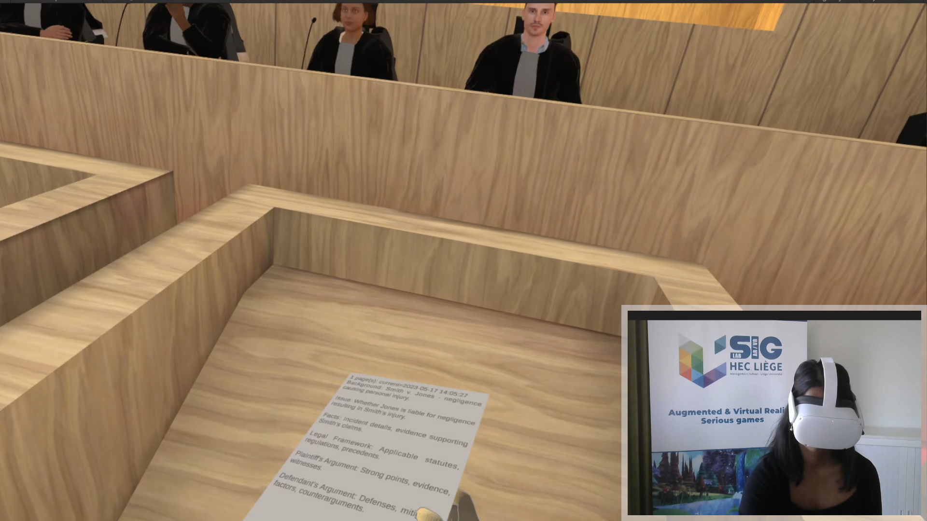
Methodology
Simulation environnement
Purpose ans semantic value of mooting: designed with Law Professors, Lawyers and judges
Different types of courtrooms (legal context, country context, …)
Notes:
To respect the specificities related to each country and legal systems because it is not only the synthesis of the courtroom that differs but also the rôle of the participants, the aim of the trail, and the results to be achieved. For example the importance of having notes

Slide 13
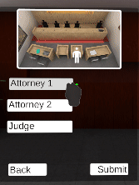
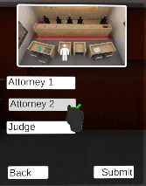
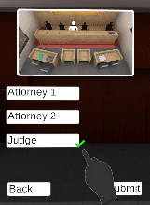
The importance of the P’s
Presence
Participation
Place
Proximity
Point of view
Notes:
Presence : photorealism, attitudes, etc
Proximity: approching, touching (importance of sense) etc
Participation (engagement)
Point of view (different point of view for the training)
Place: the context, eye tracking, bodutracking, standing or sitting positions

Slide 14
Methodology
How to enhance the experience in a virtual environment for mooting in terms of the quality of immersion, the feeling of presence, and the efficiency of the training?
Qualitative study: until data saturation
Semi-structured interviews
Professors having experience in mock trial and legal education
Quantitative study: 250 participants
Students in Law having experienced mock trial before
Immersive Tendencies Questionnaire (Witmer and Singer, 1998, and Bouchard et al., 2002)
Personal Report of Confidence as Speaker (Heeren et al., 2012 based on Gilkinson, 1942)
Gatineau Presence Questionnaire (Laforest et al., 2023)
Notes:
- Semi-structured interviews will be conducted to identify the factors a VR environment for mooting should have to be as effective as possible (i.e., to facilitate legal simulated learning).
- Two universities having an embedded mock trial module in their law course syllabus, providing an easily accessible pool of suitable participants.
The participants will be Professors having experience in mock trials and legal education.
Data will be collected until data saturation is reached (Glaser and Strauss, 1967).
Participants will be asked to provide their thoughts on how VR will impact students in their learning stages and what scenarios are the best to keep. Participants will also be asked to comment on the feasibility of using VR to facilitate mooting. This will allow for the further identification of scenarios relevant to the legal education context, focusing more on the technological aspects of the experience.
The Immersive Tendencies Questionnaire (ITQ) by Witmer and Singer (1998). It measures the participants' propensity to immerse, in other words, their tendency to engage in everyday activities and to focus on a particular activity. For Belgian students, the French version of the ITQ will be used (The questionnaire sur la propension à l'immersion developed and validated by the Cyberpsychology Laboratory of the Université du Québec en Outaouais (Bouchard et al., 2002)
- The adapted version allows us to assess the speaker's confidence in his/her speech acts, which is why we administer it in our study : a 30-item self-report scale, which assesses both behavioral and affective responses to public speaking situations.
- The questionnaires is the Gatineau Presence Questionnaire (GPQ) (Laforest et al., 2016). For students in the Belgian university, we will use the French-Canadian version of the GPQ, which is a four-item questionnaire rated in a percentage scale. As explained by Laforest et al. (2016), the GPQ consists of four items:
- the presence of being there,
- appraising the experience as being real,
- the awareness of the virtual environment as being artificial,
- the feeling of being in the physical office instead of the virtual environment.

Slide 15
Preliminary results

Slide 16
Qualitative analysis : thematic analysis
(Braun and Clarke, 2006)
Technology
Immersion
Novelty
Personalisation
Ease of use
Resourcefulness
Legal learning
Reflection
Procedural immersion
Transferability of skills
Accomodation to learners
Gamified mischief
Notes:
TECHNOLOGY
IMMERSION
Immersive
Environment Realism
Sound
Good sound
Difficult to see who is speaking
Visuals
But artificial?
Avatar Realism
Avatars stilted, lack of responsiveness, artificial behaviour/speech, no facial expression feedback, unnatural movement
Realistic judge and audience
Sense of presence
Engaging, responsive - Better than current forms of learning (virtual learning)
NOVELTY
Novelty
Exciting
Interesting
PERSONALISATION
Environment can be personalised
Use of notes
Different court settings (high court, magistrates court)
EASE OF USE
Easy to use, intuitive
Technology might not work?
Tech was difficult to use – paper
Headset is heavy
Nice to use hands rather than controllers
RESOURCEFULNESS
Resourceful
Less space needed
Less staff needed
Flexible time and space
But would it be easy to programme as a tutor?
Need admin or tech staff to support?
LEGAL LEARNING
REFLECTION
Reflection
Learn from mistakes
Good for assessment
Good for practicing eye contact
PROCEDURAL IMMERSION
Procedural realism
Can include diversity/inclusion
TRANSFERABILITY OF SKILLS
Less pressure - Increased confidence
Difficult to transfer feeling of pressure
Not the same as mooting
But might actually be good at replicating pressure
ACCOMMODATION TO LEARNERS
Students are suited to using technology
Different types of learners are accommodated
But older generation may find difficult to use
GAMIFIED MISCHIEF

Slide 17
Expected contributions
Creation of an immersive learning aids
Interactions with environment and avatars
Measurement the quality of immersion, the feeling of presence during the training, and the quality of interaction with avatars.
Comparison between Belgium and UK universities having an embedded mock trial module
Notes:
Mock trial
- creation of an immersive learning aids that can assist the students in independently gaining experience and confidence within some of the identified challenging areas

Slide 18
Next steps

Slide 19
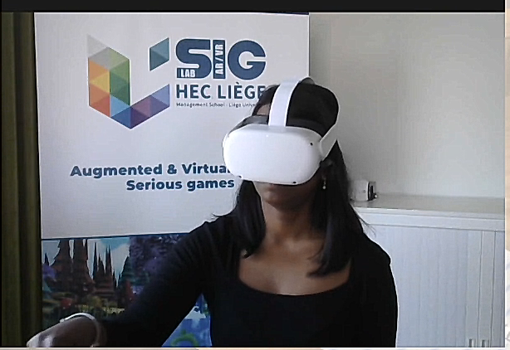
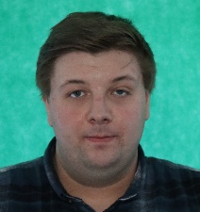
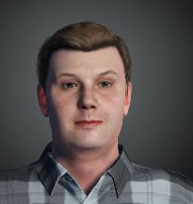
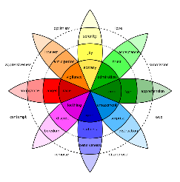
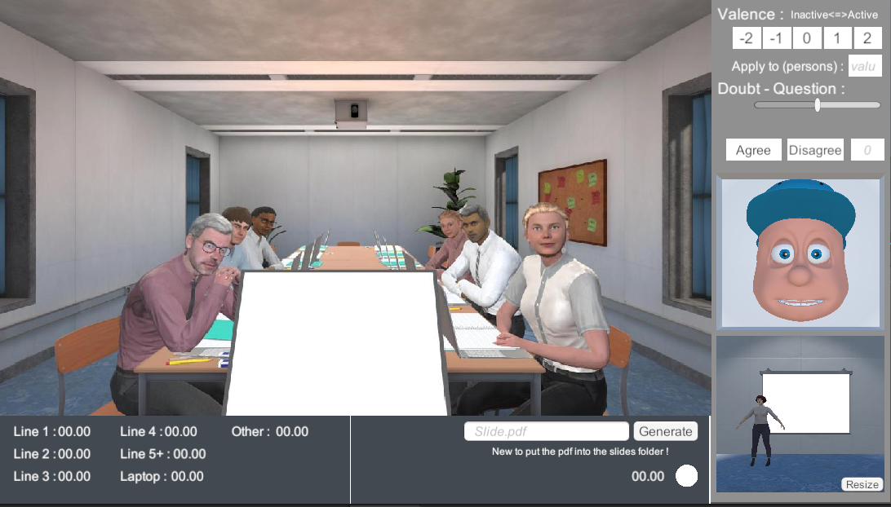
Artificial Intelligence-based project:
Collaborative platform
Creation of an interactive audience
Voice and speech analysis
Statistics, NLP, ML and DL
Training in VR
Notes:
My project is the creation of a training env for public speaking.

Slide 20
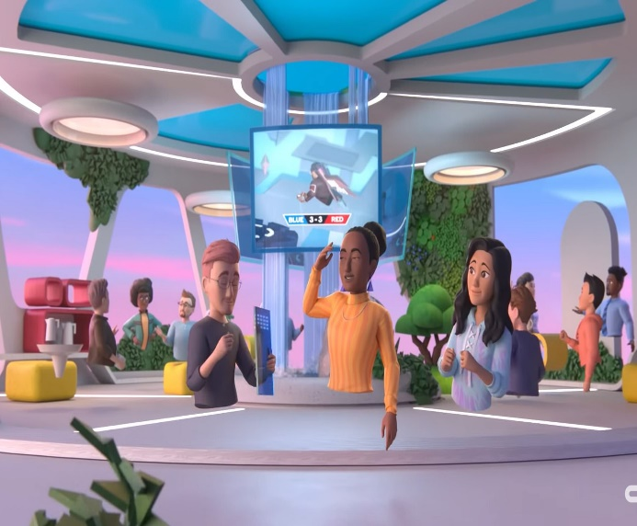
From Metaverse to Eduverse
XR
XR
Imaginary world
Multi-users
Public
Collaborative platform for education: lectures rooms, training rooms, meeting rooms, simulations rooms, …
Multi-users: avatars of actual people and Artificial Intelligence virtual robots…)
« Controlled access »
(No NFT at this stage)
Notes:
Eduverse project which is a metaverse for education where we can integrate our training environments.
This eduverse will be opened to teachers, experts, students but also avatars avatars animated with AI (which is useful for some training tasks that require several people).
But we need an audience in our training environment.
However when dealing with metaverse, we need to know

Slide 21
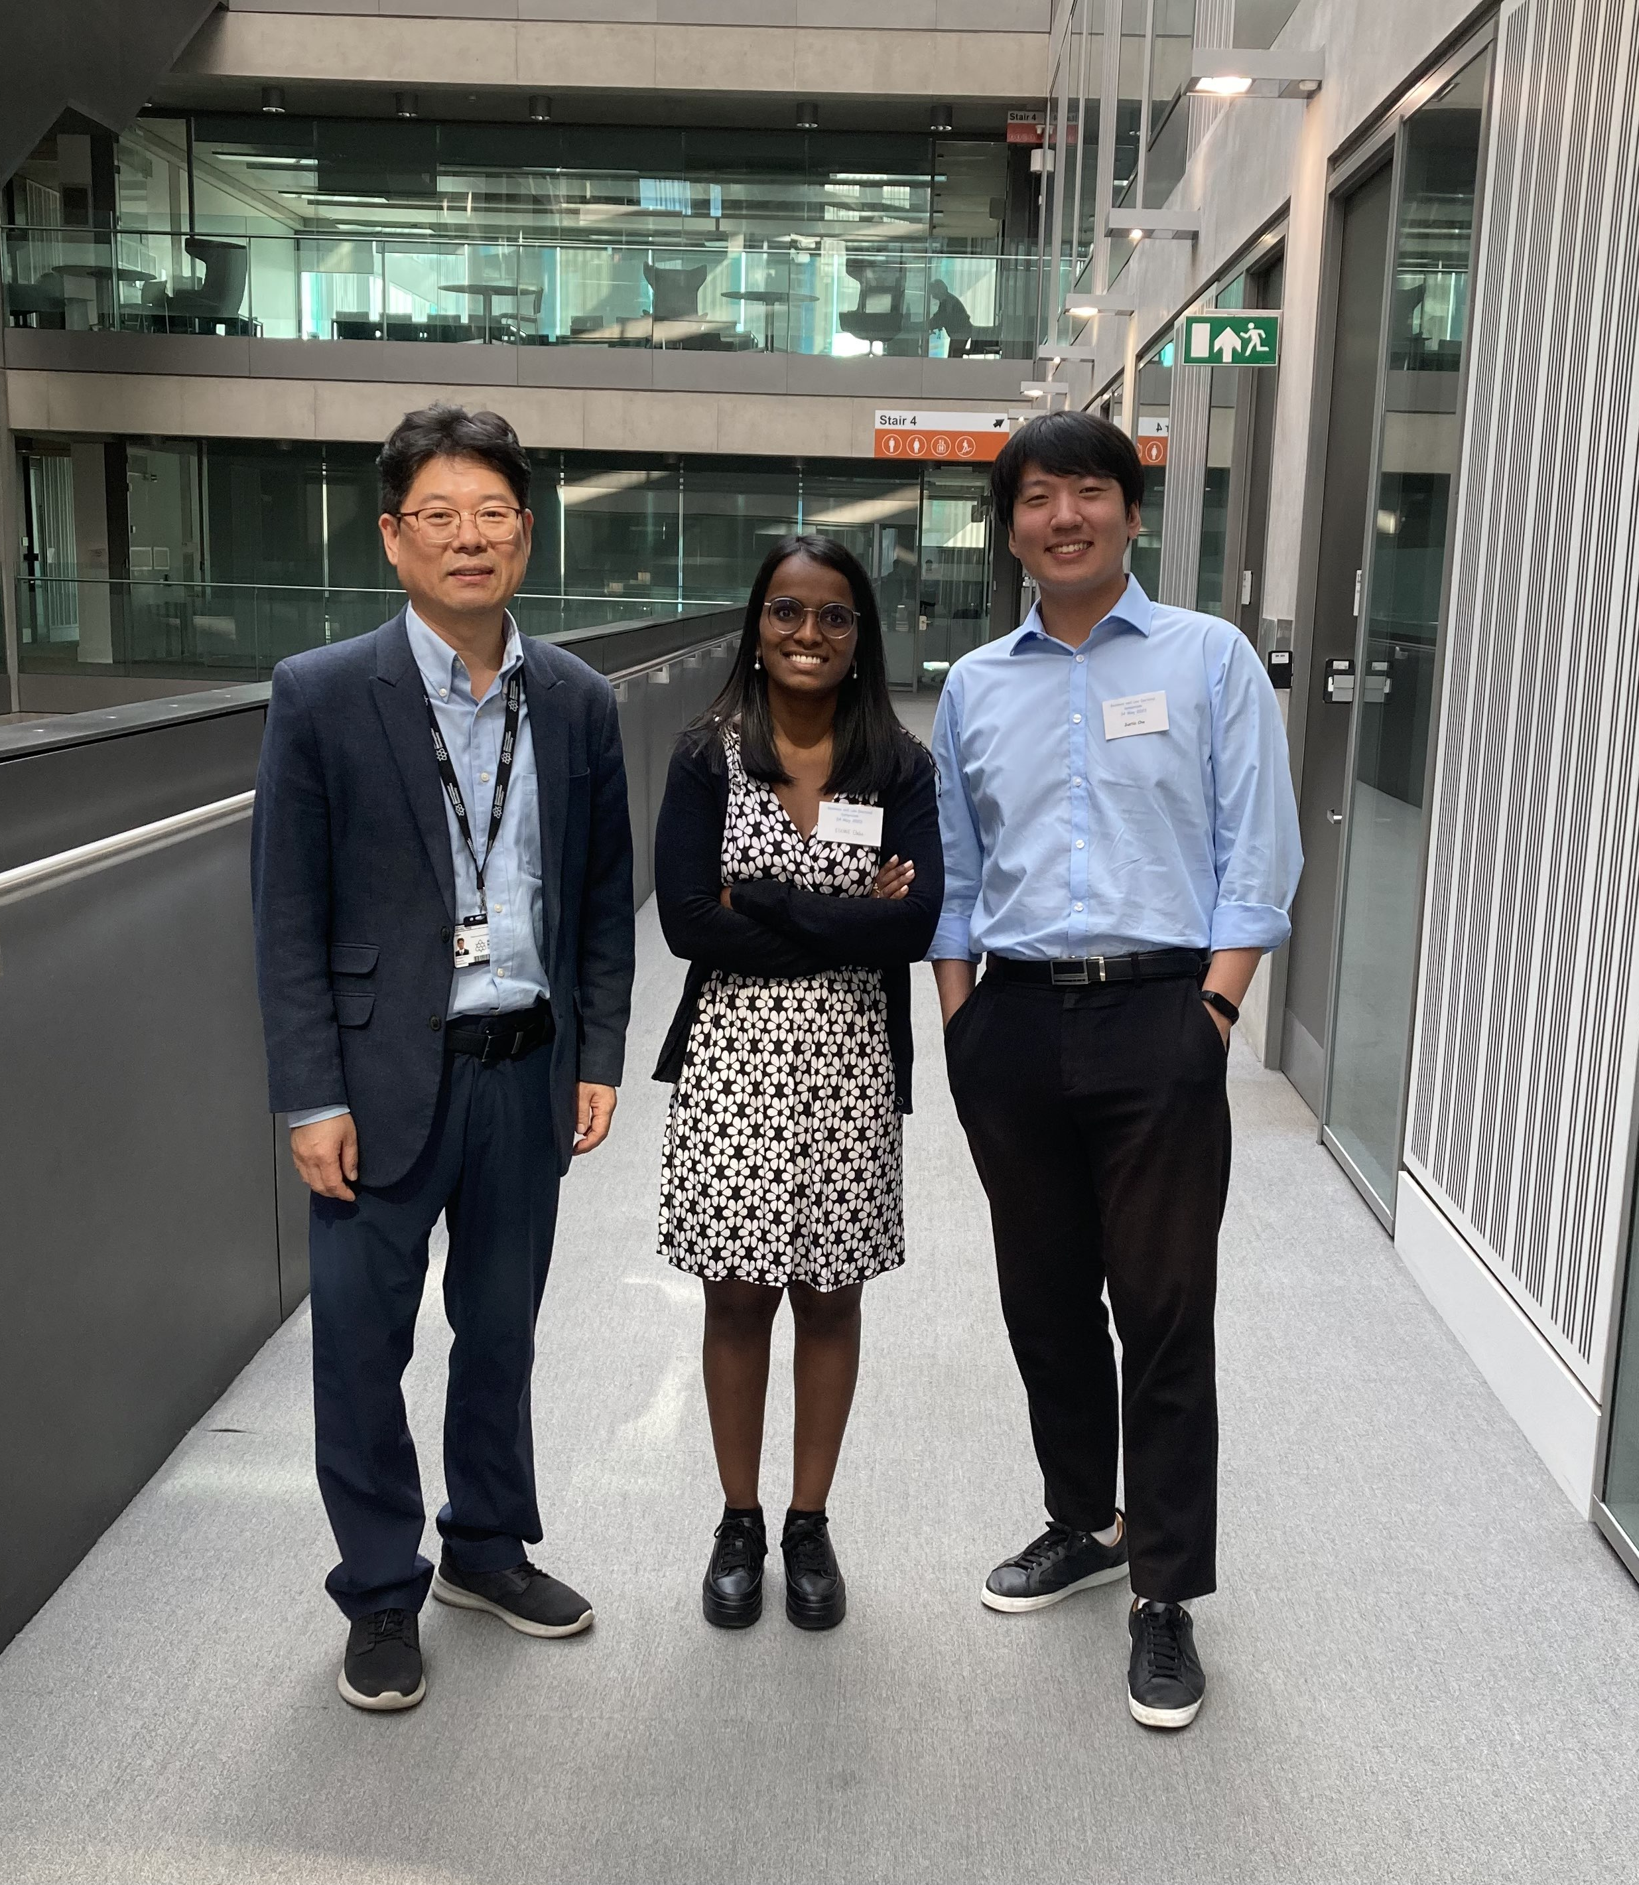
Thank you !
  Elodie ETIENNE
  HEC-Uliège
  elodie.etienne@uliege.be
  http://www.sig.hec.uliege.be/

