Slide 1
Sustainable Urban Development: A Scoping Review of Barriers to the Public Administration
Diego Galego, Giovanni Esposito & Nathalie Crutzen
Smart City Institute – ULiège, Belgium
Notes:
29/06/2023
2
1

Slide 2
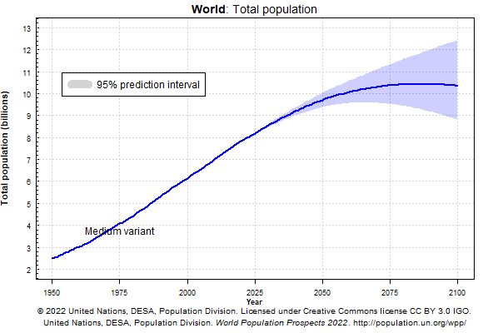
Research Problem
2
Notes:
29/06/2023
2
2

Slide 3
Introduction
Why do this research?
To map and learn which are the scope of SUD policies globally, focusing on the policy cycle and administration features
There is a lack of studies on Public Policy, Administration and Political Science regarding SUD policies
To analyse the types of barriers for SUD policies globally
Research Question
What are the key policy barriers that impede the development of effective sustainable urban development policies?
3
Notes:
29/06/2023
2
3

Slide 4
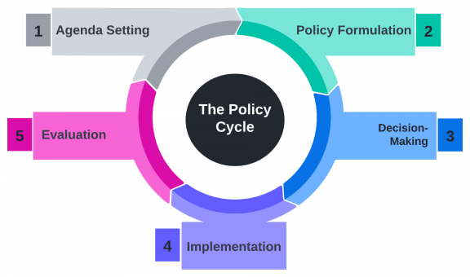
Analytical Framework – Policy Cycle
Problem Recognition
Alternatives and Solutions
Deliberation to the Proposed Solution
Putting Solution into Effect
Monitoring Outcomes
4
Notes:
29/06/2023
2
4

Slide 5
Analytical Framework - Barriers
Organisational
Interaction-specific
SUD-related characteristics
Contextual
Policy process-related
(Cinar et al., 2019)
5
Notes:
29/06/2023
2
5

Slide 6
Methodology - Scoping Review
Focus on the SUD policies presenting any stage of the policy cycle (agenda-setting, formulation, decision-making, implementation, evaluation)
Literature presenting theoretical/empirical evidence of enablers and barriers in different contexts
Content analysis of fragments (barriers)
Almost 8,000 records found
Data Collection performed on Oct 31, 2022
6
Notes:
29/06/2023
2
6

Slide 7
Scoping Review Flowchart
Searched Keywords:
“sustainable urban development”
Records excluded (e.g., research fields not appropriate, a language other than ENG, duplicates and publication types (n=1,714)
Scopus
(n=1,708)
Web of Science
(n=461)
Records screened based on titles and abstracts
(n=455)
Records excluded (e.g., not addressing the topic of PP or PA) (n=298)
Records excluded (e.g., keywords not used in the text or merely illustrative, lack of evidence of the policy cycle) (n=67)
Full-text reading
(n=157)
Final Database
(n=90)
7
Notes:
29/06/2023
2
7

Slide 8
Documents by Year – Title/Abstract (n=455)
8
Notes:
29/06/2023
2
8
35 Book Chapters published in 2018
An exponential increase in the publication of documents over the years.
8

Slide 9
Documents by Year – Full-text reading (n=157)
9
Notes:
29/06/2023
2
9

Slide 10
Documents by Year – Final Database (n=90)
10
Notes:
29/06/2023
2
10

Slide 11
Sources: Journals 48 + Books 7 = 55 Publishers
Journals | N (81) | %
Sustainability | 9 | 11.11
Regional Studies | 5 | 6.17
European Planning Studies | 5 | 6.17
Habitat International | 5 | 6.17
Land Use Policy | 3 | 3.66
Local Environment | 3 | 3.66
Progress In Planning | 3 | 3.66
International Journal Of Urban And Regional Research | 2 | 2.47
Asia Pacific Journal of Public Administration | 2 | 2.47
Cities | 2 | 2.47
European Urban And Regional Studies | 2 | 2.47
Landscape And Urban Planning | 2 | 2.47
Third World Planning Review | 2 | 2.47
Urban Policy And Research | 2 | 2.47
Books | N (9)
Sustainable Urban Development, Vol 4: Changing Professional Practice | 3
Foregrounding Urban Agendas: The New Urban Issue In European Experiences Of Policy-making | 1
Short Guide To Urban Policy | 1
Smart Cities Policies And Financing: Approaches And Solutions | 1
Sustainable Urban Development, Vol 3: The Toolkit For Assessment | 1
TERRITORIAL COHESION: The Urban Dimension | 1
Public Administration and Information Technology | 1
11
Notes:
29/06/2023
2
11

Slide 12
Academic Discipline of the Journals - Scimago
Academic Discipline | N | %
Geography, Planning and Development | 28 | 36.84
Urban Studies | 23 | 30.26
Development | 7 | 9.21
Sociology and Political Science | 6 | 7.89
Public Administration | 6 | 7.89
Law | 2 | 2.63
Social Sciences | 1 | 1.32
Management, Monitoring, Policy and Law | 1 | 1.32
Transportation | 1 | 1.32
Political Sciences and International Relations | 1 | 1.32
12
Notes:
29/06/2023
2
12

Slide 13
Results
Lack of available resources
N = 25 (28%)
Resistance or lack of support from specific actor(s)
N = 22 (24%)
Organisational Barriers (89)
Ineffective administration of process activities
N = 21 (23%)
Rigid organisational structure/culture
N = 11 (12%)
Lack of skills/knowledge/expertise
N = 10 (11%)
13
Notes:
29/06/2023
2
13

Slide 14
Results
Political Entities
N = 7 (36%)
Business as contractors/Privatisation
N = 4 (21%)
Citizens and NGOs
N = 3 (15%)
Interaction Specific Barriers (19)
Interest Groups
N = 2 (10%)
Closed networks/Centralised policy field
N = 2 (10%)
Academics as co-creators
N = 1 (5%)
14
Notes:
29/06/2023
2
14

Slide 15
Results
Lack of basic service provision and protection of natural resources
N = 8 (66%)
SUD Characteristics related Barriers (12)
Ineffective Urban Planning
N = 2 (16%)
Lack of Environmental Awareness
N = 2 (16%)
15
Notes:
29/06/2023
2
15

Slide 16
Results
Laws, Regulations
N = 9 (52%)
Lack of Standardisation
N = 5 (29%)
Contextual Barriers (17)
Geography
N = 2 (11%)
Symbolic exclusion/Inclusion mechanisms
N = 1 (5%)
16
Notes:
29/06/2023
2
16

Slide 17
Results
Lack of Integration
N = 17 (36%)
Incompatibility/Incoherence
N = 7 (15%)
Complexity
N = 6 (13%)
Policy Process-related Barriers (46)
Lack of Public Participation
N = 6 (13%)
Lack of Information
N = 5 (10%)
Policy problem definition
N = 3 (6%)
Decision-making types
N = 2 (4%)
17
Notes:
29/06/2023
2
17

Slide 18
Policy Cycle
Agenda-setting: lack of available resources, political entities, rigid organizational structure.
Formulation: resistance of specific actors, laws and regulations, need for integration in problem definition.
Decision-making: resistance or lack of support from actors, laws and regulations.
Implementation: lack of resources, skills, and ineffective administrative procedures.
Evaluation: limited resources, lack of an evaluation tradition, fragmentation in administrative procedures.
18
Notes:
29/06/2023
2
18

Slide 19
Conclusion
Several barriers exist to effectively implementing SUD policies, and scholars from PA or PP have paid little attention to this topic.
At least three policy recommendations can be drawn from a policy capacity perspective:
The first level emphasises the need for policies to be developed holistically to address environmental, social and economic crises.
The second stresses the necessity of policy-makers to create space for flexible and innovative collaboration between the state, market and networks to tackle wicked problems such as poverty, climate change, and environmental destruction, particularly in densely populated countries.
Finally, the third suggests a few policy directions for operationalising SUD in public administration.
19
Notes:
29/06/2023
2
19

Slide 20
Thank You!
dgalego@uliege.be
20
Notes:
29/06/2023
2
20

