Slide 1
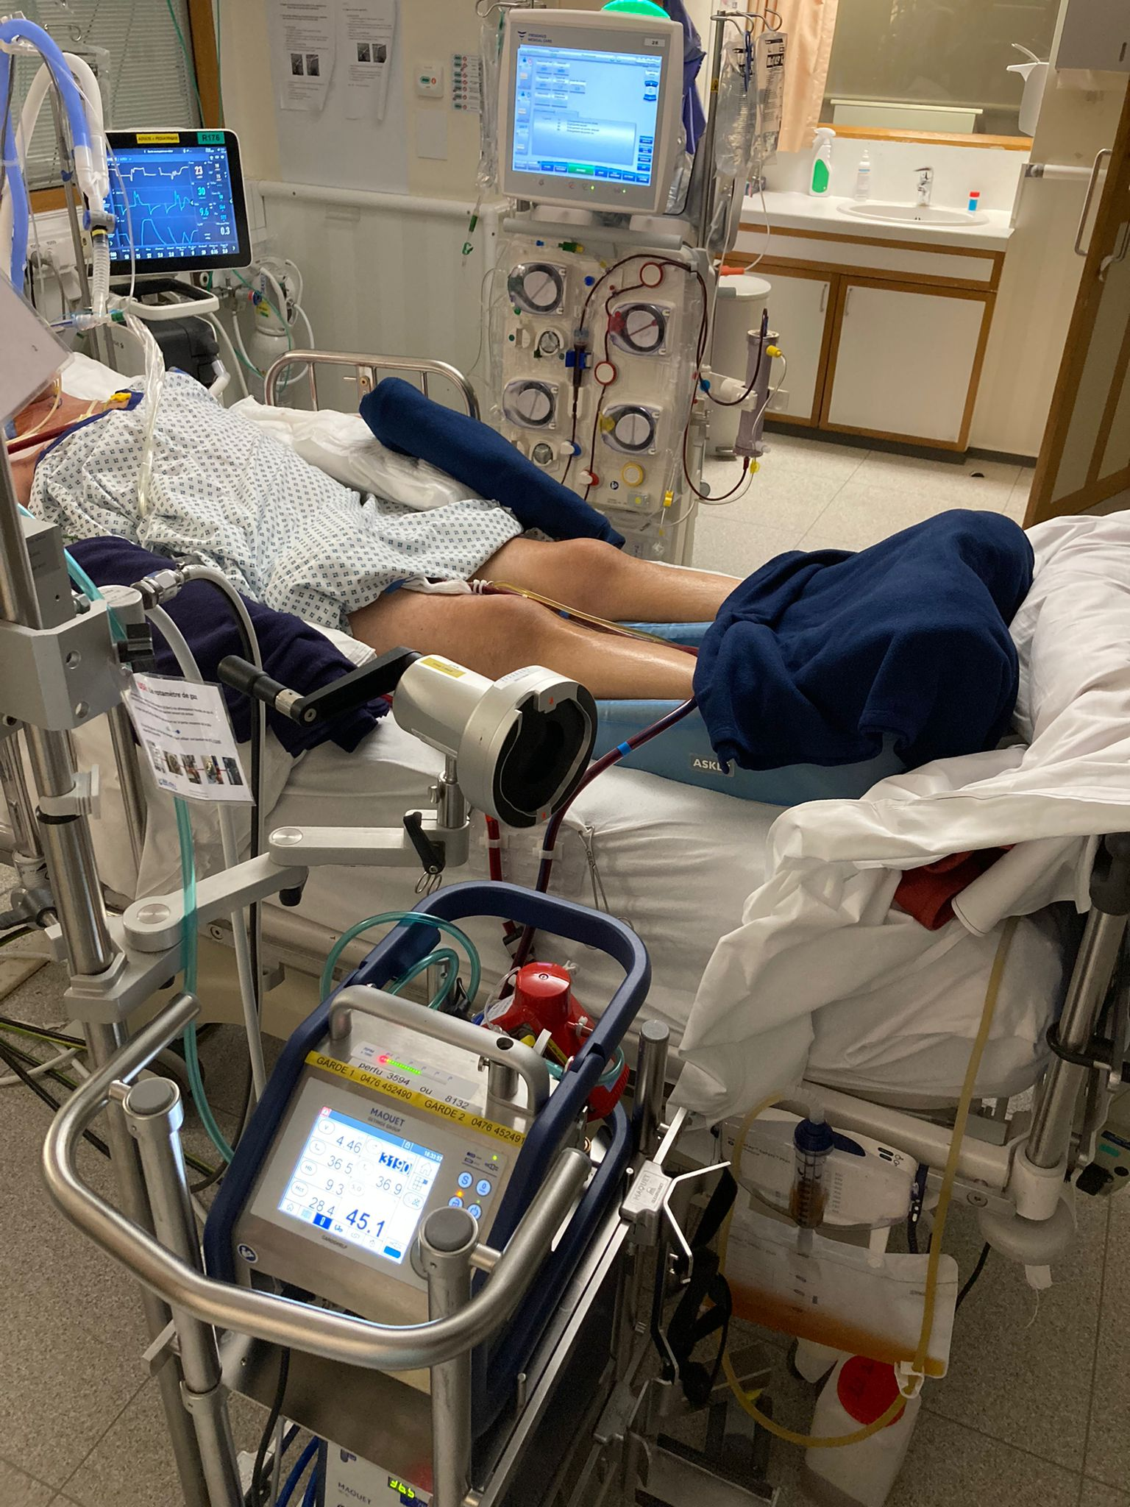
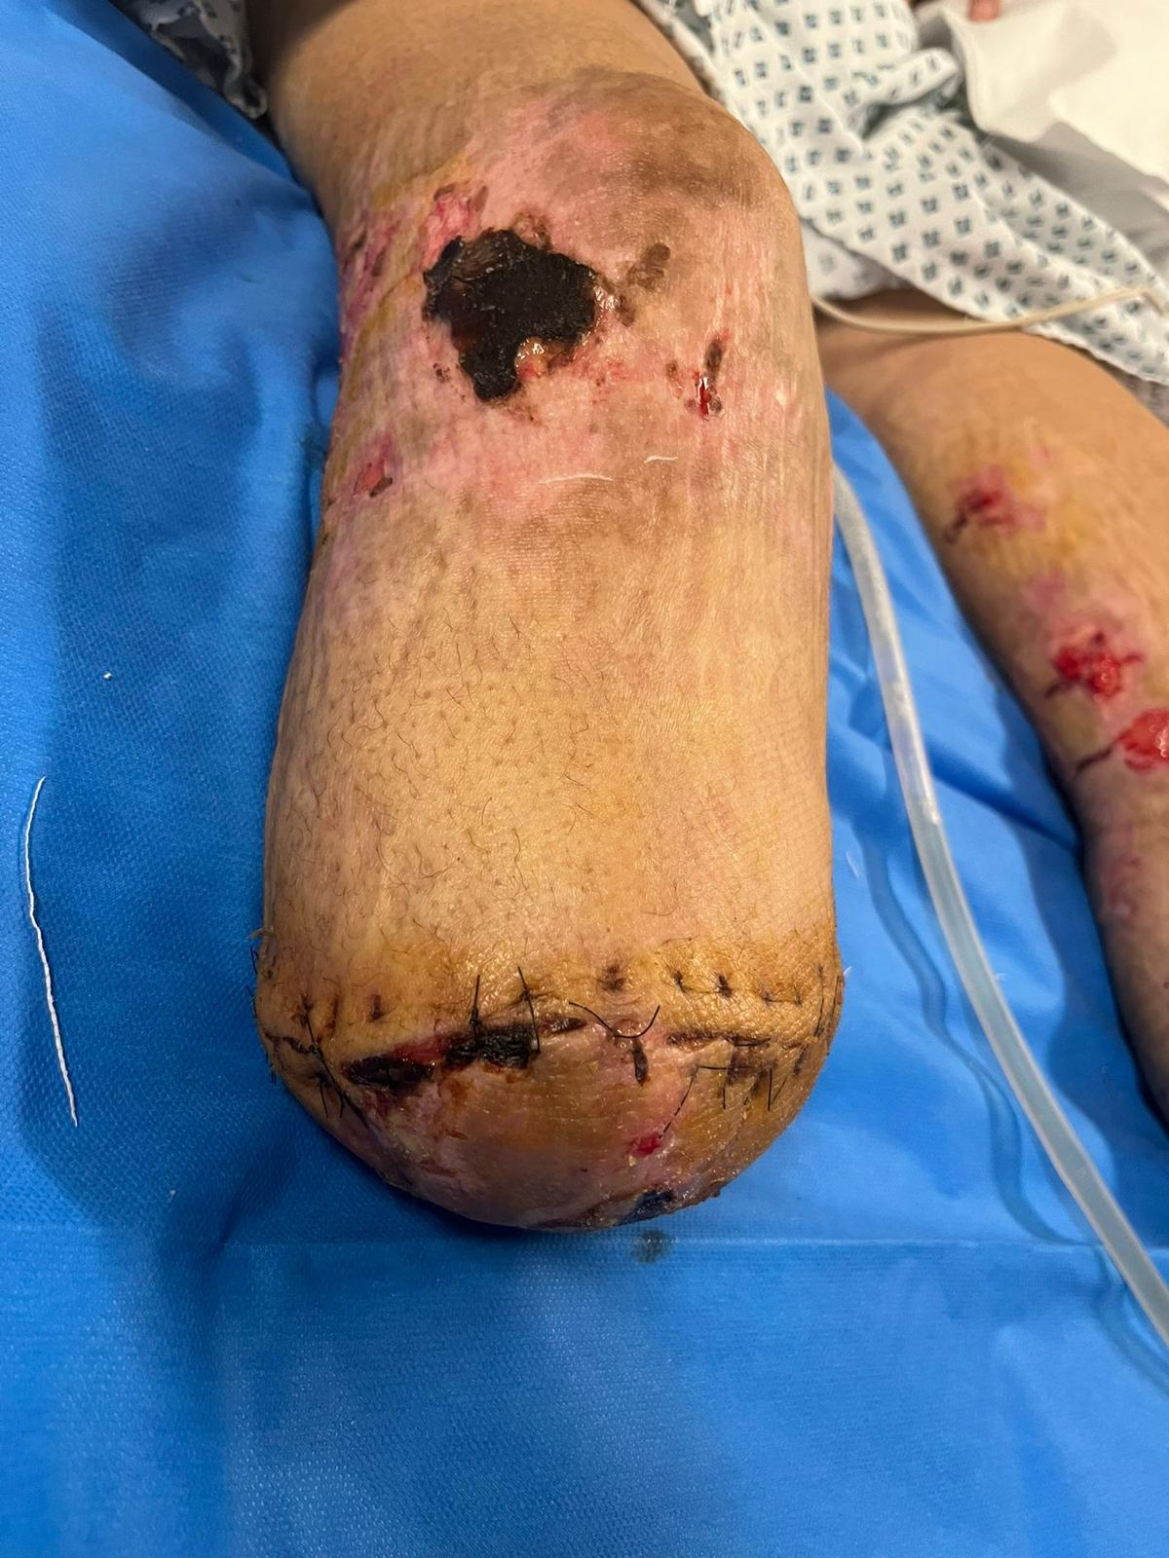
A Multicenter Case Series of invasive Streptococcus pyogenes A (GAS) Infections from a Tertiary ICU in Liège, Belgium
Hendrikx, E., Mathieu, D., Mathy, X., Fraipont, V., Misset, B., Meex, C., Layios, N. CHU Liège University Hospital, Department of Intensive Care
CHR Citadelle, Department of Intensive Care
BACKGROUND​
In December 2022, the UK reported an increased number of scarlet fever and invasive GAS infections (including several deaths in children <10y of age), above expected levels for the time of year. This report was followed by similar ones from several other EU countries leading to a WHO Europe press release to raise awareness. Early data did not indicate a new circulating strain or increased antibiotic resistance, but rather pointed towards a combination of factors including reduced exposure during the pandemic years, increased closed contacts after relaxation of NPIs and increased circulation of viral illnesses such as varicella, Influenza and RSV. In Liège, the University Hospital and CHR Citadelle faced a similar outbreak, which prompted us to conduct a retrospective case series of these patients.​
​
RESULTS
We identified 17 patients with GAS, among which 13 adults and 4 children (Table 1). The majority of adult patients had no significant comorbidities or relevant recent medical history and were not referred from other hospitals. All patients received appropriate antibiotics and /17 (%) received immunoglobulins. The median age of the adult patients was 49 years old [33-68]. They were predominantly males (8/13, 61%). Of these patients, 3 had Influenza co-infection. Upon admission, the SOFA score was 11 [8-16]. Three patients had toxic shock syndrome² and 3 patients experienced shock during their hospitalization. Eight patients were initially
diagnosed with respiratory failure, and 4 required thoracoscopic drainage of empyema. Two patients required VV-ECMO, while 1 required VA-ECMO. Two patients were diagnosed with necrotizing fasciitis, which necessitated repeated debridement. The mean length of stay was 22 days. Hospital mortality was 38.4%.
The pediatric group had a median age of 3,5 years (IQR[1,5-5]); 3 were girls. Co-infection with viruses was seen in 3 patients, including Influenza A (n=2), RSV (n=1). Most children presented with pneumonia and empyema (n=3). One patient had cardiogenic shock associated with TSS and needed fasciotomy for necrotizing fasciitis. The mean length of stay in the pediatric ICU was 6 days. All children survived.
METHOD
We performed a retrospective analysis of all medical records of patients admitted to the ICU between June 2022 and April 2023. Patients of all ages with confirmed GAS infection (i.e., in whom S. pyogenes A was isolated and cultured from a normally sterile site)¹ were included. Demographics and clinical features as well as outcome data were collected.
Demographic and clinical characteristics of iGAS patients (N=18)
Patients | Number | Median age | Sex | Viral infection | Pneumonia | STSS | Necrotizing fasciitis | ECMO | Average length of stay | Immunoglobulins
Adults | 13 | 49 (33-68) | 8M-5F | 3 (23%) | 8 (61%) | 3 (23%) | 2 (15%) | 3 (23%) | 22 | 3 (23%)
Children | 4 | 5 (1,5-5) | 1M-3F | 3 (75%) | 3 (75%) | 1 (25%) | 1 (25%) | 0 | 6 | 0
CONCLUSIONS
In conclusion, this retrospective study highlights the severity of the disease caused by GAS in both adults and children. Pneumonia was found to be the most common infectious site before TSS and necrotizing fasciitis. The mortality rate was high, as expected and considering three fulminant cases admitted late. Phenotyping of the majority of strains in this case series is ongoing in order to characterize possible hypervirulence associated with this outbreak, as seen in some European regions³ .
REFERENCES
The Working Group on Severe Streptococcal Infections, 1993 (addendum)
Schmitz et al. Ann. Intensive Care (2018) 8:883 https://doi.org/10.1186/s13613-018-0438-y
de Gier, B. Euro Surveill. 2023 Jan;28(1):2200941. doi: 10.2807/1560-7917.ES.2023.28.1.2200941

