Slide 1
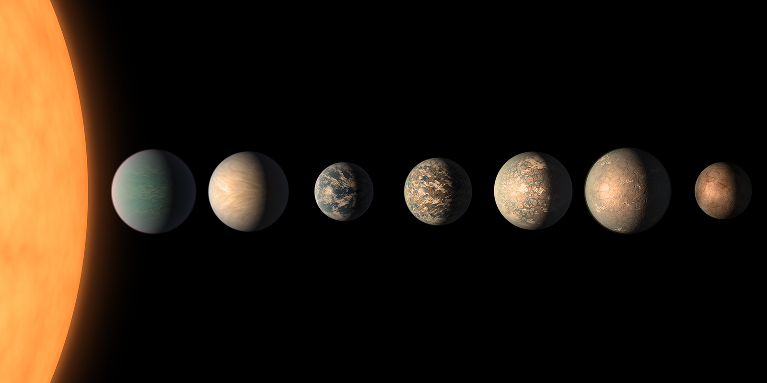
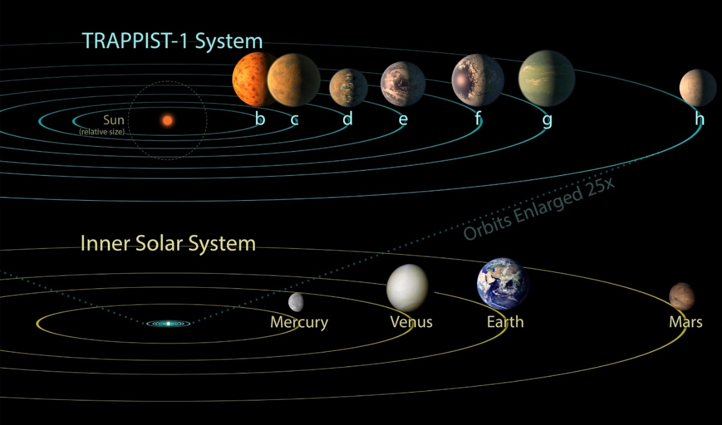
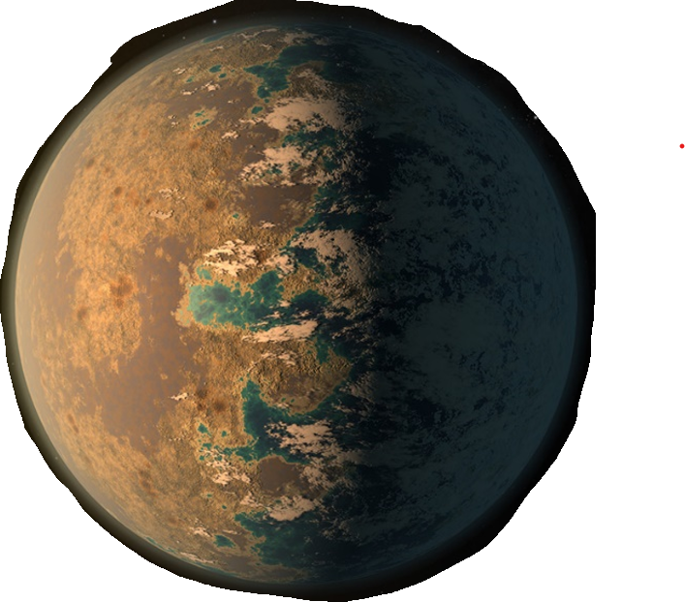
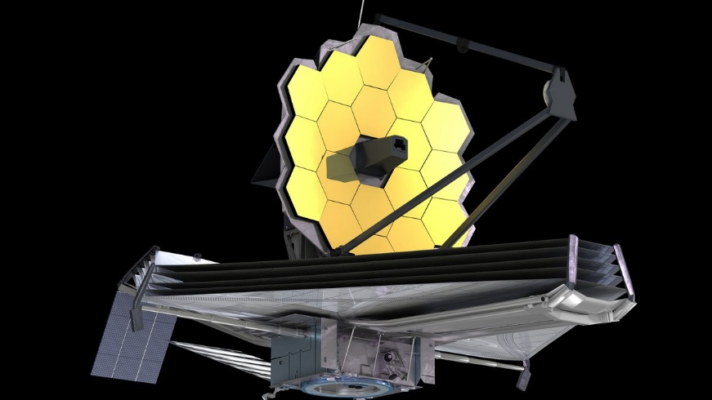
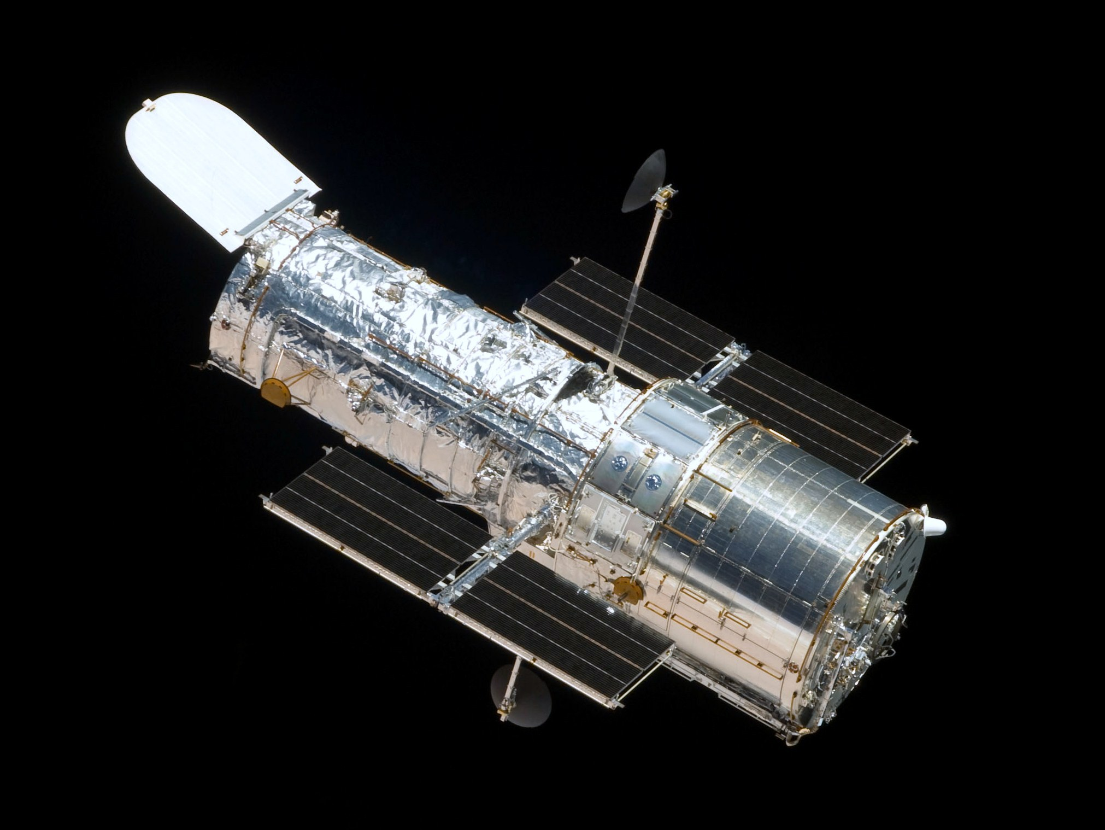
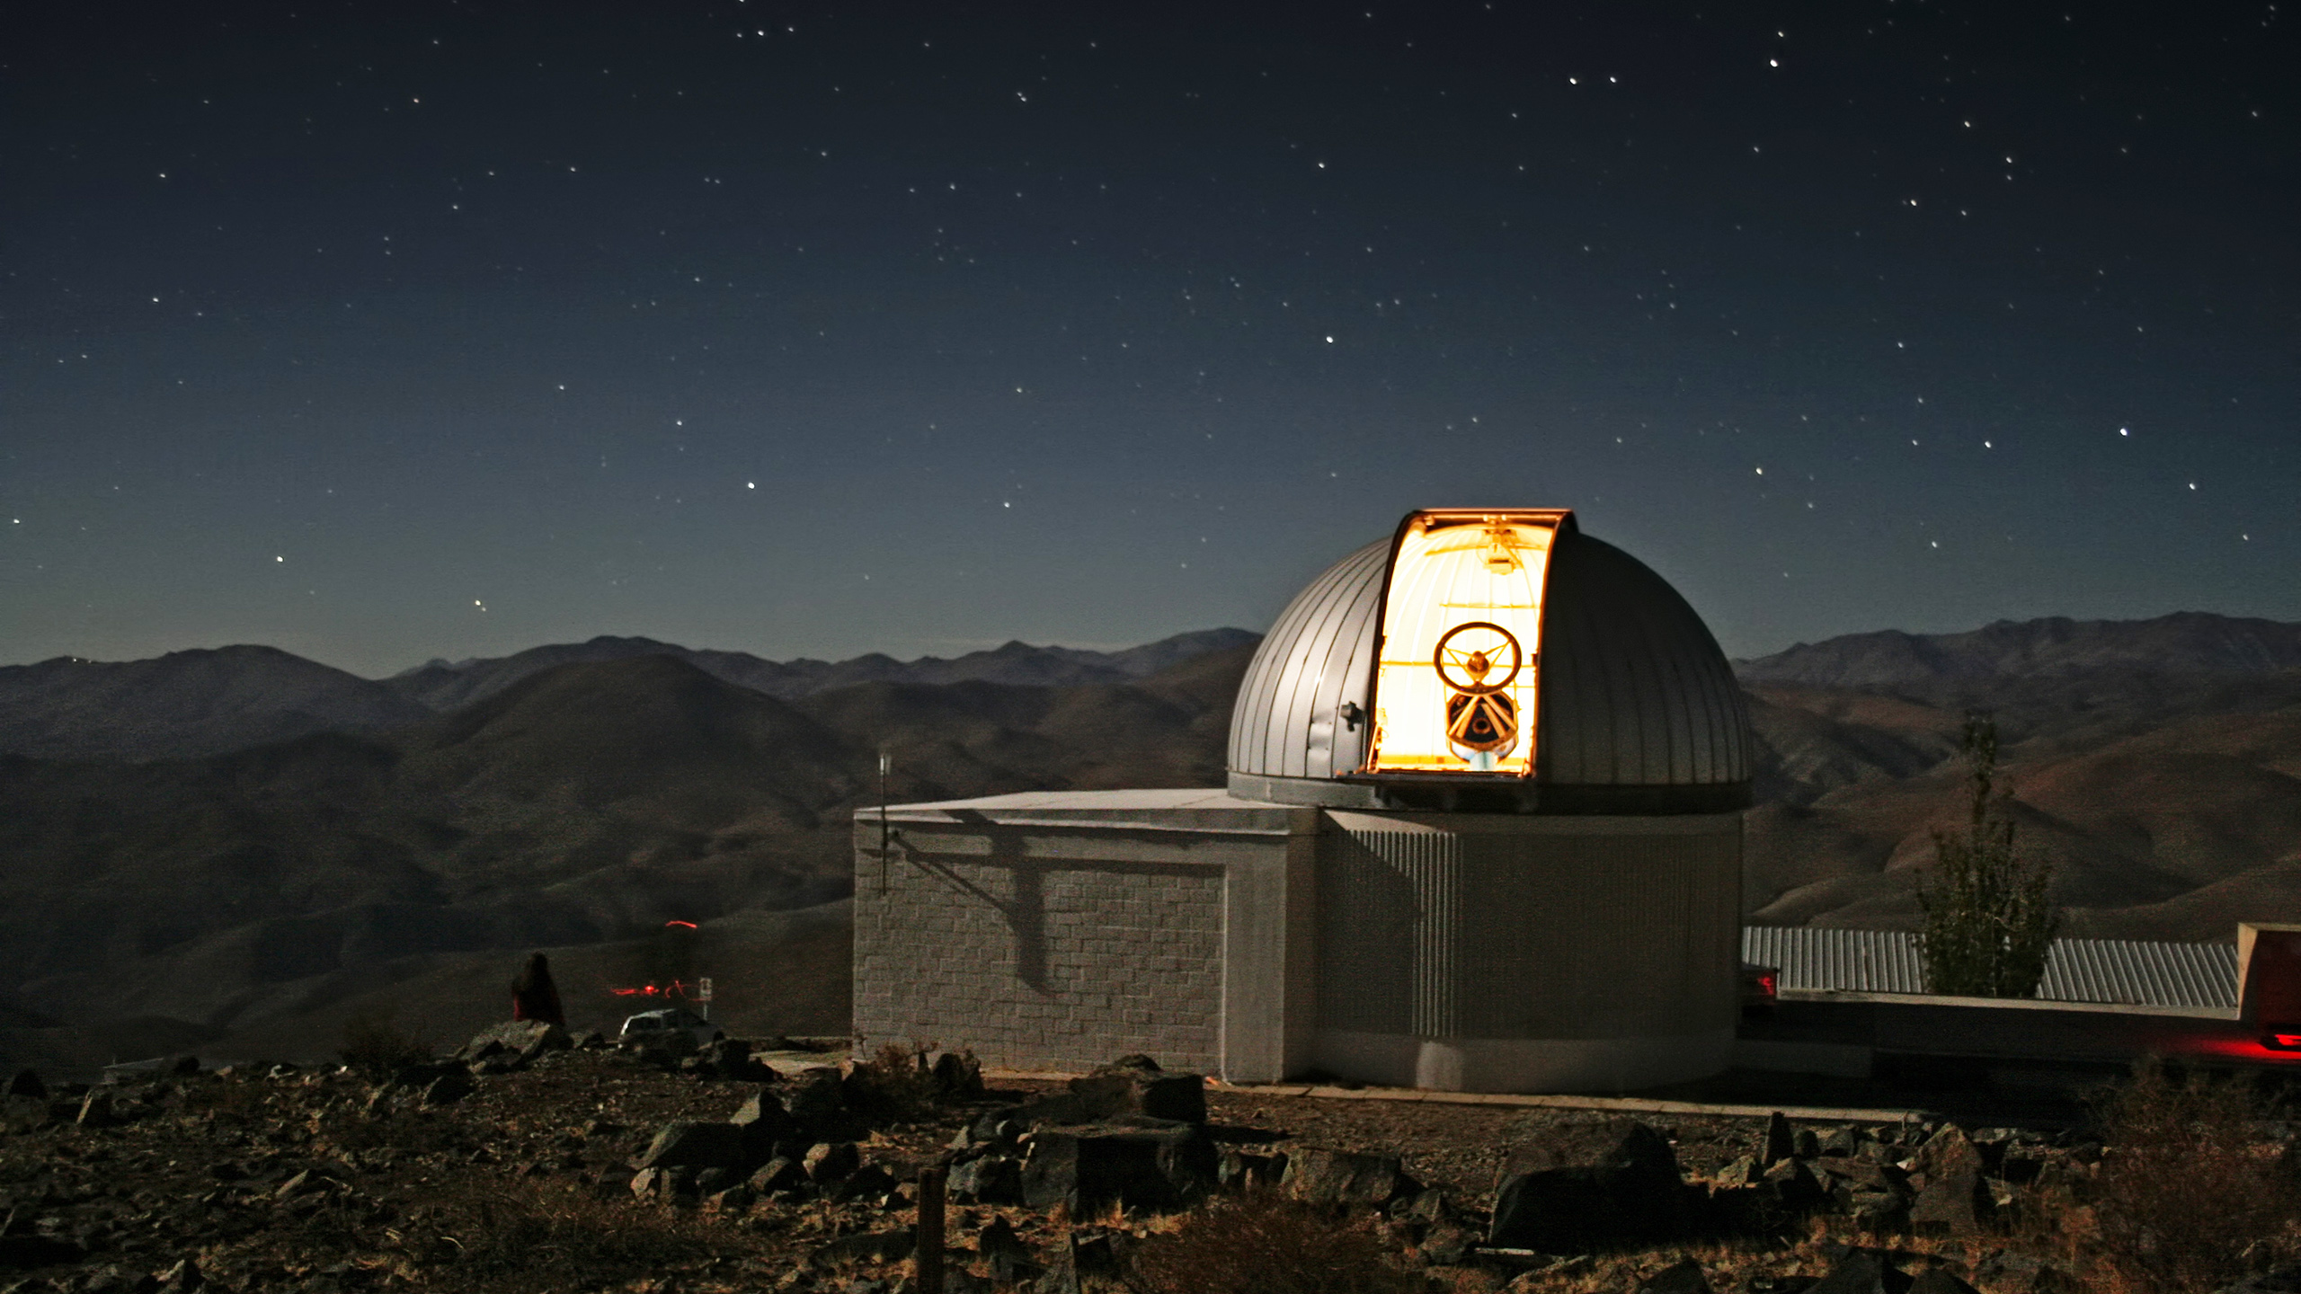
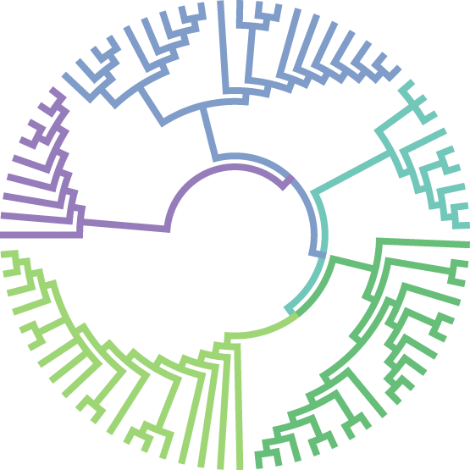
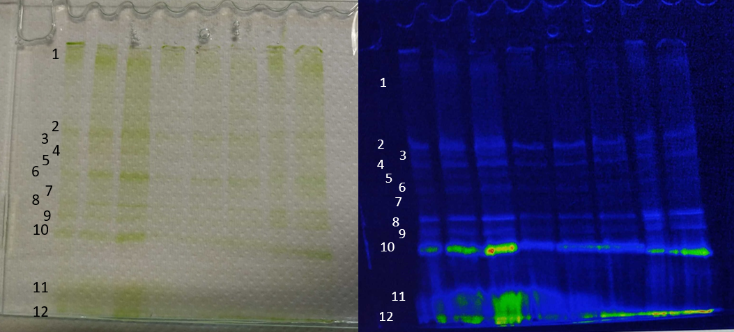
The limits of photosynthesis in the infra-red
/ Early Life
Tom Feller
Pierre Cardol, Emmanuelle Javaux
PORTAL project :
Habitability & Phototrophy (possibility and signatures) of rocky exoplanets
around very low mass stars
TRAPPIST-1 e
: 40 light-years from Earth
I. Habitability of TRAPPIST-1 Planets
Collecting data about :
Photon/proton emission of the star
Atmosphere of each planet
Surface habitability and irradiation
…
Earth-like planet
Size : 0,915 x
Density : 1,024 x
Weight : 0,772 x
Core : Iron
Rotation : Synchronic
Temperature : -27° C
James Webb Space Telescope (JWST) / Hubble / TRAPPIST telescope
II. Build of TRAPPIST-1 Biodome
Infra-red acclimated/adapted phototrophic life under TRAPPIST Star UV-IR and atmospheric conditions
Reproduction of collected conditions inside a biodome
TRAPPIST-1 : Red dwarf star
Very low mass star that emits a lot of Far-Red / Infra-Red light
III. Limits of Phototrophy
1. Selection of microalgae
3. Where is this adaptation from ?
Selection of 60 Eukaryotic microalgae
From all phyla
From 14 different orders
Photosynthetic complexes separation
by Native-PAGE
Bands Absorption
2. Screening the 60 microalgae
Based on :
Absorbance
RT Fluorescence
77K Fluorescence
Bands 77K Fluorescence
Bands R.T Fluorescence
Far-Red / IR light
White light
Diff. Red-White
Shift in absorbance/fluorescence is induced by a rearrangement of protein-pigment interactions inside Photosystem core (PS) or light harvesting antenna (LHC)
Less than 10 strains shows a red shift, related to an acclimation, when incubated under Far-red/IR light.
4. Activity analysis
720nm light can induce oxidation of Photosystem II

