Slide 1
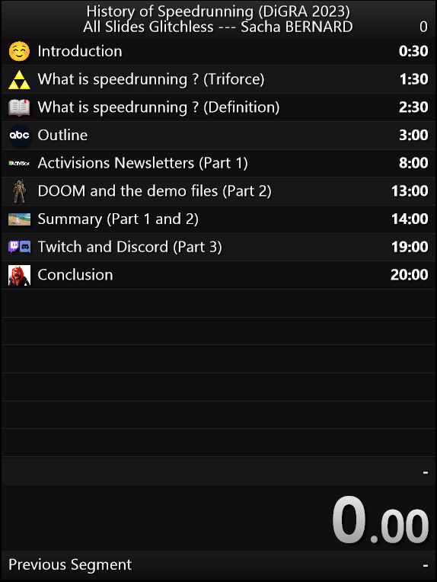
A Historical Perspective on Speedrunning : Evolution and Impact of the Informational Aspect upon Speedrunning Communites
Sacha BERNARD (he/him) – Université de Liège (Belgium) – Liège Game Lab – DiGRA 2023 – June 2023
: @SoulOfAGreyWolf

Slide 2
What is speedrunning ?
OBJECTIVE
△ objective ? any% ? 100% ? low% ? all dungeons ? all bosses ? all quests ?
△ rules ? with glitches ? glitchless ? manipless ? turbo controller ? oob ? no oob ?
△ tracking times personal best ? in-game time ? real-time attack ? consoles vs. pc
TRACKING TIMES
RULES

Slide 3
What is speedrunning ?
Speedrunning is the practice of achieving a goal within a video game (objective) as fast as a player can (tracking times) by following specific rules setting up by the community or the player (rules).

Slide 4
Outline
Part I : From home performances to community information : speed-based performances in Activision’s newsletters (1981-1983)
Part II : The demo files in DOOM (1993) : speed-based performances becoming documents
Part III : Creating, sharing, recepting, decoding documents and information : modern artefacts such as Twitch and Discord exploited by speedrunners

Slide 5
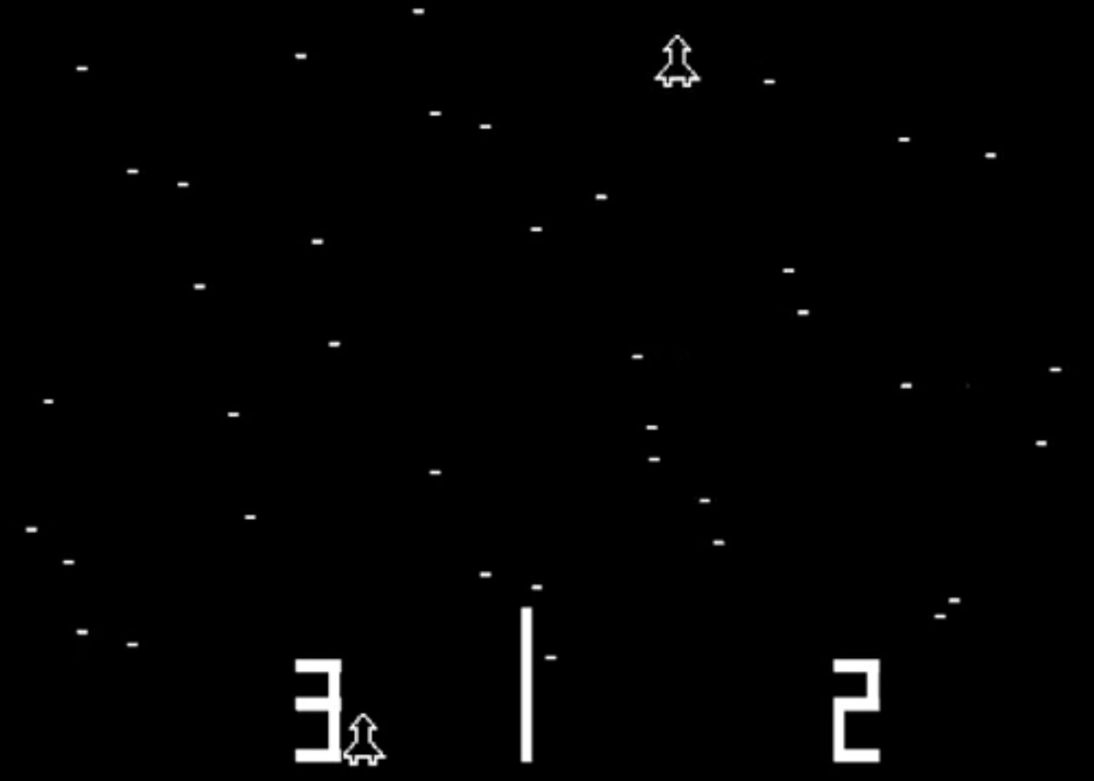
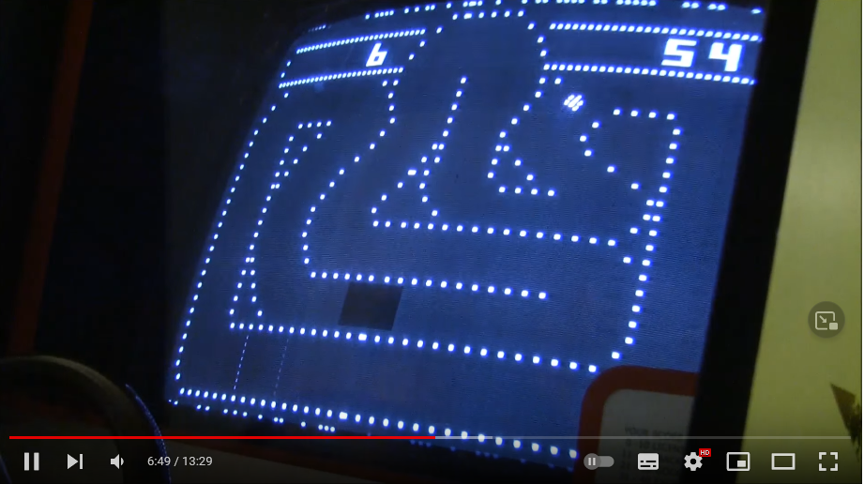
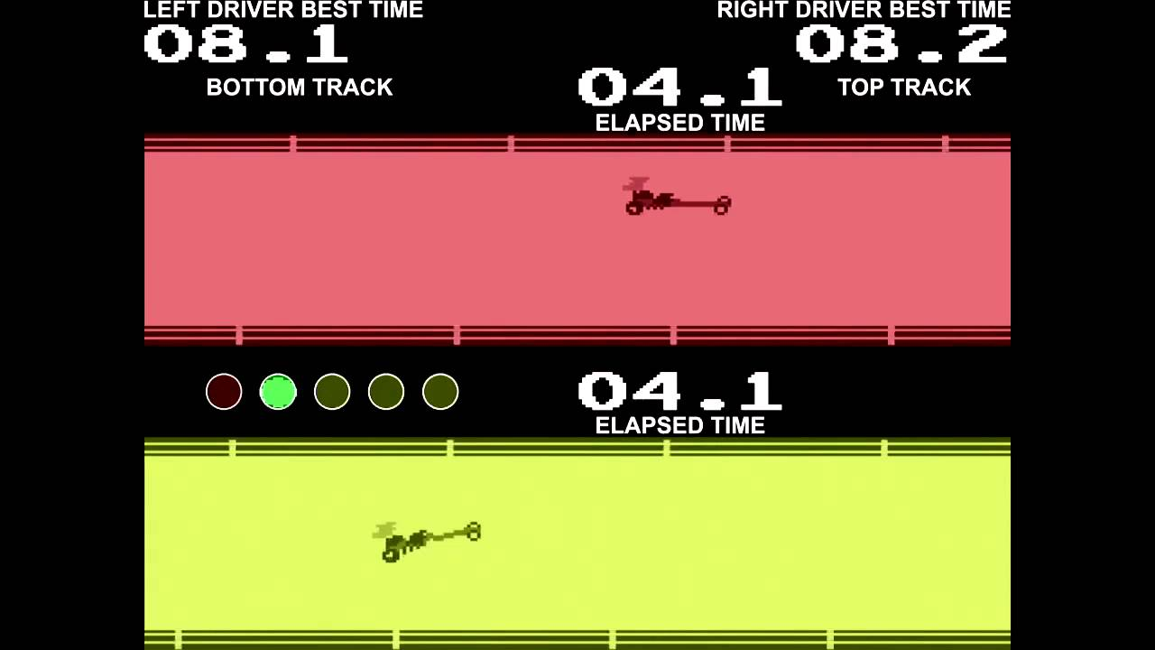
Part I The implementation of speed at the heart of a player’s videogame experience is difficult to trace. By the early 70s, we had games that put speed at the center of their gameplay such as Space Race (Atari, 1973) ; Gran Trak 10 (Atari, 1974) ; Drag Race (Kee Games, 1977).

Slide 8
Part I
Activision published seven newsletters between autumn 1981 and autumn 1983
 | Date of publication | Number of Club Members : Dragster | Number of Club Members : Skiing | Number of Club Members : Grand Prix
Volume 1 | Autumn 1981 | 2900 | 1800
Volume 2 | Winter 1982 | 3500 | 2300
Volume 3 | Spring 1982 | 3500 | 3000
Volume 4 | Autumn 1982 | 4400 | 4198 | 1178
Volume 5 | December 1982 | 5477 | 5564 | 5800
Volume 6 | Spring 1983 | Unknown | Unknown | Unknown
Volume 7 | Autumn 1983 | Unknown | Unknown | Unknown

Slide 9
Part II DOOM was a major cultural phenomenon of the 90s. Its success can be explained by id Software’s policy of encouraging players to create their own content around the game: levels, mods, tools etc.

Slide 10
Part II

Slide 11
Part II
Performance is no longer a piece of information diluted among others in a newsletter or magazine but becomes a document from which players can extract information to optimize their own performance, study strategies etc.

Slide 12
Part I and II : summary
What distinguishes these two eras is access to evidence. On the one hand, we have the best times, and on the other, the proofs that show how to obtain those best times. As the competition is now organized by the players and for the players, they need to justify the reliability of their performances.

Slide 13
Part III
Twitch :
“With the dawn of streaming more people were able to watch the long grinds and evolution of runs. Instead of speedrunning being thought of as just the end product, it shifted to being a process. And with this, along with the easier access of speedrunning streams, came a proliferation of materials and resources to learn how to speedrun.” (Schmalzer, 2022 ; 17)

Slide 14
Part III
Discord :
Discord is the preferred method of communication for practitioners. Not only they can centralized ressources from different speedrunning communities, they can also manage their own community.

Slide 15
Part III
Work in progress. Twitch and Discord through the prism of simplification, accessibility and centralization.
Twitch | Discord
INF03 : Before Twitch, people very rarely did speedruns. [...] Everyone now has access to software like OBS or XSplit very easily and that has made speedrunning very popular. | INF03 : Discord is very practical because we really have the OoT Discord where everyone is on it and there are lots of threads to discuss this or that.
INF04 : I had a crappy PC at the time, so it was easier for me to launch a stream. | INF04 : [Discord] has really become the hub for a lot of communities. [...] Now everything is accessible [...] and information is shared.

Slide 16
Part III
Work in progress. Twitch and Discord through the prism of simplification, accessibility and centralization.
Twitch | Discord
INF14 : Twitch was a good way of getting the replays, which are available for fifteen days. | INF08 : The arrival of Discord really changed a lot of things, because all of a sudden, we had public places that were really easy to access and, in the end, modern enough to discuss things and exchange strategies.
INF01 : The two big revolutions in speedrun were Twitch because now, when you make a run and you do it live, there are no more questions about whether there's been editing, cheating and so on because you can see that the guy has made 739 attempts [...]. And then Discord where, rather than everyone being doing their techniques in their own corner, well now everyone is getting together and trying to progress at the same time.

Slide 17
Conclusion
Producing, sharing, recepting, decoding informations is the very heart of any speedrunning communities.

Slide 18
Aaaaaand… TIME !
Thank you for your attention <3

