Slide 1
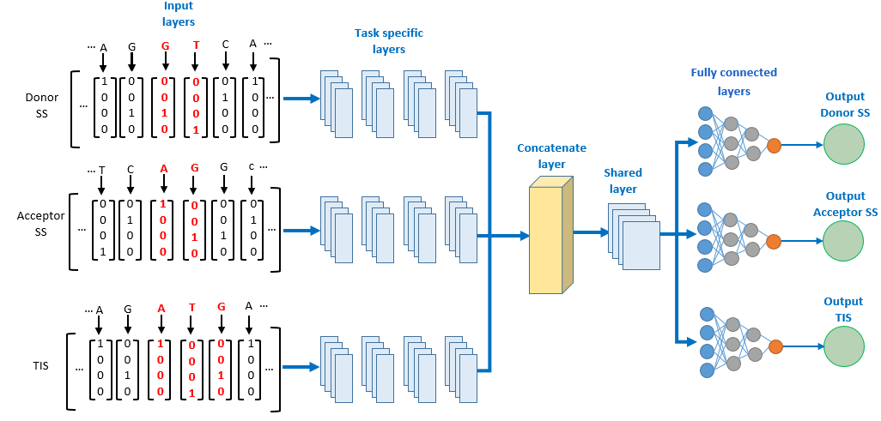
Towards interpretable multitask learning for splice site and translation initiation site prediction
Center for biosystems and biotech data science
Espoir Kabanga, Arnout Van Messem, Wesley De Neve
Abstract
In this study, we investigate the effectiveness of a multitask learning (MTL) approach for handling three bioinformatics tasks: donor splice site prediction, acceptor splice site prediction, and translation initiation site (TIS) prediction. We compare the effectiveness of a single-task model (SpliceRover) to an MTL model using the specificity, sensitivity, F1-score and Matthews Correlation Coefficient (MCC) metrics. We further analyze the effectiveness of our MTL model using visualization techniques. Our outcomes indicate that the MTL model effectively learns relevant features for all tasks when compared to single-task models.
Overview
Method
Transcription and translation process
The MTL model hyperparameters are identical to those of SpliceRover (Zuallaert et al, 2018)
Results
Task | Model | Specificity | Sensitivity | F1-score | MCC
Donor splice sites | Single task | 0.9367 ± 0.0121 | 0.9434 ± 0.0073 | 0.9403 ± 0.0028 | 0.8803 ± 0.0064
 | MTL | 0.9326 ± 0.0064 | 0.9315 ± 0.0047 | 0.9320 ± 0.0030 | 0.8642 ± 0.0062
Acceptor splice sites | Single task | 0.9265 ± 0.0043 | 0.9361 ± 0.0049 | 0.9316 ± 0.0049 | 0.8627 ± 0.0096
 | MTL | 0.9184 ± 0.0150 | 0.9269 ± 0.0167 | 0.9229 ± 0.0029 | 0.8456 ± 0.0045
Translation initiation sites | Single task | 0.9199 ± 0.0189 | 0.9211 ± 0.0136 | 0.9206 ± 0.0033 | 0.8413 ± 0.0076
 | MTL | 0.9103 ± 0.0117 | 0.9044 ± 0.0162 | 0.9070 ± 0.0038 | 0.8149 ± 0.0052
Both the single-task model (top) and the MTL model (bottom) for donor splice sites learn the typical pattern (CAGGTAAGT), also exhibiting a similar contribution pattern.
For acceptor splice sites, both the single-task model and the MTL model learn the polypyrimidine tract, typically rich in C and T nucleotides, in the region upstream of the acceptor site.
For TIS, both the models learn similar patterns. Higher contribution scores are obtained by G and C at position 3 and 4 in downstream of TIS, and by A/G (purine) at position -3 in upstream of TIS. That is the typical context for TIS as per the Kozak sequence (Kozak, 1987).
Conclusions
The single-task models outperform the MTL model for all three the tasks. However, the difference in effectiveness of the single-task models and the MTL model can be considered minimal or not statistically significant.
Based on the sequence logos generated for each model and for each task, we observe that both types of models learn similar patterns that typically correspond to each task. Therefore, we confirm that the MTL model generalized correctly for all the tasks.
Generation of high-quality labeled biological data is very costly. MTL therefore remains a promising technique for reducing label costs in the field of bioinformatics.
In our future work, we will investigate the impact of positive transfer and negative transfer across the different tasks and compare MTL models with fine-tuned foundation models.
Contact: espoir.kabanga@ghent.ac.kr

