Slide 1
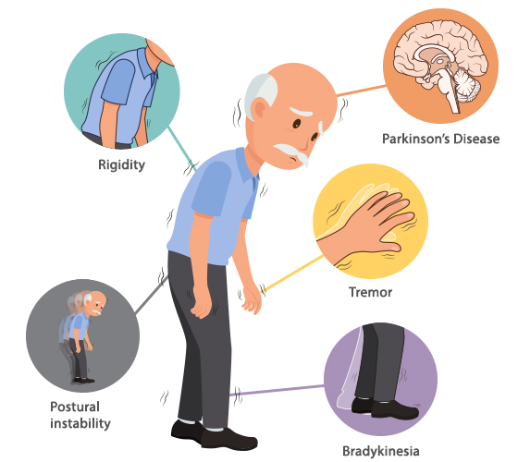
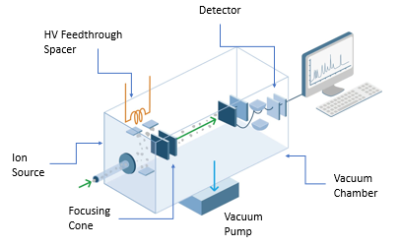
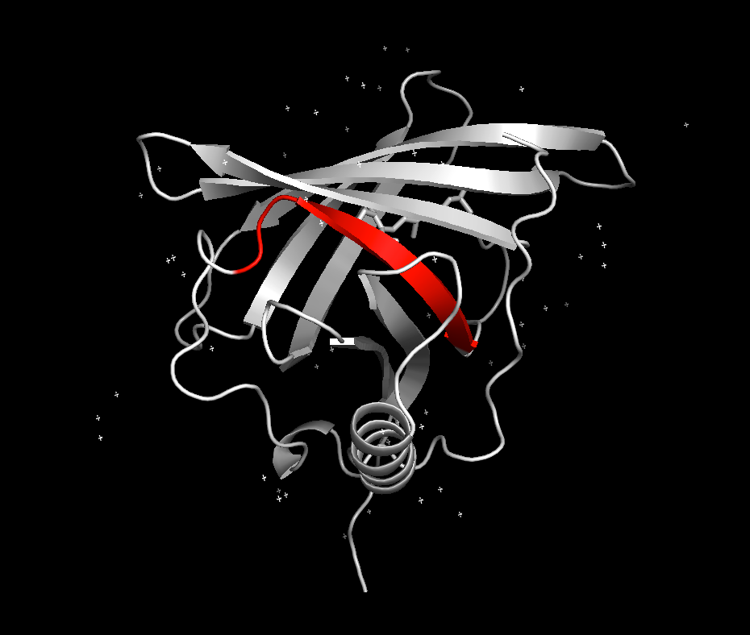
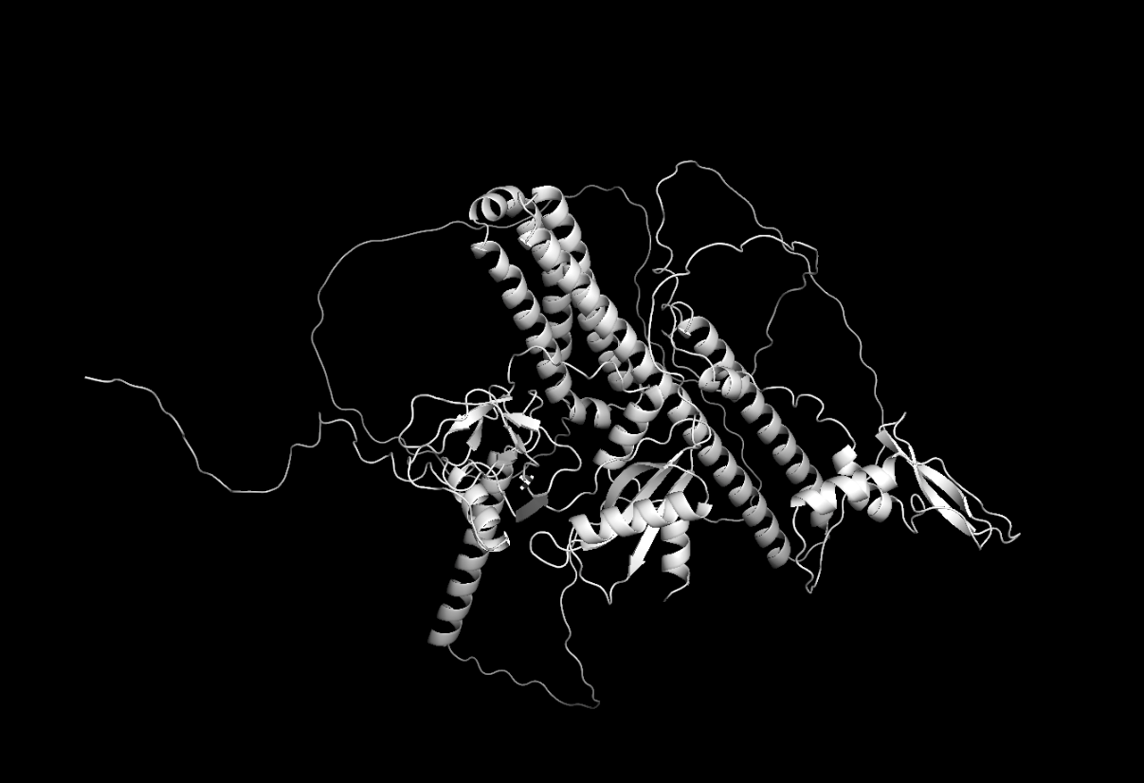
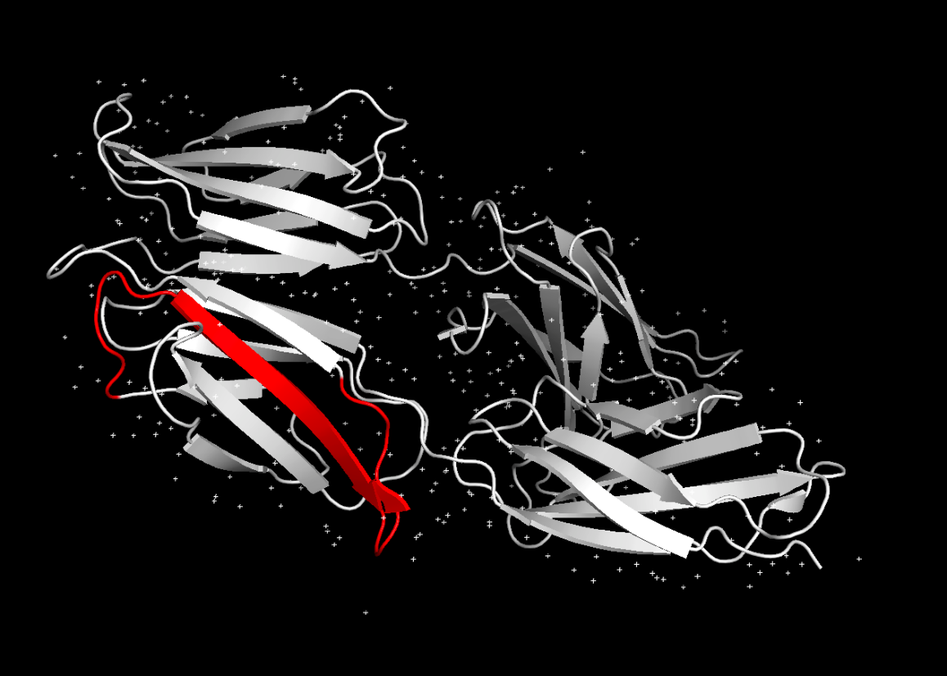
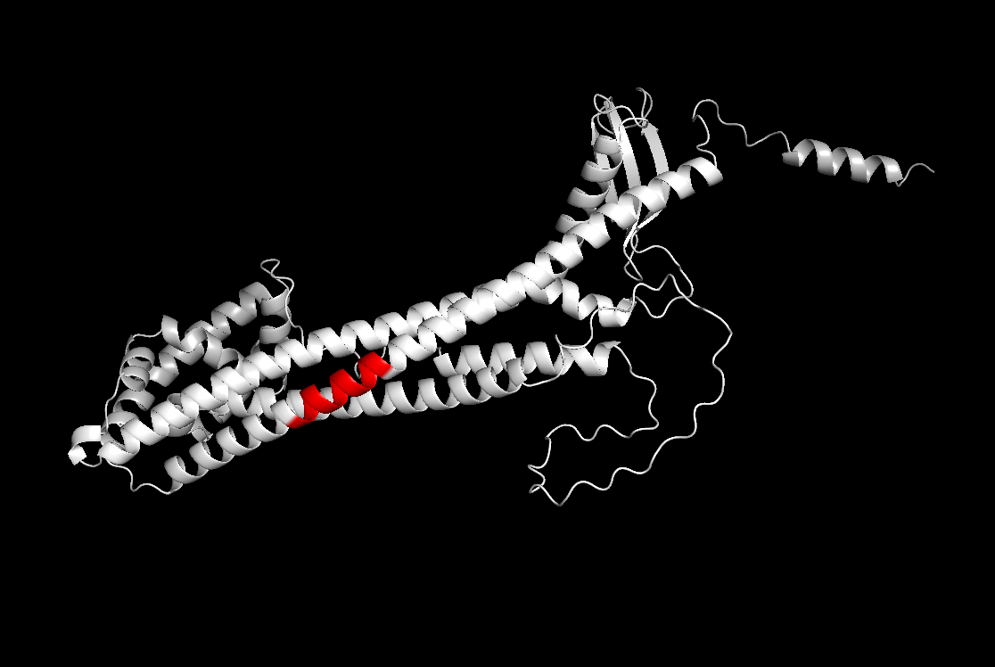
Discovering Biomarker Proteins and Peptides for Parkinson’s Disease with Machine Learning and Interpretability Methods
Center for Biosystems and Biotech Data Science, Ghent University Global Campus
Ho-min Park, Espoir Kabanga, Dongin Moon, Minjae Chung, Yujin Kim, Jiwon Im, Arnout Van Messem, and Wesley De Neve
Abstract
This study presents a machine learning pipeline for identifying candidate biomarker proteins and peptides from cerebrospinal fluid mass spectrometry tests in patients with Parkinson’s disease. Our pipeline comprises model training and candidate biomarker identification stages, with promising effectiveness in predicting Movement Disorder Society-Unified Parkinson's Disease Rating Scale scores and identifying 11 potential biomarkers. Our approach could aid in the development of new diagnostic tools and treatments for patients having Parkinson’s disease.
Overview
Cerebrospinal fluid
Mass spectrometry
Candidate biomarkers
MDS-UPDRS - 4 types of prognosis scores
(biannually and annually)
$$y= f\left(X,θ\right)$$
Three interpretability methods
https://mobile.hksh.com/en/physio-our-services/neurological-rehabilitation/parkinsons-disease
Machine learning
247 patients
Methods
EDA
Preprocessing
Feature selection
Training & evaluation
Calculate impact proteins / peptides
Evaluation
Regression problem
Skew transform,
scaling, imputation
Mutual information
5 models
Three interpretability methods
In-depth analysis of candidate biomarkers
Results
Discussion & Conclusion
* The 1st rank was taken by the treatment with levodopa, the most effective drug for symptomatic management of Parkinson's disease.
Our pipeline identified 2 proteins and 9 peptides as potential biomarkers for Parkinson's disease.
One of the selected proteins and eight of the selected peptides were associated with neuronal degeneration and Alzheimer's disease, and all were also associated with cancer.
Our pipeline outperformed four other approaches in predicting UPDRS scores, achieving the lowest Averaged-SMAPE.
Our mutual information-based feature selection strategy outperformed cases where all proteins, all peptides, or all features were used as inputs without selection.
Overall, our machine learning pipeline shows promise in identifying candidate biomarkers in Parkinson's patients using CSF-MS data.
Rank | Feature name | UniProt ID | Description | Identifier
2 | Q06481 | Q06481 | Amyloid beta precursor like protein 2 | 5JBT, 5TPT
3 | AVSEKEVDSGNDIYGNPIKR | P16035 | Metalloproteinase inhibitor 2 | 1BR9, 1GXD, 2TMP, 4ILW
4 | ISYGNDALMPSLTETK | P05067 | Amyloid-beta precursor protein | AF-P05067-F1
5 | P04433 | P04433 | Immunoglobulin kappa variable 3-11 | 3EYQ
6 | TPLGDTTHTCPR | P01860 | Immunoglobulin heavy constant gamma 3 | AF-P01860-F1
7 | NLQPASEYTVSLVAIKGNQESPK | P02751 | Fibronectin | 6MFA
8 | LQDLYSIVR | P39060 | Collagen alpha-1(XVIII) chain | AF-P39060-F1
9 | FSGTWYAMAK | P02753 | Retinol-binding protein 4 | 1BRP, 1BRQ, 1JYD, 1JYJ, 1RBP, + 7 more
10 | CFSGQCISK | P10643 | Complement component C7 | 6H03, 6H04, 7NYC, 7NYD
11 | LIADLGSTSITNLGFR | Q92520 | Protein FAM3C | AF-Q92520-F1
12 | TLLSNLEEAKK | P10909 | Clusterin | AF-P10909-F1
Q06481
NLQPASEYTVSLVAIKGNQESPK
TLLSNLEEAKK
Paper
(will be updated)
Code
(will be updated)
Biomarkers
Summary
Biomarkers
Detailed description
Contact: homin. park@ghent.ac.kr

