Slide 1





For an Understanding of Video Games Genres through the Discourse of Players
Surinx François-Xavier, FNRS-FRESH doctoral fellow

Slide 2
State of research
The majority of generic studies were on the producer side or press side or have observed games without taking into account historical or social considerations.
Video games reach a huge and diverse audience, with a massive online presence.
Video games are part of many community phenomena : participatory culture, fan cultures and folksonomy.
The authorship of video games is blurred, even abstract.

Slide 3
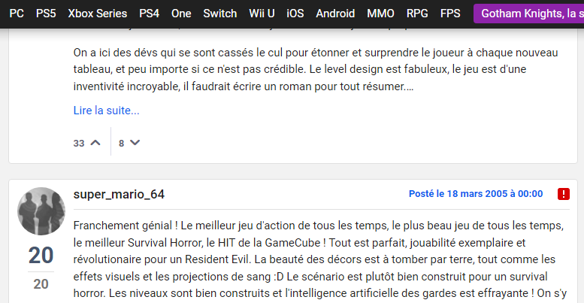
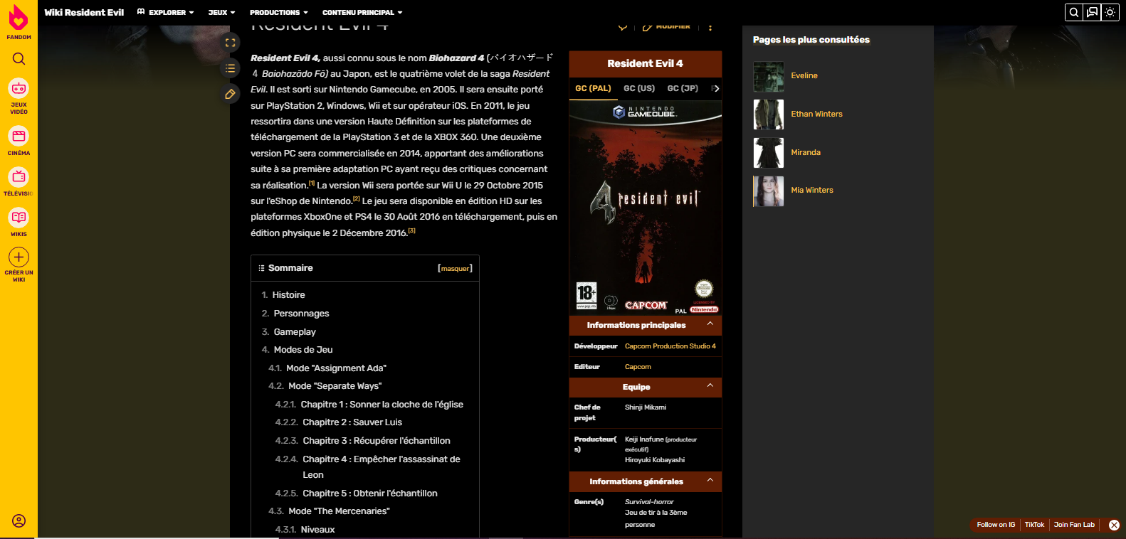

Corpus
I will analyse the discourse of players in five written formats available online :
Wikis
Forums
Tags
Posts
Game reviews

Slide 4



Corpus
Three games will serve as transversal discursive targets:
a generic paragon :
Wolfenstein 3D (id Software, 1992 [2012])
two games that are problematic from a generic point of view :
Resident Evil 4 (Capcom, 2005 [2021])
Portal (Valve, 2007 [2013])

Slide 5
Three parts of the analysis
Identification of generic labels and how they are expressed
Co-construction of points of view
Construction and authoritative effects of self-image (ethos)
Here is an example of a preliminary table that is unfortunately totally illegible, but I can go into more detail if you have any questions.

Slide 6
Identification of generic labels and how they are expressed

Slide 7
Co-construction of points of view

Slide 8
Construction and authoritative effects of self-image (ethos)

Slide 9

Two objectives
Rethinking the concept of genre in the light of the specific characteristics of the videogame medium
Helping the Bibliothèque nationale de France (BnF) to preserve and catalogue video games

Slide 10
Bibliography
Amossy, R. 2010. La Présentation de soi. Ethos et identité verbale. Paris, France: Presses universitaires de France.
Arsenault, D. 2011. Des typologies mécaniques à l’expérience esthétique. Fonctions et mutations du genre dans le jeu video. PhD Thesis. Université de Montréal.
Jenkins, H. 1992. Textual Poachers: Television Fans and Participatory Culture. London, England: Routledge.
Jenkins, H. 2006. Fans, Bloggers, and Gamers: Exploring Participatory Culture. New York, USA: New York University Press.
Le Guern, P. (ed.) 2002. Les cultes médiatiques. Culture fan et œuvres cultes. Rennes, France: Presses Universitaires de Rennes.
Letourneux, M. 2005. “La Question du genre dans les jeux video” In Le Game design de jeux vidéo. Approches de l’expression vidéoludique edited by S. Genvo, 39–54. Paris, France: L’Harmattan.
Maingueneau, D. 2015. “L’ethos discursif et le défi du Web” Itinéraires. Littérature, textes, cultures, 3, https://tinyurl.com/2p848c4x
Rabatel, A. 2005. “Les postures énonciatives dans la co-construction dialogique des points de vue : coénonciation, sur-énonciation, sous-énonciation” In Dialogisme et polyphonie. Approches linguistiques edited by J. Bres, 95–110. Bruxelles, Belgium: de Boeck.
Rabatel, A. 2012. “De l’intérêt des postures énonciatives de co-énonciation, sous-énonciation, surénonciation pour l’interprétation des textes (en classe)”. La Clé des langues. ENS de Lyon/DGESCO, https://tinyurl.com/43cysbu7

Slide 11

Thank you for your attention!

