Slide 1
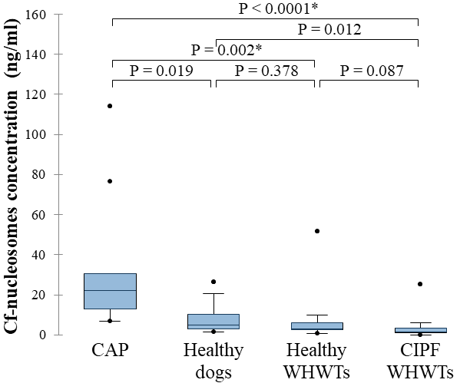
Investigation of serum circulating cell free nucleosomes as biomarker of canine idiopathic pulmonary fibrosis in West Highland white terriers
A. Fastrès¹, M. Herzog², D. Pamart², E. Roels ¹, C. Clercx¹
^{1.} Department of Clinical Sciences, FARAH, Faculty of Veterinary Medicine, University of Liège, Liège, Belgium
^{2.} Belgian Volition SRL, Namur, Belgium
Introduction
Canine idiopathic pulmonary fibrosis (CIPF) occurs in aged West Highland white terriers (WHWTs). The disease is characterized by profound fibrotic lung distortion leading to progressive respiratory impairment ¹. Cell-free nucleosomes (cf-nucleosomes), which contain DNA and histones (Figure 1), contribute to gene expression regulation and are released into the circulation from any damaged cells ². Accordingly, cf-nucleosomes have been shown increased in dogs with sepsis ^{3,4}, cancer ^{4,5}, immune-mediated haemolytic anaemia ^{6,7} and trauma ^{4,8} with both diagnostic and prognostic values. In human idiopathic pulmonary fibrosis (IPF), a disease similar to CIPF, a combination of circulating cf-nucleosomes with specific epigenetic features has been identified with a good diagnostic accuracy to discriminate IPF patients from healthy subjects ⁹.
Figure 1: Nucleosome structure consisting of a segment of DNA organized around eight histone proteins which are known as a histone octamer. Each histone octamer is composed of two copies of histone proteins of H2A, H2B, H3, and H4 (©Biorender.com).
In this study, we aimed to determine whether the amount of cf-nucleosomes in blood can be used as a non-invasive diagnostic biomarker for CIPF in WHWTs.
Material & methods
Serum cf-nucleosomes were measured in 12 WHWTs affected with CIPF and compared with 10 healthy age-matched WHWTs, 9 healthy age-matched dogs from other breeds and 9 dogs affected with community acquired bacterial pneumonia (CAP). ELISA kits (Nu.Q®) validated for dogs were used to measure cf-nucleosomes concentrations. Kruskal Wallis test with pairwise post-hoc Conover-Iman tests and Bonferroni correction for multiple comparisons were used to compare cf-nucleosomes concentrations between groups.
Results
Cf-nucleosomes concentration (Figure 2) was significantly increased in dogs affected with CAP (22.06ng/mL (12.79-30.56)) in comparison with WHWTs affected with CIPF (1.53ng/mL (0.94-3.33); P<0.0001) and healthy WHWTs (3.12ng/mL (2.42-6.16); P=0.002). Cf-nucleosomes concentration was also higher in dogs affected with CAP in comparison with healthy dogs from other breeds although it was not significant because of 2 outliers (4.88ng/mL (2.98-10.41); P=0.019). There was no difference between WHWTs affected with CIPF and healthy dogs of the same breed (P=0.087) or different breeds (P=0.012).
Conclusion
Results of this study did not support the use of circulating cf-nucleosomes for the non-invasive diagnosis of CIPF in WHWTs. However, increased circulating cf-nucleosomes concentration was found in dogs affected with CAP, probably because of a higher rate of cell injury induced by the acute inflammation that occurs in such disease. Whether measurement of circulating cf-nucleosome can help discriminate CAP from other acute respiratory diseases and serve as monitoring tool for medical therapy requires further studies.
Figure 2: Box plot graph representing serum Cf-nucleosomes concentration between the different groups: dogs affected with community acquired bacterial pneumonia (CAP), healthy dogs, healthy West Highland white terriers (healthy WHWTs) and WHWTs affected with canine idiopathic pulmonary fibrosis (CIPF WHWTs). The medians are represented by the central horizontal bars. The lower and upper limits of the box are the first and third quartiles, respectively. Points are considered as outliers. *statistically different (p ≤ 0. 05).
References
1. Clercx C, Fastrès A, Roels E. Idiopathic pulmonary fibrosis in West Highland white terriers: An update. Vet J. 2018;242:53–8.
2. Holdenrieder S, Stieber P, Holdenrieder S, Stieber P. Clinical use of circulating nucleosomes. Crit Rev Clin Lab Sci. 2009;46(1):1–24.
3. Letendre J-A, Goggs R. Determining prognosis in canine sepsis by bedside measurement of cell-free DNA and nucleosomes. J Vet Emerg Crit Care. 2018;28(6):503–11.
4. Letendre JA, Goggs R. Measurement of plasma cell-free DNA concentrations in dogs with sepsis, trauma, and neoplasia. J Vet Emerg Crit Care. 2017;27(3):307–14.
5. Dolan C, Miller T, Jill J, Terrell J, Kelly TK, Bygott T, et al. Characterizing circulating nucleosomes in the plasma of dogs with lymphoma. BMC Vet Res. 2021;17:276.
6. Lawson C, Smith SA, Brien MO, Mcmichael M. Neutrophil Extracellular Traps in Plasma from Dogs with Immunemediated Hemolytic Anemia. J Vet Intern Med. 2018;32:128–34.
7. Ruterbories L, Hanel R, Levine DN. Cell-Free DNA and DNase Activity in Dogs with Immune-Mediated Hemolytic Anemia. J Vet Intern Med. 2017;31:1441–50.
8. Letendre J-A, Goggs R. Concentrations of Plasma Nucleosomes but Not Cell-Free DNA Are Prognostic in Dogs Following Trauma. Front Vet Sci. 2018;5:180.
9. Guiot J, Struman I, Chavez V, Henket M, Herzog M, Scoubeau K, et al. Altered epigenetic features in circulating nucleosomes in idiopathic pulmonary fibrosis. Clin Epigenetics. 2017;9:84.

