Slide 1
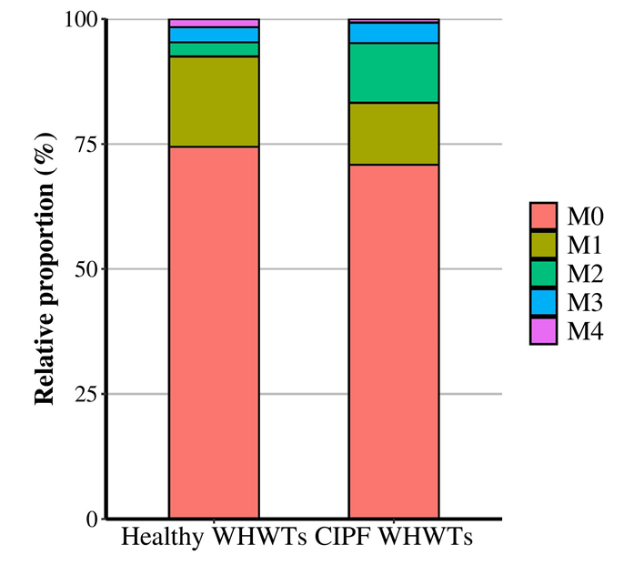
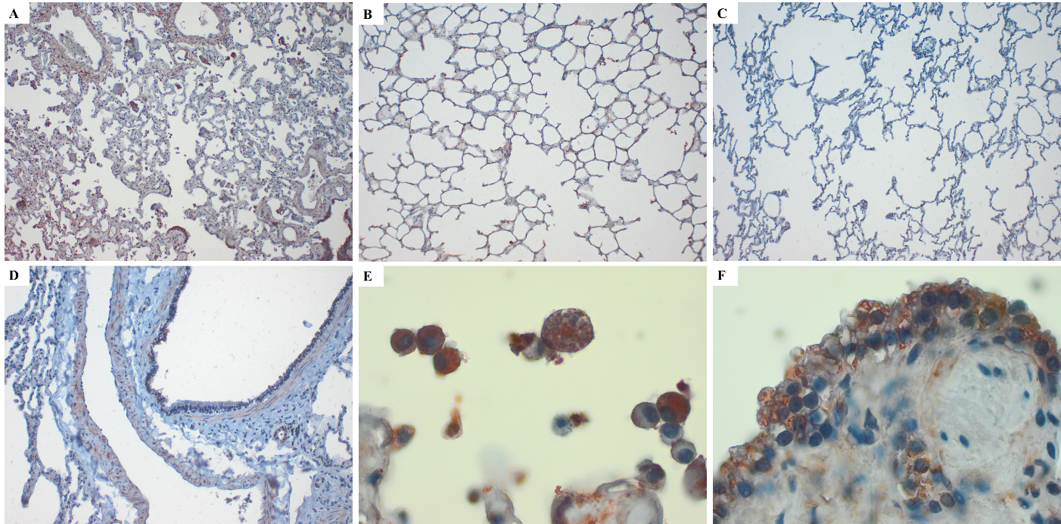
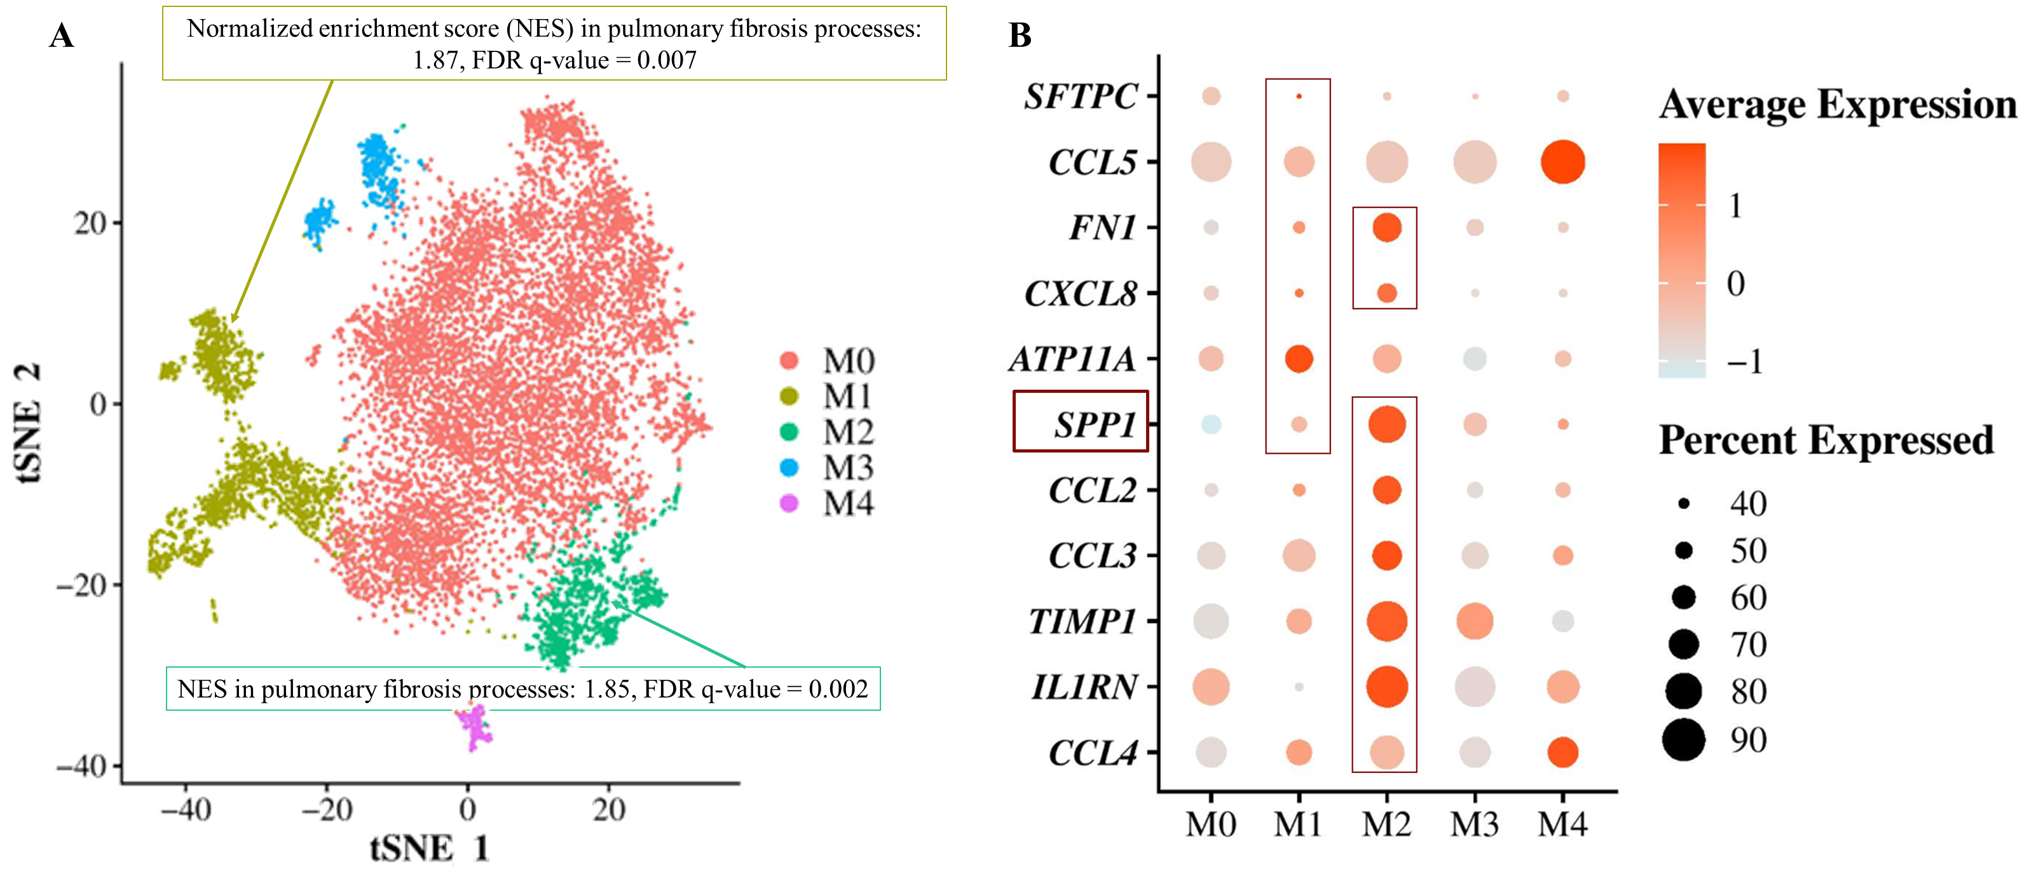
Osteopontin-expressing macrophages in dogs affected with canine idiopathic pulmonary fibrosis, a model for human idiopathic pulmonary fibrosis
Fastrès A.¹, Roels E.¹, Pirottin D.^{2,†}, Fievez L.², Tutunaru A.C.¹, Bolen G.¹, Merveille A.C.¹, Marichal T.², Desmet J.C.², Antoine N.³, Bureau F.² and Clercx C.¹
1. Department of Clinical Sciences, FARAH, Faculty of Veterinary Medicine, ULiège, Liège, Belgium
2. Department of GIGA-Inflammation, Infection & Immunity, GIGA, CHU, ULiège, Liège, Belgium
3. Department of morphology and pathology, Histology, FARAH, Uliège, Liege, Belgium
Introduction
Canine idiopathic pulmonary fibrosis (CIPF) affects West Highland white terriers (WHWTs) and mimics idiopathic pulmonary fibrosis. In this study, single cell RNA-sequencing (scRNA-seq) was used to compare transcriptomic expression of broncho-alveolar lavage fluid (BALF) macrophages sampled from CIPF and healthy WHWTs. Osteopontin (SPP1) transcript, encoding a glycoprotein associated with fibrosis in human, was further analysed at the protein level by immunohistochemistry in lung tissue and ELISA in BALF and serum from CIPF WHWTs, healthy WHWTs and healthy terriers other than WHWTs.
Results
Two macrophages clusters enriched in profibrotic genes including SPP1 were identified by scRNA-seq (Figure 1): one in a larger proportion of CIPF (13.5±4.7%) compared with healthy WHWTs (2.9±0.2%, P-value = 0.009) (Figure 2); one enriched in pro-fibrotic transcripts in CIPF compared with healthy WHWTs (normalized enrichment score in pulmonary fibrosis processes of 2.01, FDR q-value = 0.008). SPP1 immunolabelling was found in all dogs in ciliated cells, smooth muscular cells and macrophages (Figure 3). In CIPF WHWTs, pneumocytes II and lung interstitium were also labelled, while it was the case in half of healthy WHWTs and absent in terriers (Figure 3). SPP1 serum concentration was higher in CIPF (2.15ng/mL [0.87-5.13]) compared with healthy WHWTs (0.63ng/mL [0.41-1.63]) and terriers (0.31ng/mL [0.19-0.51]), and in healthy WHWTs compared with terriers (Figure 4). Higher SPP1 BALF level was found in CIPF (0.34ng/mL [0.15-0.52]) and healthy WHWTs (0.25ng/mL [0.14-0.40]) compared with terriers (0.02ng/mL [0.01-0.08]) (Figure 4).
*
Figure 2. Cell proportions in macrophage clusters. Bar plot showing the relative proportion of cells in each macrophage cluster between groups (healthy West Highland white terriers (WHWTs; n = 3) and WHWTs affected with canine idiopathic pulmonary fibrosis (CIPF; n = 5)). *Statistically different between groups (P ≤ 0.05).
Figure 3. Immunohistochemical labelling of lung tissue sections for SPP1. (A-C) SPP1 immunoreactivity of lung interstitium in a West Highland white terrier (WHWT) affected with canine idiopathic pulmonary fibrosis (CIPF), a healthy WHWT and a healthy terrier, respectively. Magnification 10x. (D) SPP1 immunoreactivity of ciliated epithelial cells and smooth muscular cells in a healthy WHWT. Magnification 20x. (E) SPP1 immunoreactivity of macrophages in a WHWT affected with CIPF. Magnification 100x. (F) SPP1 immunoreactivity of pneumocytes II in a WHWT affected with CIPF. Magnification 100x.
Figure 1: Macrophages clusters enriched in profibrotic genes. Cells identified as macrophages after the annotation of scRNA-seq data obtained from 3 healthy West Highland white terriers (WHWTs) and 5 WHWTs affected with canine idiopathic pulmonary fibrosis (CIPF) were selected and then clustered allowing the identification of 5 distinct clusters. (A) Clusters identified. Cells were visualized using a t-distributed stochastic neighbor embedding (t-SNE) plot. Gene set enrichment analyses between Comparative Toxicogenomics Database Pulmonary Fibrosis gene set and differentially expressed genes between macrophage clusters showed that clusters M1 and M2 were enriched in profibrotic processes. (B) Dot plot showing the expression of genes involved in pulmonary fibrosis processes found to be upregulated in cluster M1 and M2 compared to others. Dot size represents the percentage of cells expressing the genes, while the dot color represents the average expression of the indicated genes.
Figure 4. Osteopontin serum and bronchoalveolar lavage fluid concentration. Box plot showing osteopontin (SPP1) serum and bronchoalveolar lavage fluid (BALF) concentrations in ng/mL obtained from healthy terriers (n = 15) from other breeds than West Highland white terriers (WHWTs), healthy WHWTs (n = 13) and WHWTs affected with canine idiopathic pulmonary fibrosis (CIPF) (n = 24). The box represents the interquartile range, with the median indicated by the horizontal line. The black points represent outliers. Asterisks indicate statistically significant results (P ≤ 0.05).
Conclusion
Our results support that profibrotic macrophage clusters contribute to CIPF pathogenesis. The overexpression of SPP1 by macrophages but also by other lung cells might trigger increased SPP1 concentrations in BALF and serum, making SPP1 a possible biomarker for CIPF.

