Slide 1
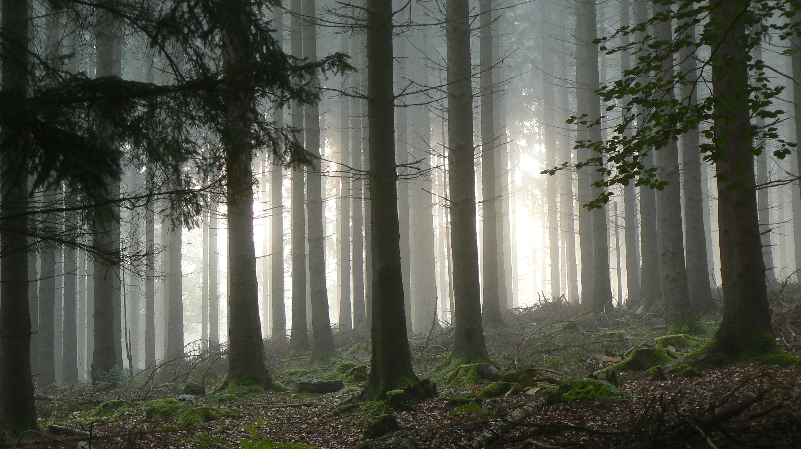
From the simulation of forest plantation dynamics to the quantification of bark-stripping damage by ungulates
Gauthier Ligot, Thibaut Gheysen, Jérôme Perin, Romain Candaele, François de Coligny, Alain Licoppe, Philippe Lejeune
FOREM 2023
Grenoble
Notes:
Sujet de recherche périphérique depuis longtemps

Slide 2
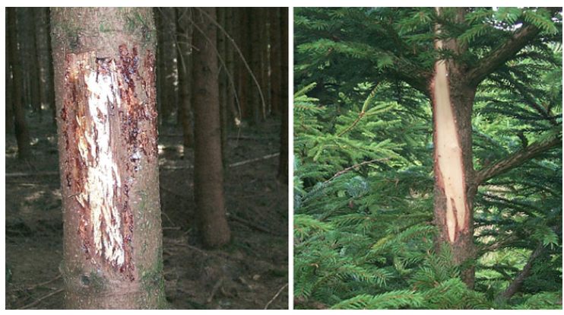
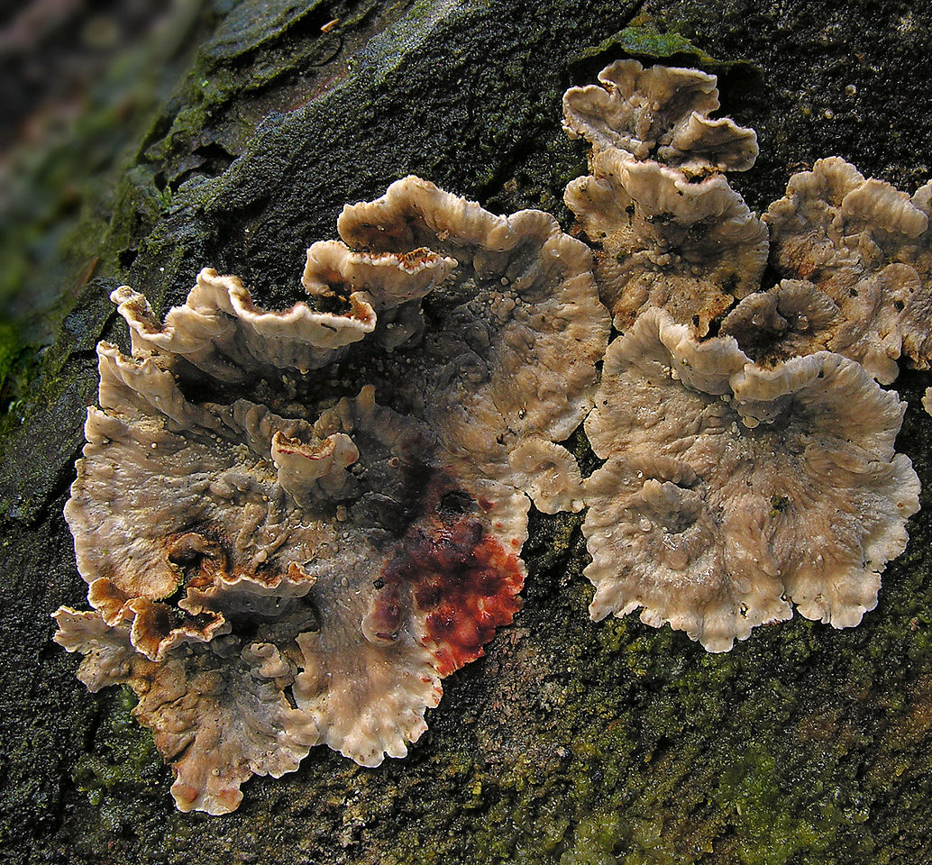
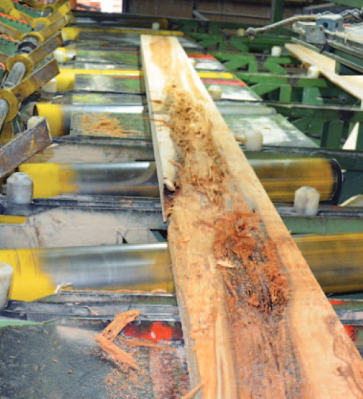
Bark-stripping damage
Excessive ungulate densities induce different damage
Including bark-stripping damage
Wounded tissues often get infected (Stereum sanguinolentum)
Rot might develop in the stems
Particularly for Norway spruce
Timber production losses

Slide 3
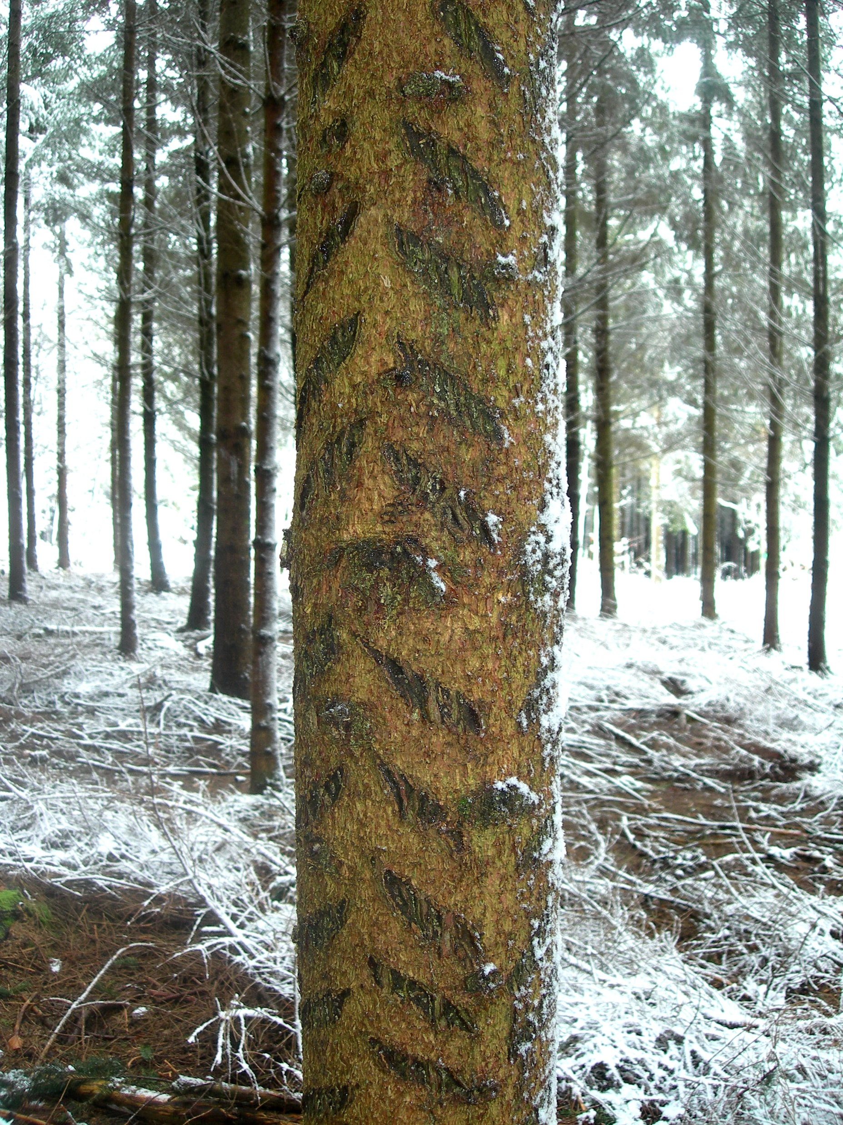
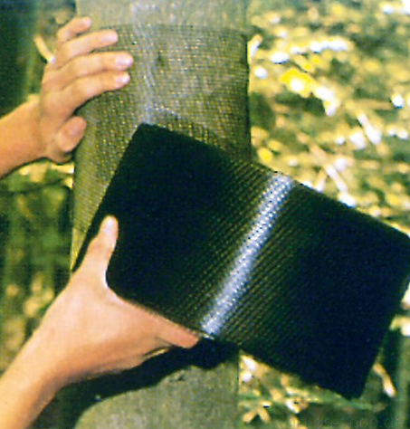
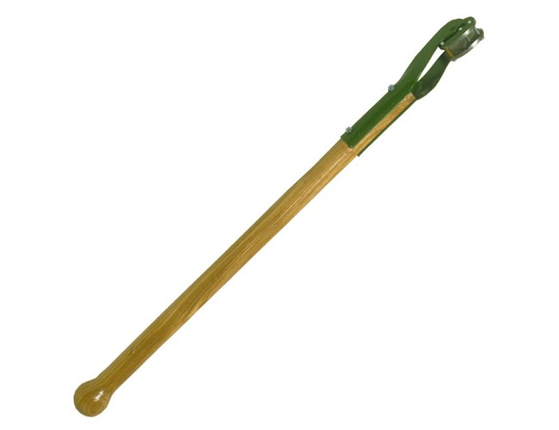
Protections against bark-stripping damage
Plastic sleeves
Gerstner plane
Fence
Notes:
Parler des éclaircie

Slide 4
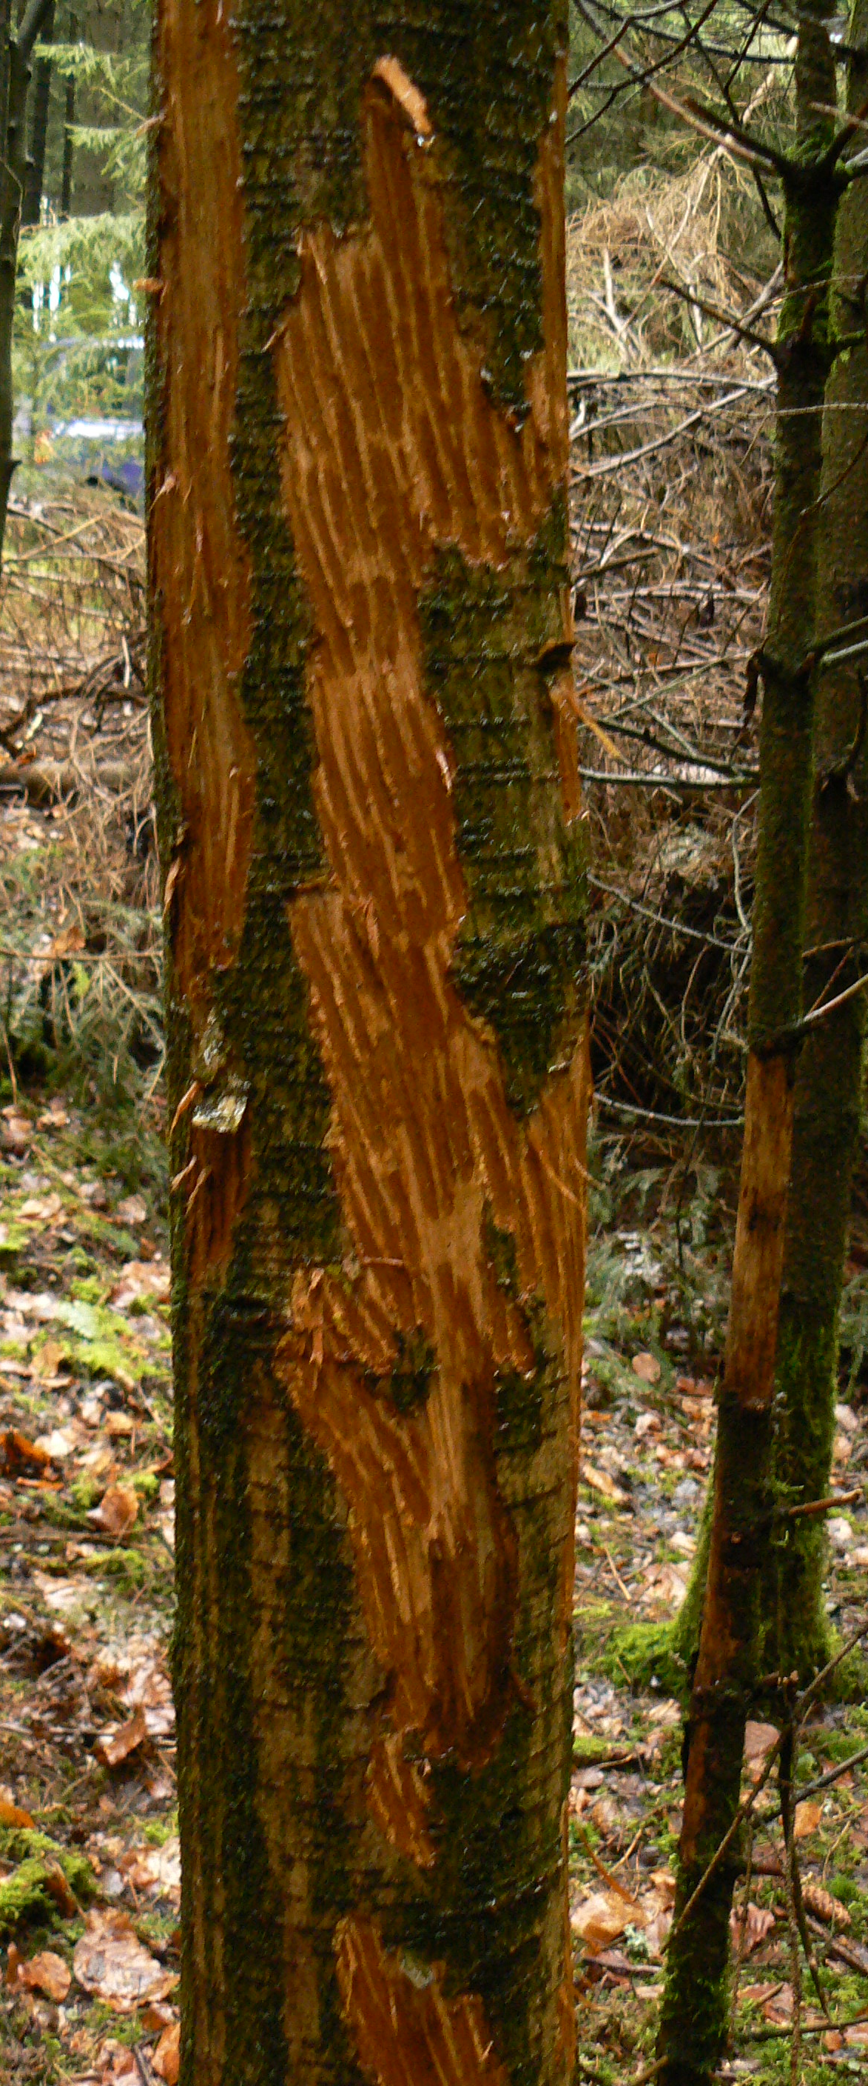
Research objectives
Model stand dynamics and bark-stripping damage
Virtual experiment
Assess the financial losses due to bark-stripping damages
Should rotation be shortened in highly impacted stands?
Is it cost-effective to protect the plantations with fences or individual protections?

Slide 5
Study area
Mostly in Ardenne
20 – 700 m a.s.l.
7.5 – 10.5 °C
800 – 1400 mm/year
Norway spruce plantation =
26% of forest area (92% in Ardenne)
50% of the timber production in Wallonia
Red deer : 0 - 16.5 deer/km² 0 - 6.7 shot deer/year/km²

Slide 6
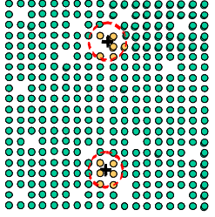
Bark-stripping inventory
Start of the permanent monitoring of bark-stripping damage in Wallonia
2004
2005
2010
2015
2020
Research timeline
P. Lejeune, H. Rotheudt, V. Verrue

Slide 7
Bark-stripping inventory
200 x 200 sampling grid
Random selection of grid nodes
Stands 8-36 years old
3 circular subplots / node
Measurements of the 6 closest trees
Dbh, bark-stripping damage, …

Slide 8
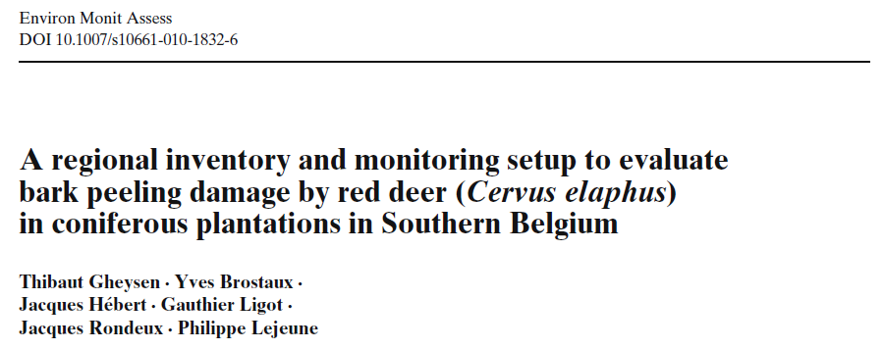
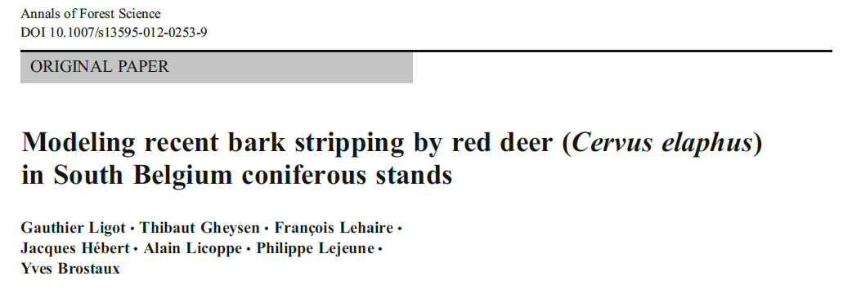
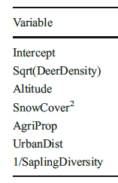
The factors driving bark-stripping damage
Characteristics of bark-stripping damage
Simulator of stand dynamics
2005
2010
2015
2020
Thibaut Gheysen
2010
2012
Damage dimensions
Bark-stripping rate variability
Bark-stripping rate in response to environmental factors
Notes:
Expliquer la notion de taux annuel de dégâts frais

Slide 9
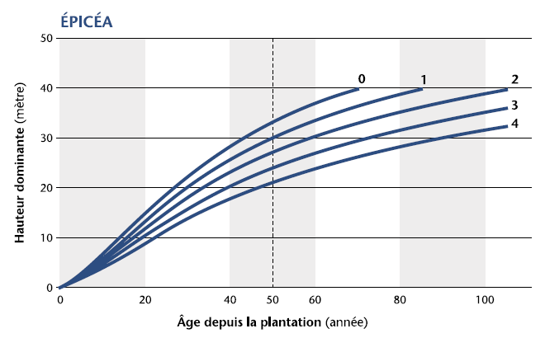
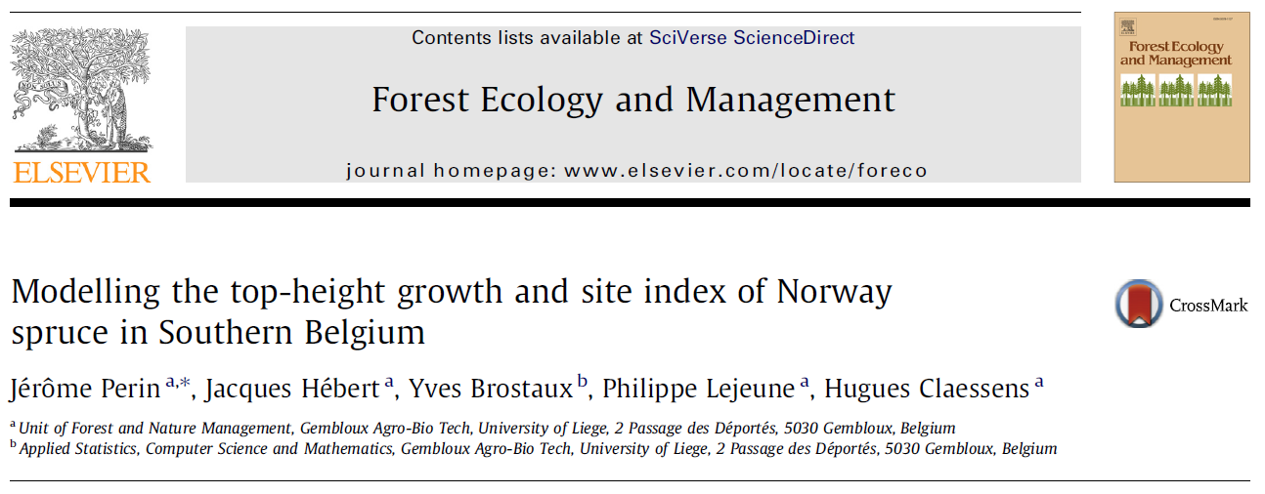
Top-height growth
Modelling top-height growth (Spruce, Douglas-fir, larch)
2005
2010
2015
2020
Jérôme Perin
Top height (m)
19.9 m³/ha/year
11 m³/ha/year
2013
Stand age (years)
Notes:
Expliquer la notion de site index, de hauteur dominante à 50 ans

Slide 10
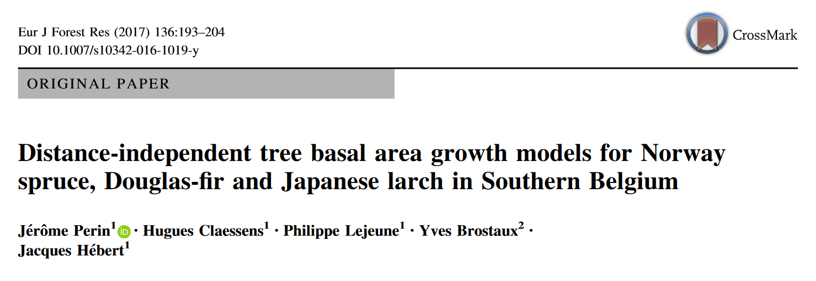
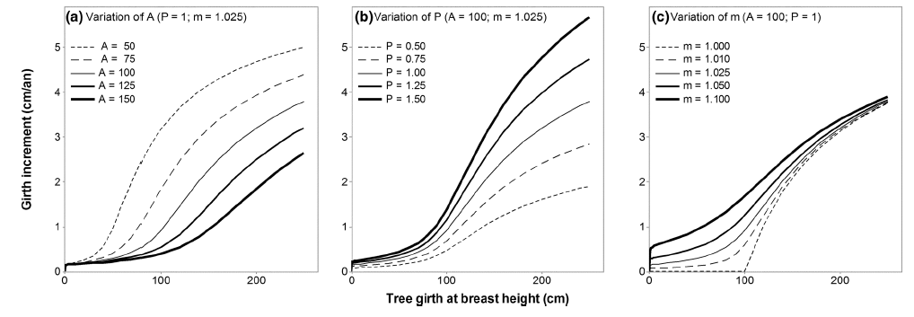
Tree growth
Modelling tree growth
2005
2010
2015
2020
Jérôme Perin
2017
Tree basal area increment
= f(top height, basal area, dbh)

Slide 11
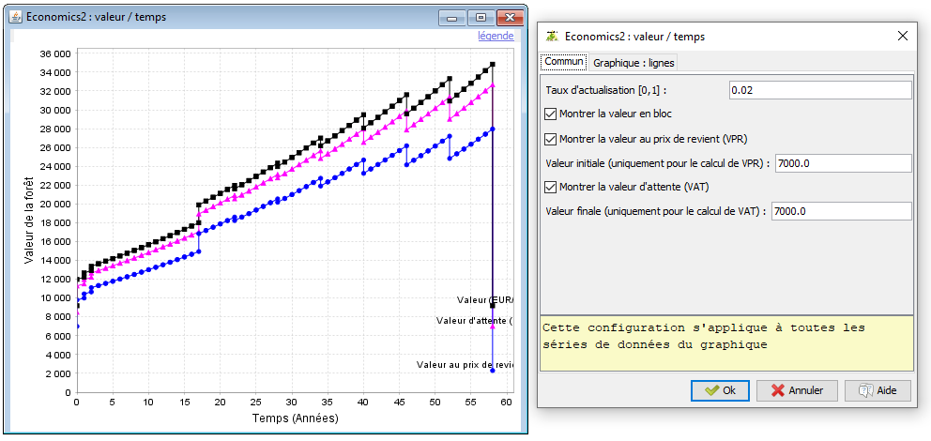
Stand dynamics model
DouglasModel
GYMNOS
ECONOMICS2
2005
2010
2015
2020
Gauthier Ligot, Jérome Perin, Samuel Quevauvillers
Notes:
Douglas model a été présenté en 2011 à Avignon

Slide 12
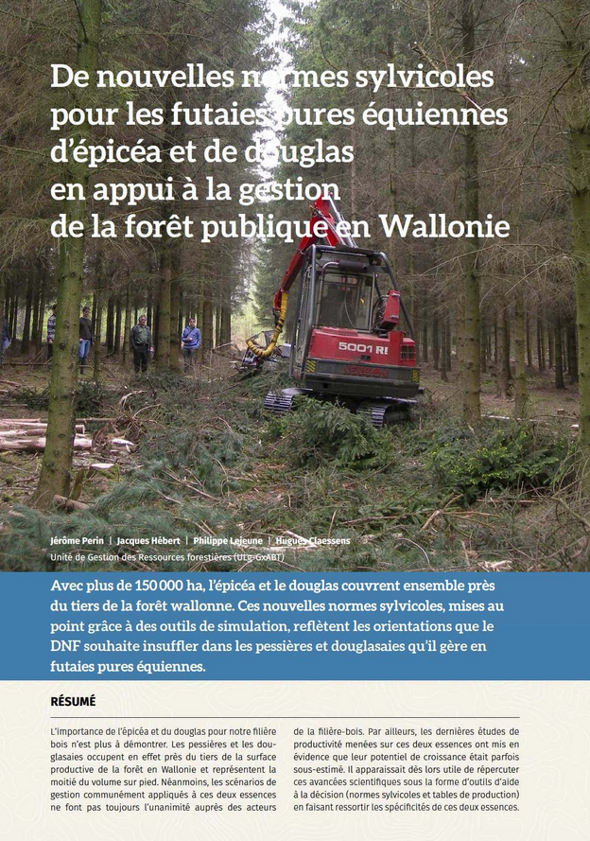
Stand dynamics model
Distance-independant tree model
Even-aged stands of Norway spruce, douglas fir, larch
Yield tables

Slide 13
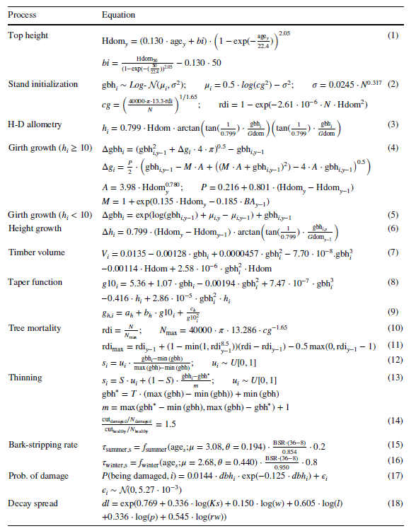
Stand dynamics model

Slide 14
Stand dynamics model
Top height (m)
19.9 m³/ha/year
11 m³/ha/year
Stand age (years)

Slide 15
Stand dynamics model

Slide 16
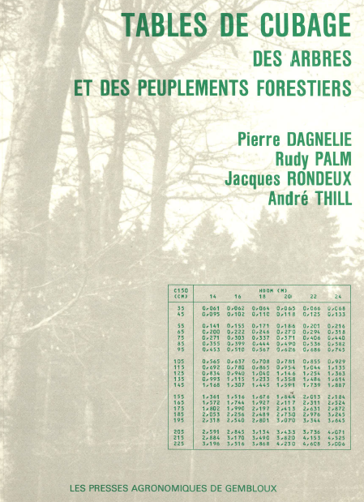
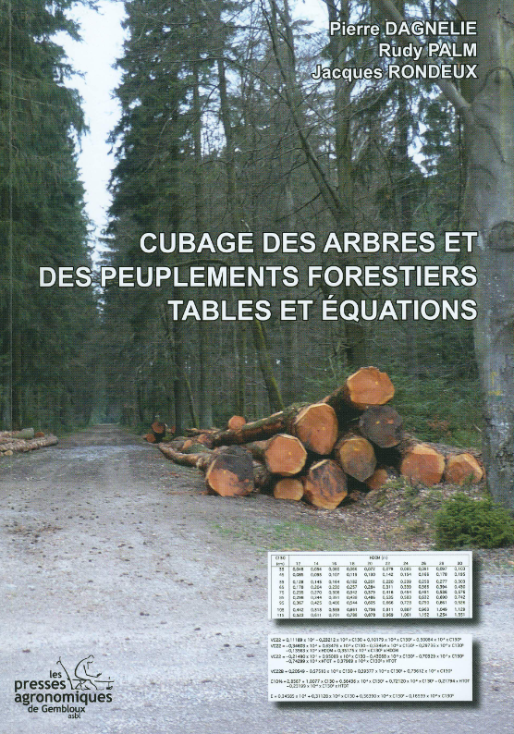
Stand dynamics model
Relations allométriques
1985
2013

Slide 17
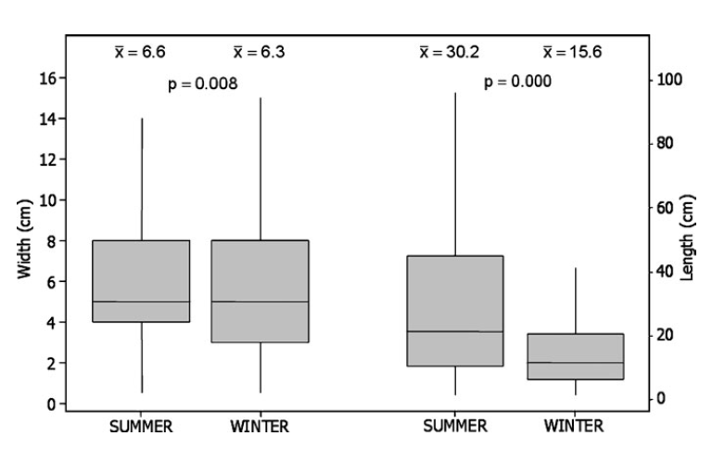
Bark-stripping models
95% of the damage occurs on 8-36 year-old tree
Winter damage
80%
Summer damage
20%
Max. in 21-year-old plantations
Max. in 12-year-old plantations

Slide 18
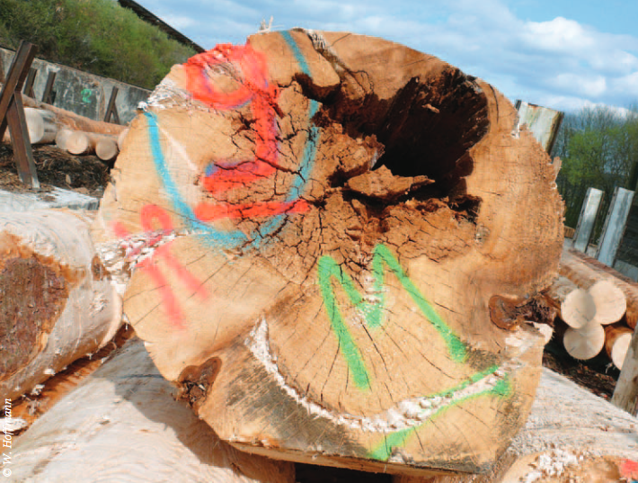
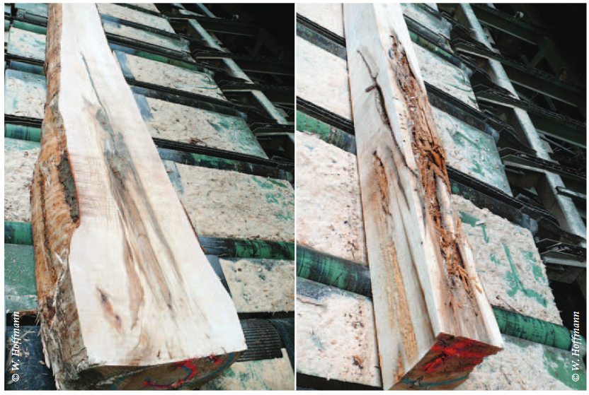
Bark-stripping models
Löffler 1975
Decay spread = f(wound dimensions, growth rate, time elapsed since damage, social status)
Decay column reaches < 3 m in most cases (rarely up to 4 m)

Slide 19
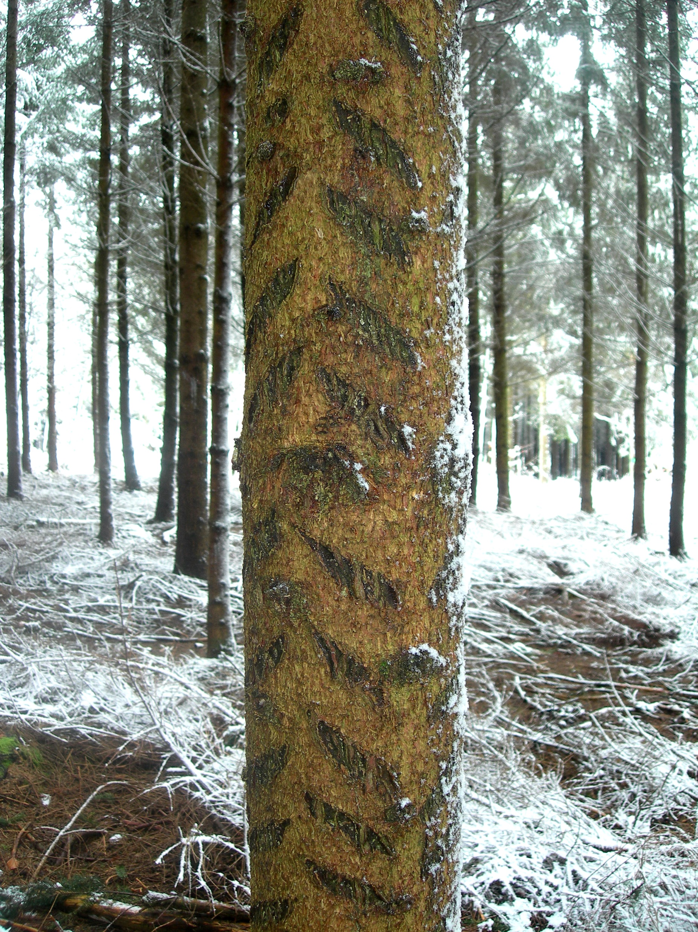
Simulation plan
11 values of annual bark-stripping rates from 0 to 10%
5 site indexes : 21, 24, 27, 30, 33 m
Thinnings as defined in the yield tables
4 protective treatments
No protection
Bark-scrapping 400 crop trees/ha
Bark-scrapping all trees
Fencing
5 répétitions
→ 1,100 simulations

Slide 20
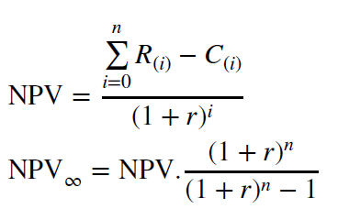
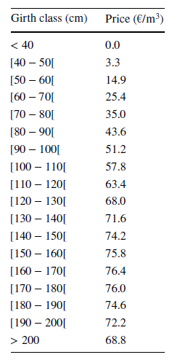
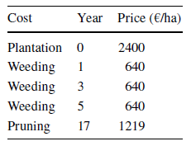
Financial assessment
Timber price
estimated from 499 public sales in 2021 (0.4 Mm³).
Decayed timber : 5 €/m³
Costs
Market price list of FNEF (2022)
Fence = 6000 €/ha
Net present value
Optimum rotation length (max. 100 years)
r = 1%, 2%, 3%, 4%
Notes:
5€ pour le bois avec de la pourriture

Slide 21
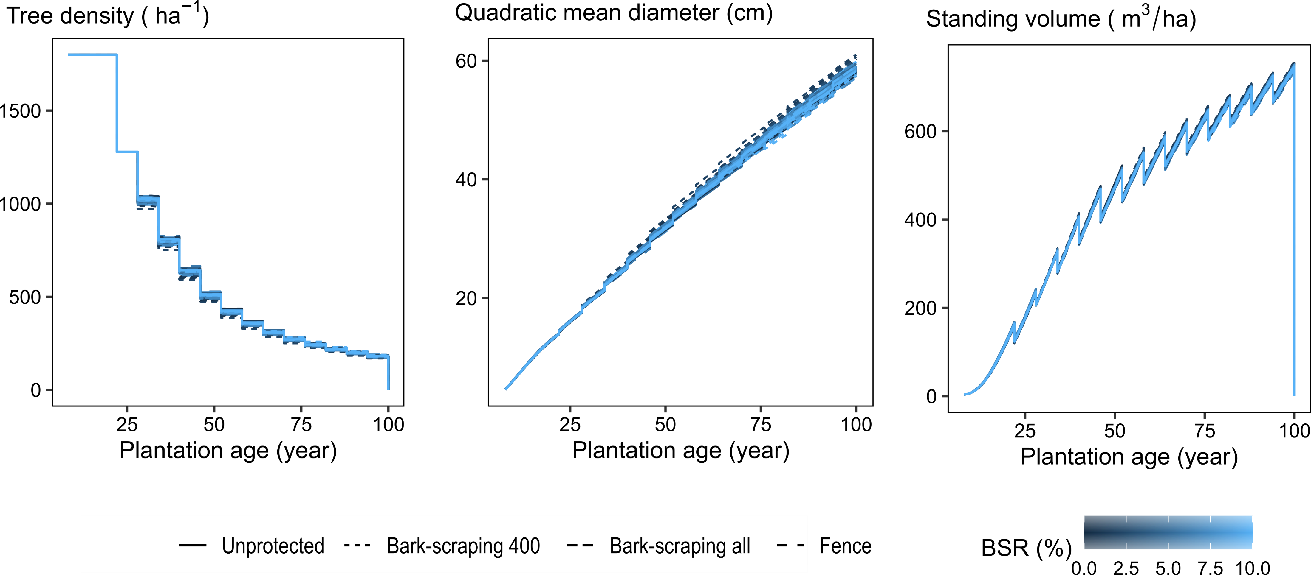
Stand characteristics over time
Site index = 27 m
Notes:
First thinning at 20 years
Regular thinnings
Optimum rotation

Slide 22
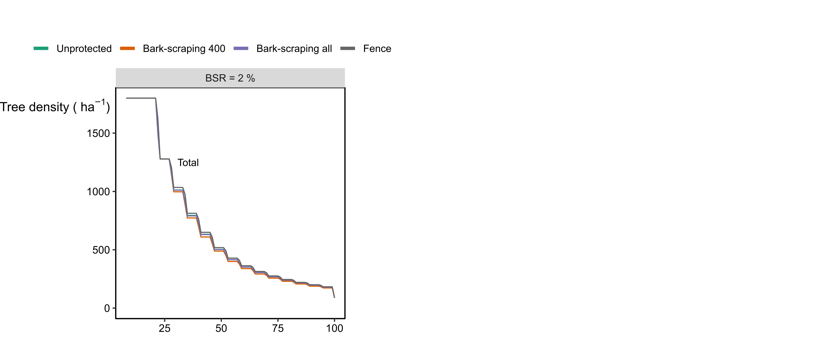
Damage instances over time
Site index = 27 m
Notes:
Thinning did reduce the density of damaged trees
But with BSR = 10 % -> all trees are damaged with individual protection that are set at the first thinning

Slide 23
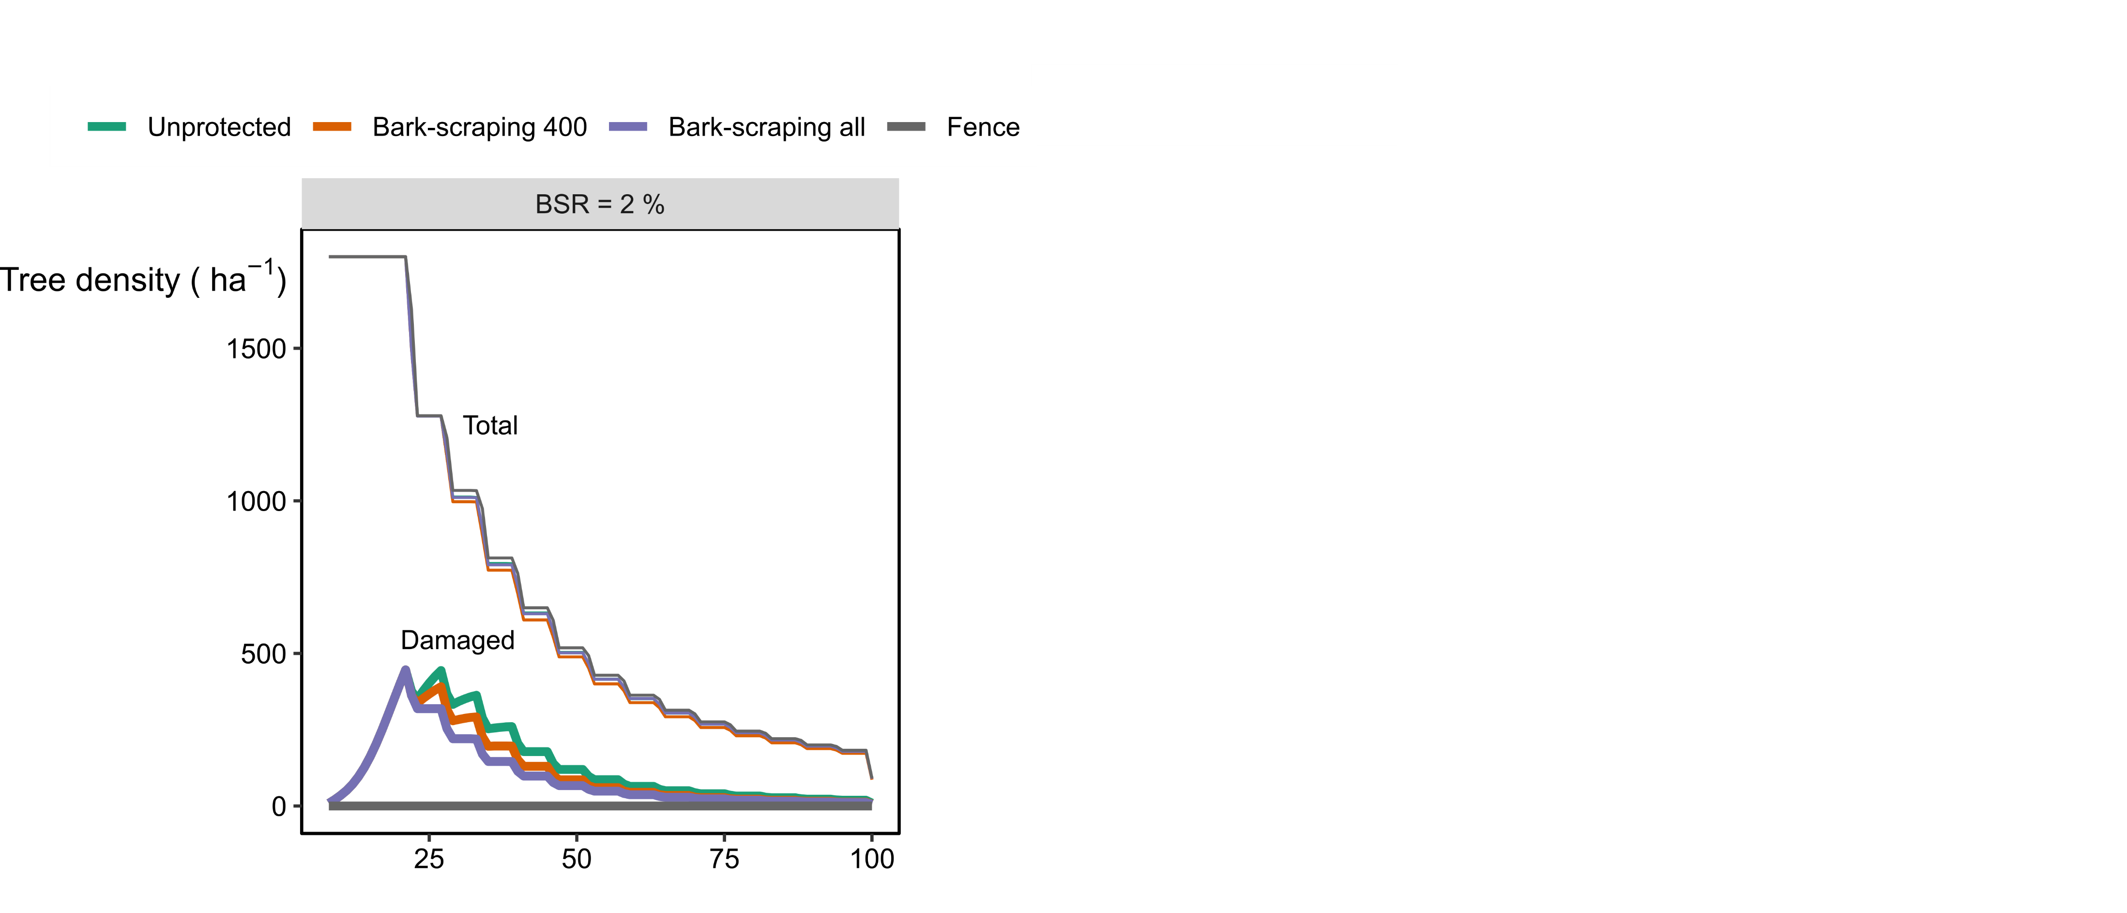
Damage instances over time
Site index = 27 m
Notes:
Thinning did reduce the density of damaged trees
But with BSR = 10 % -> all trees are damaged with individual protection that are set at the first thinning

Slide 24
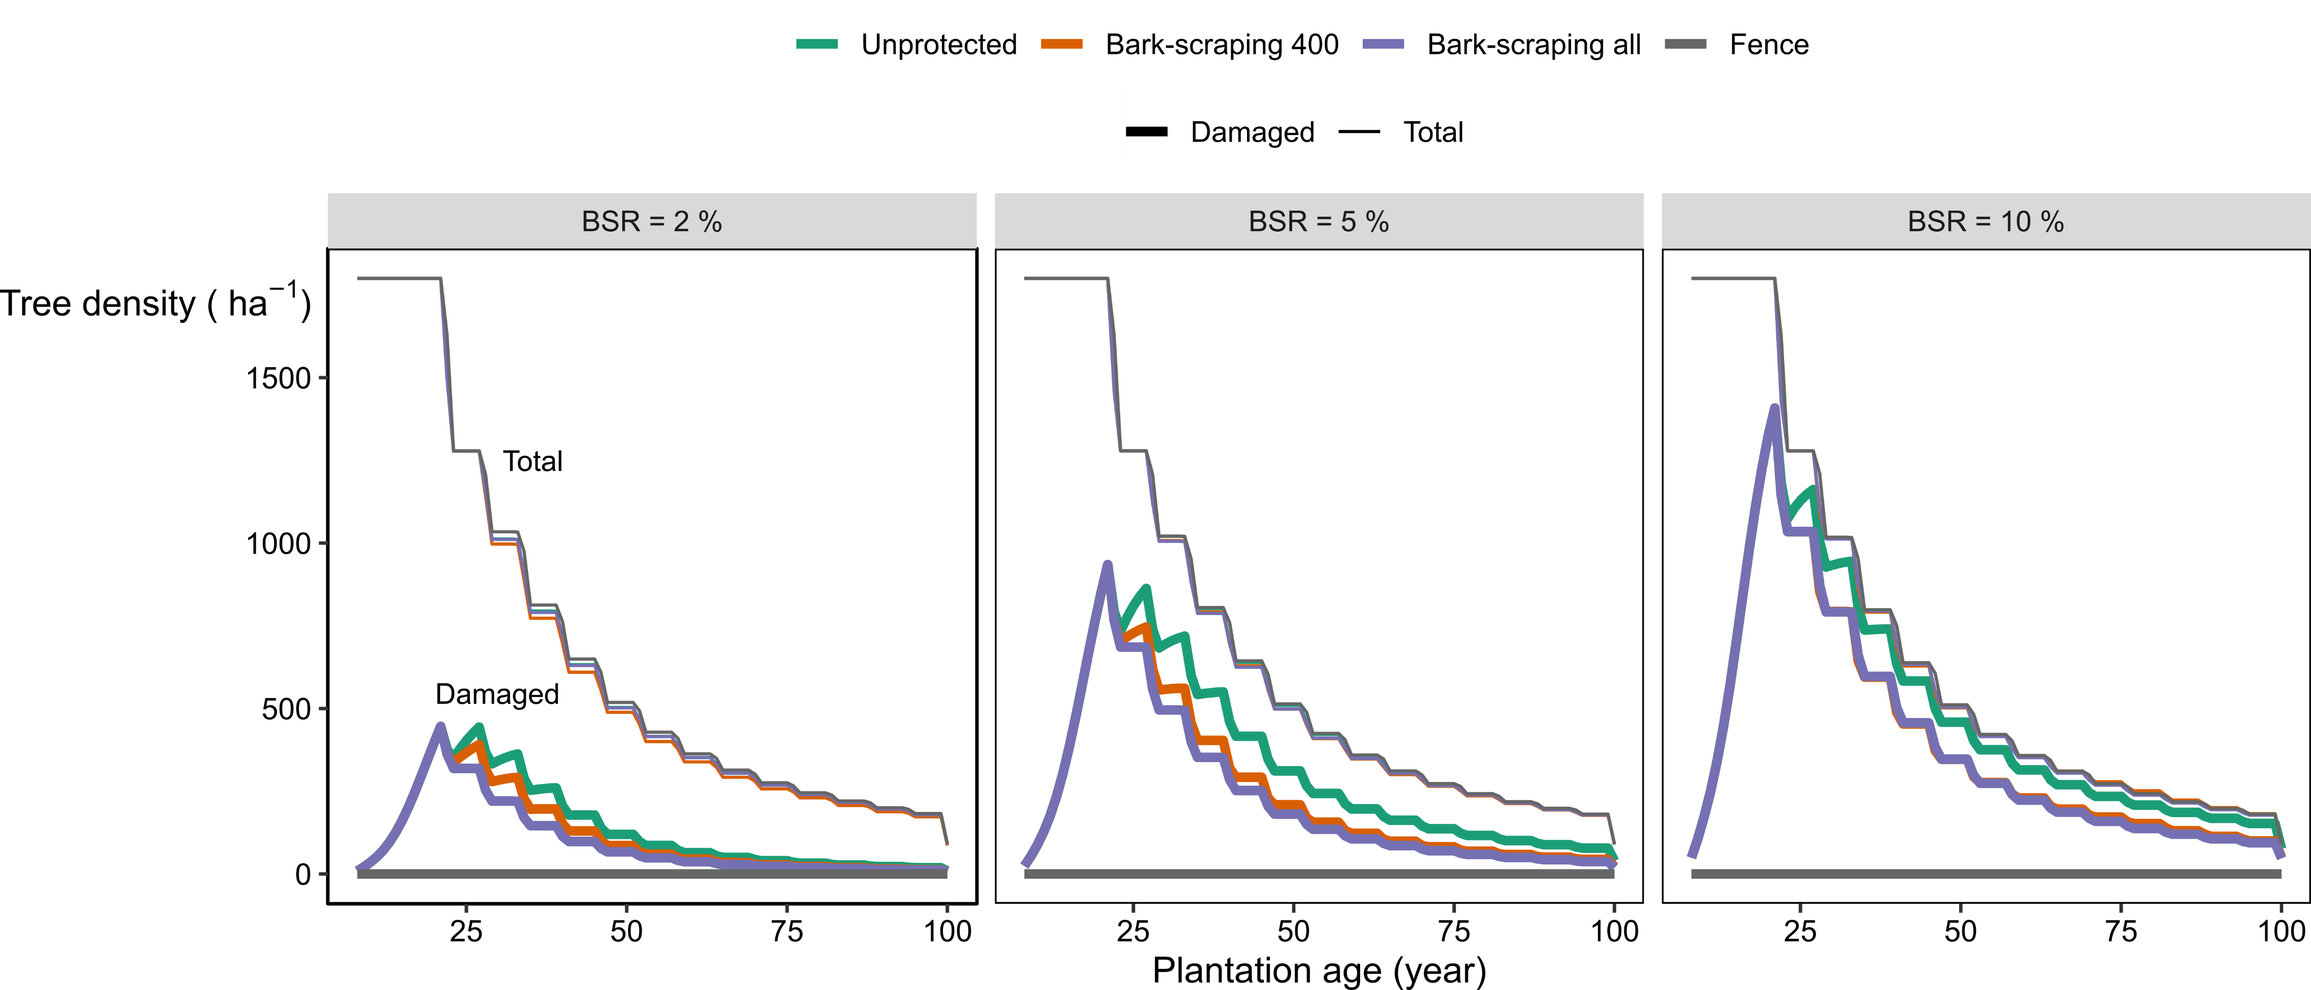
Damage instances over time
< 85% of damaged stems without protection
< 70% with protections
< 15-20 % of timber volume at clear-cut
Site index = 27 m
Notes:
Thinning did reduce the density of damaged trees
But with BSR = 10 % -> all trees are damaged with individual protection that are set at the first thinning

Slide 25
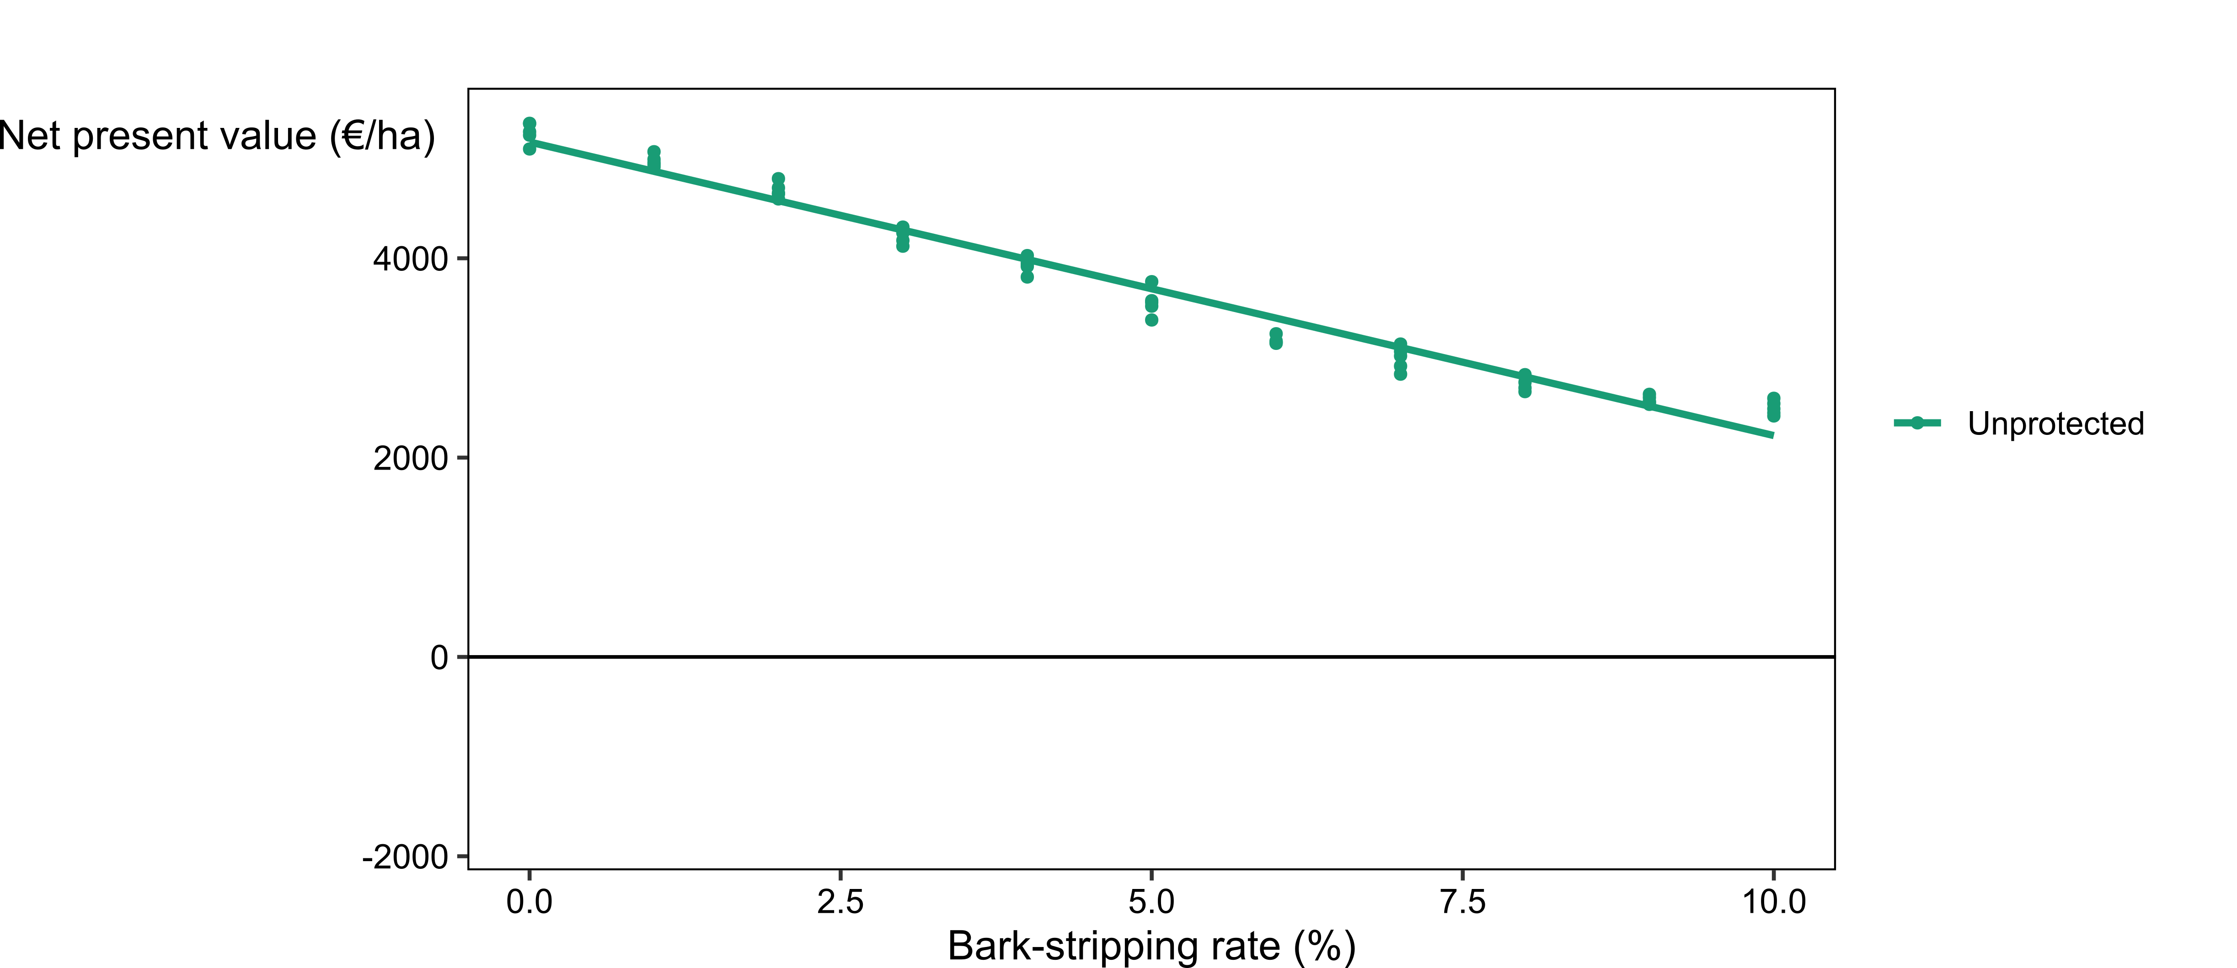
Net present value
Site index = 27 m and r = 3%

Slide 26
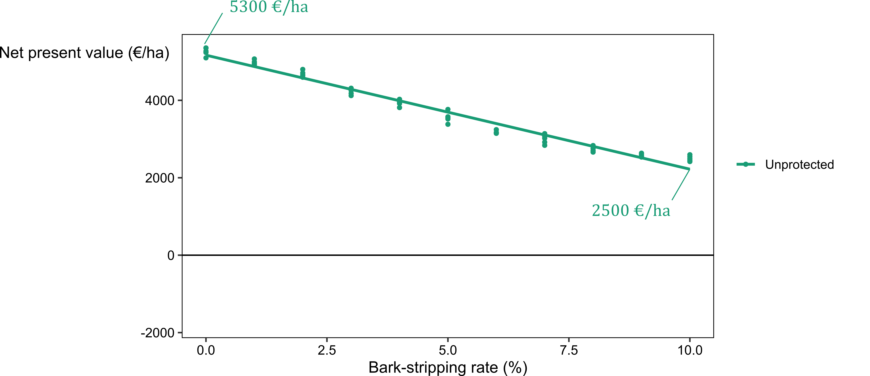
Net present value
Site index = 27 m and r = 3%

Slide 27
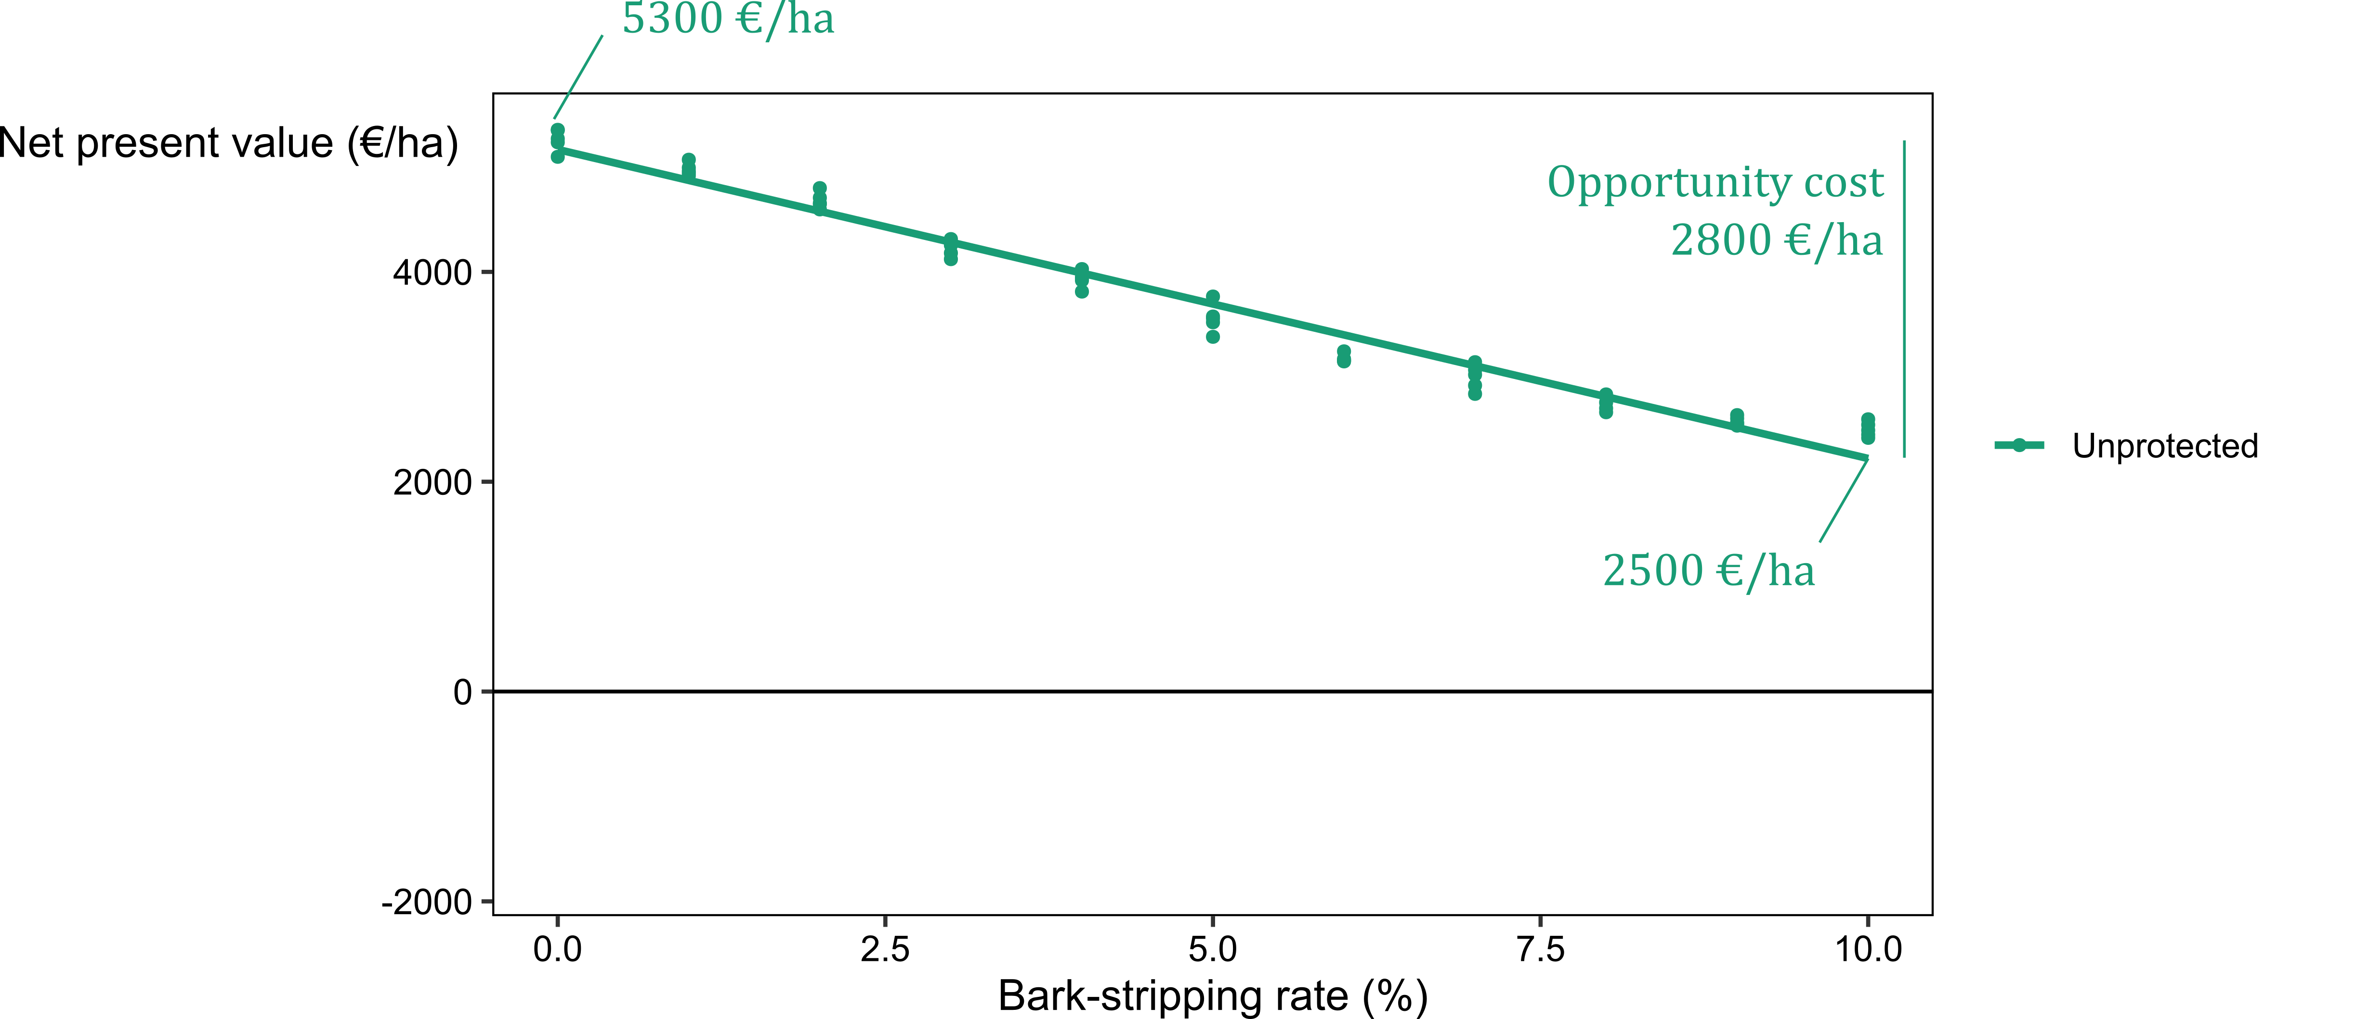
Net present value
Site index = 27 m and r = 3%

Slide 28
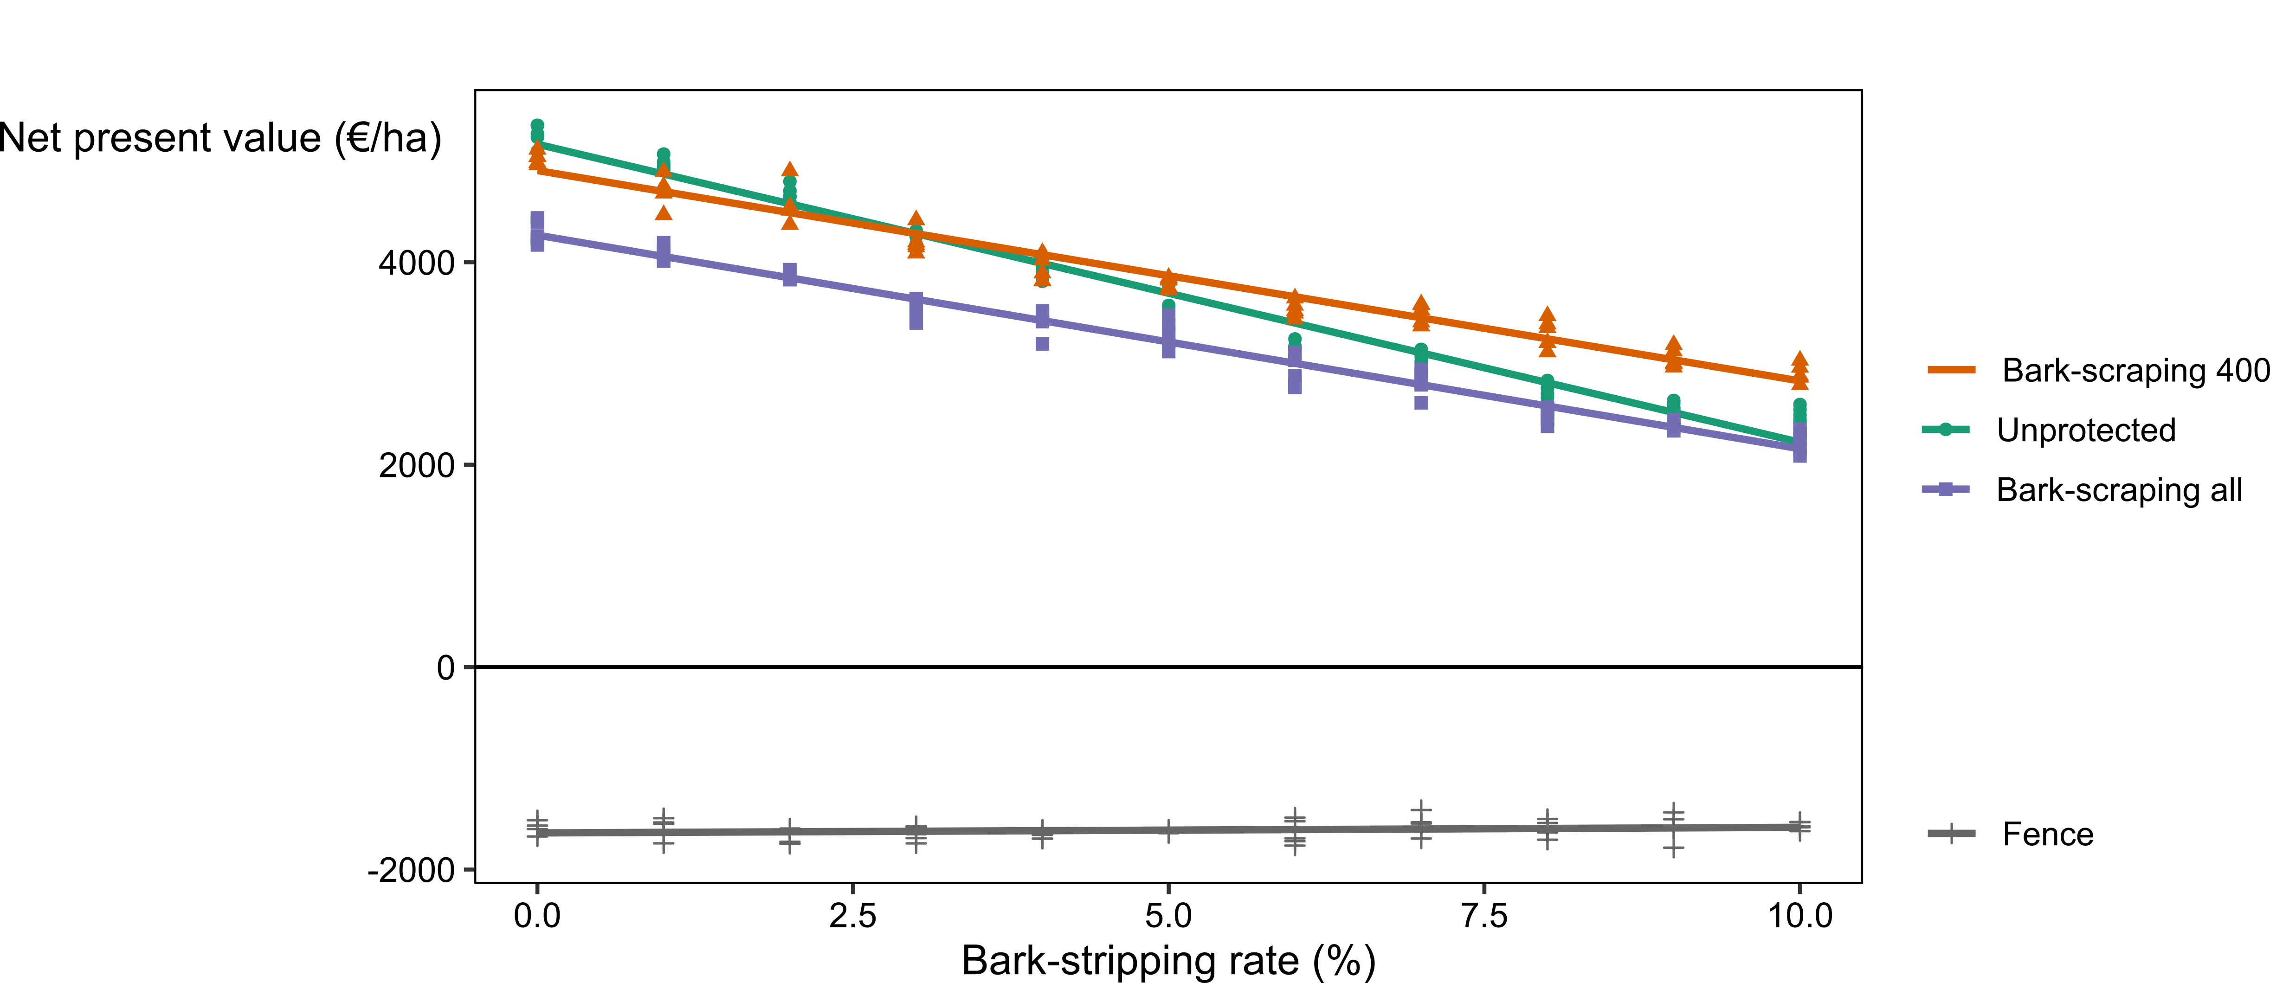
Net present value
Site index = 27 m and r = 3%

Slide 29
Net present value
Bark-scraping 400 crop trees/ha seemed more efficient than Bark-scraping all trees
Bark-scraping 400 crop trees/ha seemed efficient particularly in the most productive stands
Fencing was mostly not profitable (NPV < 0)

Slide 30
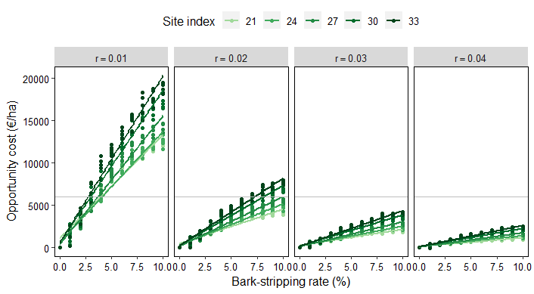
Opportunity cost
0 - 19,445 €/ha
Opportunity cost increased linearly with bark-stripping rate.
The slope increased with SI and depended on r.
Fence cost

Slide 31
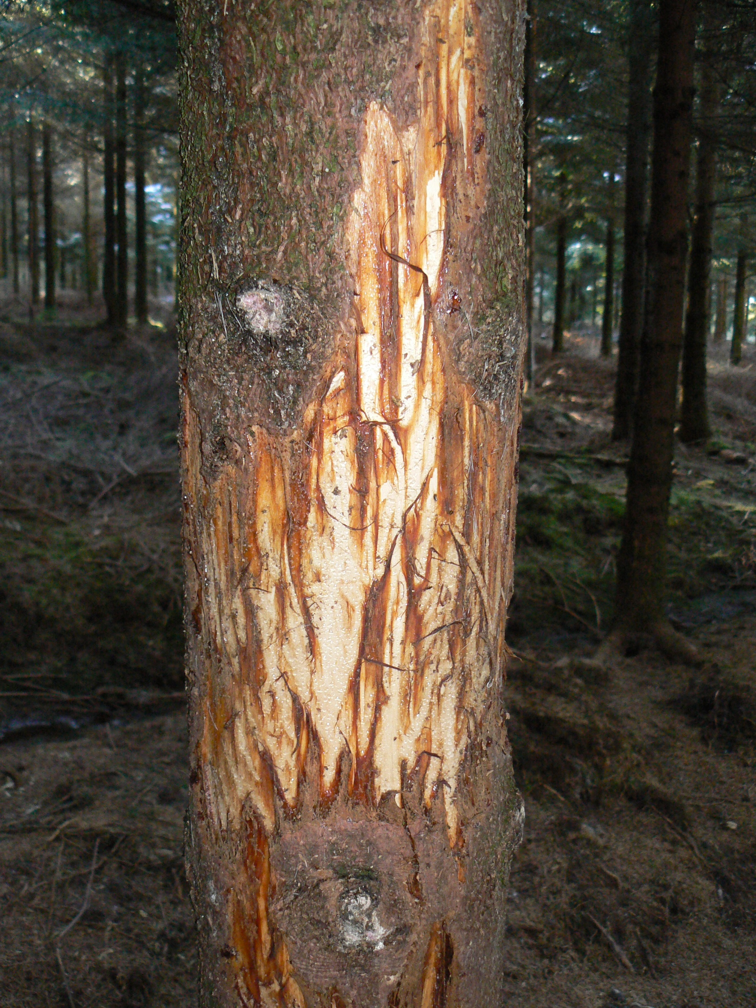
How badly does bark-stripping harm timber production ?
Bark-stripping cost can be substantial : 0 – 100 % of NPV
With BSR = 10%, 85% of the trees are damaged at clear-cut (15 % of timber volume). A few studies predicted even greater proportion of damaged timber.
In averaged conditions (BSR = 4%, SI = 27 m, r = 2%) :
loss of net revenue of 19%
Bark-stripping cost = 2,647 €/ha
53 €/ha/year (~ hunting rent)
The cost is higher in the most fertile sites

Slide 32
How should forest management be adapted ?
Rotation should be kept unchanged or slightly lengthened
Fencing is unlikely to be cost-effective (except with high BSR, low r and required protections against browsing)
Cheap individual protections can be cost-effective
Particularly on crop trees
particularly in the most productive sites
or if installed years before the first thinning

Slide 33
Study limitations
Models were calibrated for :
healthy trees (2000-2020)
even-aged stands
And rely on assumptions
Damage, decay and sensitivity to drought, wind damages, insects, …

Slide 34
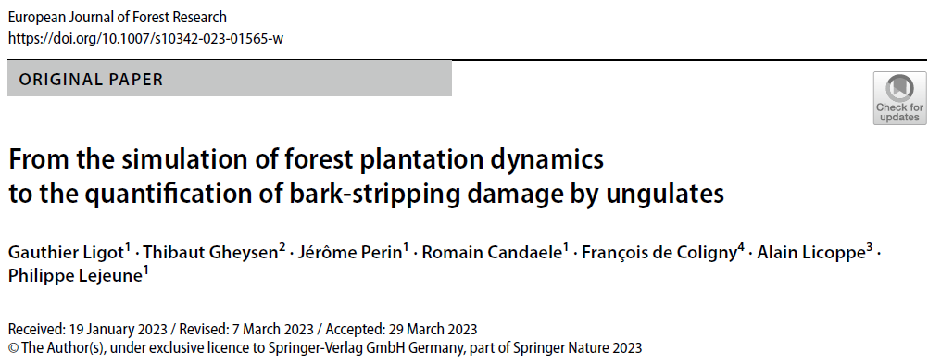
2005
2010
2015
2020
“Levels of wild ungulate populations have usually been adjusted to the damage levels, with limited regard to the actual cost of such damage.
The model we propose in this study can be used to assess the cost of bark-stripping damage balancing long-term revenues against short-term costs of protection measures and long-term costs of bark-stripping damage.”

Slide 35
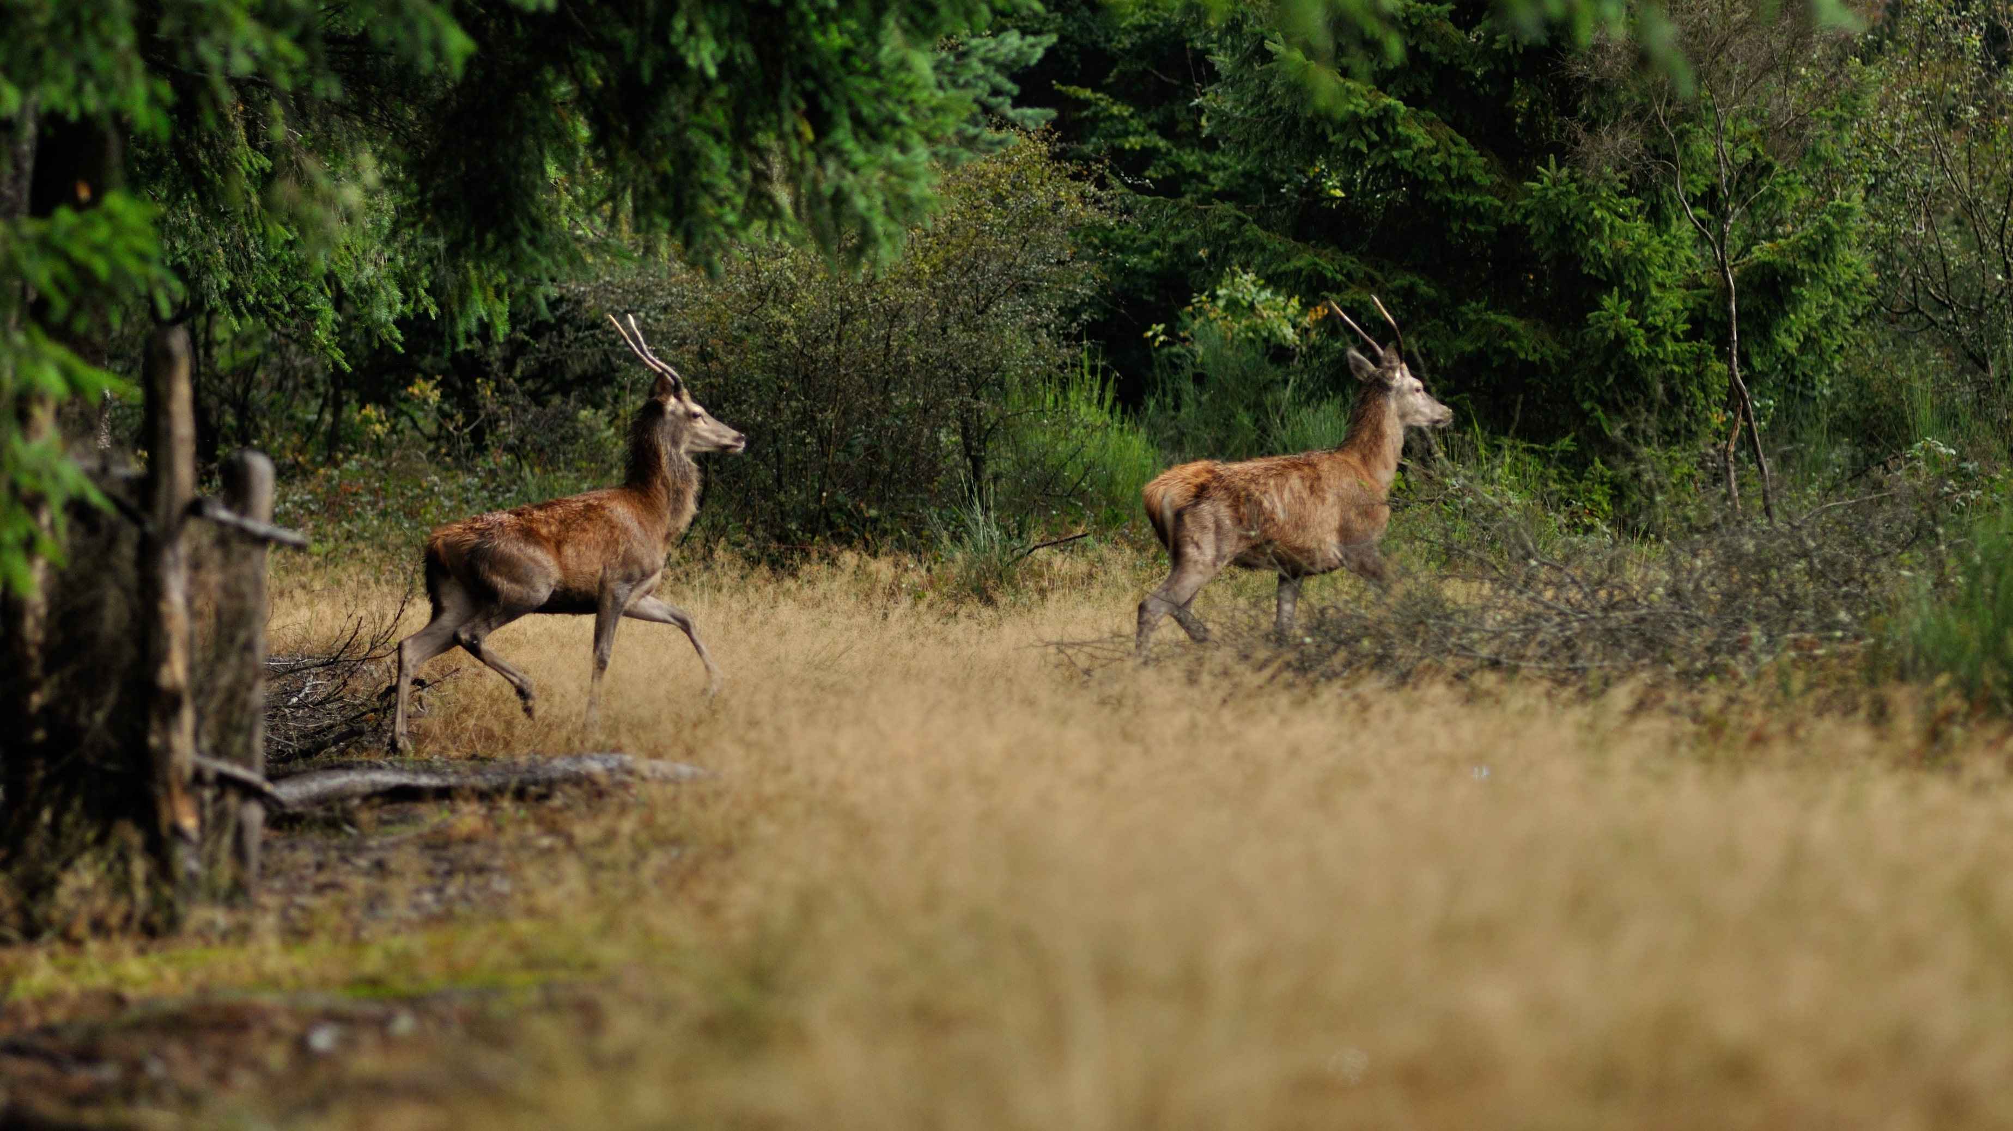
Merci pour votre attention

Slide 36
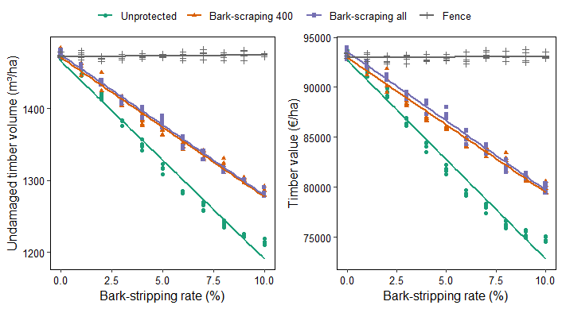
Decayed timber across all thinnings
Site index = 27 m
Notes:
In the low productivity stands,
the proportion of damaged trees could then already be high
when individual protections were applied (bark-scraping all
and bark-scraping 400). The effect of these protections thus
became limited

Slide 37
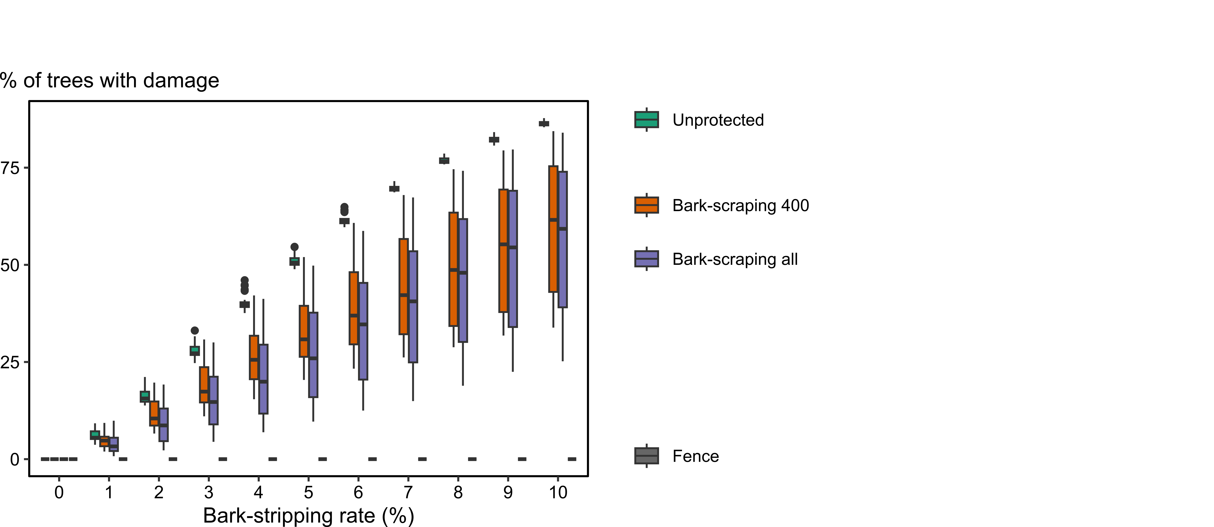
Decayed timber at clear-cut
0 – 85% of damaged stems at clear-cut without protection
< 70% with protections
Notes:
Up to 80% of the trees are damaged at clear-cut
15-20% of timber volume
Decay column height ranging between 0.6 m and 5.6 m… The average is sligthly below 2 m which corresponds to field observations

Slide 38
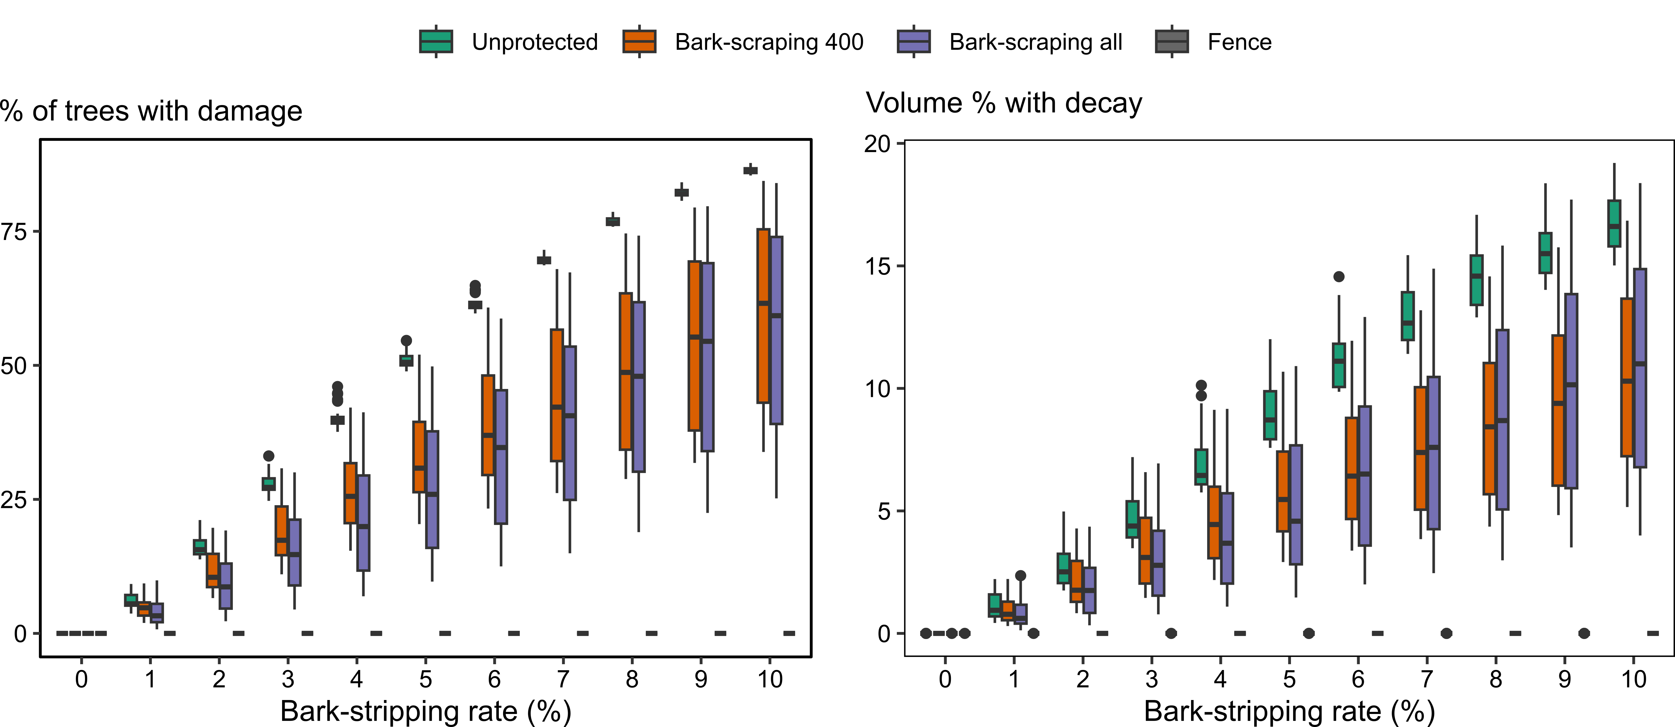
Decayed timber at clear-cut
< 15-20 % of timber volume at clear-cut
Notes:
Up to 80% of the trees are damaged at clear-cut
15-20% of timber volume
Decay column height ranging between 0.6 m and 5.6 m… The average is sligthly below 2 m which corresponds to field observations

