Slide 1
Essential oil-based biopesticides from low-tech to high-tech formulations
Marie-Laure Fauconnier
27/06/2023
Notes:
PAGE D'INTRODUCTION 1 / page permettant l'insertion du titre de la présentation ainsi que d'autres infos (date, lieu, orateur, sous-titre,…)
Si vous souhaitez modifier la photo de fond :
Allez dans le menu « Affichage » > « Masques » > « Masque des diapositives »
Supprimez l’image du drapeau déjà présente
Allez dans « Insertion » > « Photo » et chargez votre image (en veillant à la bonne qualité de celle-ci)
Placez celle-ci en « Arrière-plan » via le menu « Réorganiser »

Slide 2

Conference outline
What is an essentiel oil?
Traditionnal uses of essential oils
New applications of essential oils in agronomy
Advantages and inconvenients
Formulation of essential oil-based biopesticides
Perspectives
Notes:
PAGE DE CONTENU 1 / Possibilité d'insérer du texte, des images, de la vidéo, des graphiques …

Slide 3
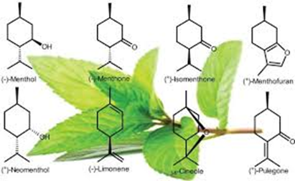
What is an essential oil?
Definition of Eos
Essential oils are complex mixtures of volatile compounds produced by living organisms and isolated by physical means only (pressing and distillation) from a whole plant or a plant part of known taxonomic origin.
A plant extract obtained by solvent extraction (like vanilla) or by supercritical CO₂ is NOT an essential oil !
Essential oils are NOT oils (like peanut oils)
Does all the plants are essential oils bearing plants?
Yes theoretically
No in fact
- typical and unique blend of volatiles (rose, lavender)
- secretion and accumulation in specialized anatomical structures (e.g. trichomes)

Slide 4
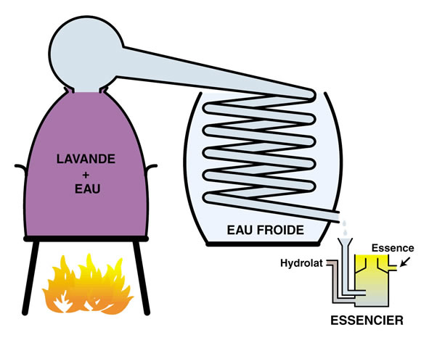
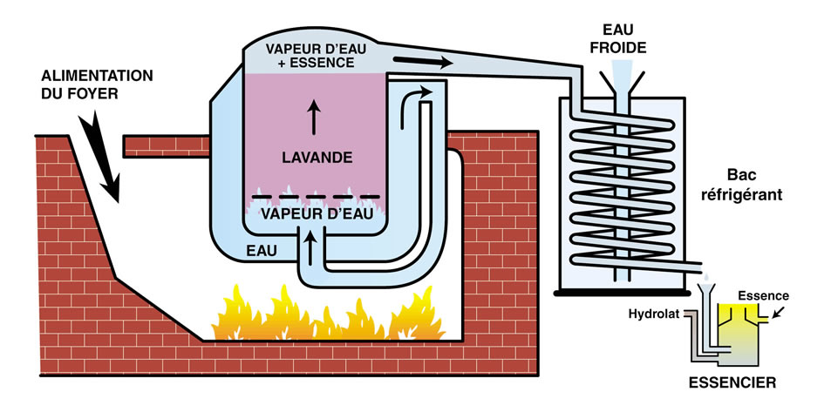
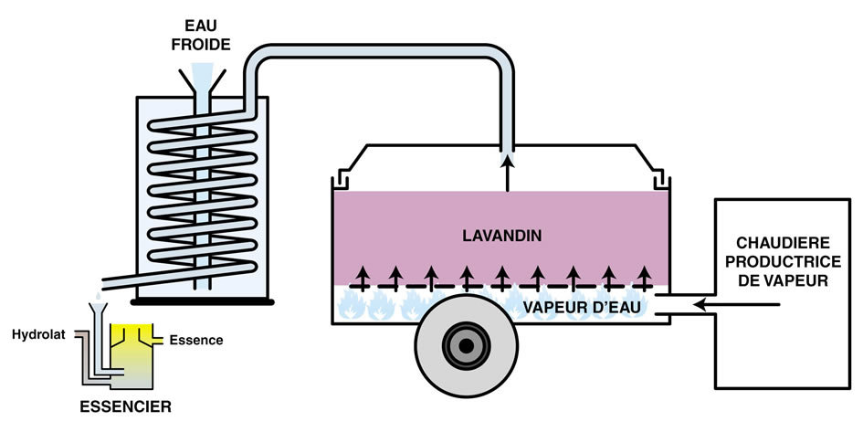
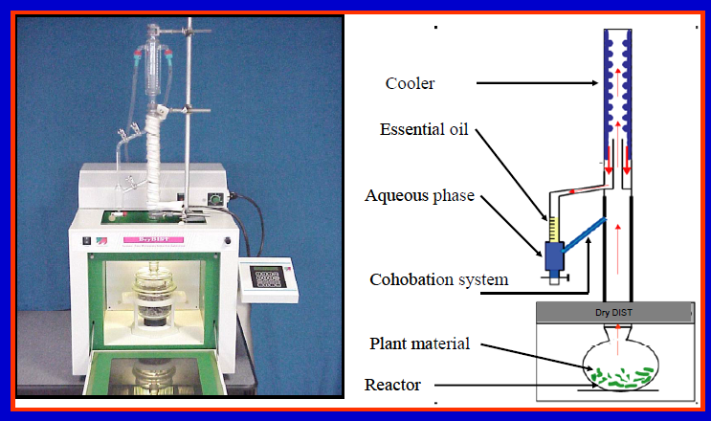
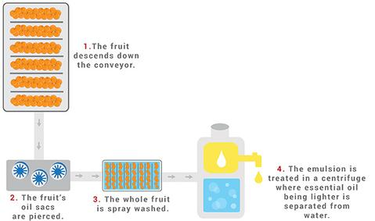
Extraction techniques
Hydrodistillation:
very simple
not expensive
direct contact with plant material
Steam distillation:
more complex
more expensive
no direct contact with plant material
In field steam distillation:
of practical use
direct distillation after harvest
limited volume
Pressing:
used for citrus Eos
Eos contain non volatile compounds
not expensive
Microwave assisted techniques

Slide 5
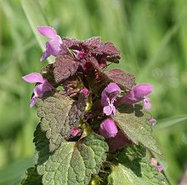
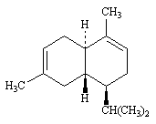
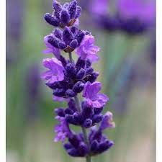
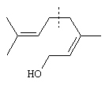
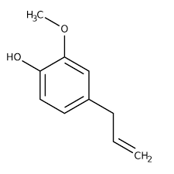
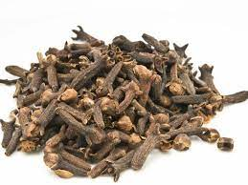
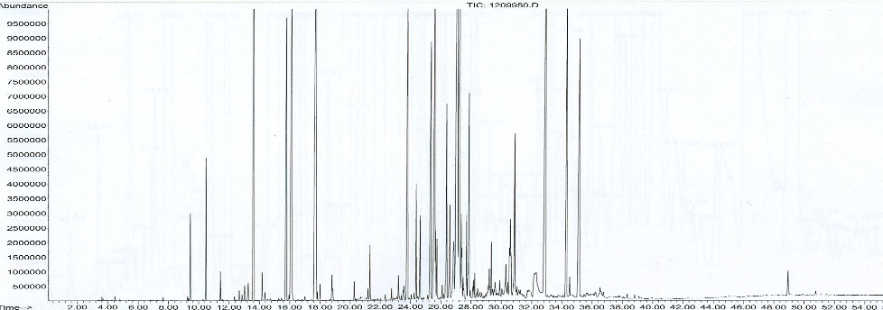
What is an essential oil?
Composition:
Mainly three pathways
- Mevalonate ➔ sesquiterpenes
- Methyl-erythritol ➔ mono and diterpenes
- Shikimic ➔ phenylpropenes
But also :
- Acid
- Alcohol
- Ketones
- Esters
- S and N containing compounds
➔ very complex composition e.g. ylang ylang EO : > 450 compounds

Slide 6
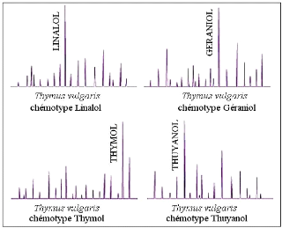
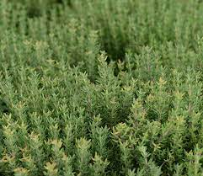
What is an essential oil?
Composition:
Depends on the organ (cinnamon leaves: eugenol, cinnamon bark: cinnamaldehyde, cinnammon roots: camphor)
Depends on the season
Depends on the climate-soil-distillation (terroir effect)
Presence of pathogens
Chemotypes
Thyme: 7 chemotypes
Linalol
Géraniol
Thymol
Thujanol
Carvacrol
α-terpinéol
Hydrate de sabinène

Slide 7



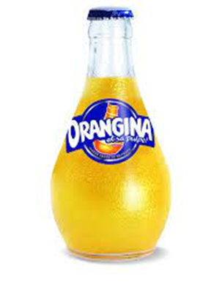
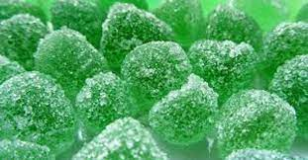
Traditionnal uses of essential oils
Conventional uses of EOs :
Food
Beverage
Cosmetics/perfume
Aromatherapy

Slide 8
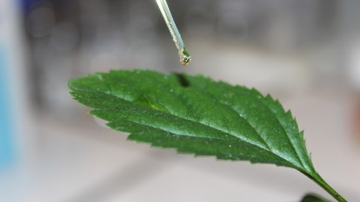
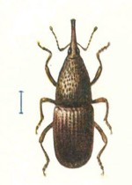
New applications of essential oils in agronomy
More recently numerous applications in agronomy (biocide)
Insecticide (GS 150 000)
Herbicide (GS 104 000)
Bactericide-fungicide (GS 111 000)
Acaricide-nematicide (GS 32 000)
But also anti-sprouting agent, virucide, soil microbiote quality improvement, post-harvest desease, self-life increase …
GS = Google Scholar (June 2023)

Slide 9
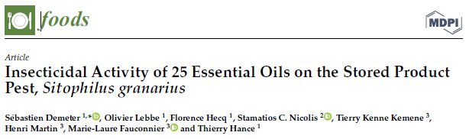
New applications of essential oils in agronomy
Eos as insecticide:
Eos used alone or mixture of it (synergy, additive effect)
Deterrent, antifeedant, repellent, acute toxicity (ingestion, inhalation, topical application)
➔ Pest of stored food, pest of crops, pest of forests, household pest

Slide 10
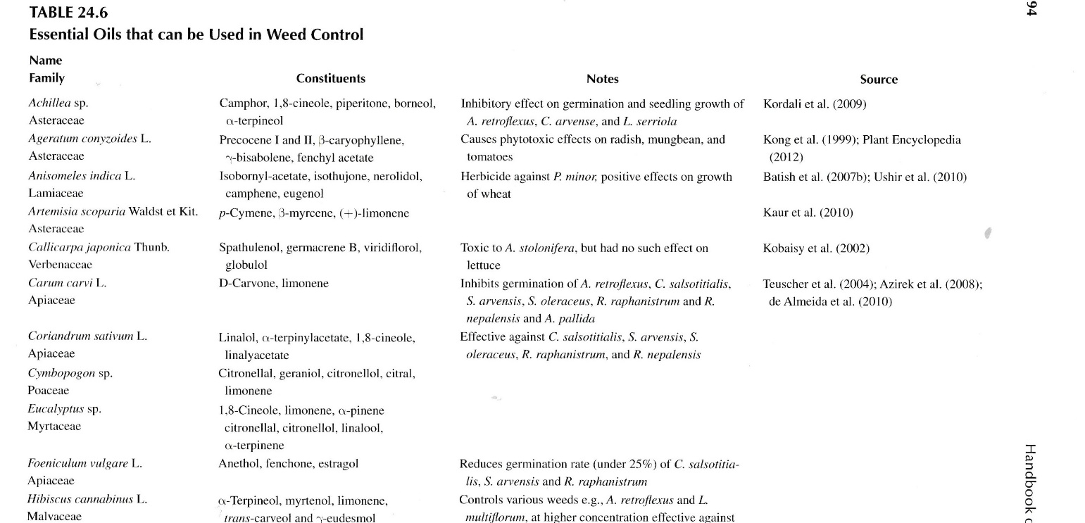
New applications of essential oils in agronomy
Eos as herbicide: weed control in the context of glyphosate replacement
- Many Eos have herbicidal activity (total or selective and/or antigerminative)

Slide 11
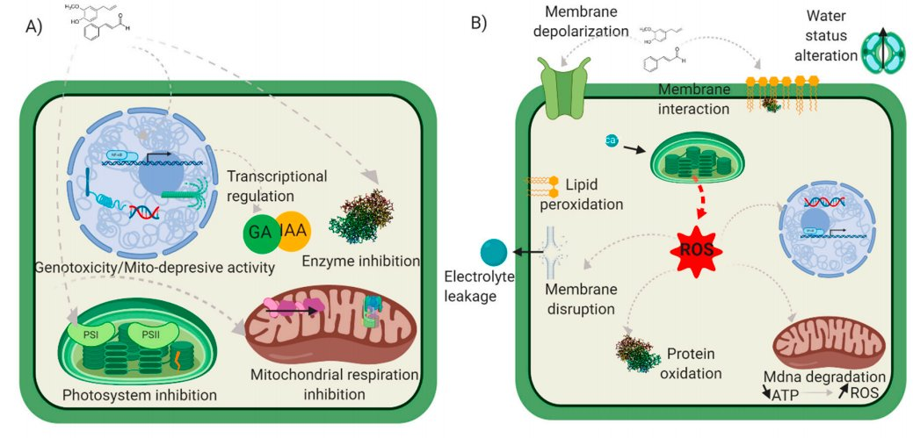
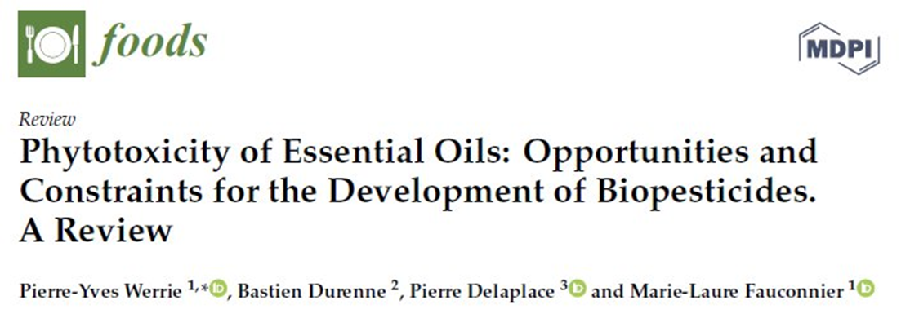
New applications of essential oils in agronomy
Eos as herbicide: weed control in the context of glyphosate replacement
Low persistance, multiple action modes (less resistance)

Slide 12
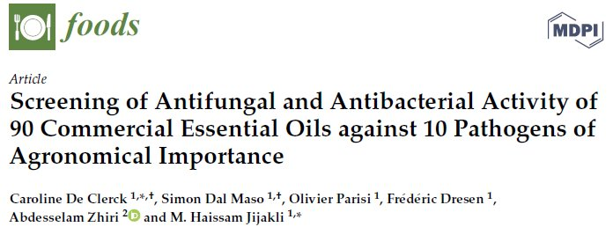
New applications of essential oils in agronomy
Eos as bactericide/fungicide
Bactericide: activity against Gram + and Gram -, various mode of action
Fungicide but also fungistatic

Slide 13
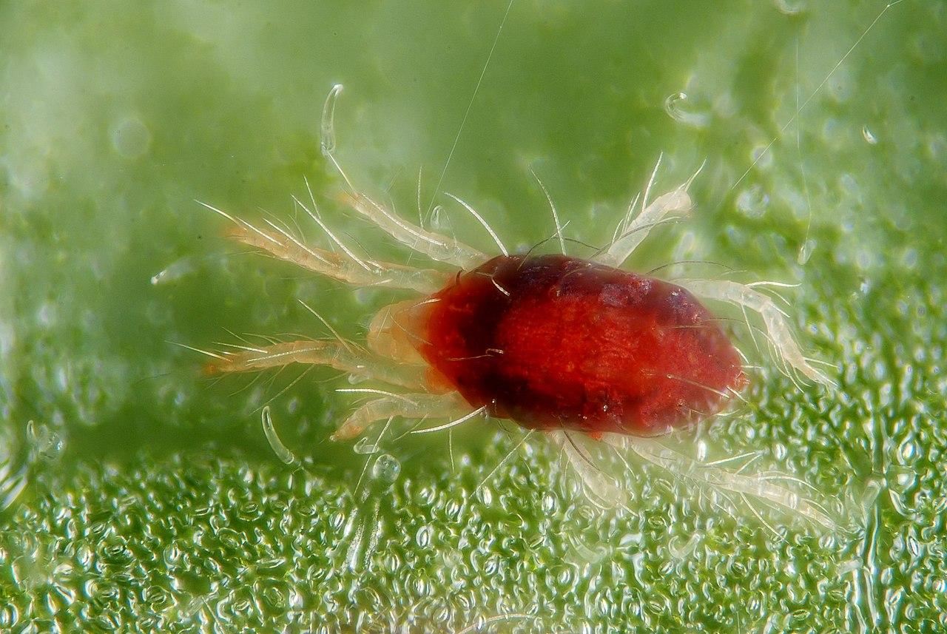
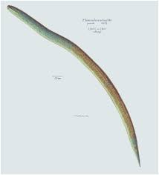
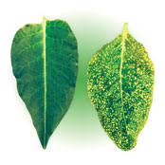
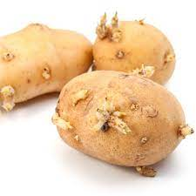
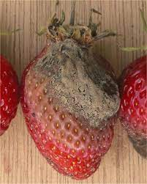
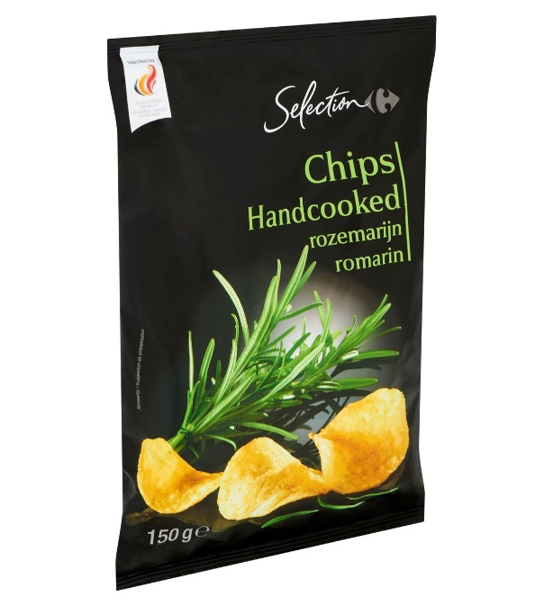
New applications of essential oils in agronomy
Acaricide: Good results of Deverra scoparia EO on Tetranychus urticae (red spider mite). Repellent, direct mortality, reduced fecundity
Nematicide : effect of limonene containg Eos and many others on nematodes
Virucide: tobacco Mosaic virus (lemongrass EO)
Anti-sprouting agent (potatoes, carvone rich EOs)
Soil microbiote improvement: biodegradation but nutriment source for soil µoorganisms
Post-harvest desease: bacteria, fungi
Due to its anti-oxidant, bactericide and fungicide activities EOs are used as preservatives in food industries to increase self live.

Slide 14
New applications of essential oils in agronomy
Advantages and constraints
Advantages:
Reduced side effects (human, not target organisms,
environment)
Low persistance
Multiple action mode (less ressistance)
Good acceptability by consumers
Constraints :
Flavour
Variability (composition)➔ standardization
Phytotoxicity
Volatility (encapsulation + new mode of injection)
Cost (only for high value crops?)
Sustainability of resource
Regulatory aspects (US versus EU)
Importance of formulation

Slide 15
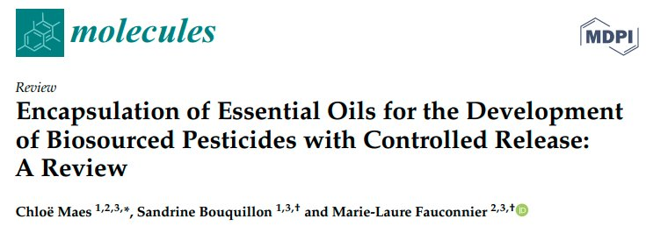
Formulation of essential oil based biopesticides
1. Encapsulation for a slow release➔ reduce volatility, protect Eos against oxidation, increase activity period
Various techniques: emulsification, coacervation, spray drying, complexation, ionic gelation, nanoprecipitation, film hydration method ➔ droplets, particles, capsules, and complexes from various sizes “micro” (1–1000 m) or “nano” (<1000 nm)
Three matrixes are often used: alginate, chitosan, and cyclodextrin(for many techniques)

Slide 16
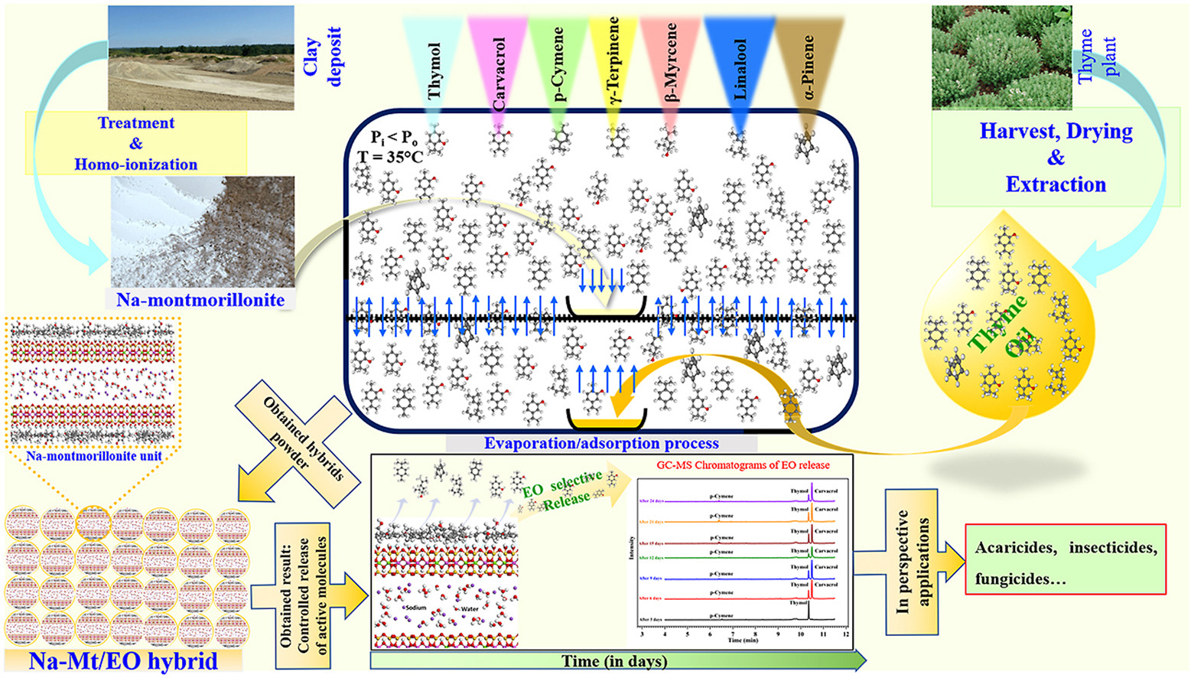
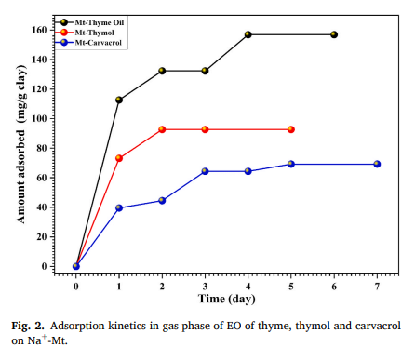
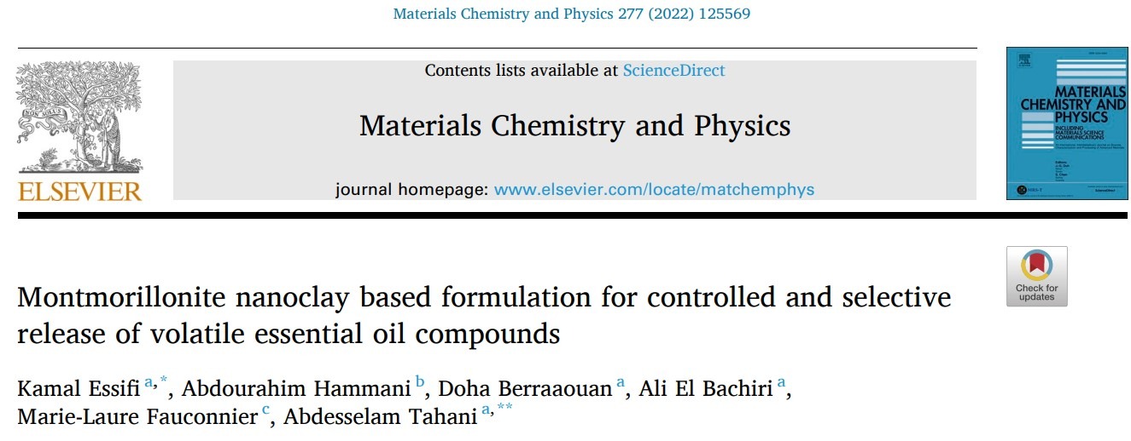
Formulation of essential oil based biopesticides
Montmorillonite treatment (HCL, NaOH)
EO clay mineral hybrid
Extended controlled release
Insecticide mecanic effect on insect

Slide 17
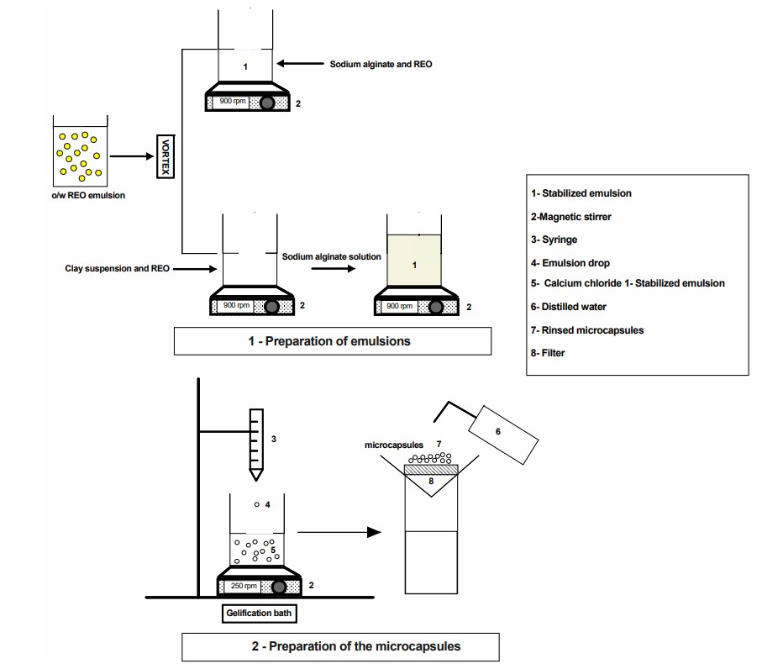
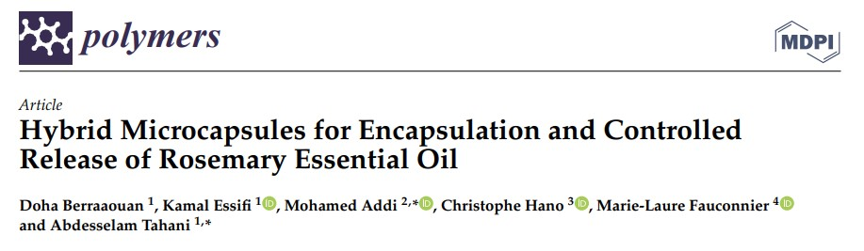
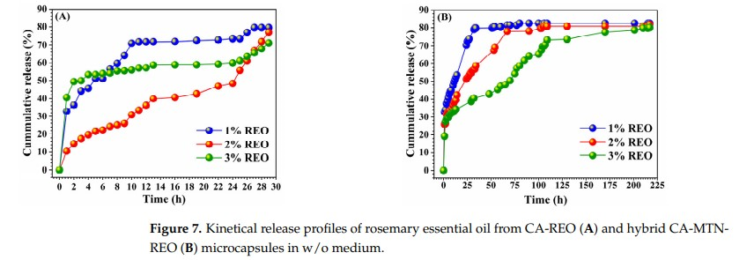
Formulation of essential oil based biopesticides
Rosemary EO Calcium alginate and calcium alginate / montmorillonite microcapsules (micrometric and spheric)
Higher thermal stability, higher loading capacity and encapsulation efficiency for hybrid µcapsules
Slower release

Slide 18
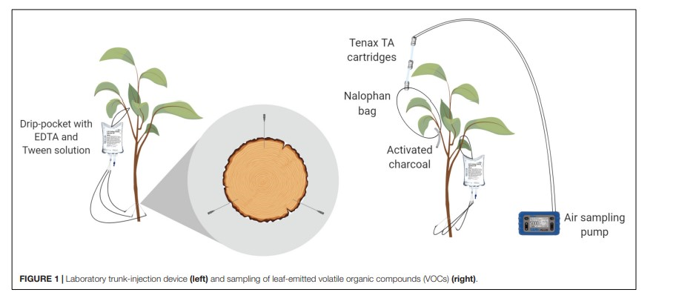
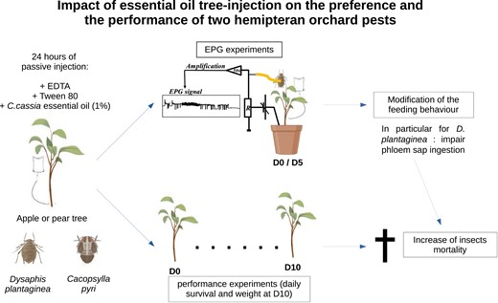
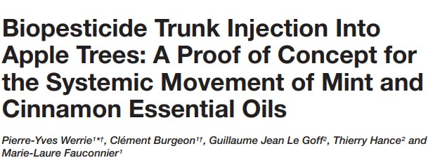
Formulation of essential oil based biopesticides
At laboratory scale the EO components are emitted by leaves and effect on insect pests
In orcard conditions emission of EO components but no effect on insect pests or pollinators

Slide 19
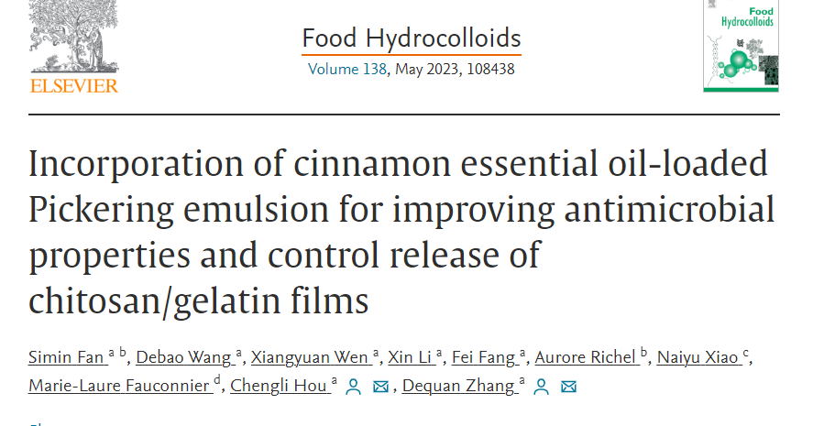
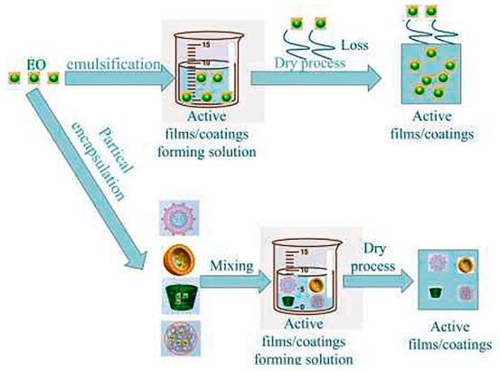
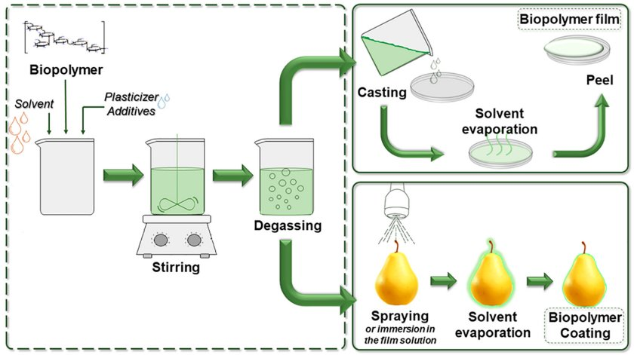
New applications of essential oils in food conservation
New applications of Eo in packaging
Inclusion of Eos into polyethylene films by extrusion: increase pork meat self-life
Use of multilayer packaging (polyurethane adhesive with cinnamon EO)
Polyolefin containg EO ➔ degradable packaging for fruits and vegetables
Edible films (gelatin capsules)

Slide 20
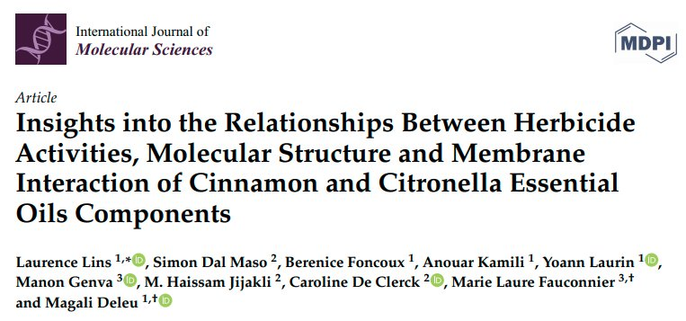
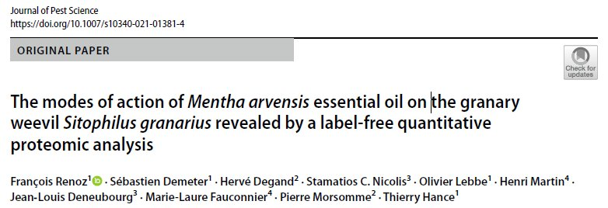
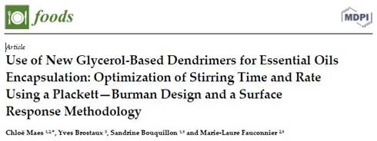
New applications of essential oils in agronomy
Challenges: what’s next
Test in vitro ➔ in vivo
Controlled conditions versus field conditions
Comprehesion of mode of action
(structure-activity relationship)
Innovative formulation
Exploring new EOs

Slide 21
Thank you for your attention!
marie-laure.fauconnier@uliege.be
Notes:
PAGE D'INTRODUCTION 2 / Page sans photo permettant l'insertion du titre de la présentation ainsi que d'autres infos (date, lieu, orateur, sous-titre,…)

