Slide 1
Reliable neuromodulation from adaptive control of ion channel expression
Here is where your presentation begins
A. Fyon, P. Sacré, A. Franci, G. Drion

Slide 2
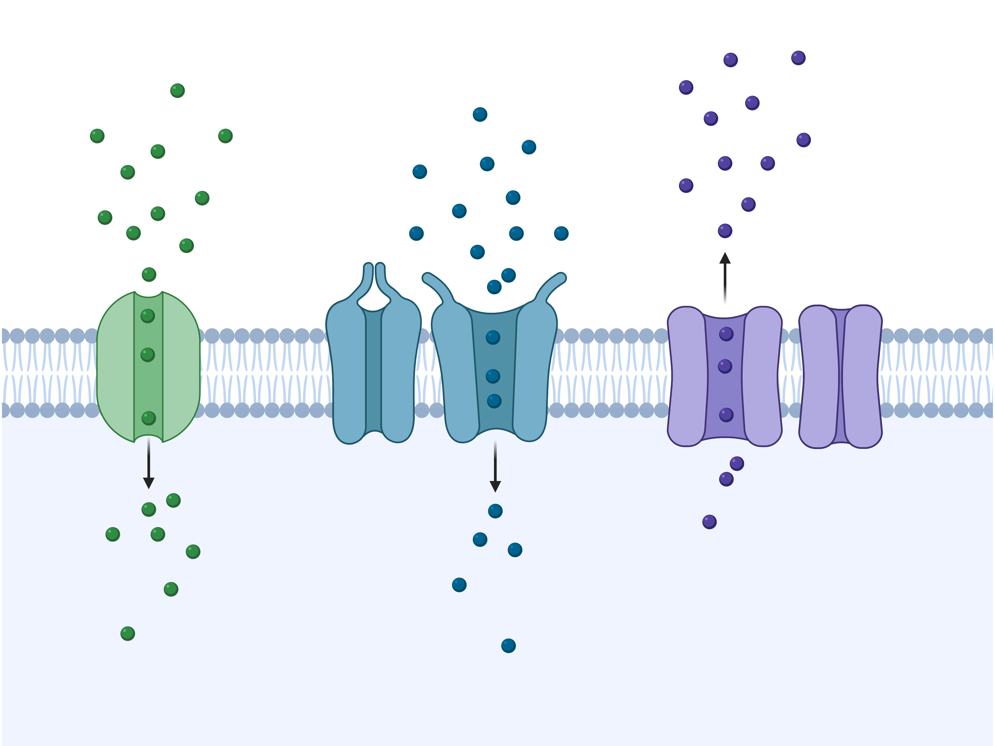
Neurons use spikes to communicate
$$Na^{+}$$
$$Ca^{++}$$
$$K^{+}$$
Drion et al., 2011
1

Slide 3
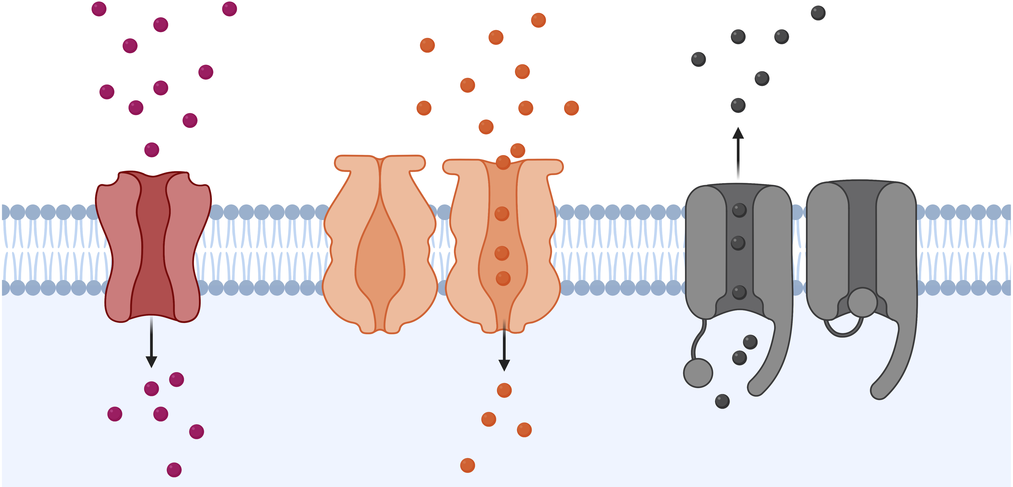
Ion channels determine spiking activity
$$Na^{+}$$
Drion et al., 2011
$$Ca^{++}$$
$$K^{+}$$
Zagha et al., 2014
2

Slide 4
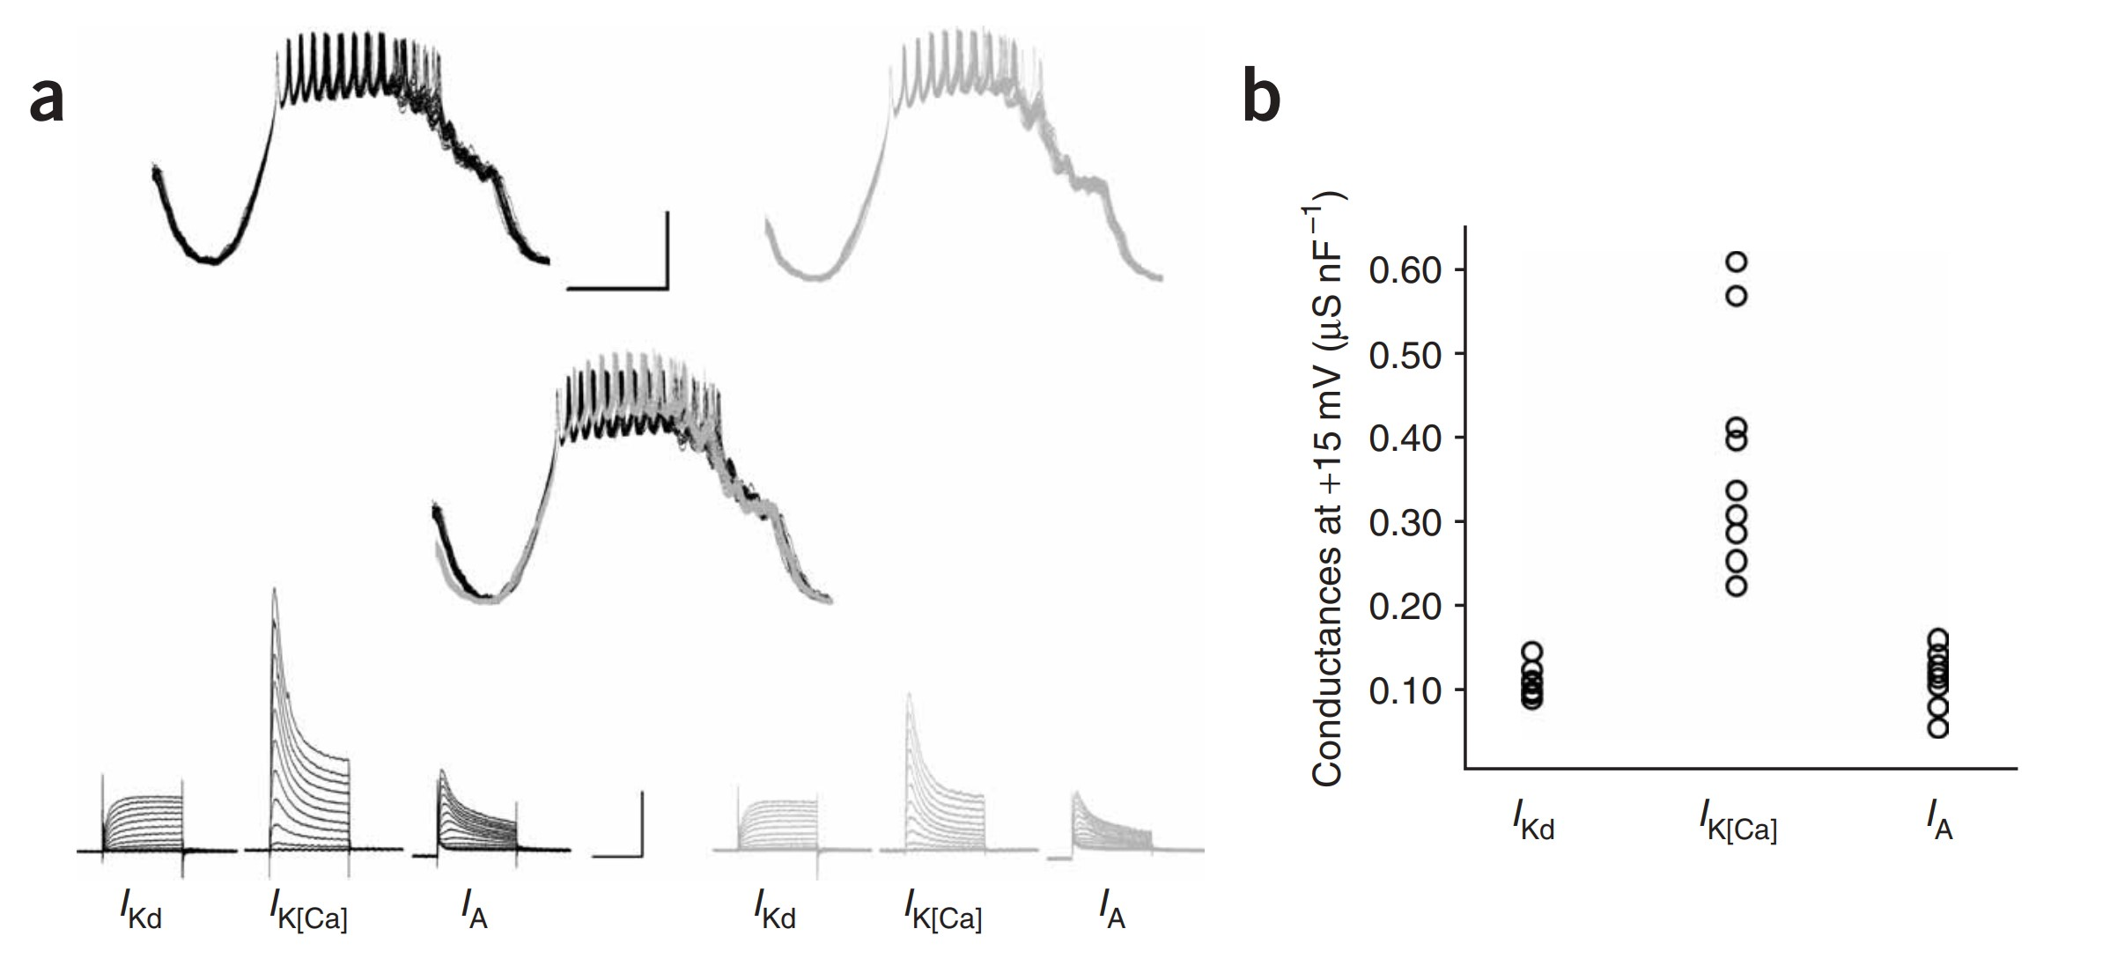
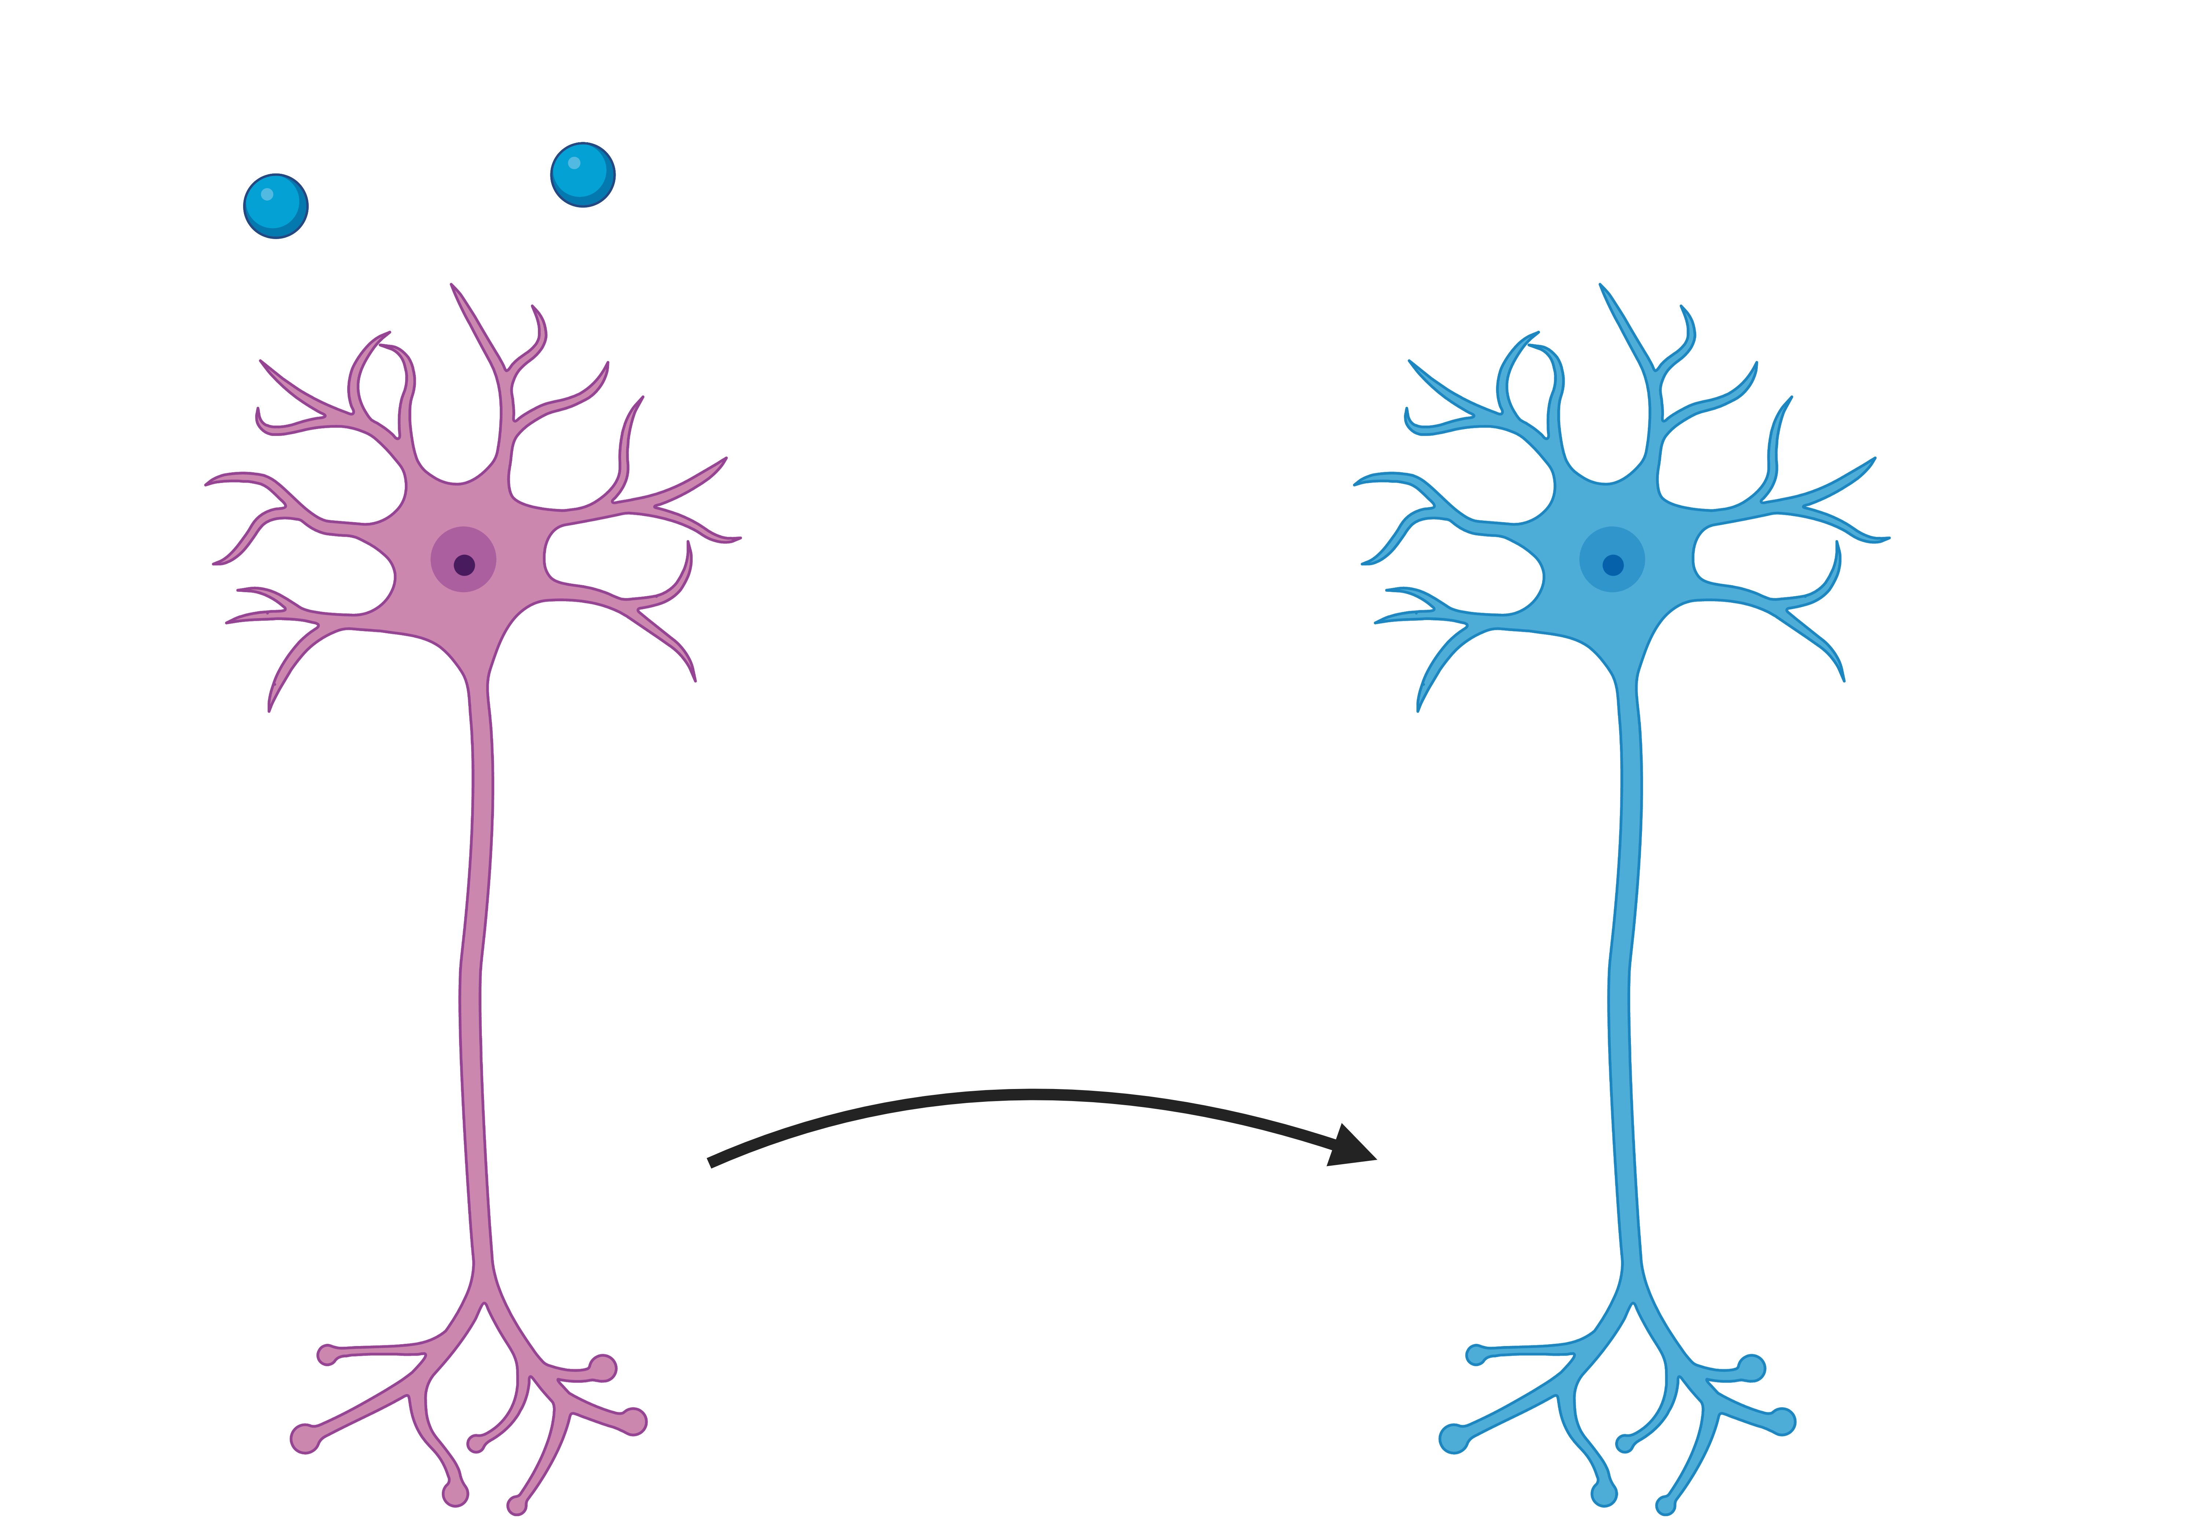
Neuronal activity is highly modulated
Control activity
Neuromodulator A
Neuromodulator B
Neuromodulation
Neuromodulator C
Schulz et al., 2006
Marder, 2012
3

Slide 5
Similar activity emerge from different parameter sets
Neuromodulator A
Control activity
Neuromodulator B
Neuromodulation
Neuromodulator C
Marder, 2012
Schulz et al., 2006
4

Slide 6
How can neuromodulation be reliable in such highly variable neurons?
Research question
5

Slide 7
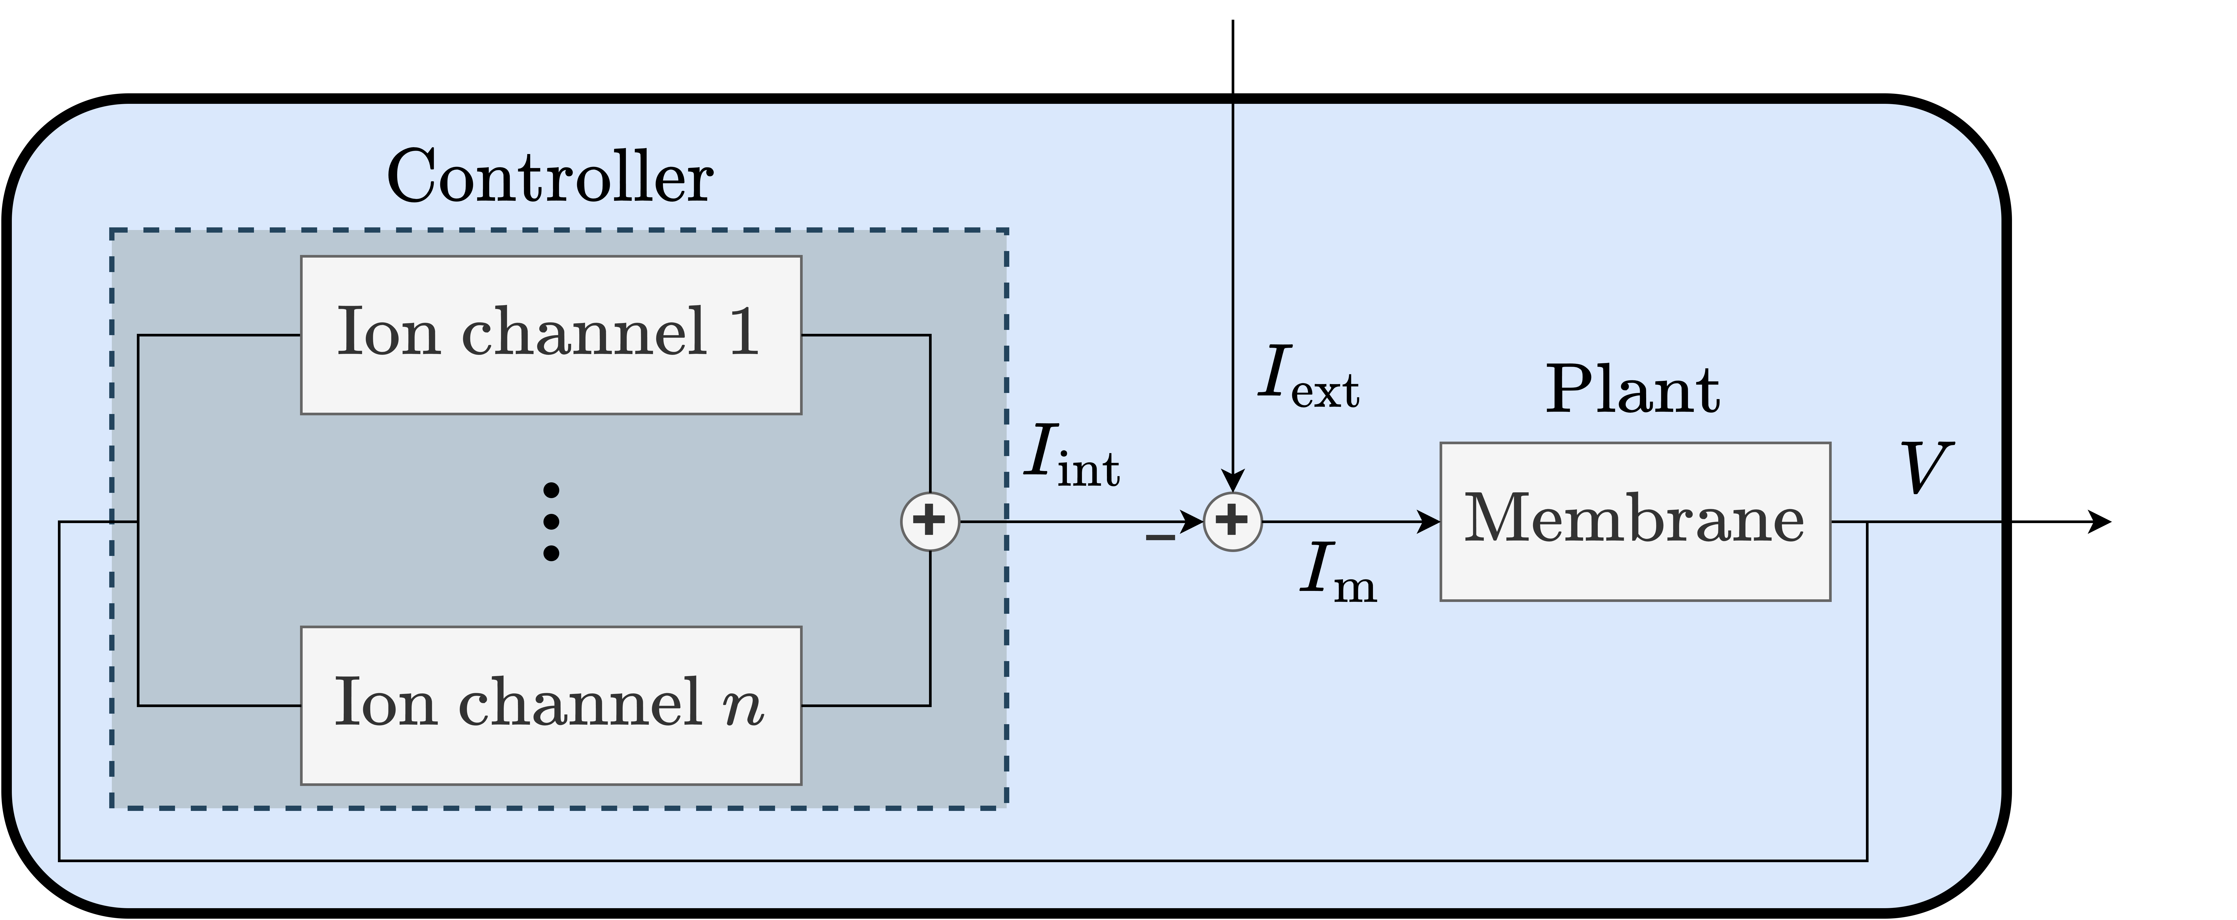
Only conductance-based models are capable of modeling ion channels
6

Slide 8
Neurons as feedback models
7

Slide 9
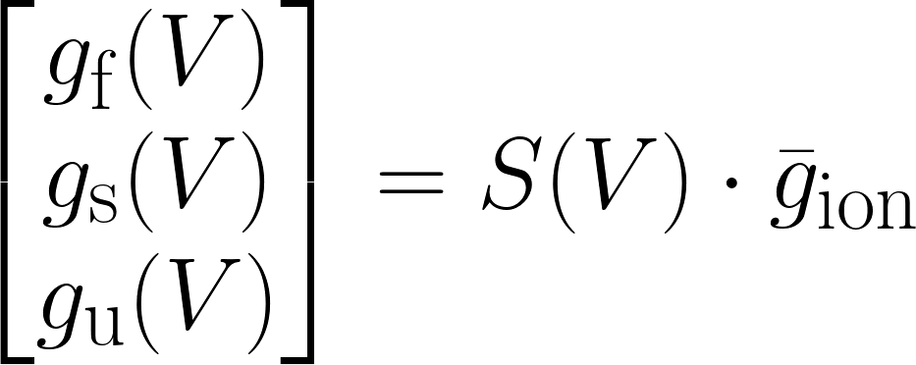
The control action of ion channels can be aggregated in 3 feedback gains
These can be aggregated into 3 neuronal feedback gains = 3 voltage dependent conductances: Dynamic Input Conductances (DICs)
Fast
Slow
Ultraslow
Drion et al., 2015
8
Tonic spiking
Bursting

Slide 10
Local feedbacks are important
Active controller with feedback gains
The ion channel conductances
These can be aggregated into 3 neuronal feedback gains = 3 voltage dependent conductances: Dynamic Input Conductances (DICs)
Fast
Slow
Ultraslow
Tonic spiking
Bursting
Drion et al., 2015
Global slow negative feedback
Global slow negative feedback
Local slow positive feedback
9

Slide 11
How can neuromodulators reliably shape neuronal activity by targeting variable ion channels
Such neuromodulator triggers complex signaling cascade inside the cell.
The end targets are a set of ion channels.
Marder, 2014
10
Notes:
Autre figure d’Eve, avec canaux ioniques.

Slide 12
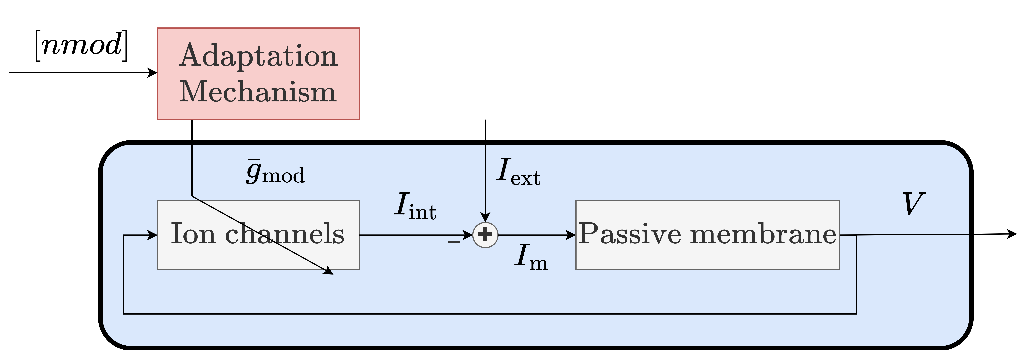
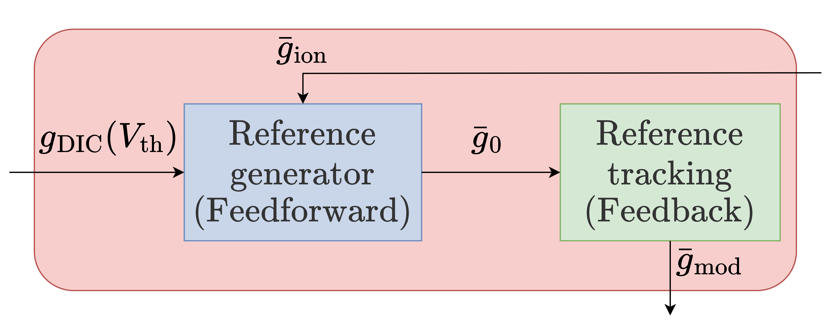
Neuromodulation can be seen as an adaptive control problem
11

Slide 13
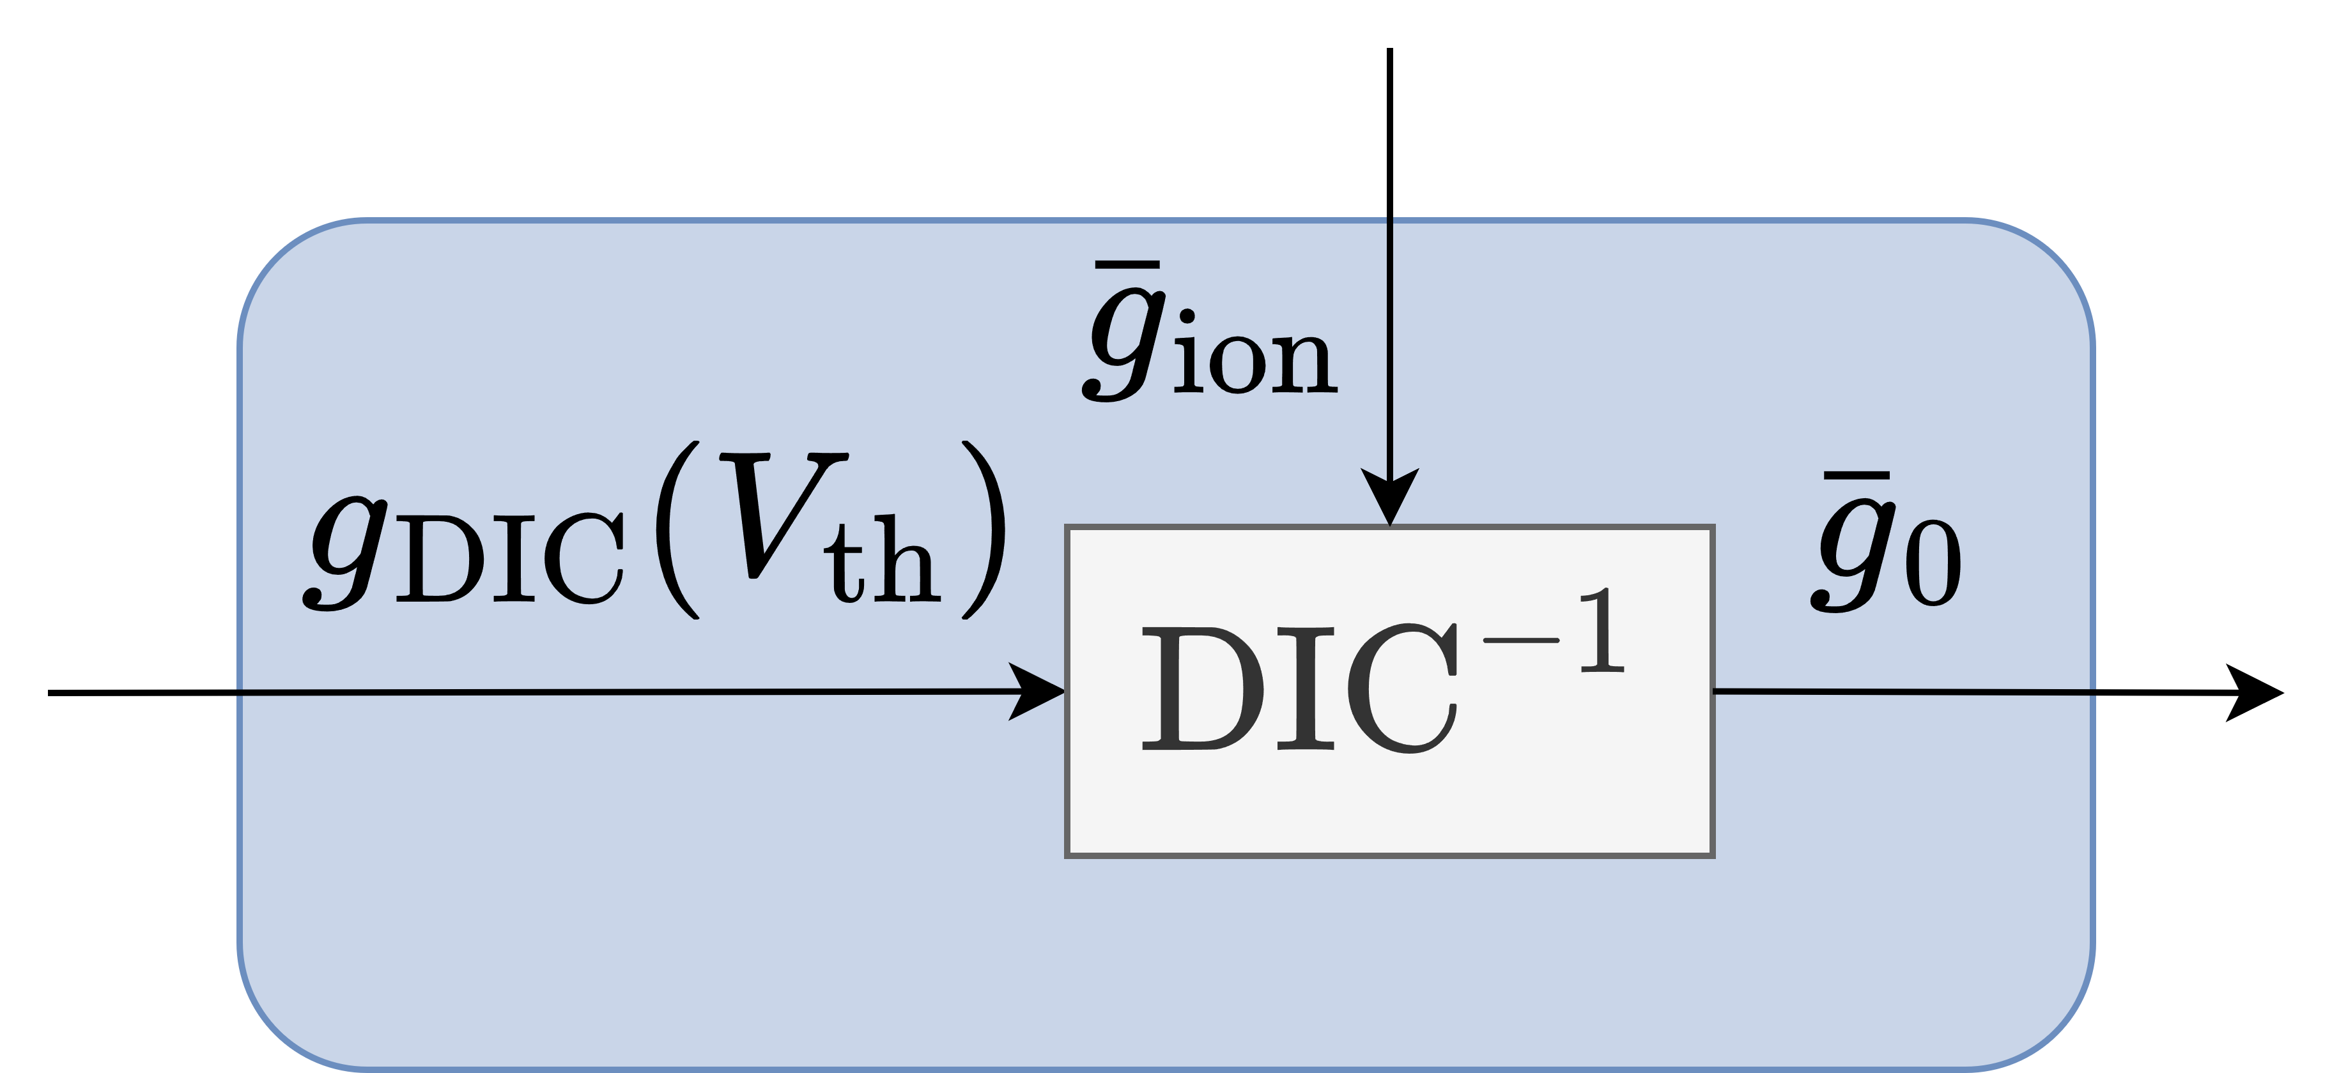
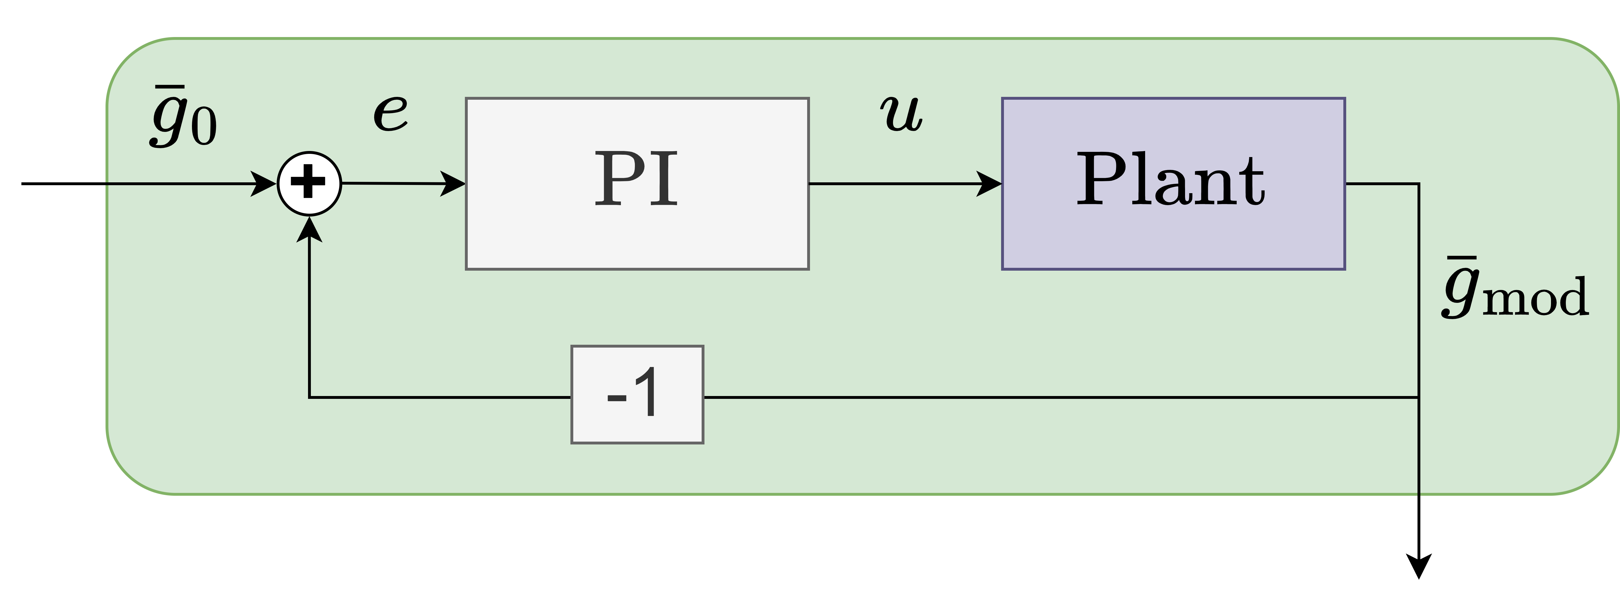
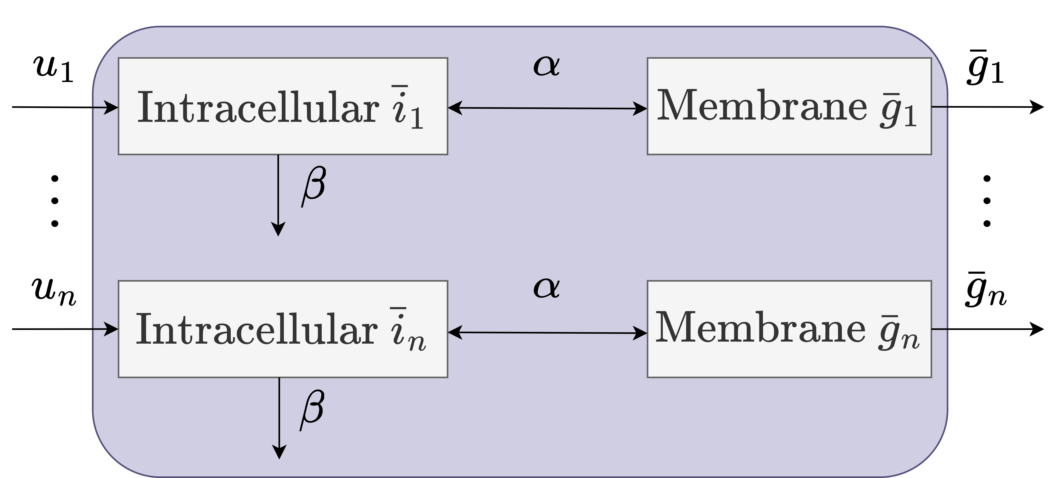
A model for reliable neuromodulation
Basic PI
Reference for
12

Slide 14
Adaptive control model enables reliable neuromodulation in variable neurons
Protocol:
Random population of 200 STG conductance based models with disparate parameters is generated
Tonic spiking to bursting transition is simulated with the adaptive control of neuromodulation
Only controlling slow and ultraslow neuronal feedback gains
13
Notes:
Boite noire disparaitre, et avoir une slide plus dynamique, avec statique en backup

Slide 15
The adaptive controller tunes ion channels in a neuron dependent way
Protocol:
Random population of 200 STG conductance based models with disparate parameters is generated
Tonic spiking to bursting transition is simulated with the adaptive control of neuromodulation
Only controlling slow and ultraslow neuronal feedback gains
14

Slide 16
1. The study of robust neuromodulation presents a challenging task due to the high dimensionality of conductance-based models. 2. By conceptualizing single neurons as feedback models, it becomes possible to lump all ion channels into three neuronal feedback gains that differ based on timescales. 3. Using this feedback representation, robust neuromodulation can be achieved using adaptive control.
Take-home messages
15

