Slide 1


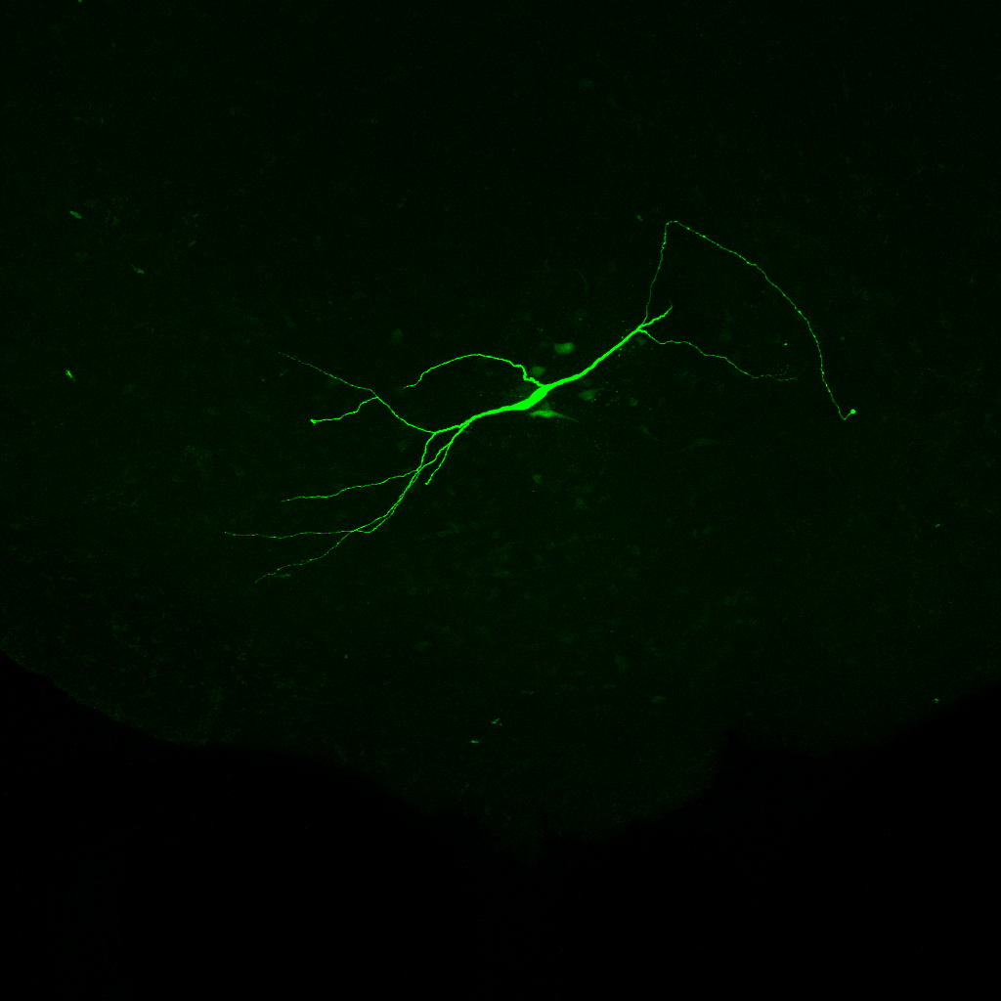
Hyperpolarization-activated cation currents I_{h} influence synaptic integration properties in substantia nigra dopamine neurons
Dominique Engel and Vincent Seutin
GIGA-Neurosciences, Electrophysiology unit, B-4000 Liège, Belgium
Introduction
The integration of synaptic potentials to form an output signal, the action potential, is the most fundamental operation neurons perform.
Excitatory postsynaptic potentials (EPSPs), elicited by the activation of excitatory synaptic contacts along the somato-dendritic domain, have to propagate to the subcellular structure where action potentials are generated to influence them. The propagation of synaptic potentials along dendrites is controlled by both the passive and active membrane properties of the dendritic tree. The influence of dendritic filtering on EPSP amplitude and time course will be apparent in neurons with large dendritic trees, such as CNS pyramidal neurons. However, in contrast to the results obtained with modeling studies, experimental data indicate little relationship between somatic EPSP time course and their presumed site of generation. These observations suggest either that distal synaptic events have different time courses at source or that their propagation is influenced by nonuniform membrane properties and/or voltage-activated channels. In cortical and hippocampal pyramidal neurons, the hyperpolarization-activated cation current (I_{h}) has been shown to shorten the width of EPSPs and dampen the summation of trains of inputs. The magnitude of this effect is distance dependent: I_{h} has a large effect on EPSPs originating in the distal dendrites and a smaller effect on proximal inputs. Thus, regardless of their origin, all EPSPs arriving at the soma have similar width, and therefore I_{h} is said to normalize the broadening effect of dendritic filtering on synaptic inputs. The presence of I_{h} is well recognized in substantia nigra dopamine neurons, which exhibit a large sag potential in response to hyperpolarizing current injections. However, the contribution of I_{h} to synaptic integration in dopamine neurons is fully unknown. The goal of this study was (1) to map the specific distribution of I_{h} currents along the somato-dendritic axis of dopamine neurons (2) to determine whether the specific distribution of I_{h} influences synaptic integration in these neurons.
Conclusion
Our results show that I_{h} shortens EPSP duration and minimize EPSP summation.
I_{h} is present in dendrites of dopamine neurons and particularly in dendrites bearing the axon. The amplitude of I_{h} in the somatic compartment is very small indicating that the presence of I_{h} is more concentrated in the dendritic compartment.
The influence of I_{h} is smaller for EPSPs evoked in the soma in comparison to those evoked in the dendrites, consistent with a larger amplitude of I_{h} in dendrites in comparison to the soma.
Overall, the data suggests a correlation between the distribution of I_{h} along the somato-dendritic axis of dopamine neurons and its effects on synaptic integration in these neurons.
Methods
Coronal 300-350 µm-thick slices were prepared from the brains of 16- to 21-day-old Wistar rats. Animal were killed by decapitation, in accordance with the Animal Care and Use Committee (IACUC, University of Liège). For dissection, the solution contained in mM: 87 NaCl, 25 NaHCO₃, 10 D-glucose, 75 sucrose, 2.5 KCl, 1.25 NaH₂PO₄, 0.5 CaCl₂ and 7 MgCl₂, equilibrated with 95 % O₂ / 5 % CO₂. Slices containing the substantia nigra were stored in standard physiological saline. For recordings, the slices were perfused with saline containing in mM: 125 NaCl, 25 NaHCO₃, 25 D-glucose, 2.5 KCl, 1.25 NaH₂PO₄, 2 CaCl₂ and 1 MgCl₂. Pipette were prepared from thick-walled borosilicate glass capillaries (o.d. 2 mm, i.d. 1 mm; Hilgenberg, Germany). Tip resistances were between 6 and 10 MΩ and between 8 and 11 MΩ for whole-cell somatic and dendritic recordings respectively. The composition of the internal solution was, in mM: 120 KMeSO₄, 20 KCl, 2 MgCl₂, 2 Na₂ATP, 0.5 Na₂GTP, 5 Na₂-phosphocreatine, 0.1 EGTA, 10 HEPES and 0.1% biocytin (pH = 7.3). In all cell-attached experiments, the pipette was coated with dental wax and the resistance was standardized at 10 MΩ. Cell-attached pipettes were filled with high potassium solution of the following composition, in mM: 120 KCl, 2 CaCl₂, 1 MgCl₂, 10 HEPES, 20 TEA-Cl, 5 4-AP, 1 BaCl₂, 0.02 CdCl₂ and 200 nM TTX. The I_{h} blocker 4-(N-ethyl-N-phenylamino)-1,2-dimethyl-6-(methylamino)pyridinum chloride (ZD 7288, Tocris) was dissolved in distilated water to obtain a final concentration of 30 µM. To prevent spontaneous firing during cell-attached recording, 200 nM TTX and 200 µM CdCl₂ were added to the external solution. Recordings were performed using two Axopatch 200B amplifiers (Molecular devices, Palo Alto, CA) connected to a PC via a Digidata 1440A interface. Data were acquired with clampEx 10. The current-clamp signal was bessel filtered at 10 kHz and sampled at 100 kHz. Whole-cell dendritic recordings were discarded if the access increased > 50 MΩ. PSPs were mimicked by injecting double-exponential current waveforms (τ_{rise}, 0.6 ms; τ_{decay}, 3 ms). All voltage recordings shown are the average of 40 single traces. The cell-attached voltage-clamp recordings were bessel filtered at 2 kHz and acquired at 20 kHz. Leak subtraction of cell-attached data were done on-line by running a P/4 subtraction protocol. The liquid junction potential was not corrected for. All recordings performed at 20−24°C. All data analysis was performed in Mathematica 7 or 8 (Wolfram Research), together with Stimfit 0.10 (Christoph Schmidt-Hieber, UCL) and Excel (Microsoft). The integral of single sEPSPs is calculated as the area, normalized to peak amplitude, from the beginning of the voltage trace to 400 ms after. For the morphology of dopamine neurons, slices were fixed for ~12 h in 4% paraformaldehyde, washed and incubated overnight with 1 µl Fluorescein Avidin DCS (Lab consult) per ml Triton X-100. After washing, slices were embedded in ProLong Antifade (Invitrogen). The fluorescence was observed with a Olympus confocal microscope (FV1000) in collaboration with the GIGA-Imaging platform.
We thank Christelle Gillissen for helping with histochemistry and Dr. Jean Defourny for helping with the confocal microscope.
1
A
B
()
2
-60 mV
A
AP amplitude ratio
B
AP half-width ratio
C
AP max rate of rise ratio
axon
-60 mV
70 µm
soma
soma
dendrite
without axon
dendrite
without axon
dendrite
without axon
100 µm
dendrite (70 µm)
dendrite with axon
dendrite with axon
dendrite with axon
dendrite (70 µm)
Distance from the soma (µm)
Distance from the soma (µm)
Distance from the soma (µm)
Correlation of observed action potential initiation site with location of the axon origin in substantia nigra dopamine neurons.
A, Confocal micrograph of a dopamine neuron filled with biocytin and stained with fluorescein isothiocyanate (FITC)-conjugated avidin. 20 µm stack projection. Simultaneous somatic (white pipette) and dendritic recording with the dendritic pipette (red) at 70 µm from the soma center. White arrows indicate the axon. An axon bled is observed at the end of the axon and results from the slicing procedure.
B, A 1 s current was injected alternatively in the soma and in the dendrite and an action potential was recorded at the soma (black) and dendrite (red). The action potential is generated first in the compartment where the axon was found to emerge. This criteria was adopted to differentiate axon- from non-axon bearing dendrites.
Action potential parameters along the somato-dendritic compartment of dopamine neurons.
A, Comparison of the amplitudes of the somatic and dendritic action potentials in dopamine neurons at different distances from the soma, expressed as the ratio of the peak of the dendritic/somatic action potential amplitude. The data are pooled to allow comparison between dendrites bearing the axon (right) and those lacking an axon (left). APs propagate without marked amplitude attenuation along dendrites.
B, Comparison of the half-width of the somatic and dendritic action potentials at different distances from the soma, expressed as the ratio of the dendritic/somatic action potential half-width.
C, Comparison of the maximal rate of rise of the somatic and dendritic action potentials at different distances from the soma, expressed as the ratio of the dendritic/somatic action potential maximal rate of rise.
3
A
axon
B
4
170 µm
-70 mV
A
Control
B
Control
C
Control
ZD 7288
ZD 7288
ZD 7288
C
Dendritic injection, somatic recording
100 µm
Half-width (ms)
Integral (mV .ms)
Rise time (ms)
-70 mV
Distance from the soma (µm)
Distance from the soma (µm)
Distance from the soma (µm)
Artificial EPSPs,
different amplitudes
100 pA
200 pA
500 pA
Effect of I_{h} on single sEPSP waveforms.
A, Half-width of somatic sEPSPs plotted as a function of distance from the injection site. Pooled data show that under control conditions
(•) the half-width of dendritic sEPSPs recorded at the soma is similar to that of somatic sEPSPs. In the presence of ZD 7288 (•), more dendritically generated sEPSPs have longer half-width at the soma. I_{h} generates site independence of EPSP time course.
B, Integral of somatic sEPSPs plotted as a function of the distance from the injection site. The integral of single sEPSPs is calculated as the area, normalized to peak amplitude.
C, Rise time of somatic sEPSPs plotted as a function of distance from the injection site. The data points at the soma are the mean ± SEM of 11 double somatic recordings. The data points for the dendrites are from 14 simultaneous somatic and dendritic recordings.
Effect of I_{h} on single sEPSP waveform.
A, Confocal micrograph of a dopamine neuron filled with biocytin and stained with FITC-conjugated avidin. 100 µm stack projection. Note the presence of the bleb at the end of the axon.
B, Voltage responses to a hyperpolarizing and a depolarizing current pulse in the dopamine neuron stained in A. Observe the sag potential and the long afterhyperpolarization. The holding potential was -70 mV.
C, sEPSPs evoked by injection of EPSC-like double-exponential waveforms (τ_{rise} = 0.6 ms; τ_{decay} = 3 ms) of different amplitudes. The holding potential was maintained to -70 mV using holding current to avoid spontaneous firing.
5
A
Dendritic injection, somatic recording
B
6
A
B
C
Control
20 pA, 50 Hz
Integral (mV .ms)
ZD 7288
E
-70 mV
dendrite
without axon
dendrite with axon
D
~ -60 mV
dendrite (70 µm)
dendrite
without axon
dendrite with axon
Distance from the soma (µm)
-150 mV
Current amplitude (pA)
Effect of I_{h} on temporal summation of sEPSPs.
A, Representative somatic sEPSPs traces from injection of five EPSC-like waveforms at a frequency of 50 Hz in the absence (black) and presence of ZD 7288 (red). The control and ZD 7288 traces from the same recording are overlaid.
B, Pooled data from experiments performed according to the experiment in panel A. The summation recorded with the somatic pipette is plotted as a function of distance from the injection site. Data points represent 10 double somatic recordings and 12 simultaneous somatic- dendritic recordings.
Distance from the soma (µm)
Distribution of I_{h} along the somato-dendritic axis of dopamine neurons.
A, Infrared Dodt gradient contrast (IR-DGC) videoimage showing a dendritic cell-attached recording.
B, IR-DGC videoimage of the soma corresponding to the dendrite in panel A, showing a whole-cell recording.
C, Current to voltage relationship of the dopamine neuron observed in panel B. Note the absence of action potentials due to the presence of TTX and CdCl₂ in the bath. Observe the presence of the sag potential with hyperpolarizing current pulses.
D, Cell-attached recording in a dendrite at 70 µm from the center of the soma. Steps from ~-60 to -150 mV evoked slowly rising inward currents. The current trace is the average of 15 sweeps.
E, Distribution of I_{h} along the somato-dendritic axis. The steady-state I_{h} amplitudes from full activation of the current at ~-150 mV (arrow in panel D) are plotted as a function of distance from the soma (n = 22 cell-attached patches).

