Slide 1
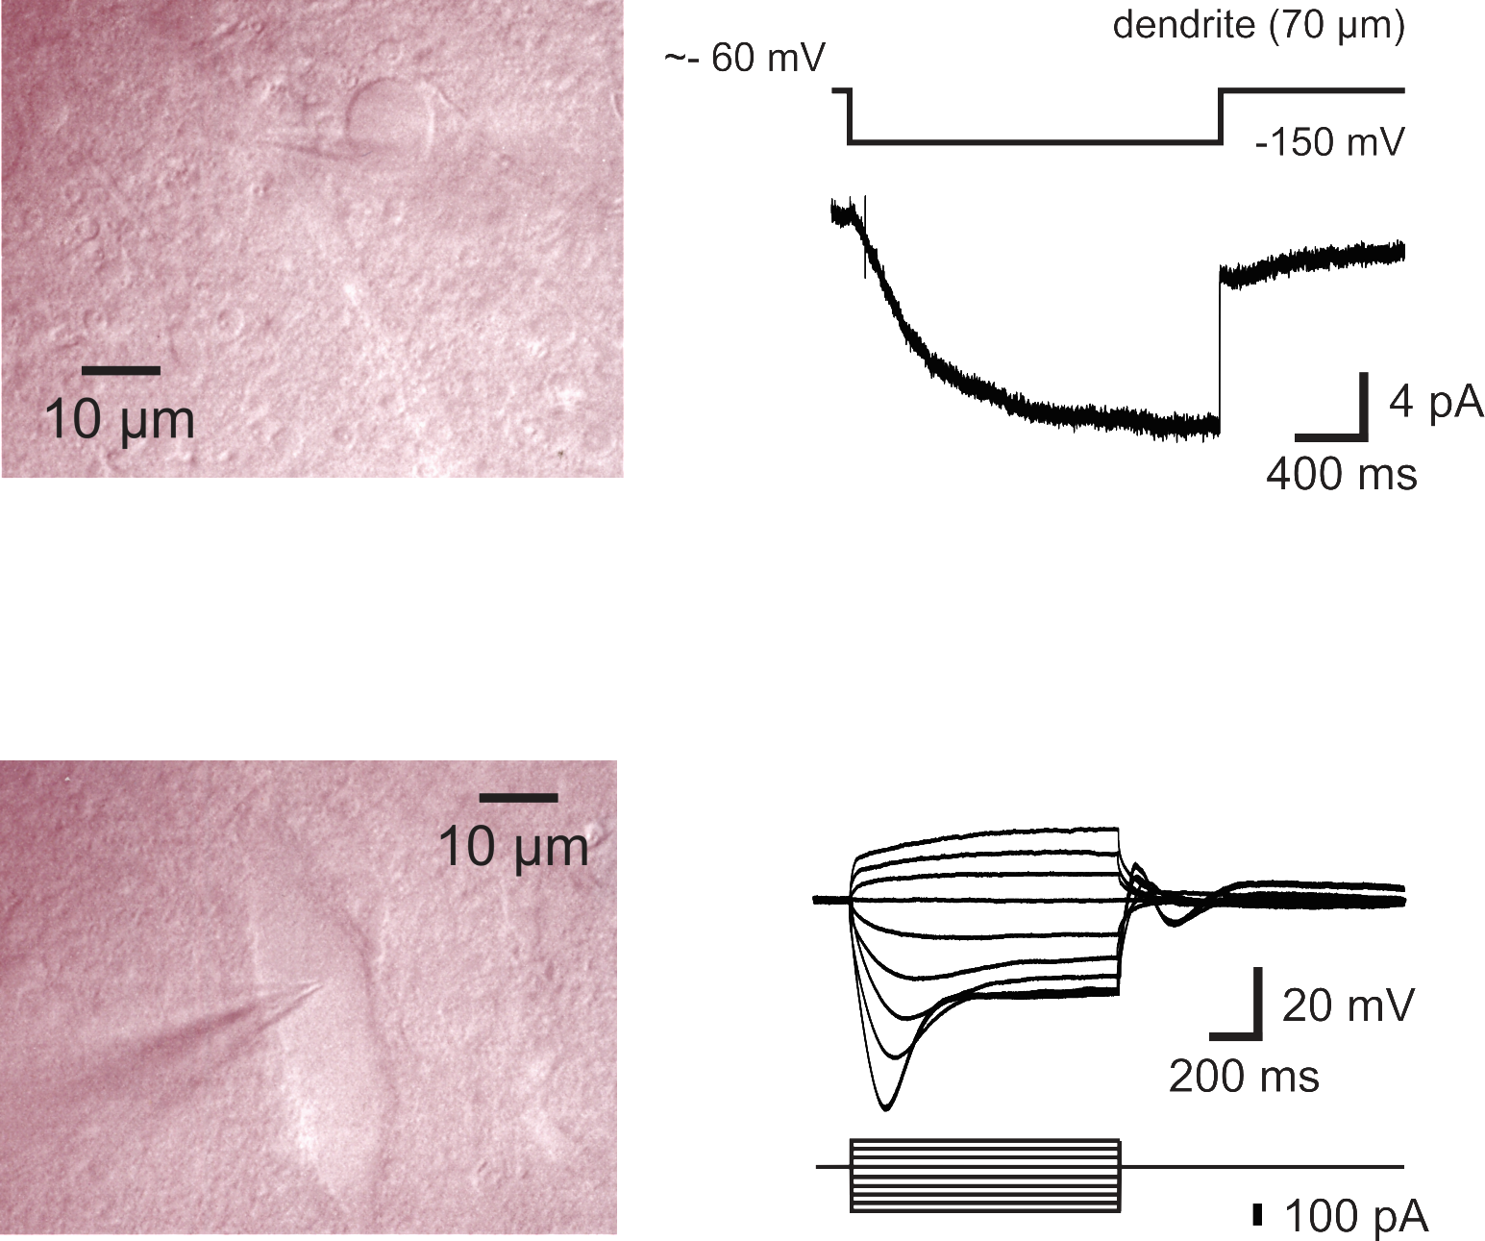
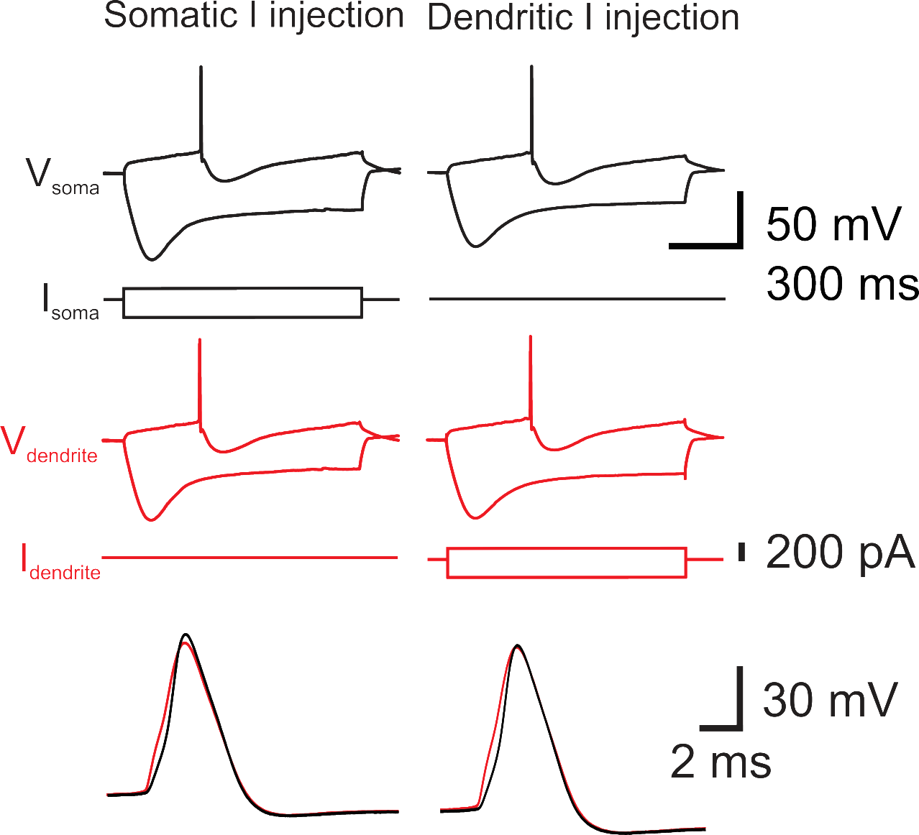
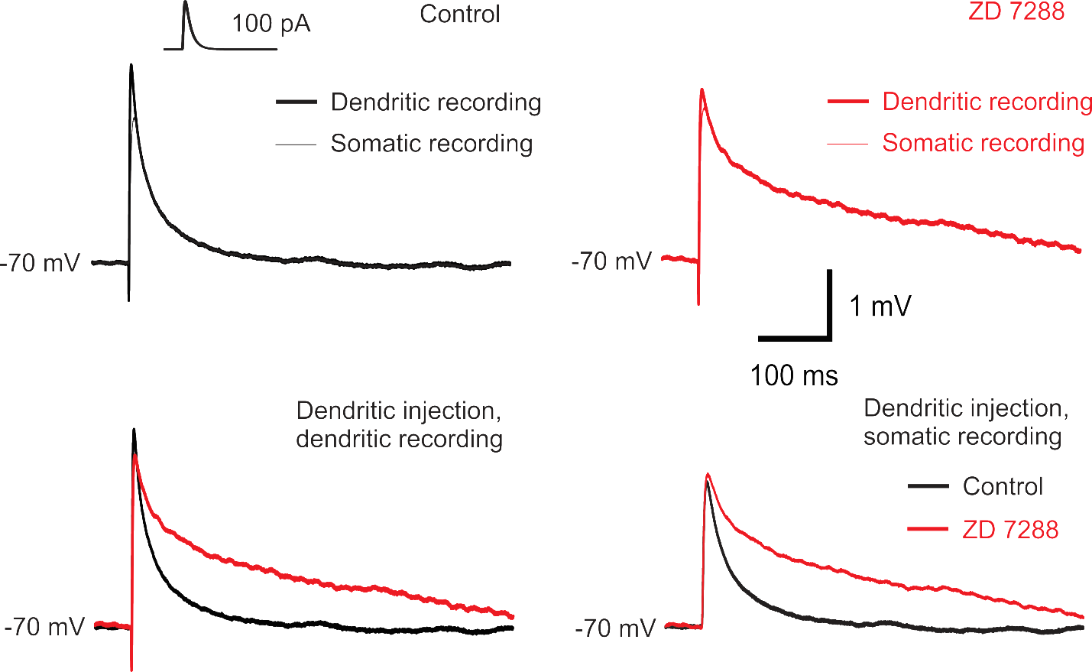
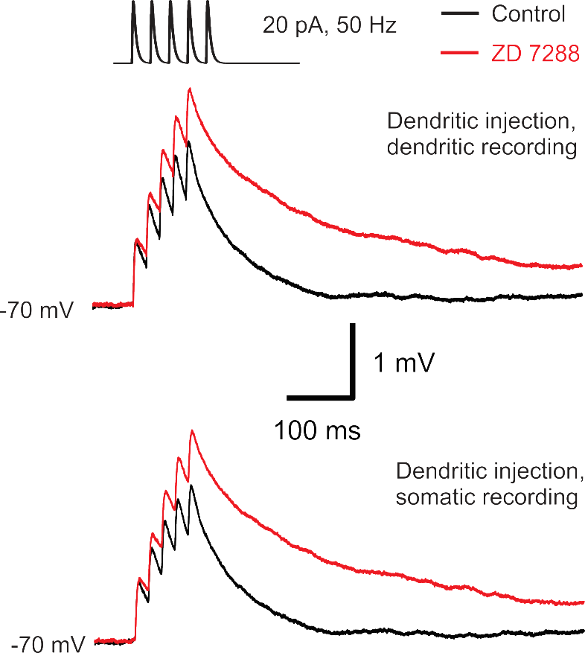
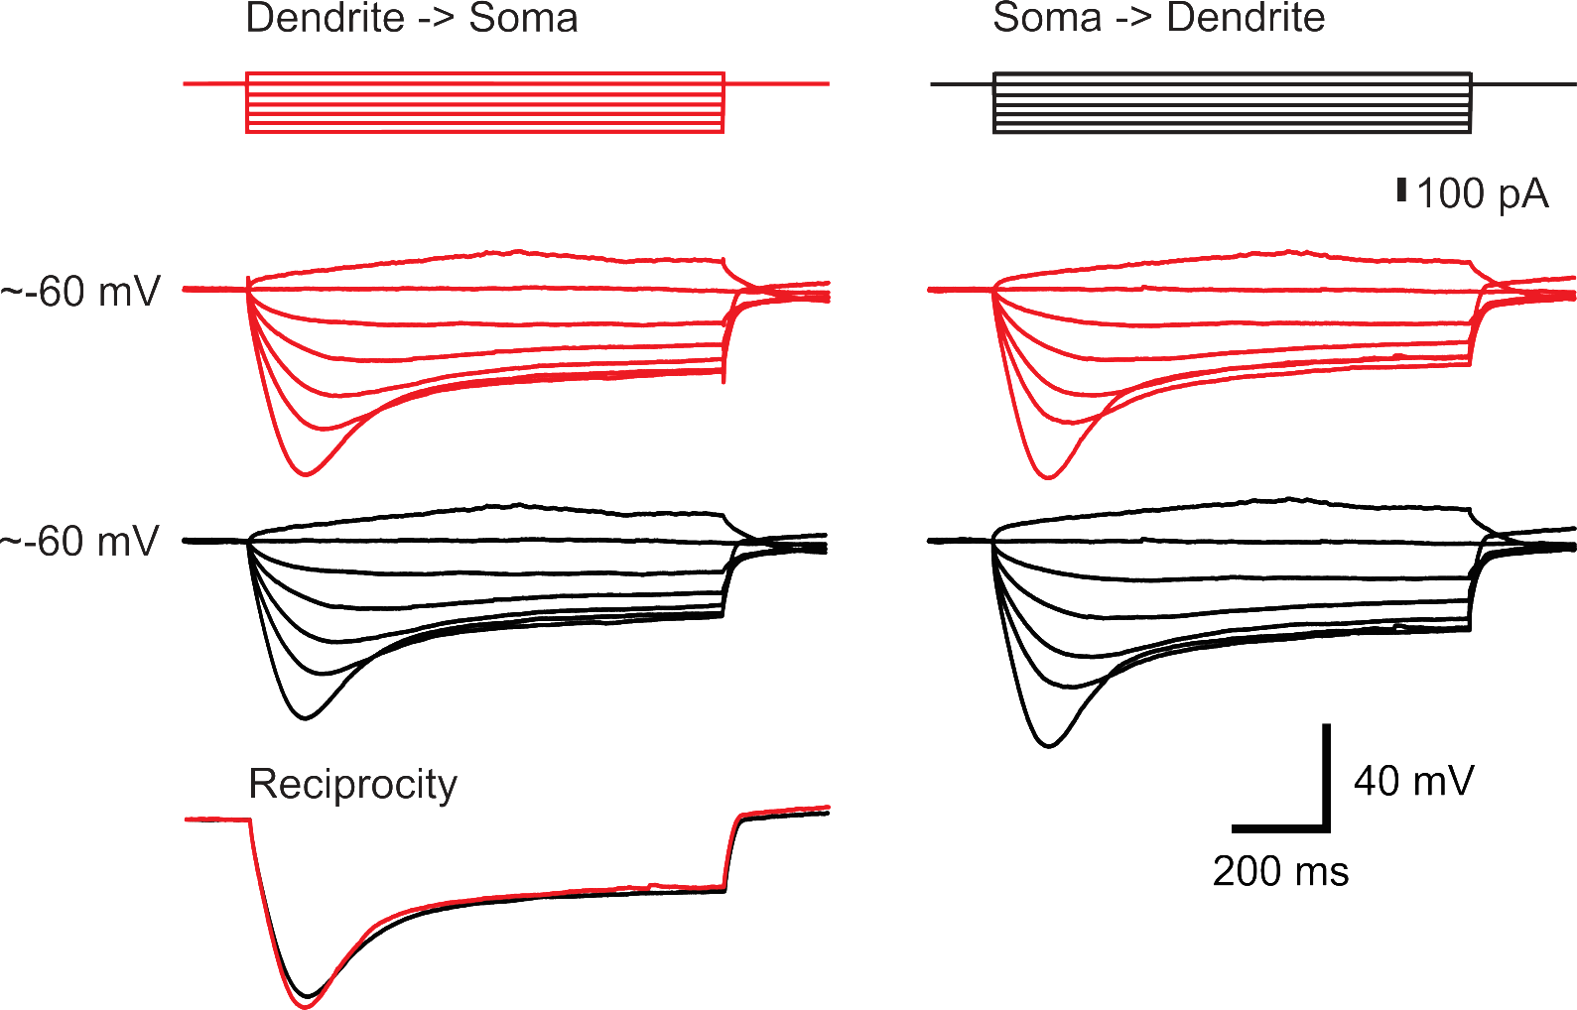
Hyperpolarization-activated cation current I_{h} influences synaptic integration properties in substantia nigra dopamine neurons
Dominique Engel and Vincent Seutin
GIGA-Neurosciences, Neurophysiology unit, B-4000 Liège, Belgium
Introduction
The hyperpolarization-activated cation current (I_{h}) is expressed in several principal neurons (Angelo et al., 2007; Berger et al., 2001; Magee, 1998; Williams & Stuart, 2000) and in interneurons (Aponte et al., 2006; Maccaferri & McBain, 1996; Vervaeke et al., 2012). Their contribution to neuronal signaling includes the modulation of various parameters such as passive and active membrane properties, intrinsic resonance, synaptic integration and synaptic plasticity. One of the most characteristic function of I_{h} is to influence synaptic integration by shortening the width of excitatory postsynaptic potentials (EPSPs) and reducing the temporal summation. Hereby, EPSPs arriving at the soma have similar width, regardless of their origin. This effect of I_{h} is due to a specific distribution of the current along the somatodendritic domain of neurons. In the substantia nigra (SN), dopamine (DA) neurons are implicated in the control of movement by the release of dopamine in the striatum. Their degeneration is related to motor disturbances as they are described for Parkinson’s disease. Interestingly, the axon of dopamine neurons generally originates from a dendrite dividing the dendritic compartment of these neurons in axon- and non-axon bearing dendrites (Häusser et al., 1995). This morphology contrasts with the typical arrangement of subcellular compartments found in neurons. DA neurons are also well known to display a prominent sag in the membrane potential with long hyperpolarizing current injections. This sag is consecutive to the activation of slow I_{h} channels composed by HCN2, HCN3 and HCN4 subunits but not HCN1 (Dufour et al., 2014; Franz et al., 2000). Given these specific characteristics of dopamine neurons, it is important to determine the subcellular distribution of I_{h} in these neurons and their role in synaptic integration. We performed local somatic and dendritic cell-attached patch-clamp recordings along the somatodendritic domain of dopamine neurons and observed that I_{h} exhibits a nonuniform distribution. Using simultaneous whole-cell somatic and dendritic recordings we examined the effects of I_{h} on single and multiple synaptic inputs and found that the current decreases EPSP integral and temporal summation.
Conclusion
The distribution of I_{h} is not uniform along the somatodendritc axis of DA neurons. Current’s highest density is found in axon-bearing dendrites, in a membrane area surrounding the axon origin. In the soma and nonaxon-bearing dendrites, I_{h} density is lower and uniform.
In control conditions, the integral of sEPSPs and temporal summation is linearly distributed in the soma and dendrites indicating that I_{h} generates a normalization of the waveform of sEPSPs and of the summation. Blocking I_{h} reveals an increase of sEPSPs integral and summation which are on average independent of input location along the somatodendritic domain.
The higher density of I_{h} near the axon origin influences the synaptic integration allover the somatodendrtic domain of DA neurons, presumably via the cellular average density of the channel.
Methods
Coronal 300-350 µm-thick slices were prepared from the brains of 16- to 21-day-old Wistar rats. Animal were killed by decapitation, in accordance with EU, national and institutional guidelines. For dissection, the solution contained in mM: 87 NaCl, 25 NaHCO₃, 10 D-glucose, 75 sucrose, 2.5 KCl, 1.25 NaH₂PO₄, 0.5 CaCl₂ and 7 MgCl₂, equilibrated with 95 % O₂ / 5 % CO₂. Slices containing the substantia nigra were stored in standard physiological saline. For recordings, the slices were perfused with saline containing in mM: 125 NaCl, 25 NaHCO₃, 25 D-glucose, 2.5 KCl, 1.25 NaH₂PO₄, 2 CaCl₂ and 1 MgCl₂. Pipette tip resistances were between 6 and 10 MΩ and between 8 and 19 MΩ for whole-cell somatic and dendritic recordings respectively. The composition of the internal solution was, in mM: 120 KMeSO₄, 20 KCl, 2 MgCl₂, 2 Na₂ATP, 0.5 Na₂GTP, 5 Na₂-phosphocreatine, 0.1 EGTA, 10 HEPES and 0.1% biocytin (pH = 7.3). In all cell-attached experiments, pipette resistance was standardized at 10 MΩ. Cell-attached pipettes were filled with high potassium solution of the following composition, in mM: 120 KCl, 2 CaCl₂, 1 MgCl₂, 10 HEPES, 20 TEA-Cl, 5 4-AP, 1 BaCl₂, 0.02 CdCl₂ and 200 nM TTX. The I_{h} blocker ZD 7288 (Tocris) was dissolved in distilated water to obtain a final concentration of 30 µM. To prevent spontaneous firing during cell-attached recording, 200 nM TTX and 200 µM CdCl₂ were added to the external solution. Recordings were performed using two Axopatch 200B amplifiers (Molecular devices, Palo Alto, CA) connected to a PC via a Digidata 1440A interface. Data were acquired with clampEx 10. The current-clamp signal was bessel filtered at 10 kHz and sampled at 100 kHz. Whole-cell dendritic recordings were discarded if the access increased > 50 MΩ. PSPs were mimicked by injecting double-exponential current waveforms (τ_{rise}, 0.6 ms; τ_{decay}, 3 ms). All voltage recordings shown are the average of 40 single traces. The cell-attached voltage-clamp recordings were bessel filtered at 2 kHz and acquired at 20 kHz. Leak subtraction of cell-attached data were done on-line by running a P/4 subtraction protocol. The liquid junction potential was not corrected for. All recordings performed at 20−24°C. All data analysis was performed in Mathematica 8 or 9 (Wolfram Research), together with Stimfit 0.10 (Christoph Schmidt-Hieber, UCL) and Excel (Microsoft). The integral of single sEPSPs is calculated as the area, normalized to peak amplitude, from the beginning of the voltage trace to 400 ms after. For the morphology of dopamine neurons, slices were fixed for ~12 h in 4% paraformaldehyde, washed and incubated overnight with 1 µl Fluorescein Avidin DCS (Lab consult) per ml Triton X-100. After washing, slices were embedded in ProLong Antifade (Invitrogen). For tyrosine hydroxylase immunohistochemistry, slices were incubated with a primary monoclonal antibody against TH, (mouse, Immunostar). The secondary antibody (goat anti-mouse-Alexa 568) was applied together with Fluorescein Avidin DCS. The fluorescence was observed with a Olympus confocal microscope (FV1000) in collaboration with the GIGA-Imaging platform.
1
C
AP amplitude ratio
2
A
B
E
dendrite with axon
F
A
B
AP half-width ratio
I_{h} (pA µm⁻²)
I_{h} (pA µm⁻²)
D
Distance from the soma (µm)
Distance from the axon origin (µm)
axon
C
D
G
Biocytin
TH
Overlay
70 µm
E
Distance from the soma (µm)
dendrite (70 µm)
Delay (µs)
100 µm
soma
D_{axon to dendrite} – D_{axon to soma} (µm)
Action potential properties of substantia nigra DA neurons.
A, Confocal micrograph of a DA neuron filled with biocytin and stained with fluorescein isothiocyanate (FITC)-conjugated avidin. 20 µm stack projection. Simultaneous somatic (white pipette) and dendritic recording (red pipette, 70 µm from the soma center). White arrows indicate the axon. Note the presence of an axon bled at the end of the axon.
B, 1-s current steps (80 pA) were injected alternatively in the soma and in the dendrite and the resulting action potential (AP) was recorded at the soma (black) and dendrite (red). APs are generated first in the compartment where the axon was found to emerge. Same neuron as in A. Sag was observed with -200 pA current injections.
C, D, AP amplitude ratio and AP half-width ratio, respectively, measured for different distances from the soma. APs propagate without marked amplitude attenuation along dendrites. Note the longer AP half-widths in axon-bearing dendrites. Data are from 12 double somatic and 21 paired somatic-dendritic recordings.
E, Plot of the delay between somatic and dendritic APs as a function of difference of distances, using the axon emergence point as reference. Full circles ( ) are from somatic current injection; open circles ( ) from dendritic current injection. Data points for APs elicited by somatic current injection (n = 16) were fitted with a linear regression. Regression line intersected the x-axis near zero indicating the proximity to the axon origin (correlation coefficient r = 0.89; p < 0.001). The average AP propagation velocity was 0.34 m s⁻¹ .
Distribution of I_{h} along the somatodendritic axis of DA neurons.
A, Infrared differential interference contrast (IR-DIC) video image of a DA neuron dendrite.
B, I_{h} recorded in the cell-attached patch configuration from the DA neuron shown in A using a high K⁺ pipette solution. Voltage step: 2 s, -90 mV. Note the long time constant of current activation, 581 ms when fitted with a monoexponential function.
C, IR-DIC video image of the soma from the neuron shown in A.
D, Somatic voltage responses to 1-s depolarizing and hyperpolarizing current pulses in the whole-cell current-clamp recording configuration. Note the presence of the sag during hyperpolarizing current pulses and the absence of APs due to the presence of Na⁺ and Ca²⁺ channel blockers in the bath (TTX and CdCl₂) to suppress spontaneous activity.
E, Plot of somatodendritic distribution of I_{h} density as a function of distance from the soma. Data are from 12 somatic and 29 dendritic cell-attached patches.
F, Plot of somatodendritic distribution of I_{h} density as a function of distance from the axon. Data are from 31 patches.
G, Confocal micrograph of a DA neuron filled with biocytin and stained with FITC-conjugated avidin (left);
tyrosine hydroxylase immunoreactivity (center); overlay (right). 33-µm stack projection.
3
B
E
4
C
D
axon
Sag dend local / Sag soma local
Sag dend local / Sag soma local
A
A
B
axon
dendrite with axon
170 µm
Distance from the soma (µm)
Distance from the axon (µm)
C
D
Control
F
dendrite with axon
E
F
100 µm
ZD 7288
R_{in} dend local / R_{in} soma local
R_{in} dend local / R_{in} soma local
Rise time (ms)
Integral (mV . ms)
Integral (mV . ms)
Distance from the soma (µm)
Distance from the soma (µm)
Distance from the soma (µm)
Effect of I_{h} on sEPSP waveform and on summation of sEPSPs.
A, Confocal micrograph of a DA neuron filled with biocytin and stained with FITC-conjugated avidin. 100 µm stack projection.
B, Top left, Local sEPSP recorded at the injection point along a dendrite (thick trace) and simultaneous sEPSP recorded at the soma (thin trace). Observe the small decrease of the sEPSP amplitude due to propagation. sEPSPs are evoked by injection of EPSC-like double-exponential waveforms (τ_{rise} = 0.6 ms; τ_{decay} = 3 ms) of 100 pA. Top right, Effects of blocking I_{h} with ZD 7288 (30 µM) on sEPSPs. Bottom left, Effects of ZD 7288 on sEPSPs at the dendritic location. Bottom right, Effects of ZD 7288 on sEPSPs at the somatic location. Holding potential was -70 mV.
C, Rise time of sEPSPs as a function of distance between the injection point and the soma. Note the slight increase of sEPSPs rise time with distance from the soma under control ( ) and in the presence of ZD 7288 ( ).
D, Integral of sEPSPs as a function of distance from the soma. Data points in C and D are from 13 double somatic recordings expressed as the mean ± s.e.m. and 21 paired somatic − dendritic recordings.
E, Top, Summation of sEPSP before (black trace) and after application of ZD 7288 (red trace) at the injection site. Bottom, Summation of sEPSP before (black trace) and after application of ZD 7288 (red trace).
F, Integral of multiple sEPSPs as a function of distance from the soma. Data points are from 11 double somatic recordings expressed as the mean ± s.e.m. and 18 paired somatic − dendritic recordings.
Distance from the soma (µm)
Distance from the axon (µm)
Subthreshold properties of DA neurons.
A, Simultaneous recording of somatic voltage (black traces) and dendritic voltage (red traces) induced by dendritic current injections of 1-s long steps (red). Bottom, Superimposition of voltage traces induced by -200 pA current injection recorded at the non-injecting pipette.
B, Dual recording of somatic voltage (black traces) and dendritic voltage (red traces) in the same neuron in response to the application of somatic current steps (black) as in A. Note the similarity of the sag at both recording locations.
C, Ratio of local sag measured at the dendritic and somatic locations as a function of distance from the soma. Values are normalized to the input resistance measured at the soma for each neuron. Sag response was measured using a -200 pA current step.
D, Ratio of sag as a function of the distance from the axon origin. Note the location independency of the sag along the somatodendritic domain.
E, Apparent input resistance (R_{in}) as a function of distance from the soma. Values are normalized to the input resistance measured at the soma for each neuron. R_{in} was calculated using small amplitude current injections around zero (-80 to +40 pA, increment 40 pA).
F, Apparent input resistance as a function of distance from the axon origin. Data points were fitted with a linear regression showing a slight increase of 9% / 100 µm.

