Slide 1

Governing (Through) Digital Urban Twins: Reconfiguring the role of public authorities in data-based governance
Hadrien Macq
FRS-FNRS Postdoctoral Research Fellow
SPIRAL Research Center
University of Liège
STS Graz, May 9 2023

Slide 2
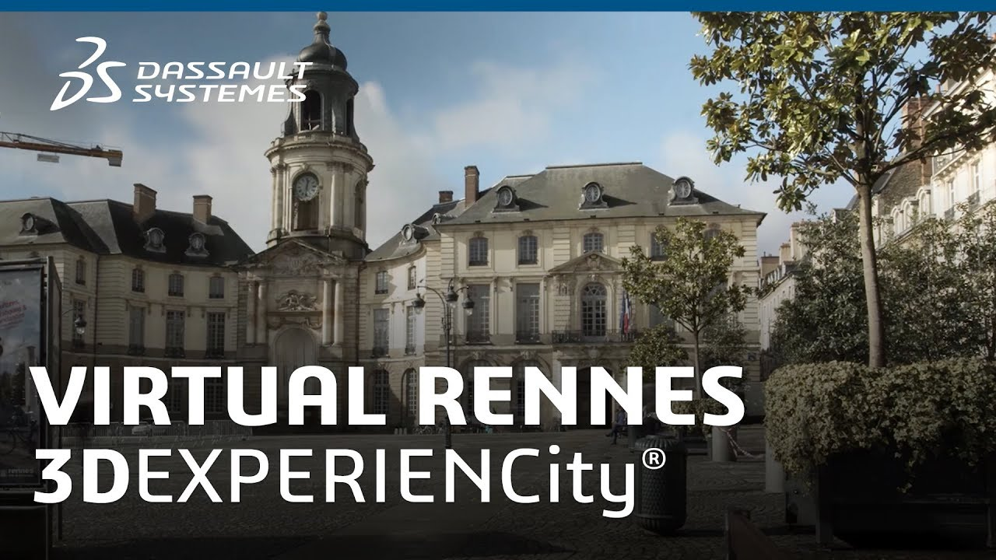
Experimenting (with) Digital Urban Twins
“The experiment we conducted with Dassault was really an experiment that was to last four years and whose objective was to evaluate the contribution of these collaborative tools based on 3D in our various activities. So we tested use cases, but the objective was not to set up a permanent solution.” (Interview, December 2022)

Slide 3
Experiments in urban governance
‘Smart city’ agendas, urban spaces as ‘testing grounds’ (Coletta et al. 2018; Halpern et al. 2013)
Technologies and society as objects of experimentation (Engels et al. 2019; Macq et al. 2021)
‘City experiments’. Both technologies and the city are experimented → redesign and reorganize the city (inc. its governance) (Laurent and Pontille 2018)
DUT as products of public authorities’ experiments as well as generative of experiments on public authorities

Slide 4
A pragmatist take on ‘What is the State?’
Sociology of ‘state trials’
  Occasions in which ‘state practitioners’ need to cope with the ‘What is the State’ question
  → Examining how they deal with it
  “… the question of what the state is (what its legitimacy is, what its shape and function are, what are its scope and its limits, its resources and its effects) is not a preliminary question but the very matter of the empirical investigation as such.” (Muniesa and Linhardt 2011, p. 551)

Slide 5
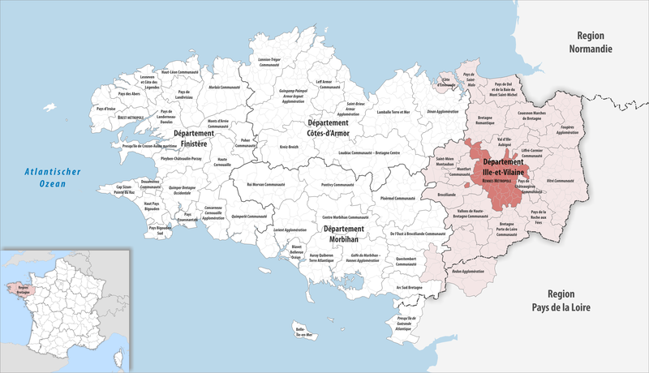
Rennes Métropole DUT

Slide 6
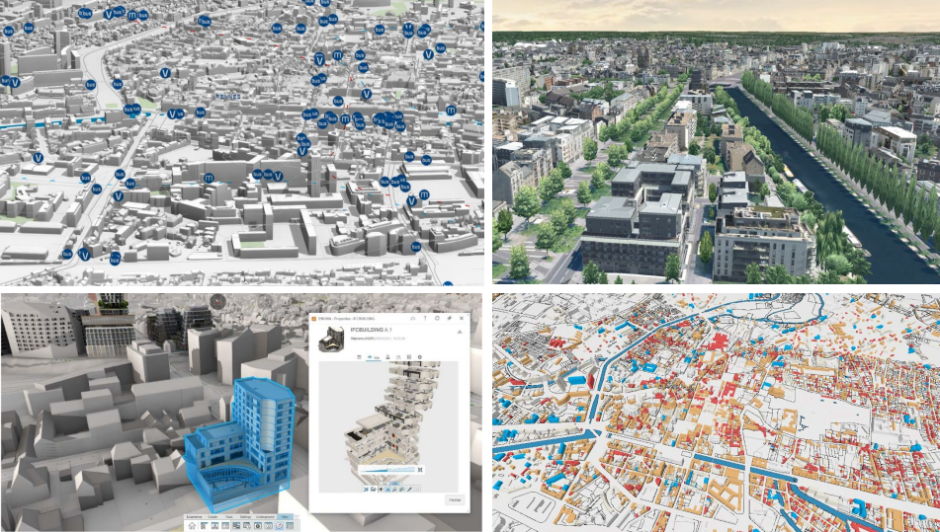
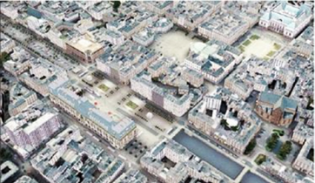

From a 3D model to digital twin(s)
1999: 3D city model
2017: Digital Twin(s)
Real-time data
Visualisation → Collaboration
Evolving uses
2017-2021

Slide 7
Articulating the DUT with (new) urban governance
“It's a somewhat atypical project, since we're going to demonstrate that we can build a sustainable city with a sandbox, a playground, and grey matter. The sandbox is the Dassault Systèmes platform, which enables cities to be designed digitally, the playground is Rennes Métropole, and then the grey matter will be provided by innovators from the digital world who will come and develop innovations to make the city more sustainable and, of course, we mustn't forget the citizens, as the objective of the platform is for citizens to take hold of these innovations and contribute to making the city more sustainable and livable.” (Official presentation discourse, May 2017)

Slide 8
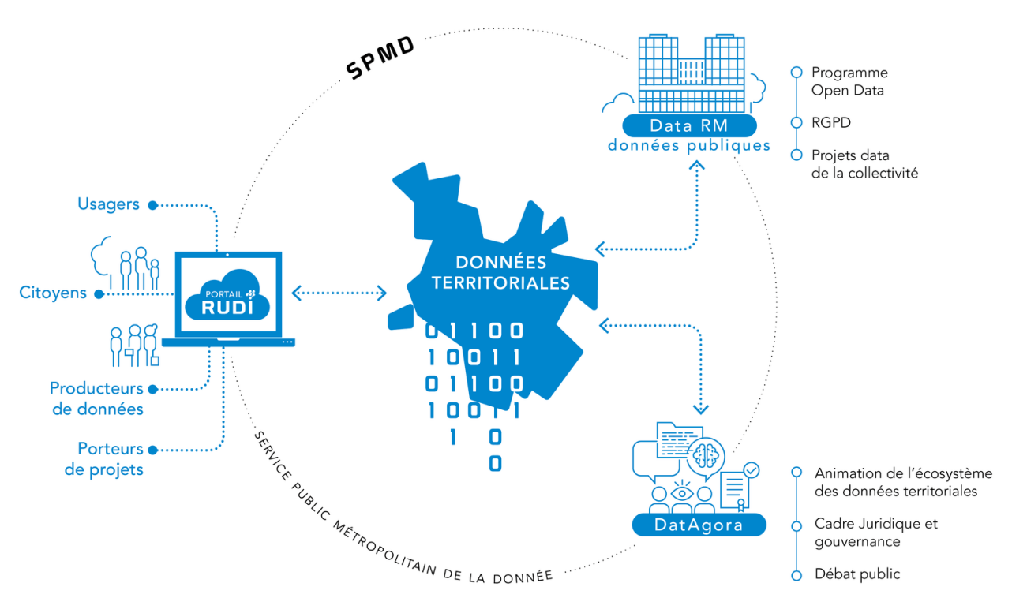
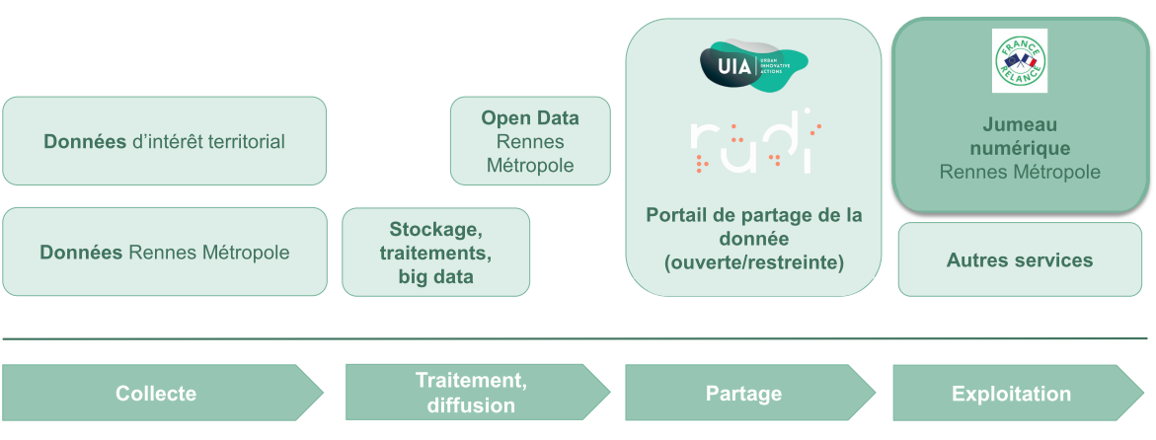
DUT in a broader ‘territorial data’ ecosystem

Slide 9
(Re)negociating the role of the State in the ecosystem
Different (evolving) uses of DUT:
  Enrich decision-making
  Educate and co-create with citizens
  Coordinate the action of private entities in ‘managing’ the city
Public bodies have to ensure a ‘coordinated approach’
  Centralization and sharing of data
  Caring for ‘public’ data

Slide 10
State practioners and their puzzles
“It is not the role of the public actor to replace private actors. And this is the whole point of the question of mastery, of knowing what we need to master: do we need to master the infrastructures? Do we need to master the applications? Do we need to master the moment of storage or the moment of exploitation? And what does "mastering" mean? It doesn't necessarily mean doing it yourself. There are many things that we control and that we don't do ourselves. We can imagine being an organizing authority for the data and still not be direct operators of the solutions that we must implement for the data.” (Interview, December 2022)

Slide 11
Discussion
DUT as platforms to be experimented, and as generative of experiments on what the State is and how it ought to act
Platform State, ‘Government 2.0’ (O’Reilly 2011)
    Value-creation lies in the harnessing of users’ power to add value (co-creation)
    The State is « a convener and an enabler rather than the first mover of civic action » (p. 15)
    Key questions and area of experimentation: How to make data ‘actionable’ (Jasanoff 2017) to ensure interoperability and re-use
From above but still in-the-making: the ‘State’ is shaped through trials faced by state practitioners
    Temporary, situated, fragile configurations of governance
    What further evolution(s)?

Slide 12
Thanks!
hadrien.macq@uliege.be

Slide 13
Governing (Through) Digital Urban Twins: Reconfiguring the role of public authorities in data-based governance
Hadrien Macq
FRS-FNRS Postdoctoral Research Fellow
SPIRAL Research Center
University of Liège
STS Graz, May 9 2023

Slide 14
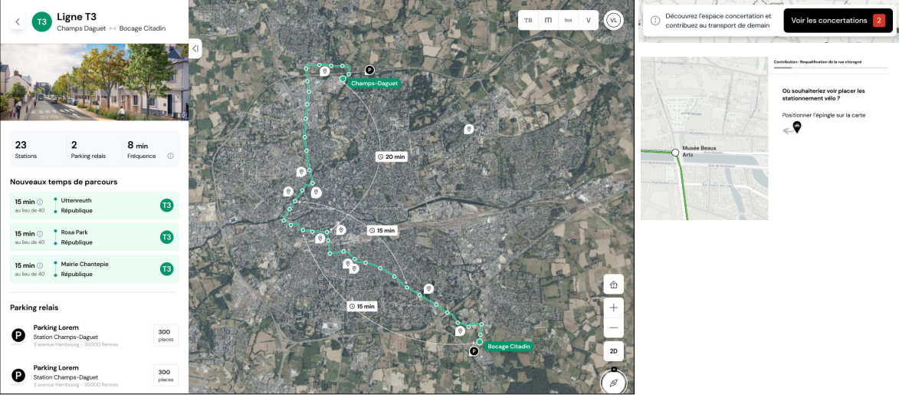
Multiple twins for multiple uses and users
Involving citizens in urban governance

Slide 15
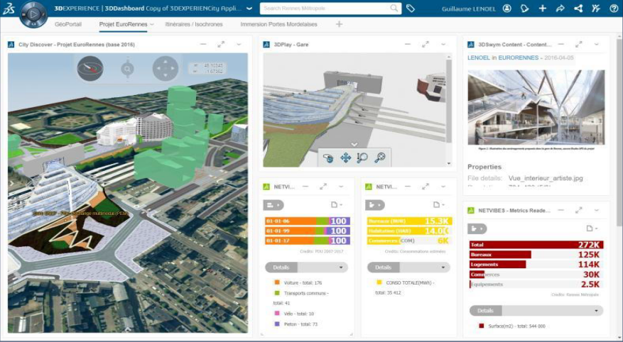
Multiple twins for multiple uses and users
Coordinating urban projects

Slide 16
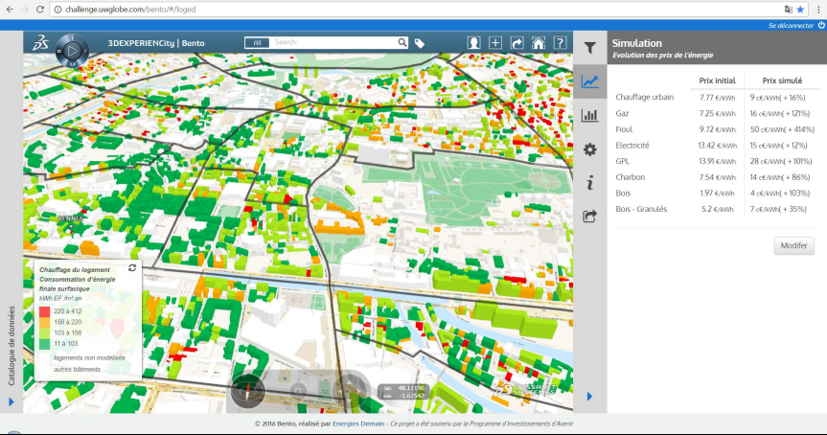
Multiple twins for multiple uses and users
Enriching urban planning

Slide 17
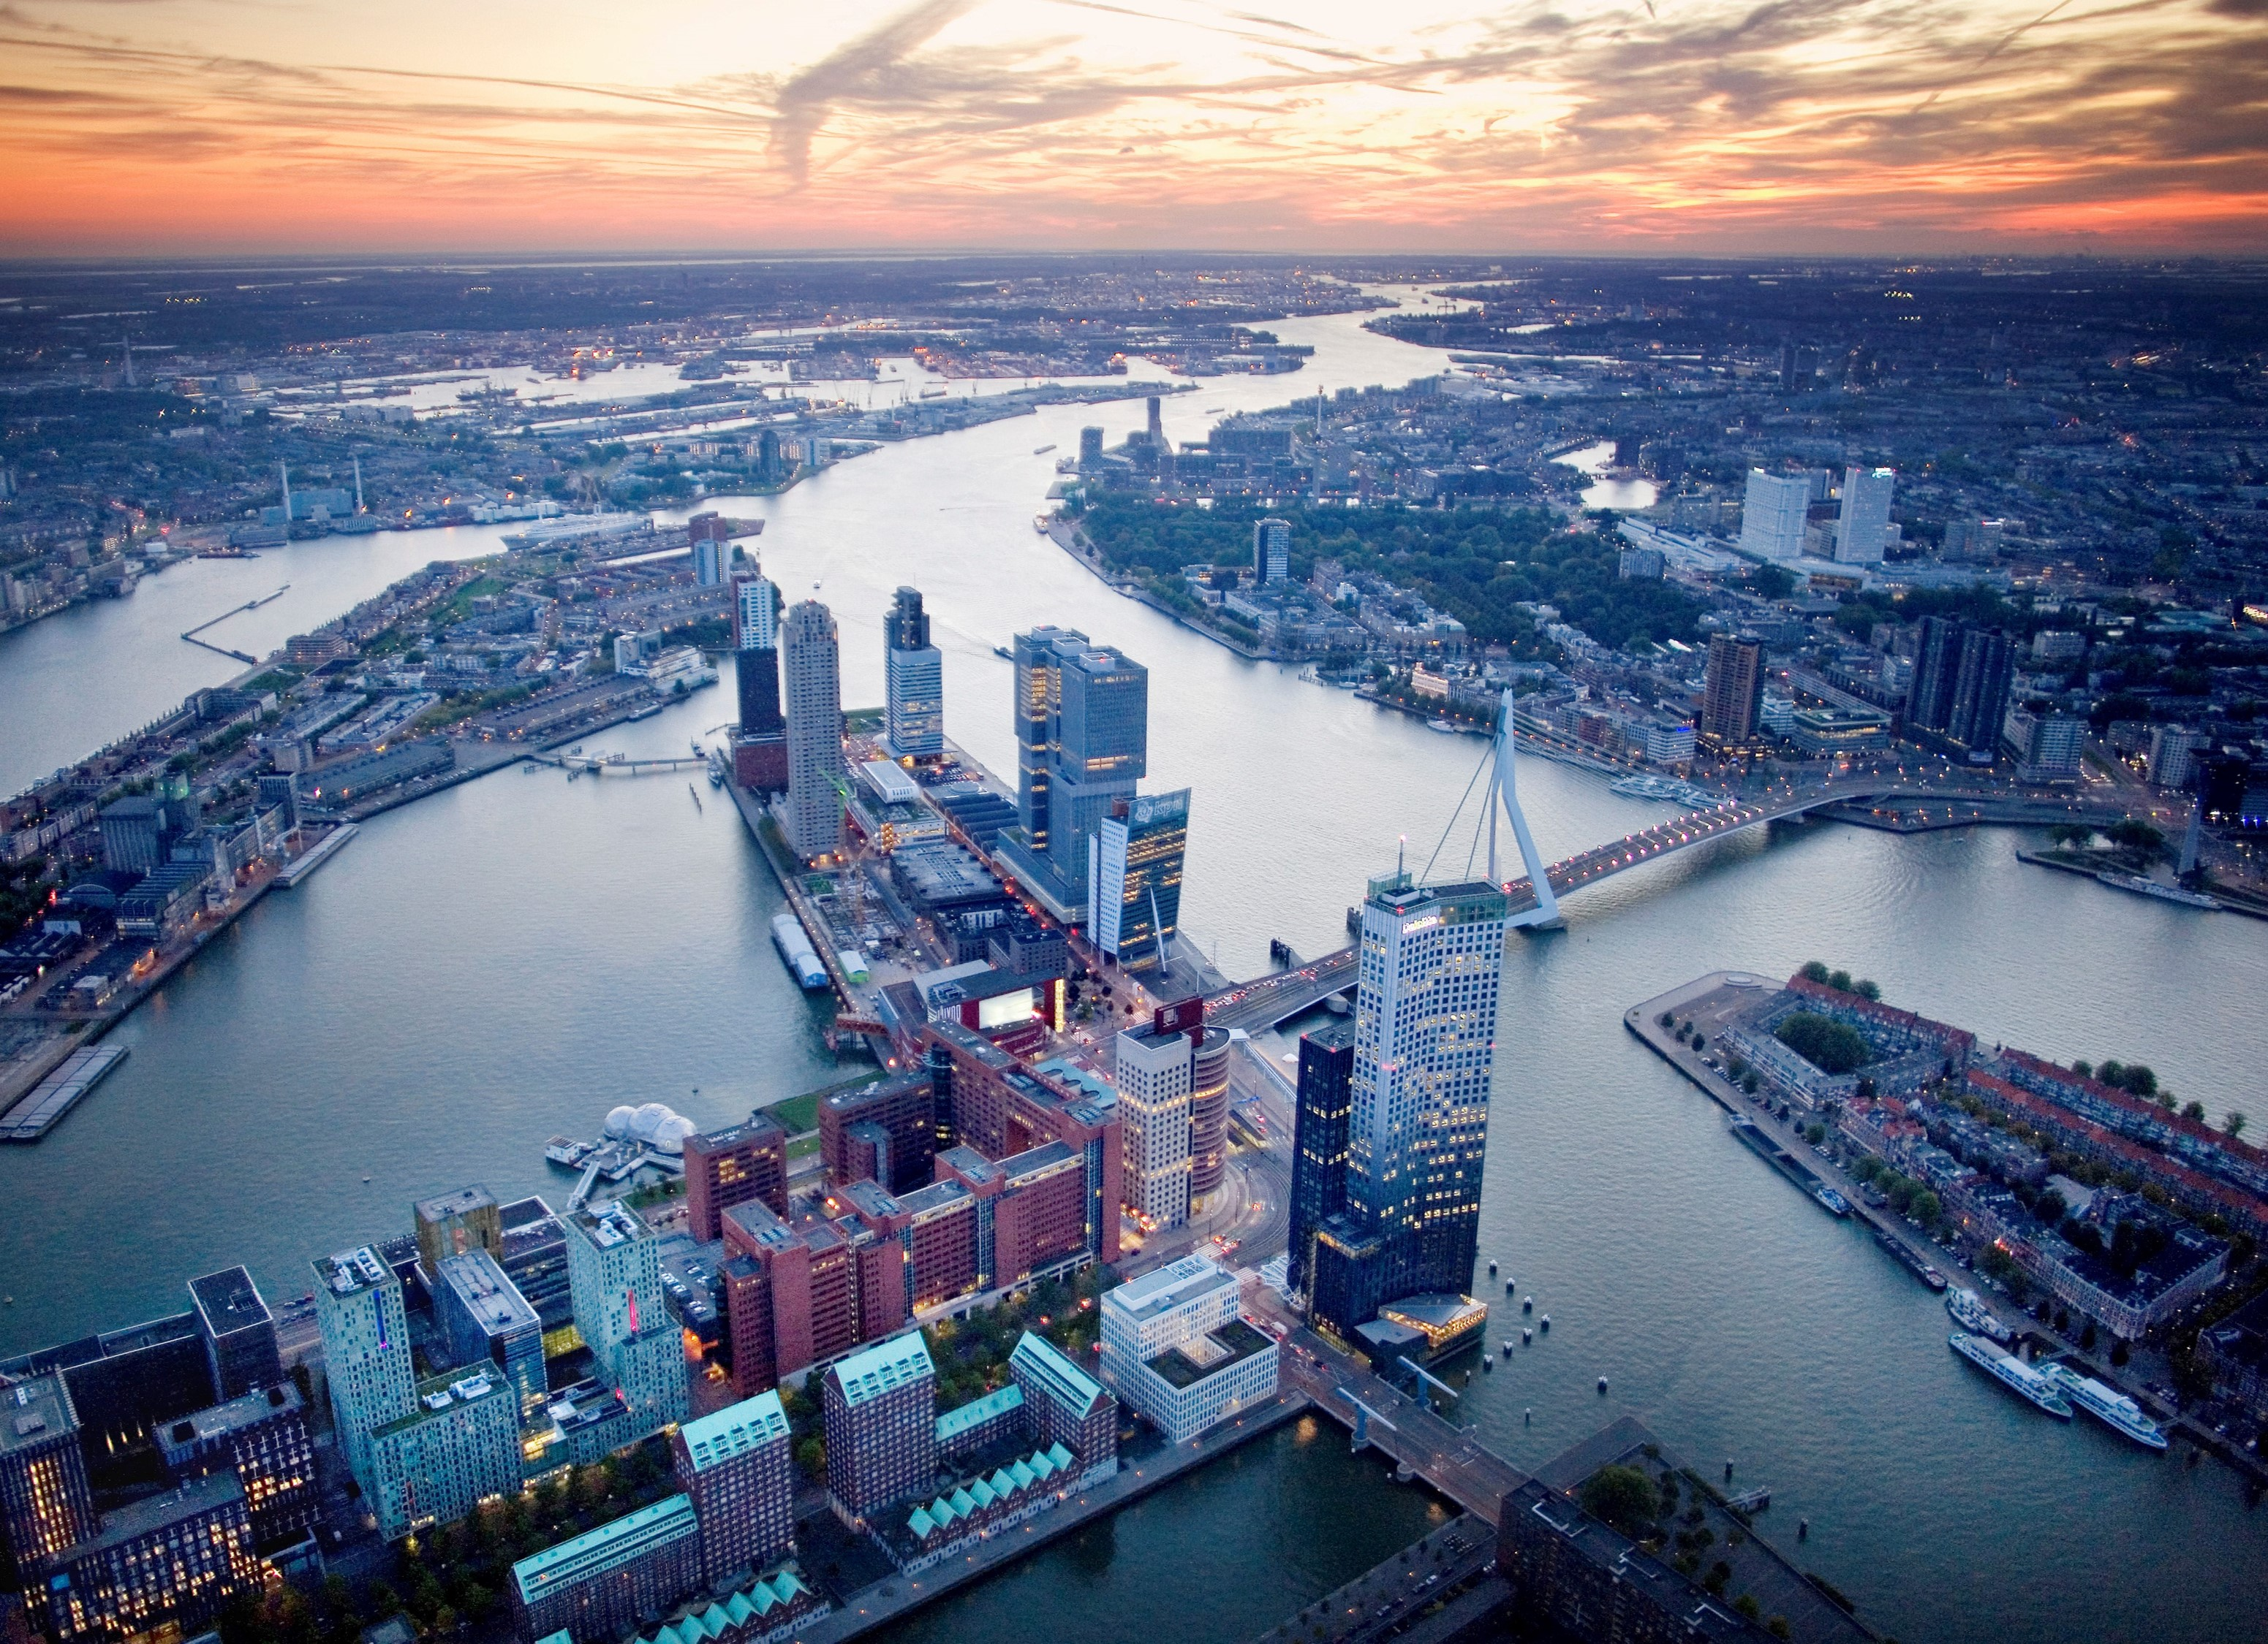
A way forward?
→ ‘Marketplace’ for the private actors of the territory
→ Reinforcing links with the economic sector
Rotterdam, NL

Slide 18
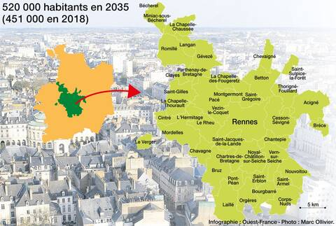
Rennes Métropole DUT

