Slide 1
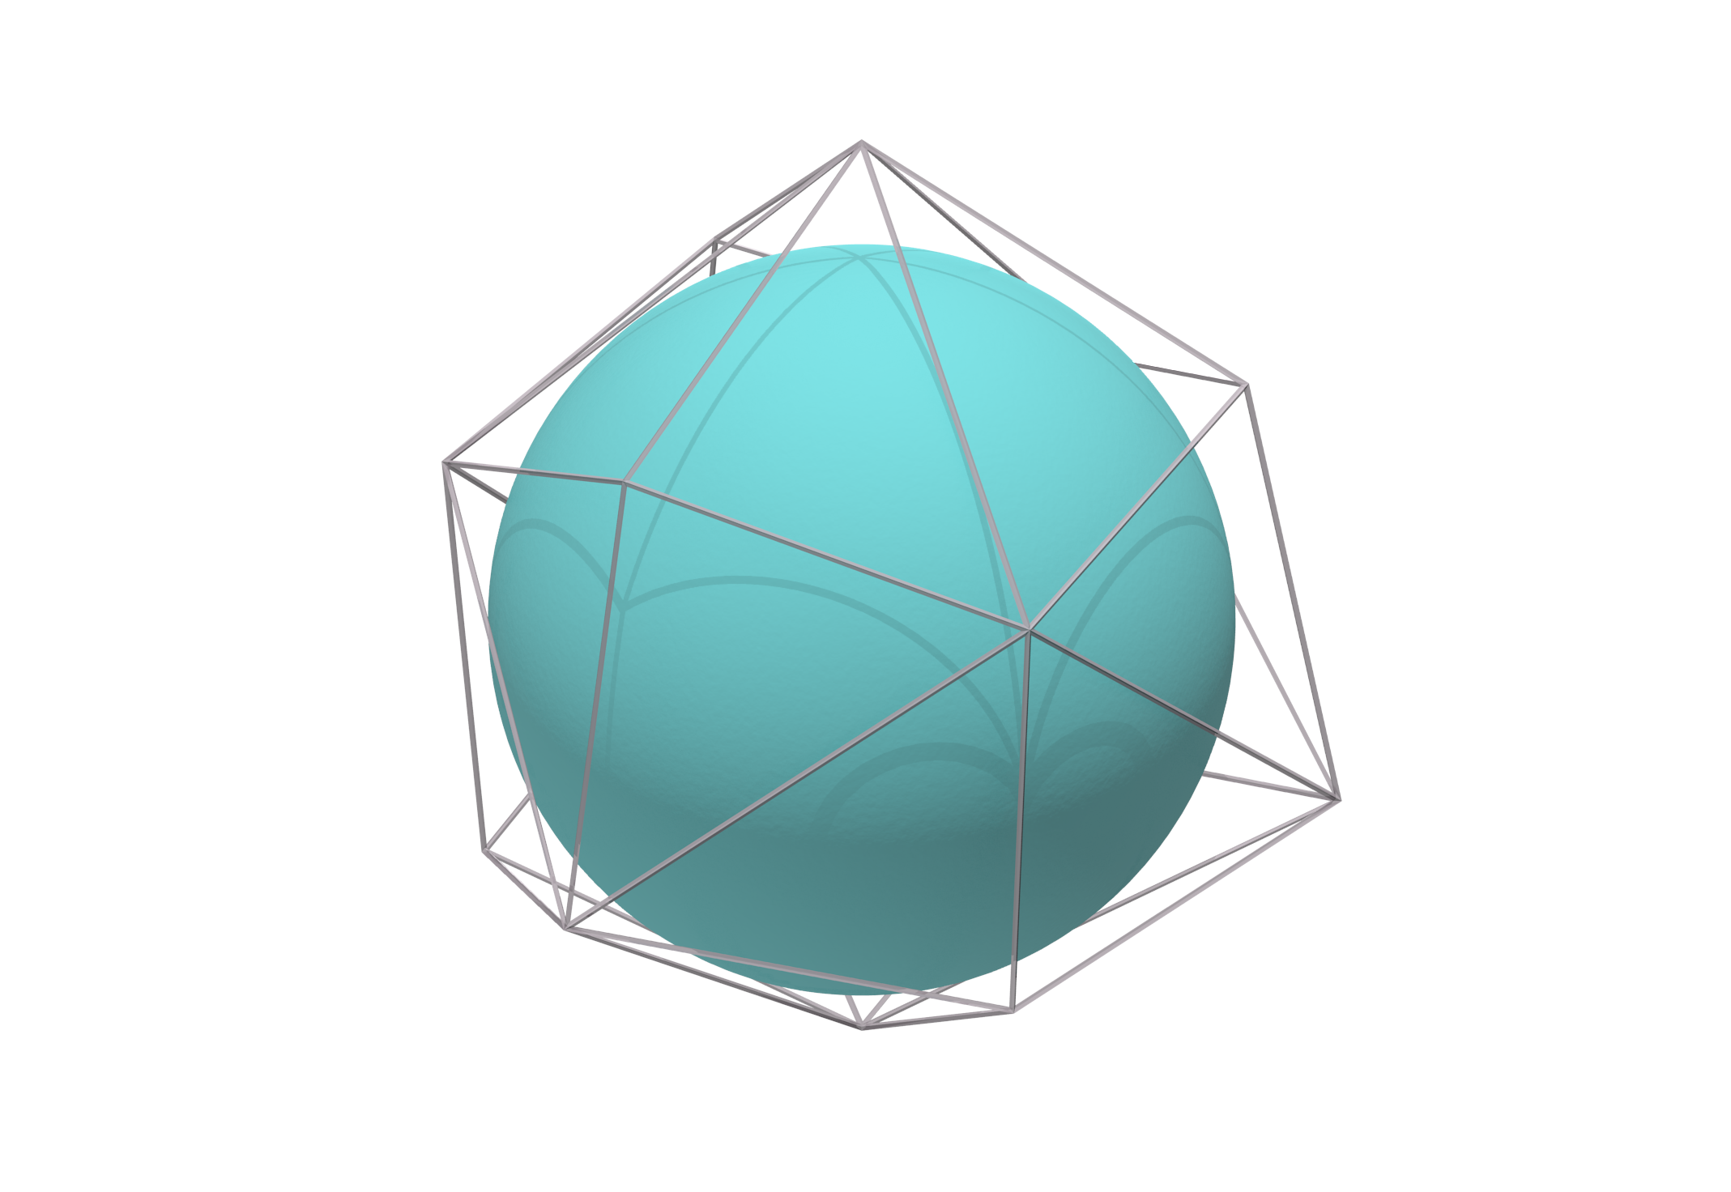
Polytopes of Absolutely Positive Wigner Spin States
J. Denis, J. Davis, R. B. Mann and J. Martin

Slide 2
Polytopes of Absolutely Positive Wigner Spin States
J. Denis, J. Davis, R. B. Mann and J. Martin

Slide 3
Everything is quantum !

Slide 4
Everything is quantum !
Okay great... But when is it not ?

Slide 5
Outline
Classical and quantum phase-space representation
Crash course on density matrix
AWP polytopes and balls
Conclusion and outlook

Slide 6
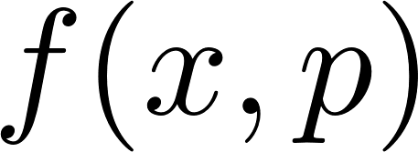
Classical phase-space mechanics
Probability distribution :
: probability that the system
has position and momentum
Positivity :
Marginals give the mean value :
Quantum problem : Heisenberg uncertainty principle

Slide 7
P.A.M. Dirac :
"I think it is obvious that there cannot be any distribution function which would give correctly the mean value of any function depending on position and momentum"

Slide 8
WRONG
P.A.M. Dirac :
"I think it is obvious that there cannot be any distribution function which would give correctly the mean value of any function depending on position and momentum"

Slide 9
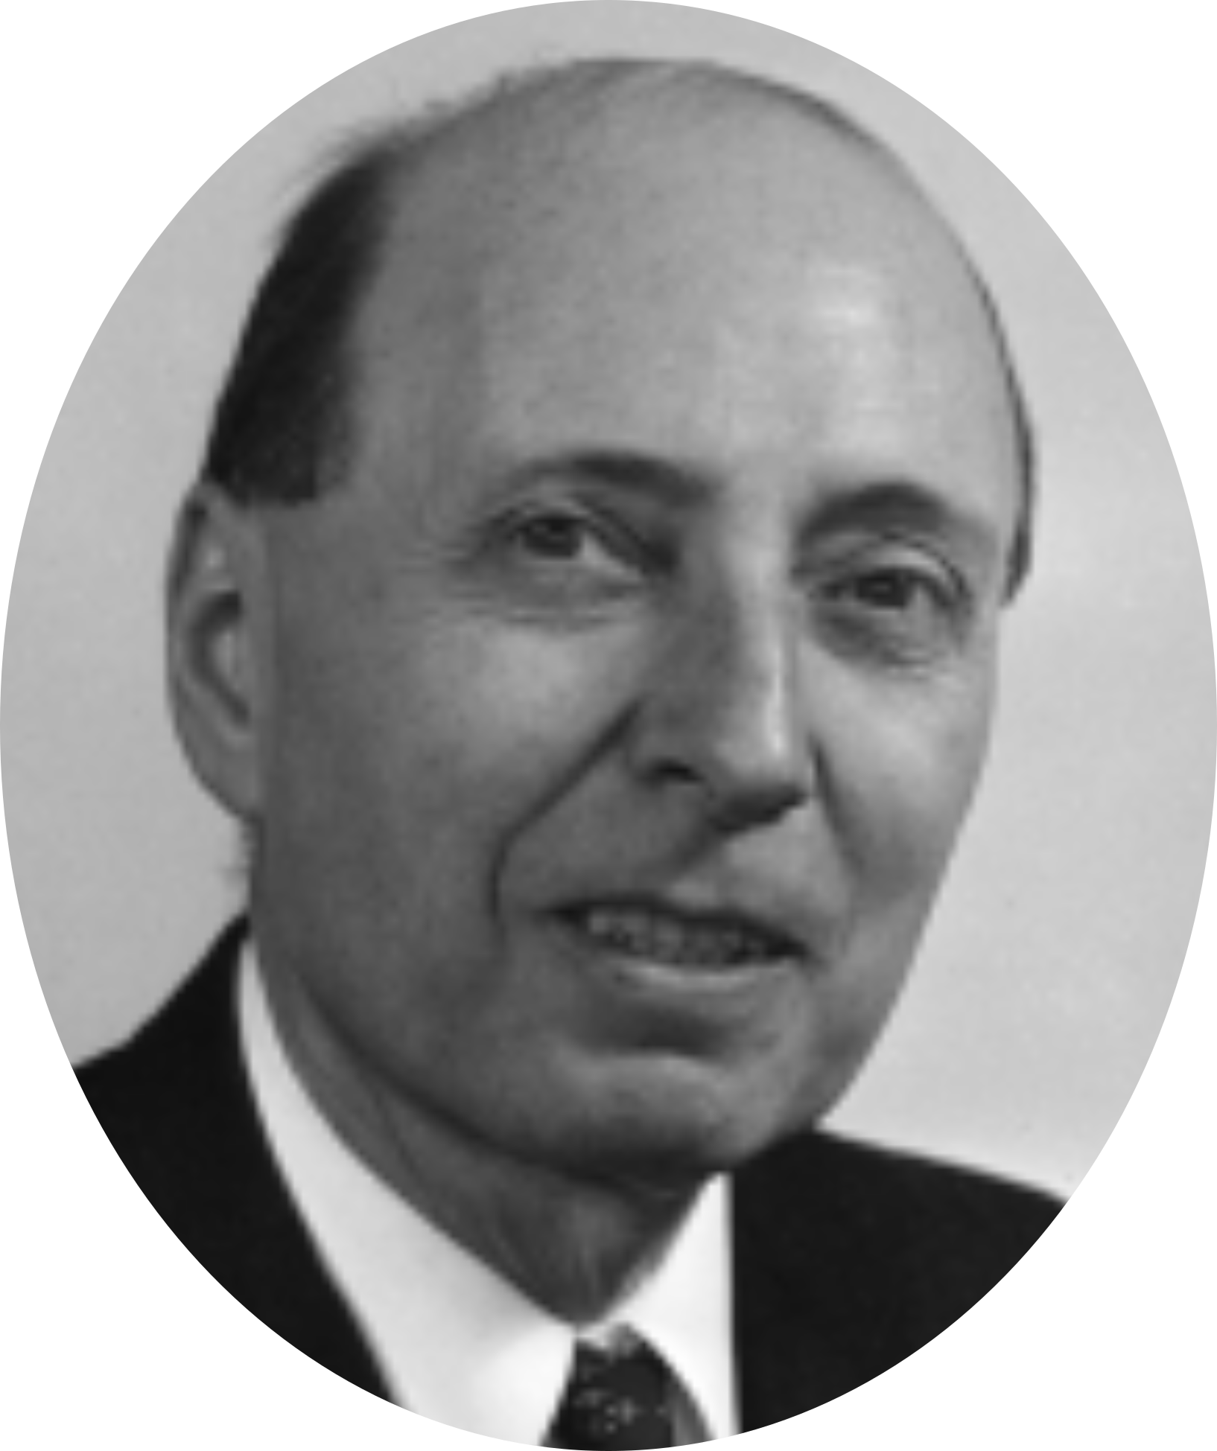
Wigner function
Marginals give
the mean value
Negativity witnesses non-classicality !

Slide 10
Can we find a simple criteria for a system to be Wigner negative ?

Slide 11
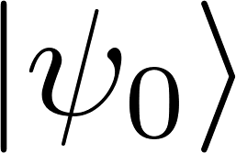
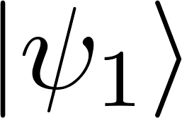
Crash course on density matrix
OR

Slide 12
Crash course on density matrix
Looks like a quantum superposition
OR

Slide 13
Crash course on density matrix
Awesome notation
OR

Slide 14
Crash course on density matrix
Awesome notation
OR

Slide 15
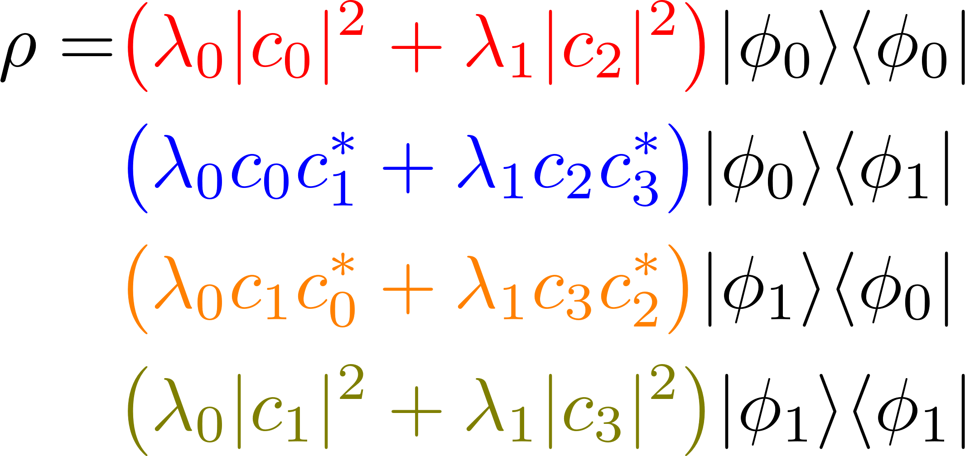
Crash course on density matrix
Awesome notation
OR

Slide 16
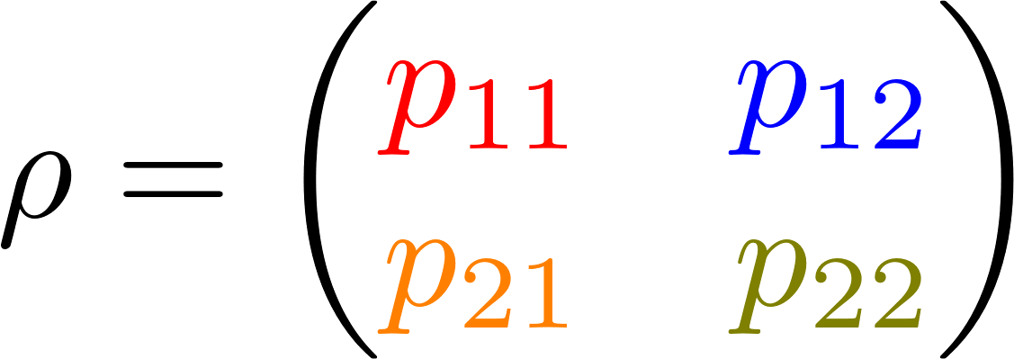
Crash course on density matrix
Awesome notation
OR

Slide 17
Crash course on density matrix
Awesome notation
OR
Linear Algebra : the eigenvalues are invariant w.r.t. the basis

Slide 18
Isolated quantum systems
e.g.
Similar to a change of basis
Eigenvalues unchanged
Quantities defined on eigenvalues are invariant under unitary evolution

Slide 19
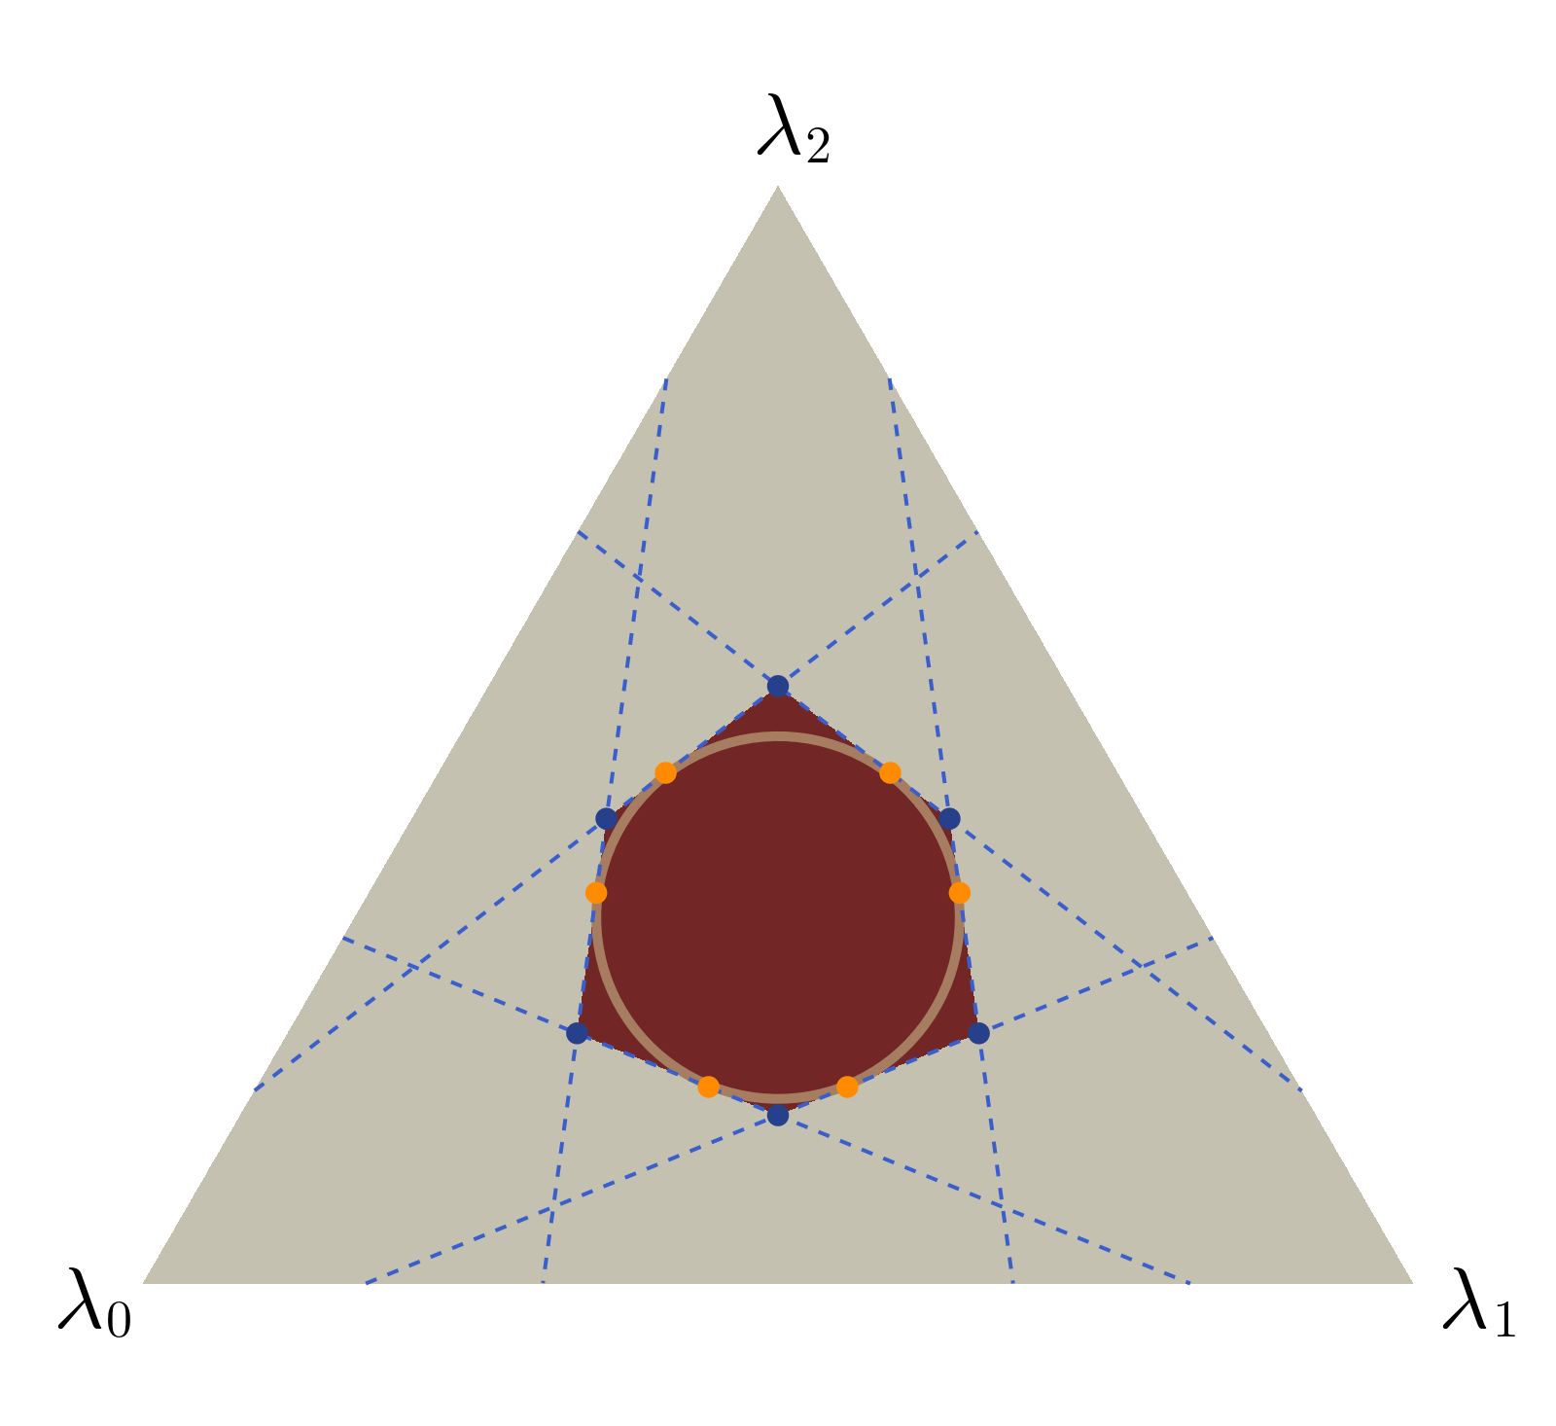
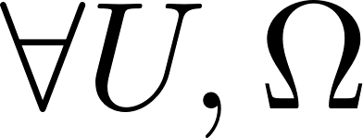
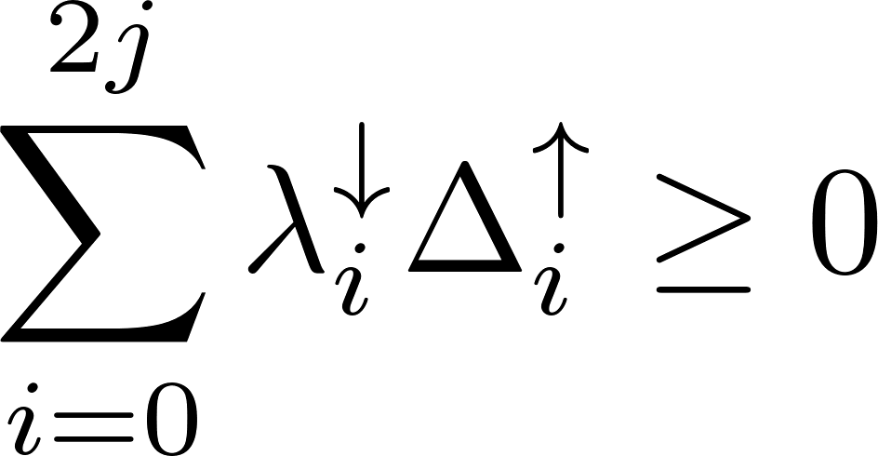
AWP polytopes
Absolutely Wigner positive states :
A spin state is AWP iff its ordered
eigenvalues verify the following
inequality

Slide 20
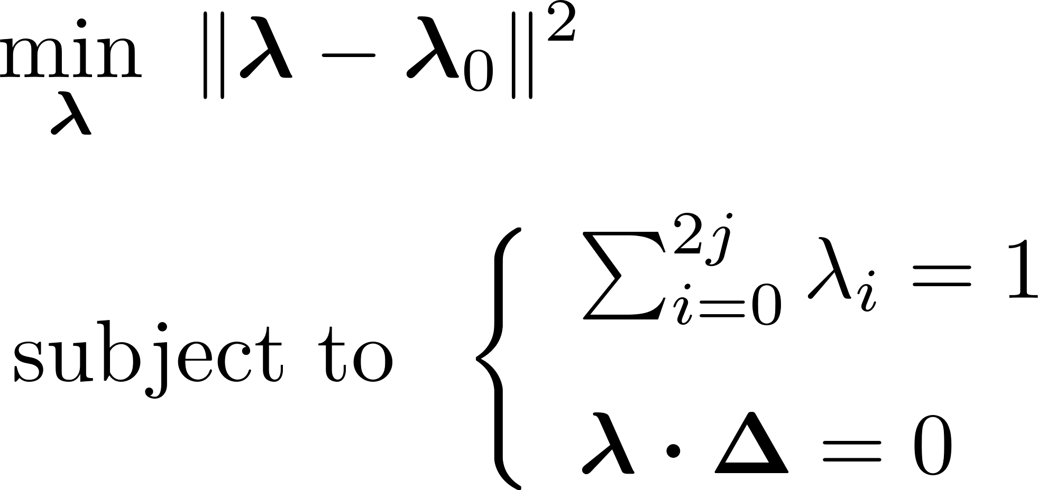
AWP balls
Lagrange multipliers :

Slide 21
Conclusion and outlook
Full characterization of the set of AWP states for any dimension
A beautiful polytope to be 3D printed
Generalization to other phase-space representation ?
Relation between Wigner negativity and entanglement ?

Slide 22
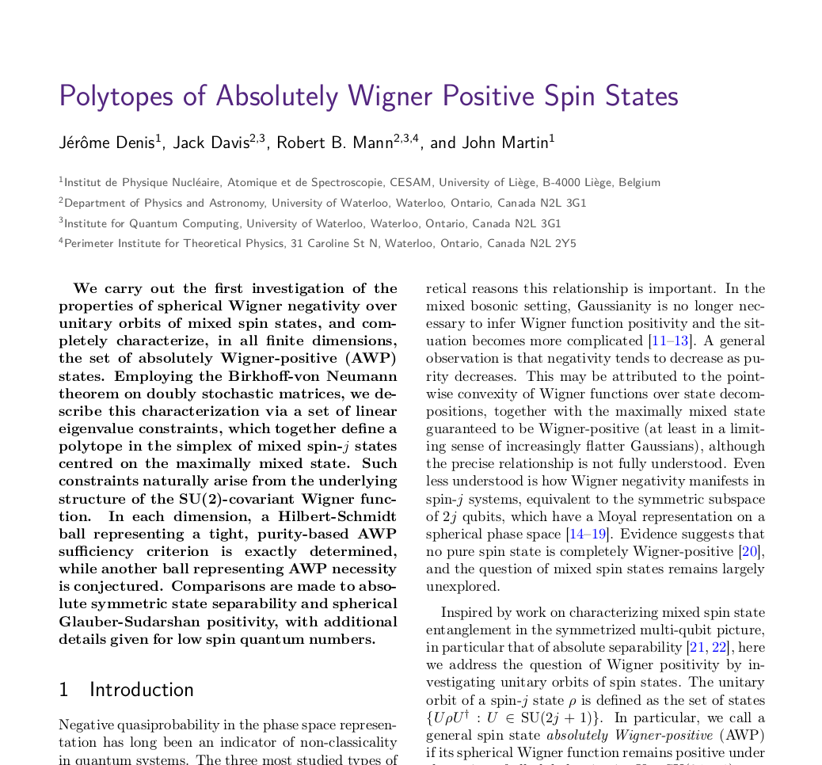
Thanks for your attention !
What an awesome paper !
arXiv:2304.09006

