Slide 1
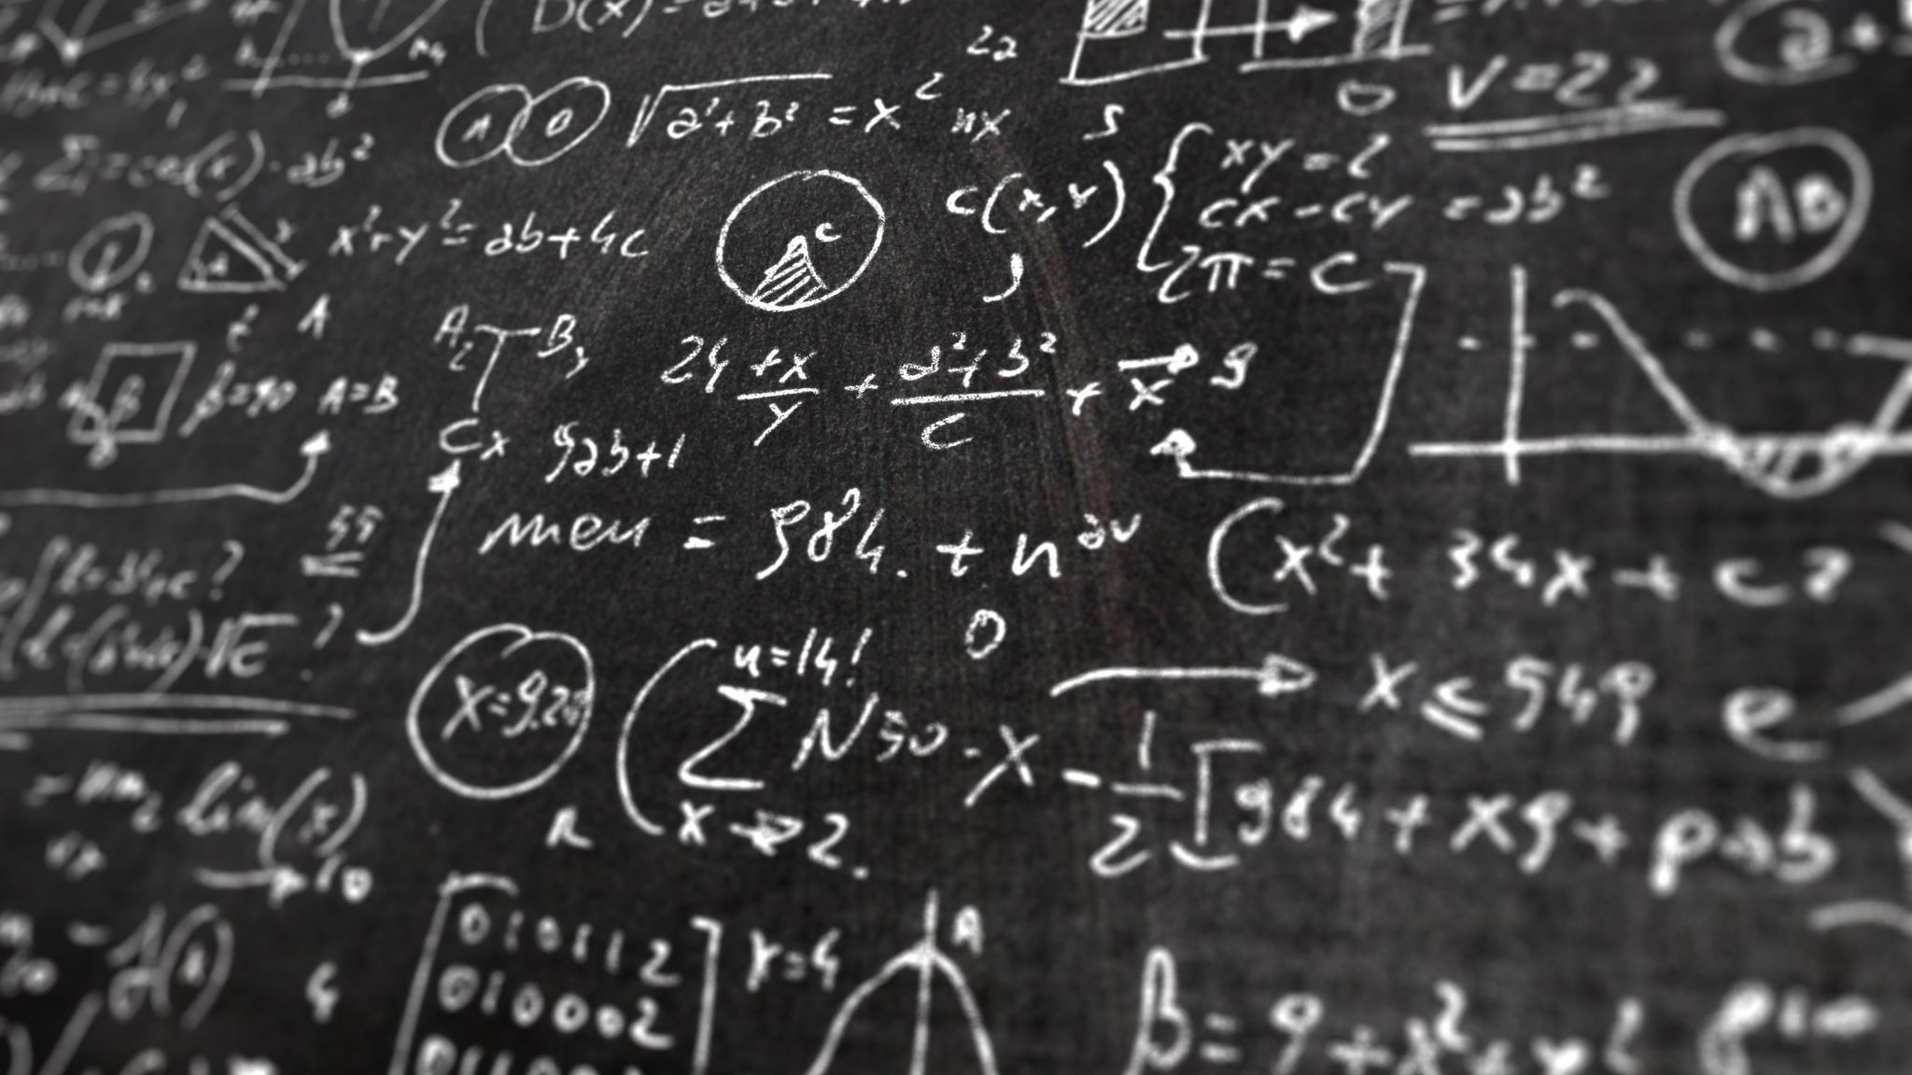
Entanglement from Wehrl Moments using Deep Learning
Jérôme Denis, François Damanet
& John Martin
University of Liège, Belgium

Slide 2
How can one predict the entanglement of a quantum state with partial information about it ?

Slide 3
Outline
Geometric measure of entanglement (GME) and Wehrl moments
How do Artificial Neural Networks (ANN) learn ?
Prediction of GME with ANN
Conclusion

Slide 4
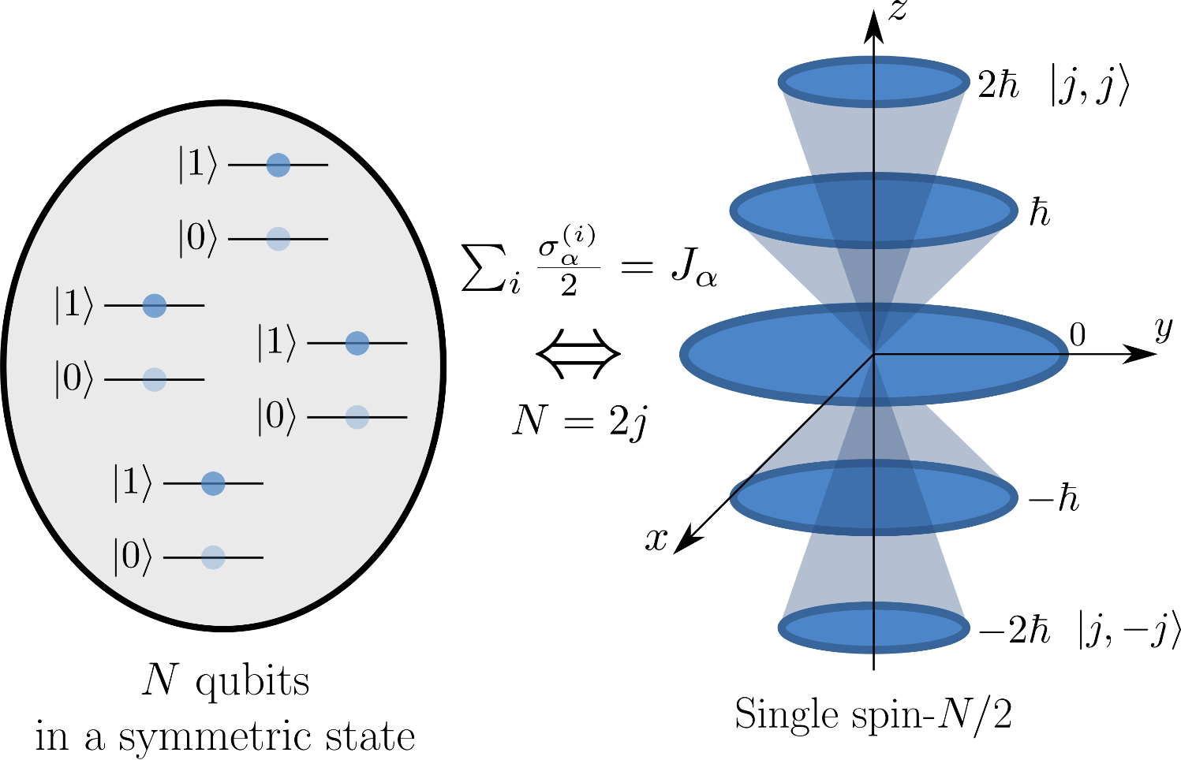
Husimi function
Husimi function
of a spin state

Slide 5
GME and Wehrl moments
Geometric measure of entanglement :
separable state
Wehrl moments :
Maximum of
the Husimi function
Partial information on the state
Can GME be predicted with only the fisrt few Wehrl moments ?

Slide 6
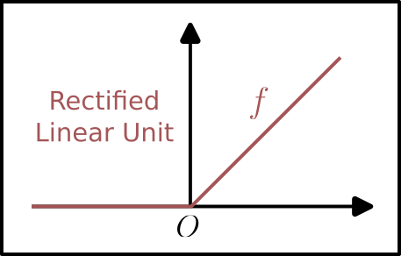
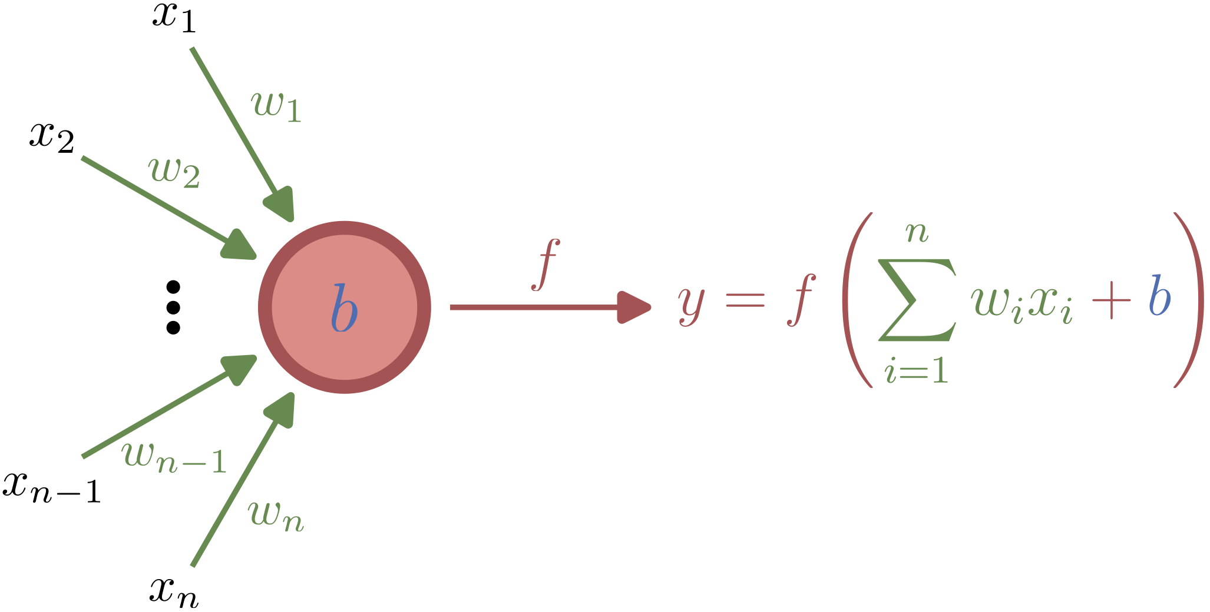
Artificial Neural Networks
You then connect many neurons together !

Slide 7
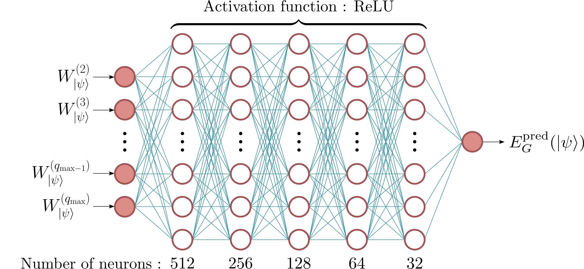
GME prediction with ANN

Slide 8
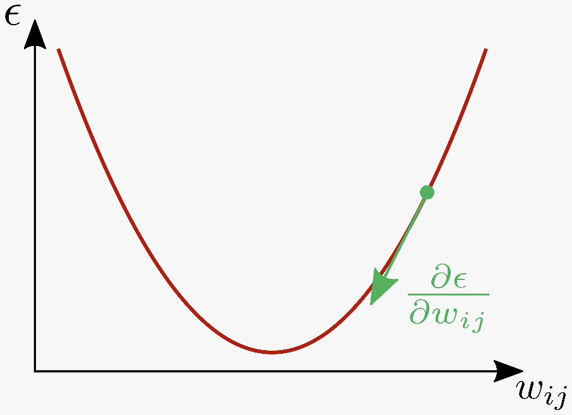
Deep Learning
Loss function :
Gradient descent :

Slide 9
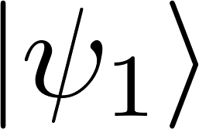
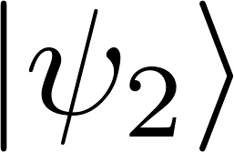
Entanglement distribution
: Random states
: Majorana degenerate states

Slide 10
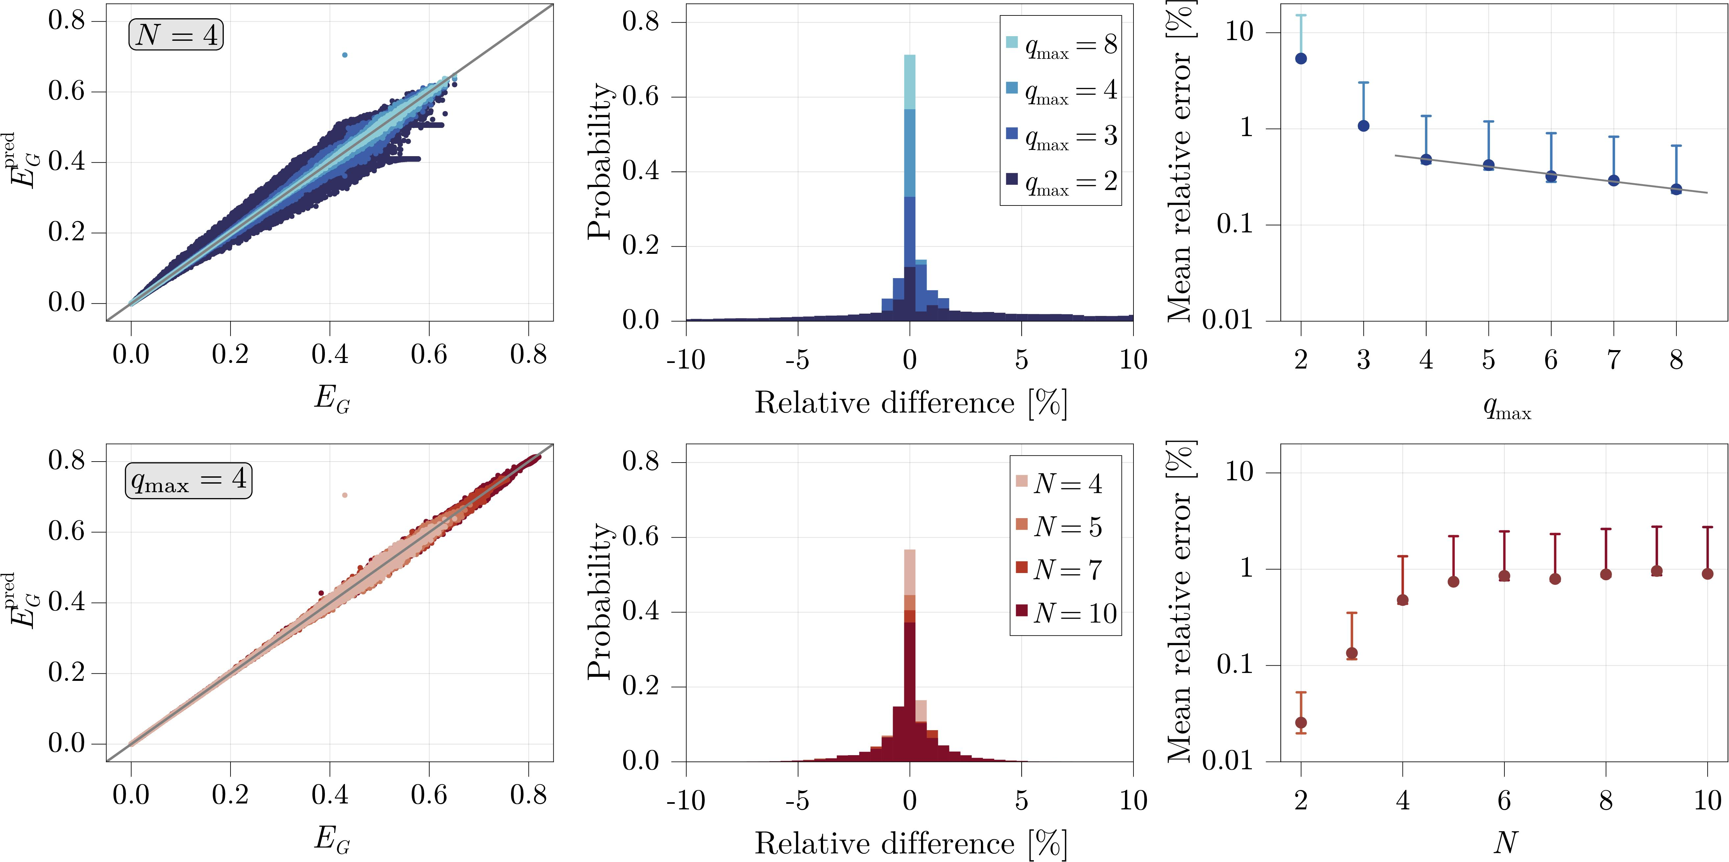
GME prediction : Results

Slide 11
GME prediction : Mixed States
Problem :
But we can still try to predict GME
with Wehrl moments !
Depolarized states:
Method still robust under
the depolarisation channel !

Slide 12
Conclusion
Good predictions even with the two first Wehrl moments
Good scaling with the number of qubits
Work also for mixed depolarized states
And more in arXiv:2205.15095
Thanks for your attention !

Slide 13
Semidefinite Programming for GME
Fidelity from SDP (Watrous 2012) :
subject to
(Watrous 2012)
Caratheodory’s Theorem :

Slide 14
Noisy Wehrl moments
Gaussian noise :

Slide 15
Random squeezed states

Slide 16
Can we encode Nicolas Cage in the Husimi function ?

