Slide 1
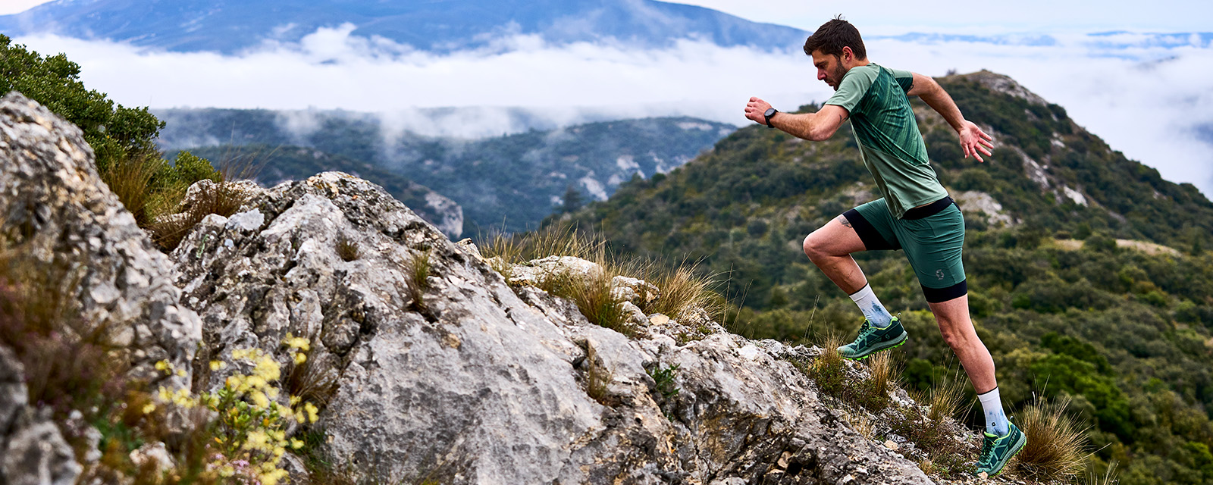
A tool to characterize trail running race and profile and to analyze effort management
DE COCK Florence, GONZALEZ Cyril, NEULENS Fabian, PARTOUNE Marie, JIDOVTSEFF Boris
Notes:
A tool to characterize trail running race and profile and to analyze effort management
Session 2B Monday 26 September 2022 at 14:30am

Slide 2
Trail running is based on a succession of efforts that are influenced by the race and its specificities
To participate in the development of knowledge in the trail community
To develop and valid a tool that provides simple and standardized rules for segmentation of a trail running
Notes:
Trail running is based on a succession of efforts that are influenced by the race and its specificities. To study trail running in a rigorous way, it is necessary to have a standardized tool which could be used to analyze the race and management of trail running effort.
This study attempts to develop and valid a tool that provides simple and standardized rules for segmentation of a trail running.

Slide 3
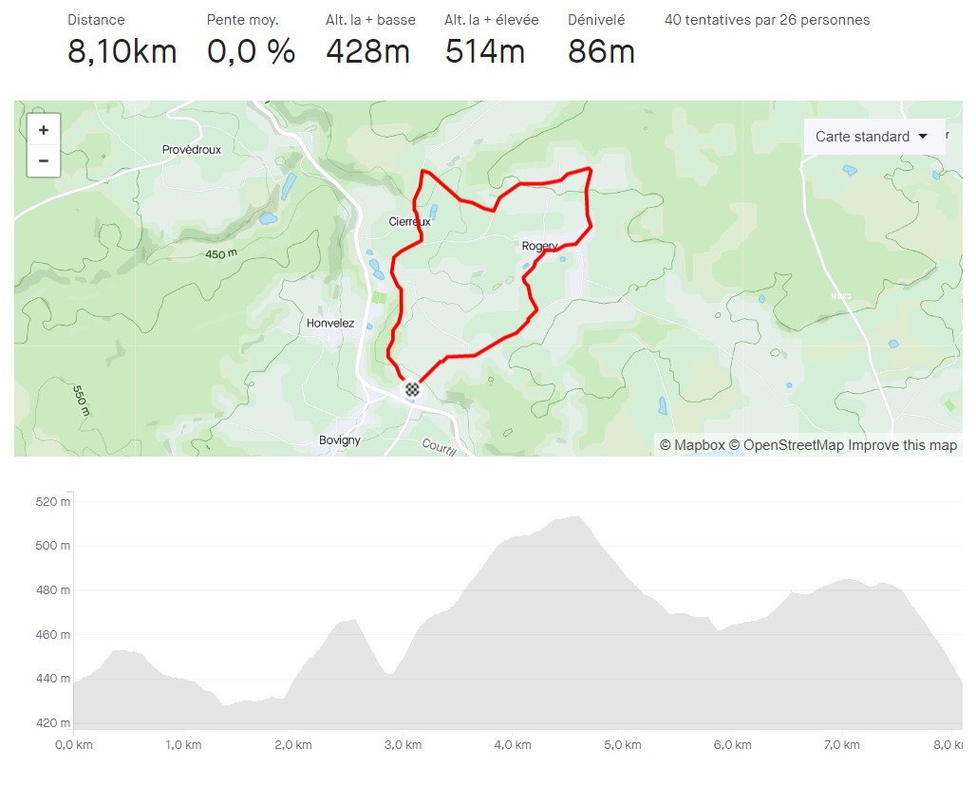
Notes:
An action research process was set up to develop and to validate the tool.
This tool allows to:
Break down the trail race into multiple segments that will be created on Strava Application with a connected watch or smartphone.
And to characterize and categorize each segment.

Slide 4
Type of segments
Uphill
Length
> 400m
Elevation gain
Main cutting criteria
Downhill
Average slope
In percent
Auto-calculated by Strava App
Intersections limited
Distant start and finish
Start and finish not on a curve
Start and finish away from intersections
Flat
Vallonated
Start / finish point set at the point of inflection of the curve
Take the uphill / downhill as a whole
Very steep uphill and downhill segments (>20%) can be 200m long
Notes:
The variables that have been integrated into the tool are :
Type of segments
Length
Elevation gain
Average slope
Technicality
Support stability
I will present you the main rules defined for each variable :
-Type of segments:
Uphill : slope of more than 3% positive
Downhill : slope of more than 3% negative
Flat : slope not exceeding 3% (positive or negative)
Vallonated : alternation of the 3 previous types over a distance too small to be able to segment them individually
-Length (m) :
A segment cannot be shorter than 400m
Intersections within the segment are limited
The start and finish points of the segment are not in close proximity
Avoid starting and ending on a curve
If there are intersections, start or end the segment at a distance from them
-Elevation gain
Main cutting criteria
Start / finish point set at the point of inflection of the curve
Take the uphill / downhill as a whole
-Average slope %
Auto calculated by strava app
Very steep uphill and downhill segments (>20%) can be 200m long.

Slide 5
Technicality
Technicality scale
From low technical to high technical
Support stability
From stable to unstable supports
Support stability scale
Notes:
The variables that have been integrated into the tool :
-Technicality : technicality scale from 1 to 4
from low technical to high technical
in green: not very technical
does not influence the technique of the runner
in yellow: technical
slightly breaks the speed of the runner
in orange : very technical
strongly breaks the speed of the runner
in red : ultra technical
stops the runner who is forced to walk/climb with the help of his hands
-Support stability
in green: stable support, very good grip
road/asphalt/tartan/ large forest roads
In orange : partially stable supports, good to average grip
Underwood, small rock, small mud
In red : unstable supports, little or no grip
mud, snow, sand, ice

Slide 6
Goal achieved
Easy
Relevant
Validation of the tool ?
Appropriate length
Complete
Vagueness about technicity and stability levels
Notes:
Experts were interviewed to give critical analysis about the tool.
The analysis of experts interview was used to validate the tool, including its global concept, rules of segmentation, scales for characterizing segments and user training.
The results show that experts validate the global concept of the tool, as well as the main rules of segmentation. More accurate rules are needed to distinguish flat and uneven segments and to rate technicity level.
Because it is difficult to define, quiet subjective

Slide 7
Benefits of the tool
Runners profile
Descriptive analysis of the trail
Notes:
I will show you the functionalities of the tool :
First of all, we can obtain a descriptive analysis of the trail and moreover, it is possible to establish runners profile
There is therefore an interest for trainers and runners to select and plan training and for trail organizers rather in marketing and customer service.

Slide 8
Benefits of the tool
Runners profile
Descriptive analysis of the trail
Notes:
For example, the descriptive analysis of the trail allows to analyze a trail in terms of topography of the race : distribution of segment types, distribution of hill types, technicality distribution, stability distribution
So we obtain parameters of comparison between trails.

Slide 9
Benefits of the tool
Runners profile
Descriptive analysis of the trail
Notes:
We also obtain a global report on the runner's profile with informations about running pace profile, exhaustion indexes, uphill and downhill speeds, stability and technicity indexes.

Slide 10
Benefits of the tool
Runners profile
Descriptive analysis of the trail
Notes:
This tool will allow to obtain the time taken by the runners to cover these different segments and therefore to analyze their speed on them.
it is then possible to analyze the effort management, to identify the profile of the runner and to realize comparisons between runners.
On this picture, we can see the speed evolution by segment based on 3 runners. In general the blue runner is faster than the orange runner and the orange runner is faster than the yellow runner.

Slide 11
Benefits of the tool
Runners profile
Descriptive analysis of the trail
Notes:
On this picture, we can see for the same runner the speed evolution according to the type of segments. For this runner, we can see that his speed is lower during the uphill and vallonated segments (in green). This runner is the fastest during the downhill segments (in blue).
We can therefore analyze the behavior of this runner on the whole race and by segments. We can also collect information on the speed according to the stability and technicity of the segments.
it is then possible to analyze the effort management, to identify the profile of the runner and to realize comparisons between runners.

Slide 12
Conclusion
Valid global concept to analyze effort management
Useful for runners, coaches and race organizers
Futher research and development
More accurate rules
Notes:
This study revealed that actual version of the tool has a valid global concept which appears relevant to analyze effort management including race pace, fatigability and uphill and downhill running speed. However, improvement are still needed before any final validation. For example, more accurate rules are needed to rate technicity level.
There is a need for further research and development of this topic.
The data from this study could help the runner to optimize his race preparation and to better manage his effort, especially in delicate moments. These data can also be useful for the coach and the race organizers. It will therefore be possible to compare intra- and inter-individual performances; to analyze the effort management (weaknesses and strengths) and to adapt the training.

Slide 13
References
Abbiss, C. R. & Laursen, P. B. (2008). Describing and Understanding Pacing Strategies during Athletic Competition. Sports Med 38 (3), 239-252. https://doi.org/10.2165/00007256-200838030-00004
BVA. (2018). Les français et les objets connectés. Observatoire de la vie quotidienne des français. https://www.bva-group.com/sondages/francais-objets-connectes/
Chase, A. W. & Hobbs, N. (2010). The Ultimate Guide to Trail Running. (Second Edition). Falcon Guides. (pp. 1-12).
Ehrström, S. (2020). Analyse de la performance en trail courte distance: Déterminants physiologiques, spécificité de la sollicitation musculaire et stratégies d’optimisation. Université Côte d’Azur.
Jockin, F. (2021). Validité et reproductibilité des segments en course Strava et implications pour l’analyse de l’effort en trail. Université de Liège.

Slide 14
References
Koerner, H. (2014). Guide to ultra-running training for an ultra-marathon. Velopress, Boulder, Colorado 80301-2338 USA.
Ratsimihah, B. & Heimburger, F. (2021). Trail-Running, Le guide complet pour se lancer et progresser! Paris, France : Larousse
STRAVA France. (2021). L’année sportive 2020. STRAVA Support, consulté en ligne https://1n4rcn88bk4ziht713dla5ub-wpengine.netdna-ssl.com/wp-content/uploads/2020/12/France_YIS_2020.pdf
Strava Support, Rosie. (2019, 8 août). Optimisation de la création de segments : comment créer de bons segments. Strava Support. Consulté le 10 février 2022 sur https://support.strava.com/hc/fr/articles/216918227-Optimisation-de-la-cr%C3%A9ation-de-segments-comment-cr%C3%A9er-de-bons-segments#short
West, L. R. (2015). Strava : Challenge yourself to greater heights in physical activity/cycling and running. British Journal of Sports Medicine, 49(15), 1024‑1024. https://doi.org/10.1136/bjsports-2015-094899

Slide 15
Thank you for your attention !

