Slide 1
‘Competent authority’ and ‘competent authorities’ in primary EU law: agents of transboundary cooperation?
Katarzyna Aleksandra Jancewicz Université de Liège
This project has received funding from the European Research Council (ERC) under the European Union's Horizon 2020 research and innovation programme (grant agreement n° 948473).

Slide 2
Topic change: why?
« The notion of -> notion is not a phrase and not a concept. Useless.
'competent authority' PLURAL? Too!
in the EU environmental legislation -> NOT ONLY, primary law?
and designs of transboundary coordination of efforts between them » -> this is what we do not know… Let’s add a question mark here.
‘Competent authority’ and ‘competent authorities’ in primary EU law: agents of transboundary cooperation?

Slide 3
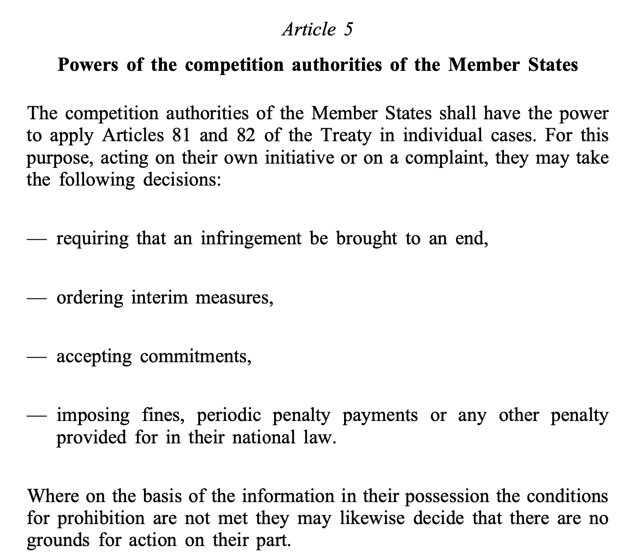
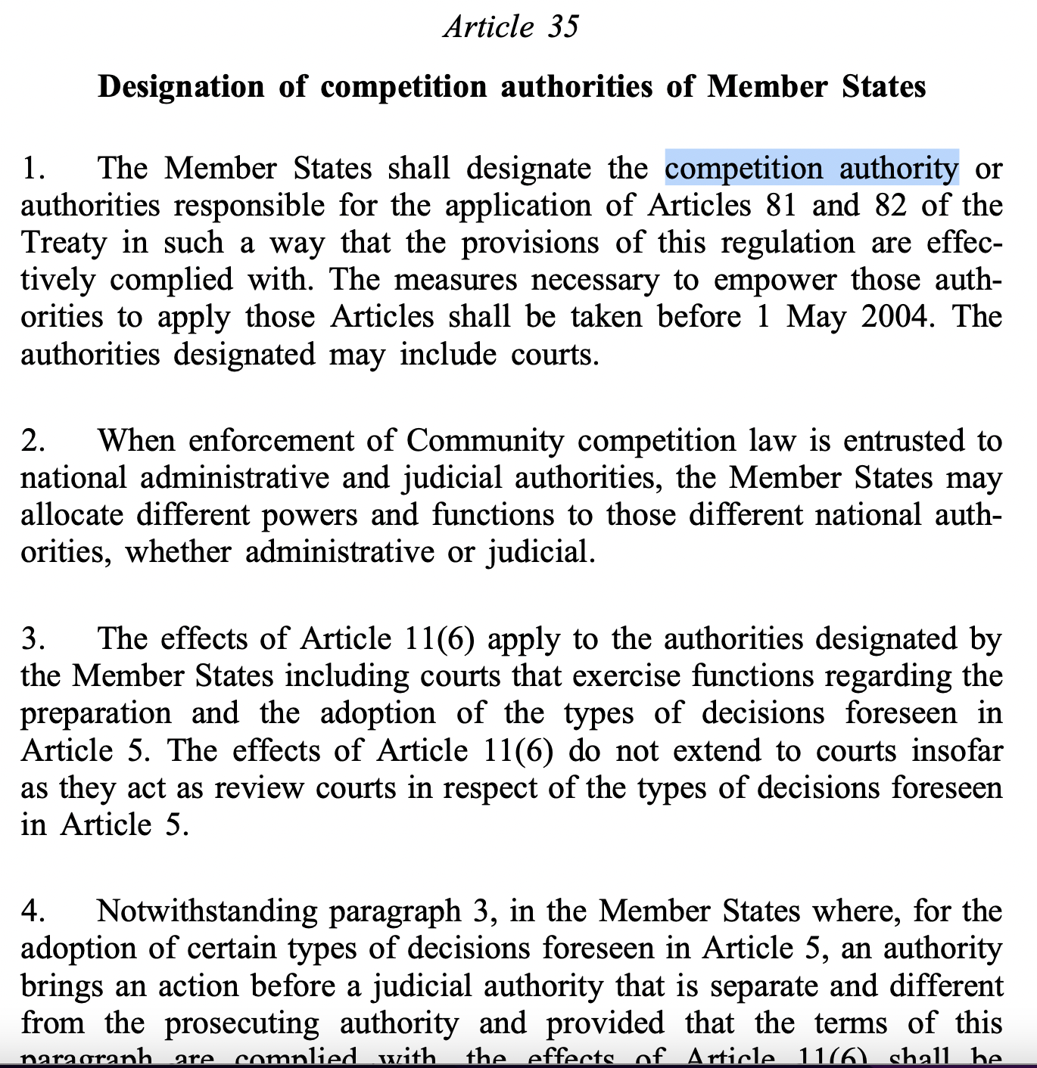
Background of idea

Slide 4
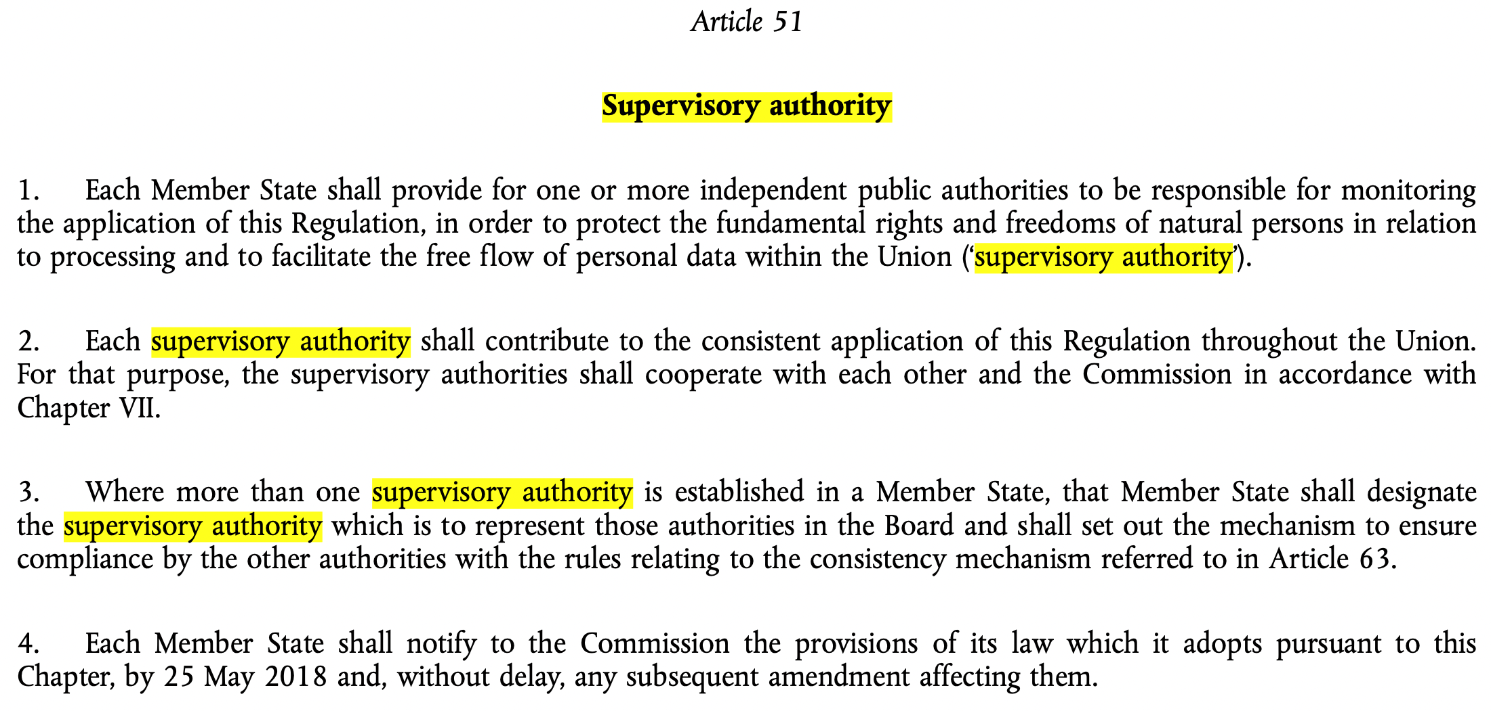
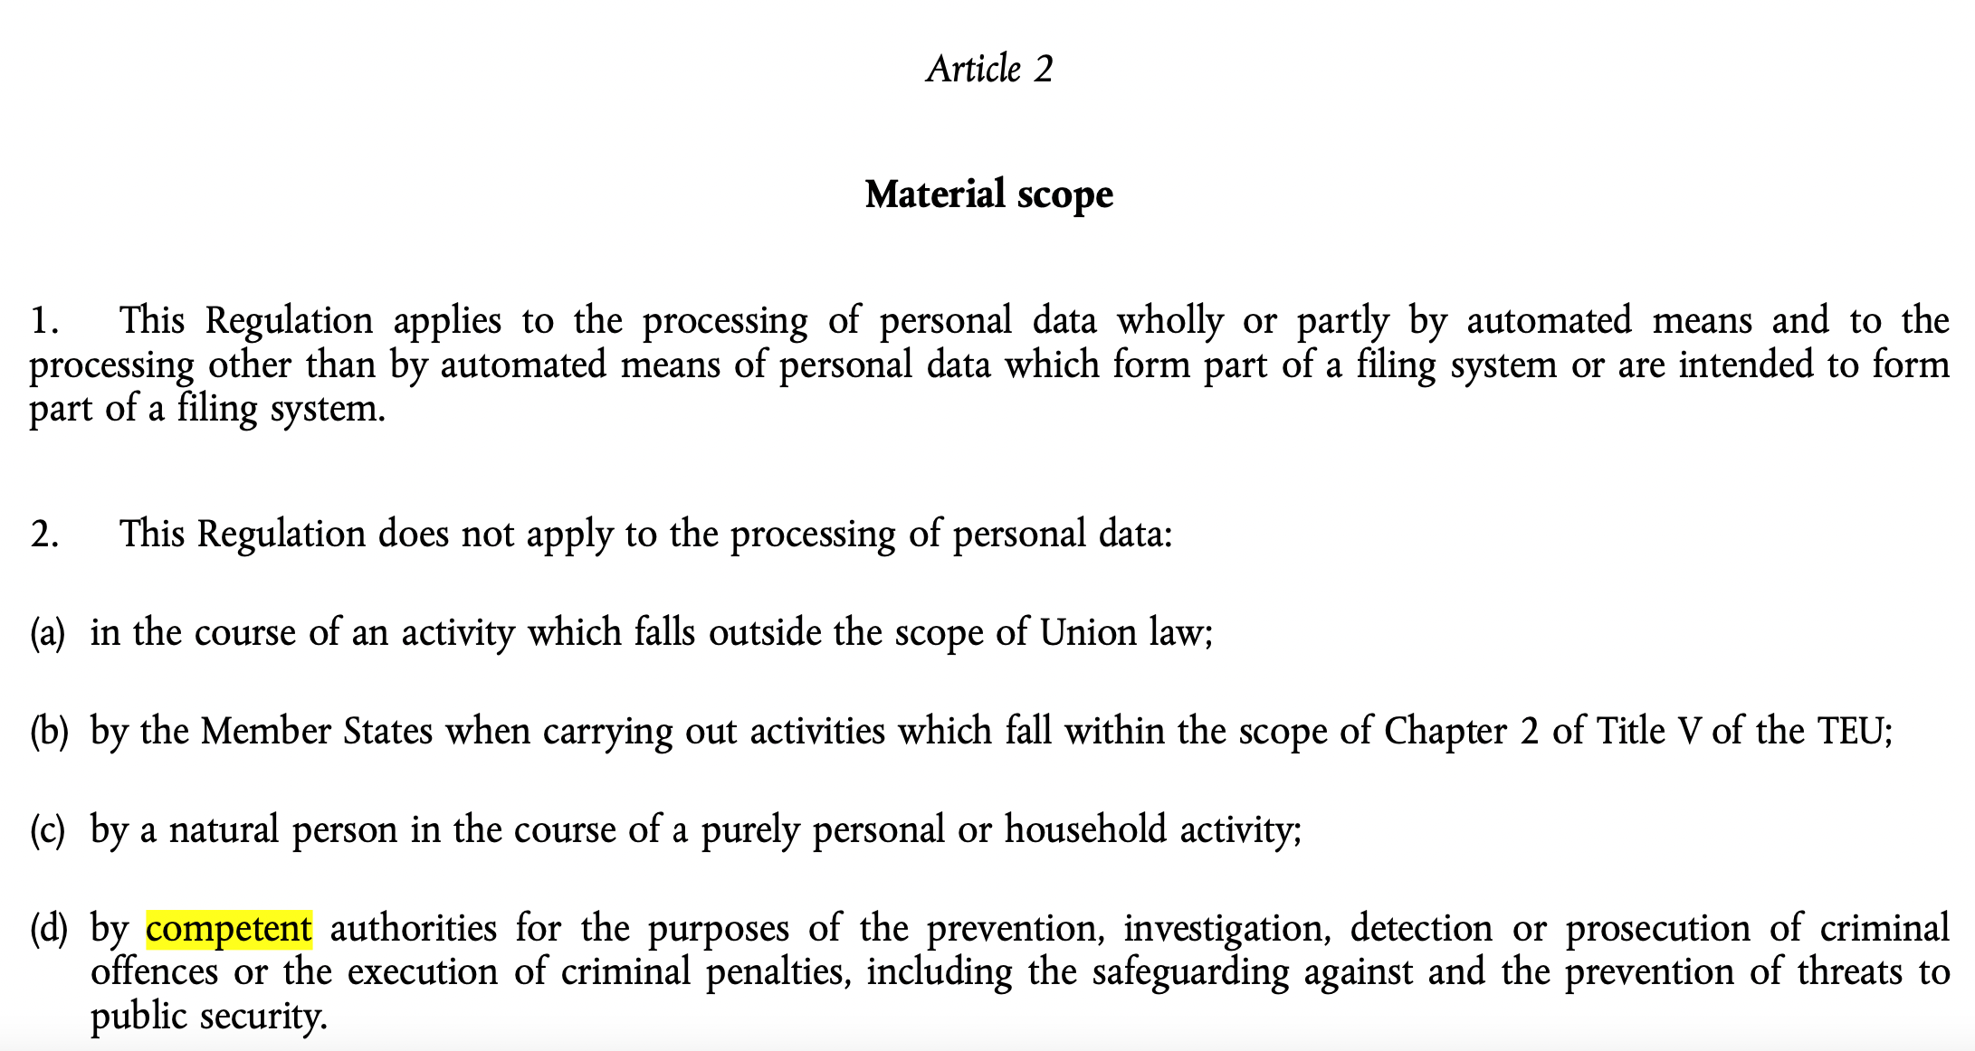
Background of idea

Slide 5
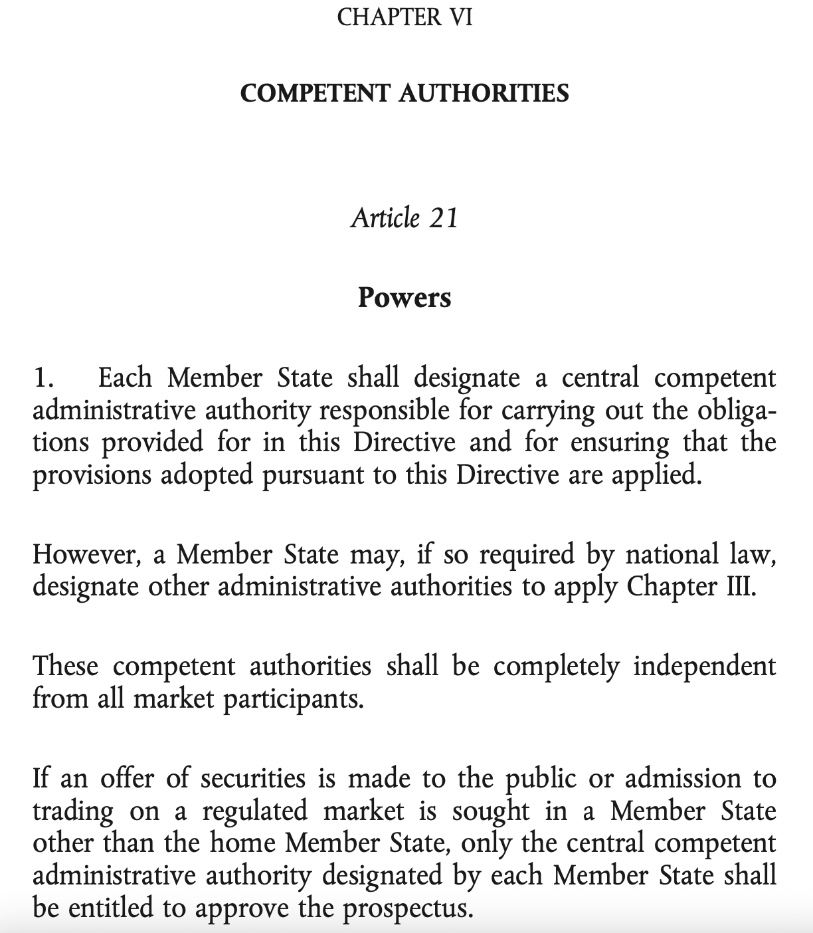

Slide 6
Issues of concern:
‘Competent authority’/‘competent authorities’ - what’s that?
These phrases appear in TFEU + three Protocols + 8. Declaration = 21 times (Treaty of Lisbon)
Not defined in the EU Treaties
Never analysed by scholars
Other terms are also used in the primary EU law, but usually 1-2 times (2 exceptions)
Terminological ambiguity and its consequences
No mention of these phrases in the Treaty provisions being a legal background of a directive/regulation (most cases)

Slide 7
Other ‘false friends’ phrases in the primary EU law
Art. 39 TEU, Art. 16 (2) TFEU | independent authorities
Art. 20, Art. 23 TFEU | diplomatic and consular authorities of any Member State
Art. 73 TFEU | competent departments of [EU Member States] administrations responsible for safeguarding national security
Art. 82 (1) (d) TFEU | judicial or equivalent authorities of the Member States
Art. 287 (3) TFEU | competent national departments
Art. 85 (1) TFEU | national investigating and prosecuting authorities (…). (…) Member States’ authorities
85 (2) TFEU | competent national officials
Art. 86 (2) TFEU | competent courts of the Member States
Art. 88 (1) TFEU | Member States’ police authorities and other law enforcement services
Art. 222 TFEU | political authorities
Art. 30 of Protocol (No 3) on the Statute of the Court of Justice of the European Union | competent court
Art. 6, Art. 18 of Protocol (No 7) on the Privileges and Immunities of the European Union | authorities in Member States, authorities of Member States
Art. 88 (2) (a) TFEU | authorities of Member States
Art. 88 (3) TFEU | authorities of the Member State or States (…) concerned
Art. 89 TFEU | authorities of that [Member] State
Art. 104 TFEU | the authorities in Member States
Art. 127 (4) TFEU, Art. 288 TFEU, Art. 4 Protocol (No 4), 53. Declaration by the Czech Republic on the Charter of Fundamental Rights of the European Union | national authorities
Art. 299 TFEU | national authority which the government of each Member State shall designate
Art. 321 TFEU | Authority designated by the [Member] State concerned
Art. 192 (5) TFEU | public authorities of a Member State
Art. 5 of Protocol (No 2) on the Application of the Principles of Subsidiarity and Proportionality | national governments, regional or local authorities
Art. 1 of Protocol (No 26) on. Services of General Interest | National, regional and local authorities
Art. 123, Art. 124, 125 (1) TFEU, Art. 21 of Protocol (No 4) | (…) central governments, regional, local or other public authorities, other bodies governed by public law, or public undertakings of Member States

Slide 8
OPINION OF ADVOCATE GENERAL SZPUNAR delivered on 18 May 2017(1) Joined Cases C‑360/15 and C‑31/16
Footnote 32 [para 46]: In the French and German language versions, Article 11 of Directive 2002/21 and Article 13 of Directive 2002/20 employ the same terms (‘autorité compétente’ or ‘zuständige Behörde’), whereas in the English language version there is a slight linguistic difference between a ‘relevant authority’ (Article 13 of Directive 2002/20) and a ‘competent authority’ (Article 11 of Directive 2002/21). In my view, however, there can be no doubt that both Article 11 of Directive 2002/21 and Article 13 of Directive 2002/20 refer to the same kind of authorities. (ECLI:EU:C:2017:397)

Slide 9
Origin of ‘competent authority’/‘competent authorities’
First mentions: Treaty of Maastricht: Art. 105 (5) TEC + Protocols
Revolution: Treaty of Amsterdam (1997)
No substantial changes via the Treaty of Nice (2001)
Treaty of Lisbon (2007): Amsterdam’s architecture slightly developed
-> path dependency?
https://en.wikipedia.org/wiki/Treaty_of_Amsterdam#/media/File:Амстердамський_договір.jpg

Slide 10
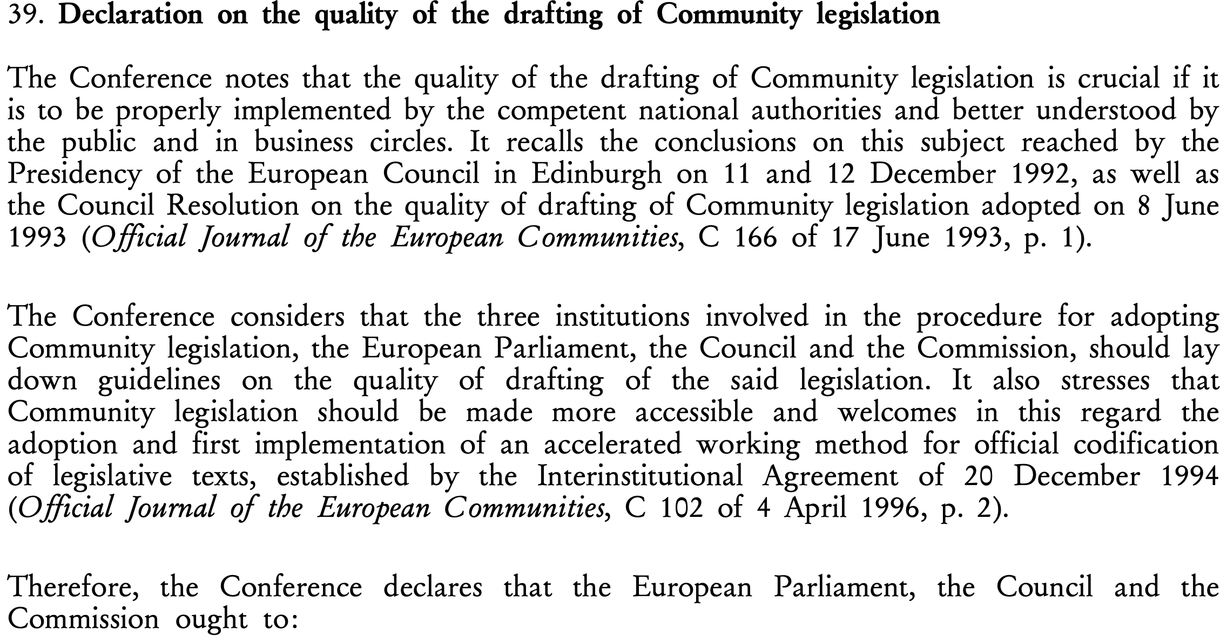
Treaty of Amsterdam’s ‘revolution’

Slide 11
‘Competent authority/authorities’ in TFEU (Lisbon)
Legal norm | European Union | action undertaken | Member States level
Art. 50 (2) (b) TFEU (ex 44 TEC) | (2) The European Parliament, the Council and the Commission (…) | (b) (…) ensuring close cooperation (…) | between the competent authorities in Member States (…)
Art. 71 TFEU (ex Art. 36 TEU) | A standing committee shall be set up within the Council (…) | (…) it shall facilitate coordination of the action | of Member States’ competent authorities. (…)
Art. 87 (1) TFEU (ex Art. 30 TEU) | The Union | shall establish police cooperation | involving all the Member States’ competent authorities, including police, customs and other specialised law enforcement services in relation to the prevention, detection and investigation of criminal offences.
Art. 88 (3) TFEU (ex Art. 30 TEU) | Any operational action by Europol | must be carried out in liason and in agreement | With the authorities of the Member State or States whose territory is concerned. The application of coercive measures shall be the exclusive responsability of the competent national authorities.
Art. 127 (5) TFEU (ex Art. 105 TEC) | The ESCB [European System of Central Banks] | shall contrubute to the smooth conduct of policies pursued | by the competent authorities relating to the prudential supervision of credit institutions and the stability of the financial system.
Art. 321 TFEU (ex Art. 278 TEC) (word order changed) | The Commission may, | transfer into the currency of one of the Member States its holdings in the currency of another Member State, (…) provided it notitfies | the competent authorities of the Member States concerned (…).

Slide 12
Reflections (= very early conclusions)
‘Competent authority’/‘authorities’ -> probably intended only terminological harmonisation via the Treaty of Amsterdam
Currently in 2/3 of cases (14), the creation of collaboration obligations in the EU primary law between EU institutions/bodies and EU Member States administrations
In 1/3 of cases (7), the creation of other duties/rights, but mostly via Protocols (5 cases). No right to create a new ‘competent authority’!
EU Treaties intend to enhance cross-border cooperation in particular cases -> ‘competent authorities’ to launch it in the scope of EU conferred competence (appear in secondary legislation as Treaties ‘agents’)
Uncontrolled transmission to the secondary EU law (secret ‘agents’ of transboundary cooperation, even on the cost of institutional autonomy of MS)
Borders of inference into national administrations set by Treaties via these and similar phrases

