Slide 1
Does the European Union need a ‘Drought Directive’? A legal perspective
Katarzyna Aleksandra Jancewicz
Université de Liège
This project has received funding from the European Research Council (ERC) under the European Union's Horizon 2020 research and innovation programme (grant agreement n° 948473).

Slide 2
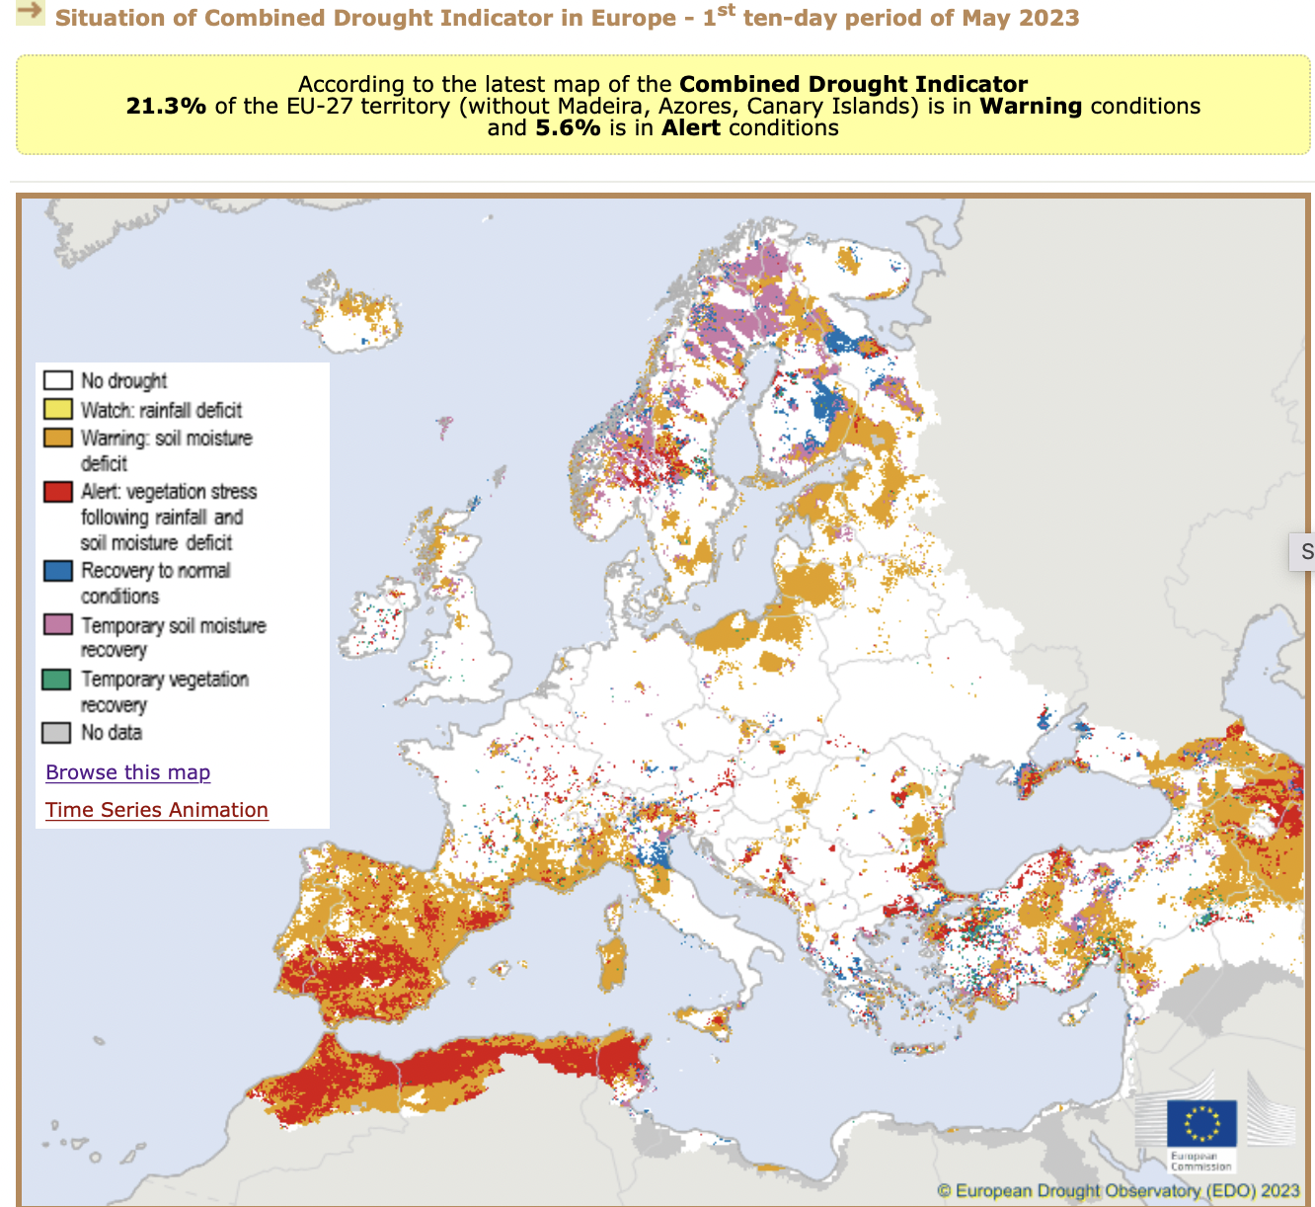
Drought monitoring by EDO - European Drought Observatory (EC JRC)
https://edo.jrc.ec.europa.eu/edov2/php/index.php?id=1000#

Slide 3
Drought - overview
Over the past 30 years, droughts dramatically increased in number and intensity in the EU
Cost of droughts every year: €2 to 9 billion; total cost of damage to the European economy between 1976-2006: up to €100 billion
Definition by EU policymakers: drought = long-term deviation from average/normal conditions in a hydrological context
Drought ≠ aridity (permanent climate condition) ≠ water scarcity (imbalance between water supply and demand in the region)
Types of drought (non-legal): meteorological, agricultural, hydrological
Other sectors suffering from the effects of drought: agriculture, livestock farming, forestry energy, public water supply; Expertise in hydrology, soil science, climate & agriculture
Droughts appear also in the autumn and winter seasons

Slide 4
EU law perspective: de lege lata
Directive 2000/60/EC - Water Framework Directive: central legal & policy framework for water management across the EU
Water Framework Directive: (international) river basin management approach
Over 1/3 of river basin districts in the EU are cross-border
River Basin Management Plans - obligatory
Drought Management Plans developed and implemented on a voluntary basis in the context of the Water Framework Directive
No legal drought definition on the EU level
Numerous soft-law and policy documents relating to drought

Slide 5
Empirical research perspective: identified current policy needs
Blauhut, V., Stoelzle, M., Ahopelto, L., Brunner, M., Teutschbein, C., Wendt, D. E., Akstinas, V., Bakke, S. J., Barker, L. J., Bartosova, L., & et al. (2022). Lessons from the 2018-2019 European droughts: a collective need for unifying drought risk management, Natural Hazards and Earth System Sciences vol:22 issue:6 pages: 2201-2217
A study on 2 recent drought events (2018 and 2019) examined the relationship between management strategies and drought perception, hazard and impact;
Results of a pan-European survey (standard questionnaire) involving national representatives from 28 countries & relevant stakeholders
Survey results compared with actual drought hazard information registered by the European Drought Observatory for 2018 and 2019
The study identified ‘an urgent need to further reduce drought impacts by constructing and implementing a European macro-level drought governance approach, such as a directive, which would strengthen national drought management and mitigate damage to human and natural assets’

Slide 6
Empirical research perspective: identified current policy needs
Need for inclusion of various drought types definitions in the Water Framework Directive
Need for development of impact-driven, regional- and sector-specific guidance on drought indices
Need for common action at a very general, broad political level (eg. drought risk management strategy), while on an operational/local level - ‘clear and common guidelines may be needed’
Need for the formation of an inter- and transdisciplinary collaborative EU working group focusing on drought risk management and estimation of the potential benefits and downsides of a European Droguht Directive

Slide 7
How about a ‘Drought Directive’? Advantages
The need was expressed unanimously by practitioners from the public and private sectors across the EU and beyond (Blauhut, V. et al [2022])
An intuitive solution, easy keyword search
Separation from other water-related subfields
Analogous solutions exist already: ‘daughter directives’ of the Water Framework Directive like the Groundwater Directive, Floods Directive
An opportunity to create a cross-sectoral, comprehensive, interdisciplinary, modern and clear legal act (incl. re-allocation of water permits, technological enhancements to save water, water pricing…)

Slide 8
How about a ‘Drought Directive’? Disadvantages
Methodology of survey and target group - repetition recommended: a ’Drought management directive’ does not have to constitute a separate ‘Drought directive’
Art. 191 (2) TFEU: adoption of measures affecting quantitative water management of water resources (…) requires a special legislative procedure -> risk of raising objection to Art. 191 (1) as a legal base
Implementation problems of the Water Framework Directive may repeat
Experience of Floods Directive: possibility to designate a different ‘competent authority’ than for Water Framework Directive purposes; Possible fragmentation of available human and financial resources
Criticism of Floods Directive
Failed proposal for a comprehensive ‘Soil Framework Directive’

Slide 9
Potential alternative solutions on the EU level
Promotion of voluntary adoption of Drought Management Plans
Amendment of Water Framework Directive by:
Creation of general definitions of drought, prolonged drought & particular drought types
Introduction of a compulsory development of Drought Management Plans for each (international) river basin district
Development of national and European networks of experts
A buildup of innovative soft-law instruments
Long-term strategy on gradual introduction of more stringent drought management practices

Slide 10
Proposal COM(2022) 540 final
Proposed amendment: Directive 2000/60/EC (Water Framework Directive), Art. 3 para 4a
‘In the case of exceptional circumstances of natural origin or force majeure, in particular extreme floods and prolonged droughts (…), Member States shall ensure that the competent authorities for downstream water bodies in such Member States, as well as the Commission, are immediately informed and that the necessary cooperation is set up to investigate the causes and address the consequences of the exceptional circumstances or incidents’.
= European Commission spotted deficits in information exchange and cooperation in case of prolonged drought. Drought management shall improve - but how to achieve that goal?

Slide 11
In sum:
An amendment of the EU legislation is urgently needed to regulate drought management
However, the current Water Framework Directive can be adjusted for this purpose
Long-term solution: a comprehensive revision of the Water Framework Directive or adoption of a separate Directive - up to the experts, then the legislator

