Slide 1


Gestational trophoblastic diseases:
Update from Belgian national centre
SCHOENEN Sophie
Department of Obstetrics and Gynecology
CHU de Liège – Liège – Belgium
On behalf of GTD.be (Pr. F. Goffin)
11th EOTTD meeting
Warsaw
May 11–13, 2023

Slide 2
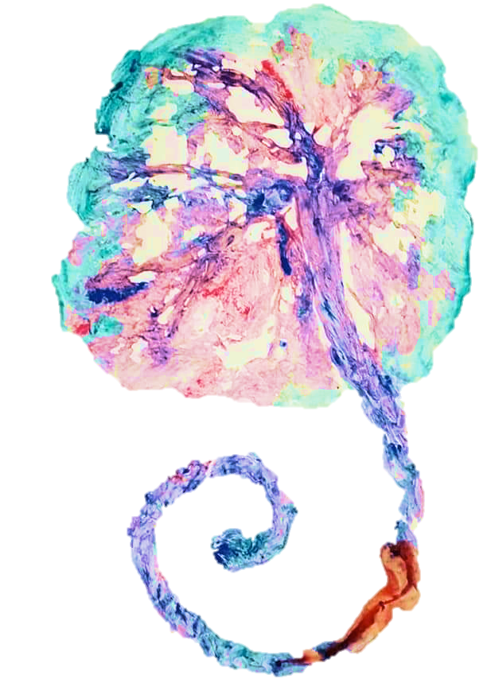
Gestational trophoblastic diseases: Update from the Belgian national centre
Outline
Background
Objective
Material and methods
Results
Discussion
Conclusion
1

Slide 3

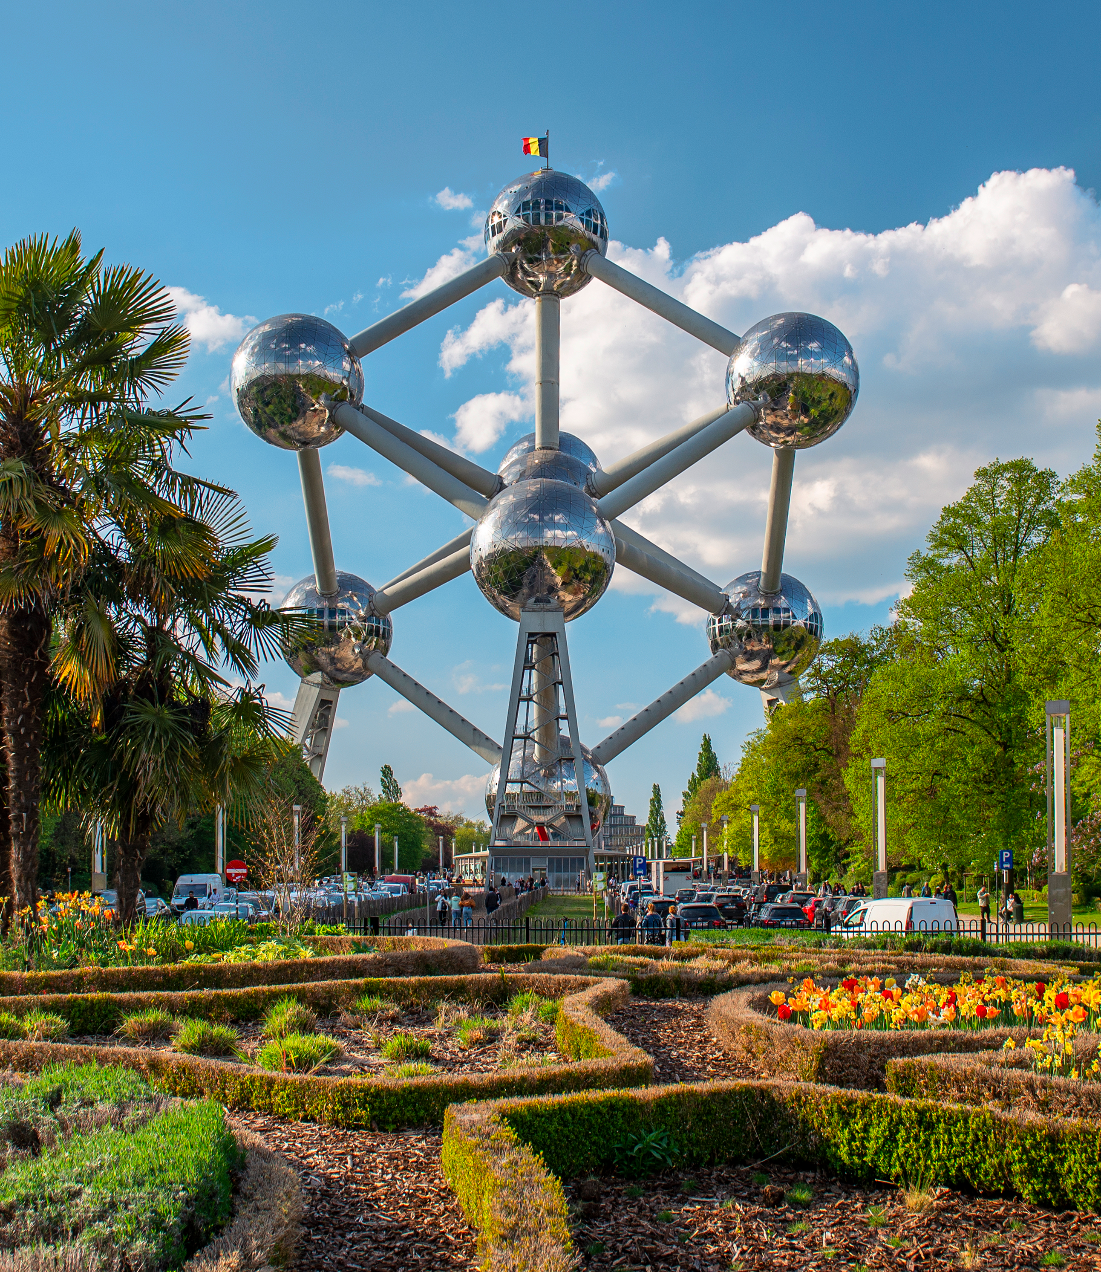




Gestational trophoblastic diseases: Update from the Belgian national centre
This is what you think of when you hear about Belgium ...

Slide 4



Gestational trophoblastic diseases: Update from the Belgian national centre
But it’s also ...
Belgian Gestational Trophoblastic Diseases Registry

Slide 5
Gestational trophoblastic diseases: Update from the Belgian national centre
Background
Gestational trophoblastic diseases (GTD):
    spectrum of rare and heterogeneous placental pathologies
    difficulties in diagnosis and management
    EOTTD encouraged since registration systems in European countries
In Belgium:
    estimation GTD incidence: 100-200 cases / year
    pathologists’ exposition: 1 GTD case every 3 years
    gynaecologists’ exposition: < 5 GTD cases in their entire career!
    Belgian Gestational Trophoblastic Diseases Registry created in 2012

Slide 6
Gestational trophoblastic diseases: Update from the Belgian national centre
Objective
Harmonise and optimise GTD diagnosis and management in Belgium.

Slide 7
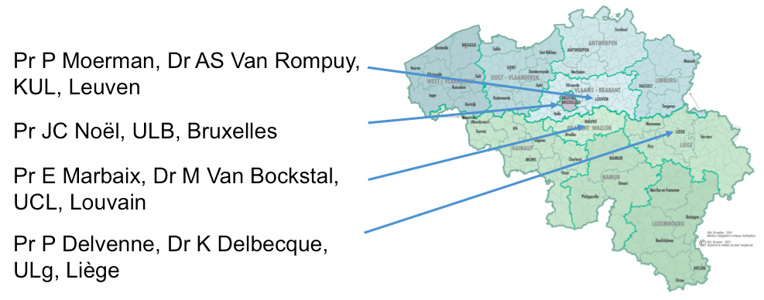
Gestational trophoblastic diseases: Update from the Belgian national centre
Material and methods
Functioning of the Belgian Registry:
  VOLUNTARY
  RECRUITMENT
  2 reference centers:
  French-speaking (Liège)
  Flemish-speaking (Leuven)
  PATHOLOGICAL
  REVIEW
  FOLLOW-UP
  hCG
  CLINICAL ADVICE
  INFORMED CONSENT
  DATA BASES
systematic reviewing of all histological slides by at least one pathological expert

Slide 8
Gestational trophoblastic diseases: Update from the Belgian national centre
Results
Focus on the French-speaking centre from 2012 to 2022
Notes:
For the purpose of this presentation, we will focuss on the french-speaking centre, which is a part of the global activity of the Belgian Registry.

Slide 9
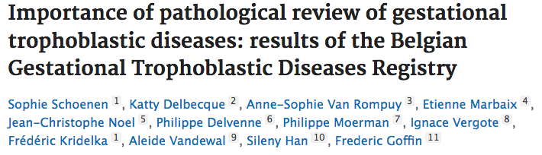
Gestational trophoblastic diseases: Update from the Belgian national centre
Material and methods
Importance of pathological review of GTD: result of the Belgian GTD Registry
    1^{ary} objective:
    To evaluate the added value of centralized pathology review of GTD
    Multicentric prospective study
    From July 2012 to December 2020

Slide 10


Gestational trophoblastic diseases: Update from the Belgian national centre
Results
Importance of pathological review of GTD: result of the Belgian GTD Registry
    35% of global discordance rate
LONDON (Paradinas, 1998): confirmation of 96% CHM – 64% PHM
FRANCE (Golfier, 2011): confirmation of 96% CHM – 64% PHM – 64% GCC
Despite the pathologists’ awareness of the diagnostic challenge of GTD,
this rate has been remarkably consistent over decades.
    95% of COMPLETE moles (CHM) are confirmed
    only 61% of PARTIAL moles (PHM) are confirmed
    42% of GTN initial diagnosis modified (13% NMP – 27% moles)

Slide 11
Gestational trophoblastic diseases: Update from the Belgian national centre
Results
Focus on the French-speaking centre from 2012 to 2022
Complete moles
n=422
Non molar GTN
n=57
Post-molar GTN
n = 111 (26%)
GTN
n=168
93% Low-risk GTN
FIGO score ≤ 6
7% High-risk GTN
FIGO score ≥ 7

Slide 12
Gestational trophoblastic diseases: Update from the Belgian national centre
Discussion
Our strengths:
    Centralised registration with 2 reference centres
    Systematic anatomopathological review
    Networking with GTD centres thanks to EOTTD: international studies
        Gestational choriocarcinoma and hCG normalization
        Study PIT-MEX
Our weaknesses:
    Small population
    Registration on a voluntary-basis (less PHM recruited than CHM)
    Limited access to genetic analyses (ploidy, genotyping)
    hCG test: no reference procedure – no centralization
    Treatments not centralised: gynaecologists decide whether or not to apply them

Slide 13


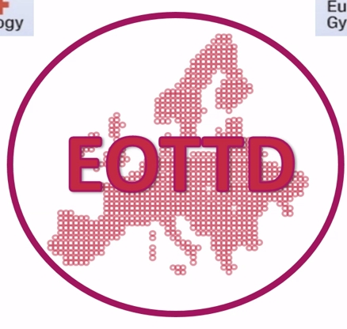


Gestational trophoblastic diseases: Update from the Belgian national centre
Conclusions
Many Thanks to :
The patients & colleagues,
The pathologists :
  K Delbecque (Ulg), P Delvenne (Ulg)
  E Marbaix & M Van Bockstal (UCL), JC Noel (ULB)
  AS Van Rompuy & P Moermans (KUL)
Pr F Goffin for the french-speaking centre
Pr S Han for the dutch-speaking centre
Data Managers

