Slide 1
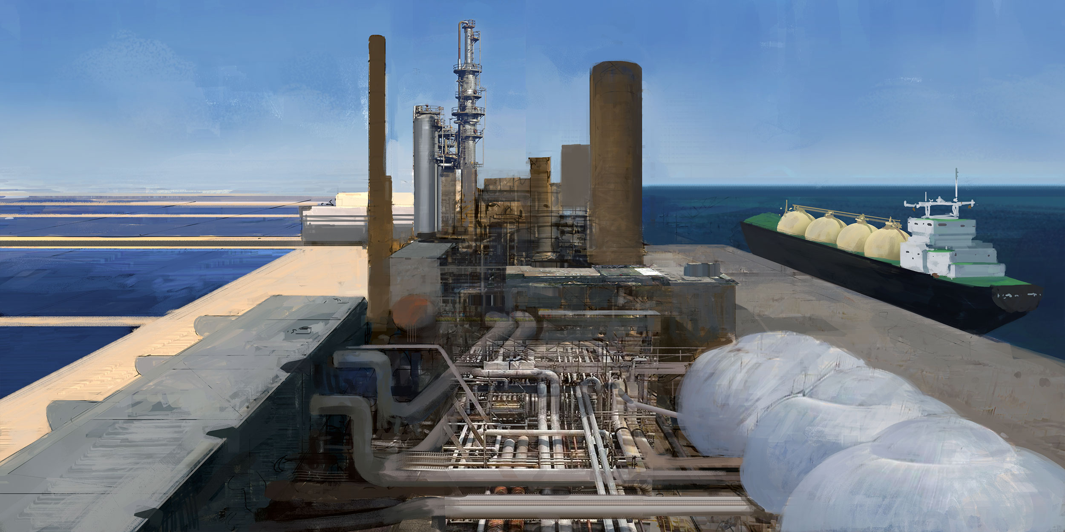


Remote Renewable Energy Hubs
Authors: Victor DACHET, Julien COLLIN and Prof. Damien ERNST

Slide 2
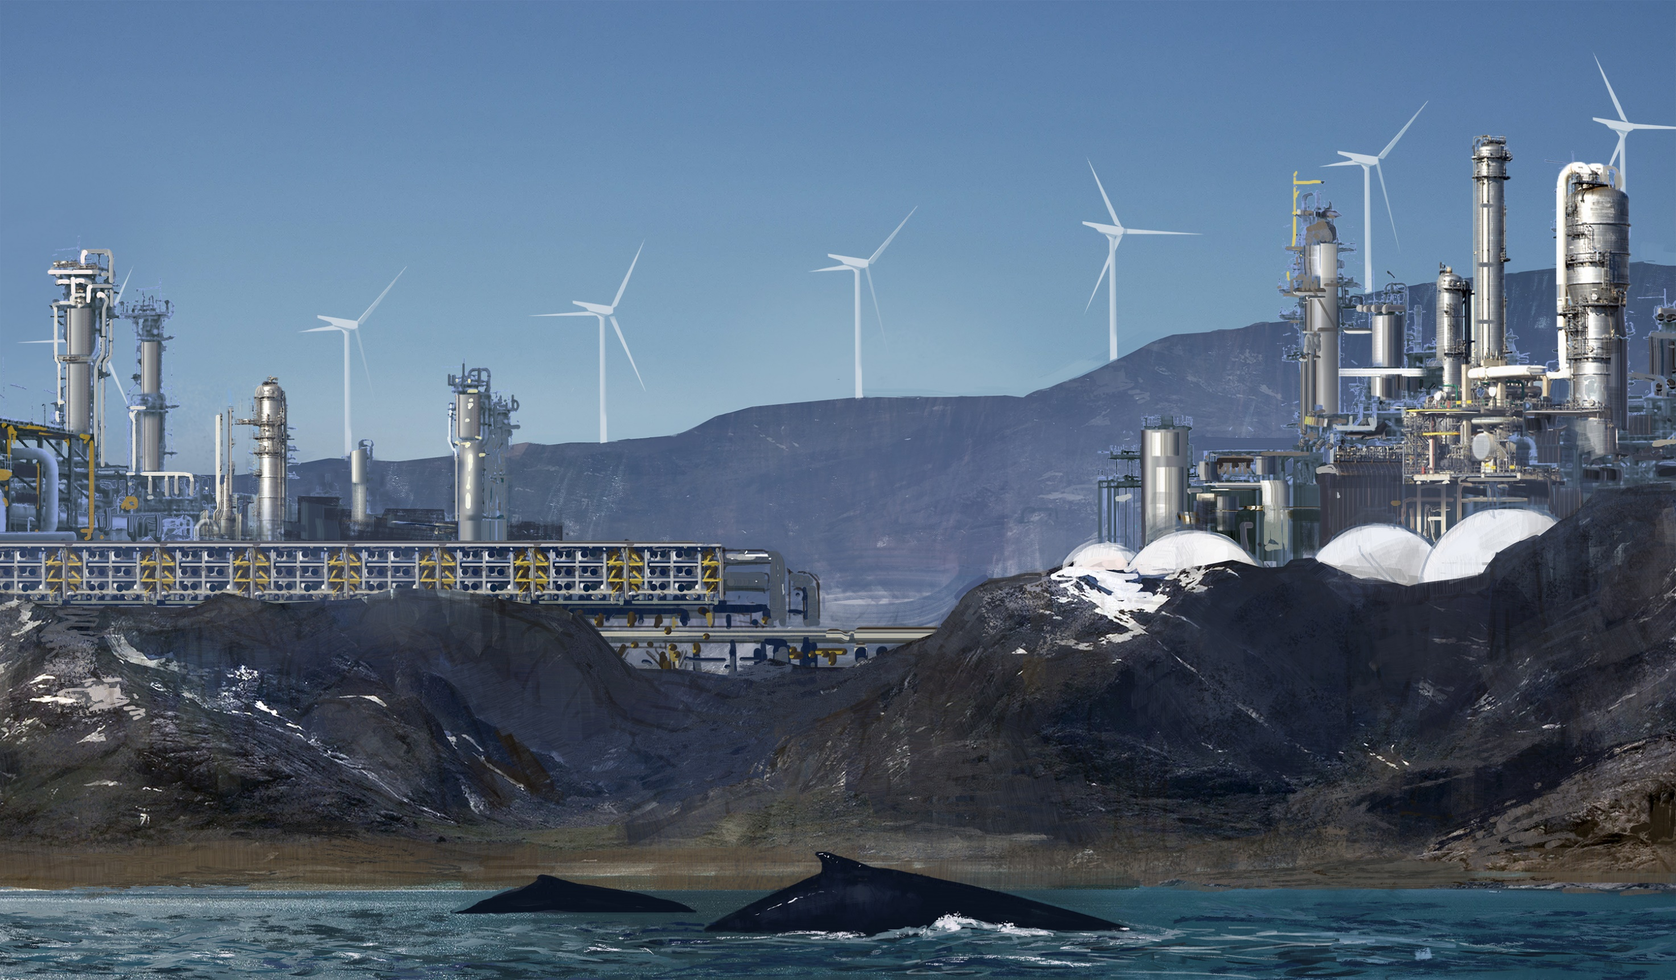
Menu
1. Remote Renewable Energy Hubs
2. Optimization of the Hubs
3. Geopolitics, Finance and Incentives
Artist’s representation of a remote energy hub in Greenland.

Slide 3
1. Remote Renewable Energy Hubs

Slide 4
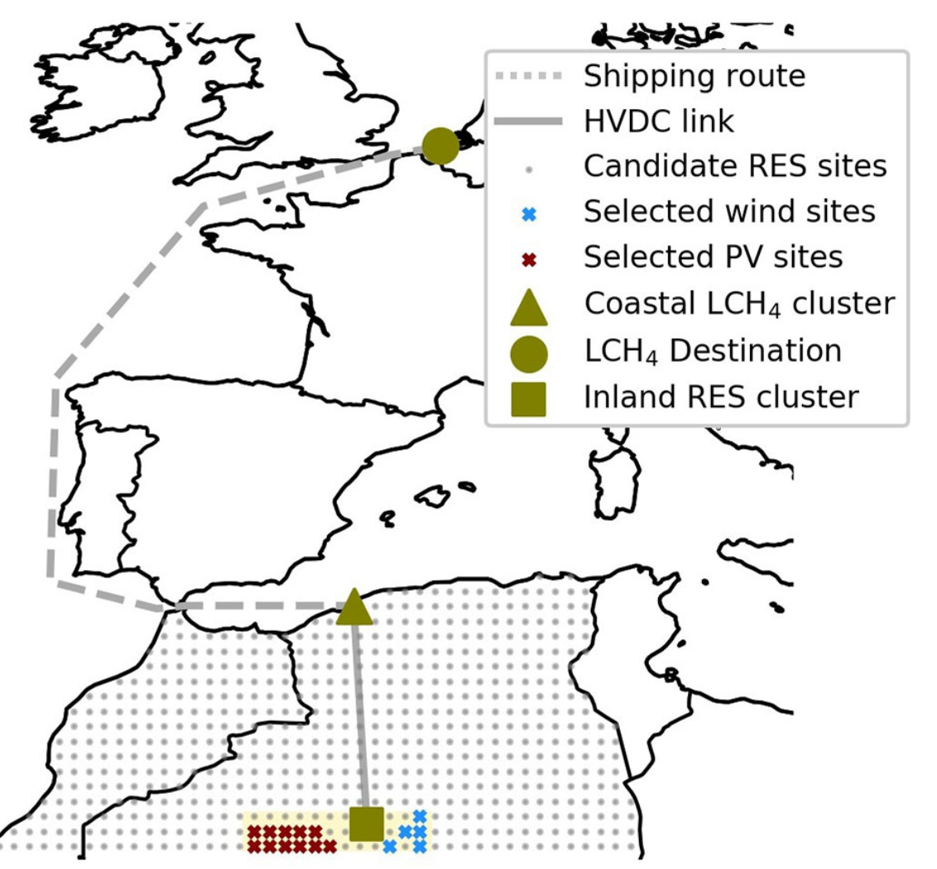
Remote Renewable Energy Hub: definition
A Remote Renewable Energy Hub (RREH) is an energy hub located far away from large load centres where abundant, high-quality renewable energy is harvested.
An example of a RREH where solar and wind energy is collected in the Algerian desert, carried to the shore via an HVDC link, transformed into carbon-neutral CH4 and then shipped to Europe.
Question: What is the exact perimeter of the RREH?

Slide 5
Why RREH?
The potential of renewable energy production near load centres is often limited and of lower quality. Thus, RREH may create new opportunities for decarbonizing economies.
There is the possibility of producing decarbonized fuels in RREH such as H2 or NH3 but also non-decarbonized but CO2-neutral fuels using, for example, a combination of direct air capture (DAC), electrolysis and Fischer-Tropsch technologies
RREH can be built very quickly, in parallel, in many places around the world using the same technology and can greatly benefit local communities.

Slide 6
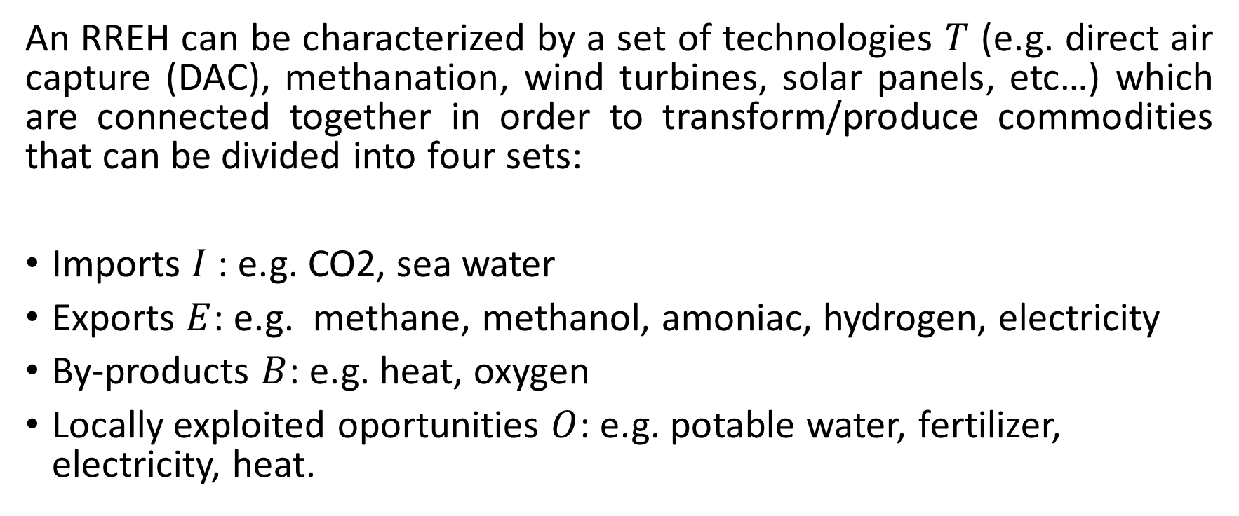
Characteristics of a RREH
An RREH can be characterized by a set of technologies $T$ (e.g. direct air capture (DAC), methanation, wind turbines, solar panels, etc…) which are connected together in order to transform/produce commodities that can be divided into four sets:
Imports $I$ : e.g. CO2, sea water
Exports $E$: e.g. methane, methanol, amoniac, hydrogen, electricity
By-products $B$: e.g. heat, oxygen
Locally exploited oportunities $O$: e.g. potable water, fertilizer, electricity, heat.

Slide 7




Schematic view of a RREH
RREH
Technologies $T$
Imports $I$
Opportunities $O$
Exports E
By-products $B$

Slide 8
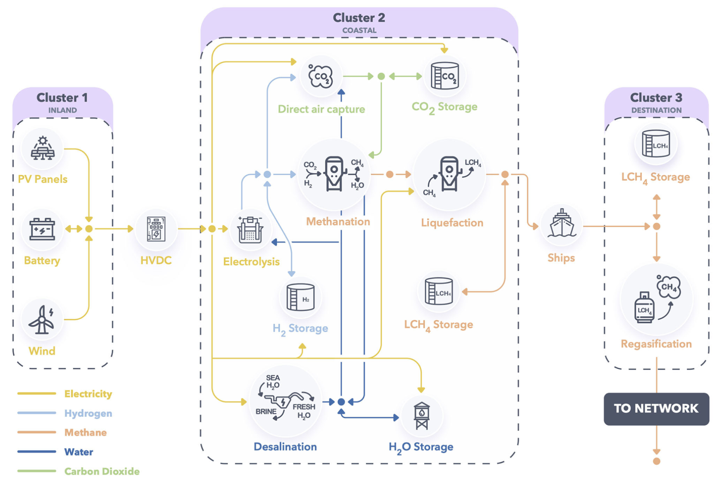
Example 1: A hub in the desert for carbon-neutral fuel
Let us go back to the RREH in the Algerian desert.
Set of technologies T described in this picture:

Slide 9
Set of imports I = sea water (should this be considered as an import?)
Set of exports E = CH4
Set of by-products B = heat, O2
Set of exploited local opportunities O = ø
Price of regazified CH4 in Zeebrugge (Zeebrugge) in an optimized hub: 149€/MWh HHV (Berger et al., 2021).
Price may be reduced (i) with the decrease in technological costs (ii) by exploiting local opportunities (selling electricity, pure water, etc., locally ) (iii) by using Post-Combustion Carbon Capture (PCCC) in addition to DAC; see Example 5.

Slide 10
Example 2: Variation of Example 1 for ammoniac production
Set T described in this picture:
Set I = sea water
Set E = NH3
Set B = heat, O2
Set O = ø

Slide 11
Example 3: Variation of Example 1 for methanol production
Set T described in this picture:
Set I = sea water
Set E = CH3OH
Set B = heat, O2
Set O = ø

Slide 12
Example 4: Variation of Example 1 for hydrogen production
Set T described in this picture:
Set I = ø,
Set E = H2,
Set B = heat, O2
Set O = ø

Slide 13
What is the best molecule to synthesize in hubs?
We have optimized the different hubs corresponding to Examples 1 to 5 and computed the cost in MWh for producing and transporting the energy-rich molecules to Belgium. Cheapest e-fuel is NH3, see Dachet et al. (2023b).
 | CH4 | NH3 | CH3OH | H2
Liquid | 146 | 102 | 140 | 118
Gazeous | 149 | 107 | / | 120
Cost in Euros per MWh for the different energy-rich molecules. WACC of 7% for investments.

Slide 14
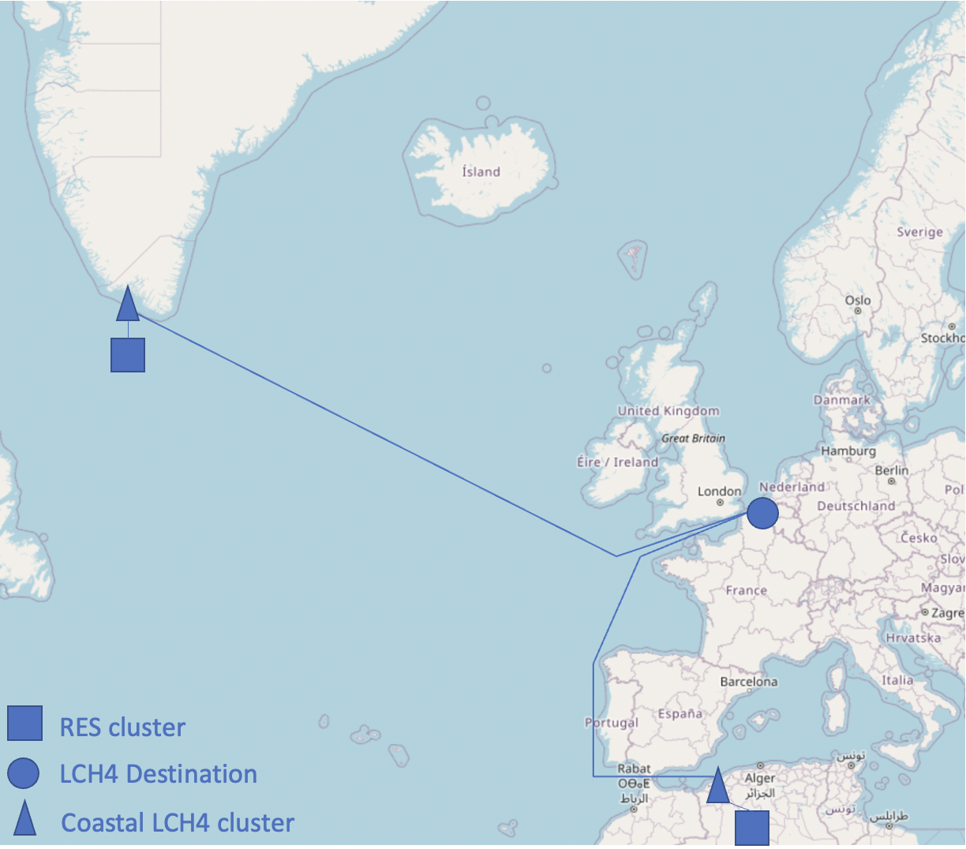
Example 5: CO2 Valorization from PCCC in Europe
Now, not all the CO2 used for methanation in Example 1 comes from DAC. There is the possiblity of importing CO2 from PCCC in Northern Europe at a price of 162 €/ton.
This the « shadow value of CO2 » established through centralized optimisation in a multi-renewable energy hub setting for CH4 production.

Slide 15
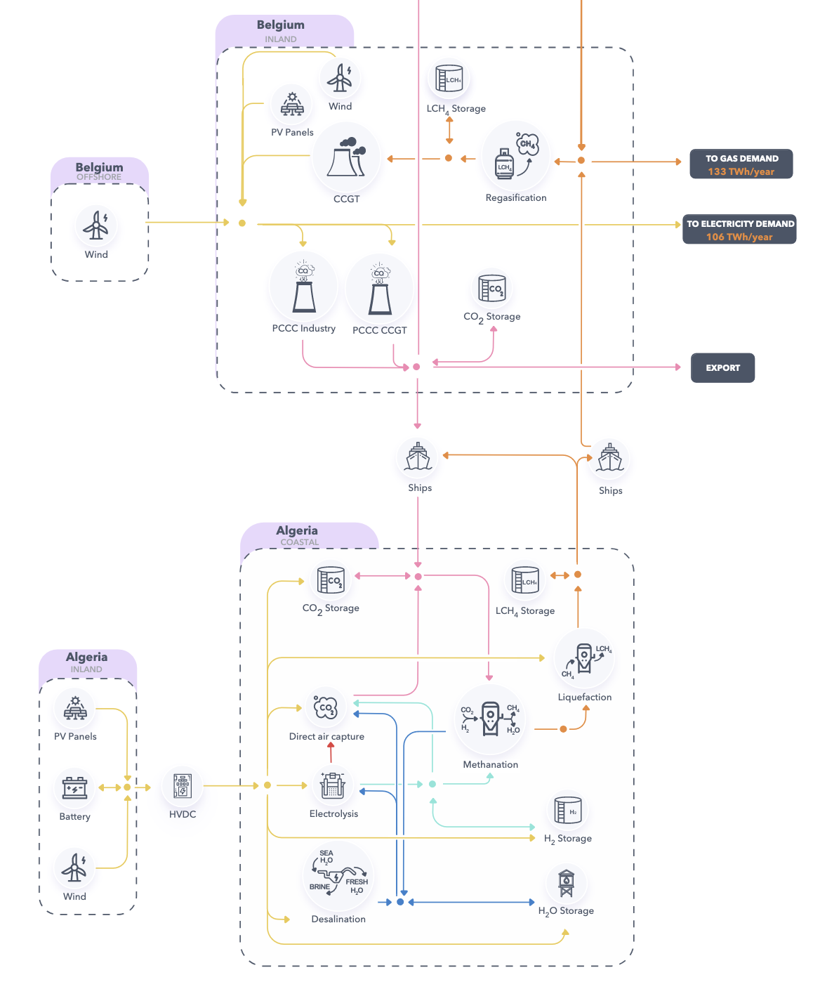
Set of technologies T described in this picture:
Set of imports I = CO2, sea water
Set of exports E = CH4
Set of by-products B = heat, O2
Set of exploited local opportunites O = ø
Price of regazified CH4 from an optimized hub: 136€/MWh versus 149€/MWh in Example 1; see Dachet et al. (2023a).

Slide 16
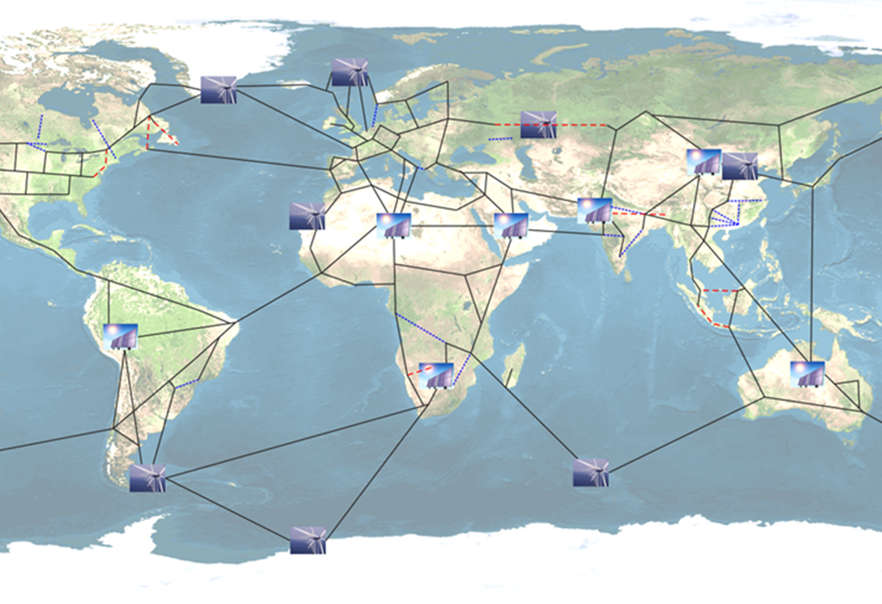
Example 6: the global grid seen as a set of connected hubs
The global grid can be seen as a set of connected hubs with sets:
Set I = electricty
Set E = electricity
Set B = ø
Set O = ø
For more information on the original Global Grid research paper, see Chatzivasileiadis et al. (2013).

Slide 17
Example 7: A ‘smart’ multi-energy vector hub
A smart multi-energy vector hub could combine Haber Bosch, methanation, methanolisation and electrolysis processes in a smart way to take advantage of each technology in order to produce different molecules.
The production level of each molecule would be adapted to market price signals.
Challenges for designing, building and operating such hubs.

Slide 18
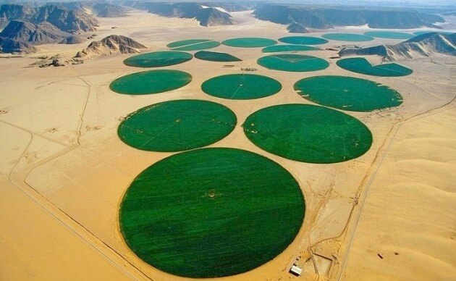
Exploiting local opportunities in sunny areas (O ≠ ø)
RREHs are likely to be developed in sunny areas where there is often very little access to fresh water.
They could be used to produce fresh water together with nitrogen fertilizers and electricity for developing local agriculture and helping (often impoverished) communities to thrive.
Irrigation carousel in the Wadi Rum desert in Jordan.

Slide 19


Valorizing the by-products $B$
The hubs reviewed for producing energy-rich molecules had a set of by-products B = heat, O2.
Valuing these by-products could help improve the business cases for these hubs.
The heat by-product of a renewable energy hub placed in cold and windy Greenland could, for example, be used for heating buildings.
Artistic representation of a ‘Dubai of Greenland’ which would emerge thanks to the significant wind resources of the country, see e.g. Radu et al. (2019).

Slide 20
2. Optimization of the Hubs

Slide 21

What is optimizing a RREH?
Once the location of a hub as been found*, the process of optimizing a hub consists of optimizing its:
Sizing: to find the optimal component dimensions of the hubs (e.g., what is the size of the battery in MWh, the power of the electrolyser)
Operational strategy: given the constraints associated with each component, how to optimally control the hub to satisfy constraints and maximize profits.
It is important to optimize both elements at the same time. Indeed there is an interdependance between the optimal sizing and the optimal operational strategy.
*May be part of the optimisation problem in itself in which case we would have a three-level optimization problem
Notes:
Why Both at the same time? Sizing + Operation => Then both

Slide 22
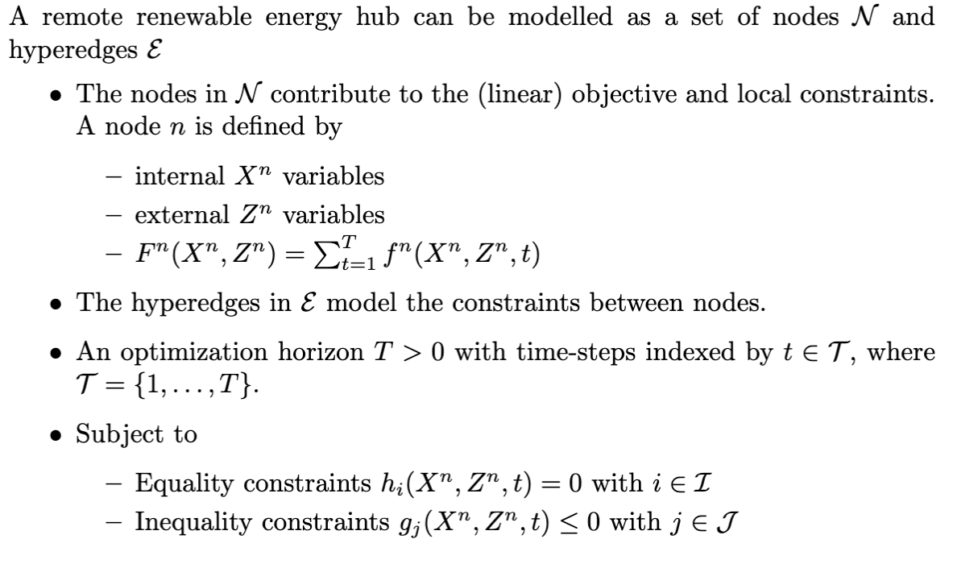
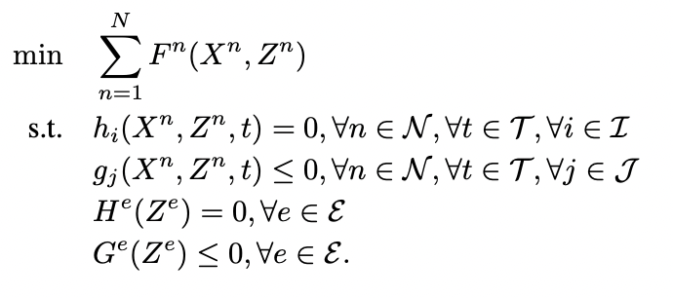
RREH seen as a set of nodes and hyperedges
We have proposed modelling a hub as set of nodes and hyperedges (Berger et al., 2021).
This modelisation could be used to ‘easily’ optimize even complex hubs.
Modelisation lead to a new tool
GBOML, which is publicly available under the MIT licence (Miftari et al., 2023).

Slide 23

GBOML: The Graph-Based Optimization Modelling Language
GBOML is a tool specifically designed for the Modelling and the Optimization of complex (energy) systems.
Optimal solution for sizing and operation under several hypotheses:
Perfect forecast
All the investment decisions made at the initial time.
Mixed Integer Linear Modelling.

Slide 24
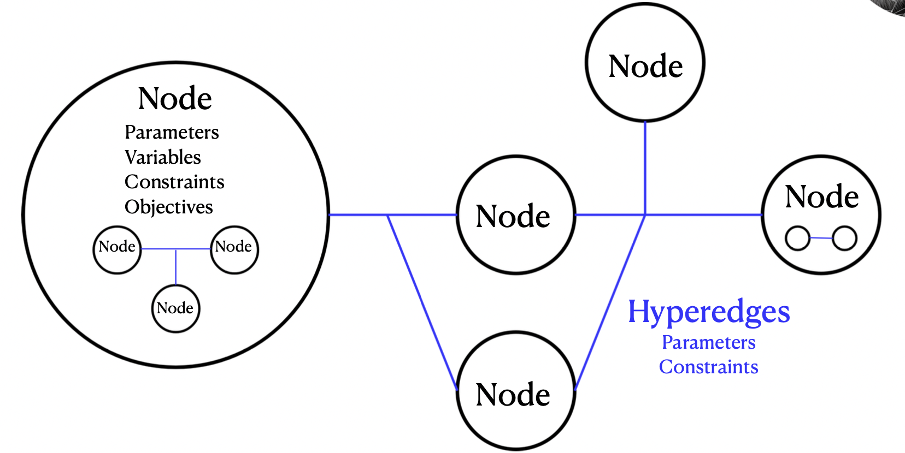
The hierarchical hypergraph modelling upon which GBMOL relies
Source: Miftari et al. (2023)

Slide 25
Three existing challenges for optimizing a hub
Uncertainty: how to take into account uncertainty related, for example, to the cost of commodities, the renewable energy profiles, the cost of technologies.
Non-Linear behaviour of the components that significantly complexifies optimization problems.
Optimizing the technology: how can we determine what improvements should be made to the technology to optimize the economy of hubs? For example, designing windmills with higher cut-out speed and rated output speed may significantly improve the economics of aRREH located in windy Greenland; see Radu et al. (2019).*
* We are currently using Reinforcement Learning (RL) techniques as a way to solve these challenges, see e.g. Boland et al. (2022).
Notes:
Renewable energy profiles (based on wheather data simulation and kind of technology chosen)

Slide 26
3. Geopolitics, Finance and Incentives

Slide 27
Deepening of multilateralism and the end of energy weaponization
A global grid and the multiplication of RREH numbers will create a complex web of interdependencies between states (ex. depending on variations of demand and supply).
The abundance of wind and solar energy resources makes it possible to avoid having hubs used as a political energy weapon as is currently the case for gas and oil, where limited resources are located in specific countries (Bordoff and O’Sullivan (2023)).

Slide 28
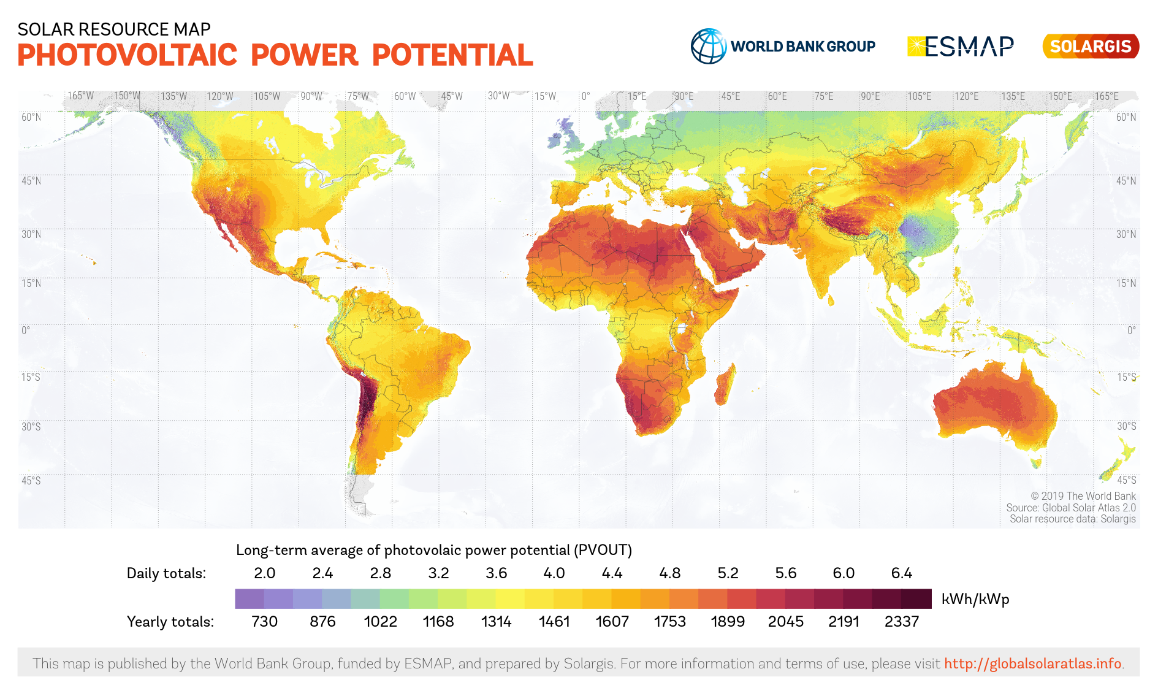
Promotion of democratic regimes through a strategic establishment of RREH
Wind and solar resources are abundant in stable and democratic parts of the world.
With RREHs there is a way to promote democratization and strengthen the EU’s role as a ‘Normative Power’ (Manners, 2002).

Slide 29
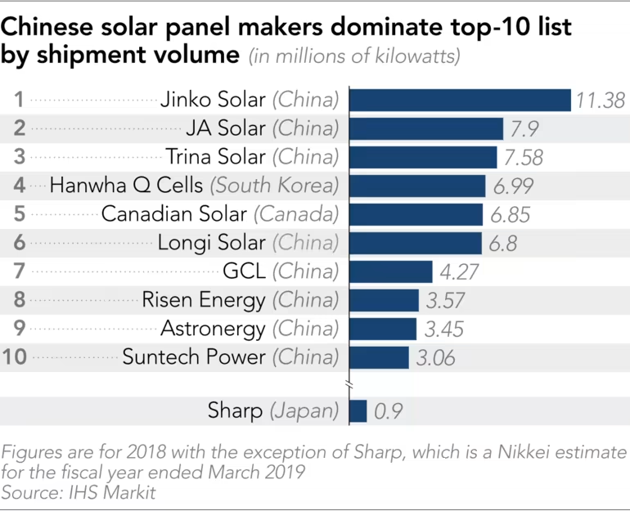
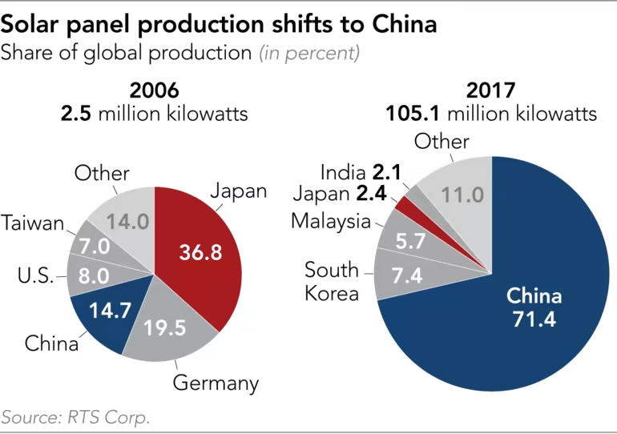
Concentration of resources
No need to worry about the concentration of resources, but attention must be paid to the concentration of resources needed for the fabrication of renewable technologies and manufacturing chains (IEA, 2022).
How to efficiently diversify supply chains to avoid over-reliance over a few technology-producing countries?

Slide 30
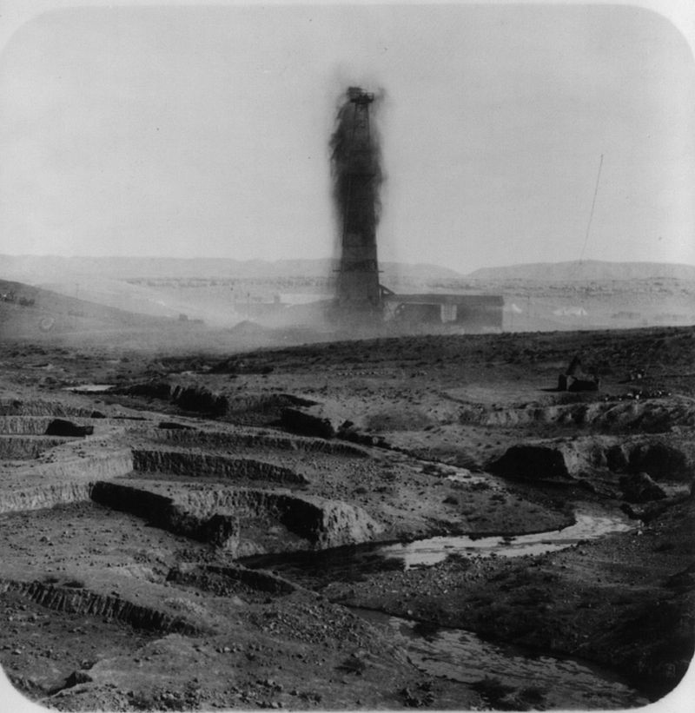
Consideration of the local environment when developing RREHs
Establishing RREHs in the Global South must not be a colonialist nor a plundering endeavour.
Valorization of local opportunities and by-products in countries developing such hubs is important.
Importance of fairness, respect of local realities of communities and sustainable development.
Kirkuk oil field (Iraq) in 1932. The oil extracted from this field at the time mainly benefited the United Kingdom. This is an example of energy colonialism that should not be reproduced with RREH.

Slide 31

United Nations Sustainable Development Goals (UN SDGs)
UN SDGs (Gymiah et al., 2023):
Set of 17 interconnected goals adopted by all United Nations Member States in 2015
Aim to address the world's most pressing social, economic, and environmental challenges by 2030.

Slide 32
RREHs and UN SDGs
The RREH concept is aligned with six UN SDGs:
SDG 6: Clean water and sanitation
SDG 7: Affordable and clean energy
SDG 8: Decent work and economic growth
SDG 9: Industry, innovation and infrastructure
SDG 12: Responsible production and consumption
SDG 13: Climate action

Slide 33
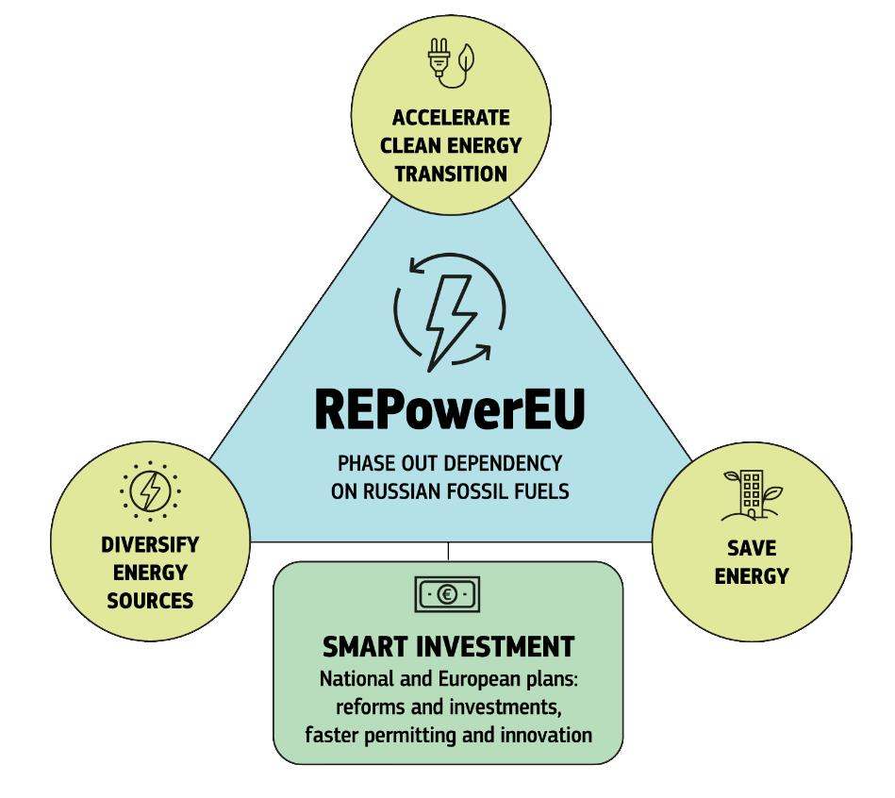
REPowerEU
REPowerEU (European Commission, 2022):
In the context of the war in Ukraine, a plan has been designed to save energy, produce clean energy and diversify energy supplies
In the short term: diversification of energy supplies and suppliers
On the mid term (to execute before 2027): financial and juridic measures to build new infrastructures and energy systems.

Slide 34
RREHs and REPowerEU
Several objectives of an RREH and REPowerEU match, namely:
Diversification of energy supplies
Accelerating the rollout of renewables
Reduction of fossil fuel reliance and consumption. Example: reduction of reliance on Russian natural gas.

Slide 35
However, the EU did not consider the possibility of importing carbon-neutral natural gas or other synthetic fossil fuels from renewable hubs. REPowerEU places too much emphasis on hydrogen, and not enough on other carbon-neutral outputs that can be produced in RREHs.
New regulatory and monitoring mechanisms will have to be put in place (e.g., amendment of Directive (EU) 2018/2001 on the promotion of the use of energy from renewable sources).
The proposal of the European Parliament and the Council for a Regulation on the internal markets for renewable and natural gases and for hydrogen is heading in the right direction.

Slide 36
Carbon Pricing and Incentives
CO2 emissions orginating from carbon-neutral fuel produced in RREHs should not be englobed in the ETS & CBAM schemes.
Increase in production and trade of carbon-neutral fuels may lead to an over-supply of carbon credits and thus will drive their prices down.

Slide 37
Conclusion
RREHs offer magnificent opportunities for rapidly transitioning to low-carbon economies.
Possibility to take advantage of local opportunities for farming and water.
GBOML can be used to model and help for the optimization of RREH.
Identifying the optimal hubs is a complex optimization task, especially if multi-energy vector hubs are considered.
Opportunity to deepen multilateralism and achieve normative objectives at both UN and EU levels.

Slide 38
References
Berger, M., Radu, D.-C., Detienne, G., Deschuyteneer, T., Richel, A., & Ernst, D. (2021). Remote Renewable Hubs for Carbon-Neutral Synthetic Fuel Production. Frontiers in Energy Research.
Bolland, A., Boukas, I., Berger, M., & Ernst, D. (2022). Jointly Learning Environments and Control Policies with Projected Stochastic Gradient Ascent. Journal of Artificial Intelligence Research, 73, 117-171.
Bordoff, J., & O’Sullivan, M. L. (2023, April 10). The Age of Energy Insecurity. How the Fight for Resources Is Upending Geopolitics. Foreign Affairs.
Boukas, I., Ernst, D., Théate, T., Bolland, A., Huynen, A., Buchwald, M., Wynants, C., & Cornélusse, B. (2021). A Deep Reinforcement Learning Framework for Continuous Intraday Market Bidding. Machine Learning, 110, 2335-2387.
Chatzivasileiadis, S., Ernst, D., & Andersson, G. (2013). The global grid. Renewable Energy, 57, 372-383.
Dachet, V., Benzerga, A., Fonteneau, R., & Ernst, D. (2023a). Towards CO2 Valorization in a Multi Remote Renewable Energy Hub Framework. Proceedings ECOS 2023.

Slide 39
Dachet, V., Larbanois A., Fonteneau, R. & Ernst, D. (2023b). E-Fuels Produced In Remote Renewable Energy Hubs: A Cross Vector Analysis. Submitted.
European Commission. (2022). Communication REPowerEU Plan.
Gymiah, P., Appiah, K. O., & Appiagyei, K. (2023). Seven years of United Nations’ sustainable development goals in Africa: A bibliometric and systematic methodological review. Journal of Cleaner Production, 395, 1-11.
lnternational Energy Agency. (2022). Special Report on Solar PV Global Supply Chains.
Manners, I. (2002). Normative Power Europe: A Contradiction in Terms? Journal of Common Market Studies, 40(2), 235-258.
Miftari, B., Berger, M., Djelassi, H., & Ernst, D. (2022). GBOML: Graph-Based Optimization Modeling Language. Journal of Open Source Software, 7(72), 4158.
Radu, D.-C., Berger, M., Fonteneau, R., Hardy, S., Fettweis, X., Le Du, M., Panciatici, P., Balea, L., & Ernst, D. (2019). Complementarity Assessment of South Greenland Katabatic Flows and West Europe Wind Regimes. Energy, 175, 393-401.

