Slide 1
The Court of Justice of the European Union as a Representative Institution?
Judicial appointments and input legitimacy of the EU’s judiciary

Slide 2
Power, Coercion, Legitimacy
Power = Asymmetrical relationship between dominating (powerholder/ruler) and dominated (subordinates) entities
How is power exercised?
  Force
  Rewards
  Voluntary obedience

Slide 3
POWER
COERCION
BRIBERY
LEGITIMACY

Slide 4

WHY IS LEGITIMACY IMPORTANT TO THE EU?
POWER
COERCION
BRIBERY
LEGITIMACY

Slide 5
Legitimacy in the EU (20th century)
INPUT (Scharpf 1999) | THROUGHPUT (Schmidt 2020) | OUTPUT (Scharpf 1999)
Sense of community Control over powerholders | Processes Good: Open, Accountable Bad: Opaque, Corrupt | Sound Policy Results Decisions benefitting the majority

Slide 6
Legitimacy of the EU in 2022?
INPUT (Scharpf 1999) | THROUGHPUT (Schmidt 2020) | OUTPUT (Scharpf 1999)
Sense of community Control over powerholders | Processes Good: Open, Accountable Bad: Opaque, Corrupt | Sound Policy Results Decisions benefitting the majority

Slide 7
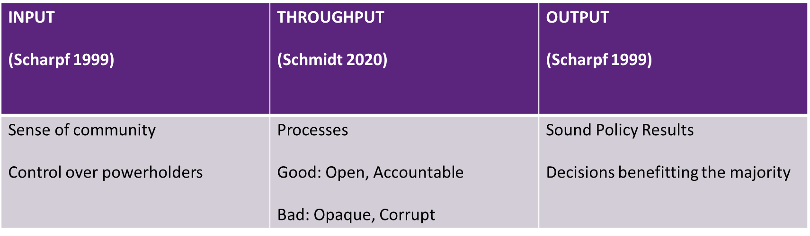
Legitimacy of the EU in 2022?

Slide 8




Legitimacy of EU institutions in 2022
 | INPUT | THROUGHPUT | OUTPUT
COMMISSION
COUNCIL
EP
ECB
CJEU

Slide 9
CJEU as the Most-likely case for legitimacy crisis in the EU?
Legitimacy crisis as:
  “when the level of social recognition that its identity, interests, practices, norms, or procedures are rightful declines to the point where the actor or institution must either adapt (by reconstituting the social bases of its legitimacy, or by investing more heavily in material practices of coercion or bribery) or face disempowerment” (Reus Smit 2007)
Judicial authority as
  Courts do not have “the power of the sword not the purse”
  Need to persuade others to accept their ruling
Judicial disempowerment = legitimacy crisis

Slide 10
CJEU Legitimacy following Scharpf and Schmidt = TURMOIL
INPUT: NONE?
  Non-majoritarian body
THROUGHPUT: DOUBTFUL?
  Criticized reasoning (Zambrano, Chen, Gravier, Portuguese judges, Weiss, Ajos and many more)
  Teleology: pro-integration bias
  ACTIVISM
OUTPUT: FAILING?
  4 ultra vires rulings (CZ, DK, DE, PL)

Slide 11
But …
NO disempowerment
  Despite many pleas in favor (T. May, Scharpf himself, etc.)
Stable mandate
  More than any other institution (no part of ‘semi-permanent constitutional revision process’)
Even EMPOWERMENT
  ESM, TSGC, EU-UK relations

Slide 12
How the CJEU uphold its authority (and thus legitimacy) despite failing outputs, doubtful throughput and allegedly inexistent input?

Slide 13
Quickly: throughput and output
Throughput: criticism about undue process not shared by many
  Various interactions with stakeholders of the European legal profession
Output: a few decisions among many
  Contested rulings: drops in an ocean of uncontroversial cases

Slide 14
But mostly: more input
Theories of legitimacy often focus on institutional properties of polities
  All Non-majoritarian agencies would be input-illegitimate
  Ignores consensual agreement about unelected power in Member States democracies
Help in giving a macro and normative perspective, but not in understanding why authority is accepted in practice
Focus on micro, sociological properties of actors working for EU institutions completes/nuances that perspective

Slide 15
Main argument: Redefinition of Input
Input = more than direct citizen control
Non-majoritarian institutions: representativity/reflection of ruled society
Constitutional judges = atypical powerholders, needing political and professional endorsement
Specific selection criteria
Possible difficulties of representation

Slide 16
Judges: ‘Chosen’ among the ‘Best’
Nomination of CJEU judges similar to those of constitutional courts
Need for political endorsement
  Only discrimination possible
  Constitutional judging = political exercise (balancing of rights)
Need for high legal pedigree
  Candidates undergo screening by expert panel (255 committee)
  Demanding standards

Slide 17
The first years of the Court
Anderson 2021
  “Who were they? The Italian president of the court, Massimo Pilotti, had been […] advising Mussolini on what counter-measures to take to shield Italy from condemnation by the League for its actions in Ethiopia […] The German judge on the court, Otto Riese, was so devoted a Nazi that without any duress – he spent the war as an academic in Switzerland – he retained his membership of the NSDAP until 1945. His compatriot Karl Roemer, an advocate-general to the court, spent the war in occupied Paris managing French companies and banks for the Third Reich; after the war, he married Adenauer’s niece, and acted as defence lawyer for the Waffen SS charged with responsibility for the massacre of the occupants of the French village of Oradour. The other advocate-general, Maurice Lagrange, was a senior functionary in the Vichy government, fully committed to the ideology of a ‘National Revolution’ to sweep away the legacy of the Third Republic […] Lagrange was in charge of co-ordinating the first wave of persecution of French Jews […] After the war he was chosen by the Americans to help democratise the civil service in Germany, and by Monnet to help draft the treaty establishing the Coal and Steel Community.”

Slide 18
Today’s Court
Criterion | Specification for the ECJ | Specification for the GC
Legal expertise (EU Law) | Degree | Degree
 | Publications | Publications
 | Hearing (questions by the committee) | Hearing (questions by the committee)
Experience | > 20 years (except "exceptional expertise") | > 12-15 years (except "exceptional expertise")
Ability to perform the duties of a Judge | Hearing: clear and reasoned answers to questions | Hearing: clear and reasoned answers to questions
Independence Impartiality | Application | Application
 | Hearing | Hearing
Languages | Proficiency | Proficiency
 | Publications | Publications
 | Minimum level of French required | Minimum level of French required

Slide 19
Name | Function |  |  | Name | Function |  |  | Name | Function
1st Panel | 2010 - 2013 |  |  | 2nd Panel | 2014 - 2017 |  |  | 3rd Panel | 2017 - 2020
J.M. SAUVÉ | Vice-President of the Conseil d'Etat | President |  | J.M. SAUVÉ |  | President |  | C. TIMMERMANS | Former ECJ judge | President
P. JANN | Former ECJ judge |  |  | L. BERLINGUER | MEP |  |  | S. BUSUTTIL | MEP
L. MANCE | UK Supreme Court |  |  | P. KOSKELO | Finnish Supreme Court President |  |  | F. CLARKE | Ireland's Chief Justice
T. MELCHIOR | Danish Supreme Court President |  |  | L. MANCE | UK Supreme Court |  |  | C. LESMES SERRANO | Spain's Supreme Court President
P. PACZOLAY | Hungarian CC President |  |  | P. PACZOLAY | Hungarian CC President |  |  | M. MARTINS DE NAZARÉ RIBEIRO | Former GC judge
A. PALACIO | Former MEP |  |  | C. TIMMERMANS | Former ECJ judge |  |  | A. VOSSKUHLE | BVerG President
V. TIILI | Former GC judge |  |  | A. VOSSKUHLE | BVerG President |  |  | M. WYRZYKOWSKI | Fomer CC judge in Poland

Slide 20
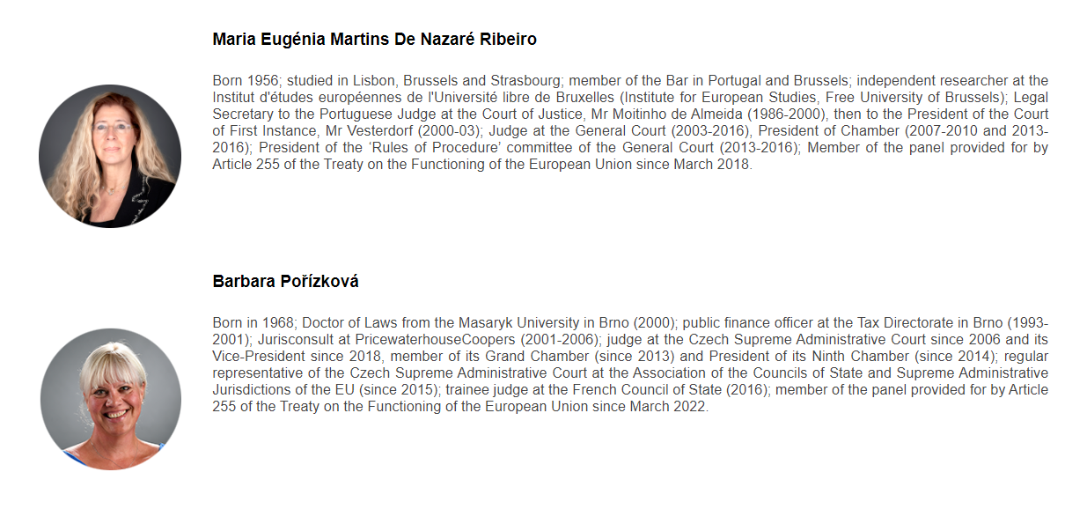
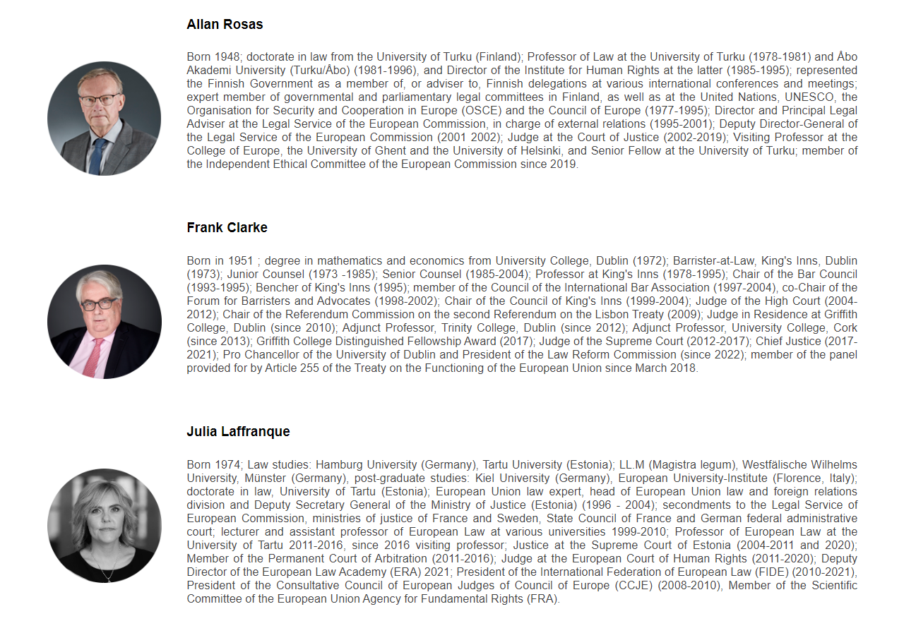
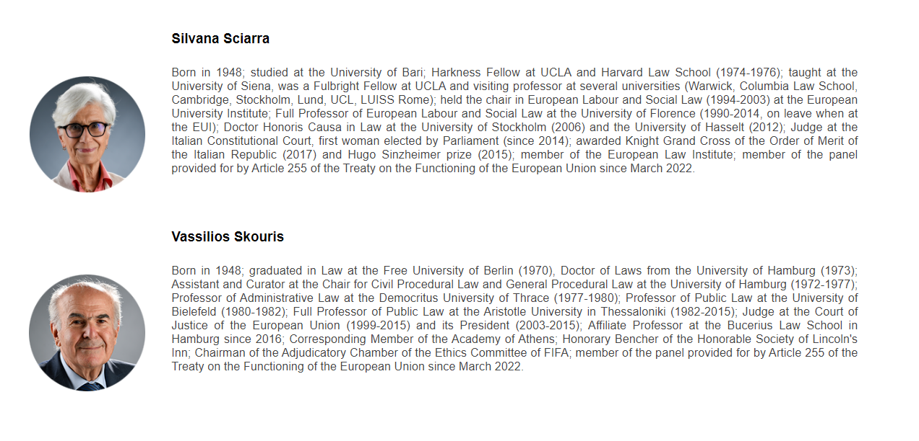

Slide 21
Political and peer endorsement process
Indirect democratic legitimation
  By directly elected national organs
Strong CV review
True European Herculeses?

Slide 22
Unequal reflection of EU society at the CJEU
Pre-existing social stratifications + Demanding selection criteria
Voluntary and Involuntary persons groups excluded
Involuntary exclusion: reflection of social pre-existing hierarchies
Voluntary: institutional mechanisms
  Some in line with consensual drivers of polity
  Some going against the constitutional balance binding EU to Member states

Slide 23
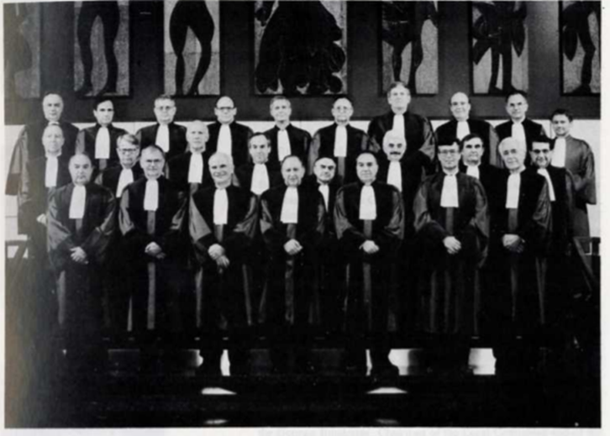
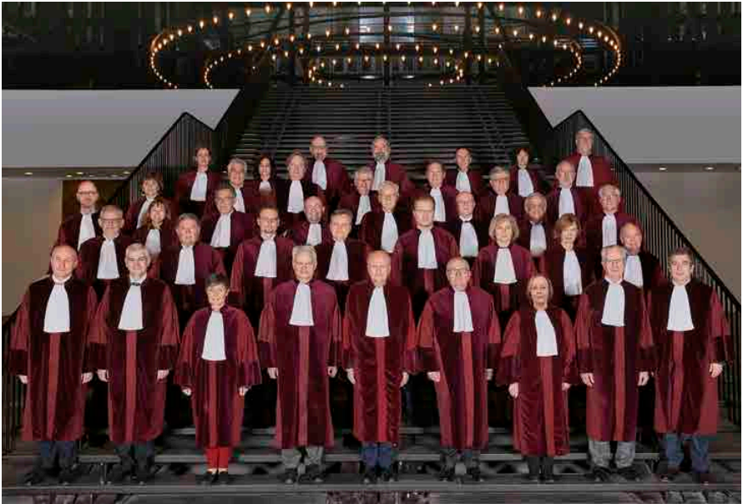
Involutary exclusion 1: Women

Slide 25
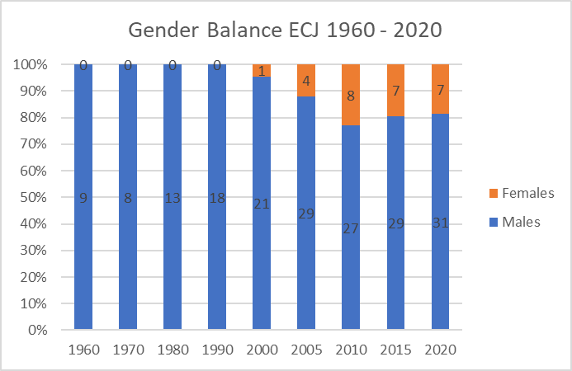

Slide 26
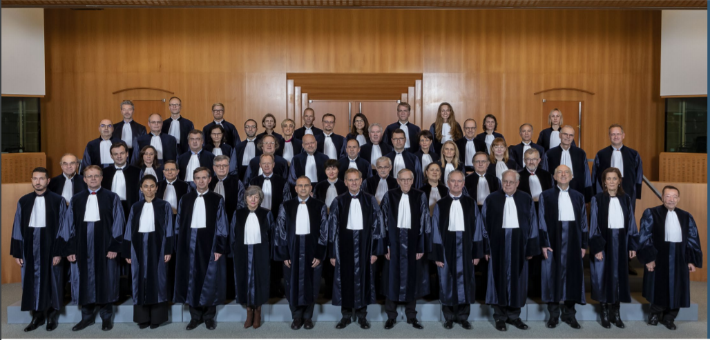

Slide 27
The Involuntary excluded 2: ethnic minorities

Slide 28
The Voluntarily Excluded 1: Member States themselves!
Need for French proficiency
  Last 255 committee: need to “acquire proficiency” (No longer a prerequisite?)
Some Member States have a difficult time to find suitable candidates
  E.g. Slovenia, 2 years ago, did not have a single judge at the GC!
  Also for more populated Member States (Pignon!)

Slide 29
The Voluntarily Excluded 1: Member States themselves!
Institutionalized discriminating mechanism: the Advocate General System

Slide 30
The Voluntarily Excluded 2: Politicians
US Supreme Court: Political ideology must be known in order to join
CJEU (and Member States CCs): ideology not only a non-factor, but must be concealed
Only a few instances where judges previously occupied political mandates before (Skouris, Biltgen) in smaller Member States

Slide 31
Conclusion
CJEU possesses more input legitimacy than suggested by Scharpf
The institution is non-majoritarian, but judges and AGs reflect societies and practices of the Member States
Judges = Super EU Legal professionals
Unequal representation of society, sociologically understandable for some groups (ethnic minorities), much less for others (gender balance), may raise challenges in the near future

