Slide 1

A comprehensive analysis of CO₂ exchanges in agro-ecosystems based on a generic soil-crop model-derived methodology
Mathieu Delandmeter, Joël Léonard, Fabien Ferchaud, Bernard Heinesch, Tanguy Manise, Ariane Faurès, Jérôme Bindelle, Benjamin Dumont
Gembloux Agro-Bio Tech – University of Liege (Belgium)

Slide 2



The idea
ICOS stations focus on specific pedo-climatic conditions and management

Slide 3



The idea
Calibration and validation
Soil-crop model
ICOS stations focus on specific pedo-climatic conditions and management
Would enable the extrapolation to other contrasted pedo-climatic conditions and management
Climate change
Different crops
Tillage?

Slide 4
The idea
Calibration and validation
Soil-crop model
ICOS stations focus on specific pedo-climatic conditions and management
Objectives
Elaborate, from field measurements, the methodology to compute CO₂ fluxes.
Discuss the influence of various environmental drivers on crop rotations CO₂ fluxes, based on both field observations and model simulations.

Slide 5
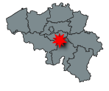
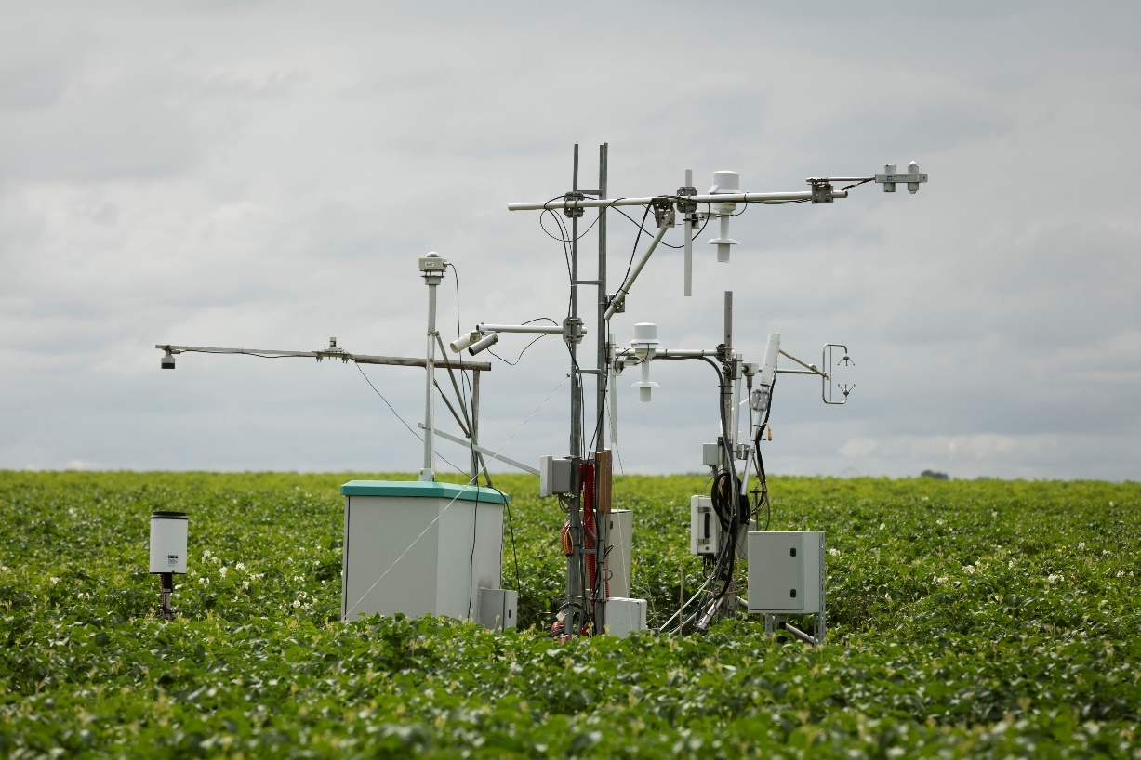




The BE-LON experimental site
Experiment started in 2004
Data collected: yield, crop growth, soil variables…
But also CO₂ and N₂O exchanges
4-year crop rotation: sugarbeet, winter wheat and potatoes
https://www.icos-belgium.be/ESLonzee.php#Lonzee. Picture by Eli Verheyen in 2018

Slide 6

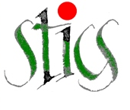
The soil-crop model STICS
INPUTS
Model daily computation
OUTPUTS
Plant
Yield
Plant development module
Soil
Stresses
Climate
Soil bio-chemical state (SOC, N…)
Water balance module
Nutrition module
Initialization
Water balance
Management

Slide 7


Methodology
Vegetative organs
Gross Primary Productivity (GPP)
Harvested organs
Autotrophic (maintenance + growth)
Ecosystem Respiration (RECO)
Fallen
leaves
Heterotrophic
Belowground
(roots + rhizodeposition)

Slide 8
Methodology
Vegetative organs
Gross Primary Productivity (GPP)
Harvested organs
Autotrophic (maintenance + growth)
Ecosystem Respiration (RECO)
Fallen
leaves
Heterotrophic
Belowground
(roots + rhizodeposition)
Used a constant coefficient coming from shoot-root ratios and harvest indices, considering rhizodeposition (Bolinder et al., 2007).

Slide 9
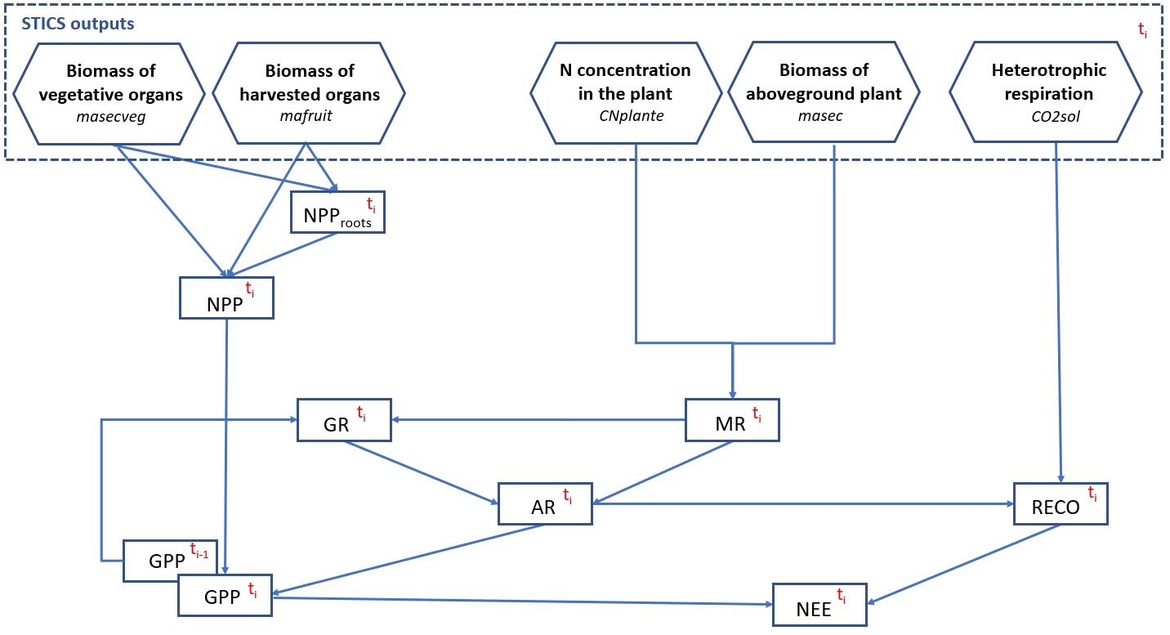
Methodology
Bolinder et al. (2007)
Amthor (2000); Kirschbaum and Mueller (2001); Sun et al. (2007)
Brisson et al. (2009)
Krinner et al. (2005)
Krinner et al. (2005)
Suleau et al. (2011)
Delandmeter et al. (in preparation)

Slide 10
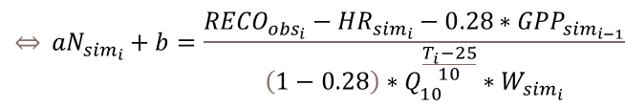
Results – Relationship between MR and plant N concentration
Following Amthor (2000), Kirschbaum and Mueller (2001) and Sun et al. (2007):
$$\begin{aligned}&MR=\left(aN+b\right) ∗ Q_{10}^{\frac{T−25}{10}}∗W\end{aligned}$$
$$\begin{aligned}&\underset{⇔}{} aN_{{sim}_{i}}+b=\frac{{RECO}_{{obs}_{i}}−{HR}_{{sim}_{i}}−0.28∗{GPP}_{{sim}_{i−1}}}{\left(1−0.28\right)∗Q_{10}^{\frac{T_{i}−25}{10}}∗W_{{sim}_{i}}} \#\end{aligned}$$
Delandmeter et al. (in preparation)

Slide 11
Results – Carbon dynamics illustration
Winter wheat
2011-2012
Delandmeter et al. (in preparation)

Slide 12
Results – Goodness of fit
Delandmeter et al. (in preparation)

Slide 13
Results – Carbon budget
Delandmeter et al. (in preparation)

Slide 14


NEE inter-annual variability
Correlations?
Winter wheat
Q_{cum} x NEE
Potatoes
NDAV x NEE
Sugarbeet
Temperature x NEE
Maize
Cover crop
(Precipitations – ETP) x NEE
.
.
.
Delandmeter et al. (in preparation)

Slide 15
NEE inter-annual variability
Objective: Quantify crop response to weather conditions
Increased period of active vegetation and/or radiation increases C sequestration, in agreement with e.g. Buysse et al. (2017) and Ceschia et al. (2010)
Delandmeter et al. (in preparation)

Slide 16
NEE inter-annual variability
The crop model allows to differentiate respiration components.
Objective: Is HR more influenced by temperature than AR (Suleau et al., 2011)?
We found a greater influence of temperature on AR than HR, in agreement with e.g. Zhang et al. (2013).
Delandmeter et al. (in preparation)

Slide 17
Conclusion
The approach computes daily CO₂ fluxes (GPP, RECO, NEE) from soil-crop model outputs
The 16-year ICOS crop rotation of BE-LON was used to set-up the approach
Goodness of fit indicators proved the method to be reliable
Environmental drivers of CO₂ fluxes inter-seasonal variability were identified
Its genericity makes it a valuable tool to investigate crop rotations CO₂ dynamics
Picture by Eli Verheyen in 2018

Slide 18
A comprehensive analysis of CO₂ exchanges in agro-ecosystems based on a generic soil-crop model-derived methodology
Mathieu Delandmeter, Joël Léonard, Fabien Ferchaud, Bernard Heinesch, Tanguy Manise, Ariane Faurès, Jérôme Bindelle, Benjamin Dumont
Gembloux Agro-Bio Tech – University of Liege (Belgium)

