Slide 1






A Summary Review Based on Case Studies of the Challenges Related to the Comparison of Displacements Measured by PS-InSAR and Simulated by Geomechanical Coupled to Groundwater Models
Aline Moreau, Atefe Choopani, Alain Dassargues, Philippe Orban, Xavier Devleeschouwer, Pierre-Yves Declerq
Notes:
PAGE D'INTRODUCTION 2 / Page sans photo permettant l'insertion du titre de la présentation ainsi que d'autres infos (date, lieu, orateur, sous-titre,…)

Slide 2
The LASUGEO Project
Global Goal:
Quantify and map land surface movements linked to groundwater exploitation using long time series of different geodetic techniques
Specific area of deformation in Antwerp
Specific area of deformation in Leuven
Observed using PS-InSAR technique
Terzaghi principle → Setting mainly occuring in clay confining layer
Local & Regional 3D groundwater flow models
1D geomechanical model
SUB package of MODFLOW
Notes:
PAGE DE CONTENU 1 / Possibilité d'insérer du texte, des images, de la vidéo, des graphiques …

Slide 3
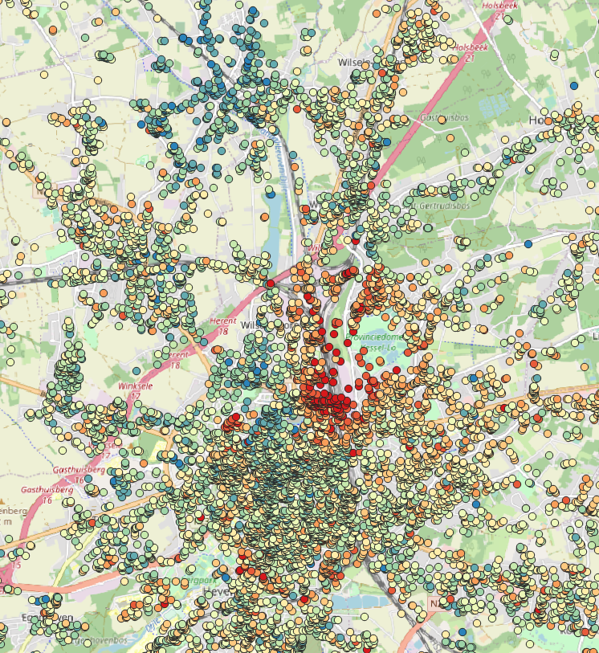
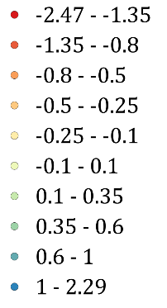
Monitoring Land Surface Deformation
Few examples of methods to monitor surface deformation:
  Extensometers
  LiDAR (Light Detection And Ranging)
  GNSS (the Global Navigation Satellite System)
  InSAR (Interferometric Synthetic Aperture Radar)
Annual average velocity (mm/year)
Cost-effective
Large coverage area
High precision
Limited temporal resolution
Limited accessibility to data
Sensitive to the type of the area (vegetated/urban)
PS-InSAR measurements from radar imagery of ENVISAT (2003-2010) over the Leuven area
Notes:
PAGE DE CONTENU 1 / Possibilité d'insérer du texte, des images, de la vidéo, des graphiques …

Slide 4
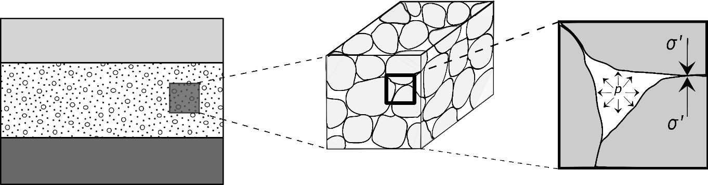

Different Causes For Land Surface Deformation
Natural and anthropogenic processes involve in the surface deformation of the Earth:
  Excessive exploitation of groundwater
  Compaction of unconsolidated sediments
  Excessive injection of water
  Decomposition of organic soil
  Mining, oil and gaz extraction
Terzaghi principle:
$$σ=σ^{′}+p$$
A decrease of water pressure in a saturated geological medium induces an increase of effective stress in confined as in unconfined conditions
REV in a saturated porous medium, and microscopic vertical cross section describing the stress distribution in the medium (A. Dassargues, 2019)
Notes:
PAGE DE CONTENU 1 / Possibilité d'insérer du texte, des images, de la vidéo, des graphiques …

Slide 5
Most Common Models For Land Surface Deformation
The black-box model
The aquitard-drainage model
  Use the Terzaghi’s 1D consolidation theory
  Numerical tools: COMPAC (1975), IBS1 (1990), SUB package (IBS2, 2000)
The poroelasticity model
Artificial Intelligence (AI) methods
Notes:
PAGE DE CONTENU 1 / Possibilité d'insérer du texte, des images, de la vidéo, des graphiques …

Slide 6
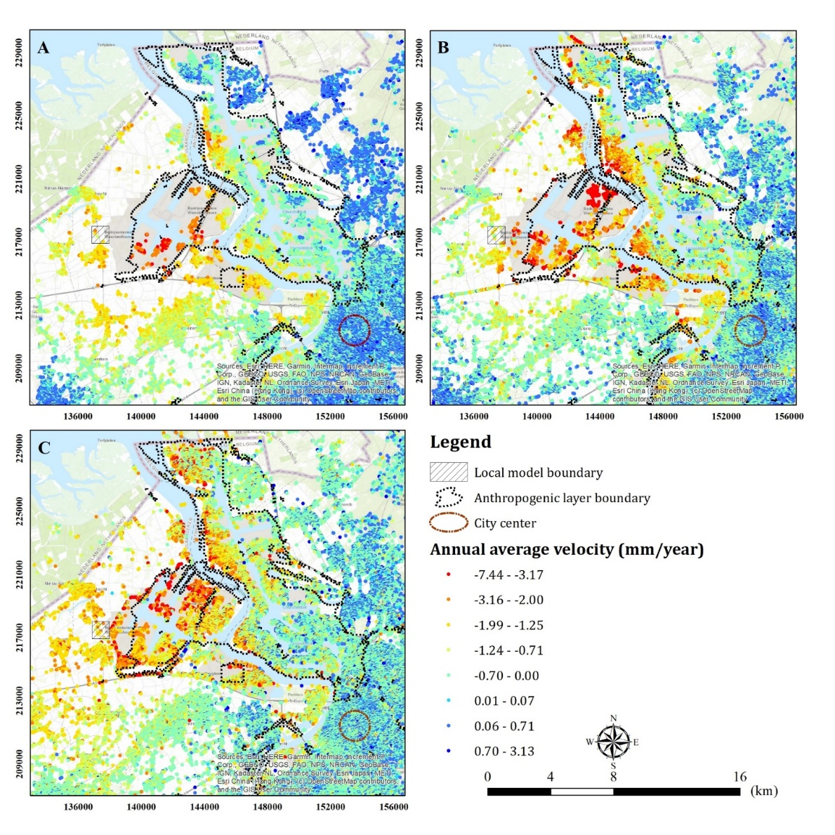
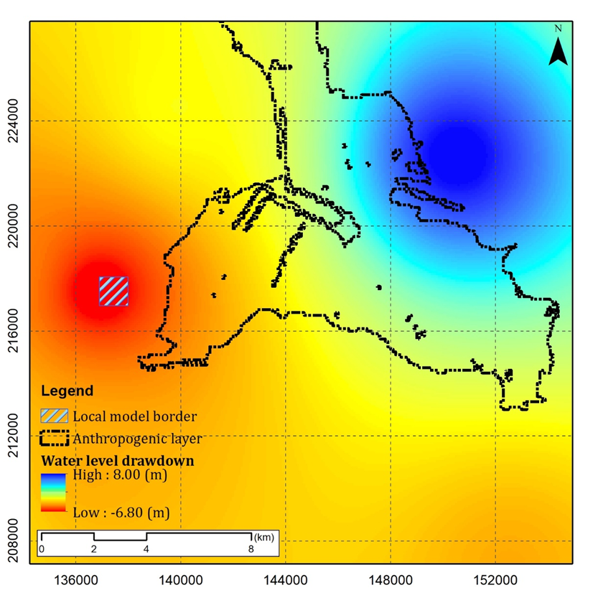
Study Site Of Antwerp In Belgium
An appropriate local model boundary is chosen in Antwerp based on the following criteria:
The local model is located out of the Anthropogenic layer to exclude its role as a subsidence driver
The local model is located in the region where it has been experiencing subsidence in 3 different periods of satellite data
The local model is located in a region where a water drawdown is observed in one of the deep aquifer systems (Oligocene aquifer system)
Notes:
PAGE DE CONTENU 1 / Possibilité d'insérer du texte, des images, de la vidéo, des graphiques …

Slide 7
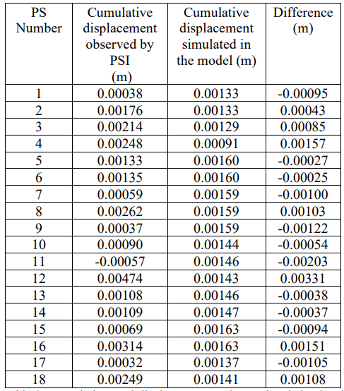
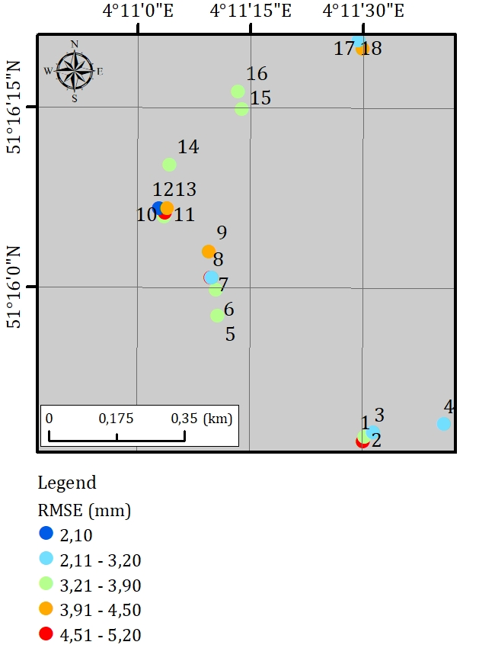
Study Site Of Antwerp In Belgium
Cumulative total displacement as observed and simulated during the comparison period (2007-2010).
Hydrogeological model
9 hydrogeological units
Hydrogeological parameters from literature and report
Piezometric level time series
Simulation period:
2007-2016
Comparison period:
2007-2010
(Investigated in 18 ENVISAT processed PS present in the local model border
Vertical deformation in each hydrogeological unit
Geomechanical model
Compression and swelling constants from literature and reports
SUB package (a 1D-geomechanical model defined in MODFLOW)
)
The RMSE (color chart) between the PSI displacement time series and cumulated displacement from the model (during the comparison period 2007-2010)
Notes:
PAGE DE CONTENU 1 / Possibilité d'insérer du texte, des images, de la vidéo, des graphiques …

Slide 8
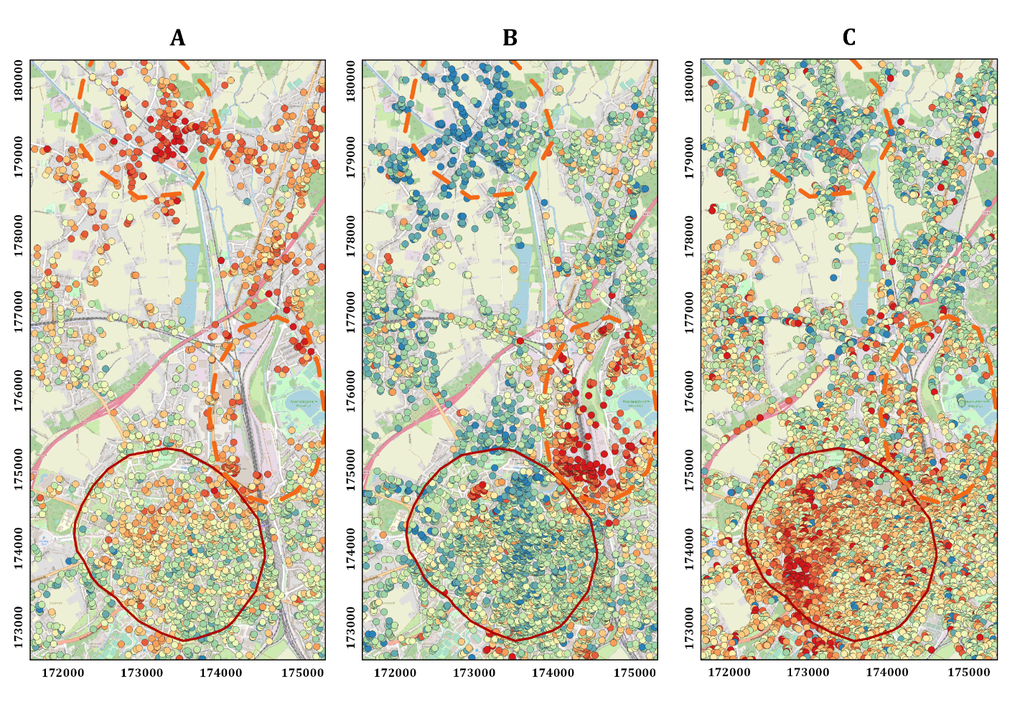
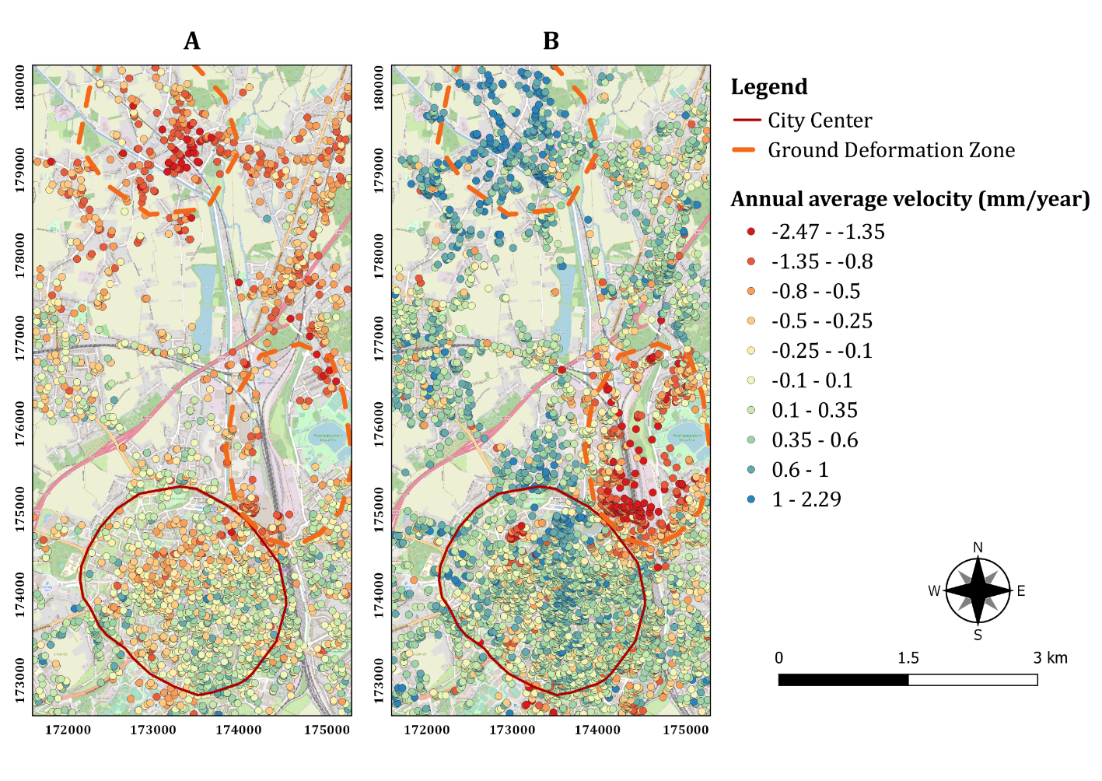
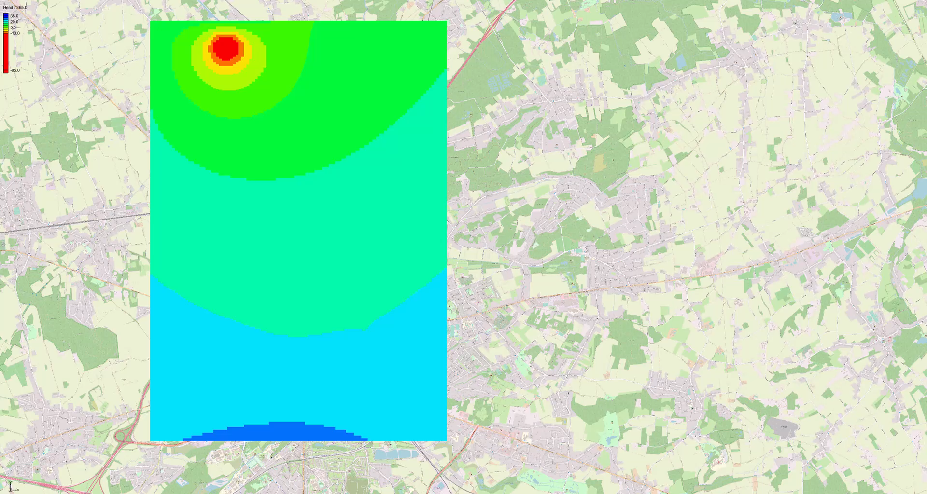
Study Site of Leuven in Belgium
InSAR measurements in the area of Leuven for satellites ERS 1/2 (A) (1992-2001), ENVISAT (B) (2003-2010) and
Sentinel 1A (C) (2016-2022)
Notes:
PAGE DE CONTENU 1 / Possibilité d'insérer du texte, des images, de la vidéo, des graphiques …

Slide 9
Study Site Of Leuven In Belgium
The trend of the total compaction curve is similar to the estimates from InSAR measurements over 30 years
The amplitude of the variation between absolute values of compaction are different
Notes:
PAGE DE CONTENU 1 / Possibilité d'insérer du texte, des images, de la vidéo, des graphiques …

Slide 10
Challenges Related To Our Study Sites
The comparison between InSAR measurements and calculated compaction of the geomechanical model is showing similar trend but the absolute values are not comparable
Here are some hypothesis that could explain it:
InSAR:
Deformation pattern not be retrieved if density of PS is insufficient
Challenges in monitoring very local deformation due to low resolution of non-commercial data
General
Can only be used as a comparison for the results of the SUB package
InSAR measurement are not continuous since the 90’s
Local
Groundwater flow model:
Missing sollicitation
Missing observation
Over simplification of the geology
High parametrization
0.08 piezometer per km² in area of Leuven
Notes:
PAGE DE CONTENU 1 / Possibilité d'insérer du texte, des images, de la vidéo, des graphiques …

Slide 11
Challenges Related To Our Study Sites
Geomechanical model
High parametrization
Over simplification needed in the SUB package
Comparison of calculated results of the SUB package and InSAR measurements
Achieving temporal overlap between datasets poses a significant challenge
Notes:
PAGE DE CONTENU 1 / Possibilité d'insérer du texte, des images, de la vidéo, des graphiques …

Slide 12
Conclusion
The study shows that InSAR techniques provide a valuable approach for accurately monitoring surface deformations
Numerous robust methods are available for modeling variations in groundwater levels and compaction
The studies conducted on our specific cases have concluded that the practical implementation of these methods represents a significant challenge. The multitude of factors that influence each of these methods create uncertainties; making it difficult to compare results
Notes:
PAGE DE CONTENU 1 / Possibilité d'insérer du texte, des images, de la vidéo, des graphiques …

Slide 13
Thank you very much !
Email: aline.moreau@uliege.be
LinkedIn: https://www.linkedin.com/in/aline-marie-moreau/

