Slide 1
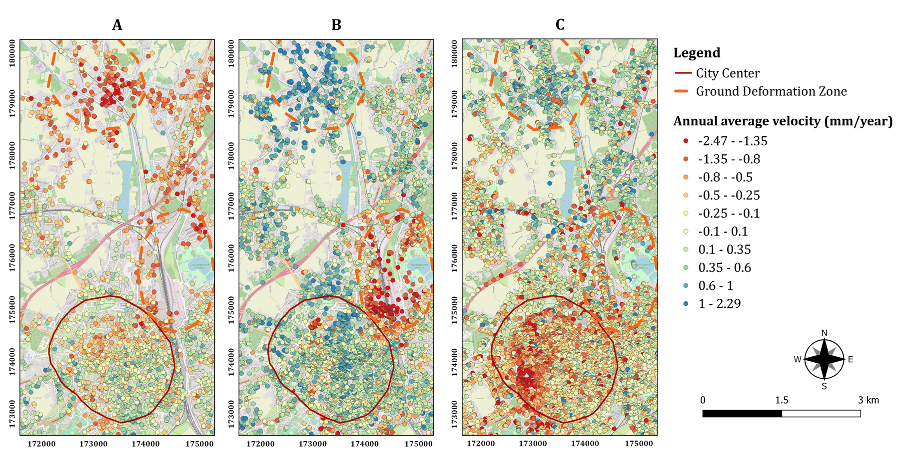
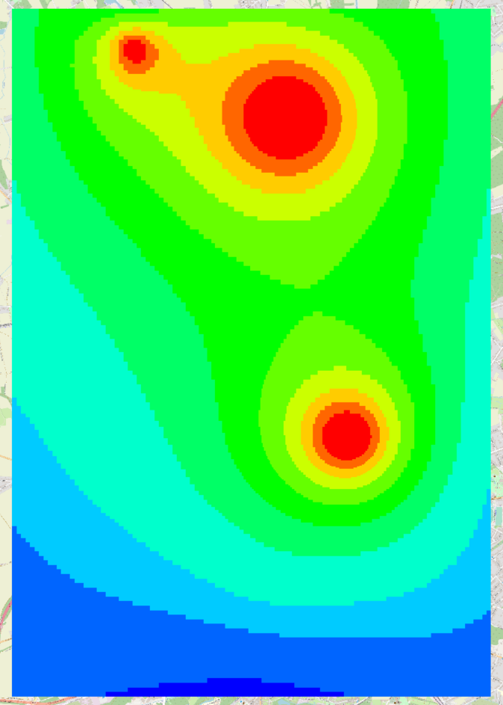
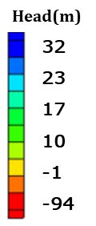
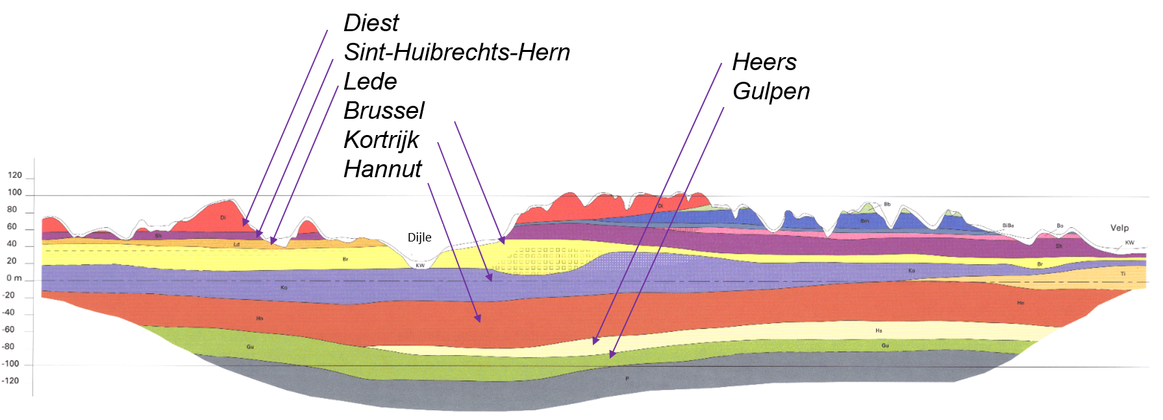
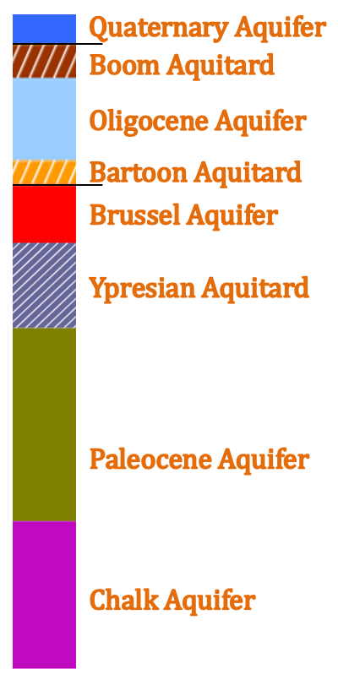
Modeling land subsidence caused by groundwater extraction and revealed by geodetic InSAR measurements in the Leuven area
In the framework of the LASUGEO project: « monitoring Land Subsidence caused by Groundwater exploitation through gEOdetic measurements »
Aline Moreau, Alain Dassargues, Philippe Orban, Xavier Devleeschouwer, Pierre-Yves Declerq
PARTNERS
aline.moreau@uliege.be
ABSTRACT
Using the Synthetic Aperture Radar Interferometry (InSAR) technique on data acquired by satellite ERS 1/2, ENVISAT and Sentinel-1A, from 1992 to 2022, localized vertical ground motion have been detected throughout Belgium. In the Leuven area, two subsidence bowls related to the Quaternary valley of the Dyle river are identified. One of the assumption to explain vertical ground motion is anthropic groundwater pressure variation induced by pumping in the upper aquifers. A general methodology is developed to identify consolidation and elastic rebound processes occurring in confined and unconfined conditions using 3D regional groundwater flow models coupled with 1D geomechanical models.
1. InSAR measurements
3. Steady state & transient groundwater flow models
This image shows the groundwater heads computed in the Hannut Formation in 2015 by the transient local model. The two main subsidence areas correspond to piezometric (head) depressions
Identification of the two ground deformation zones located North of Leuven using InSAR data from the ERS1/2 (A), ENVISAT (B) and Sentinel-1A (C) satellites
The dataset used in this study includes data from ERS1/2, ENVISAT, and Sentinel-1A, spanning distinct time periods from 1992 to 2001, 2003 to 2010, and 2016 to 2022, respectively
A two step approach was followed to model the groundwater flows:
First a regional model was developped to simulate the regional behaviour
A local model was developped for the geomechanical computation. Boundary conditions for the steady-state and transient local models are prescribed using groundwater heads calculated in the regional model
The transient model simulates the period between 1990 and 2020, integrating the temporal variation of the recharge and the pumping rates
The effects of pumping wells are very visible in the simulated heads of the Ypresian and Hannut Formations
2. Geology & hydrogeology
4. Geomechanical approach
DOV - 2023
Geological cross section of the Leuven area
In Leuven, the (hydro)geological layers are nearly horizontal and consist in a succession of sandy aquifers and clayey aquitards. From top:
the Quaternary Aquifer
the Brussel Aquifer
the Ypresian Aquitard
the Paleocene Aquifer: it contains the two sandy formations of Hannut and Heers. The base of the Hannut Formation is clayey. This aquifer is divided into 3 layers in the numerical model
the chalk aquifer
In the North of Leuven, under the Quaternary deposits, 3 additional (hydro)geological formations appear as indicated between black lines on the log. Their lithologies are mainly clayey
DOV - 2023
The graph shows the first results of compaction calculated by the SUB package in each layer of the model, in the zone near the center of Leuven (the color is linked to the local geological formations as described in the log on the right)
The vertical displacement were computed using the SUB package of MODFLOW:
The trend of the total compaction curve is similar to the estimates from InSAR measurements and shows a significant subsidence over 30 years
However absolute values of subsidence are different. This may be due to uncertainties related to the parameterization, conceptualization and calibration of the models (3D groundwater flow and 1D geomechanical models). This can also come from inaccuracies in the coupling of the models because the SUB uses parameters with constant values
At this stage, the results are less conclusive for the deformation zone located north of Leuven. There, we observe a lack of data on existing pumping wells and therefore a lack of data about actual groundwater pumping and potential induced changes in groundwater pressure in the aquifers
More works are going on to fully understand the results
DOV - 2023

