Slide 1
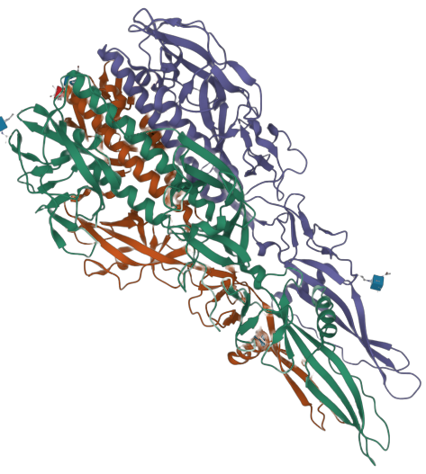
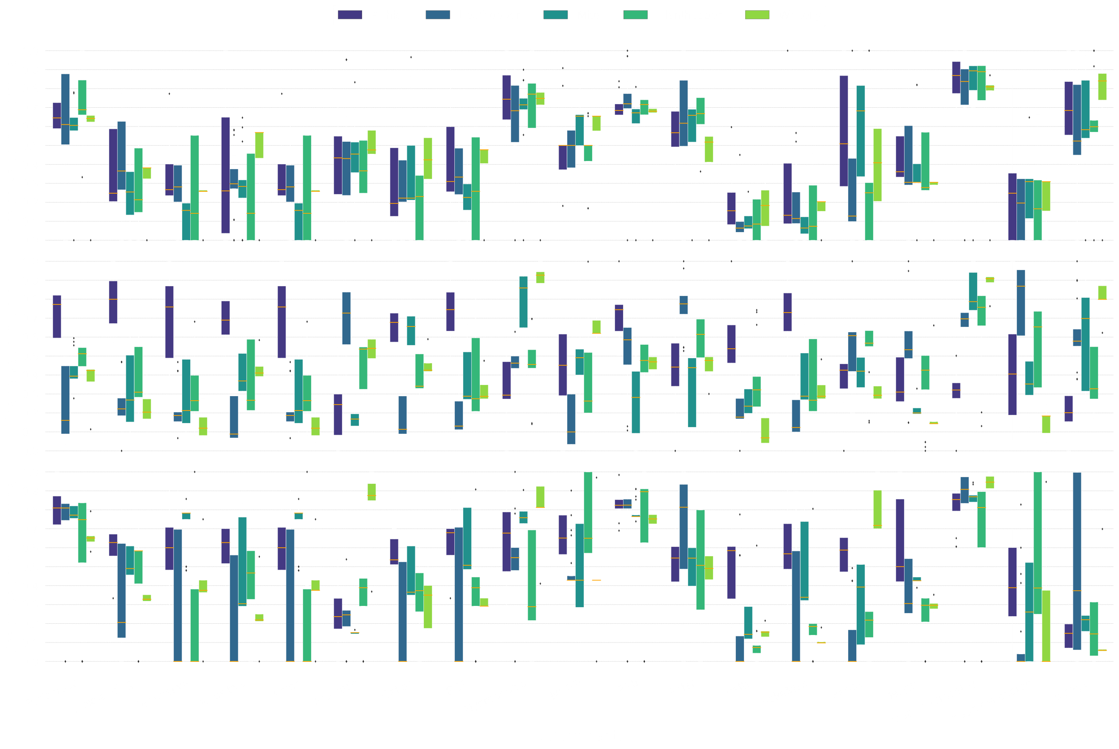
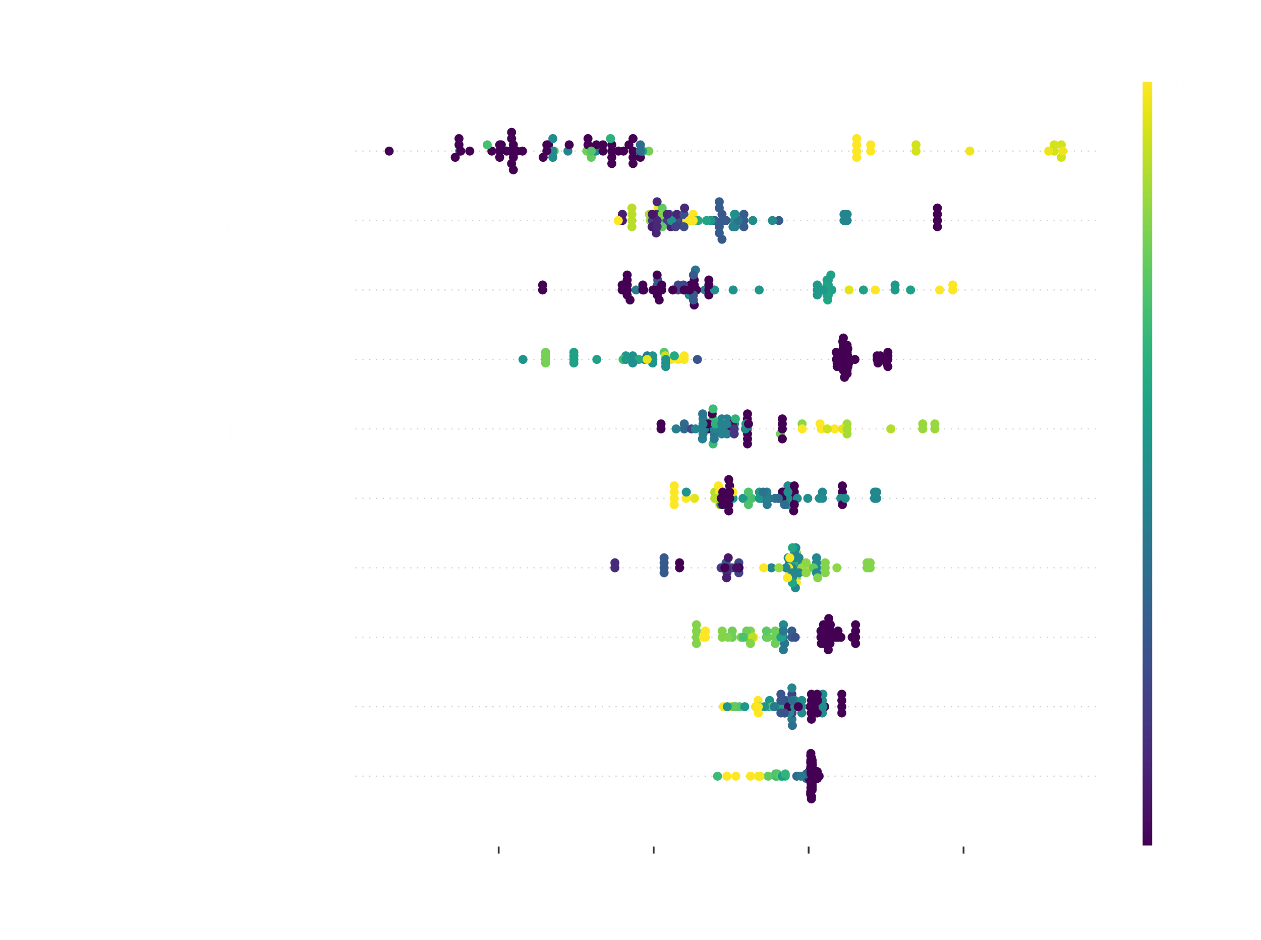
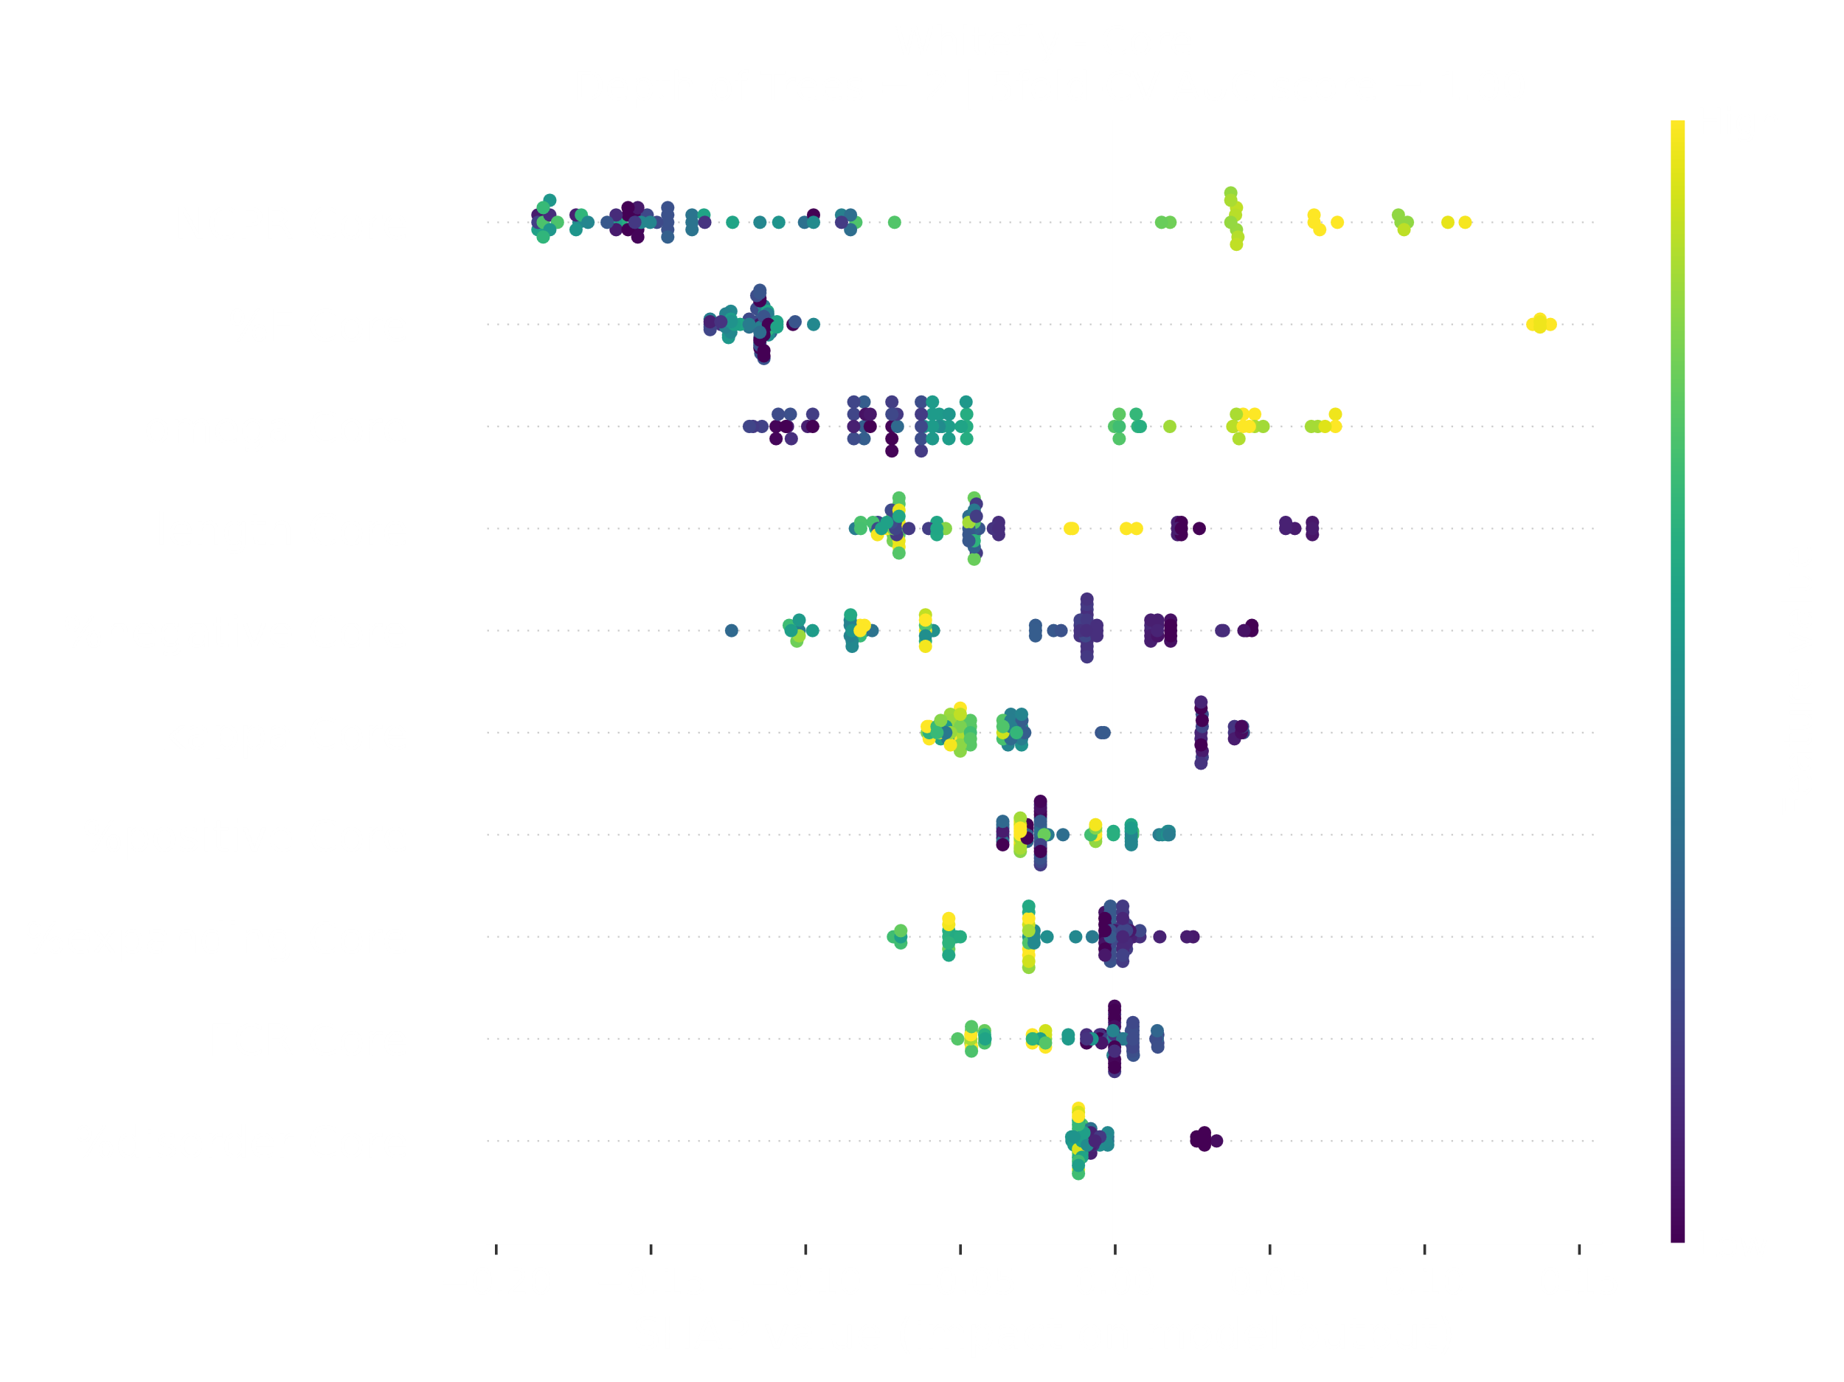
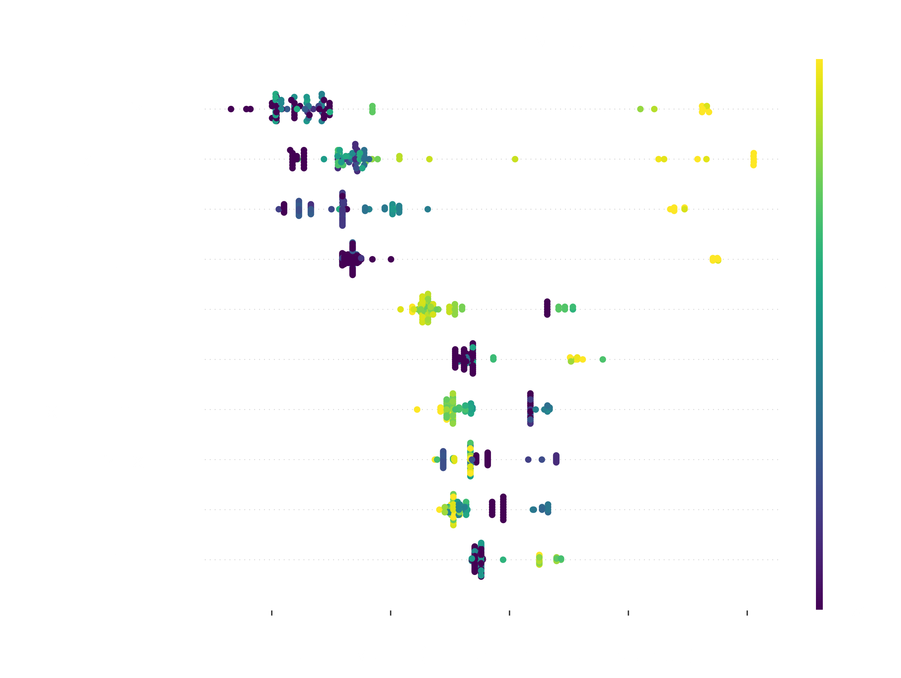
High Specificity in Disordered Domains of The Glycoprotein in The Family Rhabdoviridae
Nikolay Simankov ^{1,2}, Hélène Soyeurt ², Sébastien Massart ¹, Rachid Tahzima ^{1,3}
¹Laboratory of Plant Pathology – TERRA - Gembloux Agro-BioTech – University of Liège (ULiège) - 5030 Gembloux, Belgium. ²Statistics, Computer Science and Modeling applied to bioengineering (SIMa) – TERRA – University of Liège (ULiège) 5030 Gembloux, Belgium. ³Flanders Research Institute for Agriculture, Plant Sciences, Fisheries and Food (ILVO), 9820 Merelbeke, Belgium.
A foretaste of the relevance of the structural features and disorder regions of the rhabdoviral Gp.
The glycoprotein (Gp) is essential for virion attachment and penetration of insect (vector) host cells. The structural variation within Gp may impact the outcome of the virus/vector/host interactions.
It is still hypothesized that plant-pathogenic rhabdoviruses are derived from arthropod-borne viruses, while the essential plant rhabdoviral Gp is still PFAM-unassigned and poorly characterized.
The characterisation of Gp structural features and disorder regions could help explain the observed vector-specific transmission differences and, ultimately, viral population structures.
The ready-to-use classifiers applied to vector-unsigned viruses encoding the Gp .
A detailed probability visualisation of the prediction represents an extremely powerful tool for virologists.
Before training vector classifiers, a random forest-based sequential feature selection is applied to the data to promote parsimonious, hence more generalisable, models and to reduce over-fitting risks.
Shapley Scores are used to facilitate the understanding of the black box models and, therefore, pave novel avenues for a better biological understanding of viral proteomics.
The classifiers are validated on an independent test-set or by cross-validation when the data is limited.
Whitefly prediction for Passionfruit-associated rhabdovirus
N Terminal
Core
C Terminal
Cette communication bénéficie du soutien de la Région wallonne dans le cadre du financement d’une bourse FRIA.

Slide 2
Rhabdoviral Glycoprotein
The glycoprotein (Gp) is essential for virion attachment and penetration of insect (vector) host cells. The structural variation within Gp may impact the outcome of the virus/vector/host interactions.
It is still hypothesized that plant-pathogenic rhabdoviruses are derived from arthropod-borne viruses, while the essential plant rhabdoviral Gp is still PFAM-unassigned and poorly characterized.
The characterisation of Gp structural features and disorder regions could help explain the observed vector-specific transmission differences and, ultimately, viral population structures.

Slide 3
Before training vector classifiers, a random forest-based sequential feature selection is applied to the data to promote parsimonious, hence more generalisable, models and to reduce over-fitting risks.
Shapley Scores are used to facilitate the understanding of the black box models and, therefore, pave novel avenues for a better biological understanding of viral proteomics.
The classifiers are validated on an independent test-set or by cross-validation when the data is limited.
Relevant Proteomic Data
New Proteomic Data
Random Forest-Based
Sequential Feature Selector
Model Training
Parcimonious Models

Slide 4
The ready-to-use classifiers applied to vector-unsigned viruses encoding the Gp .
A detailed probability visualisation of the prediction represents an extremely powerful tool for virologists.
Whitefly prediction for Passionfruit-associated rhabdovirus
N Terminal
Core
C Terminal

